Slide 1
Spec Kit SDD — Todo Pilot
From refinement to sprint delivery: what we executed and what we observed
Pilot review • September 2026
Focus: the actual journey and evidence — not a Spec Kit command walkthrough
1

Slide 2
1. What did we want to validate?
How does SDD fit into a normal ADO + Scrum flow, and when is the additional structure useful?
Todo was deliberately small so the complete lifecycle could be simulated quickly.
ADO remained the source for user stories, acceptance criteria, sprint and status.
The experiment was designed to include both an SDD-assisted path and a normal-development path.
Pilot question: “What changes when we use SDD — and where does it become unnecessary ceremony?”
2

Slide 3
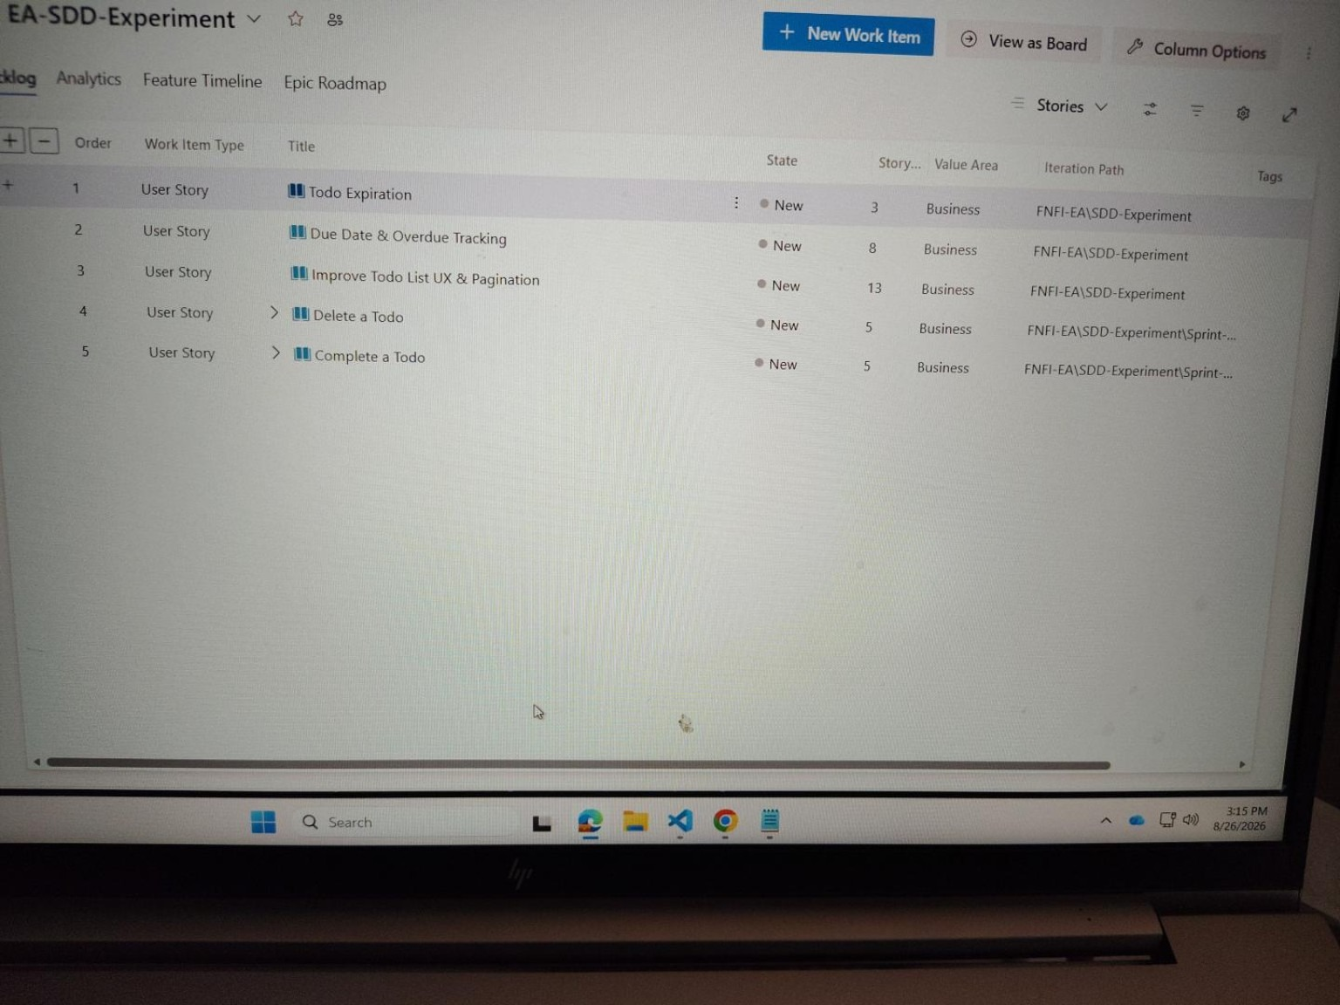
2. We simulated a realistic sprint — not an “SDD sprint”
A sprint can contain stories that benefit from SDD and stories that do not
Medium / meaningful story → evaluate SDD path
Very light / obvious story → normal development path
If work finishes early, pull another Ready story from backlog — simulate normal sprint behavior.
ACTUAL ADO BACKLOG
No need to wait artificial sprint dates for this small pilot.
3

Slide 4
3. What we actually executed
Create & View Todos
Initial SDD implementation
Working application
Complete a Todo
SDD-assisted
Lifecycle behavior
Delete a Todo
SDD-assisted
Lifecycle behavior
Improve UX & Pagination
SDD-assisted
Broader UI / interaction
Replace action text with icons
Normal development
Deliberately lightweight
Key change in the pilot: story selection became part of the experiment — not every story automatically entered SDD.
4

Slide 5
4. Scenario A — SDD-assisted journey
One representative path from requirement to working software
ADO Story
Refine
Specify / Clarify
Ready for Sprint
Plan / Tasks
Implement
Test / PR
Requirement ownership ADO remains authoritative. Clarification decisions that affect behavior are captured back in ADO.
SDD contribution Make WHAT/WHY explicit, surface ambiguity, then structure HOW through plan and tasks.
Normal governance remains Developer judgment, testing, review and PR are still required.
The useful evidence is the decision/clarification and its downstream implementation — not the number of generated files.
5

Slide 6
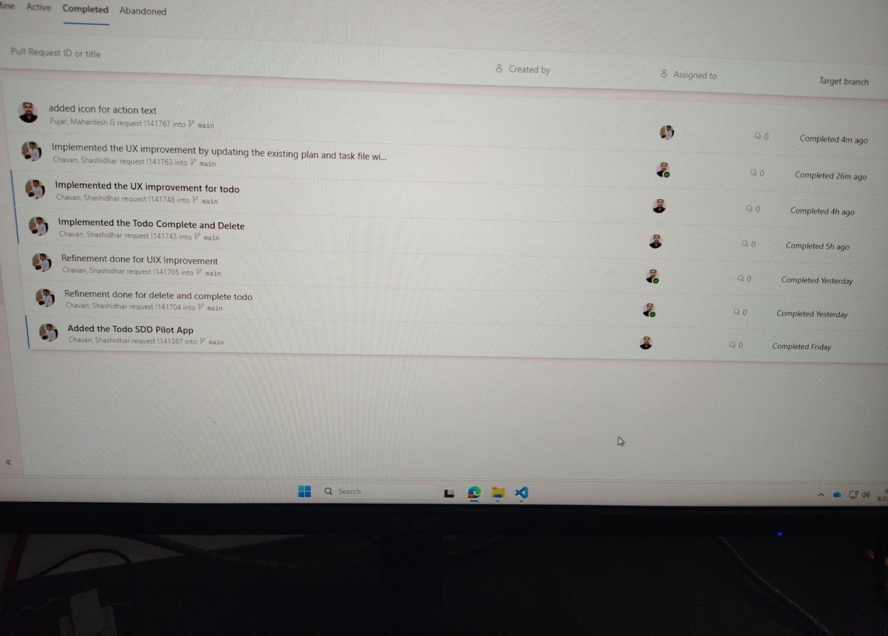
5. The SDD work reached real implementation and PRs
Repository history provides traceability across refinement and implementation
Refinement PRs
Complete + Delete implementation
UX / Pagination implementation
Icon change through normal path
ACTUAL PR HISTORY
6

Slide 7
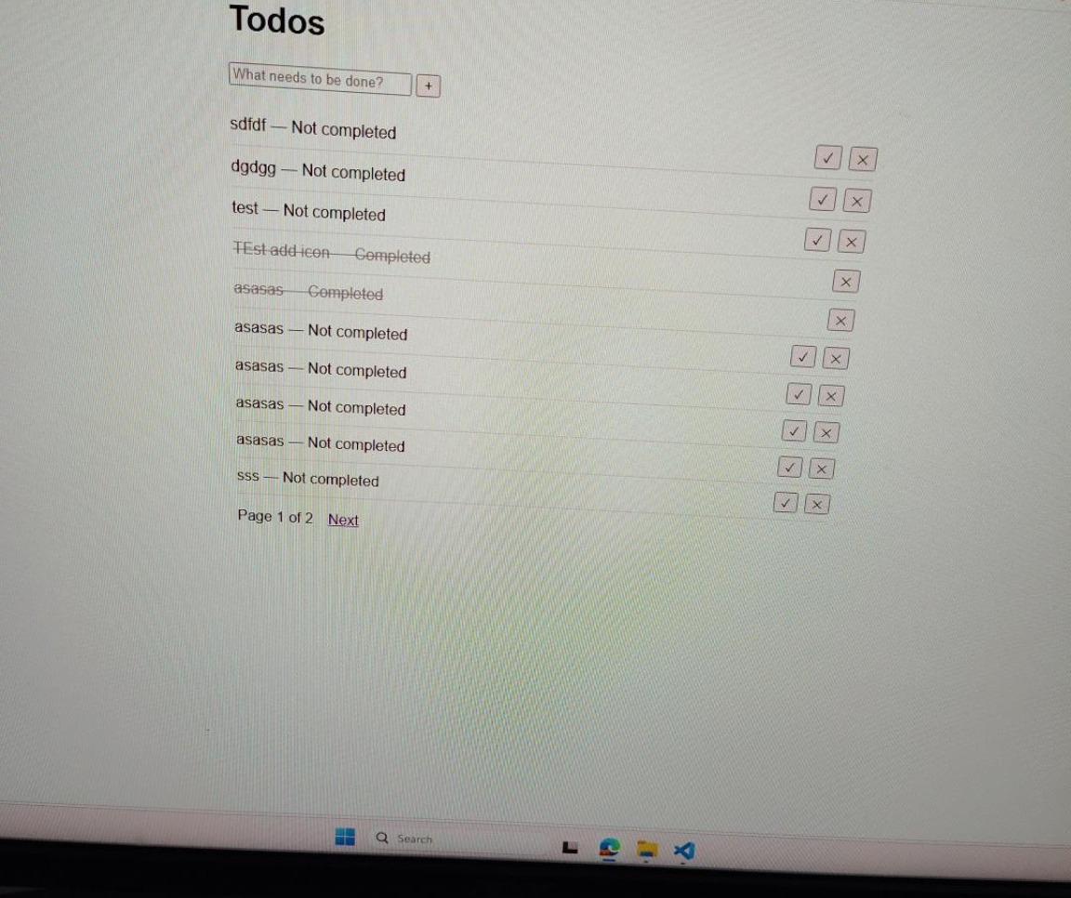
6. Scenario B — deliberately kept lightweight
A small UI story did not go through the full SDD lifecycle
Story: replace action text with + / ✓ / × icons
Requirement was clear and localized.
No meaningful new business rule, data model or API decision.
Normal path was sufficient: ADO → code → test → PR.
Running the full SDD lifecycle here would have added artifacts and review effort without equivalent reasoning value.
WORKING TODO APP
7

Slide 8
7. What did we observe?
Balanced pilot findings — value and overhead
Where SDD helped in this pilot
Where the overhead became visible
Encouraged requirement thinking before coding.
Provided explicit refinement / planning artifacts.
Created clearer traceability from requirement to implementation.
Made human review of AI assumptions an explicit step.
More prompts, artifacts and review steps.
A full flow is disproportionate for tiny, obvious changes.
Generated artifacts still need human validation.
One spec per every small story is not automatically useful.
Observation from Todo only: selective use appeared more practical than forcing the full SDD flow onto every story.
8

Slide 9
8. Review feedback — what we addressed
If a live demo is requested, the same evidence can be opened in ADO / repo / app
ADO User stories • refinement • sprint • tags/tasks
Spec Kit Representative spec • clarification • plan/tasks
Git / PR Refinement + implementation history
Working App Implemented behavior and UI
Operating-model questions after the initial pilot
End-to-end flow / timelineWhen does SDD start, who resolves questions, and when is a story ready?
Multi-developer + US ↔ Feature modelHow do shared specs, parallel developers and story mapping work?
9

Slide 10
9. Pilot conclusion for architect / manager review
The Todo experiment showed that SDD can be integrated into the existing ADO / Scrum flow, while the full lifecycle does not appear necessary for every type of story.
SDD-assisted stories gave us a structured requirement → clarification → plan → implementation trail.
The lightweight icon story demonstrated that normal development can remain the better fit for simple, obvious work.
These are pilot observations, not an organization-wide rule or framework decision.
The outcome being handed over is the executed journey, evidence, benefits, overhead and open questions for architect review.
10

Slide 11
10. Close the story
“We simulated a normal sprint using ADO, applied Spec Kit to selected Todo stories, deliberately kept one lightweight story on the normal development path, and compared the experience. The result is a practical view of where the additional SDD structure helped and where it became unnecessary overhead.”
What I am presenting: actual execution + evidence + observations
What I am not claiming: a final organization-wide SDD/framework recommendation
11

Slide 12
From Pilot Execution to a Reusable Team Operating Model
Continuation of the initial Todo SDD pilot — incorporating manager and Mani/Satish review feedback
Initial pilot established
Review asked us to strengthen
Operating model refined
• SDD can fit inside the existing ADO/Scrum flow • Clarification surfaced missing behavior before coding • Selective SDD was more practical than applying the full lifecycle to every story
• End-to-end flow and timing before Sprint Planning • Multi-developer ownership and change handling • ADO User Story ↔ specification/feature relationship
• Readiness + async clarification • Multi-developer model • US ↔ Feature mapping • Framework-neutral guidance • Controlled real-project adoption path
The continuation focuses on the operating model needed before real-project validation — not on adding more Spec Kit commands.
Todo SDD Pilot • Manager Review Continuation • 12

Slide 13
End-to-End SDD Operating Flow
Indicative timing only — the real-project pilot will validate the exact cadence
T-7 to T-5
T-5 to T-3
T-3 to T-1
T0
During Sprint
Completion
Refine & assess ADO story • AC • SDD suitability
Specify & clarify Surface ambiguity; retain unanswered business questions
Resolve & ready Stakeholder decision → ADO/AC → spec → readiness
Sprint Planning Estimate/confirm and commit ready story + supporting spec
Execute Plan → Tasks → Analyze → Implement → Converge
Verify Test → Review → PR → normal completion
→
→
→
→
→
Readiness guardrail: material unresolved business questions remain open; AI must not invent the answer.
Todo SDD Pilot • Manager Review Continuation • 13

Slide 14
Asynchronous Clarification: Keep the Question Open
Key refinement from the Mani/Satish review
Dev + BA
spec.md
ADO Story
PO / Business
ADO / AC
Spec
Readiness
Ambiguity found
Outstanding Question
Question visible
Authoritative answer
Decision recorded
Decision synchronized
Proceed when resolved
→
→
→
→
→
→
AI identifies and phrases the gap. Business decisions remain with the appropriate BA / PO / stakeholder.
If Spec Kit already retains a skipped clarification under Outstanding Questions in spec.md, a separate question file is unnecessary.
Todo SDD Pilot • Manager Review Continuation • 14

Slide 15
Multi-Developer Operating Model
Shared specification does not replace normal ADO assignment, Git branches or PR ownership
A. Independent stories / features
B. Related stories / shared feature
C. Different features / overlapping code
Dev A → Feature A branch Dev B → Feature B branch Each developer works from the reviewed baseline and follows the appropriate SDD development activities.
One coherent capability may contain US1 / US2. ADO still assigns stories to developers. Shared foundational work is coordinated before parallel story implementation.
Normal Git/PR/rebase/conflict practices remain. A physical merge conflict is different from a semantic/specification conflict.
Business-behavior change: clarify → authoritative decision → update ADO/spec → notify impacted developers → update only impacted artifacts.
Todo SDD Pilot • Manager Review Continuation • 15

Slide 16
ADO User Story ↔ Spec Kit Feature Mapping
ADO stays the backlog/sprint tracking unit; the feature groups behavior that benefits from being reasoned about together
1 US → 1 Feature
Multiple US → 1 Feature
1 US → Multiple Features
Preferred default for a cohesive SDD-selected story that is independently understandable, implementable and testable.
Allowed when there is real capability cohesion, shared reasoning value and sprint/delivery alignment. Example: Complete + Delete → Todo Lifecycle Operations.
Not the normal starting point. If clarification exposes independently valuable capabilities, return to refinement and consider splitting the ADO story first.
Small / localized story → no SDD feature is also a valid outcome.
Todo SDD Pilot • Manager Review Continuation • 16

Slide 17
Standardize the Operating Model — Not the Tool
Spec Kit is the current reference implementation; the higher-level team process remains framework-independent
Layer 1 — Existing Delivery
Layer 2 — Generic SDD Activities
Layer 3 — Current Reference
ADO Scrum ceremonies BA / PO / Dev / QA Git / PR These remain the delivery foundation.
Define behavior Clarify ambiguity Technical design Implementation breakdown Consistency validation Implementation Alignment verification
Spec Kit today /specify /clarify /plan /tasks /analyze /implement /converge
Principle: standardize outcomes, responsibilities and checkpoints — not command names.
Todo SDD Pilot • Manager Review Continuation • 17

Slide 18
Recommended Next Step: Controlled Real-Project Validation
Validate the operating model inside normal project sprints before recommending broader adoption
1
Select a small number of pilot teams
Existing ADO/Scrum • willing participants • suitable upcoming stories
2
Select stories during refinement
Use SDD where ambiguity, rules, dependencies, impact or risk justify it
3
Run normal mixed sprints
Keep SDD-selected and normal-development stories in the same sprint
4
Capture lightweight evidence
Clarifications • AC changes • rework • effort • alignment • team experience
5
Refine the guidance
Use real-project findings before any broader adoption recommendation
Success does not mean every story uses SDD. The pilot should identify where SDD adds value and where it adds unnecessary overhead.
Todo SDD Pilot • Manager Review Continuation • 18

Slide 19
Where We Are Now
The initial pilot has evolved into a reusable operating-model baseline; real-project validation is the next evidence point
Refined Baseline
Reusable Guidance
Next Validation
✓ End-to-end flow / readiness ✓ Async stakeholder clarification ✓ Multi-developer model ✓ US ↔ Feature mapping ✓ Framework-neutral operating model
SDD Operating Guide Todo worked example One-page quick reference 10–15 minute walkthrough video Pilot guidance pending real-project validation
Selected real project teams Normal mixed sprints Lightweight evidence Feedback + refinement ADO automation is intentionally deferred.
Current recommendation: introduce SDD selectively with minimum change to the existing ADO/Scrum delivery model.
Todo SDD Pilot • Manager Review Continuation • 19

Slide 20
Manager Feedback → What We Addressed
Explicit closure of the operating-model questions raised after the initial pilot
End-to-end example + timing
US-904672 journey + proposed pre-sprint cadence
ADDRESSED
Multi-developer model
Complete/Delete shared-capability simulation + branch/PR rules
MODEL DEFINED
User Story ↔ Specification relationship
1→1, many→1, broad story split rules
DEFINED
Review with Mani / Satish
Approach aligned; async PO/business clarification incorporated
COMPLETED
Reusable guidance + walkthrough
SDD Operating Guide + quick reference + Todo example + short video
DEFINED
Adoption / success criteria
Controlled real-project pilots + lightweight evidence
PROPOSED
ADO automation concept
Kept separate from current implementation
DEFERRED
This continuation is therefore focused on closing the feedback gaps — not repeating the original Spec Kit pilot.
Todo SDD Pilot • Evidence-First Continuation • 20

Slide 21
Actual Todo Evolution: How the Operating Model Emerged
Observed pilot evidence — each step changed how we think SDD should fit into normal delivery
Create & View Todos
Established the working application baseline through SDD.
→
Initial greenfield SDD
Complete + Delete
Showed related stories can be reasoned about together while remaining separate ADO work items.
→
ADO refinement + shared capability
US-904672 UX & Pagination
Four missing behavioral decisions became explicit before coding.
→
Clarification before implementation
Replace Action Text with Icons
Demonstrated selective SDD: a small localized change did not justify a full feature specification.
→
Normal development
US-904674 Due Date & Overdue
Skipped/unresolved clarification remained in spec.md instead of being guessed — enabling async stakeholder resolution.
→
Outstanding Questions
Key learning: the process was not designed only on paper; it evolved from the Todo stories and review feedback.
Todo SDD Pilot • Evidence-First Continuation • 21

Slide 22
US-904672 — Actual Pilot Journey
Observed sequence from ADO refinement through implementation; exact historical day-by-day timestamps were not captured
OBSERVED PILOT EVIDENCE
ADO Story
Refinement
Specify
Clarify
Decisions
ADO / AC
Sprint
Complete
Improve Todo List UX & Pagination 8 points • SDD-Candidate
Acceptance Criteria reviewed
Expected behavior structured
4 gaps surfaced
10/page • previous page • current+total pages • clamp invalid page
Decisions recorded
Plan → Tasks → Analyze → Implement → Converge
Test → Review → PR
→
→
→
→
→
→
→
What SDD changed: page size, empty-page behavior, pagination display and invalid-page handling were decided explicitly before implementation rather than left to developer/AI assumption.
Todo SDD Pilot • Evidence-First Continuation • 22

Slide 23
Proposed Real-Project Timing — Based on the Pilot Sequence
This is guidance to validate with project teams, not a historical claim about the Todo pilot
PROPOSED / TO VALIDATE
T-7 to T-5
BA + Dev / refinement team
Candidate story → refine → assess SDD suitability
Todo reference: UX/Pagination selected because behavior needed deeper clarification.
T-5 to T-3
Dev + BA + AI assistance
Specify / Clarify; keep unresolved business questions open
Todo reference: UX/Pagination clarification; Due Date Outstanding Questions.
T-3 to T-1
BA / PO / business + team
Resolve material questions → ADO/AC → spec → readiness
Todo reference: four UX/Pagination decisions became explicit.
T0
Sprint Planning
Estimate/confirm and commit ready story + supporting spec
ADO remains the sprint system of record.
During Sprint
Developer(s)
Plan → Tasks → Analyze → Implement → Converge
Todo reference: SDD-selected stories use development artifacts after commitment.
Readiness rule to validate: material unresolved business questions block SDD-assisted readiness; AI cannot convert missing stakeholder knowledge into a requirement.
Todo SDD Pilot • Evidence-First Continuation • 23

Slide 24
Multi-Developer Model — Grounded in the Todo Stories
Operating model to validate in a real team; the Todo pilot provides the capability/story structure, not multi-developer proof
MODEL TO VALIDATE
Shared Capability
Parallel Ownership Example
If Behavior Changes
Todo Lifecycle Operations ADO 900332 — Complete a Todo ADO 900328 — Delete a Todo One coherent feature can preserve separate story visibility.
Dev A → Complete story Dev B → Delete story ADO assigns developers. The feature/spec is a shared project artifact, not a personal developer document.
Example: Complete behavior changes mid-sprint ADO/AC decision → shared spec → identify impacted tasks/tests/code → notify both developers → Analyze/Converge.
Normal Git branch / PR / rebase / merge practices remain unchanged; SDD adds behavior alignment, not a replacement collaboration system.
Todo SDD Pilot • Evidence-First Continuation • 24

Slide 25
User Story ↔ Feature Mapping — Todo Examples
The mapping decision follows capability cohesion and delivery alignment, not a mechanical one-story-one-spec rule
1 US → 1 Feature
Multiple US → 1 Feature
Simple US → No SDD Feature
US-904672 Improve Todo List UX & Pagination A substantial independent capability with its own behavioral decisions → dedicated feature.
900332 Complete + 900328 Delete → Todo Lifecycle Operations Valid because the stories form a coherent lifecycle capability and can remain separately visible/testable.
Replace Todo Action Text with Icons Small/localized UI change → normal development was the more proportionate path.
If one broad ADO story reveals multiple independently valuable capabilities during clarification, return to refinement and consider splitting the ADO story first.
Todo SDD Pilot • Evidence-First Continuation • 25

Slide 26
Reusable Handoff Package for Pilot Teams
Defined now; content remains pilot guidance until real-project validation
SDD Operating Guide
Todo Worked Example
One-Page Quick Reference
10–15 min Walkthrough
Where SDD fits in ADO/Scrum Selection criteria Readiness Roles Multi-dev model US ↔ Feature mapping Change handling
UX/Pagination clarification Complete + Delete grouping Icon story normal path Due Date Outstanding Questions
Before Sprint ADO → Refine → Select → Specify/Clarify → Decide → Ready Sprint Plan → Tasks → Analyze → Implement → Converge
Why SDD Where it fits Actual Todo evidence Multi-dev + mapping When not to use it Guardrails / next steps
Goal: another team should be able to reproduce the pilot approach without continuous dependency on the original pilot team.
Todo SDD Pilot • Evidence-First Continuation • 26

Slide 27
Real-Project Pilot: Onboarding, Evidence and Decision Points
Proposed next step — validate the operating model with minimum change to existing team delivery
PROPOSED
Onboarding / Support
Evidence to Capture
Validation Window
Pilot Team + SDD Mentor → select first story → refinement support → first SDD execution → sprint observation → retrospective → increasing team independence
Clarification gaps ADO/AC changes Dependencies found early Rework after coding Analyze/Converge findings Approx. SDD effort BA/PO/Dev experience
Proposed starting point: 2–3 normal sprint cycles Not an SLA or approved rollout timeline. Exact cadence should be validated with selected project teams.
Success ≠ every story uses SDD. Success means we can identify where it improves clarity/alignment with manageable overhead — and where normal development is better.
Todo SDD Pilot • Evidence-First Continuation • 27

Slide 28
Leadership Decisions / Next Actions
What we need from this review to move from the Todo pilot into controlled real-project validation
1. Confirm Direction
2. Nominate Pilot Teams
3. Validate the Model
Continue with selective SDD inside the existing ADO/Scrum model rather than introducing a separate SDD process.
Identify a small number of suitable project teams and upcoming medium/high-complexity stories for validation.
Confirm/refine proposed pre-sprint timing, mentor/support approach and evidence to capture over the pilot period.
After real-project evidence: refine the SDD Operating Guide and return with an adoption recommendation. ADO automation remains a future concept, not a dependency for this validation.
Todo SDD Pilot • Evidence-First Continuation • 28

