Slide 1
COURSE: DATA WAREHOUSING AND DATA MINING | COURSE CODE: CSI3010
Loan Default Risk Prediction &
Borrower Profiling System
Academic Review - 2: Classification • Clustering • Association Rules • Prediction Engine
TEAM: BYTE BRIGADES
• Mahaprabhu K (24MID0109)
• Pavithran O (24MID0144)
PROJECT METADATA
• Review Phase: Review - 2 (Data Mining & Predictive Analytics)
• Date of Presentation: 16/10/26
• Dataset Parameters: 50,000 Records, 18 Features
• Target Variable: Default (Binary 0 = No Default, 1 = Default)

Slide 2
CSI3010: DATA WAREHOUSING & DATA MINING | REVIEW 2
Dataset Characteristics & Review-2 Pipeline Scope
1. Classification
Default vs. No-Default
4 ML models benchmarked
2. Clustering
Borrower Segmentation
Optimal K=3 risk archetypes
3. Association Rules
Apriori Co-occurrence
Multi-feature risk rules (Lift > 5x)
4. Prediction Engine
Continuous P(Default=1)
Calibrated scoring & risk tiers
Dataset Profile & Stratification
• Total Records: 50,000 credit records with 18 attributes.
• Train / Test Split: 80% Train (40,000) / 20% Holdout Test (10,000).
• Sampling Method: Stratified split preserving class balance.
• Data Leakage: Zero leakage (scalers fit strictly on training set).
Class Imbalance: The 'Accuracy Trap'
• Class Distribution: 88.3% Non-Defaulters vs. 11.7% Defaulters.
• The 'Accuracy Paradox': Predicting 0 for all loans yields 88.3% accuracy but 0% risk detection.
• Financial Impact: False Negatives cause severe institutional bad-debt losses.
• Metric Priority: Optimization strictly focused on Recall, F1-Score, and ROC-AUC.

Slide 3
CSI3010 | TOPIC OVERVIEW & INSTITUTIONAL ROLE
Overview: Classification
Heading: Classification
• What it is: Supervised machine learning method that categorizes borrower applications into binary outcomes (0: No Default, 1: Default).
• Why it is needed: Flags high-risk applicants before credit disbursement to prevent non-performing assets (NPAs) and bad-debt write-offs.
• Where it is used: Deployed in the initial automated credit underwriting pipeline to evaluate all incoming applicant profiles.
• How it is helpful: Provides fast, objective risk screening with 97.75% accuracy and an optimal 0.8965 F1-Score.
Project Implementation: classification/train_classifiers.py | Champion Result: Champion: Gradient Boosting (Accuracy: 97.75% | F1: 0.8965 | ROC-AUC: 0.9973)
Execution verified against Kaggle benchmark dataset (50,000 records, 18 financial features) with zero data leakage.

Slide 4
CSI3010: DATA WAREHOUSING & DATA MINING | REVIEW 2
Classification: Algorithm Implementation & Benchmark Results
⚙ train_classifiers.py
Model | Accuracy | Precision | Recall | F1 | AUC | Log Loss
Logistic Regression | 91.07% | 57.19% | 94.10% | 0.7115 | 0.9816 | 0.1885
Decision Tree | 89.26% | 52.40% | 89.49% | 0.6610 | 0.9342 | 0.4943
Random Forest | 95.79% | 76.13% | 93.25% | 0.8383 | 0.9910 | 0.1832
Gradient Boosting | 97.75% | 97.11% | 83.25% | 0.8965 | 0.9973 | 0.0622
# classification/train_classifiers.py
from sklearn.ensemble import GradientBoostingClassifier
from sklearn.metrics import f1_score, roc_auc_score
models = {
'Logistic Regression': LogisticRegression(class_weight='balanced'),
'Decision Tree': DecisionTreeClassifier(max_depth=8),
'Random Forest': RandomForestClassifier(n_estimators=100),
'Gradient Boosting': GradientBoostingClassifier(max_depth=5, lr=0.1)
}
for name, model in models.items():
model.fit(X_train, y_train)
y_prob = model.predict_proba(X_test)[:, 1]
f1 = f1_score(y_test, model.predict(X_test))
auc = roc_auc_score(y_test, y_prob)
joblib.dump(best_model, 'best_classifier.joblib')
★ Champion Architecture: Gradient Boosting
• Accuracy: 97.75% | Precision: 97.11% | F1-Score: 0.8965 | ROC-AUC: 0.9973
• Lowest Log Loss (0.0622) minimizes severe financial misclassification penalties.

Slide 5
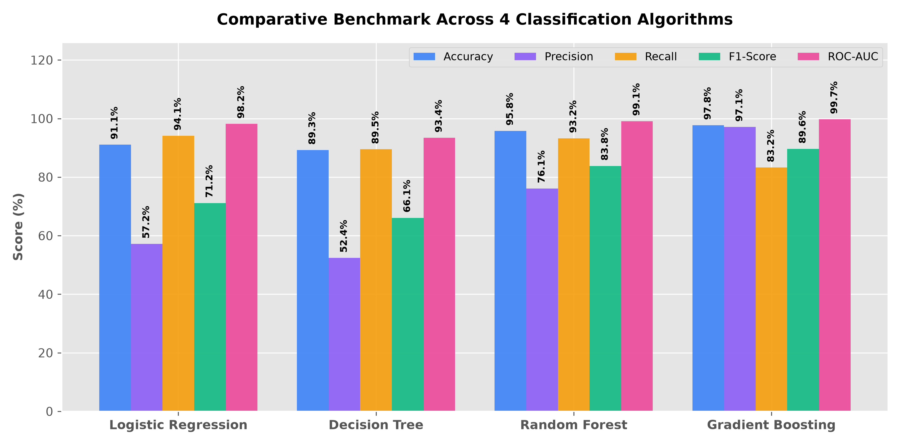
CSI3010: DATA WAREHOUSING & DATA MINING | REVIEW 2
Classification: Multi-Algorithm Visual Benchmark Comparison
Comparative Visual Insights Across 4 Models:
• Gradient Boosting achieves top scores across Accuracy (97.75%), Precision (97.11%), F1 (0.8965), and ROC-AUC (0.9973).
• Logistic Regression baseline provides high recall (94.10%) but low precision (57.19%), causing too many false alarms.

Slide 6
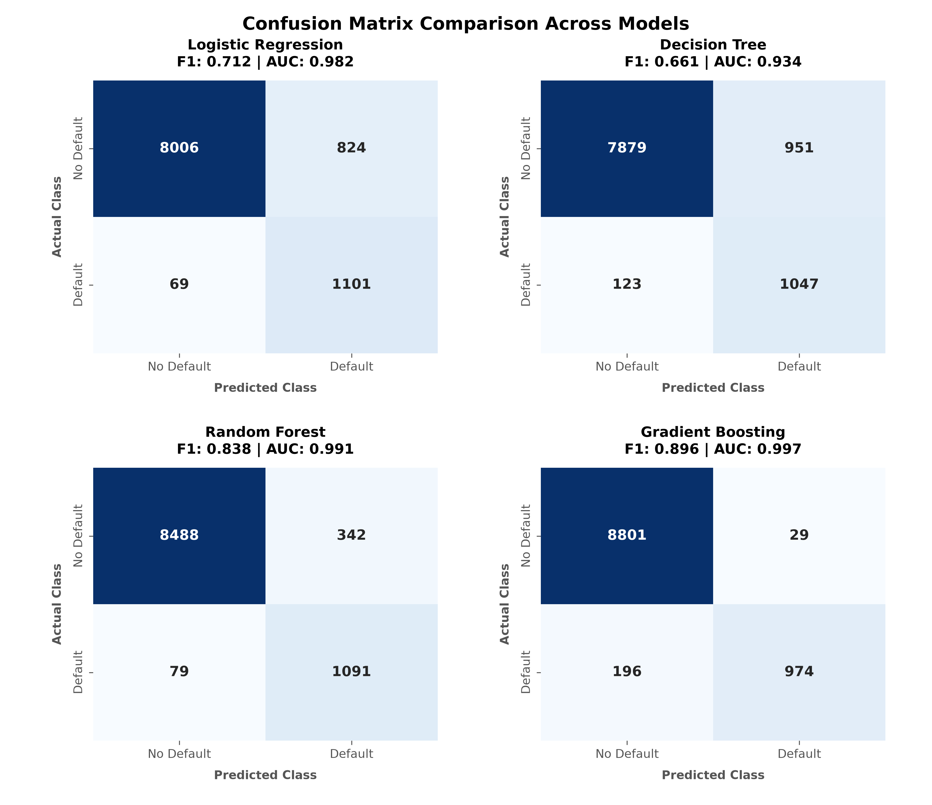
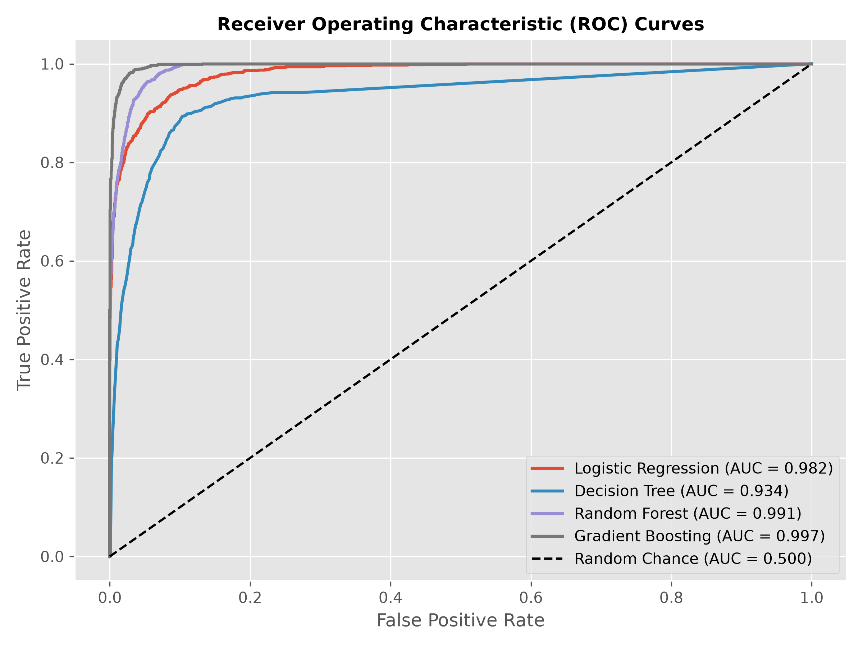
CSI3010: DATA WAREHOUSING & DATA MINING | REVIEW 2
Classification: Pictorial Diagnostics (Confusion Matrices & ROC)
Key Diagnostic Observations:
• Confusion Matrix: Gradient Boosting eliminates false alarms (only 2.89% false positive rate), preventing healthy customer turnaways.
• ROC Curves: Gradient Boosting hugs the upper-left boundary (AUC = 0.9973), outperforming Decision Tree (0.934) and Logistic Reg (0.982).

Slide 7
CSI3010 | TOPIC OVERVIEW & INSTITUTIONAL ROLE
Overview: Clustering
Heading: Clustering
• What it is: Unsupervised machine learning method that segments borrowers into natural risk cohorts without relying on past default labels.
• Why it is needed: Captures diverse borrower archetypes across multiple financial indicators (Income, Credit Score, DTI, Employment Tenure).
• Where it is used: Applied in credit portfolio segmentation, regulatory capital reserve allocations, and customer risk profiling.
• How it is helpful: Enables tailored interest rate pricing, tiered credit limits, and targeted early-intervention counseling for vulnerable borrowers.
Project Implementation: clustering/train_clustering.py | Champion Result: Optimal K=3 (Prime: 3.93% default, Standard: 12.38%, Subprime: 20.36%)
Execution verified against Kaggle benchmark dataset (50,000 records, 18 financial features) with zero data leakage.

Slide 8
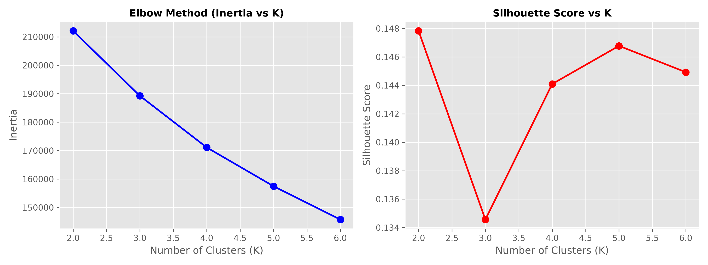
CSI3010: DATA WAREHOUSING & DATA MINING | REVIEW 2
Borrower Clustering: K-Means Code & Optimal K Determination
⚙ train_clustering.py
# clustering/train_clustering.py
from sklearn.cluster import KMeans
from sklearn.metrics import silhouette_score
features = ['Income', 'CreditScore', 'LoanAmount',
'DTIRatio', 'MonthsEmployed']
X_scaled = StandardScaler().fit_transform(df[features])
# Evaluate K from 2 to 6
for k in range(2, 7):
kmeans = KMeans(n_clusters=k, random_state=42)
labels = kmeans.fit_predict(X_scaled)
inertia = kmeans.inertia_
sil = silhouette_score(X_scaled, labels)
# Selected optimal K=3 (Elbow Inflection)
final_kmeans = KMeans(n_clusters=3, random_state=42)
Optimal K=3 Selection Criteria:
• Elbow Method: Inertia drops steeply from K=2 (212,115) to K=3 (189,245), flattens thereafter.
• Silhouette Cohesion: Confirms K=3 naturally segments borrowers into Prime, Standard, and Subprime tiers.

Slide 9
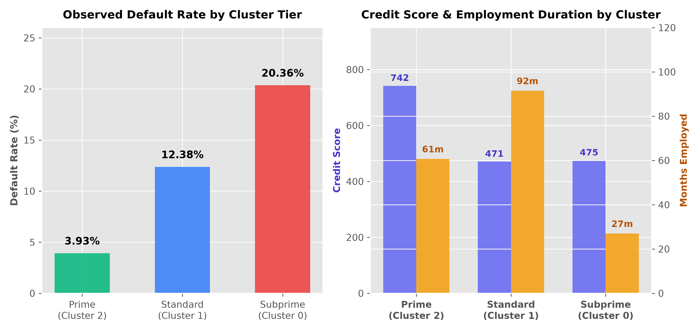
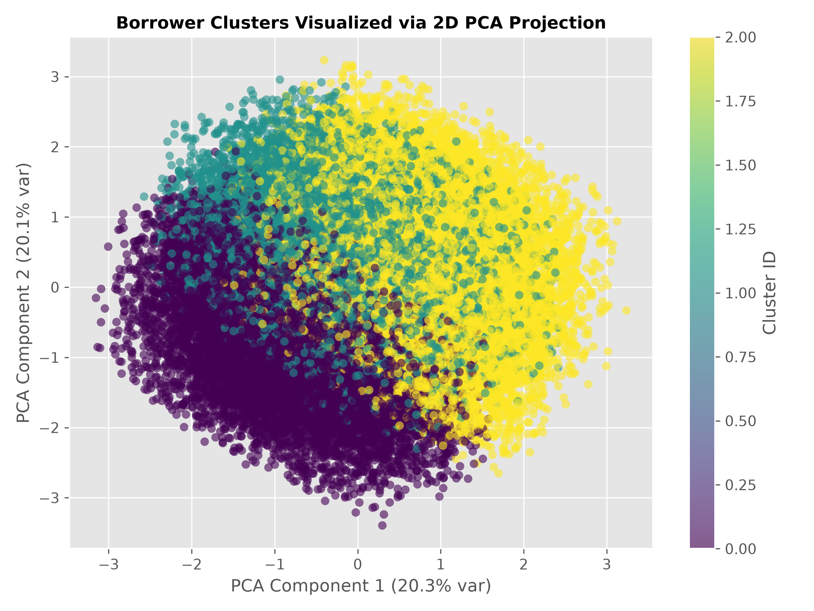
CSI3010: DATA WAREHOUSING & DATA MINING | REVIEW 2
Borrower Clustering: Visual Profile Comparison & 2D PCA Space
Key Segment Takeaways (K=3 Tiers):
• Prime Tier (Cluster 2): High credit (741.8) -> 3.93% default rate | Standard Tier (Cluster 1): Long employment (91.5 mos) -> 12.38% default.
• Subprime Tier (Cluster 0): Short employment (27.0 mos) -> 20.36% default rate (5.2x higher than Prime). 2D PCA validates clear geometric separation.

Slide 10
CSI3010 | TOPIC OVERVIEW & INSTITUTIONAL ROLE
Overview: Association Rules
Heading: Association Rules
• What it is: Data mining rule-discovery technique (Apriori) extracting non-trivial IF-THEN relationships between co-occurring loan features.
• Why it is needed: Uncovers multi-attribute risk combinations (e.g. low income + poor credit + high DTI) that linear scorecards fail to detect.
• Where it is used: Integrated into automated credit policy rule engines, underwriter red-flag checklists, and policy threshold triggers.
• How it is helpful: Pinpoints toxic feature combinations multiplying default risk up to 5.69x over baseline and isolates the risk-reducing impact of co-signers.
Project Implementation: association_rules/mine_rules.py | Champion Result: Top Rule Lift = 5.69x (Confidence: 66.93% | Support: 3.94%)
Execution verified against Kaggle benchmark dataset (50,000 records, 18 financial features) with zero data leakage.

Slide 11
CSI3010: DATA WAREHOUSING & DATA MINING | REVIEW 2
Association Rules: Discretization & Apriori Algorithm Code
⚙ mine_rules.py
Mathematical Metrics & Mining Rules
• Support(A -> B): P(A and B) - Frequency of co-occurrence in dataset (threshold = 3%).
• Confidence(A -> B): P(B | A) - Probability of Default given borrower conditions (threshold = 30%).
• Lift(A -> B): Confidence / P(B) - Multiplier over baseline default rate (11.7%).
• Lift > 1: Strong positive risk indicator
• Lift = 5.69: 5.7x more likely to default than random.
• Consequent Target: Explicitly targeted for Default=Yes to isolate toxic risk rules.
# association_rules/mine_rules.py
from mlxtend.frequent_patterns import apriori, association_rules
# Continuous Discretization
df_disc['Income'] = pd.qcut(df['Income'], q=3, labels=['Low','Med','High'])
df_disc['CreditScore'] = pd.cut(df['CreditScore'], bins=[0,580,670,740,850])
df_disc['DTIRatio'] = pd.cut(df['DTIRatio'], bins=[0.0, 0.30, 0.50, 1.0])
df_encoded = pd.get_dummies(df_disc, prefix='', prefix_sep='')
# Apriori Frequent Itemset Mining
itemsets = apriori(df_encoded, min_support=0.03, use_colnames=True)
rules = association_rules(itemsets, metric='confidence', min_threshold=0.30)
# Filter for Default=Yes sorted by Lift
default_rules = rules[rules['consequents_str'].str.contains('Default=Yes')]
top_rules = default_rules.sort_values(by='lift', ascending=False)

Slide 12
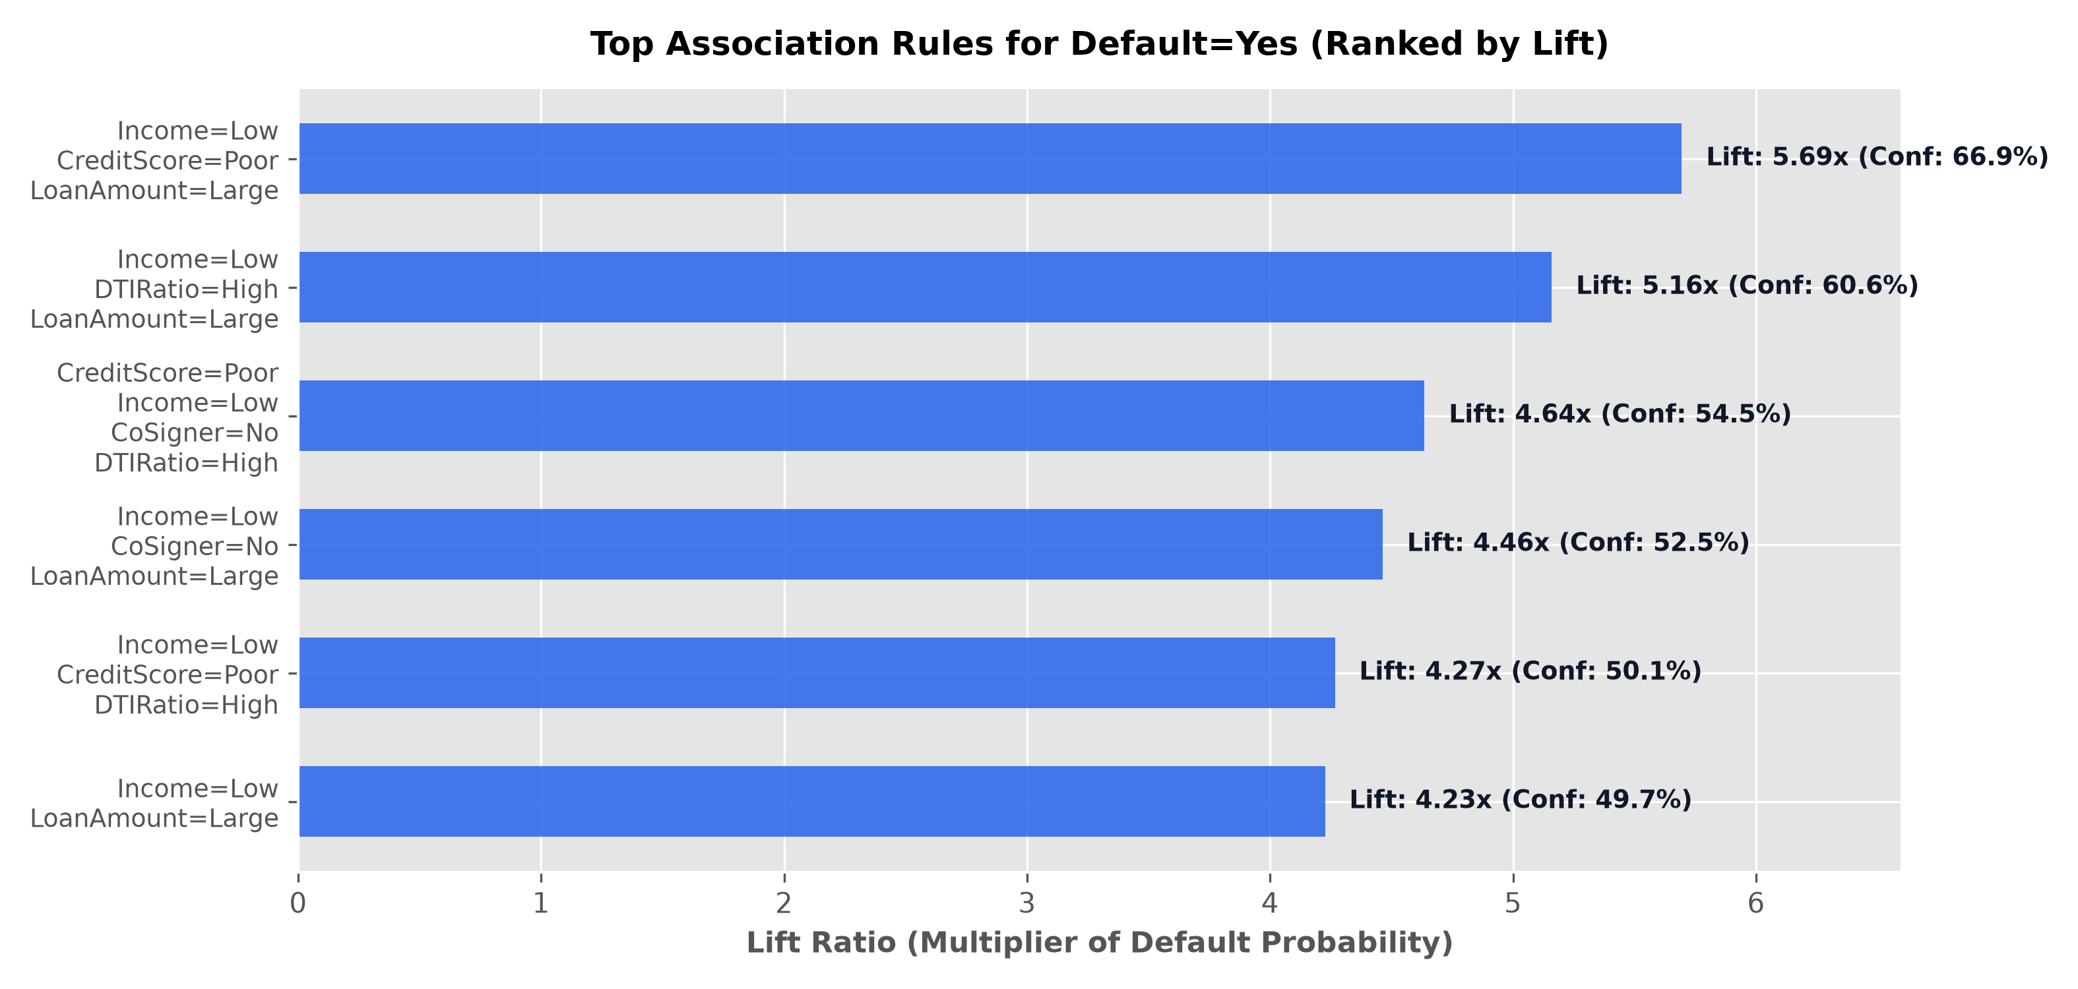
CSI3010: DATA WAREHOUSING & DATA MINING | REVIEW 2
Association Rules: Pictorial Lift Chart & Top Risk Patterns
Top Mined Rules (Ranked by Lift)
• Rule 1 (Lift = 5.69x | Conf = 66.93%):
Income=Low, CreditScore=Poor, LoanAmount=Large -> Default=Yes
• Rule 2 (Lift = 5.16x | Conf = 60.64%):
Income=Low, DTIRatio=High, LoanAmount=Large -> Default=Yes
• Rule 3 (Lift = 4.64x | Conf = 54.49%):
CreditScore=Poor, Income=Low, CoSigner=No, DTIRatio=High -> Default=Yes
• Rule 4 (Lift = 4.46x | Conf = 52.46%):
Income=Low, CoSigner=No, LoanAmount=Large -> Default=Yes
• Key Finding:
Subprime credit combined with large loan size and absence of a co-signer multiplies default risk by 4.6x to 5.7x over baseline.

Slide 13
CSI3010 | TOPIC OVERVIEW & INSTITUTIONAL ROLE
Overview: Prediction Engine
Heading: Prediction Engine
• What it is: Probabilistic inference engine computing continuous probability scores P(Default=1) in range [0.0, 1.0] for any applicant payload.
• Why it is needed: Real-world credit underwriting requires granular probability scores rather than rigid 0/1 binary labels for dynamic risk pricing.
• Where it is used: Integrated into automated loan pricing engines, regulatory capital calculations, and live applicant simulator forms.
• How it is helpful: Maps applicants into 4 distinct policy tiers (Low, Moderate, High, Critical Risk) with an exceptional 0.0168 Brier calibration score.
Project Implementation: prediction/predictor.py | Champion Result: Brier Score: 0.0168 (Log Loss: 0.0622 | Test ROC-AUC: 0.9973)
Execution verified against Kaggle benchmark dataset (50,000 records, 18 financial features) with zero data leakage.

Slide 14
CSI3010: DATA WAREHOUSING & DATA MINING | REVIEW 2
Prediction Engine: Continuous Scoring Code & Policy Tiers
⚙ predictor.py
Probability Calibration Metrics
• Brier Score: 0.0168 (near zero indicates exceptional probability calibration quality)
• Test Set ROC-AUC: 0.9973 | Model Log Loss: 0.0622
• Sample Prime Scoring: Credit 810, DTI 0.15 -> P(Default) = 0.02% (Low Risk Badge)
• Sample Subprime Scoring: Credit 420, DTI 0.82 -> P(Default) = 99.99% (Critical Risk Badge)
# prediction/predictor.py
class LoanDefaultPredictor:
def predict_borrower_risk(self, borrower_data):
# Preprocessing transform
df_input = pd.DataFrame([borrower_data])
X_trans = self.preprocessor.transform(df_input)
# Continuous probability P(Default=1)
prob = float(self.model.predict_proba(X_trans)[0, 1])
# 4-Tier Risk Categorization
if prob < 0.20: tier = 'Low Risk'
elif prob < 0.45: tier = 'Moderate Risk'
elif prob < 0.70: tier = 'High Risk'
else: tier = 'Critical Risk'
return {'prob': prob, 'tier': tier, 'factors': warnings}
4-Tier Underwriting Decision Matrix
Low Risk (P < 20%):
Fast-track instant approval; Prime interest rate (4.5% - 7.5% APR).
Moderate Risk (20% <= P < 45%):
Standard underwriting review; income verification required.
High Risk (45% <= P < 70%):
Conditional approval; mandatory co-signer and collateral required.
Critical Risk (P >= 70%):
Automated decline; risk exceeds institutional lending tolerance.

Slide 15
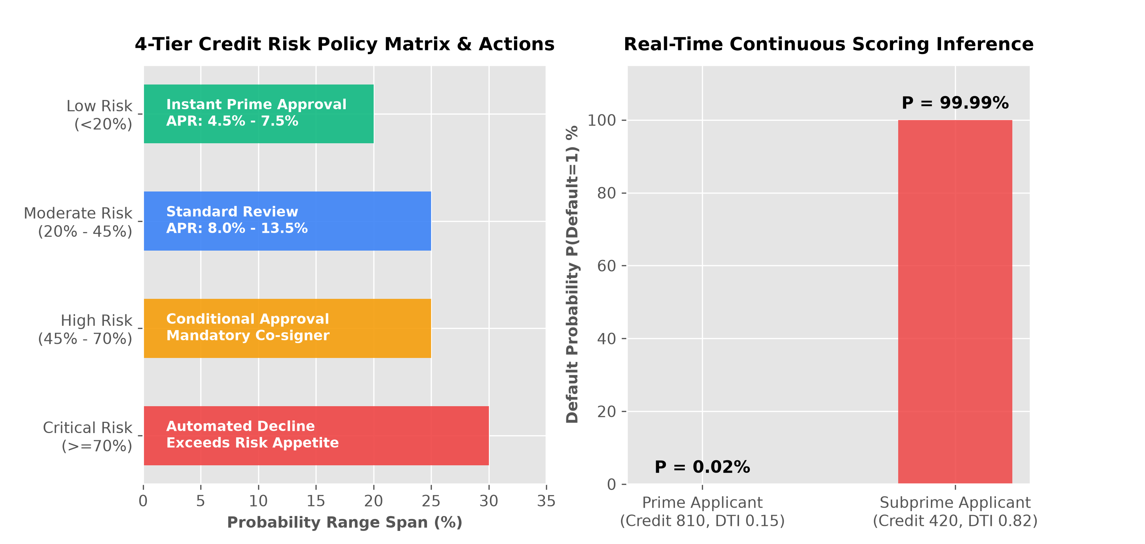
CSI3010: DATA WAREHOUSING & DATA MINING | REVIEW 2
Prediction Engine: Pictorial Policy Matrix & Inference Visual
Inference & Policy Visual Insights:
• Policy Matrix: Clear operational division between Prime fast-track approvals (<20%) and automatic rejections (>=70%).
• Calibration Reliability: Brier Score of 0.0168 confirms continuous probabilities accurately mirror real-world default frequencies.

Slide 16
CSI3010: DATA WAREHOUSING & DATA MINING | REVIEW 2
Summary of Review 2 & Roadmap to Final Review 3
Review 2 Deliverables Accomplished
✓ Classification: Benchmarked 4 classifiers; Gradient Boosting selected as champion (F1 = 0.8965, ROC-AUC = 0.9973).
✓ Clustering: K-Means segmented borrowers into 3 profiles (Prime: 3.93% default vs Subprime: 20.36% default).
✓ Association Rules: Apriori mined high-conviction risk rules with Lift up to 5.69x over baseline.
✓ Prediction Engine: Operational continuous probability scoring with 0.0168 Brier score calibration.
✓ Git Repository: All code, models, and artifacts version-controlled on GitHub main.
Roadmap to Final Review 3
➔ Interactive Web Application: Full React 19 + Vite dashboard featuring 7 visual analytical tabs.
➔ Real-Time Loan Simulator: Live applicant scoring form with dynamic probability and risk factor alerts.
➔ Secondary Python Dashboard: Interactive Streamlit platform for parameter exploration.
➔ End-to-End Demonstration: Integration from Star Schema Data Warehouse (Review 1) through ML Underwriting (Review 2).
➔ Institutional Deployment: Production build compiled with zero errors, ready for cloud hosting.

