Slide 1

DataVerse AI
Agentic Business Intelligence for Retail Mart Data Analysis
Presented By:
Muhammad Muavia (37766)
Hasnain Ali (37721)
M. Shahan Subhani (37655)
Supervisor: Mam Tayyaba Shehzad
Iqra University, Islamabad Campus - Fall 2025
Computing and Technology Department, IQRA University Islamabad - H9 Campus - Pakistan

Slide 2

Table of Content
INTRODUCTION
PROBLEM STATEMENT
OBJECTIVES
RESEARCH QUESTIONS
LITERATURE REVIEW
DATASET & TOOLS
PROPOSED METHODOLOGY
EXPERIMENTAL RESULTS
CONTRIBUTION & FUTURE WORK
REFERENCES

Slide 3
Introduction
In today’s hyper-connected world, organizations generate enormous volumes of data every second, yet transforming this raw information into strategic, actionable intelligence remains a major challenge.
Traditional Business Intelligence (BI) tools such as Power BI and Tableau rely heavily on manual query building and technical expertise, making advanced analytics inaccessible to most business users.
The system unifies Agentic AI, and Explainable AI (XAI) into a single ecosystem delivering analytics that are autonomous, transparent, and privacy-preserving.

Slide 4
Problem Statement
High Complexity: Traditional Business Intelligence (BI) tools require expert SQL/Python knowledge, making them inaccessible to non-technical business owners.
Fragmented Workflows: Users have to switch between Excel, Python scripts, and visualization tools, creating inefficient and disconnected analysis pipelines.

Slide 5
Proposed Solution
DataVerse Analytics
"DataVerse AI is a Full-Stack Intelligent BI Platform.“
It consists of a secure React Frontend for user interaction and a Fast API Backend for multi-agent intelligence.“
Goal Turn raw data into insights without human analysts.

Slide 6
Key Features
• CSV / Excel upload with retail-domain validation
• Two-agent architecture: DatasetAgent + AnalystAgent
• Natural language query support
• Automated profiling, quality scan, and EDA
• Verified insights: receipts + SHA-256 reproducibility certificate
• Explainable AI: SHAP with deterministic fallback + counterfactuals
• Supabase authentication, PostgreSQL persistence, and storage
• 2-page executive report generation (HTML / PDF)

Slide 7
Why a Two-Agent System?
Single Monolithic System
• Difficult to scale
• Hard to debug and maintain
Two-Agent System (DatasetAgent + AnalystAgent) • Single responsibility per agent • Deterministic pipeline: numbers are computed, never generated

Slide 8
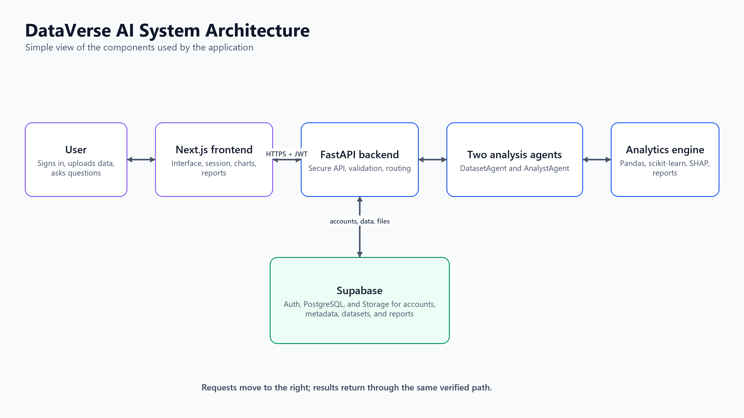
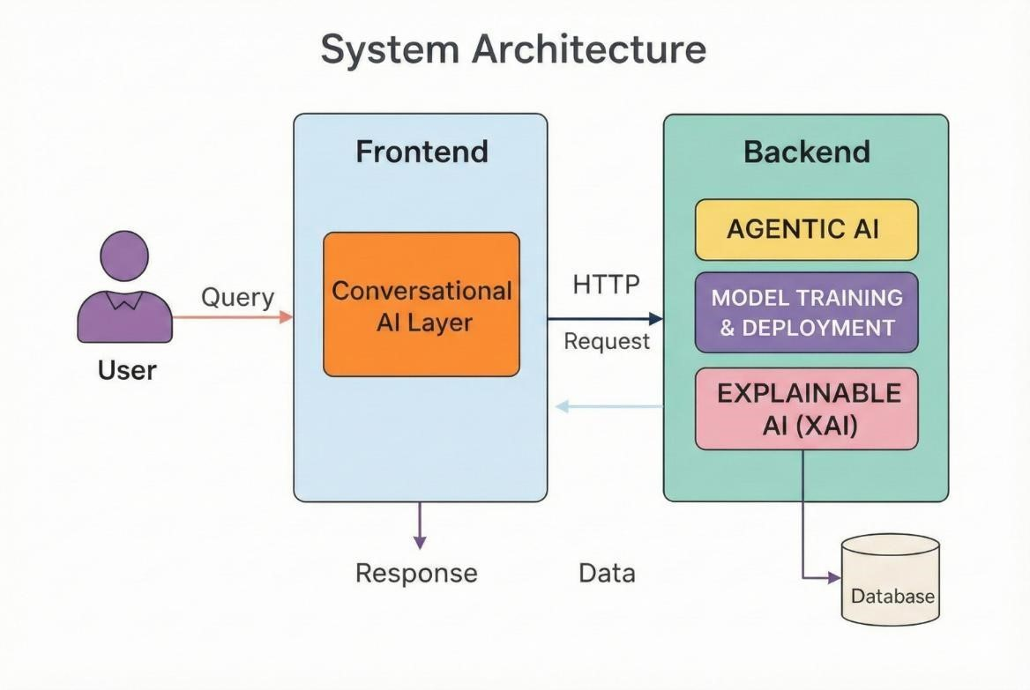

Slide 9
Frontend Architecture & User Experience
Key Points to List:
Framework: Next.js 15 + React 19 (App Router, on Vercel).
Styling: Tailwind CSS v4 (light, minimal design).
Security: Supabase Authentication (Secure Login/Signup).
Visualization: Custom SVG charts (KPIs, trends, XAI views).
State Management: React hooks + typed API client (sessions)

Slide 10
Models & Intelligence - 3 Core Modules
• Statistical & ML Models
• AI / LLM Models
• Agent Orchestration Logic

Slide 11
1. Statistical & ML Models
This module handles numerical computations, statistical analysis, and machine learning to extract patterns and insights from raw data.
It provides the foundational intelligence for data-driven decisions.

Slide 12
2. AI / LLM Models:
These models convert data results into human-readable insights and provide strategic, AI-driven recommendations.
They bridge the gap between complex analysis and actionable business guidance.

Slide 13
3. Agent Orchestration Logic
This module manages the workflow, coordinates the agents, handles failures, and combines results into a final report.
It ensures smooth, controlled, and reliable execution across the system.

Slide 14
Technology Stack
Frontend (The Interface) | Backend (The Brain) | Data & Infra (The Memory)
• Next.js 15 (React 19) | • FastAPI + Uvicorn | • Supabase PostgreSQL
• Tailwind CSS v4 | • Two-Agent Pipeline | • Supabase Auth + PostgreSQL + Storage
• Custom SVG charts | • Pandas / scikit-learn / SHAP | • Local session cache
• Supabase Auth (email + JWT) | • LLM layer (DeepAnalyze) | • ngrok tunnel (backend)
• Vercel Hosting | • pytest (214) + GitHub CI | • Docker support
Table 1: DataVerse AI technology stack used in the implemented system.

Slide 15
Sample Dataset Testing
Dataset
Tests Performed:
• retail_mart_processed_v1.csv: 35,000 rows × 21 columns • Live 10,000-row upload test on the deployed site
• Dataset upload & retail-domain validation • Profiling and data-quality scan • Exploratory Data Analysis (EDA) • Business KPIs & chart generation • Prediction + Explainable AI • HTML / PDF report generation

Slide 16
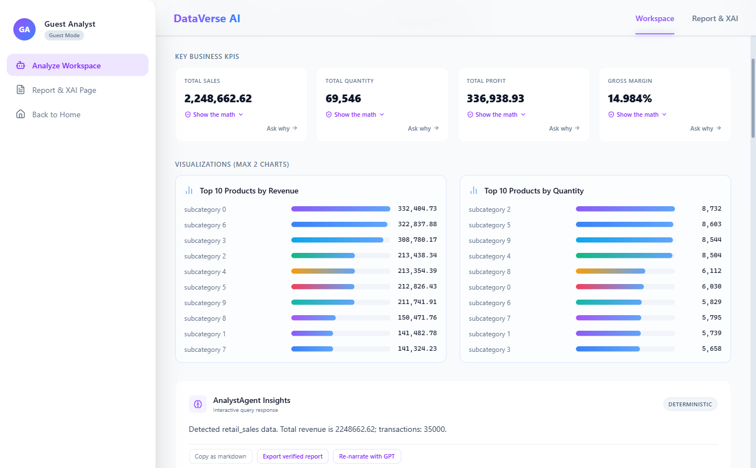
Testing Results
Metrics:
• Total Sales: $2,248,662.62 • Total Profit: $336,938.93
• Quantity Sold: 69,546 • Profit Margin: 14.98%
• Best: Region 2 · Category 1 · Store 27
• No missing values or duplicates
Performance:
• Parse 10,000 rows in 94 ms · profile in 281 ms
• Full analysis with ML + XAI in under a minute
• 214 automated backend tests passing
Live proof: deployed site analyzing the 35,000-row dataset (KPIs match this slide).

Slide 17
Business Insights (EDA)
• Total Sales $2,248,662.62 and Total Profit $336,938.93 (14.98% margin)
• 69,546 units sold across 35,000 clean transactions (0 missing, 0 duplicates)
• Region 2 is the strongest market: $1.28M sales across 19,905 orders
• Category 1 leads on both sales and profit ($964K sales, $144K profit)
• Store 27 is the top performing store by total sales
• Online slightly beats offline: $1.13M vs $1.12M in sales
• Discount vs profit correlation is only -0.0739: discounting does not drive profit

Slide 18
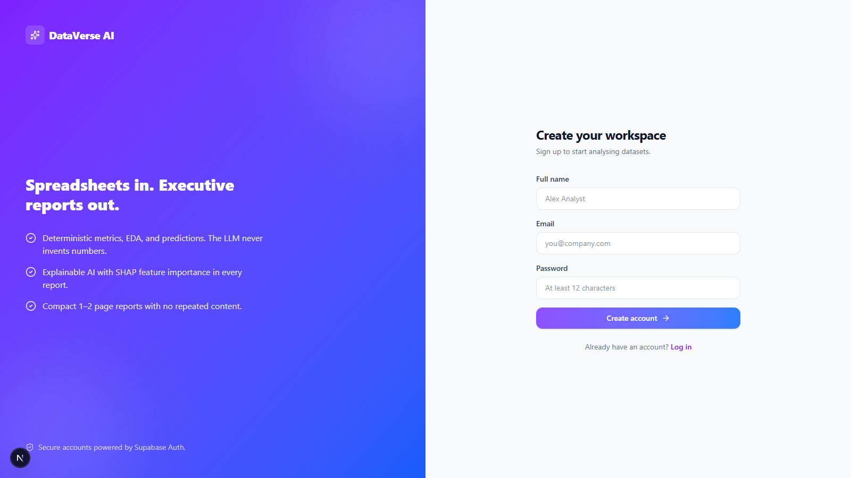
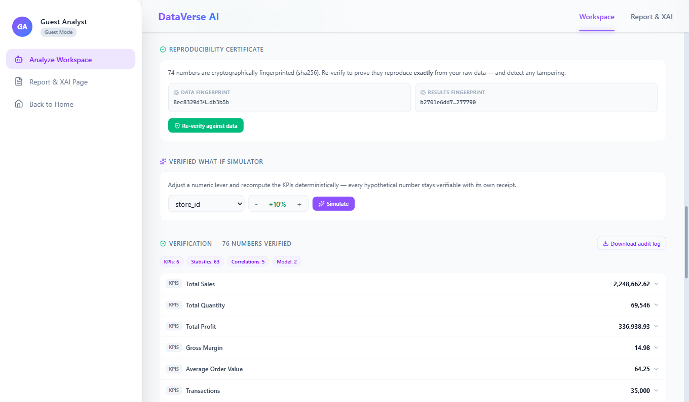
Live Deployment & Verification
• Frontend: Next.js 15 on Vercel (data-verse-ai-liard.vercel.app)
• Backend: FastAPI reached through an ngrok secure tunnel
• Data layer: Supabase Auth, PostgreSQL metadata, and private Storage buckets
• Verified account flow: sign up, confirm email, log in, upload, analyze, and download report
• Live 10,000-row upload parsed in 94 ms and profiled in 281 ms
• 214 automated backend tests passing via GitHub Actions CI
• Docker images provided for both frontend and backend
Current secure sign-up screen: Supabase sends an email confirmation link before login.

Slide 19
What Makes DataVerse Different
• Retail-domain guard detects and refuses non-retail datasets before storage
• Every number is computed by Pandas and scikit-learn, never invented by an LLM
• Verifiable receipts: Show the math on any KPI in one click
• SHA-256 reproducibility certificate seals and re-verifies each analysis
• Two-agent pipeline: DatasetAgent validates, AnalystAgent analyzes
• Explainable AI: SHAP with deterministic fallback plus counterfactuals
• DeepAnalyze-8B supported as the preferred agentic reasoning engine

Slide 20
Final Conclusion
What We Achieved
• Built and deployed a live analytics platform (Vercel + FastAPI) • Eliminated manual data analysis for retail mart data • Enabled natural language-based, verifiable insights • Integrated ML, explainable AI, and Supabase workflows • Automated 2-page executive report generation

Slide 21
References:
[1] V. V. Meduri, A. Quamar, C. Lei, V. Efthymiou, and F. Ozcan, “BIREC: Guided Data Analysis for Conversational Business Intelligence,” arXiv, arXiv:2105.00467, May 2021. Accessed: Dec. 15, 2025. [Online]. Available: http://arxiv.org/abs/2105.00467
[2] J. Lian et al., “ChatBI: Towards Natural Language to Complex Business Intelligence SQL,” arXiv, arXiv:2405.00527, May 2024. Accessed: Dec. 15, 2025. [Online]. Available: http://arxiv.org/abs/2405.00527
[3] E. Cambria, L. Malandri, F. Mercorio, N. Nobani, and A. Seveso, “XAI meets LLMs: A Survey of the Relation between Explainable AI and Large Language Models,” arXiv, arXiv:2407.15248, July 2024. Accessed: Dec. 15, 2025. [Online]. Available: http://arxiv.org/abs/2407.15248
[4] “Survey on Explainable AI: From Approaches, Limitations and Applications Aspects | HumanCentric Intelligent Systems.” Accessed: Dec. 15, 2025. [Online]. Available: https://link.springer.com/article/10.1007/s4423002300038y
[5] L. Shi, Z. Tang, N. Zhang, X. Zhang, and Z. Yang, “A Survey on Employing Large Language Models for Text-to-SQL Tasks,” ACM Comput. Surv., vol. 58, no. 2, pp. 1-37, Jan. 2026, doi: 10.1145/3737873.

Slide 22
THANK YOU

