Slide 1
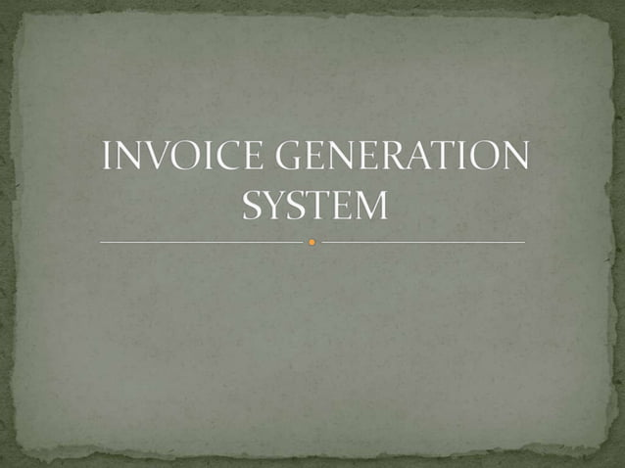

AND
RESTAURANT BILLING
INVOICE SYSTEM

Slide 2
Name | ID
Jubayer Ahmed | 22234103202
Erfan Hossain | 22234103062
Sadman Ishraq | 22234103212
Ridoy Ahsan | 22234103220
Imran Hasan Shanto | 22234103400
Md. Maharab Hosen | 22234103222
Welcome

Slide 3
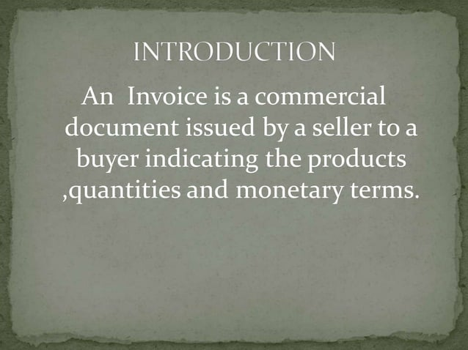

Slide 4
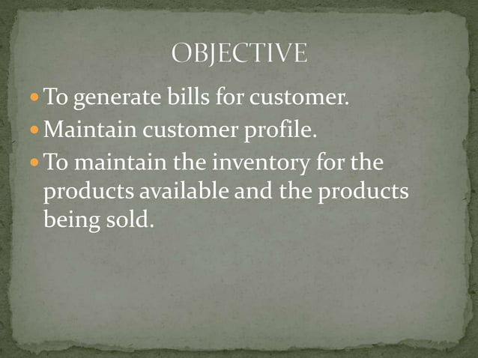

Slide 5
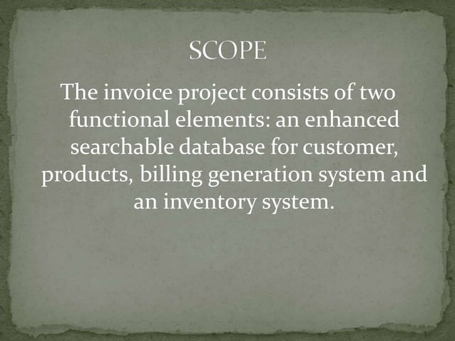

Slide 6
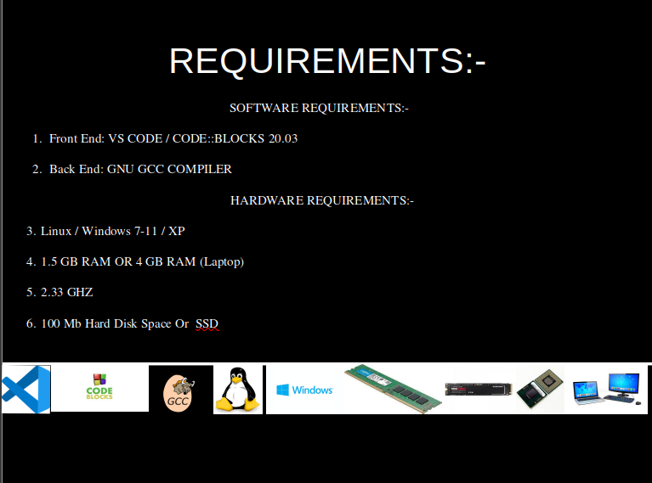

Slide 7
Friends Cafe RESTAURANT
Your Choice:
1. Generate Invoice
2. Show all Invoices
3. Search Invoice
4. Exit

Slide 8
Generate Invoice
Customer Name:
Number Of Items:
Item Name:
Enter Quantity:
Unit Price:
Save

Slide 9
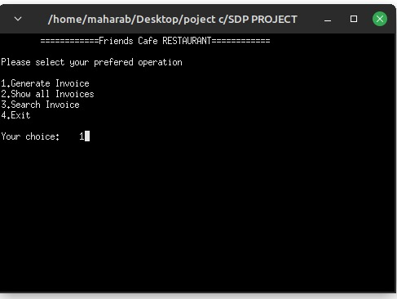

Slide 10
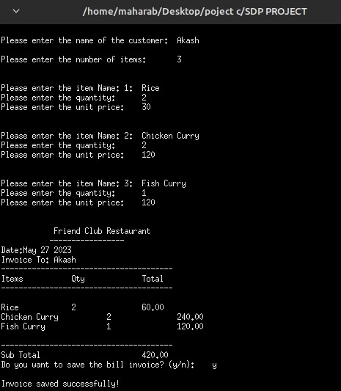

Slide 11
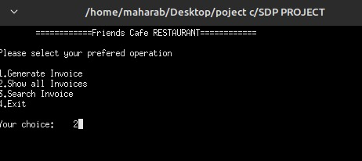

Slide 12
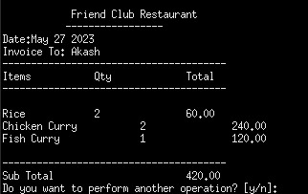

Slide 13
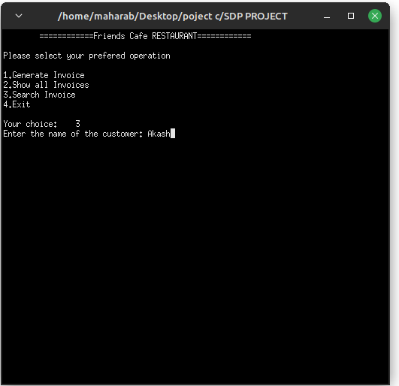

Slide 14
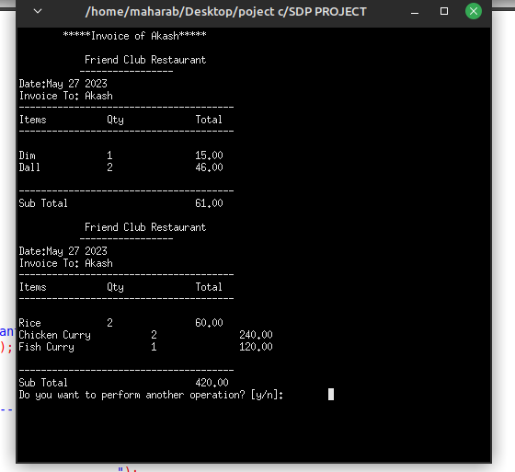

Slide 15
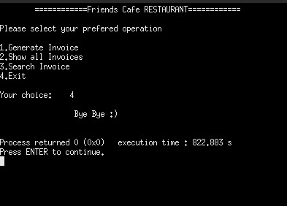

Slide 16


My future plans for this project:
Currently, this project can only save the complied file and show it to the customer. But you can't print the invoice and pay directly at this moment. In future, we will introduce invoice printing system for this project . So that the buyer can directly print the invoice and pay it to the seller.

Slide 17

Nill Akash
everyone

