Slide 1


Counselling Web Service With Unit Kaunseling Dan Psikologi Sibu
TME3413 Software Engineering Lab
by Membuaya with U

Slide 2

Introduction
When the Covid-19 pandemic struck, we were concerned not just about Coronavirus; but also, mental awareness as well.
Our department of health has taken multiple actions to deal with this problem.
The issue is that the old method of making appointments is still in use and is impractical.
As the number of patients grows by the day, a solution must be developed to solve this problem.
We spoke with our clients and intend to develop a web application based on the requirements they provided.
We want to exceed expectations and aid our client in resolving this problem.

Slide 3

Problem Statement
Unit Kaunseling and Psikologi Sibu only accepts walk-in patients.
Not every patient is brave enough to seek medical help.
Patients do not have time to get to the hospital to book an appointment.
They have other commitments, such as work and family.
Patients are having difficulty contacting anyone to inquire for FAQs or to catch up on any upcoming events.
Most posters hung around the hospital for information, which was inconvenient.

Slide 4

To study and analyse the existing system problem and find solution for Unit Kaunseling Dan Psikologi Sibu
To design a system based on our client’s requirements.
To test and assess the build system in accordance with the client's specifications in order to identify any errors and develop further based on the client’s feedback
Objectives

Slide 5
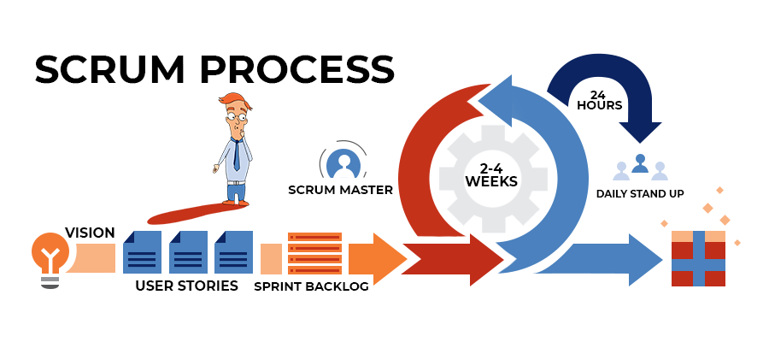

Methodology
Agile Scrum Methodology
Important roles in Scrum; Product Owner, Scrum Master, Development Team
Can ensure progress towards Product Goal is altered with the timeline
Our team can produce more learning cycles, reduce risk of expense with shorter sprint

Slide 6
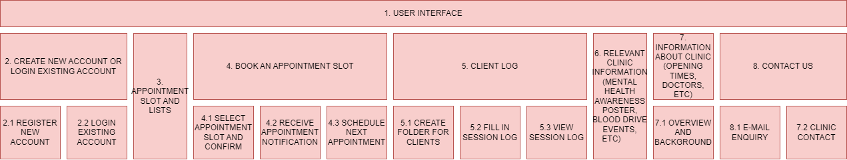
System Scopes and Outcomes
Outcomes
It is simpler to communicate with one another.
Appointments can be scheduled more quickly.
Patients are able to learn more about health.

Slide 7


title
Team Structures
Vadrianey Anak Asas
Planning Manager
Process Manager
Muhammad Hafiz bin Abu Bakar
Project Manager
Quality Manager
Jovian Jayome Anak Nyimbong
Planning Manager
Process Manager
Mohd Farhan bin Mohd Sukri
Customer Interface Manager
Support Manager
Shawn Francis Patrick Octothus
Implementation Manager
Test Manager
Muhammad Faris Musa
Customer Interface Manager
Support Manager
Mohd Ibrahim bin Khushi Mohd
Implementation Manager
Test Manager

Slide 8

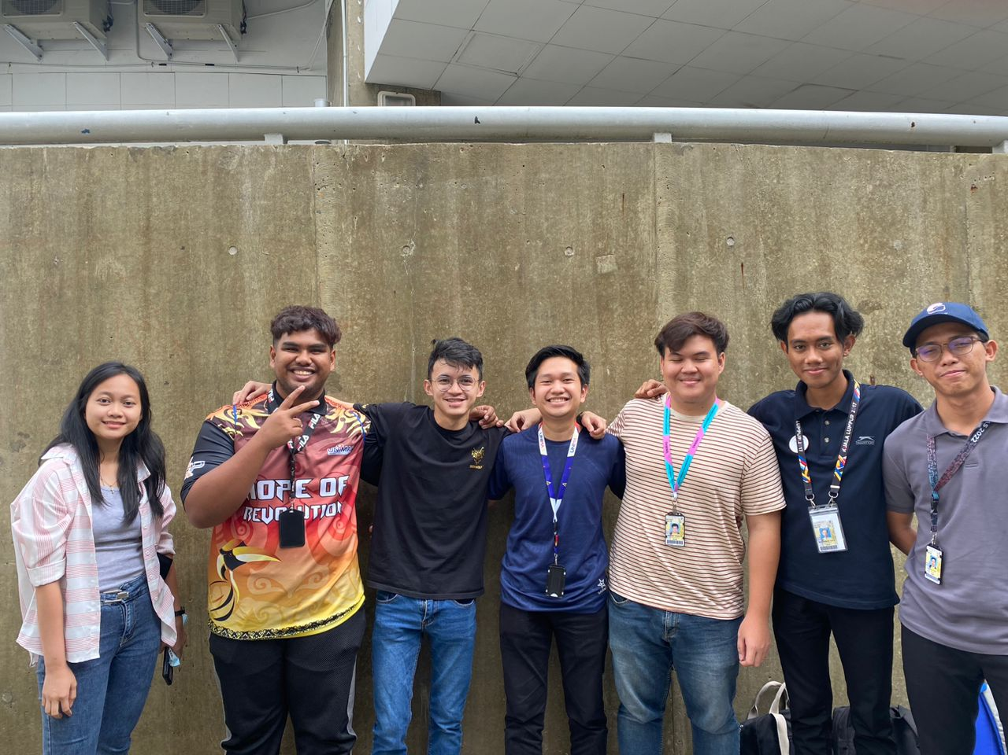
Thank You
Any Questions?

