Slide 1

Heart Disease Risk Prediction
Notes:
Photo by Ousa Chea on Unsplash

Slide 2

Introduction
It is a well-known fact that Heart Diseases are currently the leading cause of death across the world.
The development of a computational system that can predict the presence of heart diseases will significantly reduce the mortality rates & substantially reduce the costs of health care.
If such information is predicted well in advance, can provide important insights to doctors.

Slide 3
Data-set
Heart-Disease UCI Database
The data set used in the following R notebook can be found here.
Age – in years
Gender – Male/Female
Chest Pain
Resting Blood Pressure
Serum Cholesterol
Fasting Blood Sugar
Resting ECG Results
Max. Heart Rate
Exercise Induced Angina
ST Depression
Slope of ST-Segment
# of major vessels
Thalassemia
Target
Each data-set from Cleveland, Hungary, Switzerland, and Long-Beach consisted of 76 attributes.
However, it is recommended to use only 14 for our analysis.
Moreover, later we will find out that only 6 attributes have a significant effect.
In this notebook, classifiers were built using one combined dataset and the performance evaluation is carried out using cross-validation techniques.
In addition to this, heart-disease prediction is carried out using logistic regression, random forest & neural-network.

Slide 4

Goal
To predict whether a person has heart-disease or not.

Slide 5
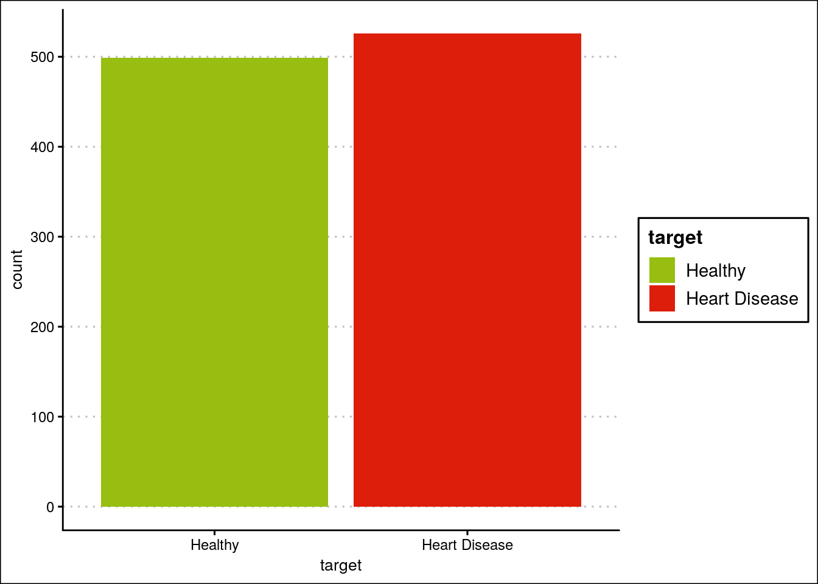
Total number of observations of healthy people and people suffering from heart-diseases.

Slide 6
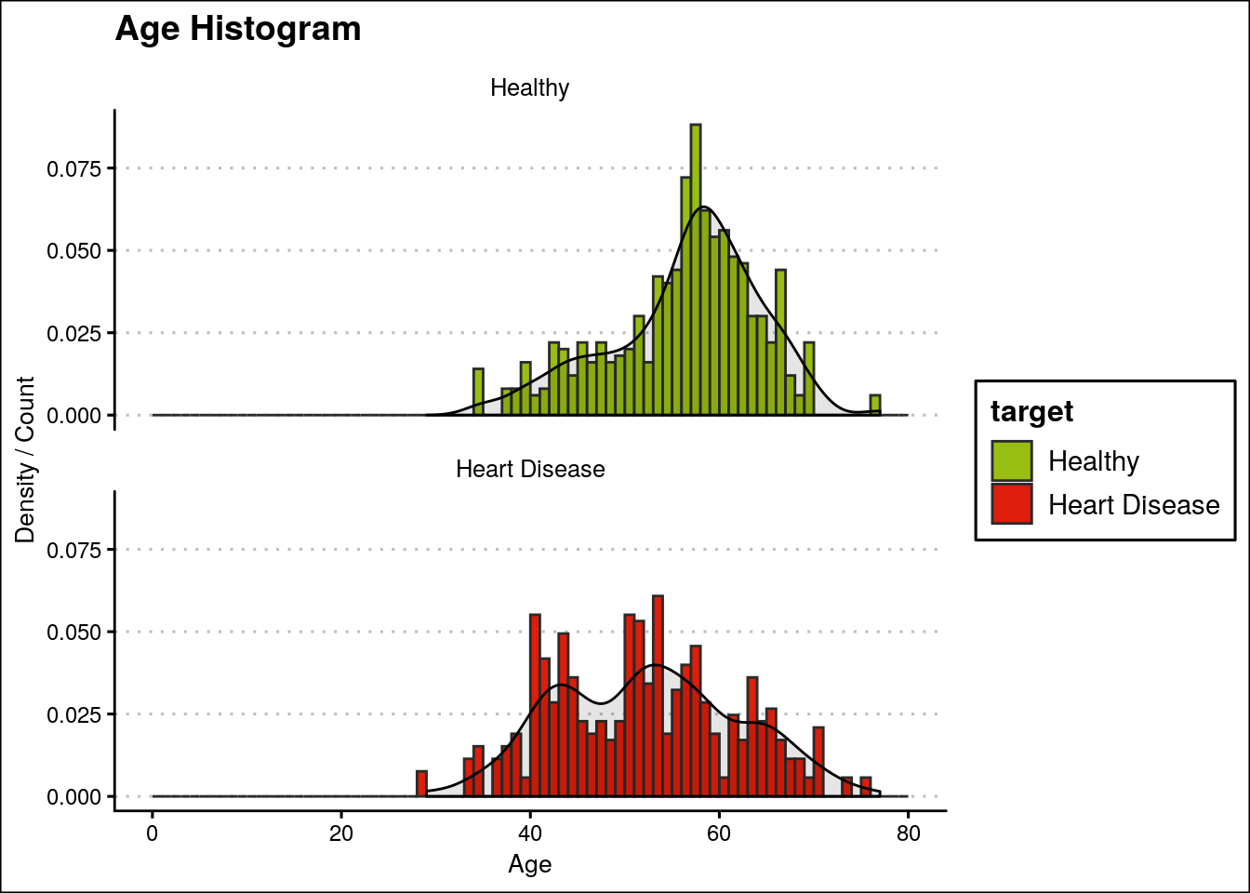
It can be observed that heart disease is uniformly spread out across age. In addition to that the median age for patients estimated was 56 with youngest and oldest being 29 and 77, respectively.

Slide 7
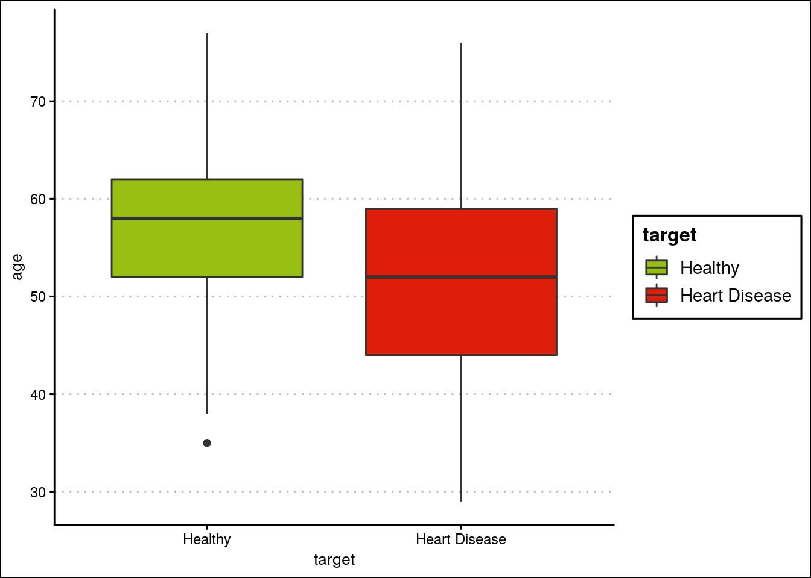
It can be observed from the plots that the median age of the people exhibiting heart diseases is less than the healthy ones. Moreover, it can be observed that the distribution of patients exhibiting heart diseases is slightly skewed. Hence, we can use age as a predictive feature.

Slide 8
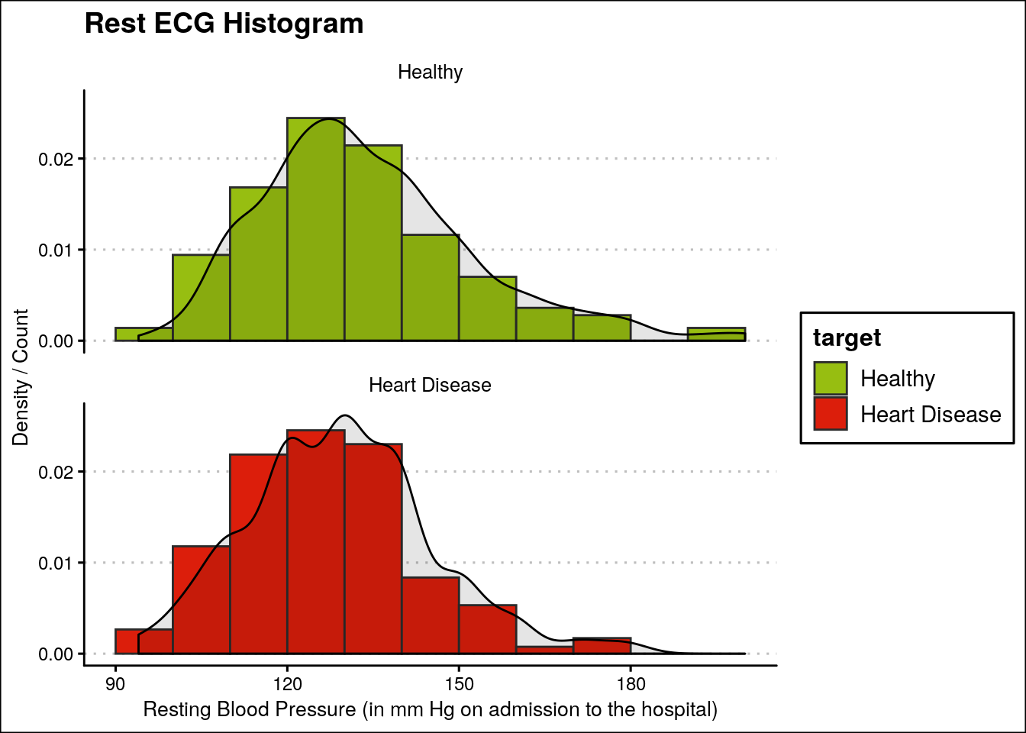
It can be observed that there is no major difference between the distributions of Rest ECG of healthy people and the ones exhibiting heart diseases.

Slide 9
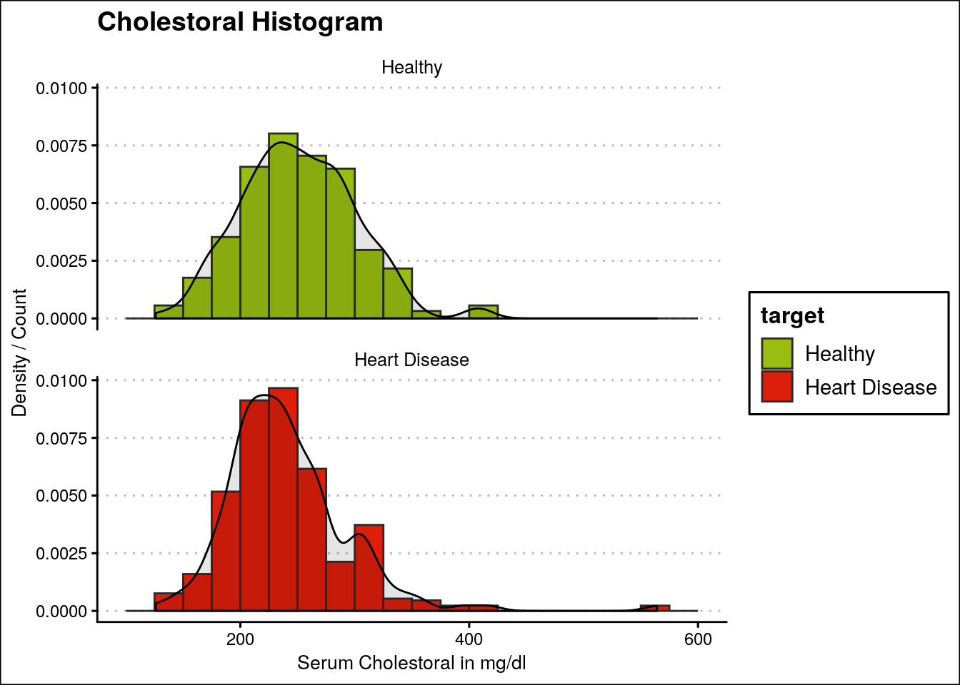
Moreover, it can be observed here that majority of the people exhibiting heart diseases have their serum cholesterol in the range of 200 - 300 mg/dl

Slide 10
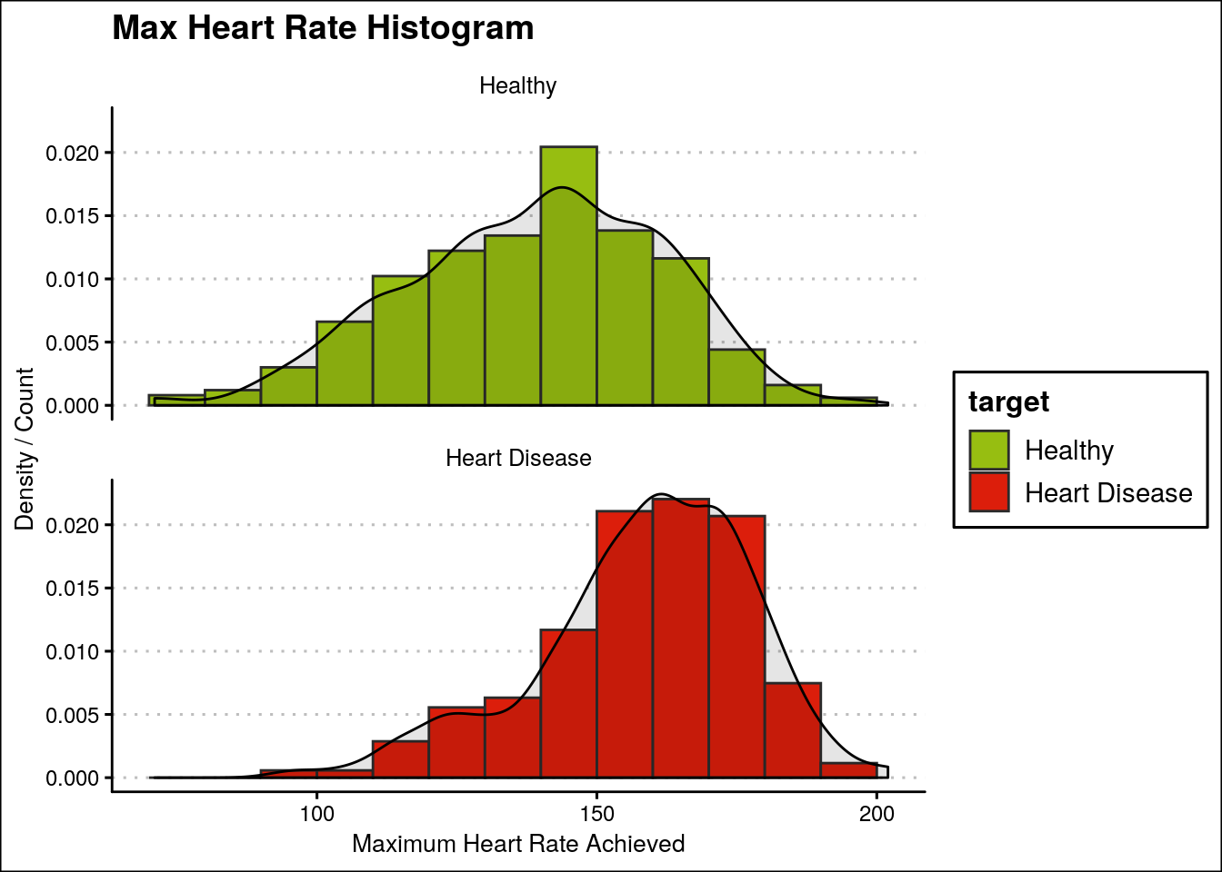
People exhibiting heart diseases generally have higher maximum heart rates as compared to health people.

Slide 11
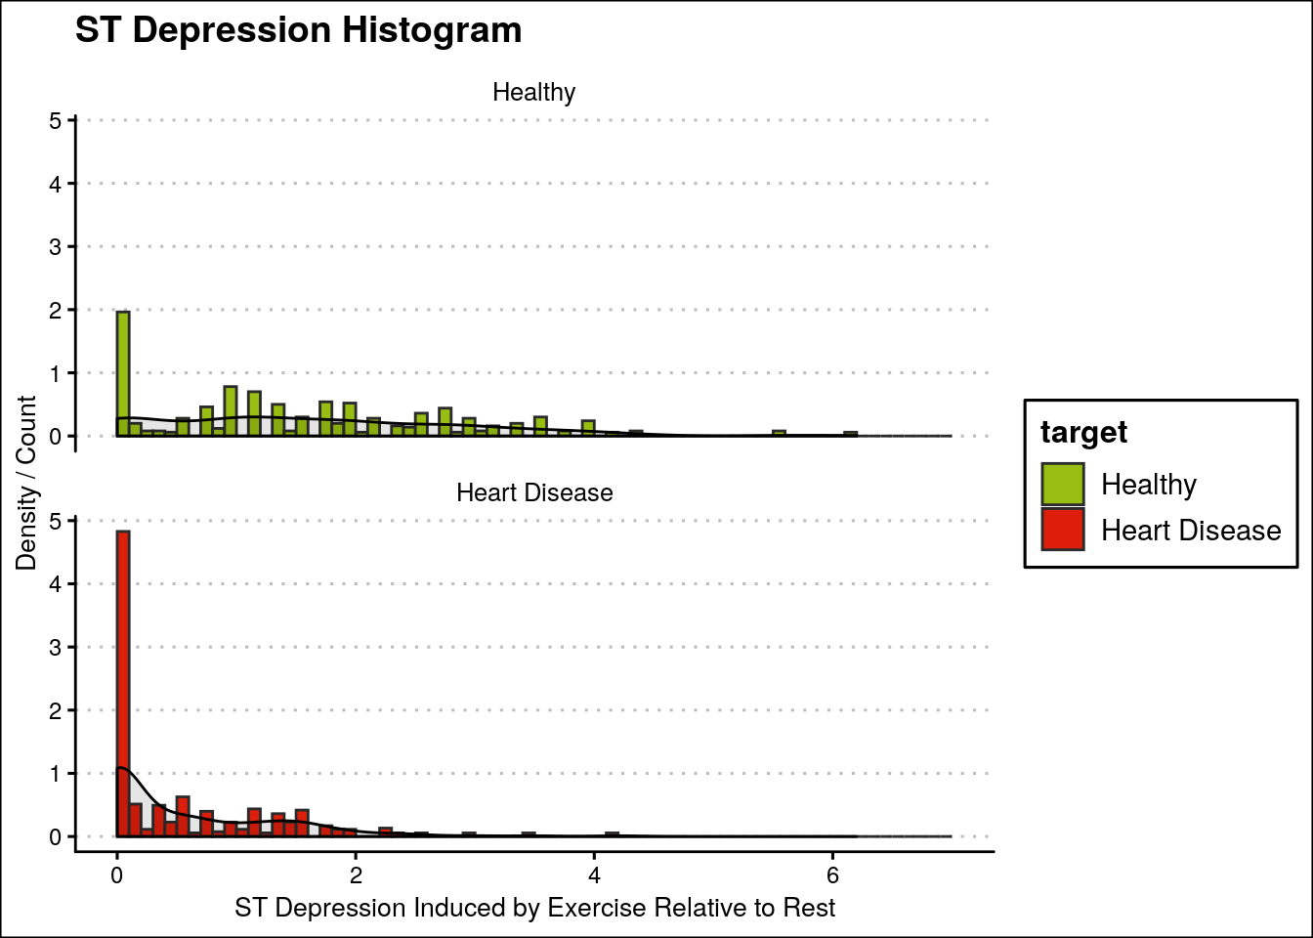
Majority of heart diseased patients have ST-Depression of 0.1

Slide 12
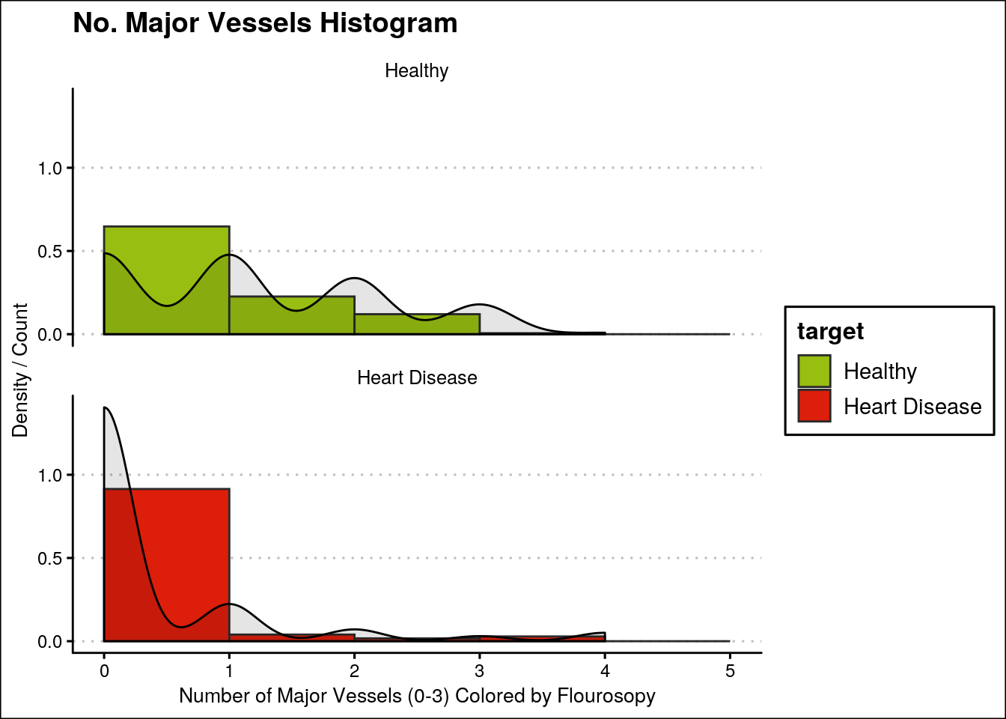
Most of the people who have 0-Major vessels are suffering from heart diseases

Slide 13
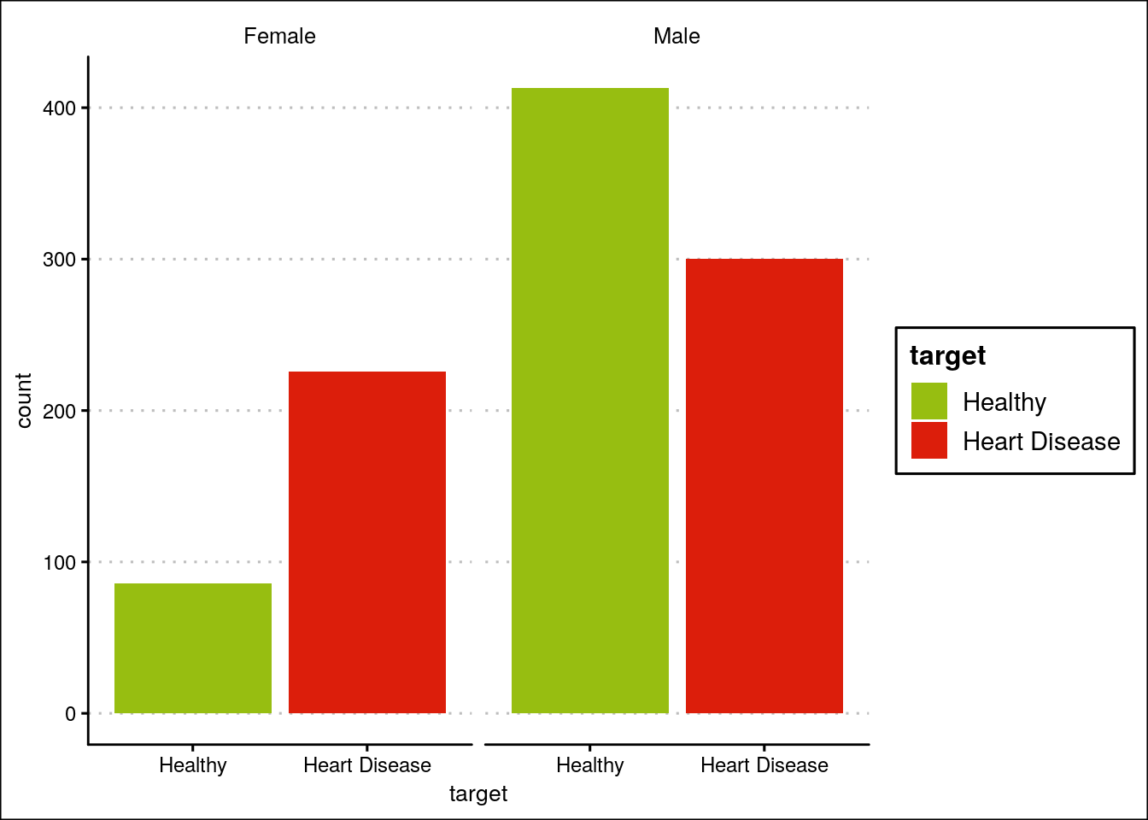
Heart diseases among females are higher as compared to males.

Slide 14
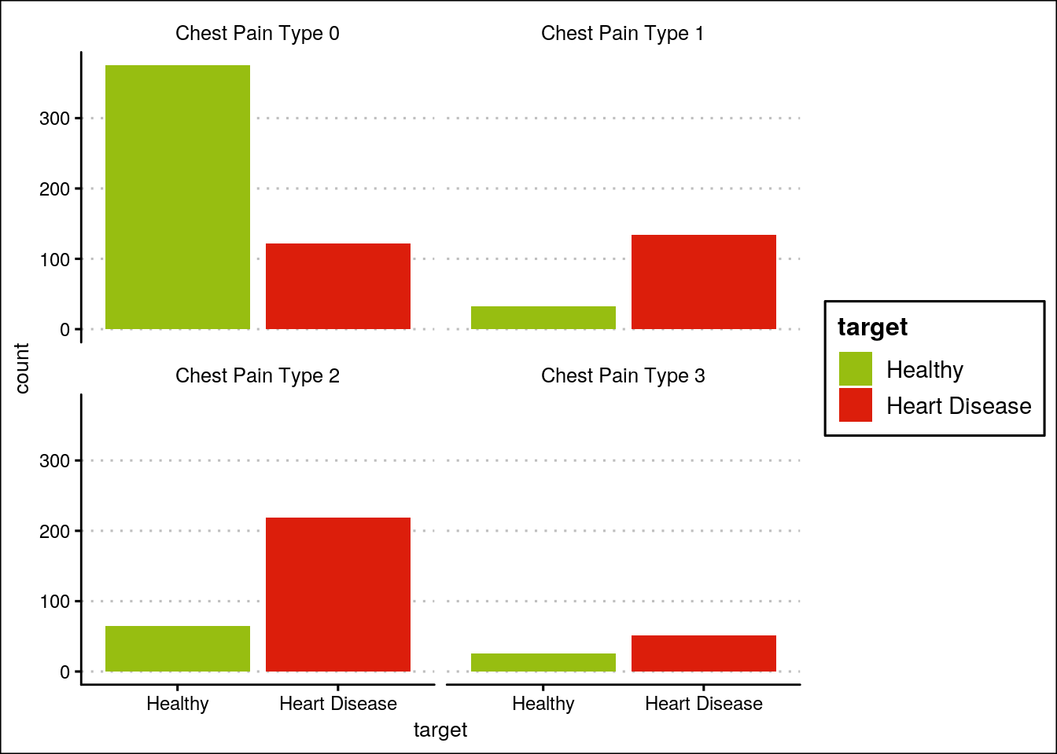
Majority of people suffering from heart-diseases have chest pain of type 1 or 2.

Slide 15
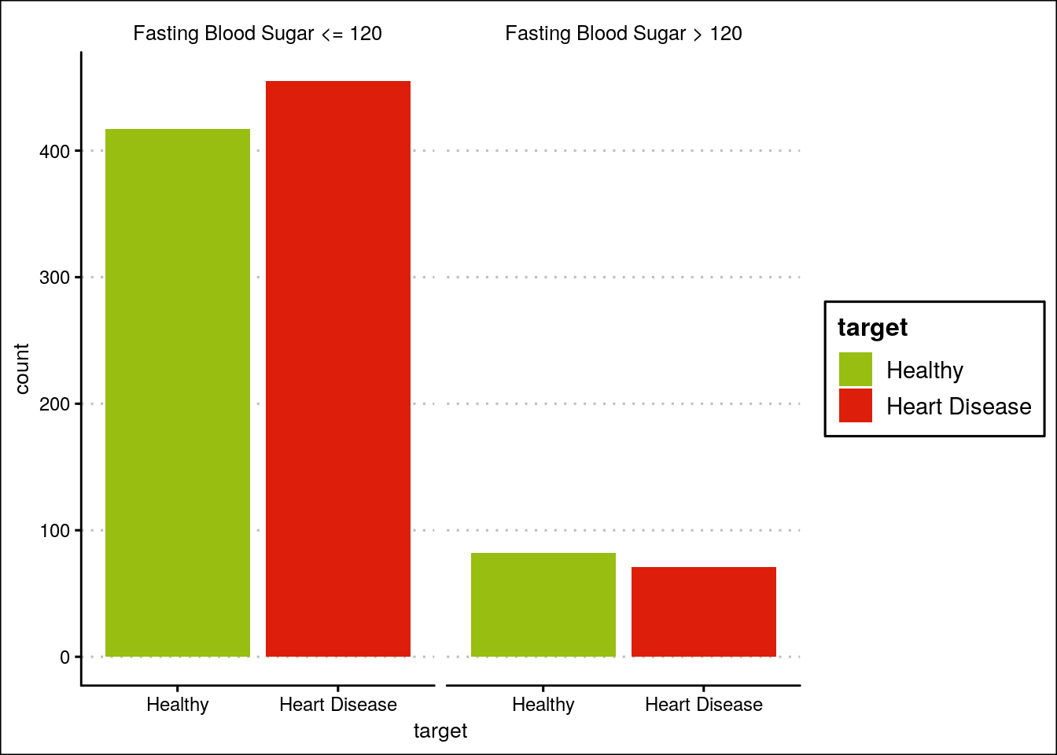
No major difference in fasting blood sugar.

Slide 16
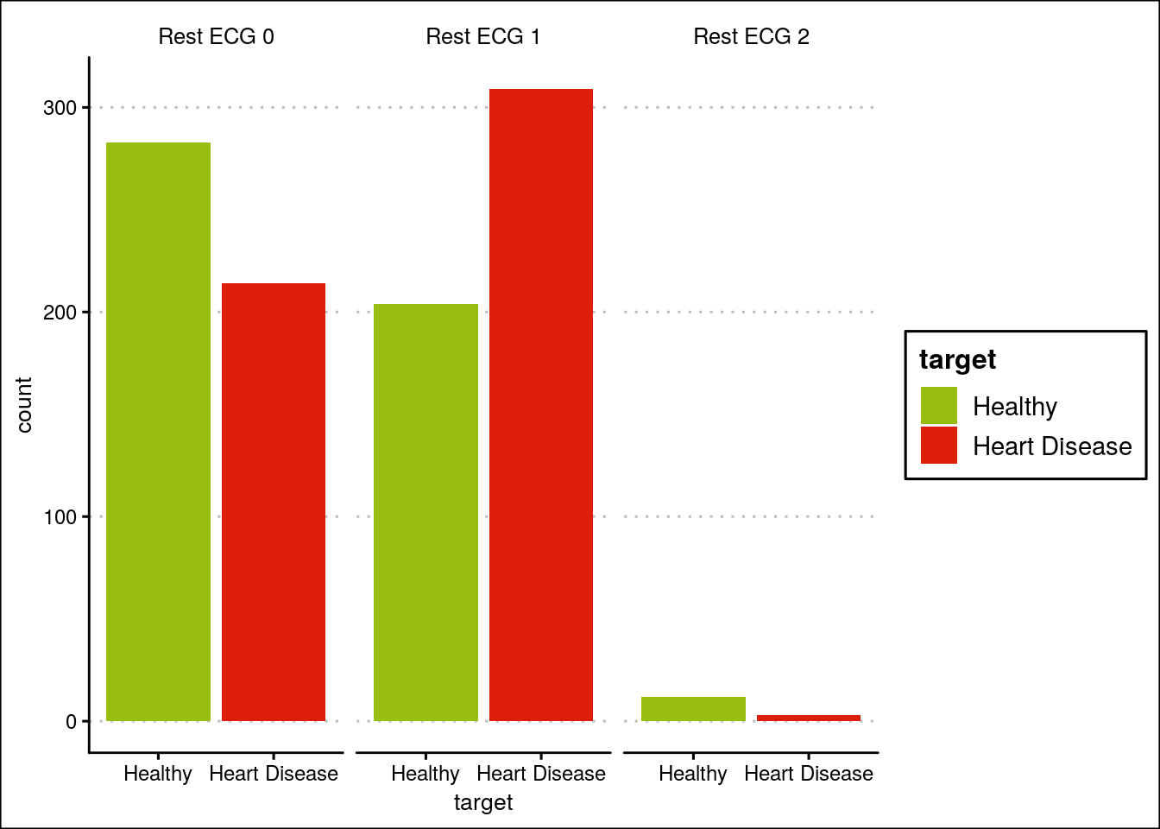
People having Rest ECG-1 have a higher probability of suffering from heart diseases.

Slide 17
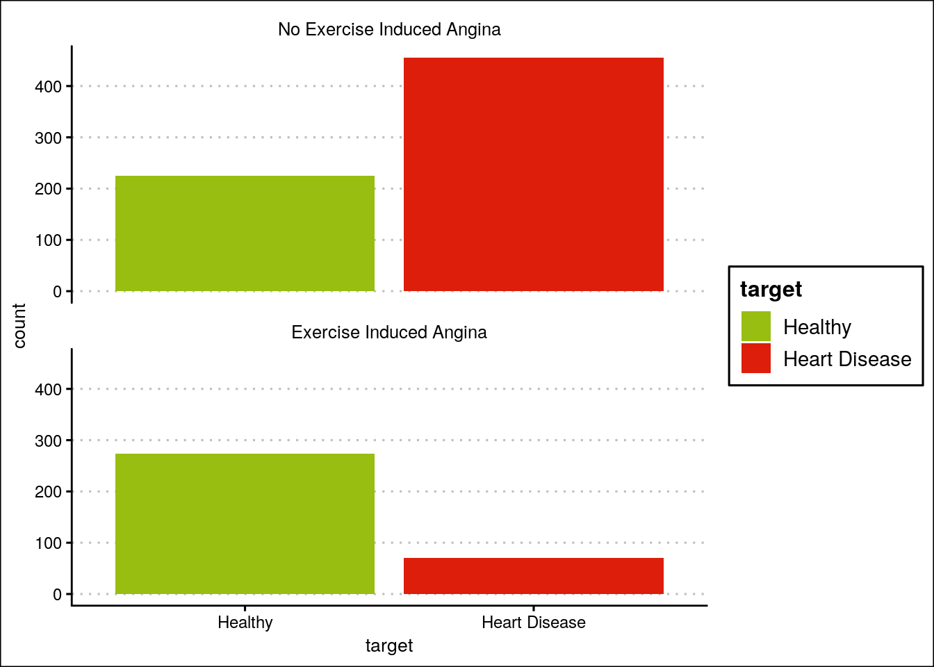
People with No exercise induced angina have a higher probability of getting heart diseases.

Slide 18
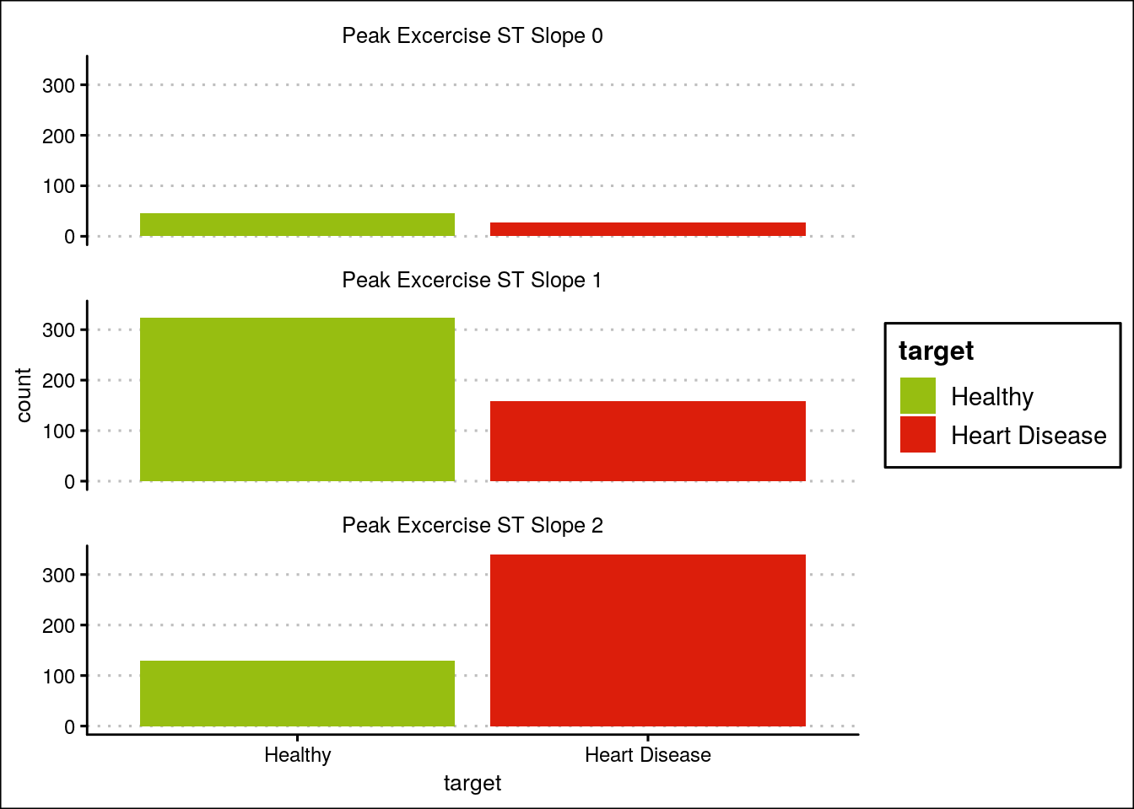
People with Peak Exercise slope 2 have a higher probability of exhibiting heart diseases.

Slide 19
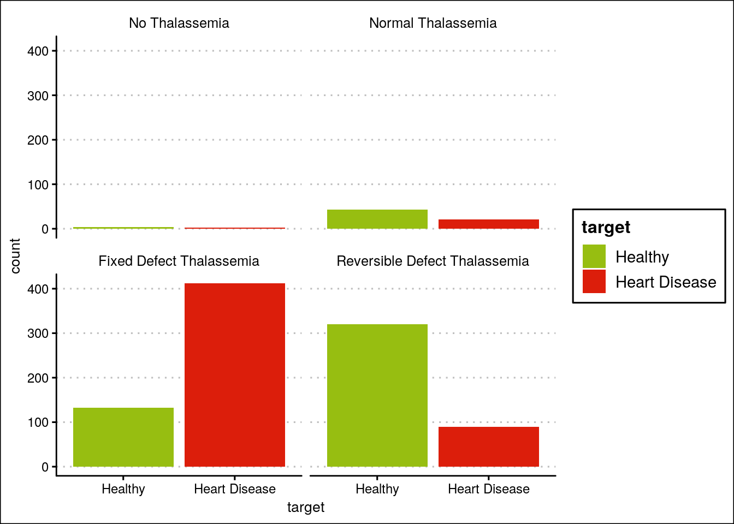
People with
fixed defect Thalassemia have a higher probability to suffer from heart diseases

Slide 20
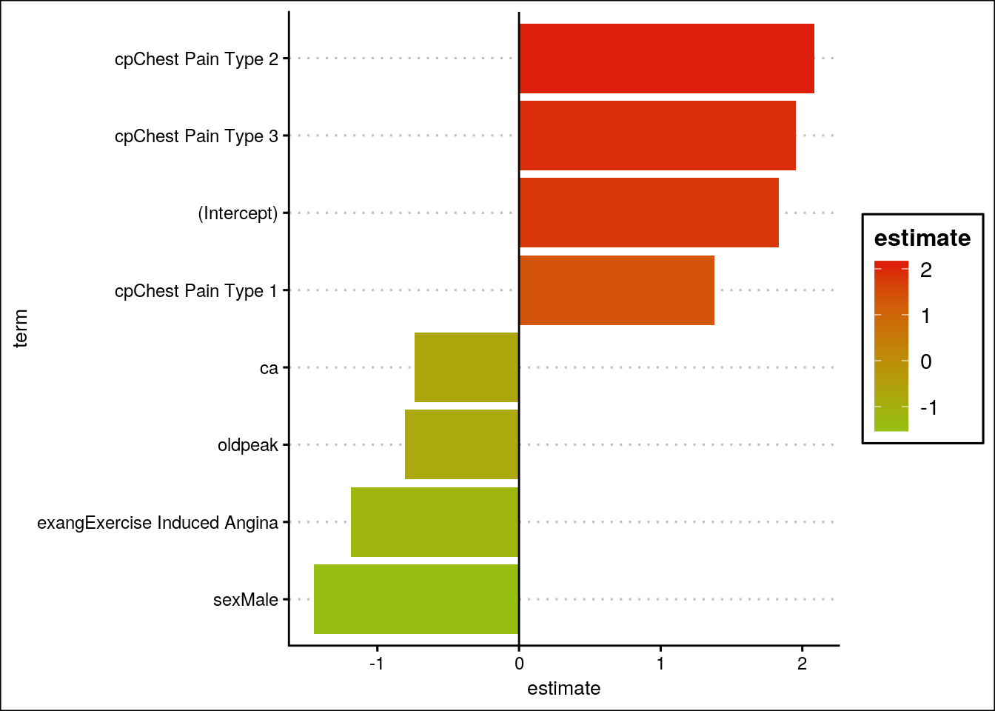
It can be observed that only a few parameters such as Chest pain type, Gender, Exercise induced angina, Number of vessels, and ST depression have a significant effect. Hence, dropping other parameters

Slide 21
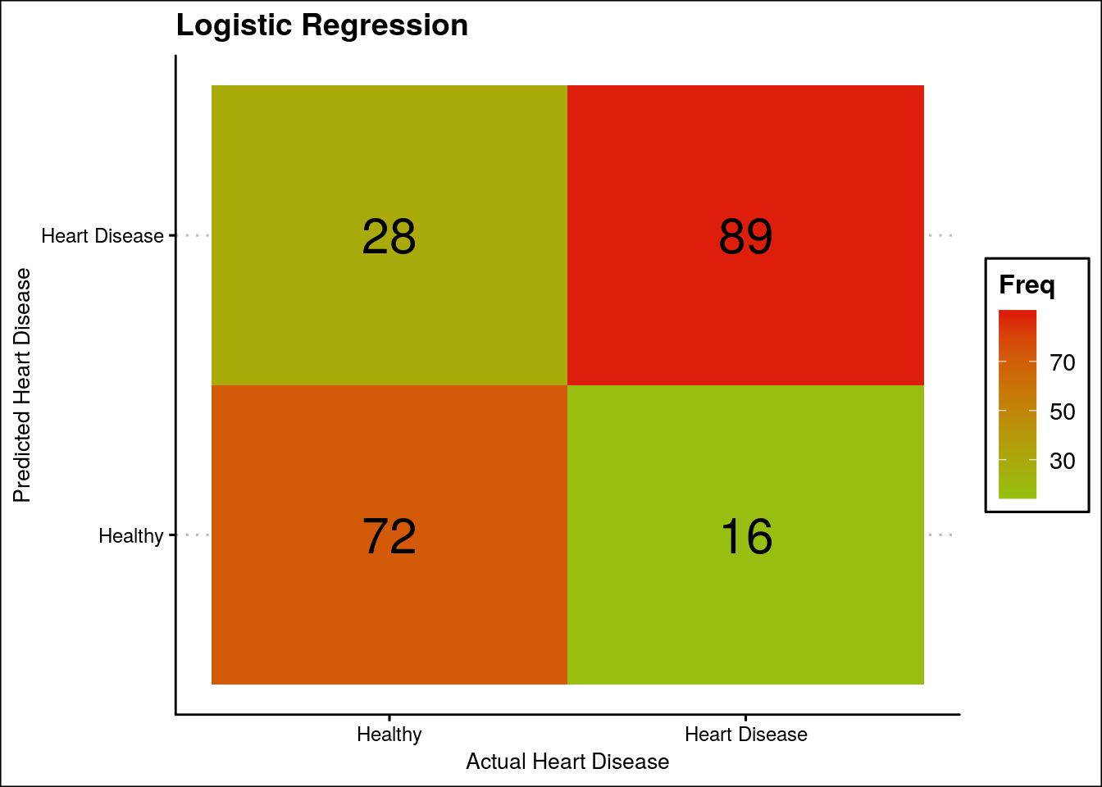
Accuracy: 78.54%
Sensitivity: 84.77%
Specificity: 72%

Slide 22
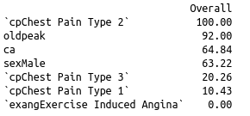
Variable Importance

Slide 23
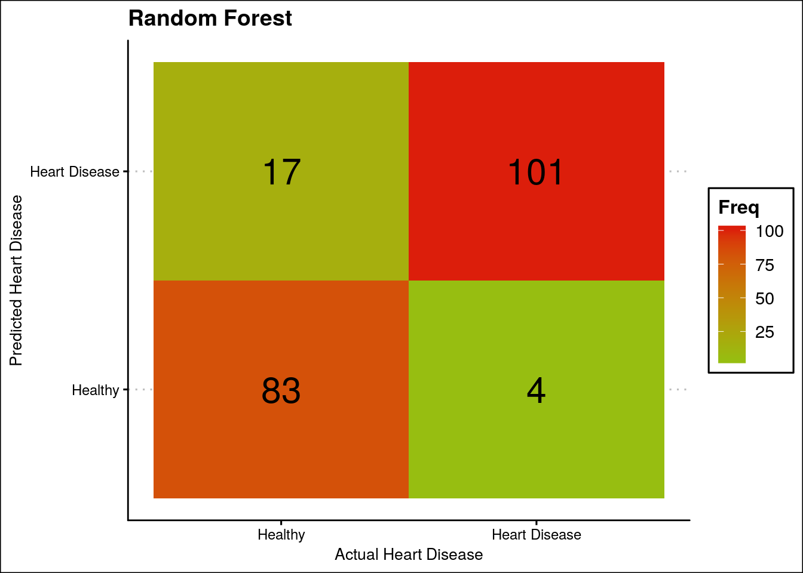
Accuracy: 89.76%
Sensitivity: 85.59%
Specificity: 95.4%

Slide 24
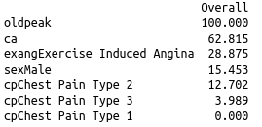
Variable Importance

Slide 25
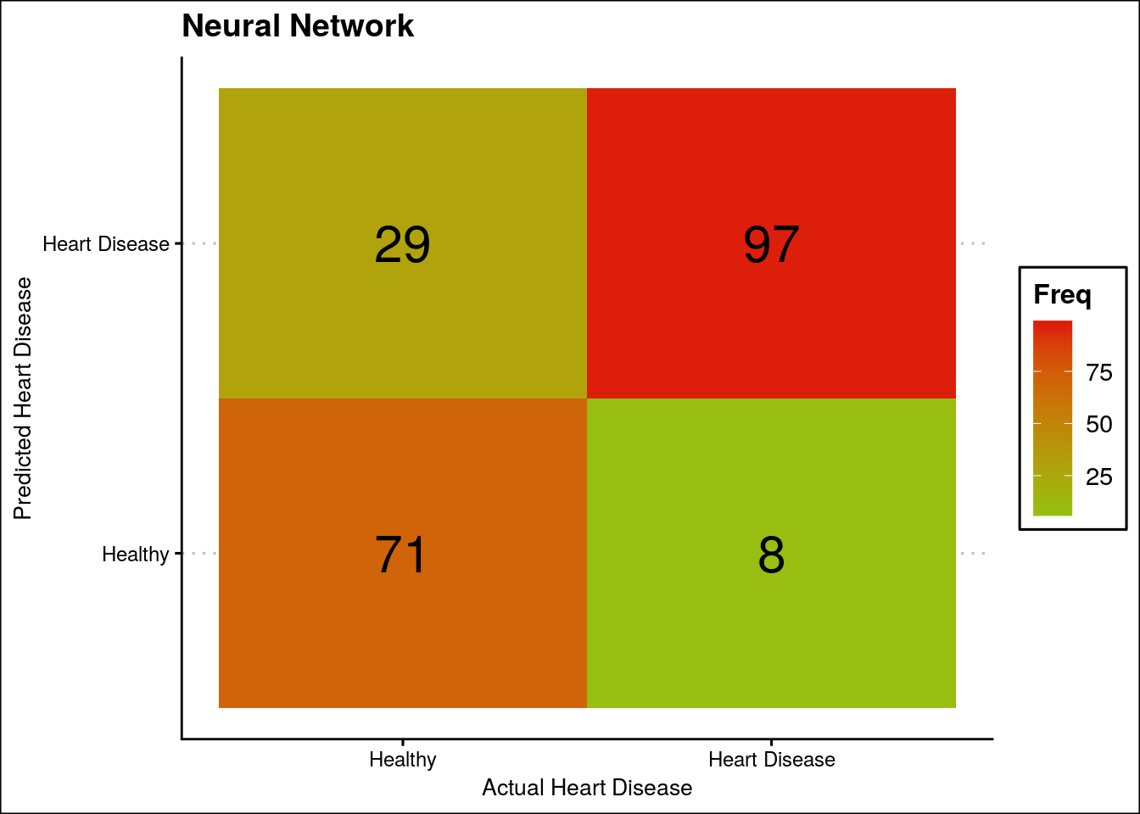
Accuracy: 81.95%
Sensitivity: 76.98%
Specificity: 89.87%

Slide 26
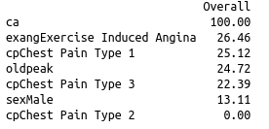
Variable Importance

Slide 27
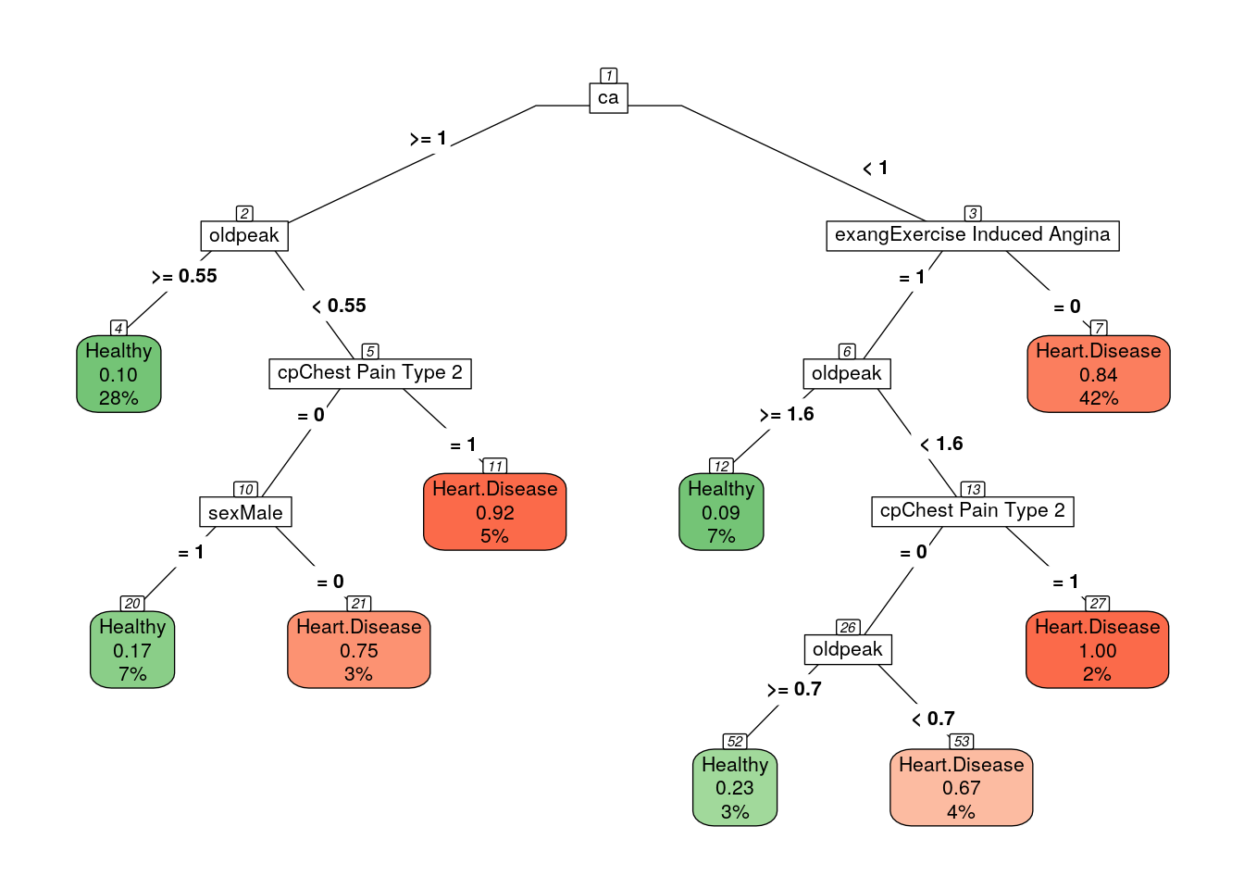
Accuracy: 86.65%
Sensitivity: 81.4%
Specificity: 87.56%

Slide 28
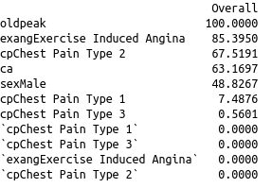
Variable Importance

Slide 29
THANK YOU
Notes:
Photo by Ousa Chea on Unsplash

