Slide 1

R PROGRAMMING FOR BIOLOGICAL DATA SCIENCES
YES BANK STOCK CLOSING PRICE PREDICTION
Submitted by
M.Ramana Maharshi
3-BI-Sec-A
Regd_No: 221FA14060

Slide 2
OUTLINE OF THE PRESENTATION
INDUSTRY OVERVIEW
CODE SNIPPETS FROM PYTHON
LINEAR REGRESSION GRAPHS
ROOT MEAN SQUARE ERROR(RMSE)
MEAN SQUARE ERROR(MSE)
REPRESENTATION
ANALYSIS OF DATASET BY APPLYING ML ALGORITHMS
RESULTS
CONCLUSIONS

Slide 3
INDUSTRY OVERVIEW
The dataset used in this project contains historical stock price data for Yes Bank from July 2005 to November 2020. It includes various features typically found in stock price datasets, such as:
1. Date: The specific trading day.
2. Open Price: The stock's price at market opening.
3. High Price: The highest price reached during the trading day.
4. Low Price: The lowest price reached during the trading day.
5. Close Price: The stock's price at market closing (target variable for prediction).
6. Adjusted Close Price: The closing price adjusted for dividends, stock splits, and other corporate actions.
7. Volume: The number of shares traded on a particular day.
These variables provide a foundation for performing regression analysis to predict future stock prices.

Slide 4

BUSINESS PROBLEM
STATEMENT
The goal is to analyze the historical stock price data of Yes Bank to predict future price movements. By understanding historical trends and patterns through exploratory data analysis (EDA), feature engineering, and model building, we aim to forecast future prices accurately. This can help businesses or investors make informed decisions about trading or investment in Yes Bank stocks.

Slide 5
AGENDA
Analyze the Given Dataset (Initial Exploratory Data Analysis-EDA).
Performing Basic Operations like Removing Null values.
Selecting any two Variables to Perform Linear Regression analysis.. Precisely Independent and Dependent Variable .
Plotting the BEST FIT LINE as it helps visualize, evaluate, and communicate the relationships between variables and the model’s effectiveness.

Slide 6
DATASET
The dataset provides the daily stock price information for YES Bank from July 2005 to September 2007. It includes the following columns:
Date: The date of the stock price observation.
Open: The opening price of the stock on that day.
High: The highest price reached by the stock on that day.
Low: The lowest price reached by the stock on that day.
Close: The closing price of the stock on that day.
This dataset can be used to analyze the stock price trends, volatility, and other relevant metrics for YES Bank during this period.

Slide 7
PLAN OF ACTION
Dataset Description and Loading
Exploratory Data Analysis (EDA)
Data Preprocessing and Feature Engineering
Data Splitting & Model Building
Model Tuning and Improvement
Insights and Evaluation Metrics
Model Explainability and Business Impact.

Slide 8
Initial Considerations
Ensure You Have All the .csv Files in Prior while performing Data Analysis(EDA).
Proper Connectivity During Execution of Code Snippets in Google colab Notebook.
Plotting BEST FIT LINE which should Pass All the Dataset Points on Which You have selected two Independent Variable and Dependent Variable.
Get the Results.
(Libraries Used : Pandas)

Slide 9
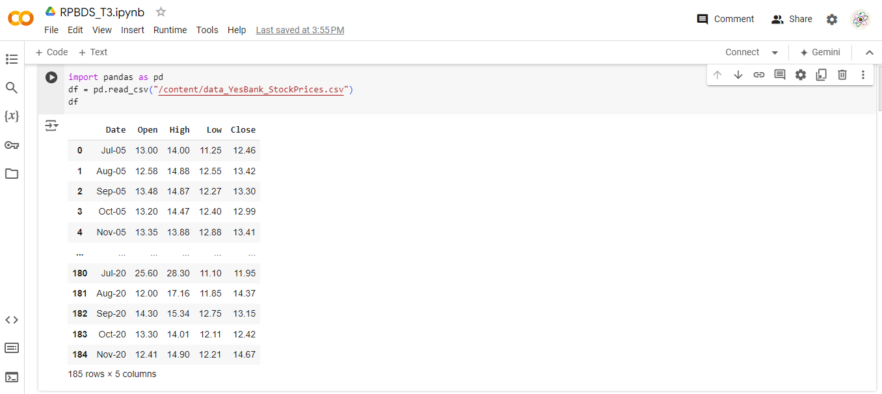
UPLOADING DATASET IN THE GOOGLE COLAB AND PERFORMING DATA ANALYSIS

Slide 10
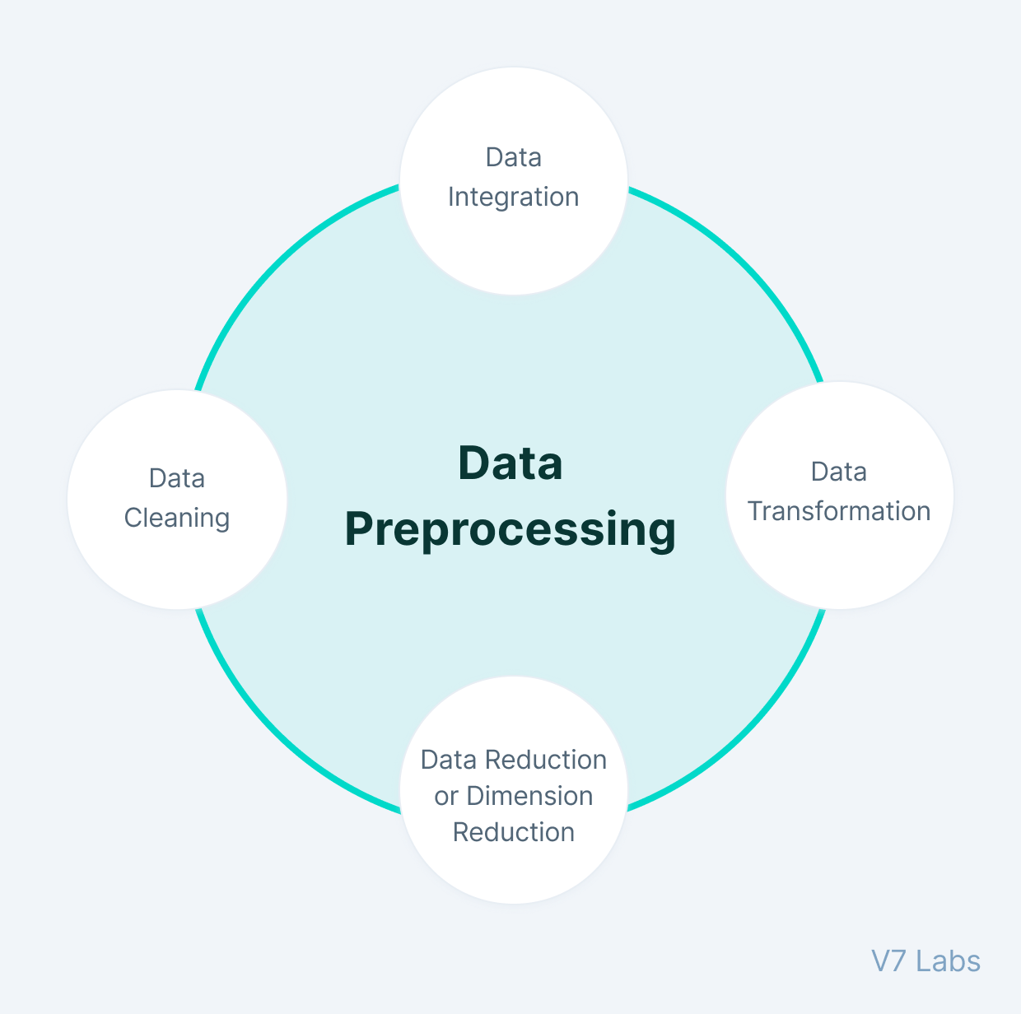
Data Preprocessing and Feature Engineering
Handle missing data, remove outliers, and create useful features like moving averages, momentum indicators, and rolling windows

Slide 11
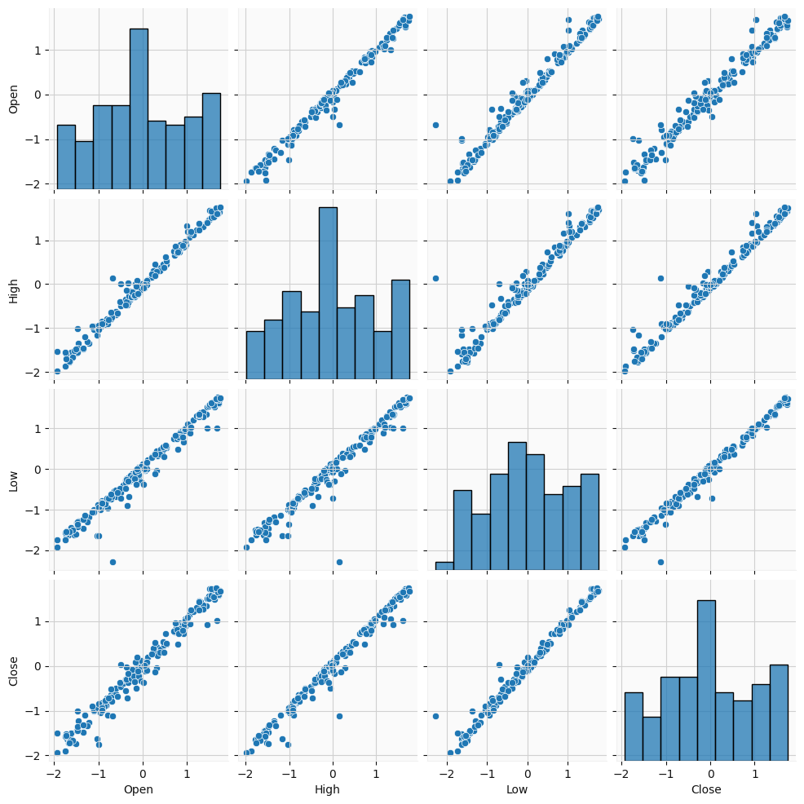
SNS.PAIRPLOT()
The sns.pairplot() function is from the seaborn library in Python, and it is typically used to create a grid of scatter plots for visualizing pairwise relationships in a dataset. Here's how you can use it with your dataset kf.
Along the diagonal, it typically shows a univariate distribution (e.g., a histogram or kernel density estimate) for each variable.
It generates a matrix of scatter plots where each variable in kf is Plotted against each other.

Slide 12
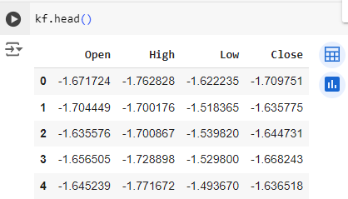
Kf.head()
DATA
PREPROCESSING
1
To preview the first few rows of the kf DataFrame by using kf.head(). This method is common in pandas to display the top 5 rows of the DataFrame.

Slide 13
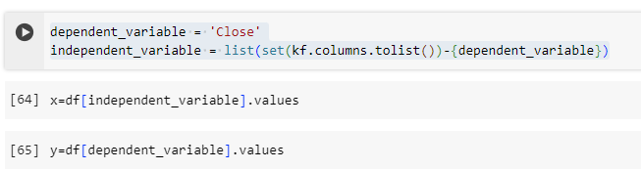
Dependent Variable: Assigning 'Close' as the dependent variable, which is likely the target trying to predict.
Independent Variables: Using set() to exclude the dependent variable 'Close' from the list of all column names in the DataFrame kf. The set() operation ensures that the target variable is removed, and list() converts the remaining set back to a list.
DATA
PREPROCESSING
2

Slide 14
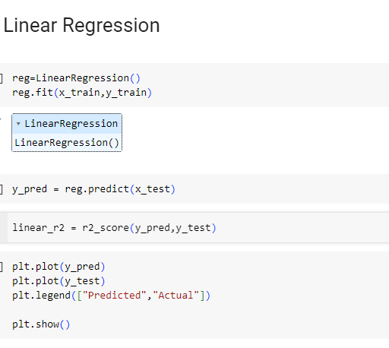
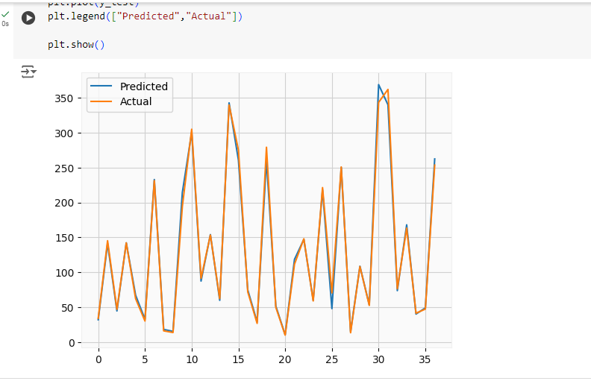
MACHINE LEARNING ANALYSIS
MODEL - 1

Slide 15
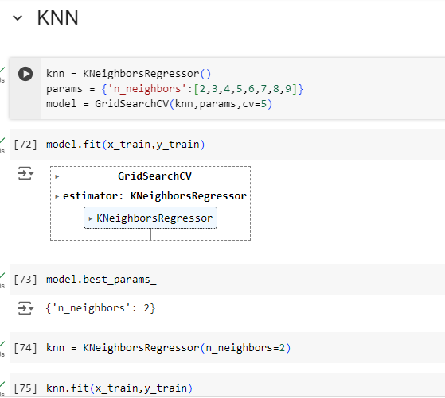
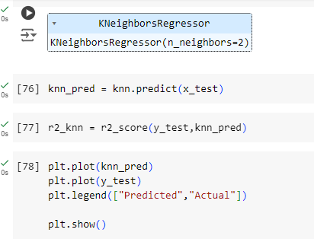
K-NEAREST NEIGHBORS (KNN) ALGORITHM
MODEL - 2

Slide 16
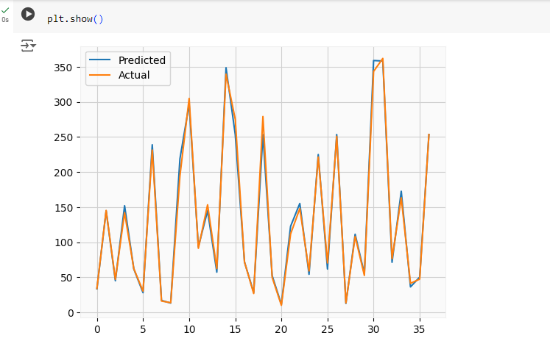
OUTPUT OF K-NEAREST NEIGHBORS ALGORITHM

Slide 17
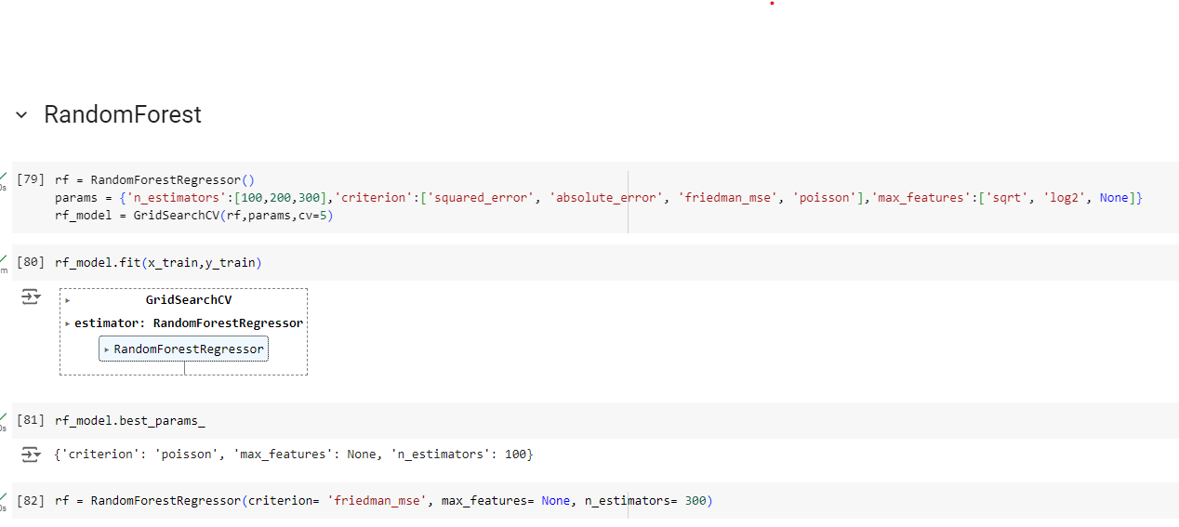
RANDOM FOREST AL GORITHM
MODEL - 3

Slide 18
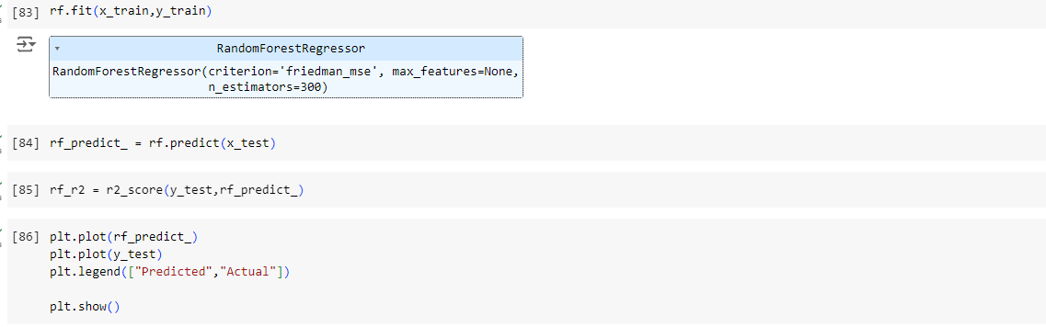
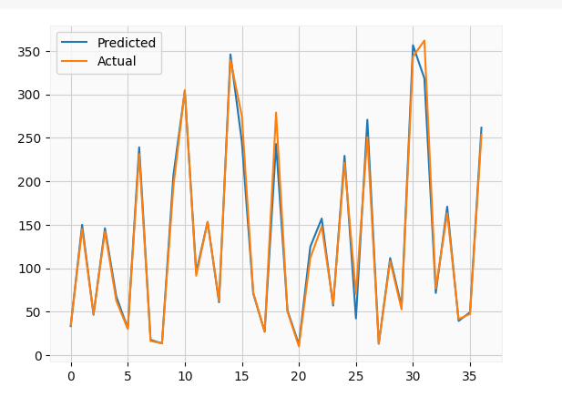
RANDOM FOREST AL GORITHM
MODEL - 3
OUTPUT

Slide 19
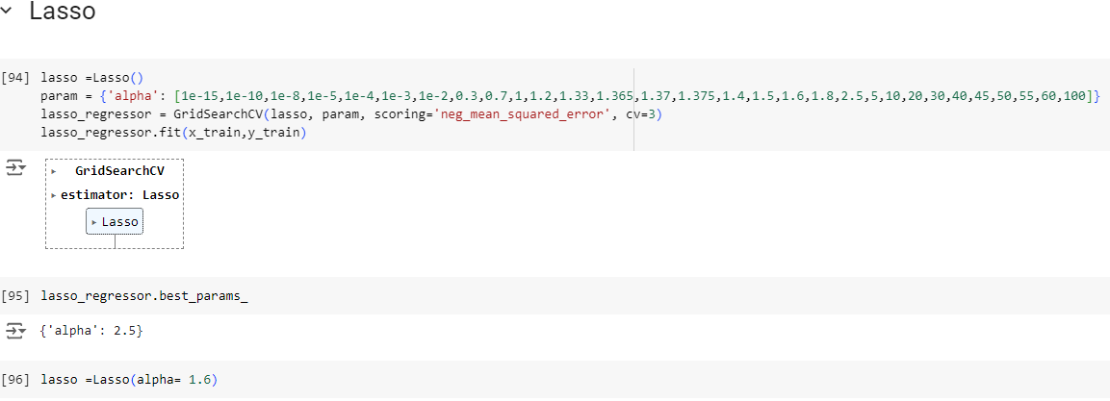
LASSO REGRESSION
MODEL - 4
OUTPUT

Slide 20
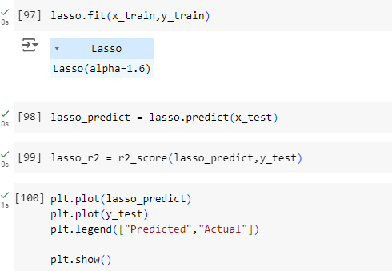
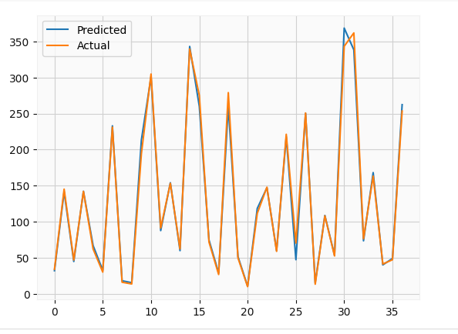
LASSO RE GRESSION
MODEL - 4
OUTPUT

Slide 21
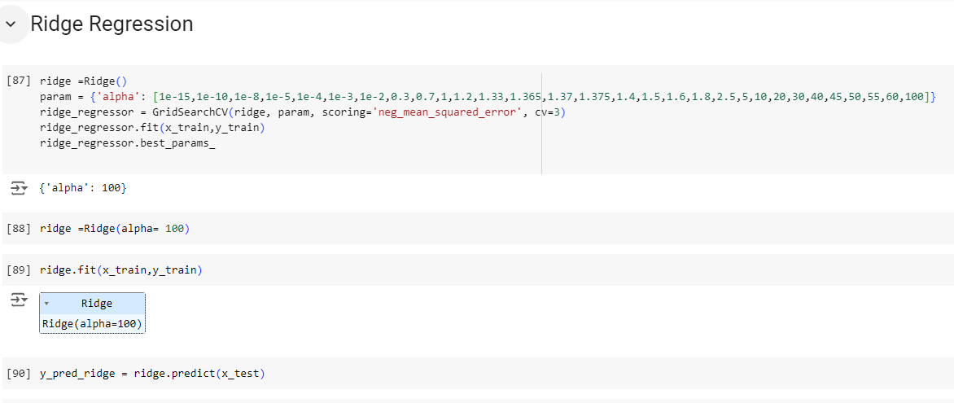
RIDGE REGRESSION
MODEL - 5
OUTPUT

Slide 22
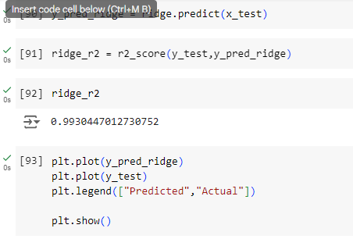
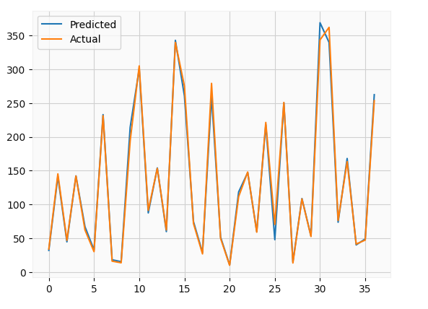
RIDGE REGRESSION
MODEL - 5
OUTPUT

Slide 23
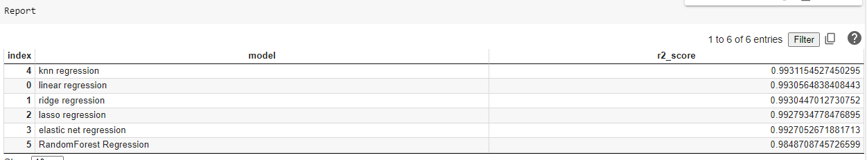
RESULTS
R-squared score is a statistical measure that indicates how well a regression model fits the data. It ranges from 0 to 1, where:
0: The model explains none of the variation in the dependent variable.
1: The model explains all of the variation in the dependent variable.

Slide 24
CONCLUSION
KNN regression has the highest R-squared score of 0.993115, indicating that it explains the most variation in the dependent variable.
Random Forest Regression has the lowest R-squared score of 0.984871, suggesting that it explains the least variation in the Dependent Variable.
Therefore, Overfitting: A model with a high R-squared score may still be overfitting the data, meaning it may not generalize well to new data.

Slide 25
THANK YOU
-An ML Analysis By
M.Ramana Maharshi
3 BI-A
221FA14060
DEPARTMENT OF BIOTECHNOLOGY,
VFSTR.

