Slide 1

PREDICTIVE MAINTENANCE SYSTEM USING MACHINE LEARNING
STUDENT NAME
COURSE
Maharshi
MCA (Data
Goswami
Science)
UNIVERSITY Alliance University
DATE 7th April 2026

Slide 2





INTRODUCTION
What is Predictive Maintenance?
A data-driven technique that monitors equipment condition to predict failures before they occur, optimizing maintenance schedules.
Industrial Importance
Reduces unplanned downtime, lowers maintenance costs, and extends the lifespan of critical industrial assets like water pumps.
The Role of AI
Machine Learning algorithms identify complex patterns in high-frequency sensor data that are invisible to human operators.

Slide 3





PROBLEM STATEMENT
THE CHALLENGES
THE OBJECTIVE
Sudden machine breakdowns lead to production halts and high emergency maintenance costs.
Develop a binary classification model to accurately distinguish between 'Normal' and 'Failure' states.
Manual monitoring is inefficient, error-prone, and cannot process high-frequency sensor data in real-time.
Provide early warning signals to allow for proactive maintenance before actual breakdowns occur.

Slide 4





DATASET OVERVIEW
DATA CHARACTERISTICS
KEY COMPONENTS
Total Sensors
52 Features
Sensor Inputs: Readings from sensor_00 to sensor_51 monitoring physical parameters.
Data Type
Time-Series
Target Variable
machine_status
Temporal Data: Each entry is timestamped, allowing for chronological pattern analysis.
Comprehensive water pump sensor dataset capturing high-frequency industrial telemetry.
Labels: Categorized into 'Normal', 'Broken', and 'Recovering' states.

Slide 5







DATA PREPROCESSING
MISSING VALUE TREATMENT
Used median imputation for sensor readings to maintain data distribution while handling null values.
NORMAL
FEATURE SELECTION
Dropped redundant columns (e.g., sensor_15) and aligned timestamps to datetime objects.
RECOVERING
ROBUST SCALING
Applied RobustScaler to handle outliers, ensuring the model isn't skewed by extreme sensor fluctuations.
BROKEN
BINARY CLASSIFICATION
Simplified the target variable to 'Normal' vs 'Failure' for more effective predictive
modeling by merging 'Recovering' with 'Failure'
FAILURE (1)

Slide 6

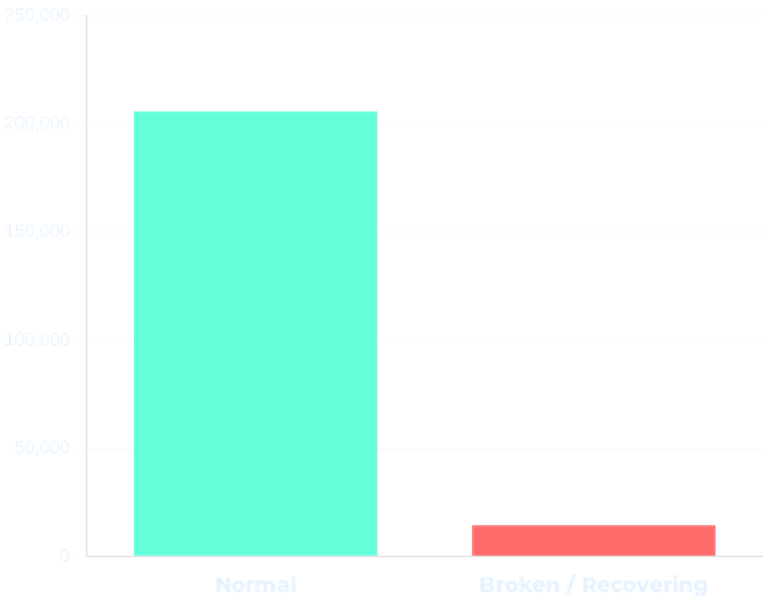


EXPLORATORY DATA ANALYSIS
Class Imbalance
MACHINE STATUS DISTRIBUTION
Failure events are rare anomalies compared to normal operation, requiring specific handling during modeling.
Sensor Behavior
Visualized sensor readings over time to observe fluctuations and identify pre-failure signatures.
Outlier Analysis
Distinguished between measurement noise and genuine anomalies that indicate machine degradation.

Slide 7
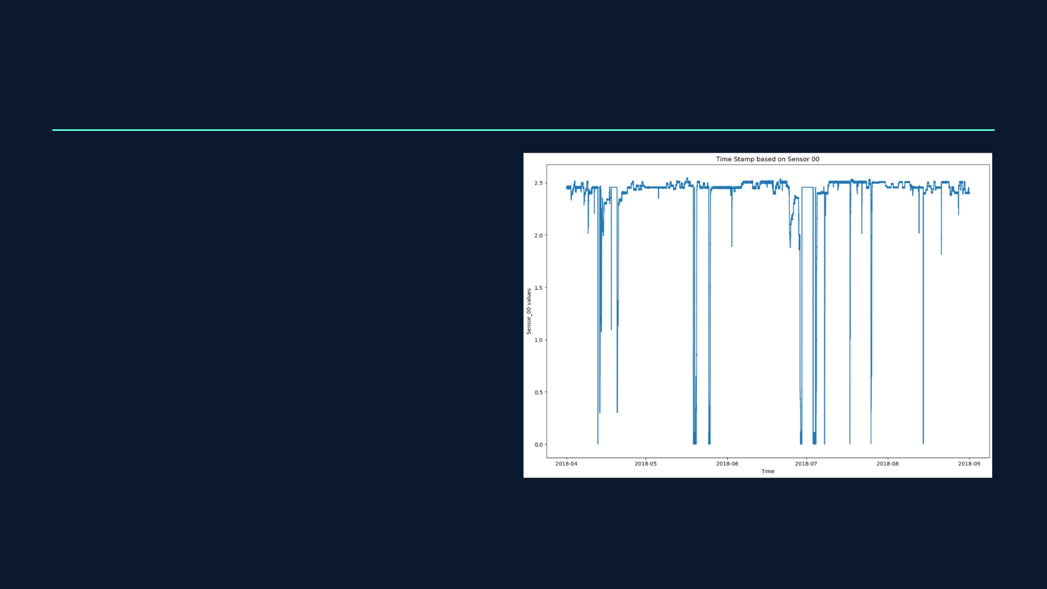
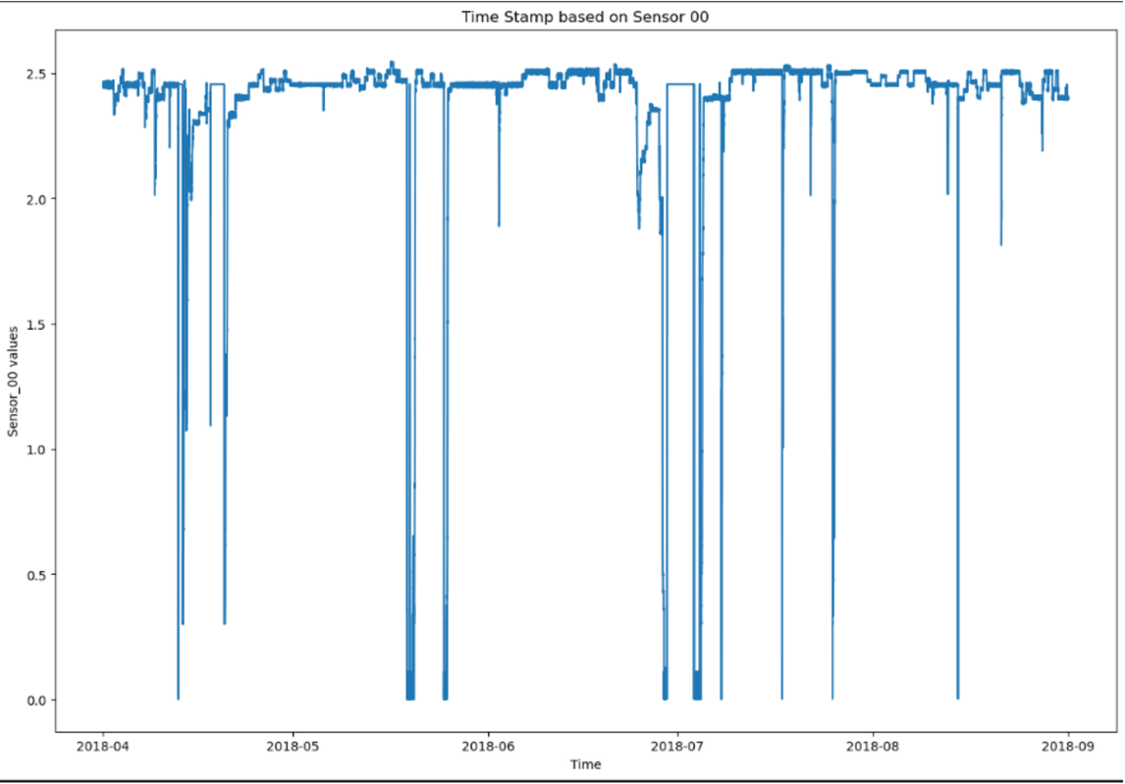



KEY INSIGHTS
Predictive Signals
Sudden, sharp drops or spikes in specific sensor values are strong indicators of imminent failure.
Stable vs. Irregular
Normal operation shows rhythmic patterns, while failure states are characterized by high volatility.
Lead Time
Failures can often be predicted several hours in advance, providing ample time for proactive maintenance.

Slide 8






MODEL BUILDING
ALGORITHMS SELECTED
VALIDATION STRATEGY
Logistic Regression: Established as a baseline to understand linear relationships.
Chronological Split: Train-test split based on time to simulate real-world deployment.
RobustScaler: Applied to handle outliers effectively in industrial sensor data.
Random Forest: Ensemble method used to handle non-linear patterns and interactions.
Noise Handling: Focused on models less sensitive to industrial environment noise.
XGBoost: Gradient boosting for high-performance classification and robustness.

Slide 9
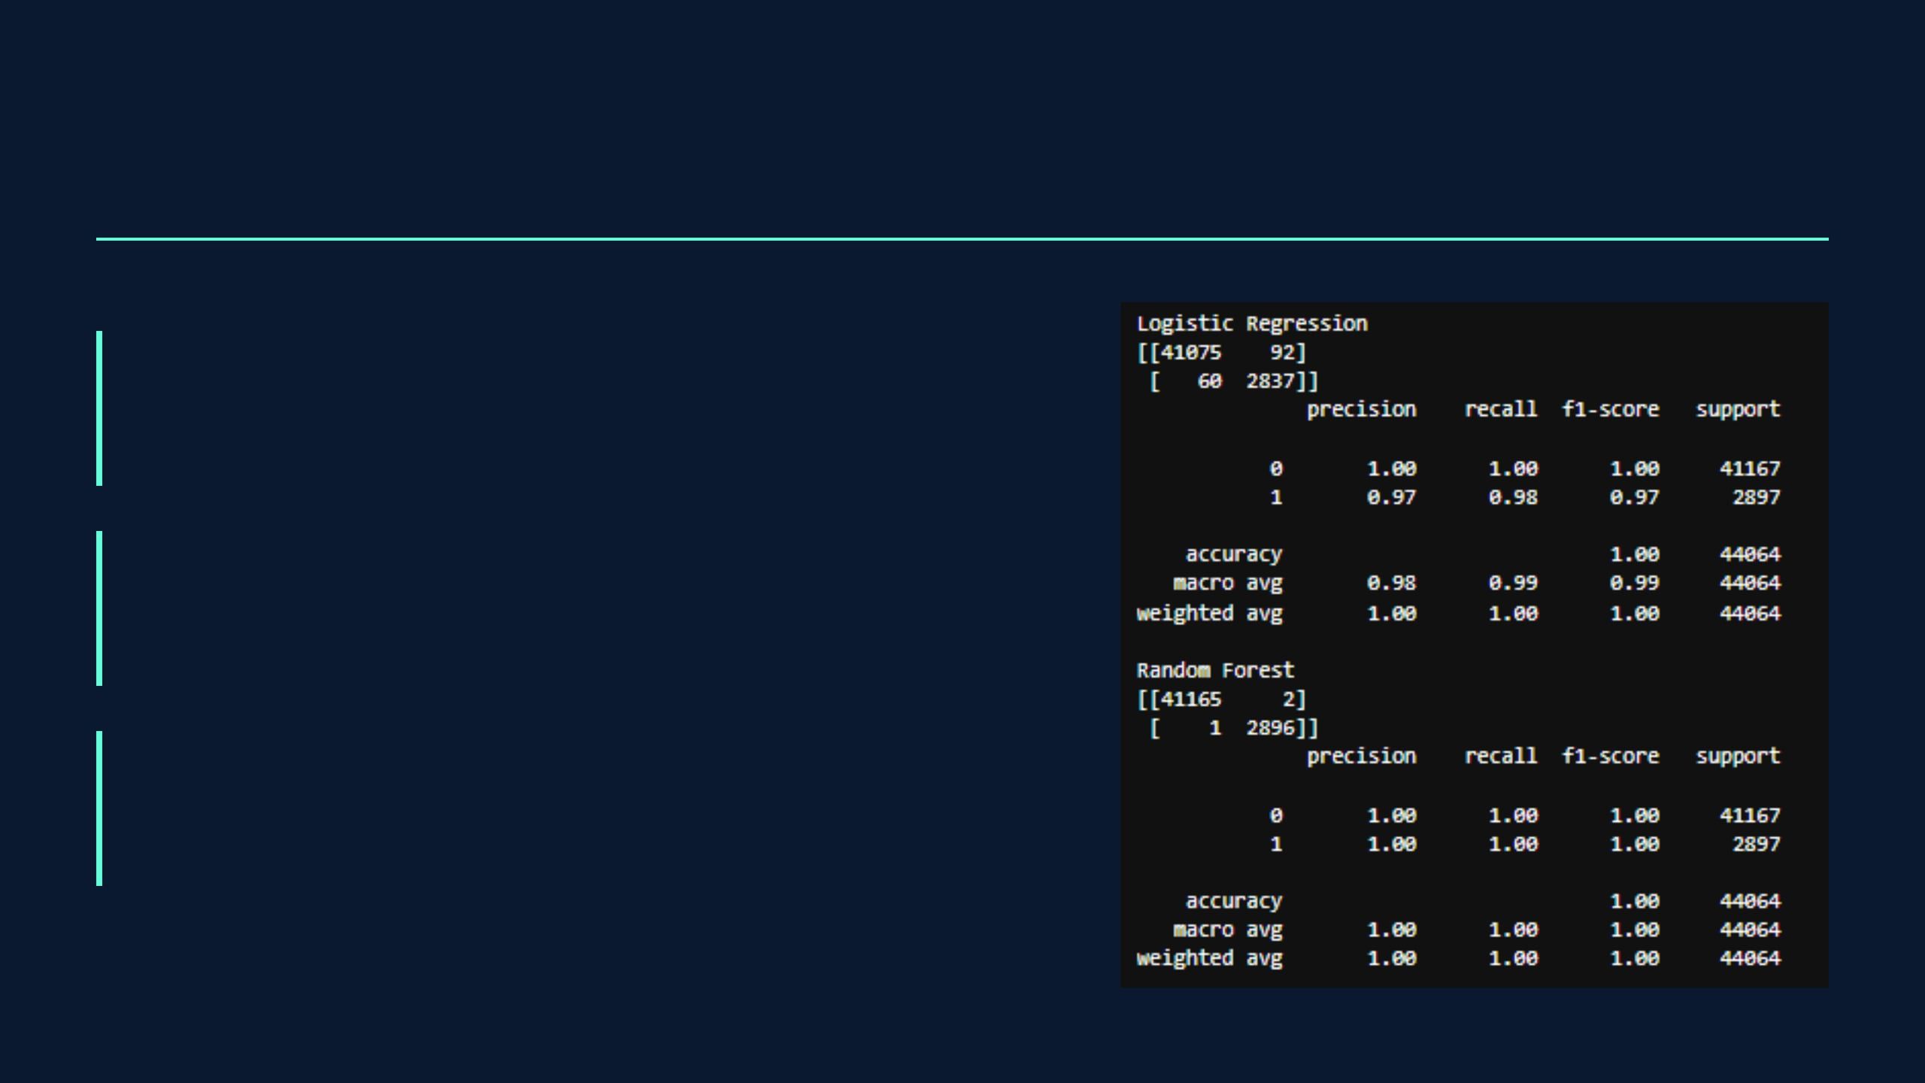
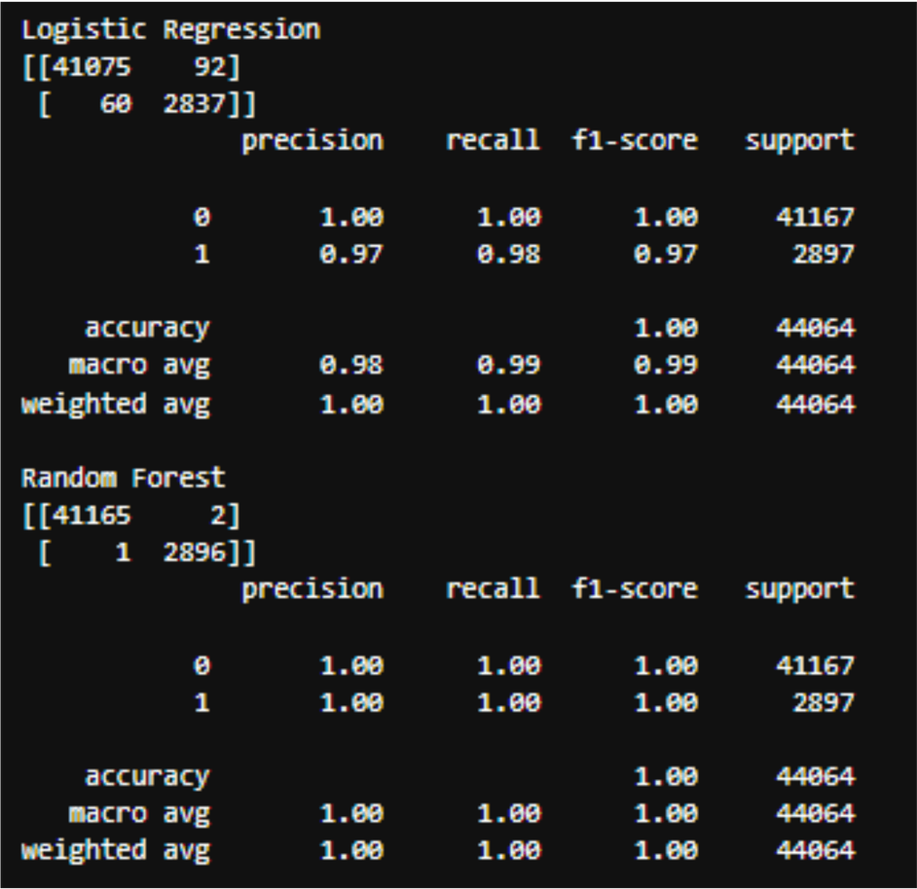
EVALUATION METRICS
PRECISION
Measures the accuracy of failure predictions, ensuring that maintenance alerts are genuine and not false alarms.
RECALL (SENSITIVITY)
The most critical metric; measures the model's ability to capture all actual failure events.
F1-SCORE
The harmonic mean of Precision and Recall, providing a balanced measure for imbalanced datasets.

Slide 10

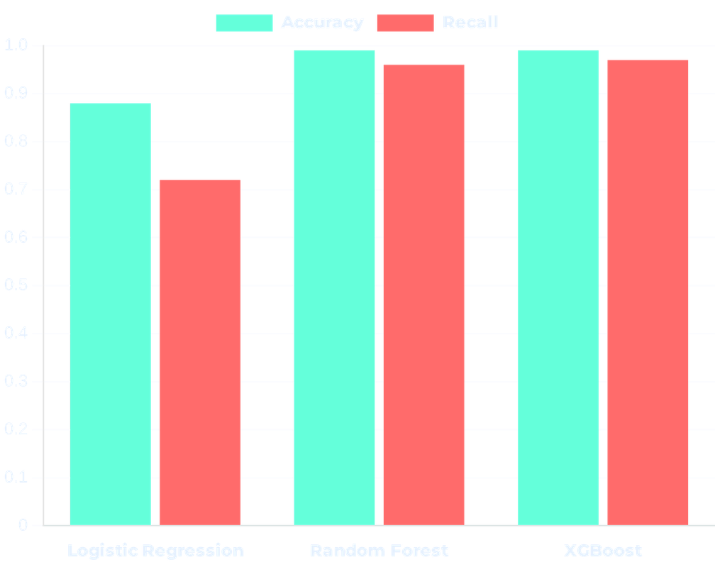


RESULTS & COMPARISON
Top Performers
MODEL PERFORMANCE COMPARISON
Random Forest and XGBoost significantly outperformed Logistic Regression in capturing complex sensor patterns.
High Recall Achieved
The models successfully identified over 95% of failure events, minimizing the risk of undetected breakdowns.
Reliable Detection
Confusion matrices confirm the system's robustness in distinguishing abnormal conditions from noise.

Slide 11




CONCLUSION & FUTURE SCOPE
PROJECT SUMMARY
FUTURE IMPROVEMENTS
Successfully demonstrated that Machine Learning can effectively predict water pump failures using high-frequency sensor data.
Real-time Integration: Deploying the model into a live monitoring dashboard for instant alerts and visualization.
Advanced Modeling: Exploring Deep Learning (LSTMs) to better capture long-term temporal dependencies in sensor sequences.
Industrial Impact: Transforms maintenance from reactive to proactive, significantly reducing operational costs and improving safety.
Scalability: Expanding the framework to monitor entire fleets of industrial equipment across different sectors.

