Slide 1

PortScan Pro
Network Port Scanner
Maharshi Vipulbhai Dihora
P P Savani School of Engineering
AICTE ID: STU699dc07316a8c1771946099

Slide 2

PROBLEM STATEMENT
In modern computer networks, open and unsecured ports can expose systems to cyber attacks and unauthorized access. Many users are unaware of active ports and running services, which increases security risks.
Key Issues:
Lack of awareness about open ports in a system
Open ports can be exploited by attackers
Difficulty in identifying running services
Increased risk of unauthorized access
Need for a fast and efficient scanning tool

Slide 3
Project Description
PortScan Pro is a Python-based Network Port Scanner developed to identify open and closed ports on a target system and detect running services. It uses efficient scanning techniques to analyze network security and potential vulnerabilities.
Key Features:
Scans IP address or domain for open/closed ports
Uses socket programming and multithreading
Supports custom port range scanning
Detects services on open ports
Provides fast and efficient results

Slide 4

WHO ARE THE END USERS?
This project is useful for individuals and professionals who want to analyze and improve network security.
End Users:
Cybersecurity students
Network administrators
Ethical hackers
IT professionals
System security analysts

Slide 5

Technology Used
This project is developed using modern programming and networking tools to ensure efficient port scanning.
Technologies:
Python (Core programming language)
Socket Programming (for network communication)
Multithreading (for faster scanning)
Tkinter (for graphical user interface)
Tools:
VS Code / PyCharm
Windows / Kali Linux environment

Slide 6
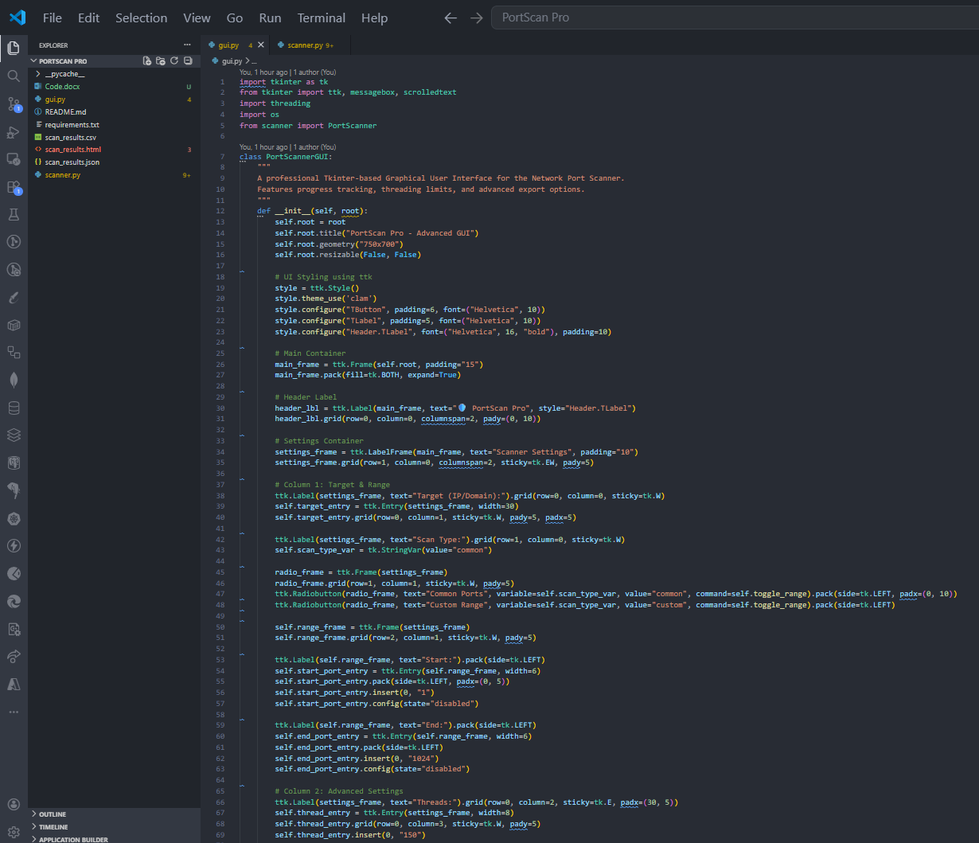
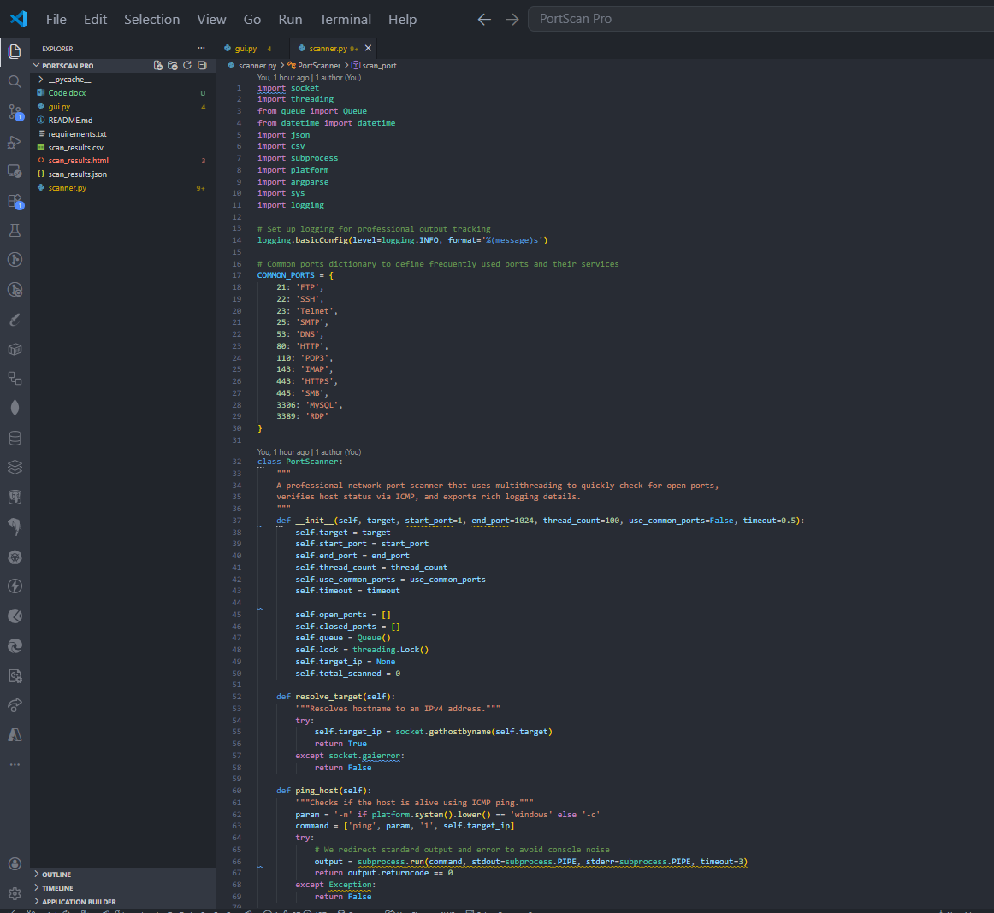
RESULTS
Code Link:
https://docs.google.com/document/Code

Slide 7
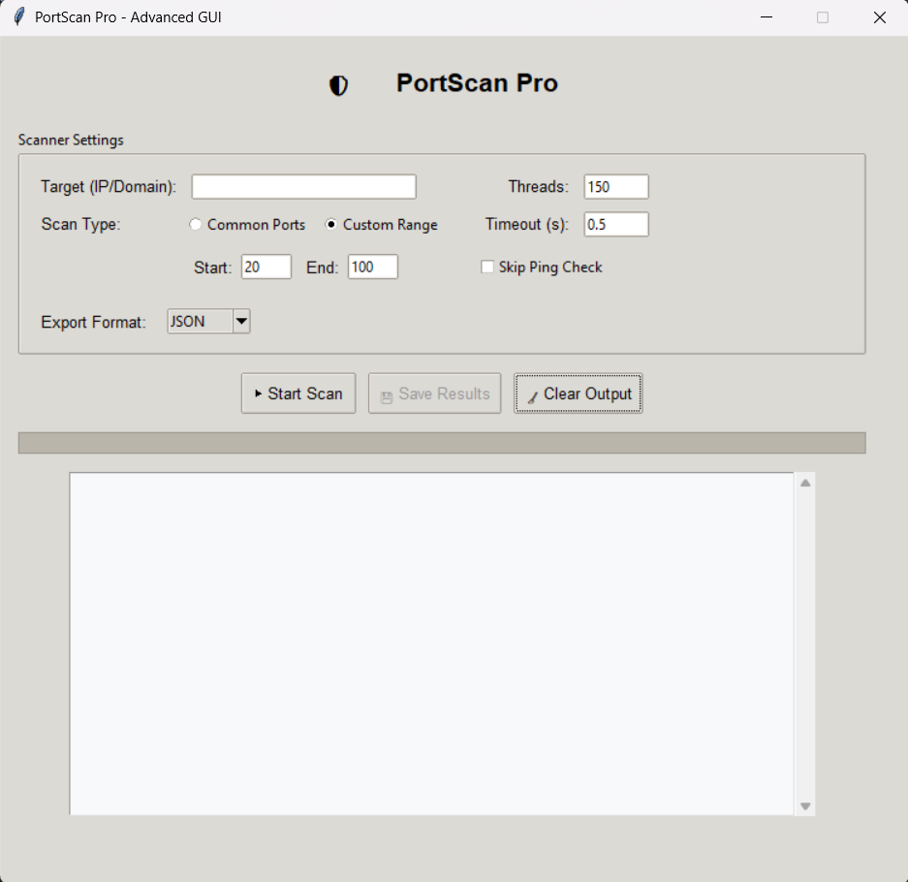
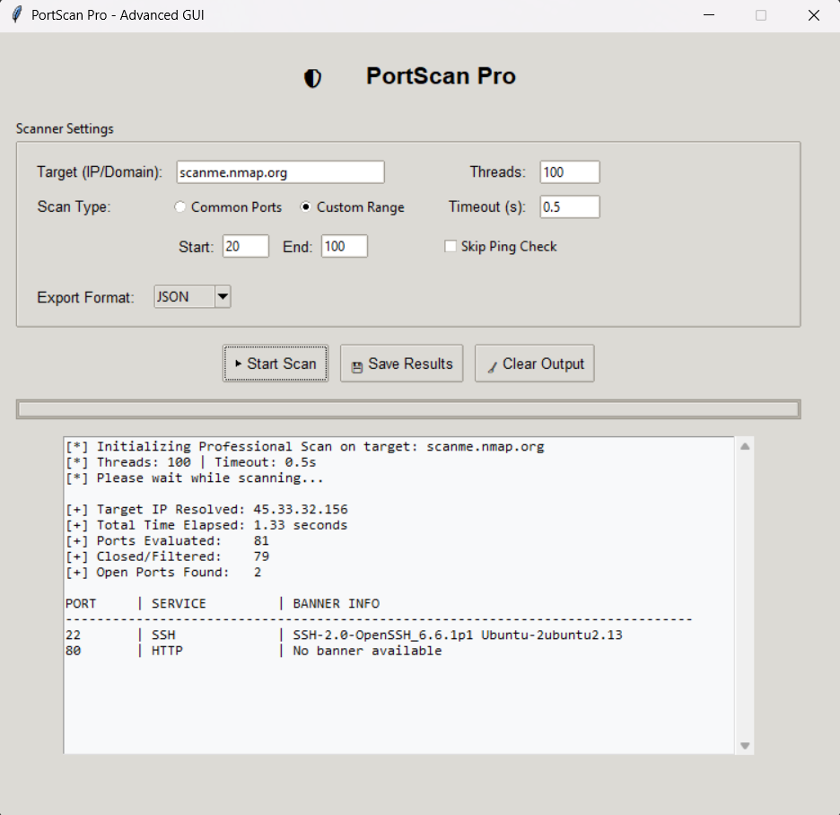
RESULTS
Demo Link:
https://drive.google.com/file/d/1W8X9f4I-aNAreaz32lma99tc-Jl7GRaW/view?usp=sharing

Slide 8

Certificate - Protection from browser attacks

Slide 9

Certificate - Introduction to System Security

Slide 10
GitHub link
Project Repository: https://github.com/MaharshiMD/PortScan-Pro
Project Includes:
Python source code (Port Scanner)
GUI implementation (Tkinter)
Multithreading and socket programming
Export features (JSON, CSV, HTML)
Project documentation (README.md)

Slide 11
Thank you
Presented by: Maharshi Vipulbhai Dihora
AICTE Internship Project PortScan Pro – Network Port Scanner
.
.
Any Questions?

