Slide 1


PU Buddy – AI RAG Assistant
Innovative AI tool enhancing retrieval augmented generation
Notes:
AI-generated content may be incorrect. ---

Slide 2
PU Buddy – AI RAG Assistant
Notes:
--- This slide references information from the following file: https://in-prod.asyncgw.teams.microsoft.com/v1/objects/0-sin-d1-5b6c9101aeda0dfde24ddb58e8ad023a/views/original/PU_Buddy_RAG_Implementation_Guide.docx,https://sphinxcoretechllp11-my.sharepoint.com/personal/maharshi_sphinxcoretech_com/_layouts/15/Doc.aspx?sourcedoc=%7B94A8C226-C5DE-4F66-BF79-A2D8194DE919%7D&file=rudra%20patel%20200345305018%20Internship_ppt.pptx&action=edit&mobileredirect=true Project Overview

Slide 3
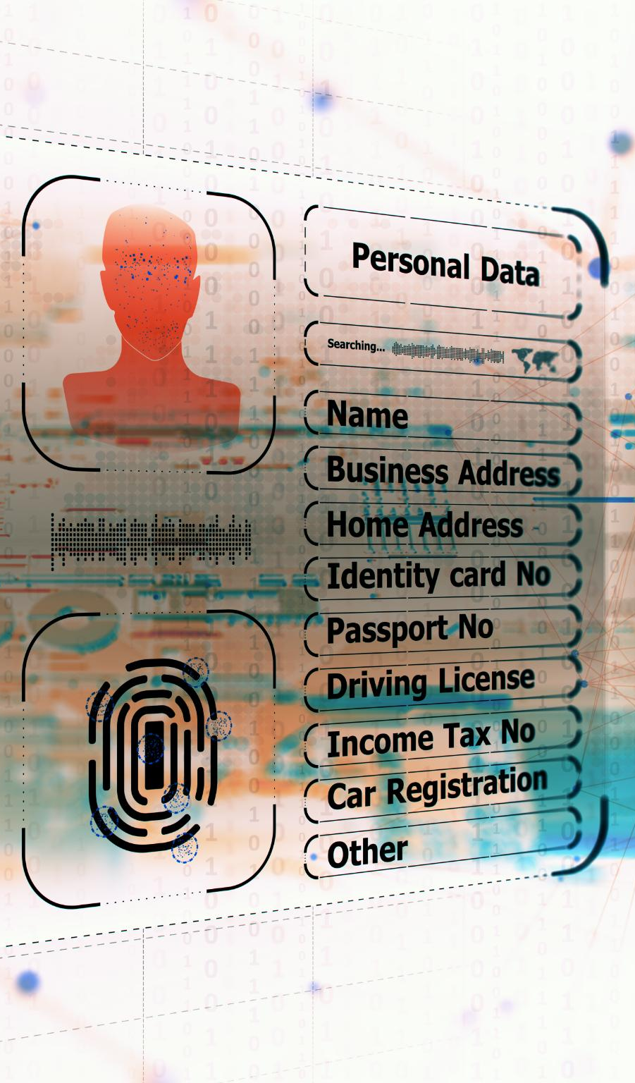
Project Overview
Secure Local AI System
PU Buddy runs all AI functions locally, ensuring sensitive university data remains private and secure.
Retrieval-Augmented Generation
RAG architecture retrieves accurate document content before generating fact-based answers for users.
Modular and Extensible Platform
PU Buddy uses Python, Streamlit, LangChain, FAISS, and Hugging Face embeddings for flexible development.
User-Friendly Web Interface
Users can ask questions, upload documents, and update search indexes via an intuitive web interface.
Notes:
--- This slide references information from the following file: https://in-prod.asyncgw.teams.microsoft.com/v1/objects/0-sin-d1-5b6c9101aeda0dfde24ddb58e8ad023a/views/original/PU_Buddy_RAG_Implementation_Guide.docx,https://sphinxcoretechllp11-my.sharepoint.com/personal/maharshi_sphinxcoretech_com/_layouts/15/Doc.aspx?sourcedoc=%7B94A8C226-C5DE-4F66-BF79-A2D8194DE919%7D&file=rudra%20patel%20200345305018%20Internship_ppt.pptx&action=edit&mobileredirect=true This presentation introduces PU Buddy, a fully open‑source university‑focused AI assistant built using Retrieval‑Augmented Generation (RAG), LangChain, FAISS, and local LLMs such as Mistral or LLaMA through Ollama or GPT4All. The project aims to provide a secure, private, and cost‑free intelligent automation system for Parul University. As educational institutions increasingly rely on digital services, PU Buddy offers a scalable AI-driven platform capable of understanding student, faculty, and administrative queries and responding with precise, context-based information. Since the entire pipeline runs locally, including LLM inference and vector search, PU Buddy ensures that sensitive university documents—like circulars, handbooks, policies, academic calendars, or HR manuals—never leave the on-premise environment. This also makes the solution fully compliant with institutional privacy policies and avoids dependence on paid cloud services. The architecture incorporates RAG to retrieve accurate textual content from indexed documents before generating answers. This approach ensures that responses remain grounded in official university information rather than relying solely on model knowledge, helping maintain factual consistency. PU Buddy’s technical stack includes Python, Streamlit, LangChain, FAISS, and Hugging Face embeddings, enabling a modular and extensible platform. Through its web-based interface, users can ask questions, upload documents, and rebuild FAISS indexes dynamically. This structure allows PU Buddy to adapt over time, ingesting new academic regulations, faculty guidelines, or student notices automatically. Its open‑source nature also ensures future expandability toward voice‑based interaction, ERP system integration, usage analytics, as well as multilingual support tailored to the university’s diverse population.

Slide 4
Introduction
Notes:
--- This slide references information from the following file: https://sphinxcoretechllp11-my.sharepoint.com/personal/maharshi_sphinxcoretech_com/_layouts/15/Doc.aspx?sourcedoc=%7B94A8C226-C5DE-4F66-BF79-A2D8194DE919%7D&file=rudra%20patel%20200345305018%20Internship_ppt.pptx&action=edit&mobileredirect=true System Purpose

Slide 5
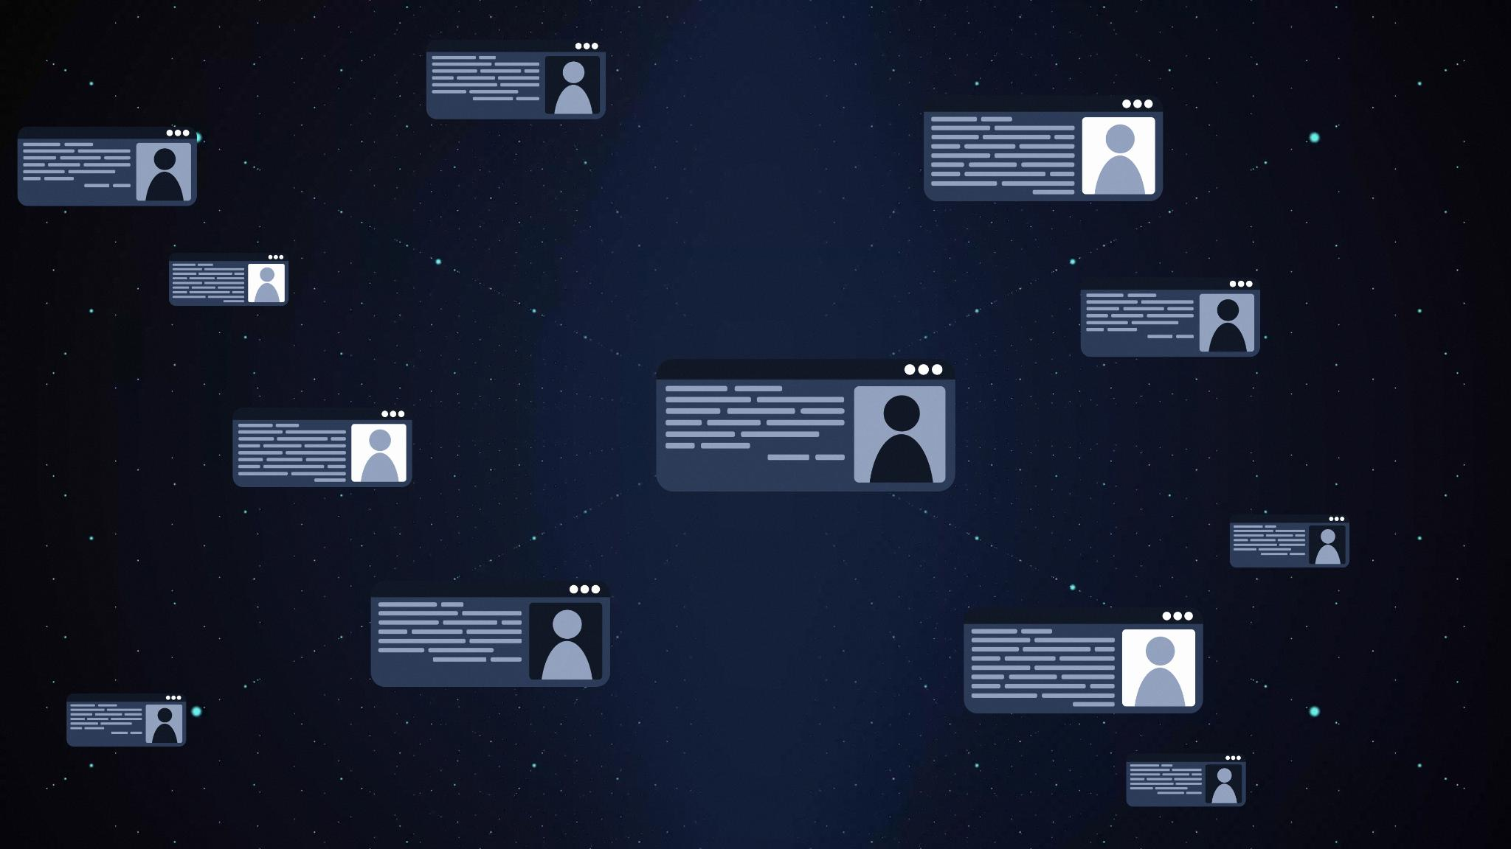
System Purpose
Enhancing Information Accessibility
PU Buddy uses RAG workflow to provide accurate, contextual university information to students and staff.
Reducing Administrative Workload
Automating repetitive query handling reduces delays and eases workload on university administrative staff.
Data Sovereignty and Open Source
Open-source design allows deployment without external data transfer, preserving privacy and compliance.
Extensible and Future-ready
Designed for future enhancements like voice commands, ERP integration, and multilingual support.
Notes:
--- This slide references information from the following file: https://sphinxcoretechllp11-my.sharepoint.com/personal/maharshi_sphinxcoretech_com/_layouts/15/Doc.aspx?sourcedoc=%7B94A8C226-C5DE-4F66-BF79-A2D8194DE919%7D&file=rudra%20patel%20200345305018%20Internship_ppt.pptx&action=edit&mobileredirect=true The core purpose of PU Buddy is to enhance accessibility to academic, administrative, and institutional information at Parul University by utilizing a Retrieval‑Augmented Generation (RAG) workflow. Traditional university helpdesks deal with thousands of repetitive queries every semester, including admissions, hostel information, examination schedules, HR guidelines, and policies. These queries often lead to delays, inefficiencies, and inconsistent communication. PU Buddy addresses these challenges by providing an automated system capable of delivering precise, contextual, and verified information. The system leverages embeddings generated from official documents—such as exam regulations, academic calendars, and HR manuals—which ensures that responses remain grounded in verified university data. The solution aims to reduce workload on administrative staff, eliminate response delays, and offer students and faculty a 24/7 intelligent support system. Furthermore, being completely open source and free to deploy, PU Buddy can operate on individual machines, university servers, or on-campus cloud environments without requiring API keys, paid subscriptions, or external data transfer. This preserves data sovereignty and maintains compliance with institutional governance. The system is also designed to be extensible so future enhancements—voice commands, ERP integration, chatbots, or multilingual support—can be smoothly incorporated.

Slide 6
Problem Statement
Notes:
--- This slide references information from the following file: https://sphinxcoretechllp11-my.sharepoint.com/personal/maharshi_sphinxcoretech_com/_layouts/15/Doc.aspx?sourcedoc=%7B94A8C226-C5DE-4F66-BF79-A2D8194DE919%7D&file=rudra%20patel%20200345305018%20Internship_ppt.pptx&action=edit&mobileredirect=true Challenges in University Information Handling

Slide 7
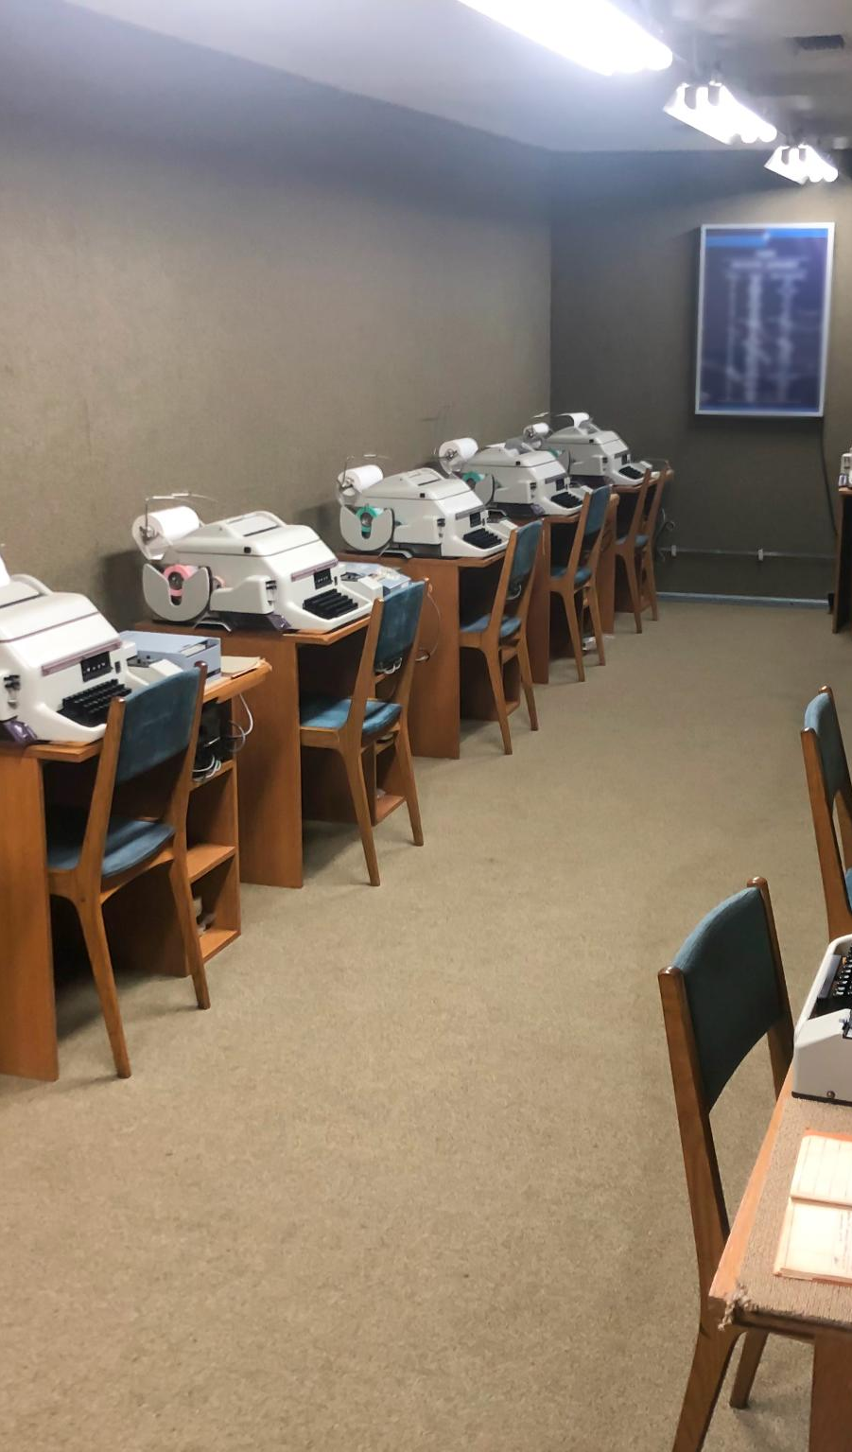
Challenges in University Information Handling
Manual Process Bottlenecks
Manual helpdesks and outdated portals cause bottlenecks with repetitive queries that waste staff time and resources.
Inconsistent Information Access
Scattered documents and inconsistent messaging lead to student delays, confusion, and miscommunication across departments.
Inefficient Faculty Resource Retrieval
Faculty struggle to quickly access teaching schedules, research guidelines, and ethics documents due to inefficient systems.
Need for AI-Driven Solutions
Centralized AI-powered tools like PU Buddy enable real-time natural language queries and efficient document retrieval.
Notes:
--- This slide references information from the following file: https://sphinxcoretechllp11-my.sharepoint.com/personal/maharshi_sphinxcoretech_com/_layouts/15/Doc.aspx?sourcedoc=%7B94A8C226-C5DE-4F66-BF79-A2D8194DE919%7D&file=rudra%20patel%20200345305018%20Internship_ppt.pptx&action=edit&mobileredirect=true Universities handle a large volume of recurring questions covering admissions, exam timetables, scholarships, academic rules, HR procedures, payroll queries, and hostel-related concerns. Existing systems typically rely on manual processes such as helpdesk staff, email support, or outdated portals. This leads to frequent bottlenecks as staff are burdened with repetitive queries that consume time and resources. Students often experience delays, confusion, or miscommunication due to inconsistent information dissemination across departments. Additionally, faculty members frequently need quick access to teaching schedules, research guidelines, or ethics documentation, but traditional systems may not be optimized for efficient retrieval. The absence of centralized AI-driven support also means that institutions cannot scale their response systems during peak periods such as exam seasons or admission cycles. Manual systems also cannot offer personalized, context-aware responses. Lastly, scattered document storage—across PDFs, portals, emails, and circulars—makes it difficult for stakeholders to access precise information instantly. PU Buddy addresses these challenges by centralizing documents, indexing them using FAISS, and enabling real-time retrieval via natural language queries.

Slide 8
Solution Overview
Notes:
--- This slide references information from the following file: https://in-prod.asyncgw.teams.microsoft.com/v1/objects/0-sin-d1-5b6c9101aeda0dfde24ddb58e8ad023a/views/original/PU_Buddy_RAG_Implementation_Guide.docx,https://sphinxcoretechllp11-my.sharepoint.com/personal/maharshi_sphinxcoretech_com/_layouts/15/Doc.aspx?sourcedoc=%7B94A8C226-C5DE-4F66-BF79-A2D8194DE919%7D&file=rudra%20patel%20200345305018%20Internship_ppt.pptx&action=edit&mobileredirect=true RAG-Based Intelligent Assistant

Slide 9
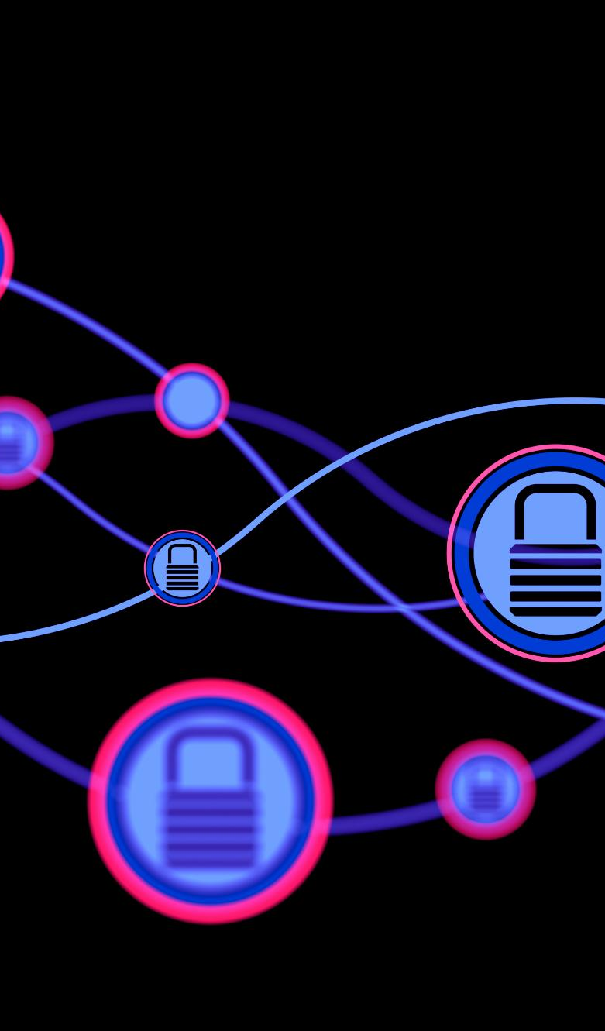
RAG-Based Intelligent Assistant
Retrieval-Augmented Generation
The system combines semantic retrieval with local language model generation to produce accurate, context-driven responses.
Offline Operation and Privacy
PU Buddy operates fully offline ensuring data privacy and cost-free usage, unlike cloud-hosted chatbots.
Dynamic User Interface
Streamlit interface allows users to ask questions, upload documents, and rebuild indexes with ease.
Modular and Adaptable Design
The assistant supports integration with voice, mobile apps, ERP connectors, and multilingual features for long-term value.
Notes:
--- This slide references information from the following file: https://in-prod.asyncgw.teams.microsoft.com/v1/objects/0-sin-d1-5b6c9101aeda0dfde24ddb58e8ad023a/views/original/PU_Buddy_RAG_Implementation_Guide.docx,https://sphinxcoretechllp11-my.sharepoint.com/personal/maharshi_sphinxcoretech_com/_layouts/15/Doc.aspx?sourcedoc=%7B94A8C226-C5DE-4F66-BF79-A2D8194DE919%7D&file=rudra%20patel%20200345305018%20Internship_ppt.pptx&action=edit&mobileredirect=true PU Buddy implements a RAG (Retrieval‑Augmented Generation) architecture that enhances the accuracy and factual reliability of responses by combining semantic document retrieval with local large language model generation. When a user submits a query, the system first retrieves relevant content chunks from a FAISS vector index created from university documents. These chunks are then passed to a local LLM—powered by Ollama or GPT4All—which generates a context-grounded response. This architecture ensures that the assistant does not hallucinate or provide incorrect information because answers are strictly constrained by retrieved factual content. Unlike cloud‑hosted chatbots, PU Buddy remains fully operational offline, guaranteeing data privacy and cost-free usage. The solution includes a Streamlit-based user interface where users can ask questions, upload new documents, and rebuild indexes with a single click. This makes the assistant dynamic and capable of evolving as policies or circulars update throughout the academic year. With its modular design and open standards, PU Buddy can integrate additional components such as voice interfaces, mobile apps, ERP connectors, or multilingual support. Its adaptability ensures long-term institutional value.

Slide 10
Architecture
Notes:
--- This slide references information from the following file: https://in-prod.asyncgw.teams.microsoft.com/v1/objects/0-sin-d1-5b6c9101aeda0dfde24ddb58e8ad023a/views/original/PU_Buddy_RAG_Implementation_Guide.docx System Flow & Data Pipeline

Slide 11
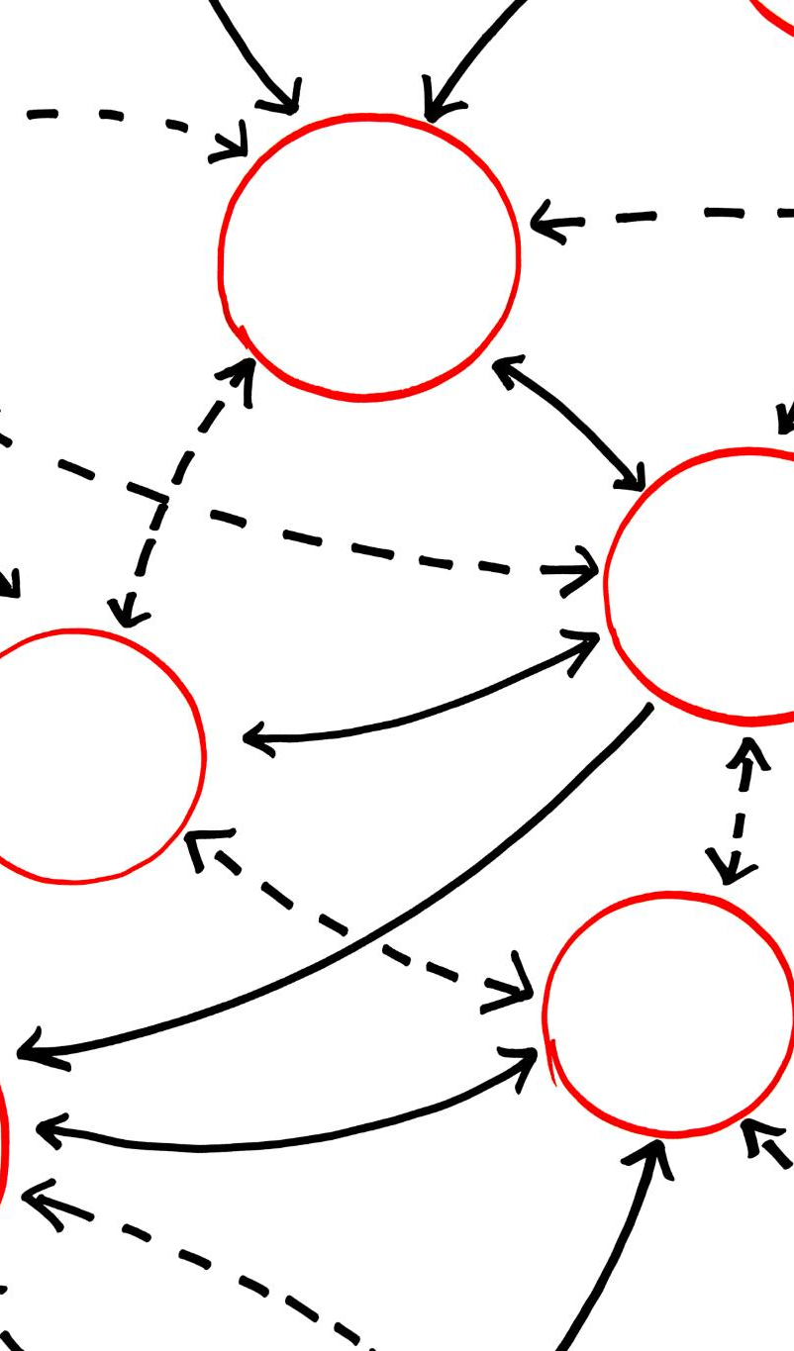
System Flow & Data Pipeline
Query Submission and Embeddings
User queries are submitted via Streamlit and transformed into numerical vectors using sentence-transformer embeddings.
Vector Storage and Retrieval
FAISS stores vectors and performs fast nearest-neighbor retrieval to find relevant document chunks efficiently.
Local Language Model Processing
Local LLM uses retrieved document chunks as context to generate concise, accurate, and fact-based answers.
Secure Local Architecture
All processing remains local, ensuring data security and enabling scalable deployment within university systems.
Notes:
--- This slide references information from the following file: https://in-prod.asyncgw.teams.microsoft.com/v1/objects/0-sin-d1-5b6c9101aeda0dfde24ddb58e8ad023a/views/original/PU_Buddy_RAG_Implementation_Guide.docx The architecture of PU Buddy is built around a structured sequence that transforms user queries into accurate, document‑grounded responses. The workflow begins with query submission in the Streamlit interface. The system then uses pretrained sentence‑transformer embeddings to convert documents and queries into numerical vectors, making them searchable in semantic space. FAISS (Facebook AI Similarity Search) stores these vectors, enabling fast nearest‑neighbor retrieval of the most relevant document chunks. Once the retriever identifies top‑K results, these chunks are packaged into a prompt template designed to guide the local LLM to provide concise, contextually accurate answers. The LLM—running through Ollama or GPT4All—uses the retrieved content as grounding material, ensuring factual responses. The final answer, accompanied by source citations, is returned to the user. The architecture is entirely local, ensuring that all embeddings, indexes, and sensitive academic documents remain within the institution. This secure and efficient design allows for scalable deployment across university systems and seamless updates as documentation changes.

Slide 12
Project Modules
Notes:
--- This slide references information from the following file: https://sphinxcoretechllp11-my.sharepoint.com/personal/maharshi_sphinxcoretech_com/_layouts/15/Doc.aspx?sourcedoc=%7B94A8C226-C5DE-4F66-BF79-A2D8194DE919%7D&file=rudra%20patel%20200345305018%20Internship_ppt.pptx&action=edit&mobileredirect=true Core Functional Areas

Slide 13

Core Functional Areas
Student Services Module
Handles admissions, exam schedules, hostel processes, fees, and scholarship queries using indexed student documents.
Faculty Support Module
Provides instant access to academic policies, research guidelines, ethics, and teaching schedules for faculty members.
Administrative Module
Supports HR policies, payroll guidelines, institutional circulars, and administrative operations to reduce bottlenecks.
Notes:
--- This slide references information from the following file: https://sphinxcoretechllp11-my.sharepoint.com/personal/maharshi_sphinxcoretech_com/_layouts/15/Doc.aspx?sourcedoc=%7B94A8C226-C5DE-4F66-BF79-A2D8194DE919%7D&file=rudra%20patel%20200345305018%20Internship_ppt.pptx&action=edit&mobileredirect=true PU Buddy is organized into three foundational modules, each addressing a specific set of institutional needs. The Student Services module handles queries related to admissions, examination schedules, hostel processes, fee structures, and scholarship eligibility. By indexing official student-related documents, PU Buddy can deliver accurate and up-to-date information in real time. The Faculty Support module focuses on academic policies, research guidelines, ethical frameworks, and teaching schedules—areas that faculty frequently inquire about. This module ensures that faculty members can retrieve procedural or policy details instantly without navigating through multiple PDF documents or online portals. The Administrative module supports HR policies, payroll guidelines, institutional circulars, and general administrative operations. This helps staff obtain critical information quickly, reducing internal bottlenecks. Together, these modules enable PU Buddy to function as a comprehensive institutional knowledge assistant, easily extensible as additional university departments adopt the system.

Slide 14
Tech Stack
Notes:
--- This slide references information from the following file: https://sphinxcoretechllp11-my.sharepoint.com/personal/maharshi_sphinxcoretech_com/_layouts/15/Doc.aspx?sourcedoc=%7B94A8C226-C5DE-4F66-BF79-A2D8194DE919%7D&file=rudra%20patel%20200345305018%20Internship_ppt.pptx&action=edit&mobileredirect=true,https://in-prod.asyncgw.teams.microsoft.com/v1/objects/0-sin-d1-5b6c9101aeda0dfde24ddb58e8ad023a/views/original/PU_Buddy_RAG_Implementation_Guide.docx Technologies Used

Slide 15

Technologies Used
Core Programming Language
Python serves as the main programming language enabling flexibility and extensive community support for the project.
Vector-Based Retrieval
FAISS library optimizes similarity search for fast retrieval in large document collections using vector embeddings.
User Interface Platform
Streamlit offers an interactive and lightweight UI for users to submit queries and upload files seamlessly.
Containerized Deployment
Docker and Docker Compose enable easy deployment by containerizing the app and LLM server for consistency.
Notes:
--- This slide references information from the following file: https://sphinxcoretechllp11-my.sharepoint.com/personal/maharshi_sphinxcoretech_com/_layouts/15/Doc.aspx?sourcedoc=%7B94A8C226-C5DE-4F66-BF79-A2D8194DE919%7D&file=rudra%20patel%20200345305018%20Internship_ppt.pptx&action=edit&mobileredirect=true,https://in-prod.asyncgw.teams.microsoft.com/v1/objects/0-sin-d1-5b6c9101aeda0dfde24ddb58e8ad023a/views/original/PU_Buddy_RAG_Implementation_Guide.docx The project utilizes a robust open‑source technology stack to ensure scalability, maintainability, and cost-free deployment. Python serves as the core programming language, with LangChain providing high-level abstractions for building retrieval pipelines and chains. FAISS—an optimized library for similarity search—enables rapid vector-based retrieval, even with large document collections. Hugging Face sentence-transformers generate embeddings that map documents and queries into a semantic vector space. Streamlit powers the user interface, offering a lightweight but interactive platform for users to submit queries, upload files, and trigger ingestion. Docker and Docker Compose simplify deployment by containerizing both the app and the LLM server (via Ollama). The system supports two categories of local LLMs: models running through Ollama (like Mistral or LLaMA variants) and GPT4All models, which operate entirely offline and require no GPUs. This tech stack ensures that PU Buddy remains accessible, secure, and customizable for any institution.

Slide 16
Ingestion Pipeline
Notes:
--- This slide references information from the following file: https://in-prod.asyncgw.teams.microsoft.com/v1/objects/0-sin-d1-5b6c9101aeda0dfde24ddb58e8ad023a/views/original/PU_Buddy_RAG_Implementation_Guide.docx Document Processing & Indexing

Slide 17

Document Processing & Indexing
Multi-format Document Parsing
Supports PDF, DOCX, and TXT formats using parsers like pypdf and python-docx for efficient document loading.
Text Splitting for Retrieval
Recursive text splitter divides documents into manageable chunks optimized for semantic search and retrieval.
Vector Embedding & Indexing
Chunks embedded using pretrained sentence-transformer models and stored as vectors in FAISS indexes for fast search.
User-friendly Access & Updates
Pipeline accessible via command-line and Streamlit interface, enabling easy updates without technical skills.
Notes:
--- This slide references information from the following file: https://in-prod.asyncgw.teams.microsoft.com/v1/objects/0-sin-d1-5b6c9101aeda0dfde24ddb58e8ad023a/views/original/PU_Buddy_RAG_Implementation_Guide.docx The ingestion pipeline is responsible for transforming raw university documents into searchable FAISS vector indexes. PU Buddy supports multiple file formats, including PDF, DOCX, and TXT. During ingestion, each document is loaded using appropriate parsers such as pypdf or python‑docx, then passed through a recursive text splitter that divides content into manageable chunks optimized for semantic retrieval. These chunks are then embedded using a pretrained sentence‑transformer model and stored as vectors in a FAISS index. The ingestion script automatically merges new indexes with existing ones, allowing the system to grow incrementally as new documents—such as updated academic calendars or fresh circulars—are added. The pipeline is accessible through command-line utilities as well as via the Streamlit interface, making it easy for staff to update the assistant without technical expertise.

Slide 18
RAG Chain
Notes:
--- This slide references information from the following file: https://in-prod.asyncgw.teams.microsoft.com/v1/objects/0-sin-d1-5b6c9101aeda0dfde24ddb58e8ad023a/views/original/PU_Buddy_RAG_Implementation_Guide.docx Retriever + LLM Integration

Slide 19

Retriever + LLM Integration
Unified Retrieval and LLM Pipeline
The RAG chain integrates document retrieval and language models into a single, seamless response pipeline.
Context-Restricted Prompting
Structured prompts restrict language model responses strictly to retrieved document context to prevent hallucinations.
Flexible LLM Backends
LangChain enables interchangeable LLMs like Ollama or GPT4All, allowing flexible configuration for response generation.
Transparency through Source Return
The system returns original document sources alongside answers for user verification and factual transparency.
Notes:
--- This slide references information from the following file: https://in-prod.asyncgw.teams.microsoft.com/v1/objects/0-sin-d1-5b6c9101aeda0dfde24ddb58e8ad023a/views/original/PU_Buddy_RAG_Implementation_Guide.docx The RAG chain connects the retriever and the LLM into a unified response generation pipeline. Using LangChain’s RetrievalQA architecture, PU Buddy retrieves top‑K documents from the FAISS vector store and feeds them into a structured prompt designed to restrict responses strictly to the provided context. This prevents hallucination and ensures fact-based responses. The LLM, chosen from Ollama or GPT4All depending on configuration, analyzes the prompt and generates concise answers, often summarized into bullet points for clarity. LangChain handles orchestration, allowing interchangeable LLM backends and flexible prompt customization. The chain also returns the original document sources to ensure transparency, allowing users to verify the factual basis of each response.

Slide 20
User Interface
Notes:
--- This slide references information from the following file: https://in-prod.asyncgw.teams.microsoft.com/v1/objects/0-sin-d1-5b6c9101aeda0dfde24ddb58e8ad023a/views/original/PU_Buddy_RAG_Implementation_Guide.docx Streamlit Application

Slide 21
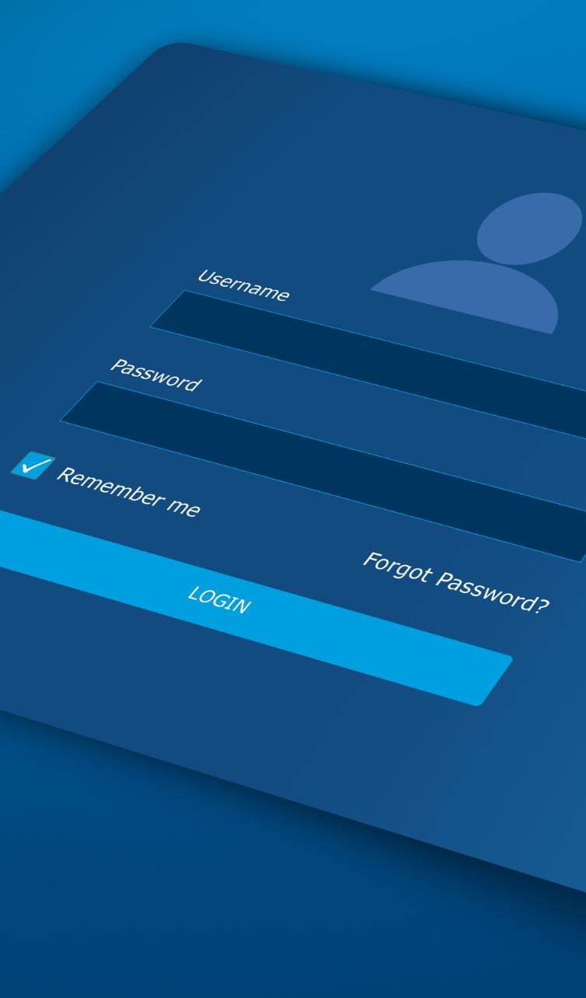
Streamlit Application
User-Friendly Interface
Streamlit provides a clean and interactive platform accessible to both students and staff with minimal technical skills.
System Configuration Display
The sidebar shows system details like selected LLM, vector store path, and ingestion controls for transparency and control.
Document Upload & Live Ingestion
Users can upload documents and trigger live ingestion to quickly update and retrain the assistant with new data.
Chat & Query History
The interface supports natural language questions with chat history and expandable panels for exploring cited sources.
Notes:
--- This slide references information from the following file: https://in-prod.asyncgw.teams.microsoft.com/v1/objects/0-sin-d1-5b6c9101aeda0dfde24ddb58e8ad023a/views/original/PU_Buddy_RAG_Implementation_Guide.docx The Streamlit interface acts as the primary access point for PU Buddy, offering a clean and interactive platform for both students and staff. It displays system configuration details in the sidebar—including chosen LLM, vector store path, and ingestion controls. Users can upload new documents, rebuild indexes, and ask natural language questions through a simple chat interface. The interface also maintains a query history, enabling participants to revisit previous questions and explore cited sources through expandable panels. This design makes PU Buddy fully usable even for individuals with minimal technical experience. The interface also supports live ingestion of uploaded documents, allowing rapid retraining of the assistant when new academic circulars or guidelines are released.

Slide 22
Deployment
Notes:
--- This slide references information from the following file: https://in-prod.asyncgw.teams.microsoft.com/v1/objects/0-sin-d1-5b6c9101aeda0dfde24ddb58e8ad023a/views/original/PU_Buddy_RAG_Implementation_Guide.docx Running Locally or with Docker

Slide 23

Running Locally or with Docker
Docker Deployment
Docker Compose bundles the Streamlit app and LLM server for easy, consistent installation and production-grade performance.
Local Python Environment
Users can run PU Buddy locally by installing dependencies and launching the app manually for offline use.
Offline and Private Operation
Both deployment methods operate fully offline with no API keys, ensuring complete data privacy for institutions.
Flexible Deployment Options
PU Buddy runs on laptops, servers, and clusters with minimal setup, offering high flexibility across environments.
Notes:
--- This slide references information from the following file: https://in-prod.asyncgw.teams.microsoft.com/v1/objects/0-sin-d1-5b6c9101aeda0dfde24ddb58e8ad023a/views/original/PU_Buddy_RAG_Implementation_Guide.docx PU Buddy can be deployed in two straightforward ways: via Docker Compose or through a native Python environment. The Docker deployment bundles the Streamlit app and the LLM server (through Ollama) into coordinated containers, simplifying installation and ensuring consistent performance across systems. This method is recommended for production‑grade usage in institutional settings. Alternatively, users can operate PU Buddy locally by installing Python dependencies, running the ingestion script, and launching the Streamlit interface manually. In both cases, the solution operates entirely offline, requires no API keys, and maintains complete privacy for institutional data. These deployment options make PU Buddy extremely flexible, able to run on personal laptops, departmental servers, or institution-wide clusters with minimal configuration.

Slide 24
Future Scope
Notes:
--- This slide references information from the following file: https://sphinxcoretechllp11-my.sharepoint.com/personal/maharshi_sphinxcoretech_com/_layouts/15/Doc.aspx?sourcedoc=%7B94A8C226-C5DE-4F66-BF79-A2D8194DE919%7D&file=rudra%20patel%20200345305018%20Internship_ppt.pptx&action=edit&mobileredirect=true Potential Enhancements

Slide 25

Potential Enhancements
Voice-Based Interaction
Integrate voice commands with speech-to-text engines for kiosks and accessibility to enhance user interaction.
Mobile Companion App
Develop a smartphone app to allow students access to critical university information anytime and anywhere.
Advanced Analytics Dashboards
Provide administrators with dashboards to analyze student concerns and optimize university services efficiently.
ERP and Multilingual Support
Integrate ERP for real-time data and support multiple languages to serve diverse academic communities.
Notes:
--- This slide references information from the following file: https://sphinxcoretechllp11-my.sharepoint.com/personal/maharshi_sphinxcoretech_com/_layouts/15/Doc.aspx?sourcedoc=%7B94A8C226-C5DE-4F66-BF79-A2D8194DE919%7D&file=rudra%20patel%20200345305018%20Internship_ppt.pptx&action=edit&mobileredirect=true The modular and open-source nature of PU Buddy allows for extensive future enhancements. Voice-based interaction can be integrated using local speech-to-text engines for kiosk-based deployments or accessibility features. A mobile companion app could extend the assistant’s usability to smartphones, enabling students to access critical information on the go. Advanced analytics dashboards could help university administrators understand common student concerns and optimize service delivery. ERP integration would allow PU Buddy to fetch real-time data such as attendance, grades, or fee payment status. Multilingual support could enable the system to serve linguistic-diverse academic communities more effectively. These expansions would further elevate PU Buddy’s value as a comprehensive university automation tool.

Slide 26
Conclusion
Notes:
--- This slide references information from the following file: https://sphinxcoretechllp11-my.sharepoint.com/personal/maharshi_sphinxcoretech_com/_layouts/15/Doc.aspx?sourcedoc=%7B94A8C226-C5DE-4F66-BF79-A2D8194DE919%7D&file=rudra%20patel%20200345305018%20Internship_ppt.pptx&action=edit&mobileredirect=true,https://in-prod.asyncgw.teams.microsoft.com/v1/objects/0-sin-d1-5b6c9101aeda0dfde24ddb58e8ad023a/views/original/PU_Buddy_RAG_Implementation_Guide.docx Final Summary

Slide 27

Final Summary
Innovative AI Integration
PU Buddy combines Retrieval-Augmented Generation with local language models for powerful AI-driven assistance.
Privacy-Preserving Offline Operation
Operating fully offline, PU Buddy ensures complete privacy and security for university data and interactions.
Cost-Free and Scalable
PU Buddy is freely available, customizable, and scalable across various university departments and use cases.
Future-Ready Roadmap
Strong technical foundation and a clear roadmap position PU Buddy as a model for future AI academic tools.
Notes:
--- This slide references information from the following file: https://sphinxcoretechllp11-my.sharepoint.com/personal/maharshi_sphinxcoretech_com/_layouts/15/Doc.aspx?sourcedoc=%7B94A8C226-C5DE-4F66-BF79-A2D8194DE919%7D&file=rudra%20patel%20200345305018%20Internship_ppt.pptx&action=edit&mobileredirect=true,https://in-prod.asyncgw.teams.microsoft.com/v1/objects/0-sin-d1-5b6c9101aeda0dfde24ddb58e8ad023a/views/original/PU_Buddy_RAG_Implementation_Guide.docx PU Buddy represents a powerful fusion of Retrieval-Augmented Generation, local large language models, and open‑source engineering to meet modern university needs. By centralizing institutional knowledge, providing instant and accurate responses, and operating entirely offline, it sets a new benchmark for privacy‑preserving academic automation. The system is cost‑free, fully customizable, and scalable, allowing Parul University to adapt it across multiple departments and use cases. With its strong technical foundation and clear roadmap for future enhancements, PU Buddy stands as a model project for AI-driven information assistance in educational institutions.

