Slide 1


ETL / ELT Pipeline Basics
Fundamental processes for data integration workflows
Notes:
---

Slide 2
ETL / ELT Pipeline Basics
Notes:
OOP for ETL / ELT Pipeline Design, Designing Reusable Pipeline Components, Pipeline-Oriented Folder Structures, Orchestration Concepts, Apache Airflow, Cloud Composer, Logging, Monitoring & Error Handling

Slide 3

OOP for ETL / ELT Pipeline Design
Organized Pipeline Structure
  Using classes helps clearly organize ETL pipeline steps, simplifying extension and updates.
Encapsulation for Safety
  Encapsulation keeps data and logic within classes, reducing errors and confusion in pipelines.
Code Reuse via Inheritance
  Inheritance enables building new pipeline components from existing ones, saving development time.
Flexible Components with Polymorphism
  Polymorphism allows swapping components without changing workflow, enabling easy pipeline updates.
Notes:
Object-Oriented Programming (OOP) helps make ETL and ELT pipelines easier to build, manage, and reuse. By using classes, developers can organize the steps of the pipeline clearly, making the system simple to extend or update. Encapsulation ensures that data and logic stay safely within each class, reducing confusion and errors. Inheritance allows developers to build new components from existing ones without rewriting code, which saves time and helps keep pipelines consistent. Polymorphism makes it possible to switch or replace components without changing the entire workflow, allowing teams to introduce new transformations or data sources with minimal updates. These OOP principles lead to cleaner, more modular, and maintainable data pipelines that can scale as business needs grow. They also help ensure that pipelines behave predictably and can be tested or debugged more effectively, making long-term maintenance easier for engineering teams.

Slide 4
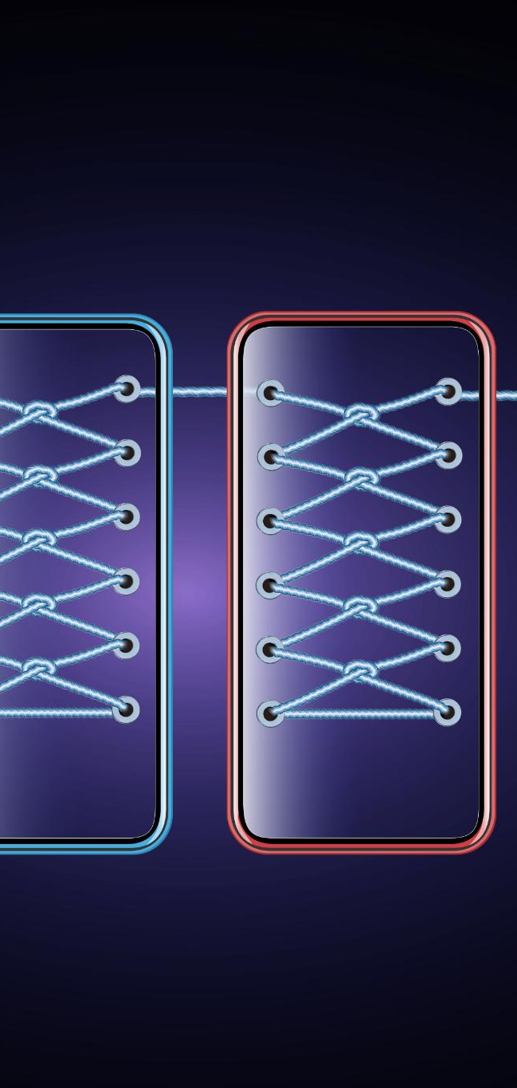
Designing Reusable Pipeline Components
Modular Pipeline Design
  Extract, transform, and load functions are separated into modules for reuse across workflows.
Configuration Driven Flexibility
  Simple configuration files enable pipeline adjustments without modifying code, reducing errors.
Easy Upgrades and Adaptation
  Designing components for easy replacement supports quick adaptation to new data sources and validations.
Consistency and Scalability
  Reusable components improve pipeline reliability, ease onboarding, and reduce technical debt over time.
Notes:
Reusable components are essential for building efficient ETL and ELT pipelines. A reusable design means that extract, transform, and load functions are separated into different modules so that each part can be used in many different workflows. Using simple configuration files allows teams to adjust how a pipeline works without changing code, which reduces errors and speeds up development. When components are designed to be easy to replace or upgrade, teams can adjust to new requirements quickly, such as adding new data sources or applying additional validation rules. Reusable pieces also create consistency in how pipelines behave, which improves reliability and makes onboarding easier for new engineers. By designing components to be modular, predictable, and flexible, organizations can scale pipeline development and reduce long-term technical debt.

Slide 5
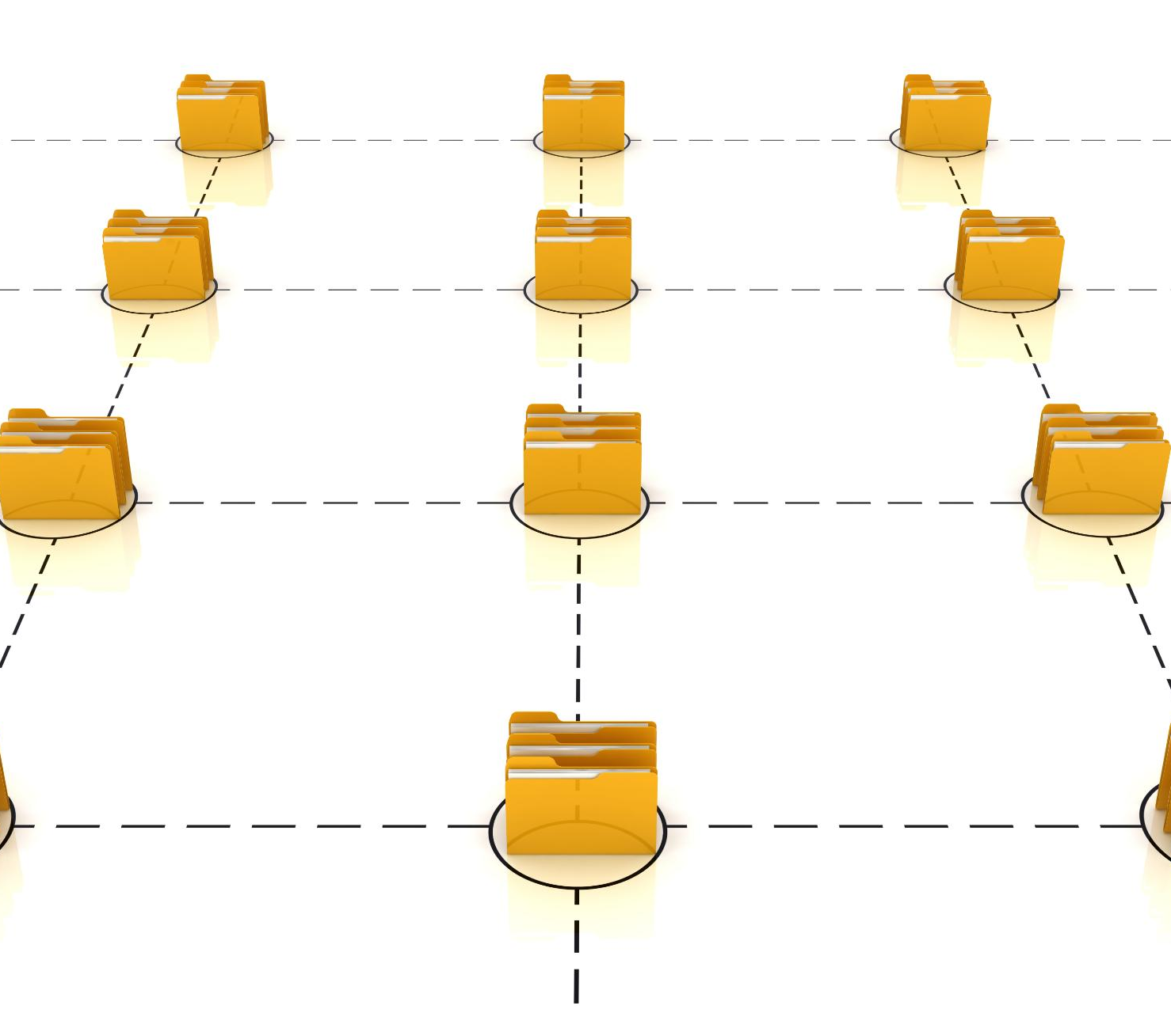
Pipeline-Oriented Folder Structures
Dedicated Folders for Pipeline Stages
  Separate folders for extract, transform, and load logic help developers quickly locate pipeline components.
Configuration File Organization
  Storing configuration files in their own folder keeps environment-specific settings organized and easy to update.
Log Management
  A dedicated folder for logs facilitates system behavior tracking and efficient debugging processes.
Orchestration Script Separation
  Logical structure for orchestration scripts separates workflow configuration from business logic to reduce confusion.
Notes:
A clear folder structure helps teams manage and maintain ETL and ELT pipelines more easily. Separating extract, transform, and load logic into dedicated folders ensures that developers know exactly where each part of the pipeline is located. Configuration files should be stored in their own folder so that environment-specific settings, such as development or production configurations, remain organized and easy to update. Logs also need their own dedicated folder to allow for proper tracking of system behavior and debugging. By maintaining a logical structure for orchestration scripts, teams ensure that workflow configuration stays separate from business logic. This approach reduces confusion, supports collaboration, and creates predictable patterns that scale across multiple pipelines. Clear organization also helps new team members quickly understand how the pipeline is built and where to find key components.

Slide 6

Orchestration Concepts
Task Dependency Management
  Orchestration enforces the correct order of pipeline tasks based on dependencies and data availability.
Retry and Failure Handling
  Retry strategies enable automatic handling of failures, improving pipeline resilience during external system errors.
Parallel Task Execution
  Running tasks in parallel enhances performance by executing multiple steps simultaneously when dependencies allow.
Dependability and Visibility
  Orchestration ensures pipelines are dependable, scalable, and visible, enabling quick failure recovery and monitoring.
Notes:
Orchestration is the process of controlling the execution of pipeline tasks in the correct order. It ensures that steps run when they should, based on dependencies and data availability. Defining tasks clearly helps prevent errors, and specifying how tasks depend on each other allows teams to coordinate complex workflows. Retry strategies are important for handling failures automatically, especially when dealing with external systems that may fail occasionally. Running tasks in parallel improves performance by allowing multiple steps to execute at the same time when dependencies permit. Orchestration makes pipelines more dependable, scalable, and predictable, ensuring that data is processed correctly and on time. It also allows teams to respond quickly when failures occur by automating recovery processes and providing visibility into workflow behavior.

Slide 7
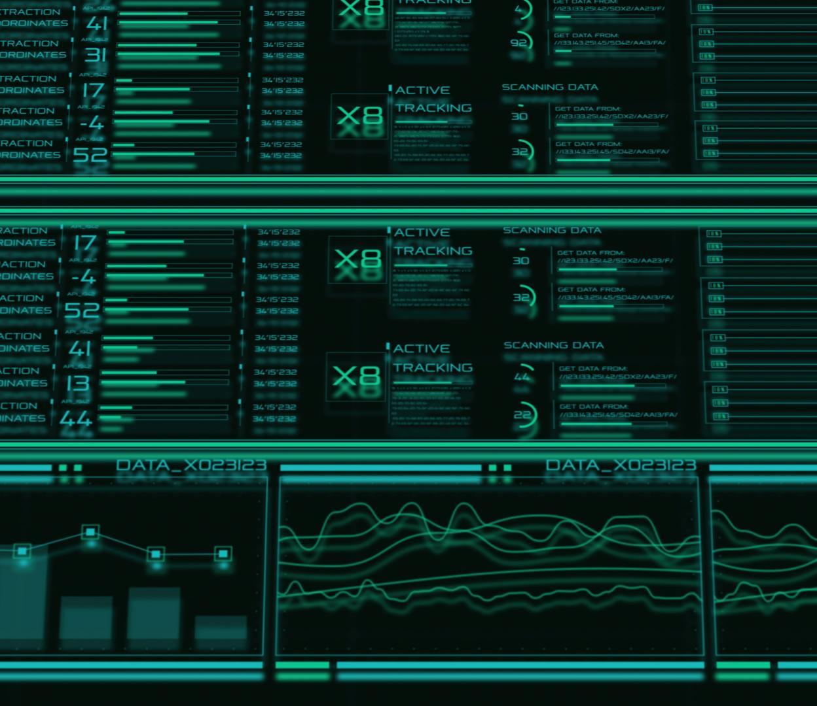
Apache Airflow
Workflow Visualization with DAGs
  Airflow uses Directed Acyclic Graphs to clearly visualize the sequence and dependencies of tasks in workflows.
Built-in Operators and Extensibility
  Airflow offers many built-in operators and supports extensions for connecting to diverse systems with minimal code.
Monitoring and Management Interface
  Its web interface provides real-time monitoring including logs, task history, and job status.
Modular and Scalable Design
  Airflow’s modular architecture allows flexible, reliable workflows that scale with growing data needs.
Notes:
Apache Airflow is a powerful orchestration tool used to schedule and manage ETL and ELT pipelines. It uses Directed Acyclic Graphs (DAGs) to show the order in which tasks should run, which makes workflows easy to visualize and understand. Airflow comes with many built-in operators that allow teams to connect to different systems without writing a lot of custom code. It also includes sensors and hooks that help pipelines wait for events or connect to external services. Airflow’s web interface provides access to logs, task history, and current job status, making monitoring simple. Because of its modular design, teams can build flexible and reliable data workflows that scale as data needs grow. Airflow’s open‑source ecosystem also supports extensions and integrations that allow organizations to customize their orchestration environment.

Slide 8

Cloud Composer
Managed Infrastructure
  Cloud Composer automates upgrades, scaling, and maintenance, removing the need for manual infrastructure management.
Seamless Service Integration
  Composer integrates easily with services like BigQuery, Cloud Storage, and Pub/Sub for streamlined data workflows.
Autoscaling for Performance
  Autoscaling dynamically balances workloads to enhance performance for large data pipelines.
Centralized Monitoring
  Centralized logging and monitoring allow teams to easily track system behavior and troubleshoot issues.
Notes:
Cloud Composer is Google Cloud’s fully managed version of Apache Airflow. It removes the need for teams to manage infrastructure by handling upgrades, scaling, and maintenance automatically. Composer integrates easily with other Google Cloud services such as BigQuery, Cloud Storage, and Pub/Sub, allowing pipelines to connect to different data systems without extra configuration. Autoscaling ensures that workloads are balanced effectively, improving performance when large pipelines need additional resources. With centralized logging and monitoring through Google Cloud tools, teams can track system behavior and troubleshoot issues more easily. Composer is ideal for organizations that want the power of Airflow without the complexity of managing servers, making it a reliable and scalable option for production-grade orchestration.

Slide 9
Logging, Monitoring & Error Handling
Structured Logging
Structured logging records key events to help engineers understand pipeline workflow steps clearly.
Performance Monitoring
Monitoring tools track pipeline performance, detect failures, and raise alerts for quick issue resolution.
Effective Error Handling
Error handling ensures graceful recovery by catching issues early and using retries to prevent failure.
Notes:
Logging, monitoring, and error handling are essential for maintaining healthy ETL and ELT pipelines. Structured logging helps record important events, making it easier for engineers to understand what happened during each step of the workflow. Monitoring tools track pipeline performance, detect failures, and raise alerts when something goes wrong, ensuring that issues are addressed quickly. Good error handling practices help pipelines recover gracefully by catching problems early and preventing full system failures. Using fallback steps or retries helps avoid interruptions and ensures that data keeps flowing even when unexpected issues occur. By investing in strong logging and monitoring practices, teams can improve visibility, reduce downtime, and maintain trust in their data systems.

