Slide 1

AI-DRIVEN EXPLORATION AND PREDICTION OF COMPANY REGISTRATION TRENDS WITH REGISTER OF COMPANIES(RoC)
PHASE4 PROJECT

Slide 2
PREPARED BY
M.MAHALAKSHMI,
510521205022,
BHARATHIDASAN ENGINEERING COLLEGE,
PHASE4 PROJECT SUBMISSION.

Slide 3

INTRODUCTION

Slide 4
AI-driven exploration and prediction performing exploratory data analysis refers to the use of artificial intelligence (AI) techniques to automate and enhance the process of exploring and analyzing data to make predictions. It involves leveraging machine learning algorithms, data mining, and statistical methods to uncover hidden patterns, trends, and insights within a dataset, thereby aiding in the prediction of future outcomes or behavior. This approach combines the power of AI to assist in data preprocessing, feature selection, and modeling, making the exploratory data analysis more efficient and accurate.

Slide 5
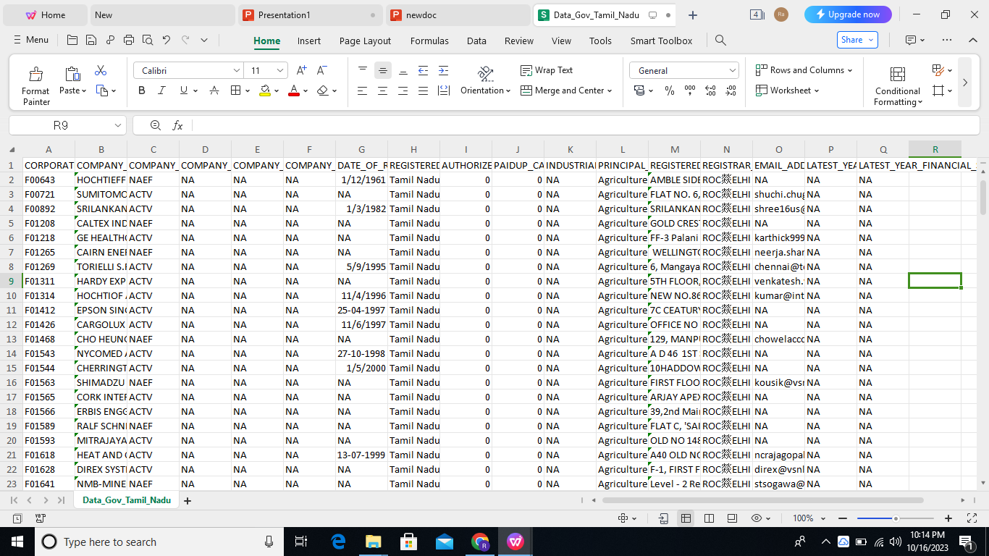
DATASET

Slide 6
OVERVIEW

Slide 7
Personality test
Exploratory
Data
Analysis
Feature
Engineering
Predictive
Modeling

Slide 8
EXPLORATORY DATA ANALYSIS:
AI-driven exploration and prediction performing exploratory data analysis refers to the use of artificial intelligence (AI) techniques to automate and enhance the process of exploring and analyzing data to make predictions. It involves leveraging machine learning algorithms, data mining, and statistical methods to uncover hidden patterns, trends, and insights within a dataset, thereby aiding in the prediction of future outcomes or behavior. This approach combines the power of AI to assist in data preprocessing, feature selection, and modeling, making the exploratory data analysis more efficient and accurate.

Slide 9
FEATURE ENGINEERING:
AI-driven exploration and prediction performing feature engineering involves using artificial intelligence techniques to automatically create, select, or transform features (variables) in a dataset to improve the performance of machine learning models. Feature engineering is a critical step in the machine learning pipeline, and AI-driven methods can help identify relevant features, reduce dimensionality, and generate new attributes from the existing data. This process aims to enhance the predictive capabilities of AI models by optimizing the input data, ultimately leading to better model accuracy and effectiveness in solving specific tasks.

Slide 10
PREDICTIVE MODELING:
AI-driven exploration and prediction performing predictive modeling refers to the application of artificial intelligence and machine learning techniques to build and deploy models that make predictions based on historical or existing data. In this process, AI algorithms analyze the data to identify patterns, relationships, and trends, and use this information to forecast future outcomes or make informed decisions. The predictive models created through this approach can be used in various domains, such as finance, healthcare, marketing, and more, to make predictions about customer behavior, stock prices, disease diagnoses, or any other relevant forecasting task. AI-driven predictive modeling automates and enhances the accuracy of prediction tasks by leveraging advanced machine learning algorithms and data-driven insights.

Slide 11
STEPS FOR EXPLORATORY DATA ANALYSIS
1.Data Collection 9.Hypothesis Testing
2.Data Preprocessing 10.Feature Engineering
3.Feature Selection 11.Model Training
4.Data Visualization 12.Model Evaluation
5.Descriptive Statistics 13.Hyperparameter Tuning
6.Correlation Analysis 14.Model Interpretability
7.Outlier Detection 15.Model Deployment
8.Data Exploration 16.Continuous Monitoring

Slide 12
STEPS FOR FEATURE ENGINEERING
1.Data Collection 9.Hypothesis Testing
2.Data Preprocessing 10.Feature Engineering
3.Feature Selection 11.Model Training
4.Data Visualization 12.Model Evaluation
5.Descriptive Statistics 13.Hyperparameter Tuning
6.Correlation Analysis 14.Model Interpretability
7.Outlier Detection 15.Model Deployment
8.Data Exploration 16.Continuous Monitoring

Slide 13
STEPS FOR PREDICTIVE MODELING
1.Data Collection 9.Model Interpretability
2.Data Preprocessing 10.Cross-Validation
3.Feature Engineering 11.Model Fine-Tuning
4.Data Splitting 12.Ensemble Methods
5.Model Selection 13.Model Validation
6.Model Training 14.Model Deployment
7.Hyperparameter Tuning 15.Continuous Monitoring
8Model Evaluation 16.Feedback Loop

Slide 14
STEPS FOR PREDICTIVE MODELING
1.Data Collection 9.Model Interpretability
2.Data Preprocessing 10.Cross-Validation
3.Feature Engineering 11.Model Fine-Tuning
4.Data Splitting 12.Ensemble Methods
5.Model Selection 13.Model Validation
6.Model Training 14.Model Deployment
7.Hyperparameter Tuning 15.Continuous Monitoring
8Model Evaluation 16.Feedback Loop

Slide 15
PROGRAM

Slide 16
Pandas and Numpy have been used for Data Manipulation and numerical Calculations
Pandas and Numpy have been used for Data Manipulation and numerical Calculations
Matplotlib and Seaborn have been used for Data visualizations.
import pandas as pd
import numpy as np
import matplotlib.pyplot as plt
import seaborn as sns
#to ignore warnings
import warnings
warnings.filterwarnings('ignore')
data = pd.read_csv("used_cars.csv")
data.head()

Slide 17
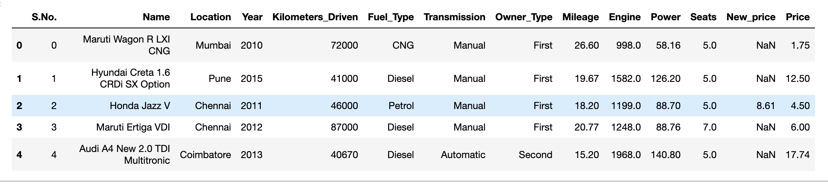

Slide 18
cat_cols=data.select_dtypes(include=['object']).columns
num_cols = data.select_dtypes(include=np.number).columns.tolist()
print("Categorical Variables:")
print(cat_cols)
print("Numerical Variables:")
print(num_cols)

Slide 19
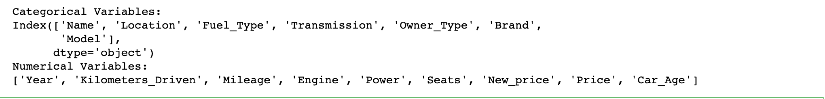

Slide 20
for col in num_cols:
print(col)
print('Skew :'
, round(data[col].skew(), 2))
plt.figure(figsize = (15, 4))
plt.subplot(1, 2, 1)
data[col].hist(grid=False)
plt.ylabel('count')
plt.subplot(1, 2, 2)
sns.boxplot(x=data[col])
plt.show()

Slide 21
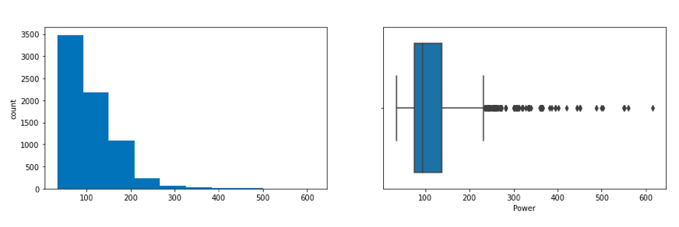

Slide 22
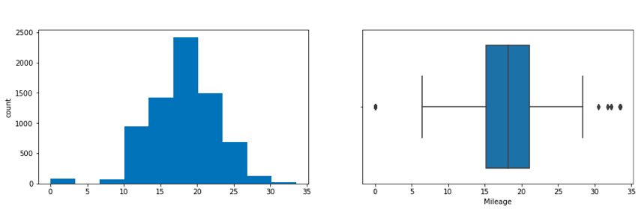

Slide 23
# Function for log transformation of the column
def log_transform(data,col):
for colname in col:
if (data[colname] == 1.0).all():
data[colname + '_log'] = np.log(data[colname]+1)
else:
data[colname + '_log'] = np.log(data[colname])
data.info()
log_transform(data,['Kilometers_Driven'
,
'Price'])
#Log transformation of the feature 'Kilometers_Driven'
sns.distplot(data["Kilometers_Driven_log"], axlabel=
"Kilometers_Driven_log"

Slide 24
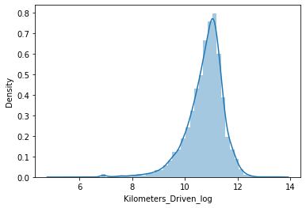

Slide 25
CONCLUSION

Slide 26
In conclusion, AI-driven exploration and prediction represent a transformative approach to data analysis and forecasting. By harnessing the power of artificial intelligence, this methodology enhances the efficiency, accuracy, and depth of insights derived from data. Through advanced techniques in data preprocessing, feature engineering, and predictive modeling, AI enables us to uncover hidden patterns, make informed predictions, and drive data-driven decision-making in a wide range of applications.
This approach has the potential to revolutionize industries such as finance, healthcare, marketing, and many others, by automating and optimizing the data analysis process. By continuously learning from data and adapting to changing circumstances, AI-driven exploration and prediction systems provide a valuable tool for organizations seeking to gain a competitive edge, improve efficiency, and make more informed choices.

Slide 27
New York University
Thank you so much for your watching
My name：Aaron My major：Finance

