Slide 1

CAPSTONE PROJECT
DATA SCIENCE PROJECT ON BILLING SYSTEM USING PYTHON
﻿Presented By:
M. MAHASAKTHI (2021301026)-Alagappa college of technology, Anna University –Department of ceramic technology.

Slide 2

OUTLINE
Problem Statement
Proposed System/Solution
System Development Approach
Algorithm & Deployment
Result
Conclusion
Future Scope
References

Slide 3
PROBLEM STATEMENT
“Develop a python program for a billing system for a retail store. The program should allow the cashier to input the items purchased by the customer along with their quantities and prices. It should then calculate the total bill amount, including any applicable taxes. Additionally, the program should provide options for applying discounts if available. Finally, it should generate a detailed bill receipt showing the itemized list of purchases, their prices, quantities, subtotal, taxes, discounts (if any), and the final total amount payable by the customer.”

Slide 4
PROPOSED SOLUTION
Define Classes: Create classes to represent items and the billing system.
Input Handling: Implement functions to handle user input for adding items to the bill.
Tax Calculation: Implement methods within the ‘BillingSystem’ class to calculate taxes based on the subtotal.
Discount Application: Implement methods within the ‘BillingSystem’ class to apply discounts based on predefined rules or conditions.
Generate Receipt: Implement a method to generate a detailed bill receipt.
User Interface: Depending on the preference, you can implement a command-line interface (CLI) or a graphical user interface (GUI) to interact with the billing system.
This is a basic outline to get you started. You can expand upon this solution by adding more features such as handling discounts, taxes, and generating a more detailed receipt. Additionally, you can enhance the user interface to make it more interactive and user-friendly.

Slide 5
SYSTEM APPROACH
Requirement Gathering: Understand the requirements of the billing system. Identify the features and functionalities it should have.
Design: Design the system architecture. This includes deciding on the components, their interactions, and the data flow within the system.
Database Design: Design the database schema to store information such as customer details, products, invoices, etc.
User Interface Design: Design the user interface for the billing system. This could be a command-line interface, a graphical user interface, or a web-based interface.

Slide 6
SYSTEM APPROACH(CONTD)
Development: Develop the billing system using Python. Break down the development process into smaller tasks and implement them one by one.
Testing: Test the system thoroughly to ensure that it works as expected. This includes unit testing, integration testing, and system testing.
Documentation: Document the system including its architecture, components, functionalities, and usage instructions.
Deployment: Deploy the billing system in the desired environment. This could be on-premise or on the cloud.
Maintenance: Maintain the billing system by fixing bugs, adding new features, and updating it as required.

Slide 7
ALGORITHM & DEPLOYMENT
Designing a billing system involves several steps, including algorithm development and deployment.
Requirements Gathering: Understand the requirements of the billing system, such as types of products or services, pricing models, billing frequency, etc.
Data Modeling: Design the database schema to store customer information, products/services, pricing details, transactions, etc.
Algorithm Development:
Billing Calculation: Develop algorithms to calculate bills based on the usage of products/services, applying any discounts or taxes as necessary.
Invoice Generation: Create algorithms to generate invoices, including itemized details of charges.
Payment Processing: Implement algorithms for processing payments, including tracking outstanding balances, handling partial payments, and generating receipts.

Slide 8
ALGORITHM & DEPLOYMENT(CONTD)
Security: Implement security measures to protect sensitive customer information and financial transactions, such as encryption, access control, and data integrity checks.
Testing: Thoroughly test the billing system to ensure accuracy in billing calculations, invoice generation, and payment processing.
Deployment:
Choose Deployment Environment: Decide whether to deploy the billing system on-premises or in the cloud.
Setup Infrastructure: Configure servers, databases, and other necessary infrastructure components.
Deploy Application: Deploy the billing system application, ensuring that it is accessible to authorized users.
Monitoring and Maintenance: Set up monitoring tools to track system performance and address any issues that arise. Regularly maintain the system to apply updates and security patches.

Slide 9
ALGORITHM & DEPLOYMENT(CONTD)
Integration: Integrate the billing system with other systems such as CRM (Customer Relationship Management), accounting software, and payment gateways for seamless operation.
Documentation: Document the system architecture, algorithms, deployment procedures, and user manuals to aid in system understanding and troubleshooting.
Training: Provide training to users on how to use the billing system effectively, including entering data, generating invoices, and processing payments.
Support: Offer ongoing support to users to address any issues or questions they may have regarding the billing system.

Slide 10
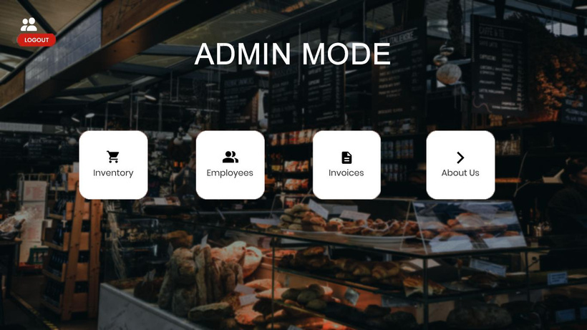
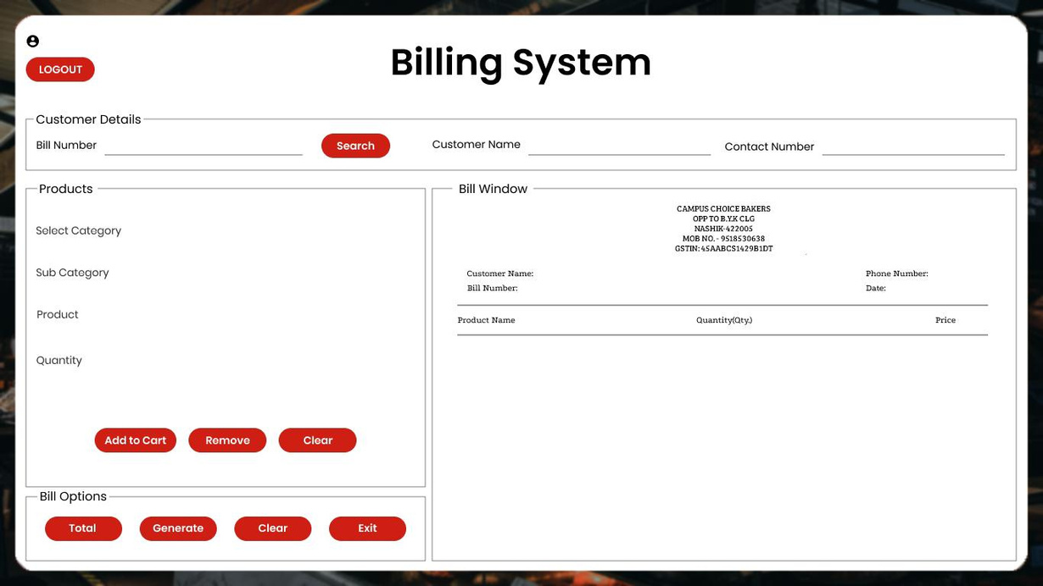
RESULT
This implementation serves as a starting point and can be extended with additional features such as handling discounts, taxes, multiple payment methods, and database integration for storing transaction history.

Slide 11
CONCLUSION
In conclusion, the billing system implemented in Python provides a basic framework for managing products, a shopping cart, and generating bills. The system consists of three main classes: Product, ShoppingCart, and BillingSystem.
The Product class represents individual items with their name and price.
The ShoppingCart class manages the items added by the user along with their quantities and calculates the total amount.
The BillingSystem class acts as a controller for adding items to the cart and generating the bill.
This implementation serves as a starting point and can be extended with additional features such as handling discounts, taxes, multiple payment methods, and database integration for storing transaction history. Overall, it provides a foundation for building more complex billing systems tailored to specific business needs.

Slide 12
FUTURE SCOPE
User Interface Enhancements: Improve the user interface for better usability.
Database Integration: Integrate with databases for data management and analysis.
Inventory Management: Add features to manage inventory levels and stock.
Billing Features: Enhance billing capabilities with support for various payment methods, discounts, and taxes.
Localization and Internationalization: Support multiple languages, currencies, and regional preferences.
Mobile Application Development: Develop mobile applications for increased accessibility.
Customer Relationship Management (CRM): Integrate CRM functionalities for managing customer interactions and marketing efforts.
These enhancements can make the billing system more efficient, adaptable, and user-friendly, catering to the evolving needs of businesses and customers.

Slide 13
REFERENCES
Python Documentation:
Official Python documentation: https://docs.python.org/
Dive Into Python: A free Python tutorial for experienced programmers: https://diveintopython3.problemsolving.io/
Payment Processing:
Stripe API Documentation: A popular payment processing platform with comprehensive API documentation: https://stripe.com/docs/api
PayPal Developer Documentation: PayPal’s developer documentation for integrating payment processing: https://developer.paypal.com/docs

Slide 14
THANK YOU

