Slide 1

STUDENT NAME: MAHA LAKSHMI. S
REGISTER NO AND NMID: 35224U09011/ auttvu352hc24bca025
DEPARTMENT: BCA
COLLEGE: COLLEGE/ UNIVERSITY:HOLY CROSS ARTS AND SCIENCE COLLEGE FOR WOMEN/THIRUVALLUR UNIVERSITY

Slide 2
AGENDA
Problem Statement
Project Overview
End Users
Tools and Technologies
Portfolio design and Layout
Features and Functionality
Results and Screenshots
Conclusion

Slide 3
Problem Statemen. Add smooth scrolling when a user clicks on a navigation link (so the page scrolls smoothly to the section).
Add a dark/light mode toggle button that changes background and text colors dynamically using JavaScript.
When a user hovers over any project card, display a small popup tooltip (e.g., “Click to learn more”).
In the contact form, validate that the email contains “@” and a “.com” before submission.
Input & Output Example:
Input: User clicks “Projects” in the navigation.
Output: Page scrolls smoothly to the projects section.
Input: User enters as email and clicks “Send”.
Output: Show alert → “Please enter a valid email address.”
Goal: Implement this using HTML, CSS, and JavaScript only.

Slide 4
Project Overview
Developed a personal portfolio website using HTML, CSS, and JavaScript.
Designed with a modern and colorful UI for better user experience.
Includes sections for:
About Me – introduction and career goals.
Problem Statement – identifying the issue solved by the project.
Skills – showcasing technical expertise.
Projects – highlighting completed work with visuals.
Contact – simple form for communication.
Implemented smooth scrolling for easy navigation.
Responsive layout, works on desktop and mobile devices.

Slide 5
👥 End User
Students – to showcase their skills, projects, and achievements.
Job seekers – to create an interactive online resume.
Recruiters / Employers – to quickly view candidate skills and projects.
Peers & Mentors – to collaborate, give feedback, and connect.
Personal branding – anyone who wants a creative digital profile.

Slide 6
🛠️ Tools & Techniques
HTML5 – for structuring the portfolio website.
CSS3 – for styling, layout, and animations.
JavaScript (ES6) – for interactivity (smooth scroll, form handling).
Google Fonts (Poppins) – for clean typography.
Icons8 & Placeholder Images – for visuals and project mockups.
Responsive Design – using flexible layouts for desktop & mobile.

Slide 7
🎨 Portfolio Design & Layout
Header Section – with profile picture, name, tagline, and navigation menu.
About Section – short introduction about me.
Problem Statement Section – the challenge addressed by this project.
Project Overview Section – highlights of features and scope.
End User Section – identifies target users.
Tools & Techniques Section – technologies used in development.
Skills Section – visual cards for technical expertise.
Projects Section – showcases completed work with images and descriptions.
Contact Section – simple form for communication.
Footer – with copyright details.

Slide 8
⚡ Features & Functionality
Responsive Design – works on desktop, tablet, and mobile.
Smooth Scrolling – easy navigation between sections.
Hover Effects – animations on skill and project cards.
Interactive Contact Form – allows users to send messages.
Dynamic Navbar – quick access to all sections.
Visually Appealing Layout – gradient backgrounds, modern typography, and icons.
Showcase Projects – with images, titles, and short descriptions.
Lightweight & Fast – built using only HTML, CSS, and JavaScript.

Slide 9
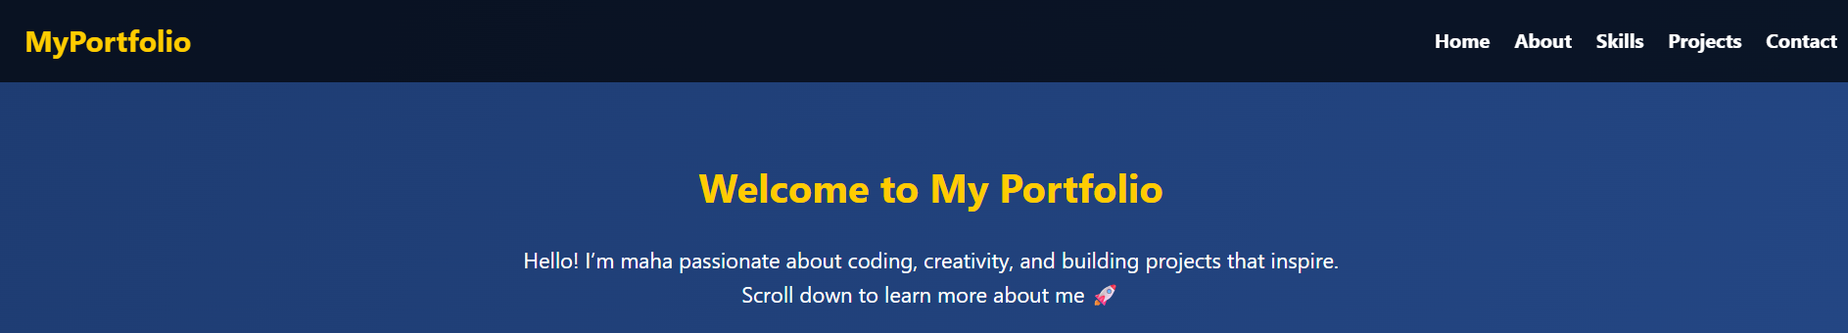
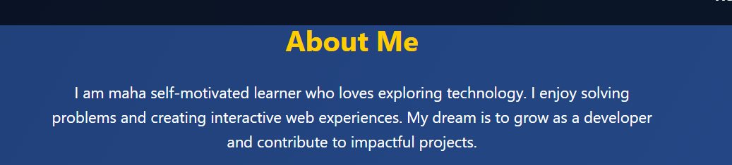
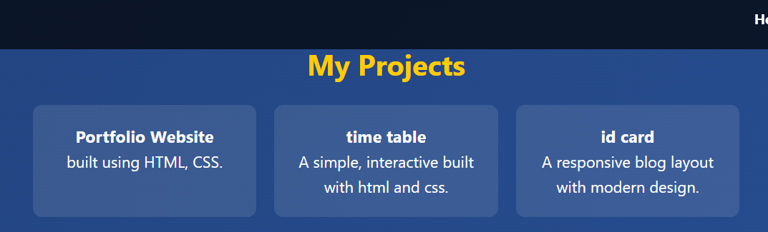
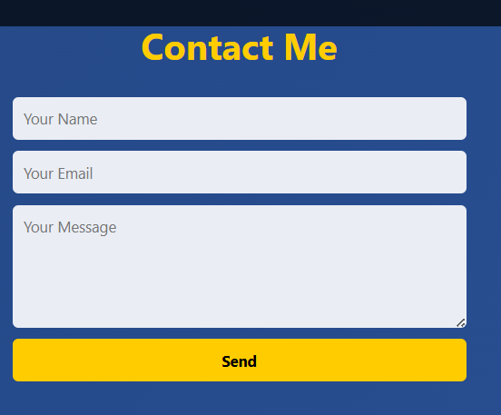

RESULT
Successfully built a personal portfolio website.
Provided an interactive platform to showcase skills and projects.
Improved presentation of achievements compared to a static resume.
Enabled easy communication through the contact form.
Designed with a modern, colorful, and responsive layout.
Can be extended in the future with more projects, blogs, or certificates.

Slide 10
conclusion
A personal portfolio website is an effective way to showcase skills, projects, and creativity.
It solves the problem of static resumes by providing an interactive and engaging platform.
The project demonstrates the use of HTML, CSS, and JavaScript in real-world applications.
It is responsive, user-friendly, and visually appealing, making it suitable for students and job seekers.
This portfolio can be continuously updated with new projects, skills, and achievements.

