Slide 1


Comprehensive Sales Analysis and Business Insights for Flipkart

Slide 2

Problem Statement :
E-commerce platforms like Flipkart generate vast amounts of transactional data, including customer preferences, sales trends, and pricing dynamics. Businesses require systematic data-driven analysis to optimize decision-making and enhance profitability. This project focuses on collecting, cleaning, and analyzing Flipkart’s sales data using Python (Pandas), SQL queries for deeper analytics, and Power BI for dashboard visualization.

Slide 3
Introduction :
Data-driven strategies are essential for enhancing business performance, particularly in competitive e-commerce environments. By leveraging data analytics, businesses can uncover trends, improve product recommendations, and optimize inventory management. This project follows a systematic approach—starting with data collection, cleaning, exploratory analysis using Python (Pandas), structured processing with SQL, and dynamic visualization through Power BI dashboards. The goal is to provide actionable insights into sales trends, customer preferences, pricing impact, and product performance.

Slide 4
The Dataset :
The dataset consists of historical sales data, including product details, pricing, customer ratings, reviews, platform information, and discount offers. It contains 16 key attributes, categorized into numerical (e.g., price1, Rating, noreviews1) and categorical (e.g., maincateg, platform). Missing values are handled using mean imputation for numerical features and mode imputation for categorical variables, ensuring data integrity for model training. The structured dataset enables a comprehensive analysis of product performance, customer preferences, and sales distribution.

Slide 5
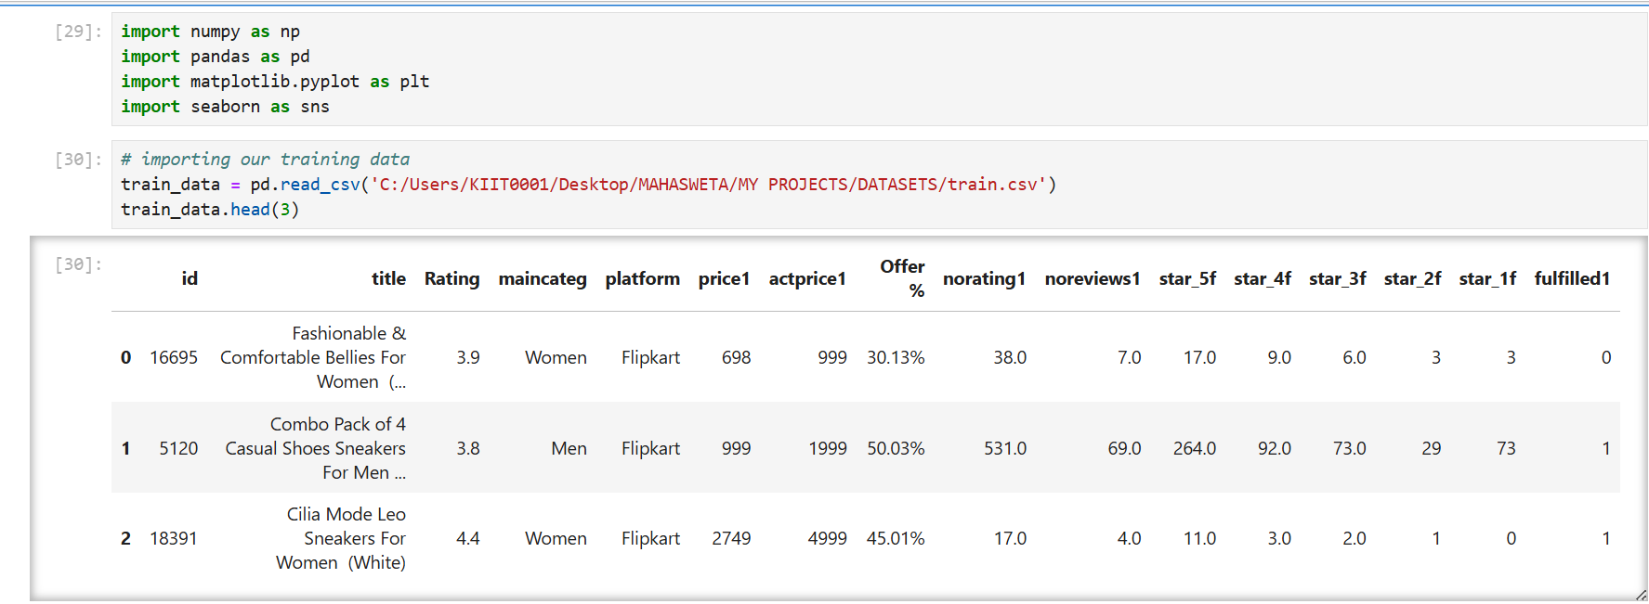
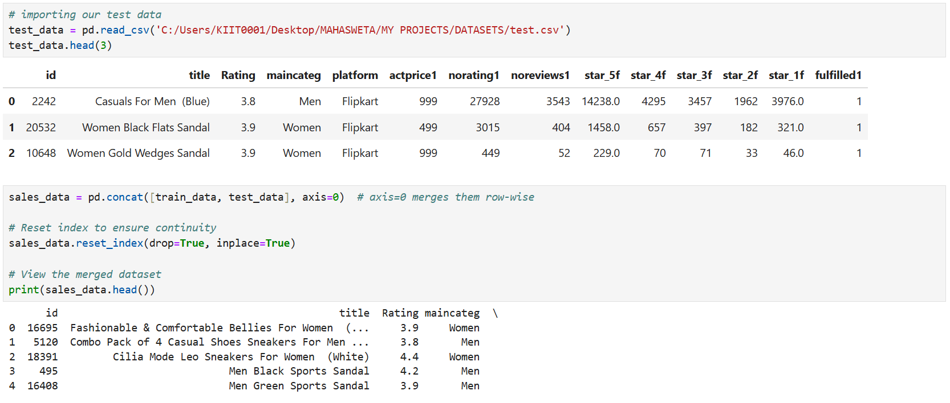

Slide 6
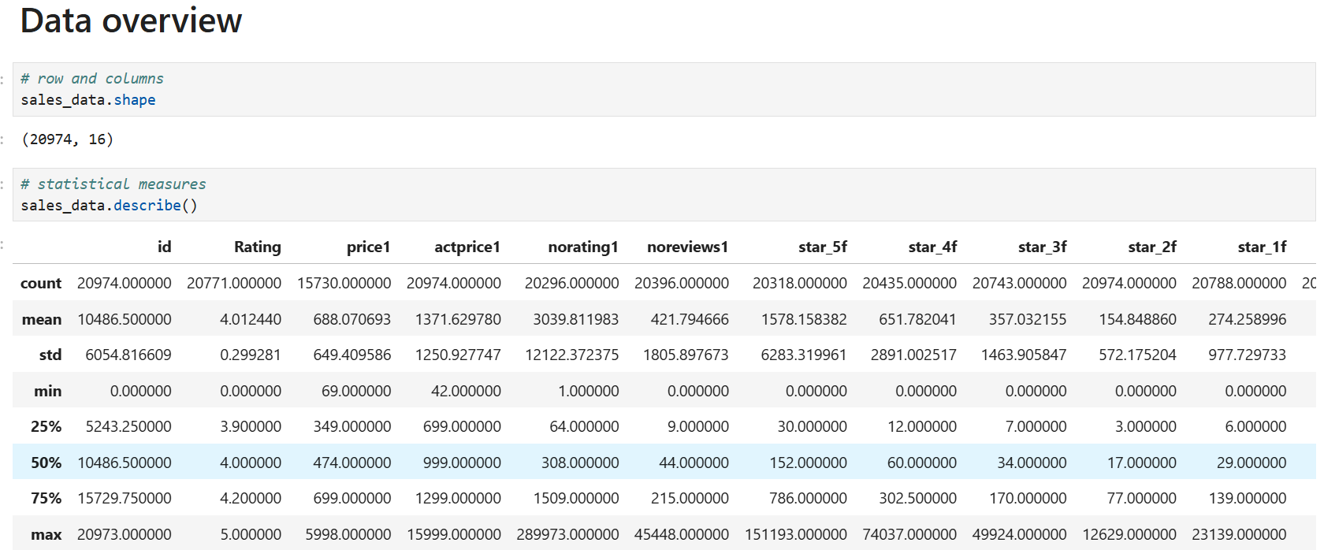
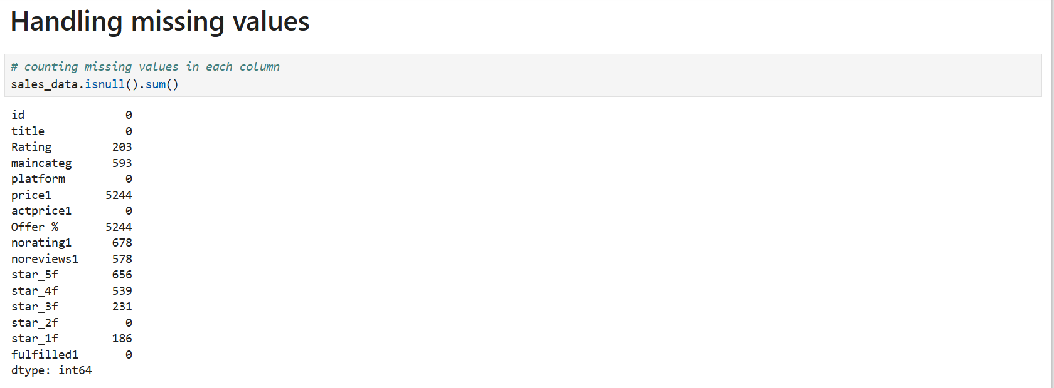

Slide 7
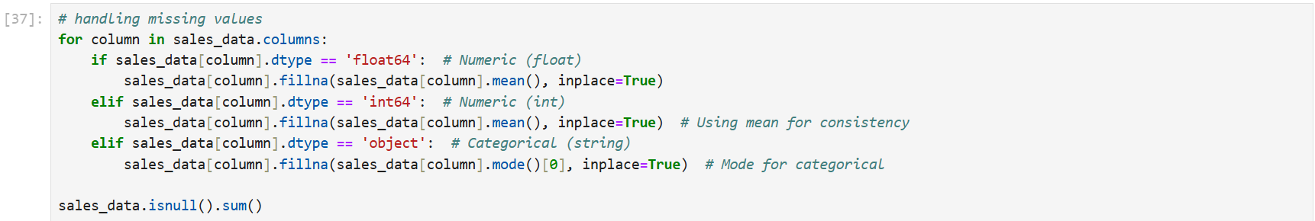
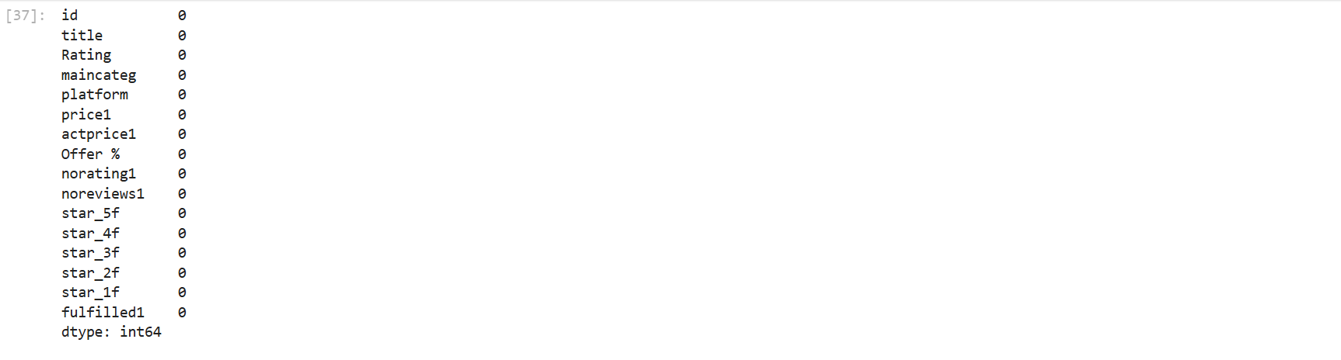

Slide 8
Data Visualization :
To enhance data understanding, various visualization techniques are applied:
- Sales Performance by Platform: A bar chart compares average sales prices across platforms to identify revenue trends.
- Ratings Distribution: A histogram displays customer ratings, revealing product satisfaction levels.
- Discount vs. Actual Price: A scatter plot analyzes how discounts impact product pricing.
- Review Counts vs. Star Ratings: A correlation heatmap examines whether higher reviews translate into better ratings.
These visualizations support pattern recognition and optimize sales strategies through graphical analysis.

Slide 9
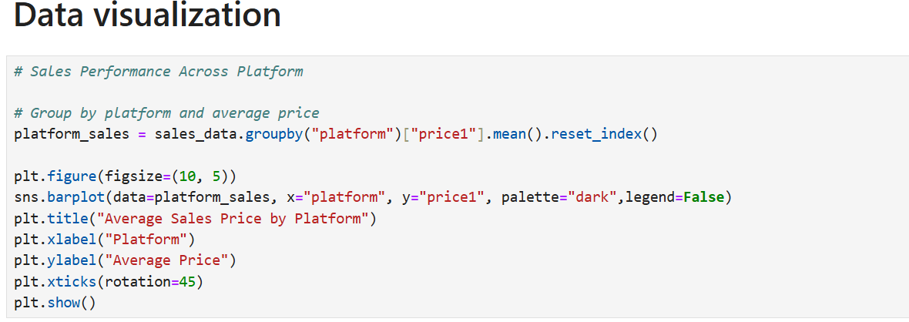
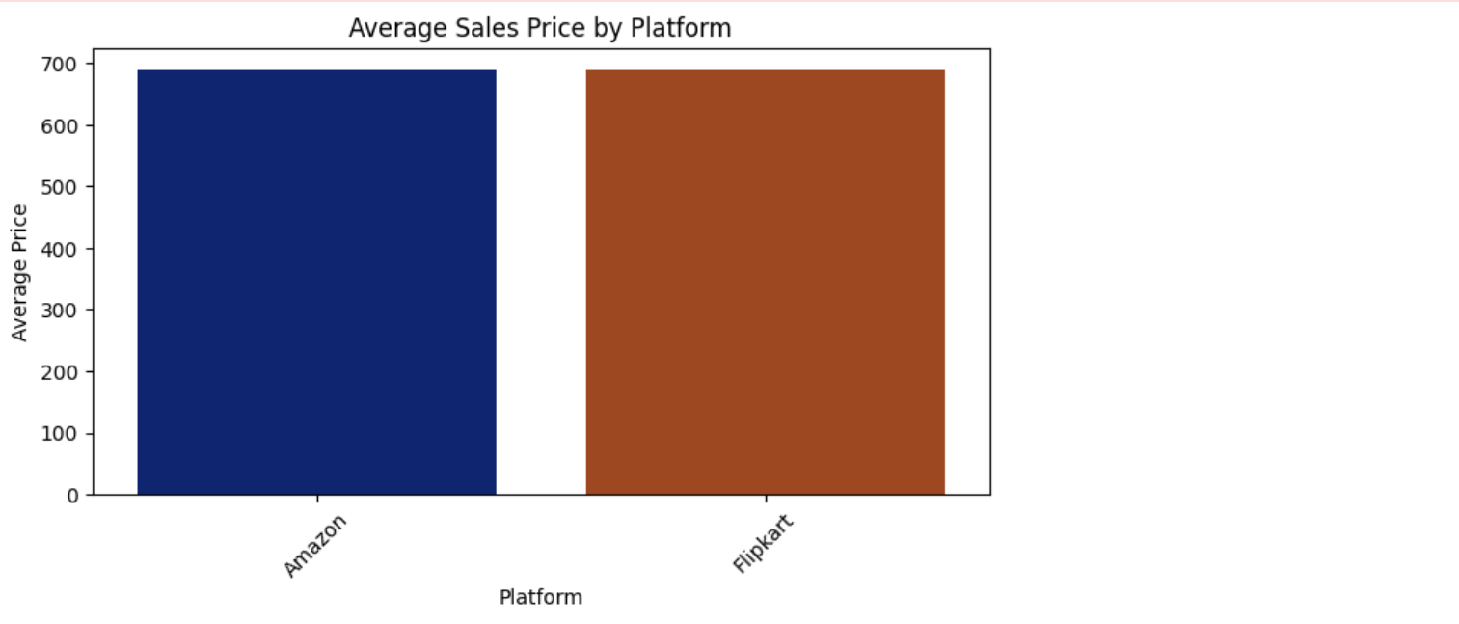

Slide 10
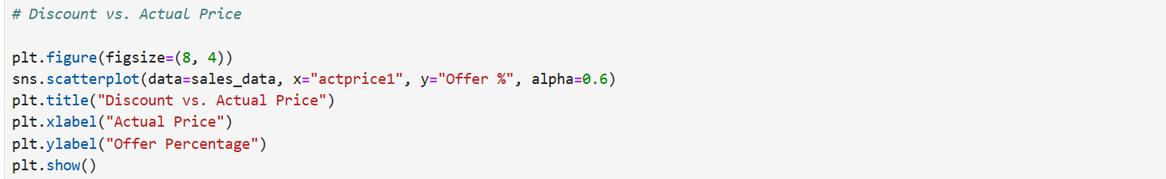
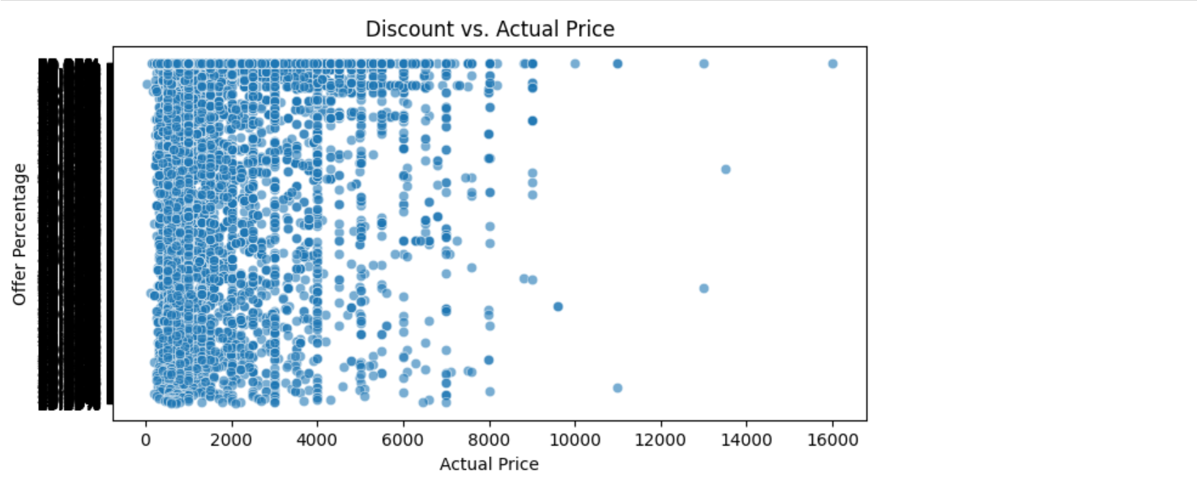

Slide 11
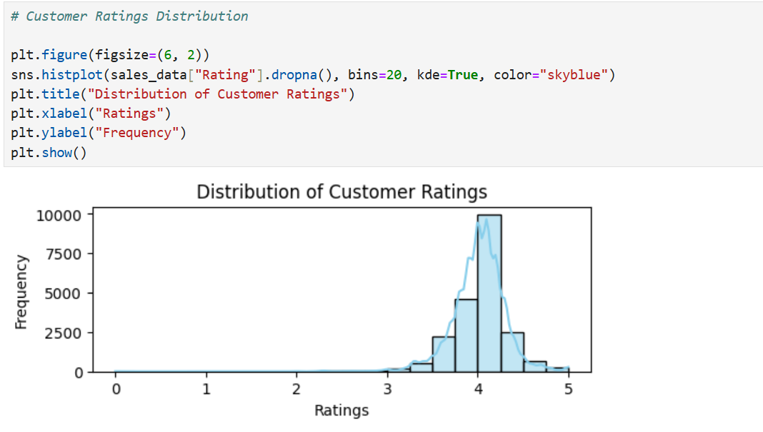
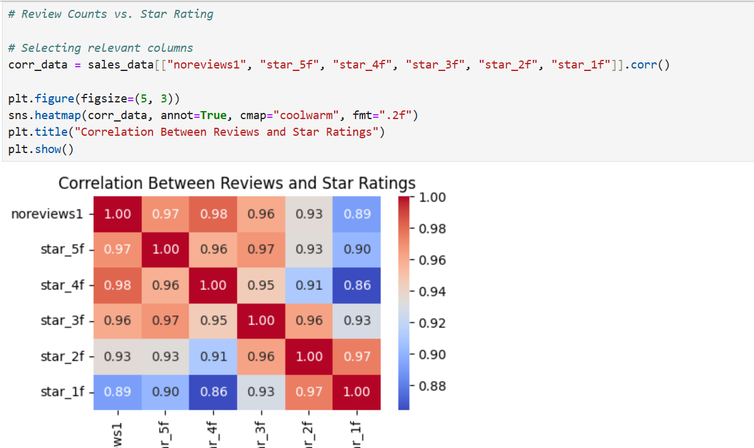

Slide 12
Exploratory Data Analysis (EDA):
EDA is conducted to understand dataset structure, detect missing values, and explore relationships between features. Key steps include:
- Data Summary: Checking column types, missing values, and unique category distributions.
- Statistical Analysis: Examining price and rating variations using descriptive statistics.
- Categorical Feature Insights: Identifying dominant product categories and platform preferences.
- Correlation Analysis: Determining how price, ratings, and reviews influence customer purchasing behavior.
This preprocessing stage ensures data quality and enhances model accuracy by selecting relevant predictors.

Slide 13
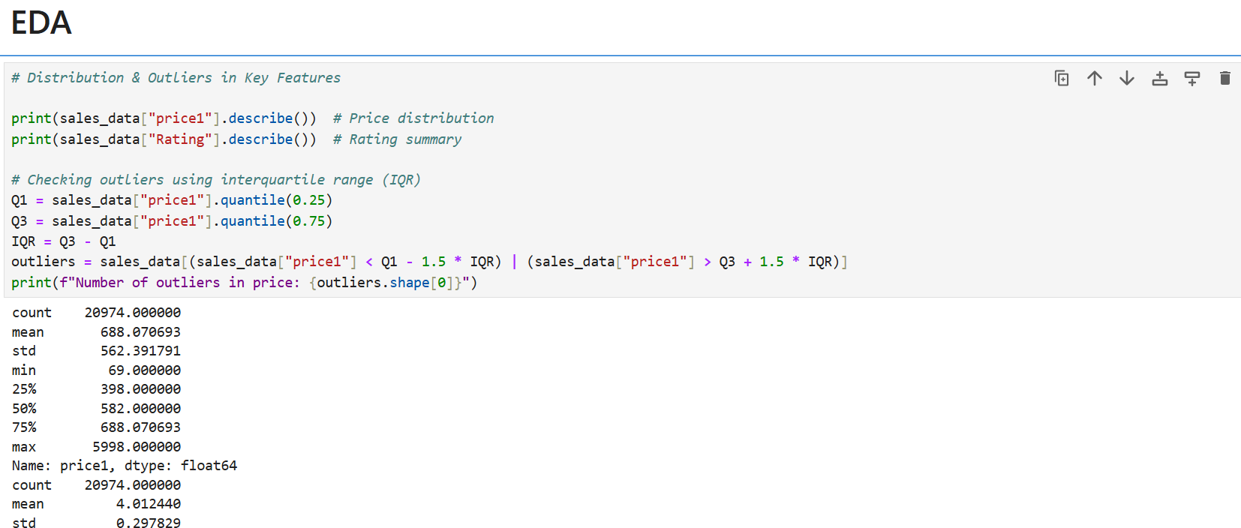

Slide 14
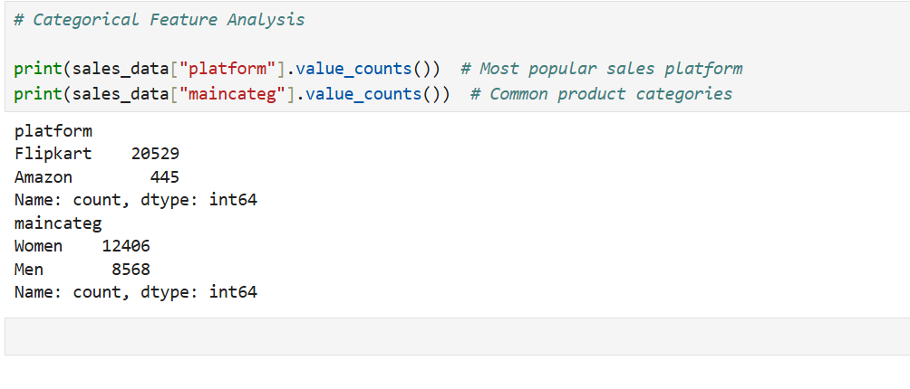

Slide 15
MySQL Queries:
SQL queries streamline data preprocessing by summarizing dataset structure, identifying missing values, and extracting key insights. GROUP BY, COUNT, and DISTINCT aid in categorical analysis, while aggregate functions like AVG, MIN, and MAX assess numerical trends. Conditional queries reveal dominant product categories and customer preferences, while correlation analysis using JOIN and subqueries establishes relationships between price, ratings, and purchasing behavior. Efficient SQL operations enhance data integrity and model accuracy.

Slide 16
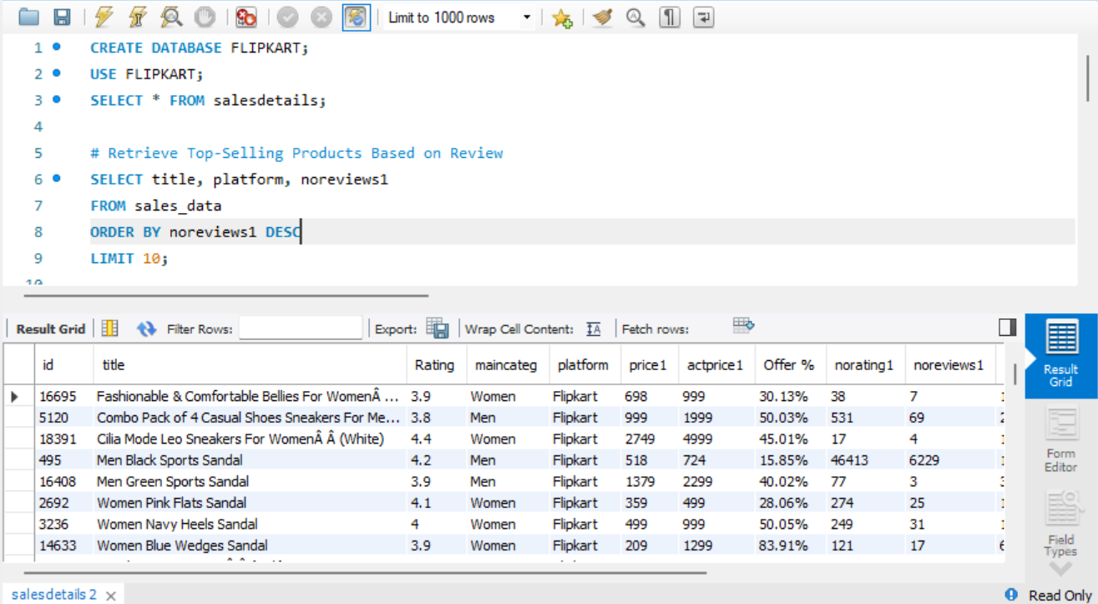

Slide 17
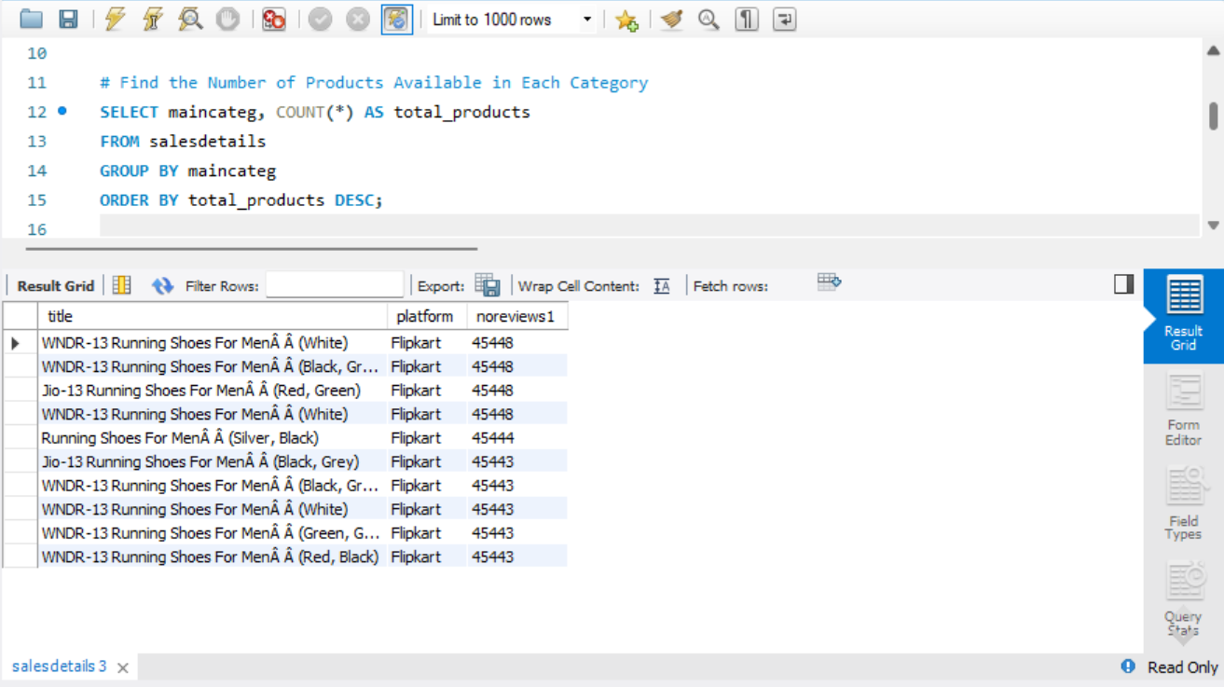

Slide 18
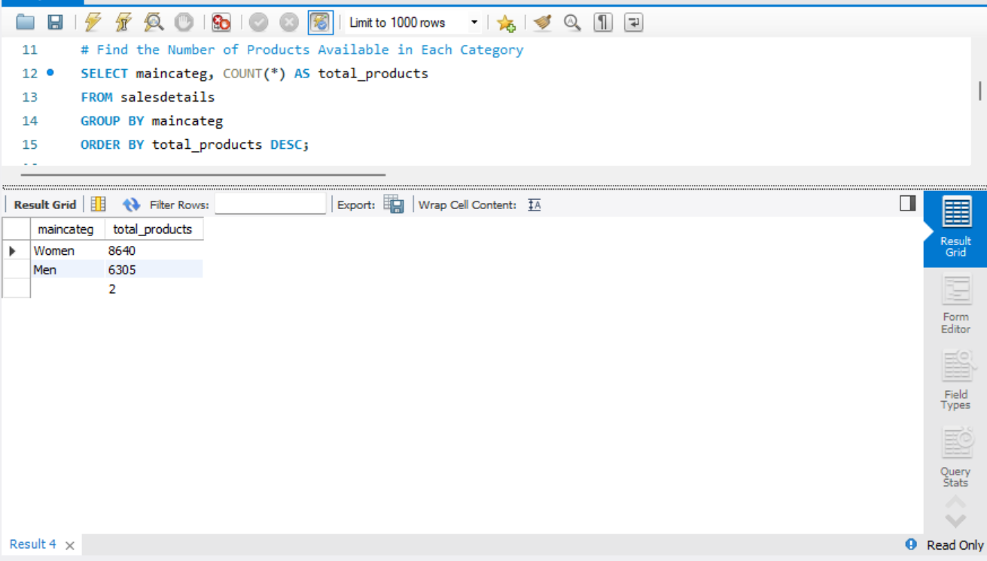

Slide 19
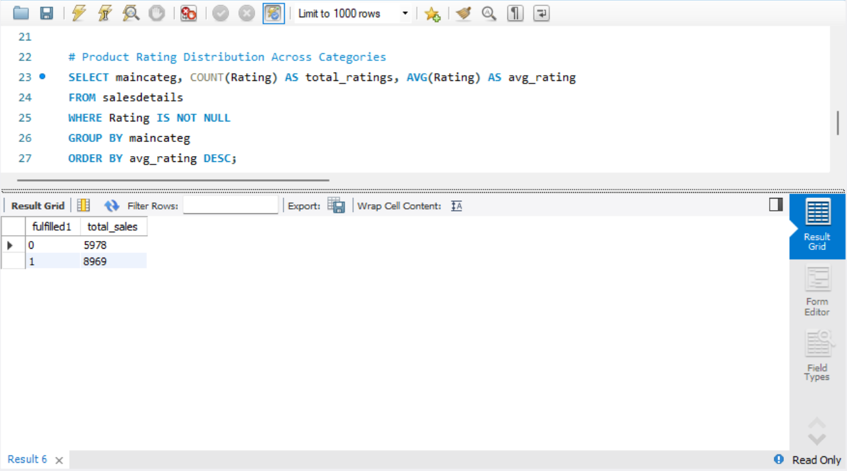

Slide 20
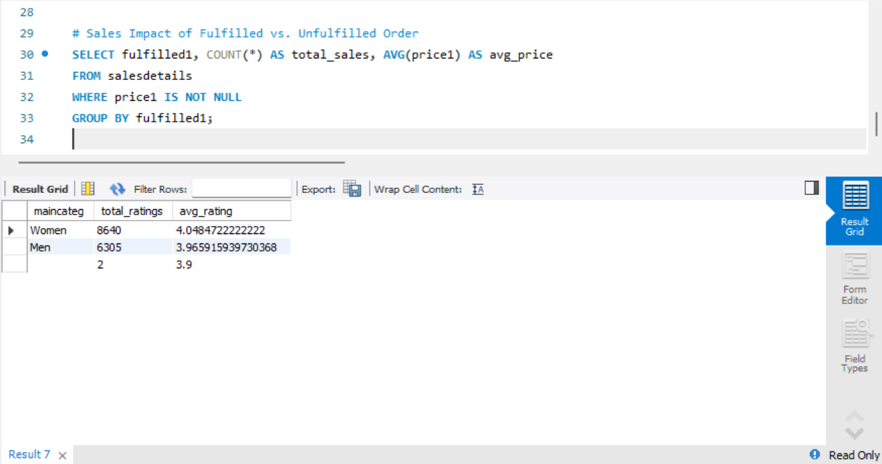

Slide 21
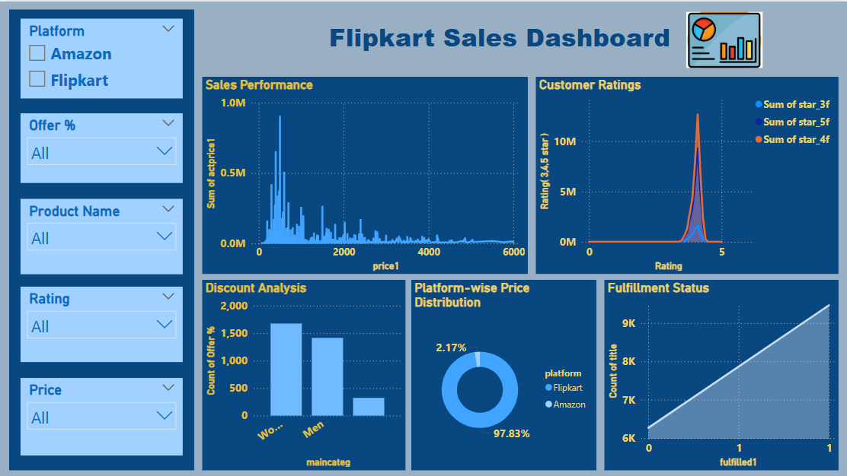


Slide 22

Conclusion:
By integrating Python for analysis, SQL for structured processing, and Power BI for visualization, this project delivers actionable business intelligence that enhances decision-making in Flipkart’s e-commerce strategy. The findings provide valuable insights into pricing optimization, sales forecasting, and customer engagement, helping businesses refine their models for revenue growth and market competitiveness.

Slide 23

Insights & Key Findings:
✔️ Platform-specific sales trends reveal significant variations in pricing and customer engagement.
✔️ Customer reviews and ratings play a crucial role in influencing purchase behavior.
✔️ Discount offers impact conversion rates, but not all discounted products perform equally well.
✔️ Predictive analytics based on structured data helps optimize inventory management and pricing strategies.
✔️ Power BI dashboards enable real-time analysis and dynamic business intelligence for informed decision-making.

Slide 24

THANKS

