Slide 1

Silent Signals:
Tracking Student Mental Health Trends
Data listens when voices go unheard

Slide 2
Problem Statement
Student depression is an increasingly pressing issue shaped by factors like academic pressure, financial instability, and lifestyle choices. This project seeks to examine the core influences on student mental health through structured data analysis, identifying trends that can support early intervention and improve well-being strategies.

Slide 3
01
Data Collection
CONTENTS
Data was collected from Kaggle, utilizing structured datasets on student mental health.The dataset includes key variables such as academic pressure, financial stress, sleep duration,physical activity, study satisfaction, and suicidal thoughts,providing comprehensive insights into mental well-being trends.
02
Data Cleaning & Preprocessing
Data preprocessing was conducted using Pandas, SQL, and Excel. Missing values were handled through mean/mode imputation in Pandas and Excel. Standardization of numerical features like study hours and sleep duration was performed using Excel functions. Categorical encoding (gender, occupation, dietary habits) was done manually in Pandas and SQL queries.Duplicate removal and data integrity checks were carried out using SQL and Pandas, ensuring a clean dataset for analysis.

Slide 4
Exploratory Data Analysis (EDA)
The EDA involved cleaning and preprocessing data using SQL, handling missing values and normalizing formats. Feature engineering categorized physical activity levels based on sleep duration, scaling them from 1 to 100. Correlations between sleep and activity were analyzed to extract trends. A Power BI dashboard visualized insights with slicers, pie charts, time-series graphs, and KPIs for quick decision-making. Time-series analysis was integrated to track variations in sleep and activity over different periods, while KPIs and cards highlighted key findings for quick decision-making. The structured EDA ensured optimized data-driven insights for actionable health analytics.

Slide 5

SQL Queries & Insights: Questions, Answers, and Results

Slide 6
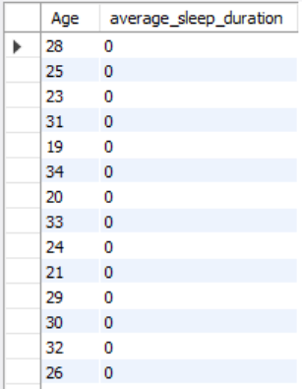
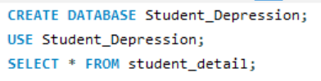
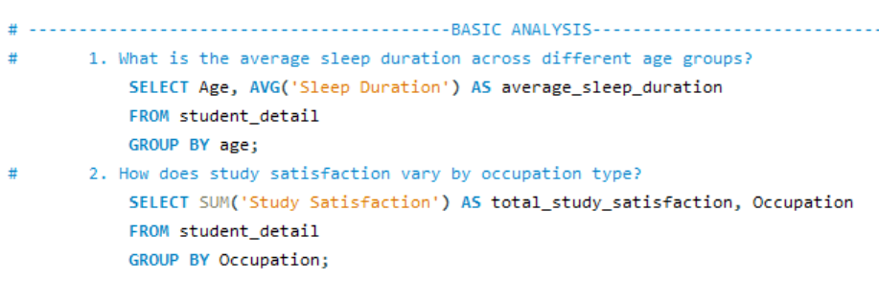
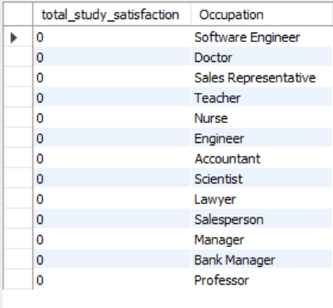
Creating Database
Basic Analysis

Slide 7
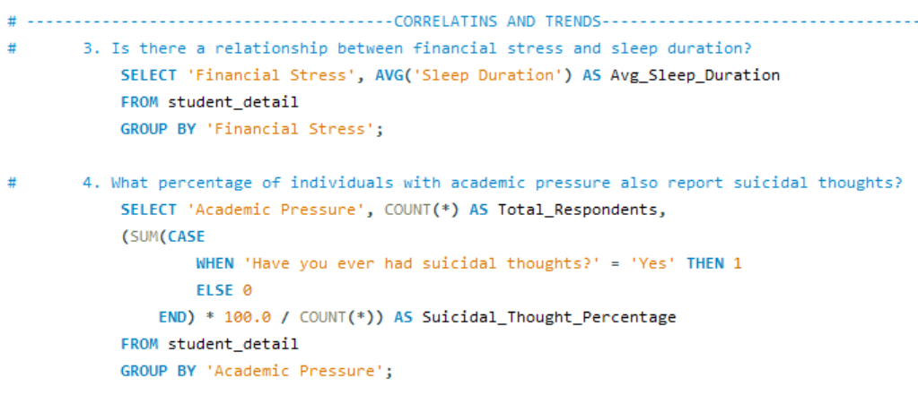


Correlations and Trends

Slide 8
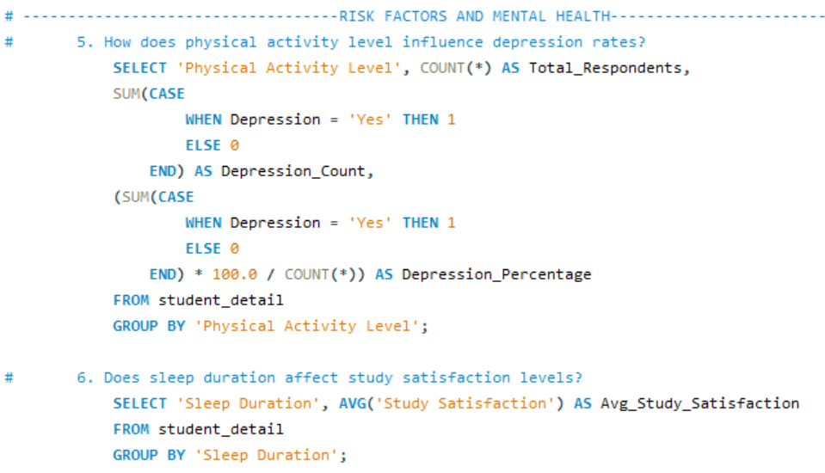


Risk Factors and Mental Health

Slide 9
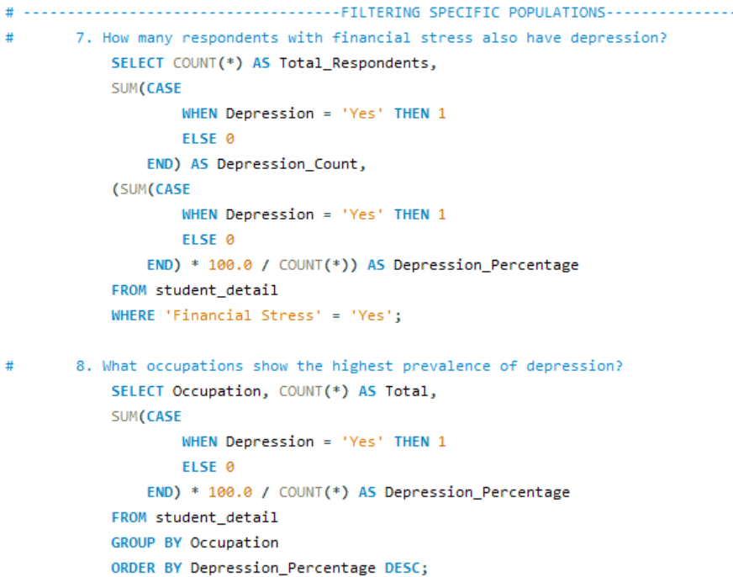

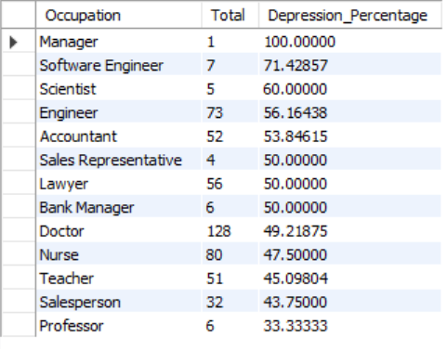
Filtering Specific Populations

Slide 10
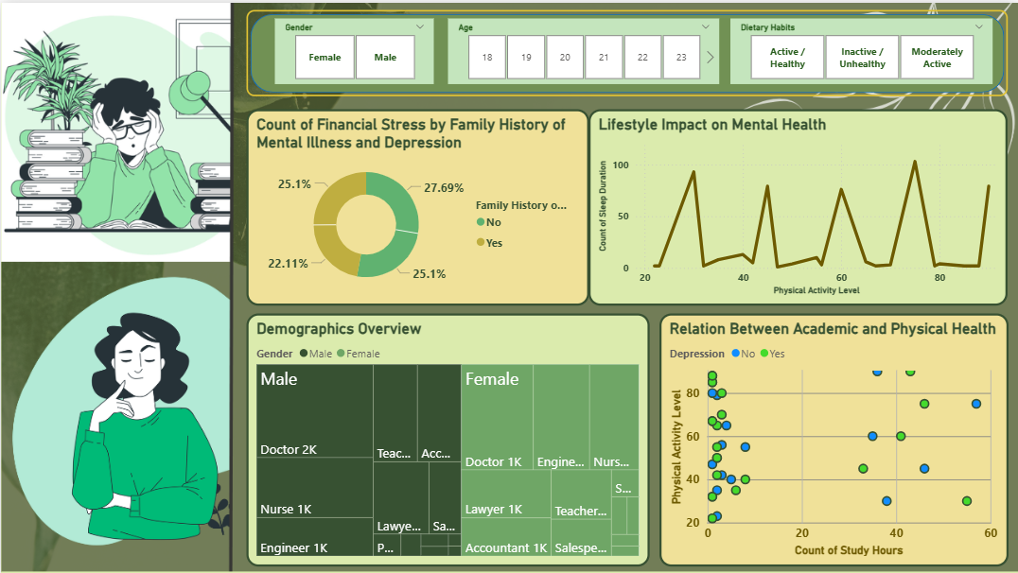
Power BI Dashboard

Slide 11

Results & Insights
Identified significant correlations between sleep deprivation and depression symptoms.
Observed how high academic pressure leads to increased stress and emotional instability.
Found that students facing financial stress reported higher levels of anxiety.
Discovered that physical activity and diet play a role in maintaining mental well-being.
Established early warning signs of depression based on sentiment trends in survey responses.

Slide 12

Conclusion
This study provides data-driven insights into student mental health, focusing on factors such as academic pressure, financial stress, sleep duration, and lifestyle habits. By identifying emotional distress patterns, it highlights early intervention strategies for improving student well-being. The findings show that excessive study hours, financial struggles, and lack of physical activity contribute to stress, making mental health a critical aspect of academic success.
To enhance mental stability, institutions should implement counseling programs, stress management initiatives, and peer support networks. Encouraging healthy routines, open communication, and balanced workloads can help students manage their mental health, fostering a supportive educational environment for academic and personal growth.

Slide 13
THANKS

