Slide 1


Fraud Detection in Internships:
Ensuring Transparency in Job Listings

Slide 2


Introduction
Internship scams have become increasingly prevalent, particularly in platforms like Internshala, where aspiring candidates seek Computer Science Engineering (CSE) job opportunities. Fake listings exploit students by charging hidden fees, offering unverifiable projects, or presenting misleading job descriptions. The goal of this project is to identify fraudulent internship postings using SQL analysis, machine learning models, and dashboard visualization, ensuring students have access to genuine opportunities.

Slide 3

Dataset Collection
To build a dataset for fraud detection, internship postings were scraped from Internshala using the AutoScraper Python library.This process focused on extracting details such as:
Identifying Target Pages: Internshala internship listings for CSE-related roles.
Extracting Key Attributes: Company details, stipend information, and suspicious indicators.
Storing Data: Structuring information into a CSV/SQL database for further analysis.
The collected dataset forms the foundation for fraud detection by enabling deep inspection of misleading patterns.

Slide 4
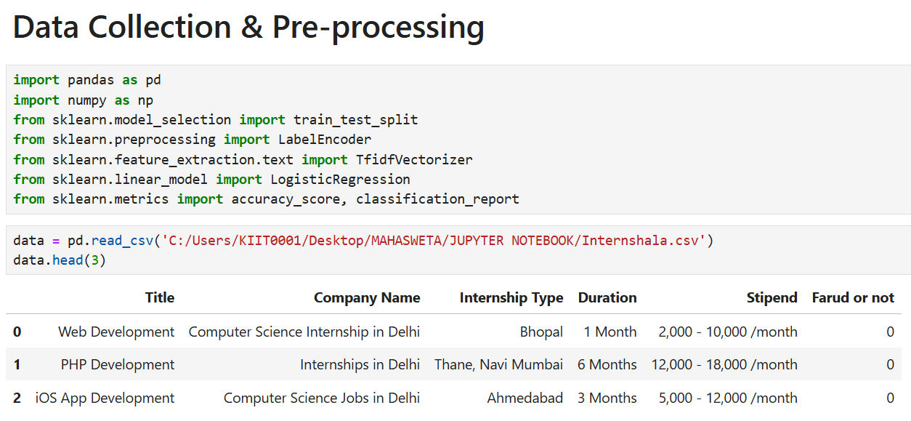

Slide 5
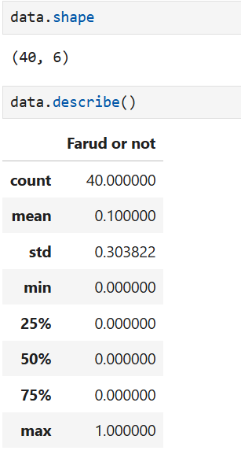
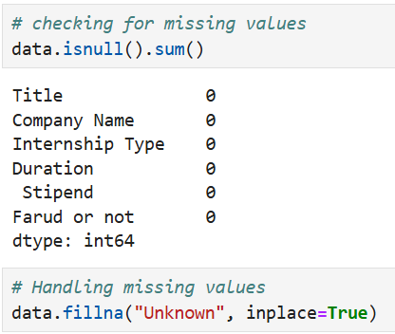

Slide 6

Machine Learning Model
Using historical data, a fraud detection model was built to classify suspicious internships based on key attributes. The process included:
Feature Engineering: Extracting indicators like stipend range, job description uniqueness, and employer verification.
Data Partitioning: Splitting legitimate vs. fraudulent listings for training and evaluation.
Model Selection & Training: Deploying machine learning classifiers to identify misleading postings.
Evaluation: Measuring accuracy and precision in fraud classification.
The trained model could effectively detect internship scams by analyzing subtle inconsistencies in listings.

Slide 7
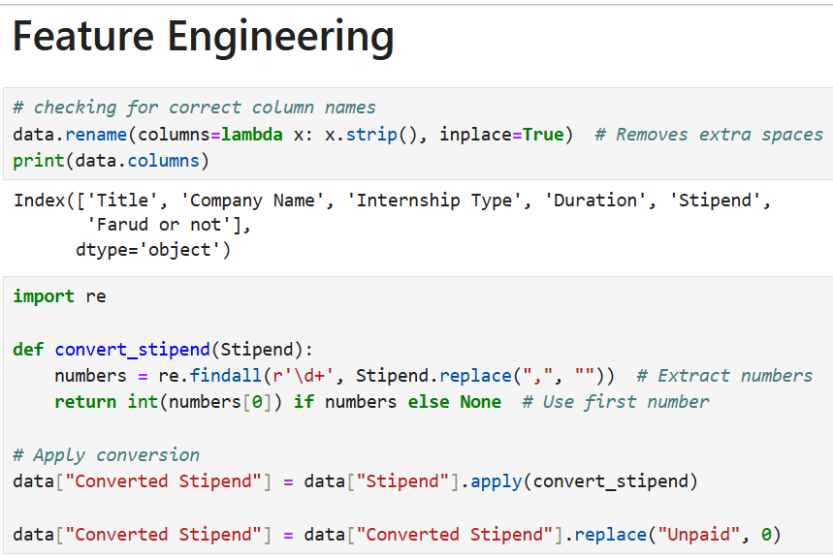
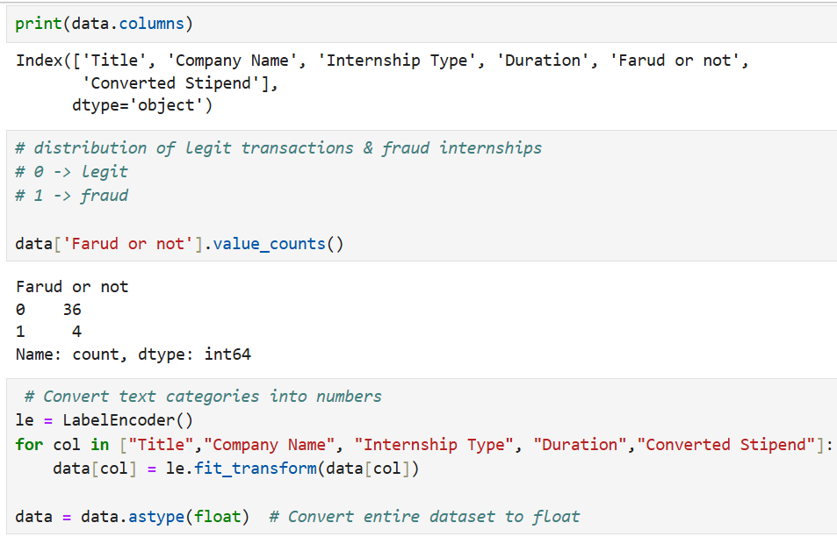

Slide 8
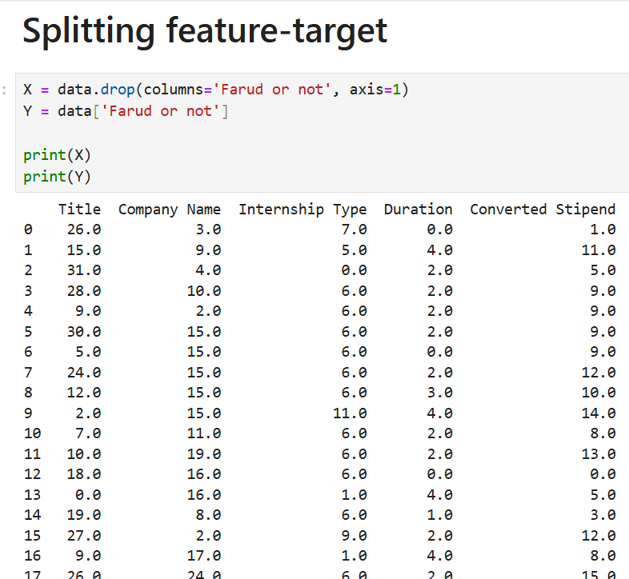
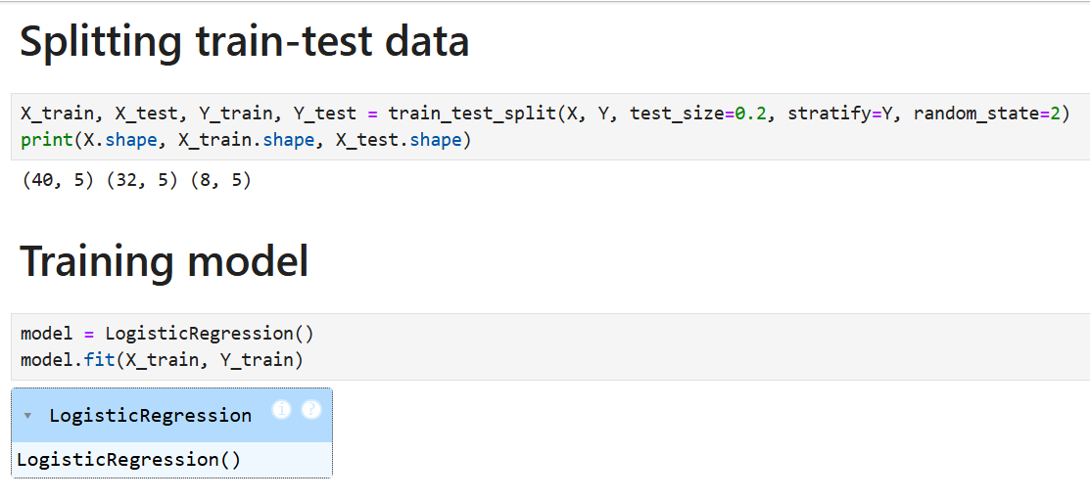

Slide 9
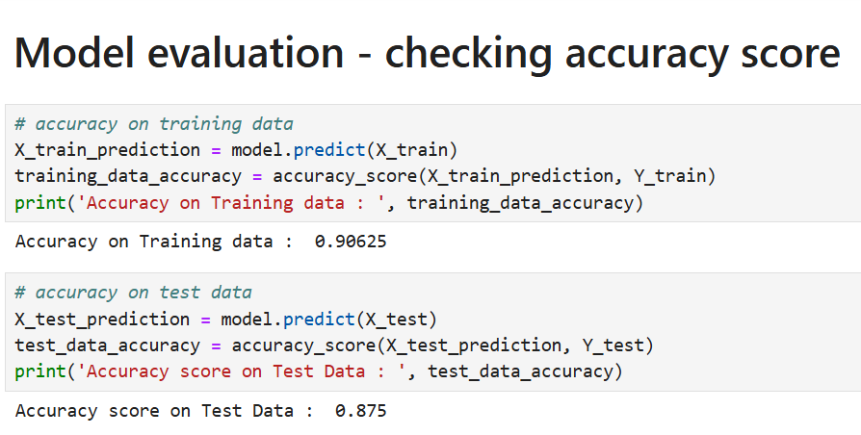
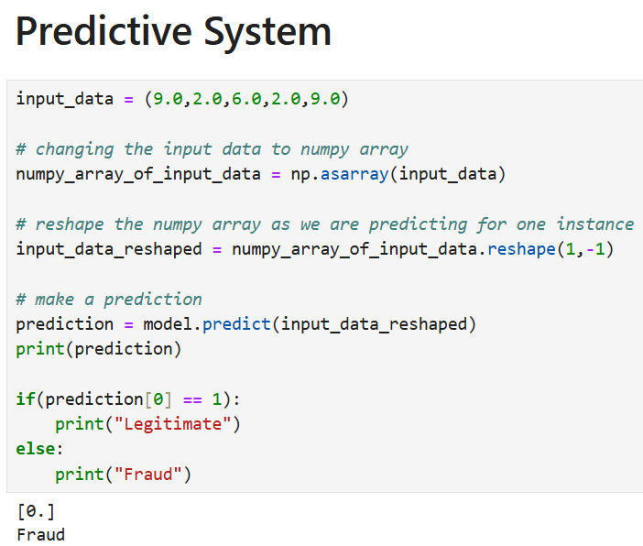

Slide 10

Dashboard Visualization with Power BI
A concise Power BI dashboard was developed to visualize fraud patterns in internship listings. It highlights high-risk trends, ranks companies by trustworthiness, maps application volume against fraud likelihood, and includes real-time fraud alerts. This dashboard offers a quick, data-driven overview to help students confidently navigate and avoid misleading internship opportunities.This dashboard provides a comprehensive view of suspicious listings, helping students make informed application decisions.

Slide 11
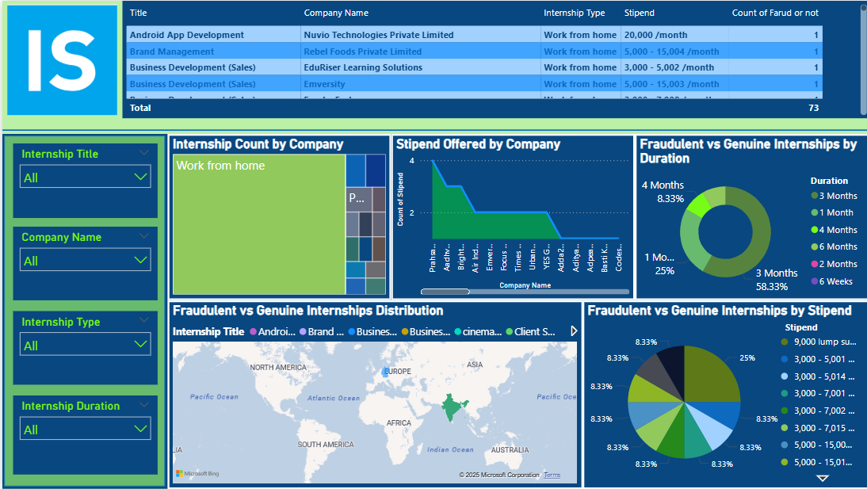

Slide 12
Insights Gained
Implementing real-time monitoring and a fraud scoring system greatly enhanced early detection and helped ensure safer application decisions for students.
Internships lacking clear descriptions, authentic web presence, or offering irregular stipends were strong indicators of fraud. Upfront payment requests further raised red flags during analysis.

Slide 13

Conclusion
This project successfully integrates web scraping, SQL analytics, machine learning, and interactive dashboards to create a scalable fraud detection framework for internships. By identifying misleading postings, analyzing employer credibility, and tracking anomalies, students can be safeguarded from deceptive internship opportunities. Future improvements could involve real-time flagging mechanisms and crowdsourced verification systems to further refine accuracy and usability.

Slide 14

THANK YOU

