Slide 1
Gas Leakage and Water Level Detection System

Slide 2
Group information
Group 5
Group Members
Jesmin Akter 180104052
Hasan Bin Jamal 180104070
Fatima Juairiah 180104071
Mostafa Mahatabe 180104074

Slide 3
Objective
The purpose of the project is monitoring water level and controlling pumps automatically. Also, the system checks for gas leakage and cut off the LPG gas supply automatically.

Slide 4
Social Values
Every year we hear so many unexpected occurrence due to gas leakage and uncontrolled increases of water level. To prevent this kind of incidents, importance of this kind of project knows no bounds. Our projects detects gas leakage and immediately stops the gas flow immediately. This also detects the water level of any source and if the water level rises too much than it stops the water flow.

Slide 5
Required components
Arduino UNO
Ultrasonic Sensor
MQ-5 Gas Sensor
Motor
Relay Module
Pot
Resistance(RES)
20*4 LCD(LM044L)
Battery
Logicstate
NPN Bipolar Transistor
Diode

Slide 6
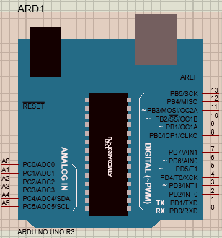
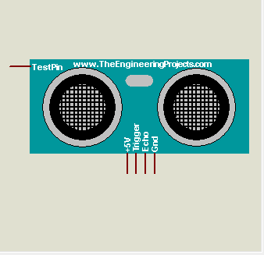
Required components

Slide 7
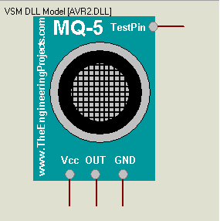
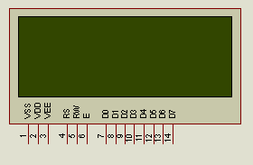
Required components

Slide 8
Working procedure
The basic components that react to the input are
Arduino UNO
It controls and connect all the components together.
Ultrasonic Sensor
To detect water level.
MQ-5 Gas Sensor
To detect Gas Leakage.

Slide 9
Working procedure
The components that receive commands
Motor
It indicates water and gas flow.
Relay Module
It controls water and gas valve.
20*4 LCD
It displays message.

Slide 10
Working procedure
At first the Gas sensor will detect any leakage. If it find any it will send signal to the relay and relay will cut off the gas flow. The message will be shown to the LCD display.
The Ultrasonic Sensor will check the water flow level. If the water level is higher than 70%, a signal will be sent to the relay and that will stop the water flow. Also the water level and the message will be shown to the display.

Slide 11
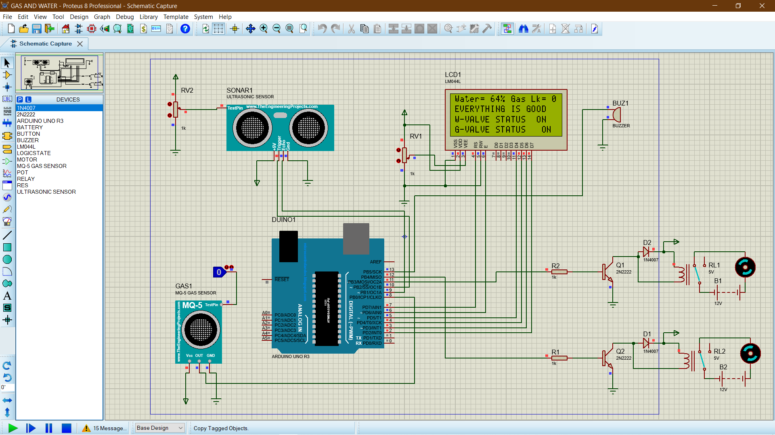
Proteus simulation

Slide 12
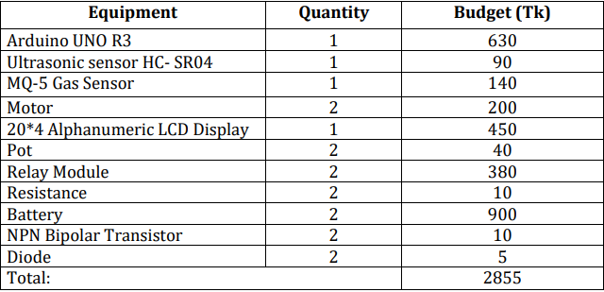
Estimated budget

Slide 13
Future plan
We will add smoke detection system.
Will also add automated door security system.

Slide 14
conclusion
Gas leakage and Water level detection system is a project which can be implemented easily. This system can ensure any kind of gas leakage and water level is detected accurately. Thus, it can play a vital role in reducing the potential risk of accidents.

Slide 15
Thank You !

