Slide 1
New York Citi Bike Analysis
Time Span: 2019, Second Quarter

Slide 2
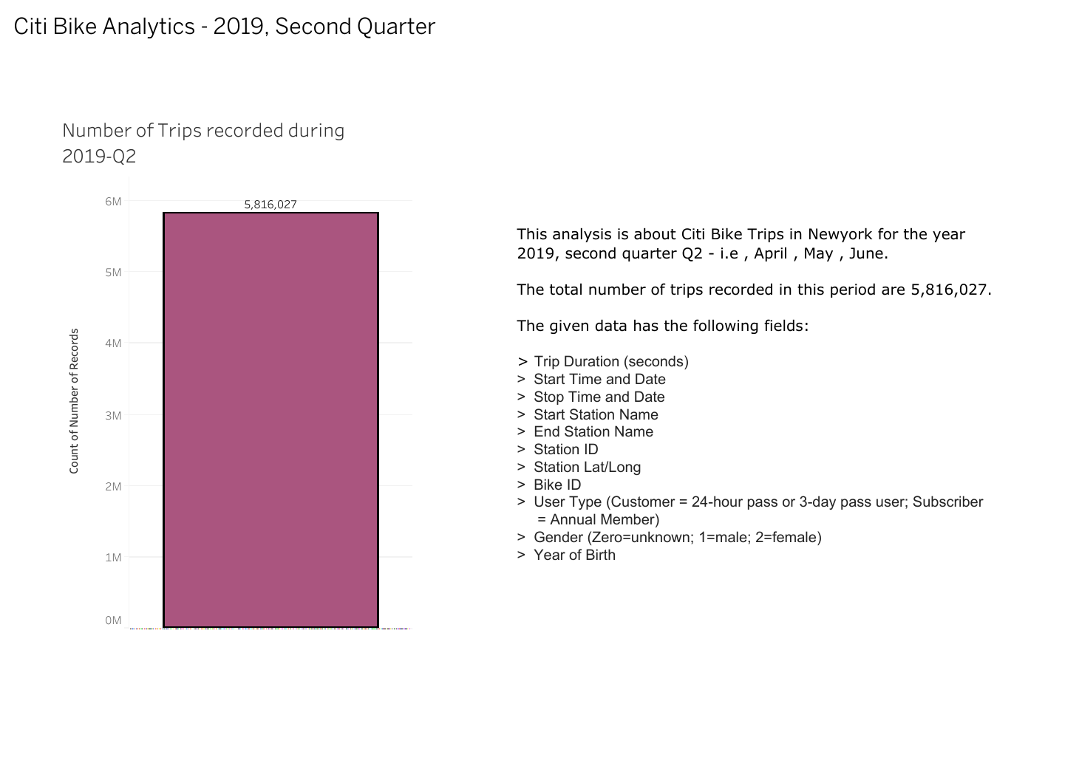

Slide 3
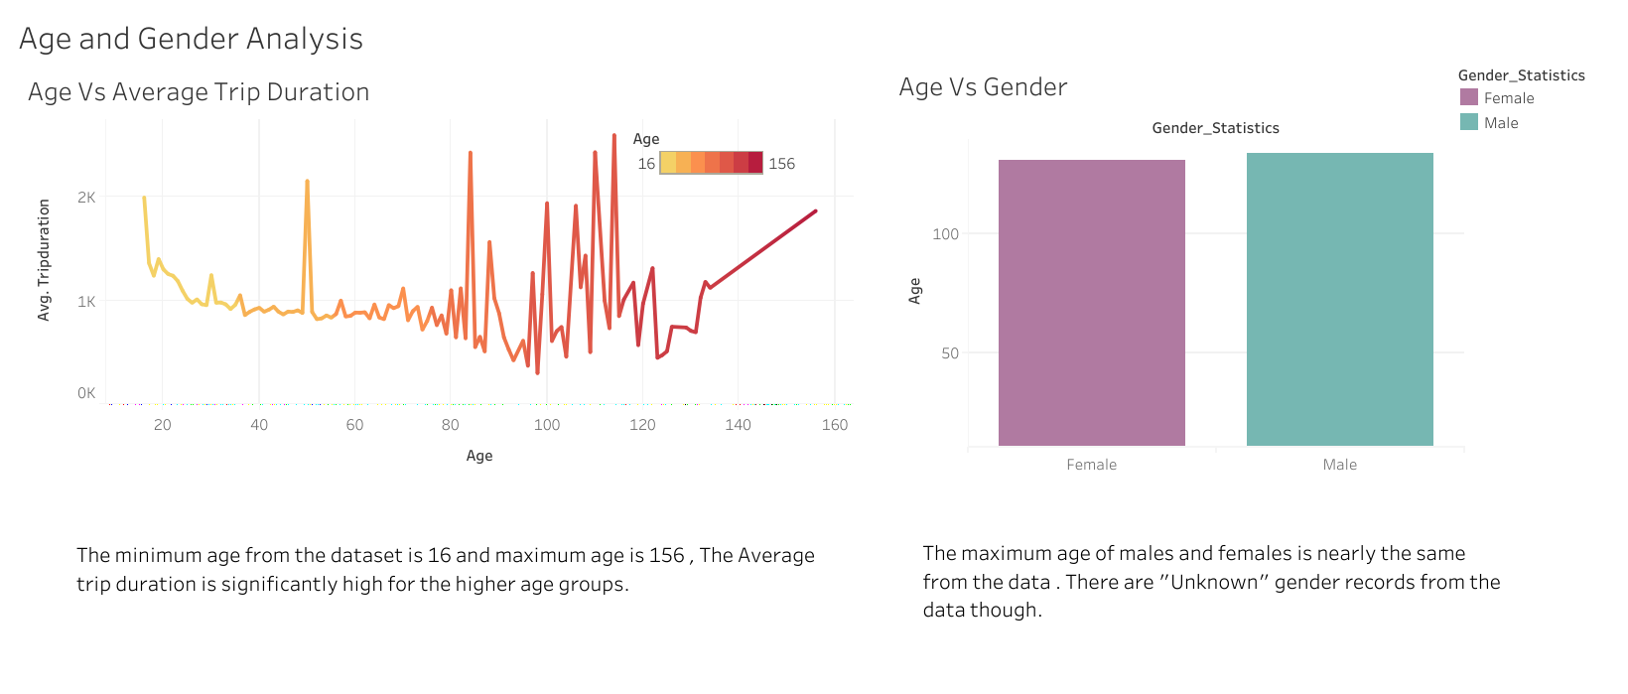

Slide 4
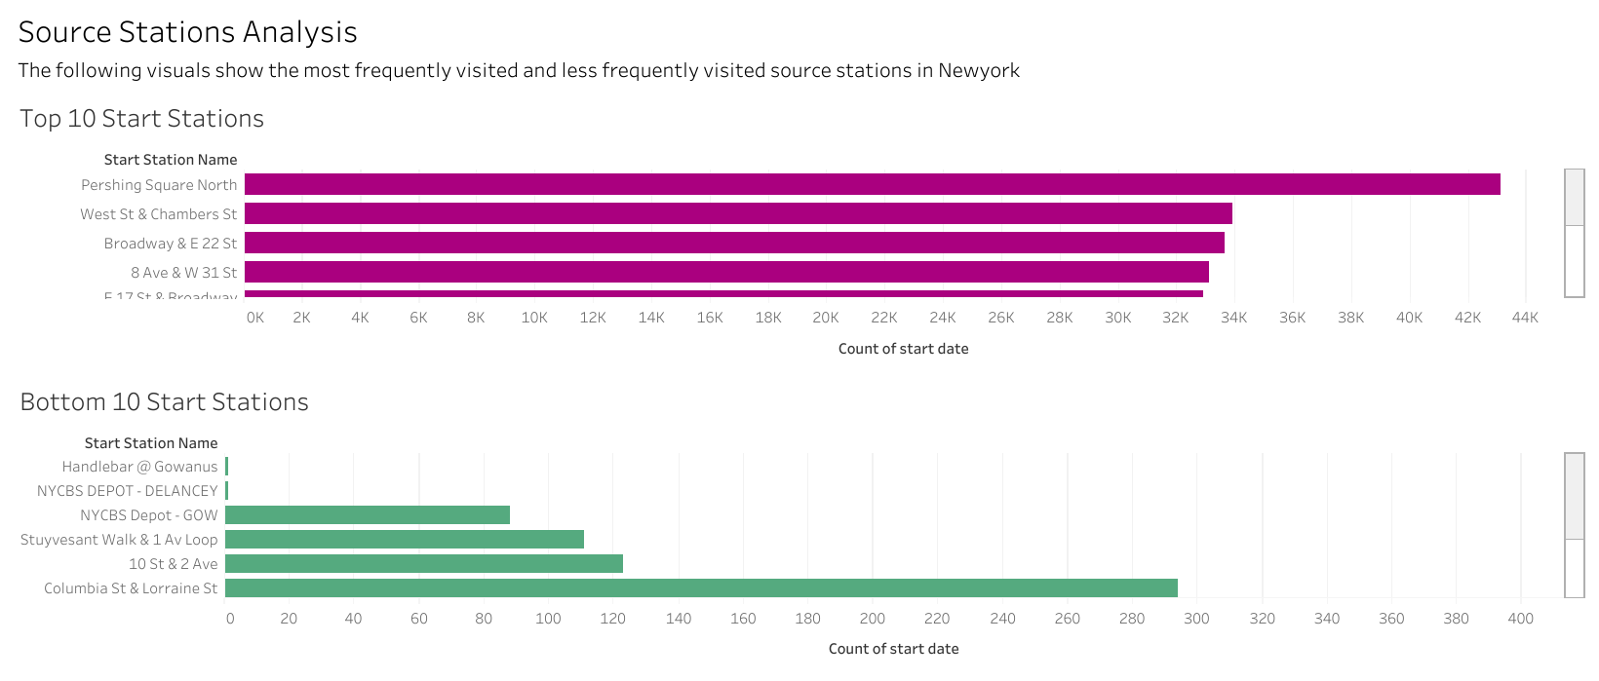

Slide 5
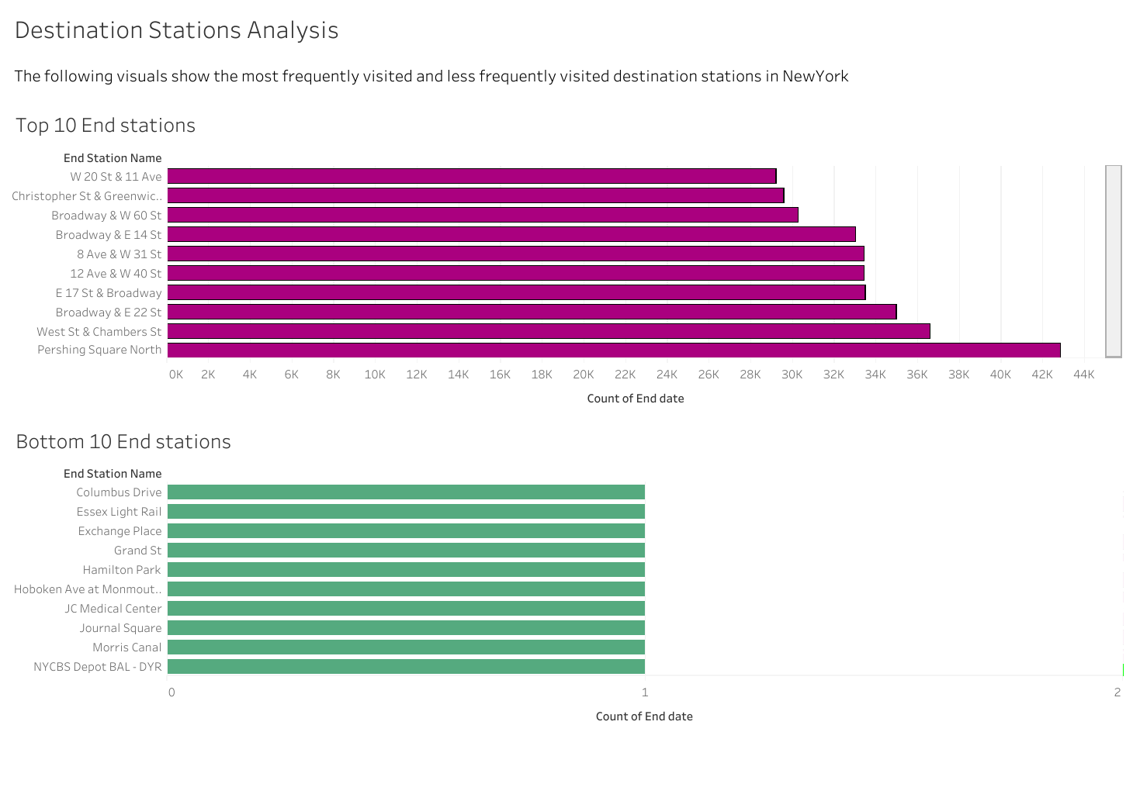

Slide 6
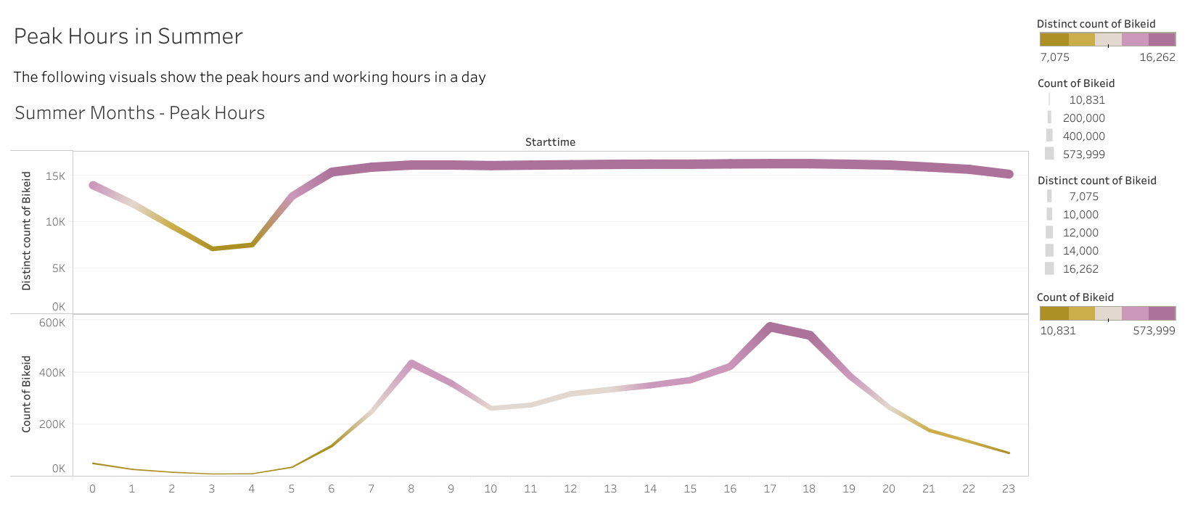

Slide 7
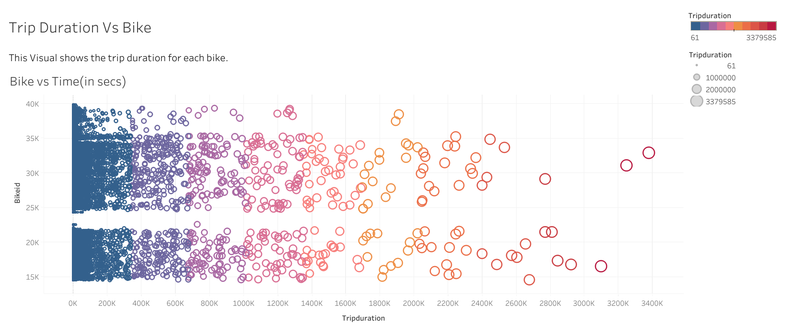

Slide 8
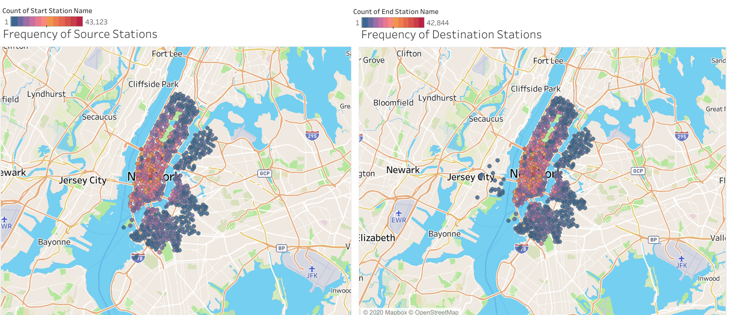

Slide 9
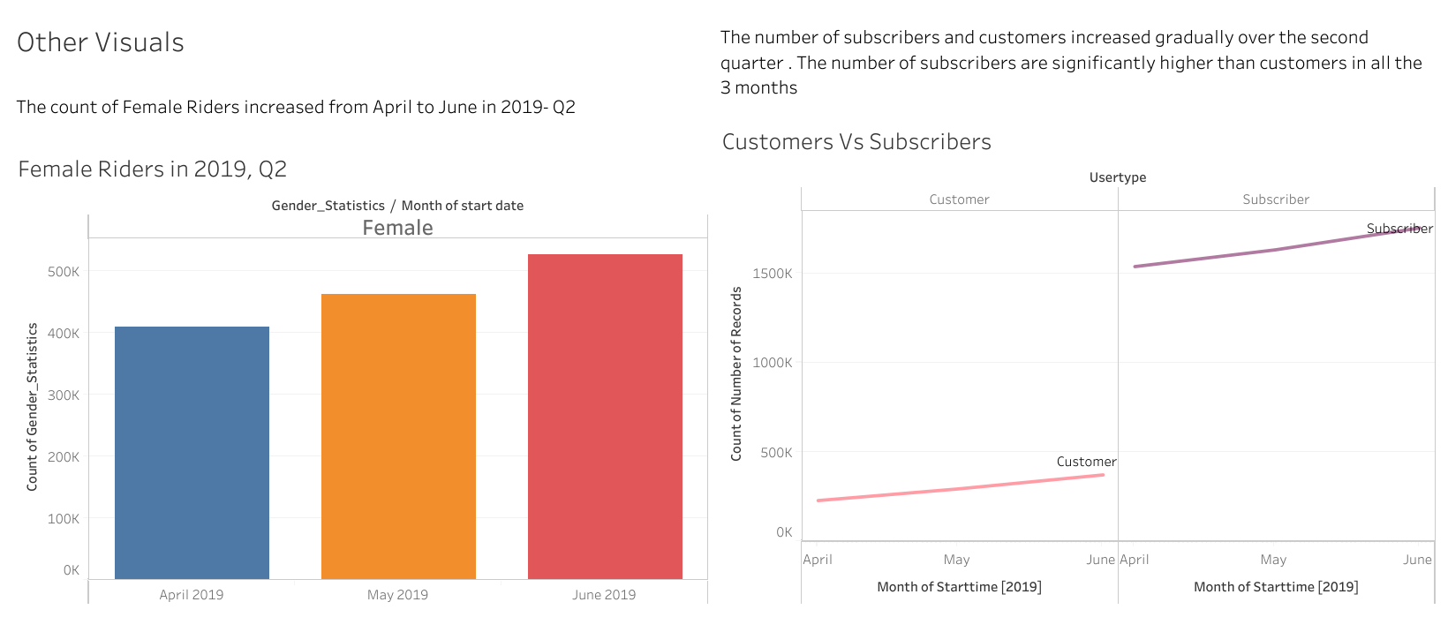

Slide 10
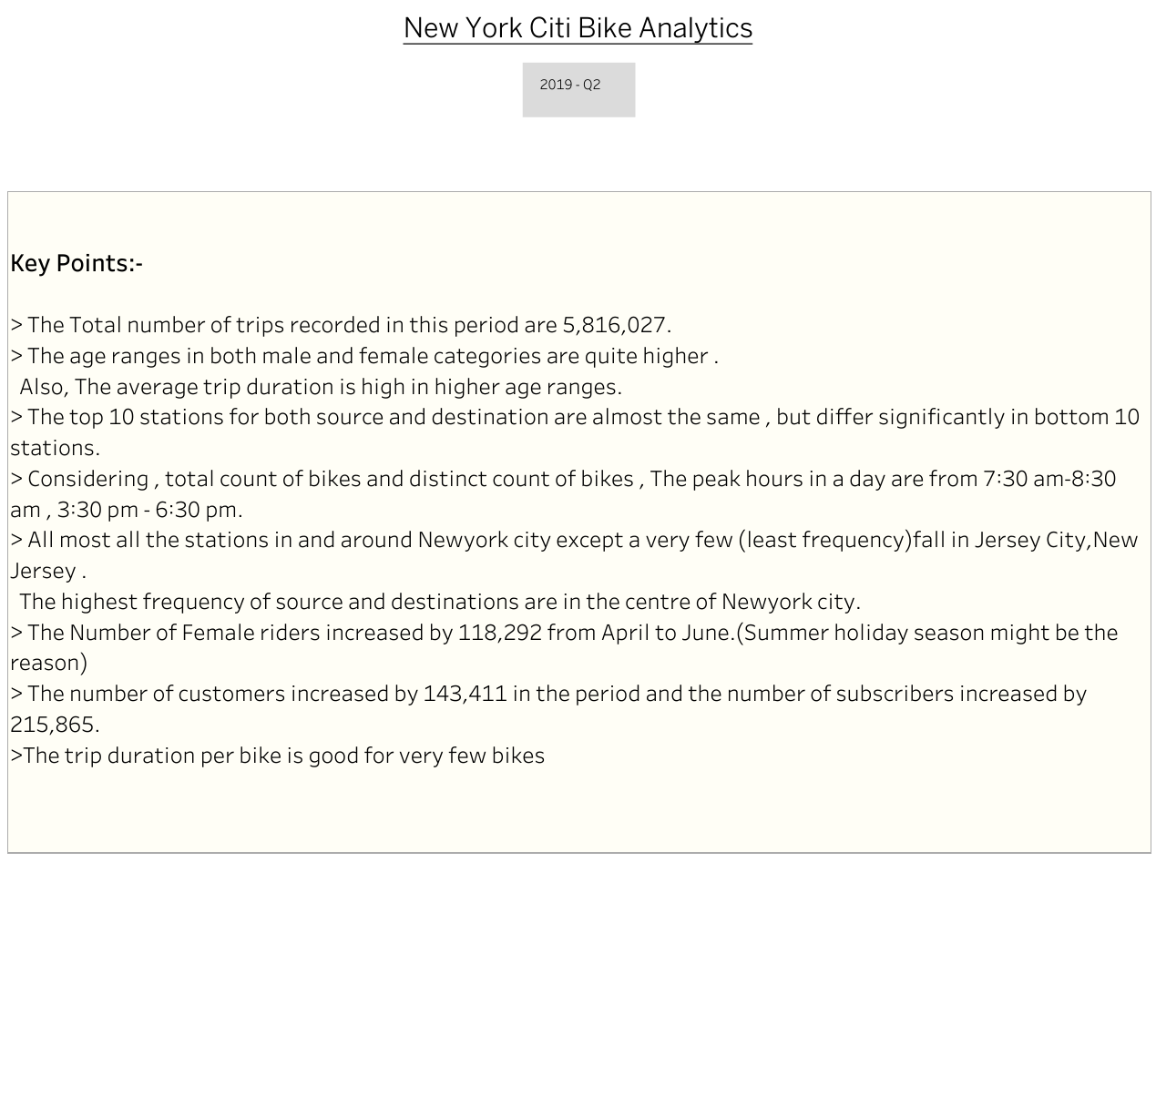

Slide 11
Conclusion:
Considering the factors like,
Age
Gender
Customer and Subscriber count
Season(holiday season)
Climate
from 2019 , Q2 , We can expect a very good number of rides this summer But considering “Corona” virus situation which is a burning issue may have impact on the rides.

Slide 12
Thank You

