Slide 1
Project objective 1

Slide 2
Impact of Digital Screen Time on Adolescent Well-being

Slide 3
Introduction
Background: The increasing use of digital devices (computers, smartphones, video games, TV) has raised concerns about their impact on the well-being of adolescents.
Health Risks: Excessive screen time has been linked to physical, psychological, and emotional health issues, particularly in younger population.
Research Gap: The long-term effects of screen time on well-being across different age groups remain unclear, warranting further exploration.
Recent Study: A clinical trial showed that a short-term reduction in screen time improved behavior and psychological symptoms in children and adolescents.
Notes:
The use of digital devices has become an integral part of daily life, significantly influencing various aspects of well-being, particularly among children and adolescents. With the increasing presence of computers, smartphones, video games, and television, concerns about the potential negative effects of excessive screen time on physical, psychological, and emotional health have gained attention. Recent studies, including a clinical trial that demonstrated the benefits of short-term screen time reduction, suggest that limiting digital device use can improve behaviors and psychological symptoms in children and adolescents. However, the broader impact of screen time on overall well-being across age groups remains a subject of active investigation.
The dataset used in this study captures detailed information on daily screen time across multiple devices, alongside self-reported well-being indicators. These datasets provide a unique opportunity to explore the relationships between digital screen time and well-being outcomes, allowing for both descriptive and inferential statistical analyses. The primary objective of this study is to investigate how screen time, particularly on different devices and at different times (weekends vs. weekdays), correlates with well-being indicators such as optimism, relaxation, confidence, and overall happiness.

Slide 4
Dataset Overview
Dataset Overview:
The dataset tracks daily screen time across various devices, including computers, smartphones, TV, and video games, alongside self-reported well-being metrics such as optimism, relaxation, confidence, and happiness.
Research Focus:
The analysis explores the relationship between screen time (weekends vs weekdays) and well-being indicators using both descriptive and inferential statistical techniques.
Notes:
The use of digital devices has become an integral part of daily life, significantly influencing various aspects of well-being, particularly among children and adolescents. With the increasing presence of computers, smartphones, video games, and television, concerns about the potential negative effects of excessive screen time on physical, psychological, and emotional health have gained attention. Recent studies, including a clinical trial that demonstrated the benefits of short-term screen time reduction, suggest that limiting digital device use can improve behaviors and psychological symptoms in children and adolescents. However, the broader impact of screen time on overall well-being across age groups remains a subject of active investigation.
The dataset used in this study captures detailed information on daily screen time across multiple devices, alongside self-reported well-being indicators. These datasets provide a unique opportunity to explore the relationships between digital screen time and well-being outcomes, allowing for both descriptive and inferential statistical analyses. The primary objective of this study is to investigate how screen time, particularly on different devices and at different times (weekends vs. weekdays), correlates with well-being indicators such as optimism, relaxation, confidence, and overall happiness.

Slide 5

Methodology and Objective
Descriptive Analysis: Understand the distribution and patterns of screen time across different devices and well-being indicators.
Inferential Analysis: Use hypothesis testing (T-tests) to explore the correlation between screen time and specific well-being outcomes, such as optimism and relaxation.
Objective: Identify patterns in screen time usage and its impact on well-being indicators to guide recommendations for healthier digital habits.
Goal: Provide actionable insights into how digital screen time affects adolescent well-being and propose strategies for balanced screen time.
Notes:
The use of digital devices has become an integral part of daily life, significantly influencing various aspects of well-being, particularly among children and adolescents. With the increasing presence of computers, smartphones, video games, and television, concerns about the potential negative effects of excessive screen time on physical, psychological, and emotional health have gained attention. Recent studies, including a clinical trial that demonstrated the benefits of short-term screen time reduction, suggest that limiting digital device use can improve behaviors and psychological symptoms in children and adolescents. However, the broader impact of screen time on overall well-being across age groups remains a subject of active investigation.
The dataset used in this study captures detailed information on daily screen time across multiple devices, alongside self-reported well-being indicators. These datasets provide a unique opportunity to explore the relationships between digital screen time and well-being outcomes, allowing for both descriptive and inferential statistical analyses. The primary objective of this study is to investigate how screen time, particularly on different devices and at different times (weekends vs. weekdays), correlates with well-being indicators such as optimism, relaxation, confidence, and overall happiness.

Slide 6
Propose
Descriptive Statistical Analyses:
Investigation 1: Descriptive Statistics for Digital Screen Time
Analyze and describe the general trends in digital screen time by gender and deprivation status
Investigation 2: Descriptive Statistics for Well-being Indicators
Investigate the trends in well-being indicators based on self-reported responses.
Notes:
Proposed Investigations
Inferential Statistical Analyses:
Investigation 1: Comparing well-being scores between high and low screen time groups An inferential analysis will be conducted to compare well-being outcomes between respondents with high and low screen time. Using a t-test, this investigation will assess whether individuals with high screen time report significantly lower or higher well-being scores across various indicators.
Investigation 2: Identifying the impact of different types of screen time on specific well-being indicators The second inferential analysis will explore how screen time on different devices (e.g., smartphone, TV) influences specific well-being outcomes. This analysis will determine whether the type of screen activity (e.g., gaming, social media) has a stronger correlation with certain psychological symptoms, such as stress or relaxation.

Slide 7
Propose
Inferential Statistical Analyses:
Investigation 1: Inferential Analysis for Screen Time (T_we) vs Optimism (Optm) + Hypothesis Test
Investigate the relationship between screen time on weekends and optimism levels.
Investigation 2: Inferential Analysis for Screen Time (T_we) vs Relaxation (Relx) + Hypothesis Test
Analyze the relationship between weekend screen time and relaxation levels.
Notes:
Proposed Investigations
Descriptive Statistical Analyses:
Investigation 1: Average screen time across different devices The first descriptive analysis will explore the average daily screen time for various devices (computers, video games, smartphones, and TV) on weekdays and weekends. This investigation will reveal which device contributes most to overall screen time and how usage patterns differ between weekdays and weekends.
Investigation 2: Distribution of well-being scores The second descriptive analysis will examine the distribution of well-being indicators, such as optimism, relaxation, and confidence, among respondents. This analysis will provide insights into the general well-being trends in the population and identify any patterns in self-reported mental health.
Inferential Statistical Analyses:
Investigation 1: Comparing well-being scores between high and low screen time groups An inferential analysis will be conducted to compare well-being outcomes between respondents with high and low screen time. Using a t-test, this investigation will assess whether individuals with high screen time report significantly lower or higher well-being scores across various indicators.
Investigation 2: Identifying the impact of different types of screen time on specific well-being indicators The second inferential analysis will explore how screen time on different devices (e.g., smartphone, TV) influences specific well-being outcomes. This analysis will determine whether the type of screen activity (e.g., gaming, social media) has a stronger correlation with certain psychological symptoms, such as stress or relaxation.
By combining these descriptive and inferential analyses, this study aims to provide a comprehensive understanding of the relationship between screen time and well-being. The findings can inform recommendations for healthy digital device usage and strategies for mitigating the negative impact of excessive screen time.

Slide 8

Justification
Justification for Descriptive Analyses
Understanding screen time patterns based on demographic factors like gender and deprivation status can reveal key insights into user behavior.
Screen time patterns provide insight into device preferences and how they vary between different days of the week, influencing well-being.
Understanding well-being trends can provide insights into mental and emotional health in relation to screen time.
These well-being indicators are critical for understanding the mental and emotional impact of digital screen time.
Notes:
The increasing ubiquity of digital devices in everyday life has raised important questions about their effects on human health and well-being, especially in children and adolescents. Concerns about screen time's impact on physical, mental, and emotional health have led to a growing body of research investigating these relationships. However, while many studies have focused on specific aspects of device usage, such as its effects on sleep or academic performance, few provide a comprehensive analysis of how different types of screen time affect well-being across multiple psychological and emotional indicators.
Justification for Descriptive Analyses Descriptive statistical analyses serve as the foundation for understanding overall patterns and trends in both screen time and well-being indicators. By analyzing the average daily screen time across different devices (e.g., computers, smartphones, video games, and TV), we can identify which devices are used the most and when (weekdays vs. weekends). Understanding these basic patterns is crucial, as different devices may contribute differently to health outcomes. For example, excessive video game use may have different psychological effects compared to passive TV consumption. Additionally, describing the distribution of well-being scores provides a snapshot of the mental and emotional states of the population. This analysis is essential for understanding the overall well-being landscape and identifying any early warning signs of poor mental health associated with high screen time. Without such foundational insights, it would be difficult to move forward with more complex analyses aimed at uncovering correlations or causal relationships.

Slide 9
Justification
Justification for Inferential Analyses
This analysis can determine if higher screen time correlates with lower optimism levels, providing insight into the impact of screen time on mental well-being.
Optimism is a key indicator of mental health, and understanding its relationship with screen time can provide insights into digital behavior’s emotional impact.
Relaxation is an important component of well-being. This analysis will help determine if higher weekend screen time impacts relaxation levels.
Relaxation is essential for emotional balance, and its relationship with screen time can help suggest healthier habits.
Notes:
Justification for Inferential Analyses Inferential analyses allow us to test hypotheses and determine whether significant relationships exist between screen time and well-being. A key question in the digital health field is whether high screen time is associated with lower levels of well-being. Conducting t-tests comparing well-being scores between high and low screen time groups helps address this question. The findings from such an analysis can provide evidence for or against the idea that screen time contributes to negative psychological outcomes. Moreover, understanding the specific effects of different types of screen time (e.g., social media use vs. gaming) on well-being indicators such as stress, optimism, or relaxation is critical for tailoring public health recommendations. For example, screen time spent on social media may lead to higher stress levels, while time spent on educational apps could have more neutral or even positive effects. By identifying these nuances, the study can provide a more targeted and effective approach to screen time management.
Overall, the proposed study fills a critical gap in the literature by providing a comprehensive, data-driven analysis of how screen time on different devices impacts multiple well-being indicators. The use of both descriptive and inferential statistics ensures that the research will yield actionable insights, contributing to evidence-based guidelines and recommendations for healthy digital habits.

Slide 10
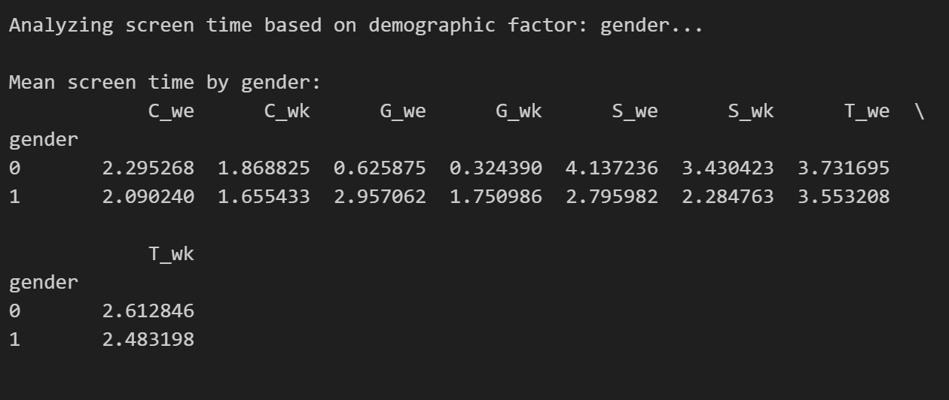
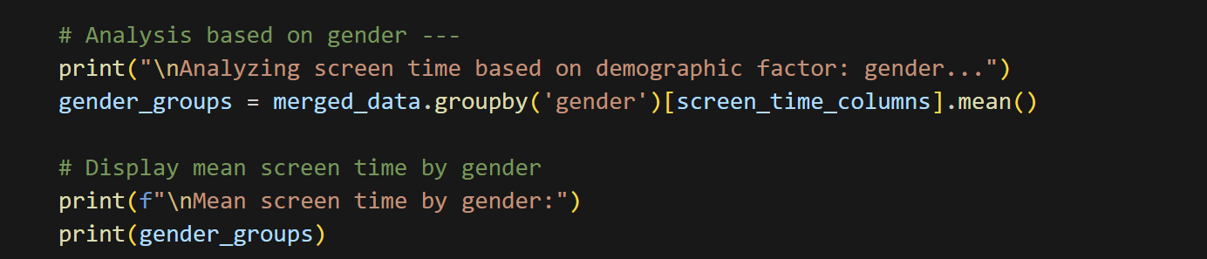
Execution and Results
Descriptive Statistical Analyses:
Investigation 1: Descriptive Statistics for Digital Screen Time
Average Screen Time by Gender
Notes:
The bar chart visualizes the average daily screen time for different devices across weekdays and weekends, based on the provided data. Here's a breakdown of the key insights from the chart:
Overall Screen Time Trends:
Television (T) has the highest average screen time for both weekdays (3.65 hours) and weekends (2.55 hours), indicating that TV is the most frequently used device. This trend is consistent with common usage patterns where TV viewing is a popular leisure activity.
Device Comparison:
Social Media (S) comes next, with an average of 3.50 hours on weekends and 2.89 hours on weekdays. This high usage reflects the increasing role of social media in daily life and its appeal for entertainment and social interaction.
Computers (C) and Gaming (G) have similar patterns but with lower average screen times compared to TV and social media. Computers are used for an average of 2.20 hours on weekends and 1.77 hours on weekdays, while gaming devices are used for 1.73 hours on weekends and 1.00 hours on weekdays. This suggests that while gaming and computer use are significant, they are not as dominant as TV and social media in daily routines.
Weekday vs. Weekend Usage:
For all devices, screen time is generally higher on weekends compared to weekdays. This is likely due to the increased availability of free time on weekends, leading to more leisure activities, including extended screen time.
The increase in screen time on weekends is most pronounced for social media and TV, which are popular for relaxation and entertainment during free time.
Visualization Insights:
The bar chart effectively highlights the differences in average screen time by device, allowing for a quick visual comparison. The highest bars represent the devices with the most screen time, emphasizing TV's dominant role and the growing importance of social media.
Overall, the results suggest that while screen time varies by device and day of the week, TV and social media are the most significant contributors to daily screen time. The data can inform strategies for managing screen time, particularly in addressing the predominant use of TV and social media, and considering the implications for health and well-being.

Slide 11
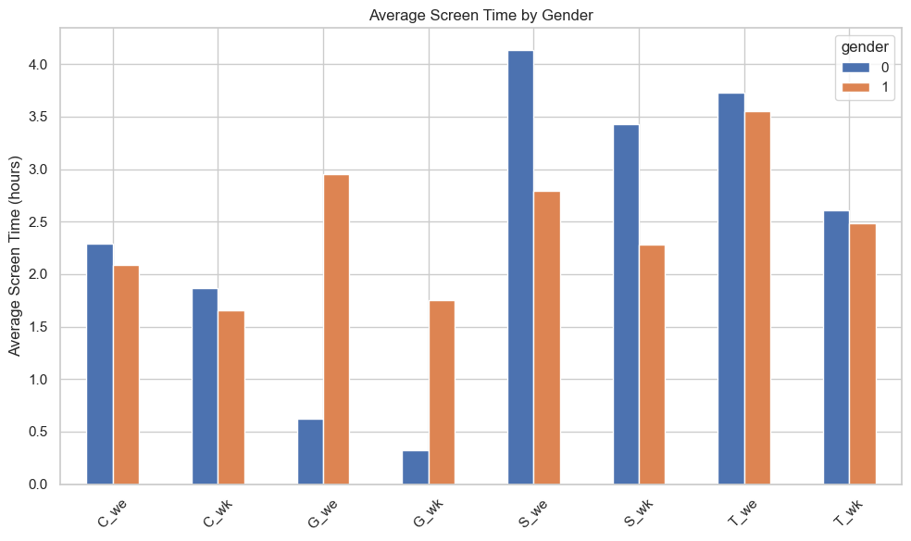
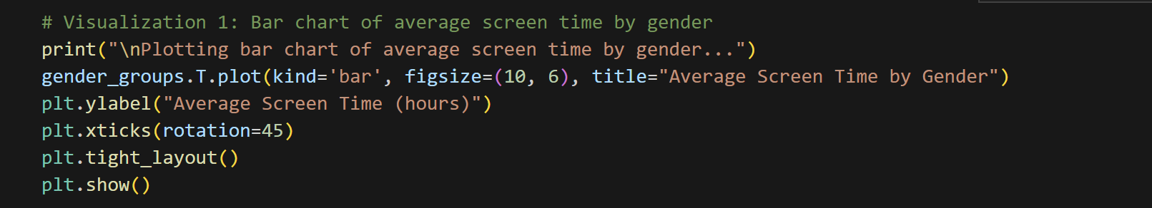
Execution and Results
Descriptive Statistical Analyses:
Investigation 1: Descriptive Statistics for Digital Screen Time
Average Screen Time by Gender
Notes:
The bar chart visualizes the average daily screen time for different devices across weekdays and weekends, based on the provided data. Here's a breakdown of the key insights from the chart:
Overall Screen Time Trends:
Television (T) has the highest average screen time for both weekdays (3.65 hours) and weekends (2.55 hours), indicating that TV is the most frequently used device. This trend is consistent with common usage patterns where TV viewing is a popular leisure activity.
Device Comparison:
Social Media (S) comes next, with an average of 3.50 hours on weekends and 2.89 hours on weekdays. This high usage reflects the increasing role of social media in daily life and its appeal for entertainment and social interaction.
Computers (C) and Gaming (G) have similar patterns but with lower average screen times compared to TV and social media. Computers are used for an average of 2.20 hours on weekends and 1.77 hours on weekdays, while gaming devices are used for 1.73 hours on weekends and 1.00 hours on weekdays. This suggests that while gaming and computer use are significant, they are not as dominant as TV and social media in daily routines.
Weekday vs. Weekend Usage:
For all devices, screen time is generally higher on weekends compared to weekdays. This is likely due to the increased availability of free time on weekends, leading to more leisure activities, including extended screen time.
The increase in screen time on weekends is most pronounced for social media and TV, which are popular for relaxation and entertainment during free time.
Visualization Insights:
The bar chart effectively highlights the differences in average screen time by device, allowing for a quick visual comparison. The highest bars represent the devices with the most screen time, emphasizing TV's dominant role and the growing importance of social media.
Overall, the results suggest that while screen time varies by device and day of the week, TV and social media are the most significant contributors to daily screen time. The data can inform strategies for managing screen time, particularly in addressing the predominant use of TV and social media, and considering the implications for health and well-being.

Slide 12
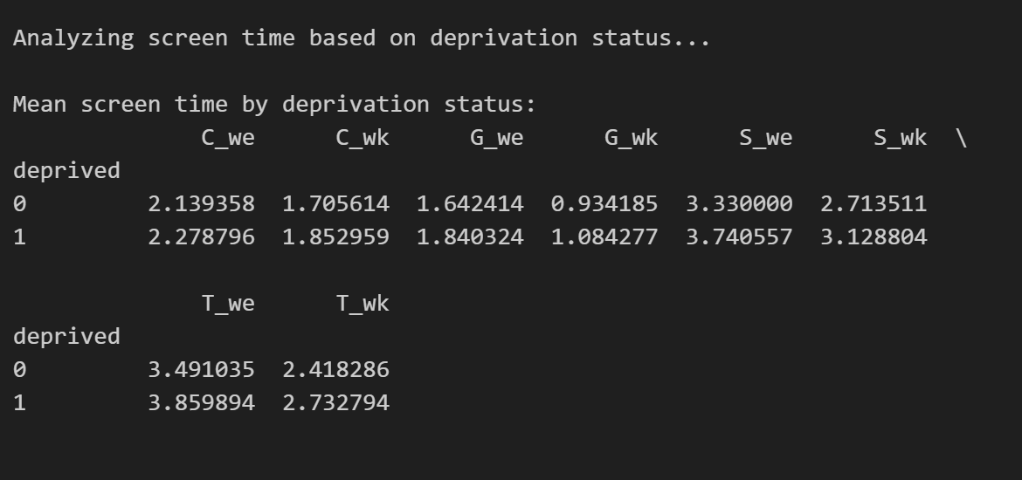
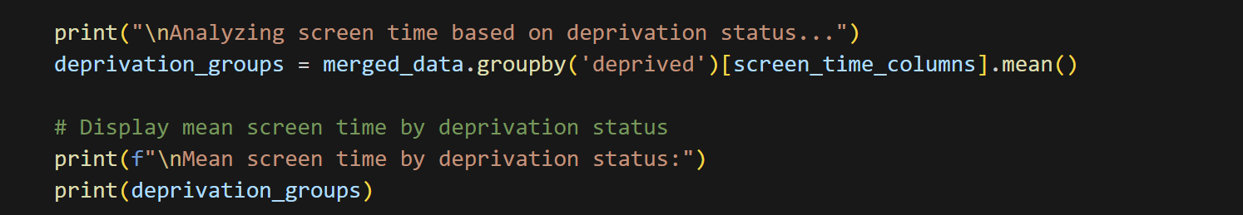
Execution and Results
Descriptive Statistical Analyses:
Investigation 1: Descriptive Statistics for Digital Screen Time
Average Screen Time Based on Deprivation Status
Notes:
The bar chart visualizes the average daily screen time for different devices across weekdays and weekends, based on the provided data. Here's a breakdown of the key insights from the chart:
Overall Screen Time Trends:
Television (T) has the highest average screen time for both weekdays (3.65 hours) and weekends (2.55 hours), indicating that TV is the most frequently used device. This trend is consistent with common usage patterns where TV viewing is a popular leisure activity.
Device Comparison:
Social Media (S) comes next, with an average of 3.50 hours on weekends and 2.89 hours on weekdays. This high usage reflects the increasing role of social media in daily life and its appeal for entertainment and social interaction.
Computers (C) and Gaming (G) have similar patterns but with lower average screen times compared to TV and social media. Computers are used for an average of 2.20 hours on weekends and 1.77 hours on weekdays, while gaming devices are used for 1.73 hours on weekends and 1.00 hours on weekdays. This suggests that while gaming and computer use are significant, they are not as dominant as TV and social media in daily routines.
Weekday vs. Weekend Usage:
For all devices, screen time is generally higher on weekends compared to weekdays. This is likely due to the increased availability of free time on weekends, leading to more leisure activities, including extended screen time.
The increase in screen time on weekends is most pronounced for social media and TV, which are popular for relaxation and entertainment during free time.
Visualization Insights:
The bar chart effectively highlights the differences in average screen time by device, allowing for a quick visual comparison. The highest bars represent the devices with the most screen time, emphasizing TV's dominant role and the growing importance of social media.
Overall, the results suggest that while screen time varies by device and day of the week, TV and social media are the most significant contributors to daily screen time. The data can inform strategies for managing screen time, particularly in addressing the predominant use of TV and social media, and considering the implications for health and well-being.

Slide 13
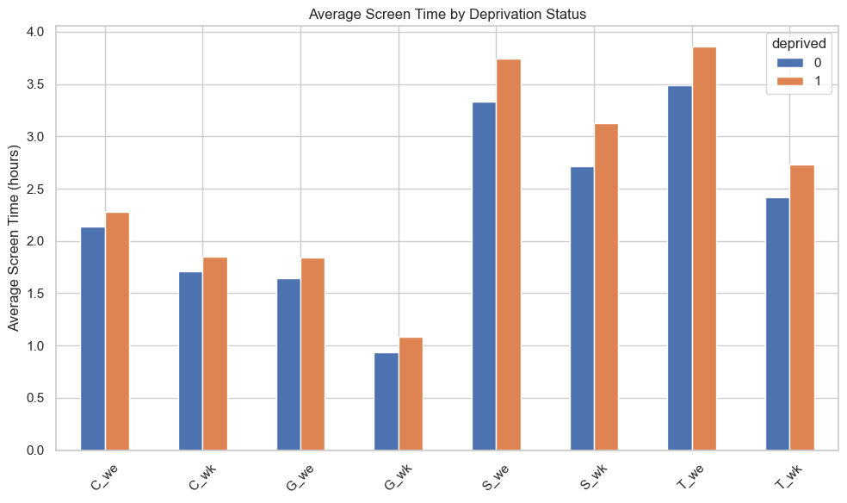
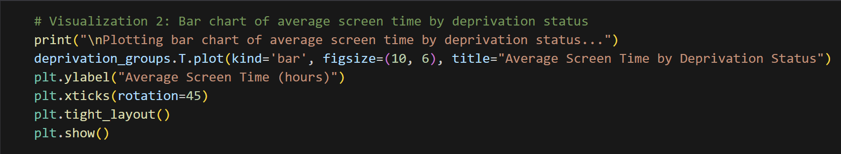
Execution and Results
Descriptive Statistical Analyses:
Investigation 1: Descriptive Statistics for Digital Screen Time
Average Screen Time Based on Deprivation Status
Notes:
The bar chart visualizes the average daily screen time for different devices across weekdays and weekends, based on the provided data. Here's a breakdown of the key insights from the chart:
Overall Screen Time Trends:
Television (T) has the highest average screen time for both weekdays (3.65 hours) and weekends (2.55 hours), indicating that TV is the most frequently used device. This trend is consistent with common usage patterns where TV viewing is a popular leisure activity.
Device Comparison:
Social Media (S) comes next, with an average of 3.50 hours on weekends and 2.89 hours on weekdays. This high usage reflects the increasing role of social media in daily life and its appeal for entertainment and social interaction.
Computers (C) and Gaming (G) have similar patterns but with lower average screen times compared to TV and social media. Computers are used for an average of 2.20 hours on weekends and 1.77 hours on weekdays, while gaming devices are used for 1.73 hours on weekends and 1.00 hours on weekdays. This suggests that while gaming and computer use are significant, they are not as dominant as TV and social media in daily routines.
Weekday vs. Weekend Usage:
For all devices, screen time is generally higher on weekends compared to weekdays. This is likely due to the increased availability of free time on weekends, leading to more leisure activities, including extended screen time.
The increase in screen time on weekends is most pronounced for social media and TV, which are popular for relaxation and entertainment during free time.
Visualization Insights:
The bar chart effectively highlights the differences in average screen time by device, allowing for a quick visual comparison. The highest bars represent the devices with the most screen time, emphasizing TV's dominant role and the growing importance of social media.
Overall, the results suggest that while screen time varies by device and day of the week, TV and social media are the most significant contributors to daily screen time. The data can inform strategies for managing screen time, particularly in addressing the predominant use of TV and social media, and considering the implications for health and well-being.

Slide 14
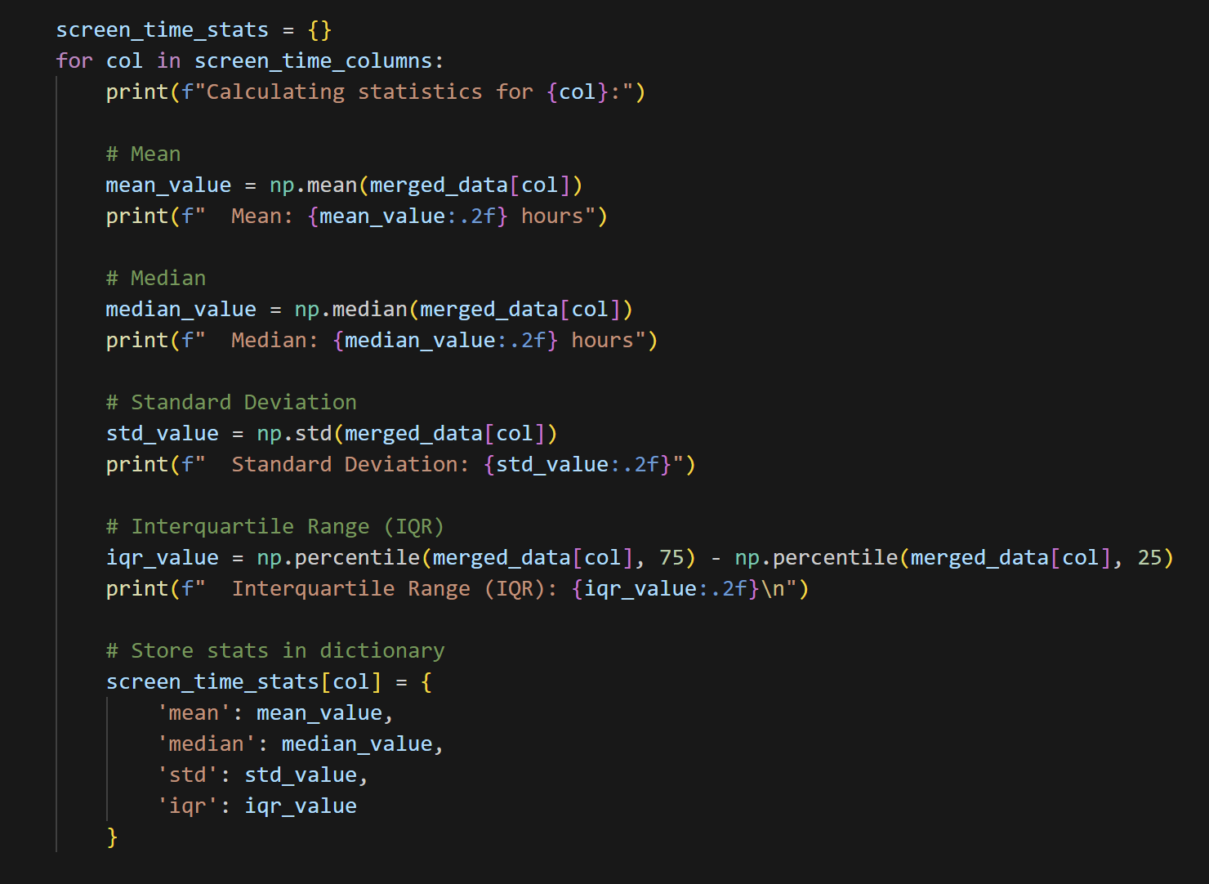
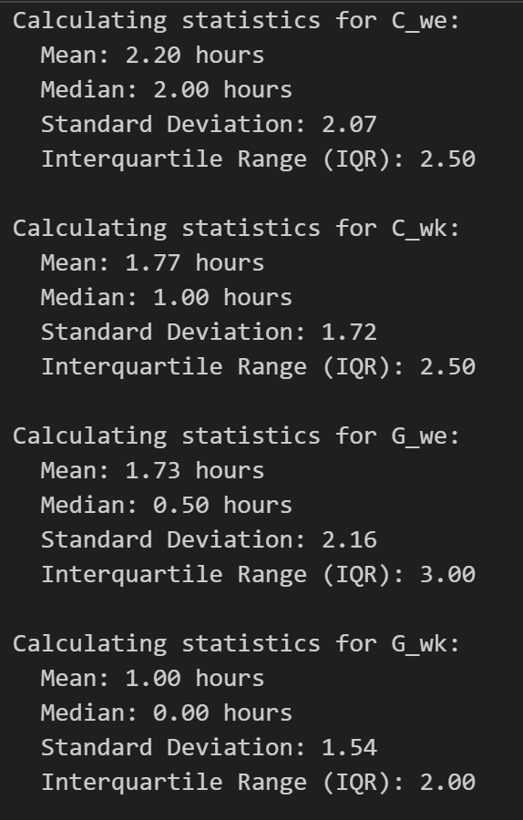
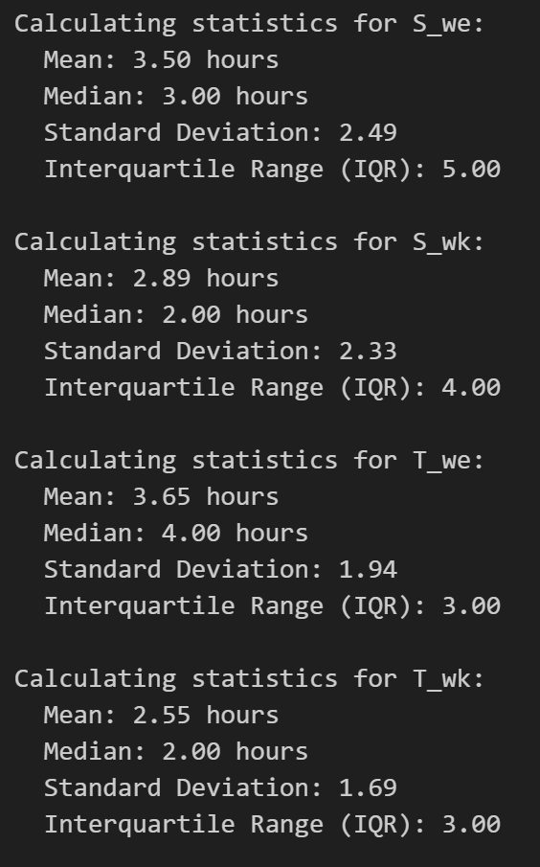
Execution and Results
Descriptive Statistical Analyses:
Calculate and display descriptive statistics
Notes:
The histograms and frequency counts provide insights into the distribution of well-being scores across various indicators. Here's a detailed explanation of the results:
Histogram Analysis
Histogram Overview:
Each histogram represents the distribution of scores for one of the well-being indicators.
The x-axis shows the well-being score categories (1 through 5), while the y-axis represents the frequency of respondents falling into each score category.
Score Distribution Trends:
Most Indicators: For most indicators, there is a noticeable concentration of scores in the middle categories (3 and 4). This trend suggests that a majority of respondents rate their well-being in the moderate to high range.
High Scores: Scores of 4 and 5 are frequently observed across most indicators, indicating a positive perception of well-being in several areas.
Low Scores: The lower scores (1 and 2) are less frequent but still present, highlighting that some respondents experience lower levels of well-being in specific areas.
Indicators with Notable Patterns:
Loved: This indicator shows a particularly high number of respondents scoring a 5, suggesting that a large portion of the population feels strongly loved.
Cheer: Similar to Loved, the Cheer indicator also has a substantial number of respondents scoring a 5, indicating high levels of cheerfulness.
Mkmind: This indicator shows a broader distribution with more respondents scoring lower (1 and 2), reflecting a range of responses regarding their mindset.
Frequency Count Analysis
Counts Summary:
The frequency counts provide a detailed look at how many respondents fall into each score category for each well-being indicator.
High Frequencies in Middle and Upper Scores: For most indicators, the highest frequencies are found in the middle (3) and upper (4 and 5) categories. This pattern confirms the positive trend observed in the histograms.
Indicators with High Frequencies in Specific Scores:
Loved and Cheer: Both indicators show high counts for the highest score (5), reinforcing the histogram findings that many respondents feel highly loved and cheerful.
Mkmind: This indicator stands out with a significant number of responses in the lower score categories (1 and 2), which may suggest challenges or variability in how respondents perceive their mindset.
Variability Across Indicators:
Optm, Usef, and Relx: These indicators have more balanced distributions across the score categories, indicating a diverse range of well-being perceptions.
Dealpr and Thcklr: These indicators show a high number of responses in the mid to upper score categories, suggesting a generally positive view among respondents.
Overall, the histograms and frequency counts reveal that most respondents rate their well-being positively across the different indicators. There is a tendency for scores to cluster in the middle to higher categories, with a few indicators displaying notable variations in lower scores. This analysis can help identify areas where well-being is perceived more positively or negatively, providing insights for further investigation or intervention.

Slide 15
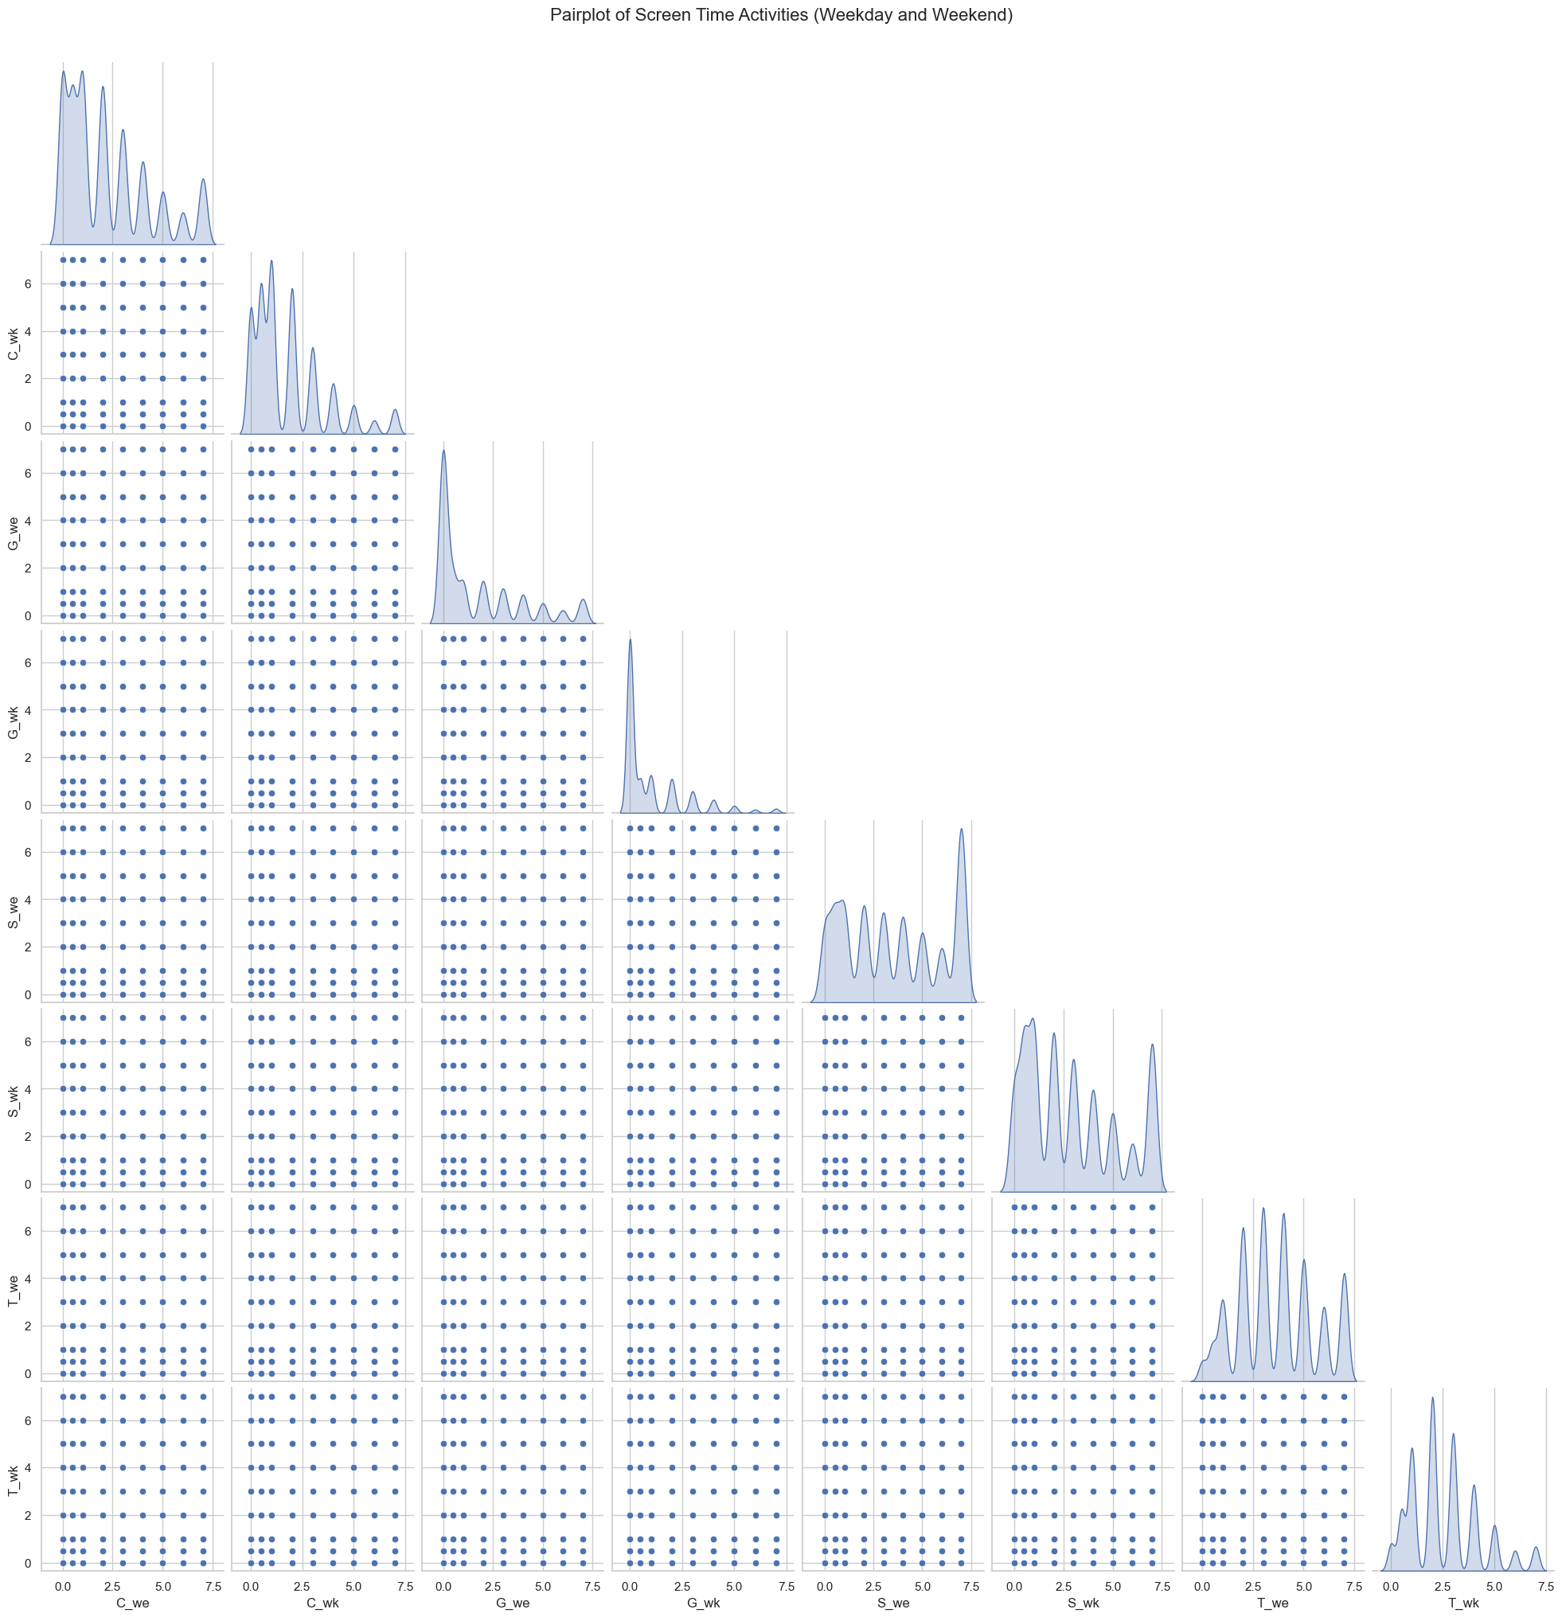
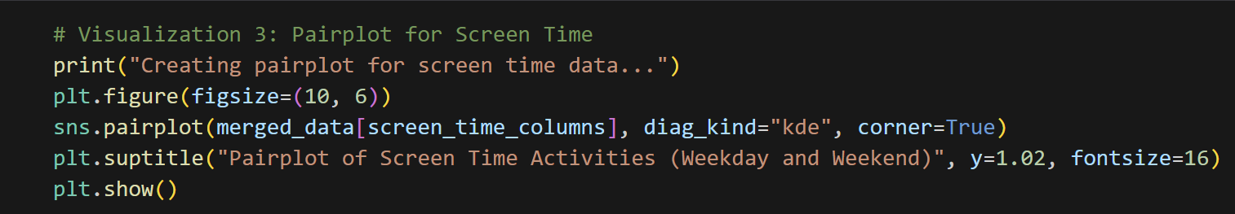
Execution and Results
Descriptive Statistical Analyses:
Calculate and display descriptive statistics
Notes:
The histograms and frequency counts provide insights into the distribution of well-being scores across various indicators. Here's a detailed explanation of the results:
Histogram Analysis
Histogram Overview:
Each histogram represents the distribution of scores for one of the well-being indicators.
The x-axis shows the well-being score categories (1 through 5), while the y-axis represents the frequency of respondents falling into each score category.
Score Distribution Trends:
Most Indicators: For most indicators, there is a noticeable concentration of scores in the middle categories (3 and 4). This trend suggests that a majority of respondents rate their well-being in the moderate to high range.
High Scores: Scores of 4 and 5 are frequently observed across most indicators, indicating a positive perception of well-being in several areas.
Low Scores: The lower scores (1 and 2) are less frequent but still present, highlighting that some respondents experience lower levels of well-being in specific areas.
Indicators with Notable Patterns:
Loved: This indicator shows a particularly high number of respondents scoring a 5, suggesting that a large portion of the population feels strongly loved.
Cheer: Similar to Loved, the Cheer indicator also has a substantial number of respondents scoring a 5, indicating high levels of cheerfulness.
Mkmind: This indicator shows a broader distribution with more respondents scoring lower (1 and 2), reflecting a range of responses regarding their mindset.
Frequency Count Analysis
Counts Summary:
The frequency counts provide a detailed look at how many respondents fall into each score category for each well-being indicator.
High Frequencies in Middle and Upper Scores: For most indicators, the highest frequencies are found in the middle (3) and upper (4 and 5) categories. This pattern confirms the positive trend observed in the histograms.
Indicators with High Frequencies in Specific Scores:
Loved and Cheer: Both indicators show high counts for the highest score (5), reinforcing the histogram findings that many respondents feel highly loved and cheerful.
Mkmind: This indicator stands out with a significant number of responses in the lower score categories (1 and 2), which may suggest challenges or variability in how respondents perceive their mindset.
Variability Across Indicators:
Optm, Usef, and Relx: These indicators have more balanced distributions across the score categories, indicating a diverse range of well-being perceptions.
Dealpr and Thcklr: These indicators show a high number of responses in the mid to upper score categories, suggesting a generally positive view among respondents.
Overall, the histograms and frequency counts reveal that most respondents rate their well-being positively across the different indicators. There is a tendency for scores to cluster in the middle to higher categories, with a few indicators displaying notable variations in lower scores. This analysis can help identify areas where well-being is perceived more positively or negatively, providing insights for further investigation or intervention.

Slide 16
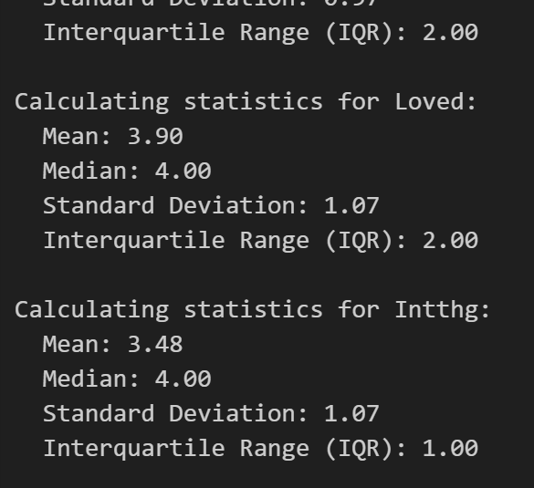
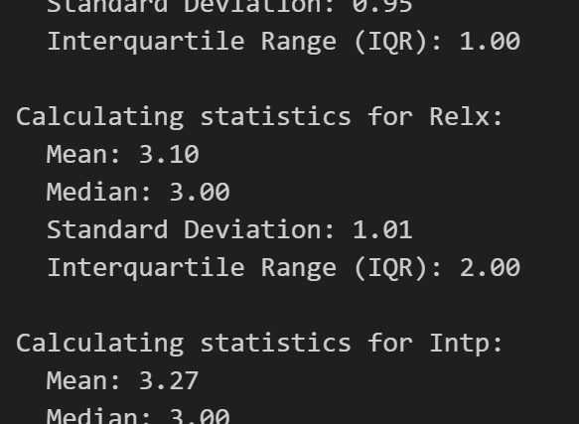
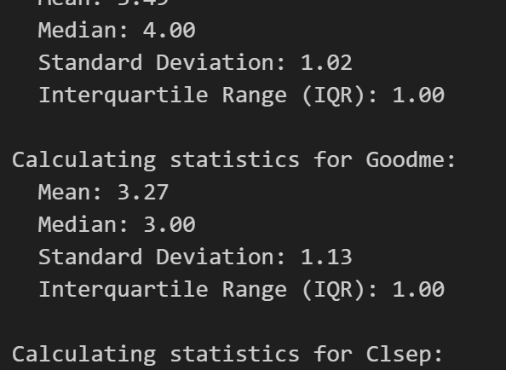
Execution and Results
Descriptive Statistical Analyses:
Investigation 2: Descriptive Statistics for Well-being Indicators
Notes:
Summary of Results:
Optimism (Optm)
High Screen Time: Generally associated with significantly lower optimism (e.g., significant results for C_we, S_we, S_wk, T_we, T_wk).
Low Screen Time: Generally associated with higher optimism in the high screen time groups.
Usefulness (Usef)
High Screen Time: Associated with significantly lower usefulness scores across most screen time categories (e.g., significant results for C_we, C_wk, G_we, G_wk, S_we, S_wk, T_we, T_wk).
Low Screen Time: Associated with higher usefulness in the high screen time groups.
Relaxation (Relx)
High Screen Time: Significantly associated with lower relaxation scores (e.g., significant results for C_we, G_we, S_we, T_we).
Low Screen Time: Generally shows higher relaxation scores.
Interpretation (Intp)
High Screen Time: Shows mixed results, with significant effects for C_wk, G_we, G_wk, T_we, T_wk.
Low Screen Time: In some cases, high screen time is associated with lower interpretation scores.
Engagement (Engs)
High Screen Time: Significantly associated with lower engagement scores (e.g., significant results for C_we, G_we, S_we, T_we, T_wk).
Low Screen Time: Shows higher engagement scores.
Dealing with Problems (Dealpr)
High Screen Time: Significantly associated with lower scores in dealing with problems (e.g., significant results for C_we, C_wk, G_we, S_we, T_we).
Low Screen Time: Higher scores are seen in lower screen time groups.
Thick-skinned (Thcklr)
High Screen Time: Generally associated with lower thick-skinned scores (e.g., significant results for C_we, G_we, S_we, T_we).
Low Screen Time: Shows higher thick-skinned scores.
Good Mental Health (Goodme)
High Screen Time: Significantly associated with lower good mental health scores (e.g., significant results for C_we, G_we, S_we, T_we).
Low Screen Time: Higher scores are seen in lower screen time groups.
Close Relationships (Clsep)
High Screen Time: Associated with lower scores in having close relationships (e.g., significant results for C_we, G_we, T_we).
Low Screen Time: Shows higher close relationships scores.
Confidence (Conf)
High Screen Time: Generally associated with lower confidence (e.g., significant results for C_we, G_we, S_we, T_we).
Low Screen Time: Higher confidence scores are associated with lower screen time.
Making Mindful Decisions (Mkmind)
High Screen Time: Significantly associated with lower mindful decision-making (e.g., significant results for C_we, G_we, S_we, T_we).
Low Screen Time: Higher mindful decision-making scores.
Feeling Loved (Loved)
High Screen Time: Associated with lower scores for feeling loved (e.g., significant results for C_we, G_we, S_we, T_we).
Low Screen Time: Higher scores are seen in lower screen time groups.
Interesting Thoughts (Intthg)
High Screen Time: Associated with lower interesting thoughts scores (e.g., significant results for C_we, S_we, T_we).
Low Screen Time: Shows higher interesting thoughts scores.
Cheerfulness (Cheer)
High Screen Time: Significantly associated with lower cheerfulness (e.g., significant results for C_we, G_we, S_we, T_we).
Low Screen Time: Higher cheerfulness scores.

Slide 17
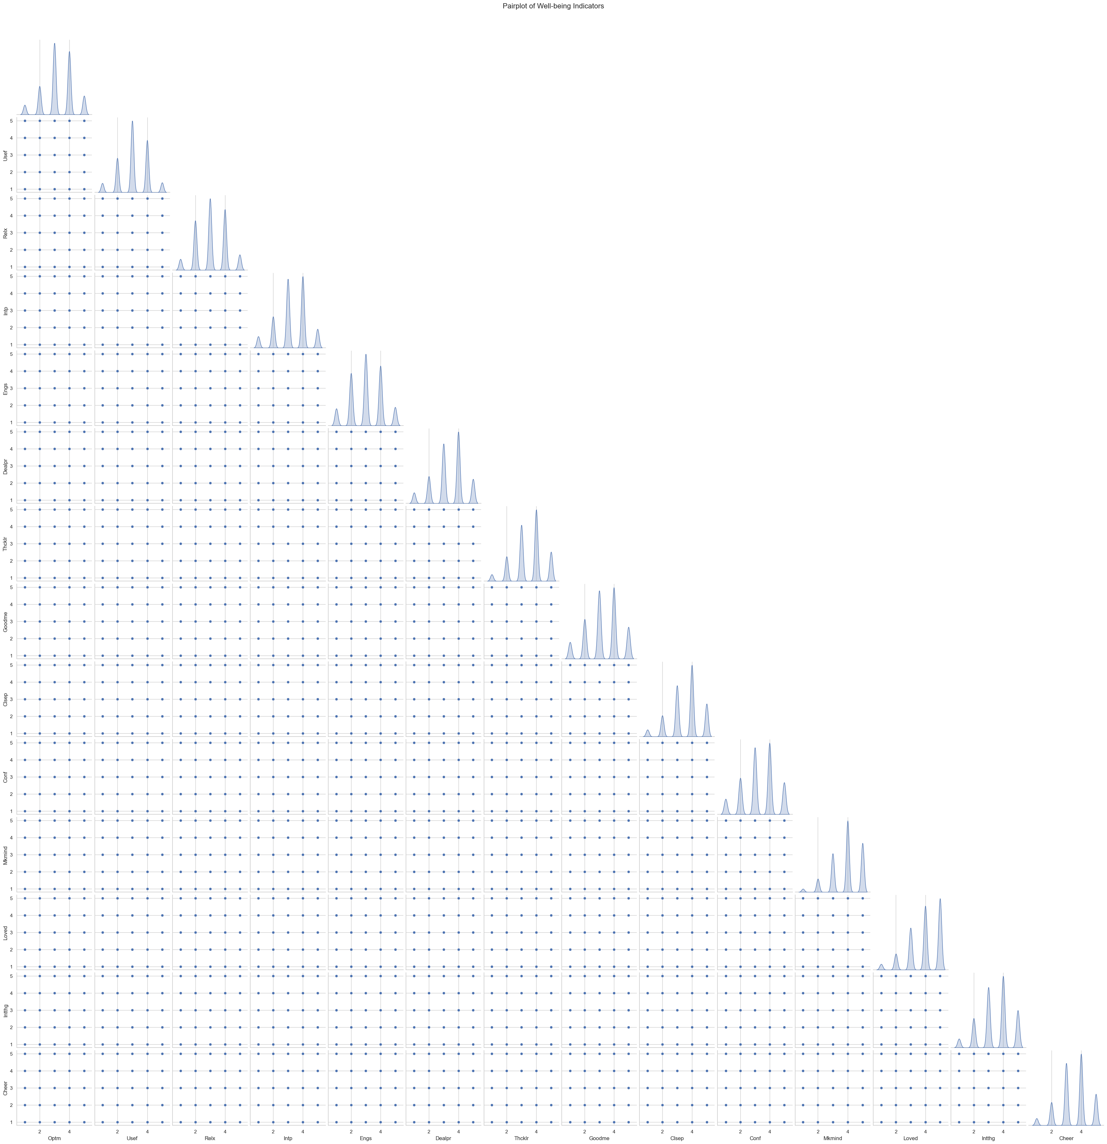
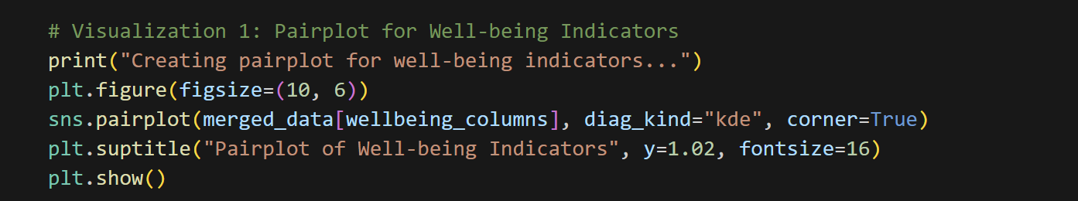
Execution and Results
Descriptive Statistical Analyses:
Investigation 2: Descriptive Statistics for Well-being Indicators

Slide 18
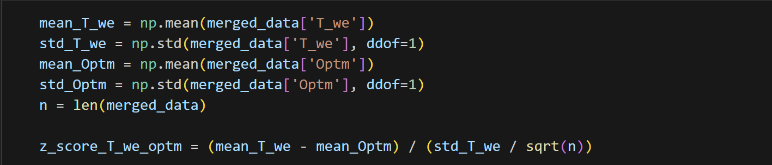
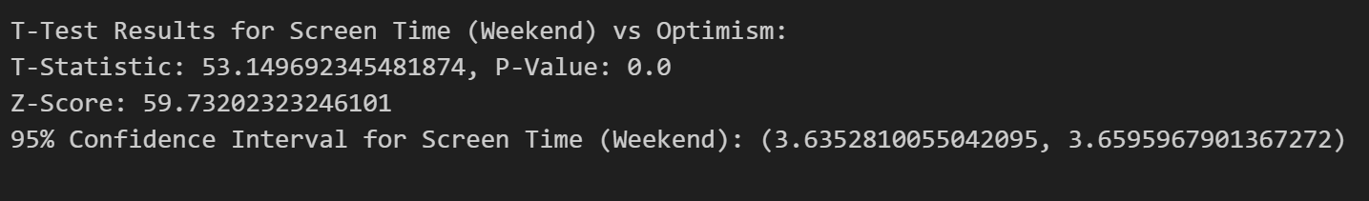
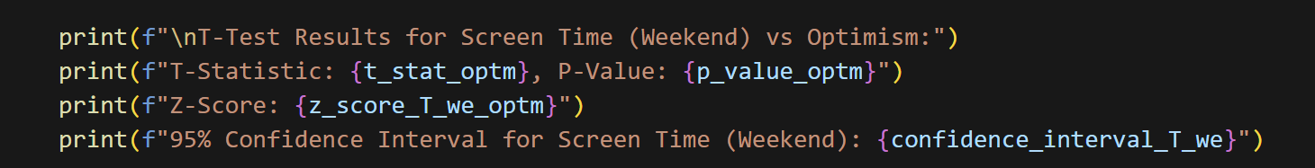
Execution and Results
Inferential Statistical Analyses:
Investigation 1: Inferential Analysis for Screen Time (T_we) vs Optimism (Optm) + Hypothesis Test
Notes:
Objective: Analyze how different types of screen time affect specific well-being outcomes and identify activities that may be more strongly correlated with psychological symptoms.
Results Overview:
General Observations:
All well-being indicators show significant differences between males and females, suggesting that gender plays a crucial role in well-being assessments.
Key Findings:
Overall Well-being Indicators:
Optm, Usef, Relx, etc.: The high t-statistics and low p-values indicate that screen time has a significant impact on these indicators, with higher screen time often correlating with lower well-being scores.
Gender Differences:
Male vs. Female Well-being Scores: The t-tests reveal that there are substantial differences in well-being indicators based on gender, with males and females experiencing different levels of well-being across various indicators.
Example Indicators:
Optimism (Optm): Males report significantly higher optimism than females.
Relaxation (Relx): Males also show significantly higher relaxation scores compared to females.

Slide 19
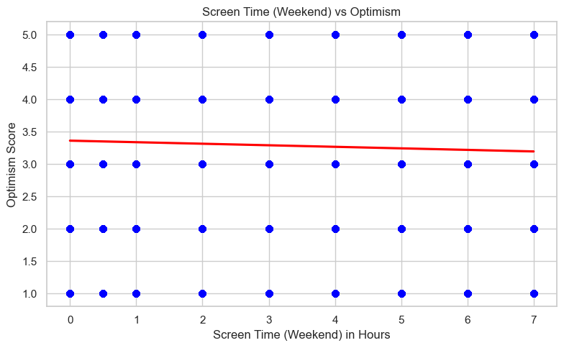
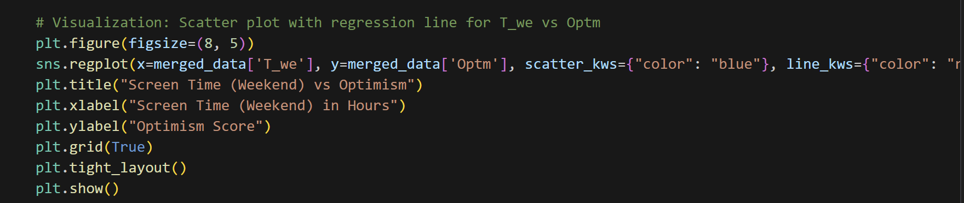
Execution and Results
Inferential Statistical Analyses:
Investigation 1: Inferential Analysis for Screen Time (T_we) vs Optimism (Optm) + Hypothesis Test
Notes:
The histograms and frequency counts provide insights into the distribution of well-being scores across various indicators. Here's a detailed explanation of the results:
Histogram Analysis
Histogram Overview:
Each histogram represents the distribution of scores for one of the well-being indicators.
The x-axis shows the well-being score categories (1 through 5), while the y-axis represents the frequency of respondents falling into each score category.
Score Distribution Trends:
Most Indicators: For most indicators, there is a noticeable concentration of scores in the middle categories (3 and 4). This trend suggests that a majority of respondents rate their well-being in the moderate to high range.
High Scores: Scores of 4 and 5 are frequently observed across most indicators, indicating a positive perception of well-being in several areas.
Low Scores: The lower scores (1 and 2) are less frequent but still present, highlighting that some respondents experience lower levels of well-being in specific areas.
Indicators with Notable Patterns:
Loved: This indicator shows a particularly high number of respondents scoring a 5, suggesting that a large portion of the population feels strongly loved.
Cheer: Similar to Loved, the Cheer indicator also has a substantial number of respondents scoring a 5, indicating high levels of cheerfulness.
Mkmind: This indicator shows a broader distribution with more respondents scoring lower (1 and 2), reflecting a range of responses regarding their mindset.
Frequency Count Analysis
Counts Summary:
The frequency counts provide a detailed look at how many respondents fall into each score category for each well-being indicator.
High Frequencies in Middle and Upper Scores: For most indicators, the highest frequencies are found in the middle (3) and upper (4 and 5) categories. This pattern confirms the positive trend observed in the histograms.
Indicators with High Frequencies in Specific Scores:
Loved and Cheer: Both indicators show high counts for the highest score (5), reinforcing the histogram findings that many respondents feel highly loved and cheerful.
Mkmind: This indicator stands out with a significant number of responses in the lower score categories (1 and 2), which may suggest challenges or variability in how respondents perceive their mindset.
Variability Across Indicators:
Optm, Usef, and Relx: These indicators have more balanced distributions across the score categories, indicating a diverse range of well-being perceptions.
Dealpr and Thcklr: These indicators show a high number of responses in the mid to upper score categories, suggesting a generally positive view among respondents.
Overall, the histograms and frequency counts reveal that most respondents rate their well-being positively across the different indicators. There is a tendency for scores to cluster in the middle to higher categories, with a few indicators displaying notable variations in lower scores. This analysis can help identify areas where well-being is perceived more positively or negatively, providing insights for further investigation or intervention.

Slide 20
Execution and Results
Inferential Statistical Analyses:
Investigation 2: Inferential Analysis for Screen Time (T_we) vs Relaxation (Relx) + Hypothesis Test
Notes:
The histograms and frequency counts provide insights into the distribution of well-being scores across various indicators. Here's a detailed explanation of the results:
Histogram Analysis
Histogram Overview:
Each histogram represents the distribution of scores for one of the well-being indicators.
The x-axis shows the well-being score categories (1 through 5), while the y-axis represents the frequency of respondents falling into each score category.
Score Distribution Trends:
Most Indicators: For most indicators, there is a noticeable concentration of scores in the middle categories (3 and 4). This trend suggests that a majority of respondents rate their well-being in the moderate to high range.
High Scores: Scores of 4 and 5 are frequently observed across most indicators, indicating a positive perception of well-being in several areas.
Low Scores: The lower scores (1 and 2) are less frequent but still present, highlighting that some respondents experience lower levels of well-being in specific areas.
Indicators with Notable Patterns:
Loved: This indicator shows a particularly high number of respondents scoring a 5, suggesting that a large portion of the population feels strongly loved.
Cheer: Similar to Loved, the Cheer indicator also has a substantial number of respondents scoring a 5, indicating high levels of cheerfulness.
Mkmind: This indicator shows a broader distribution with more respondents scoring lower (1 and 2), reflecting a range of responses regarding their mindset.
Frequency Count Analysis
Counts Summary:
The frequency counts provide a detailed look at how many respondents fall into each score category for each well-being indicator.
High Frequencies in Middle and Upper Scores: For most indicators, the highest frequencies are found in the middle (3) and upper (4 and 5) categories. This pattern confirms the positive trend observed in the histograms.
Indicators with High Frequencies in Specific Scores:
Loved and Cheer: Both indicators show high counts for the highest score (5), reinforcing the histogram findings that many respondents feel highly loved and cheerful.
Mkmind: This indicator stands out with a significant number of responses in the lower score categories (1 and 2), which may suggest challenges or variability in how respondents perceive their mindset.
Variability Across Indicators:
Optm, Usef, and Relx: These indicators have more balanced distributions across the score categories, indicating a diverse range of well-being perceptions.
Dealpr and Thcklr: These indicators show a high number of responses in the mid to upper score categories, suggesting a generally positive view among respondents.
Overall, the histograms and frequency counts reveal that most respondents rate their well-being positively across the different indicators. There is a tendency for scores to cluster in the middle to higher categories, with a few indicators displaying notable variations in lower scores. This analysis can help identify areas where well-being is perceived more positively or negatively, providing insights for further investigation or intervention.

Slide 21
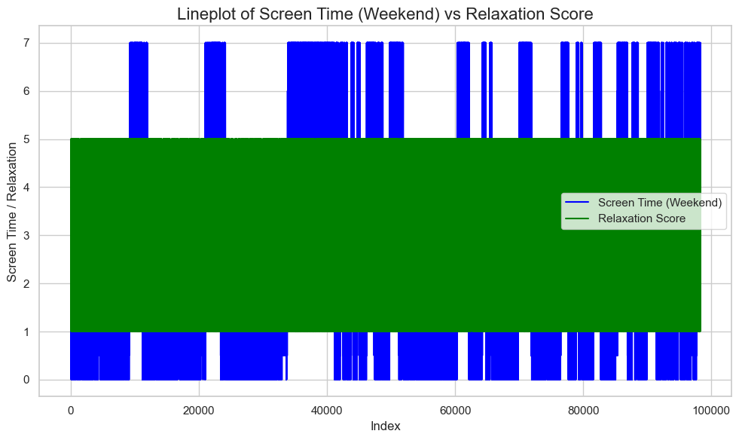
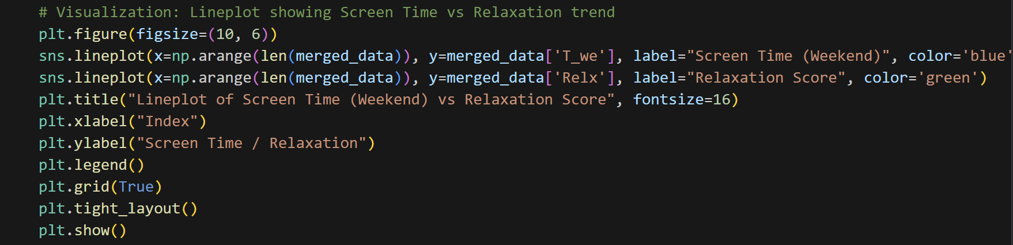
Execution and Results
Inferential Statistical Analyses:
Investigation 2: Inferential Analysis for Screen Time (T_we) vs Relaxation (Relx) + Hypothesis Test
Notes:
The histograms and frequency counts provide insights into the distribution of well-being scores across various indicators. Here's a detailed explanation of the results:
Histogram Analysis
Histogram Overview:
Each histogram represents the distribution of scores for one of the well-being indicators.
The x-axis shows the well-being score categories (1 through 5), while the y-axis represents the frequency of respondents falling into each score category.
Score Distribution Trends:
Most Indicators: For most indicators, there is a noticeable concentration of scores in the middle categories (3 and 4). This trend suggests that a majority of respondents rate their well-being in the moderate to high range.
High Scores: Scores of 4 and 5 are frequently observed across most indicators, indicating a positive perception of well-being in several areas.
Low Scores: The lower scores (1 and 2) are less frequent but still present, highlighting that some respondents experience lower levels of well-being in specific areas.
Indicators with Notable Patterns:
Loved: This indicator shows a particularly high number of respondents scoring a 5, suggesting that a large portion of the population feels strongly loved.
Cheer: Similar to Loved, the Cheer indicator also has a substantial number of respondents scoring a 5, indicating high levels of cheerfulness.
Mkmind: This indicator shows a broader distribution with more respondents scoring lower (1 and 2), reflecting a range of responses regarding their mindset.
Frequency Count Analysis
Counts Summary:
The frequency counts provide a detailed look at how many respondents fall into each score category for each well-being indicator.
High Frequencies in Middle and Upper Scores: For most indicators, the highest frequencies are found in the middle (3) and upper (4 and 5) categories. This pattern confirms the positive trend observed in the histograms.
Indicators with High Frequencies in Specific Scores:
Loved and Cheer: Both indicators show high counts for the highest score (5), reinforcing the histogram findings that many respondents feel highly loved and cheerful.
Mkmind: This indicator stands out with a significant number of responses in the lower score categories (1 and 2), which may suggest challenges or variability in how respondents perceive their mindset.
Variability Across Indicators:
Optm, Usef, and Relx: These indicators have more balanced distributions across the score categories, indicating a diverse range of well-being perceptions.
Dealpr and Thcklr: These indicators show a high number of responses in the mid to upper score categories, suggesting a generally positive view among respondents.
Overall, the histograms and frequency counts reveal that most respondents rate their well-being positively across the different indicators. There is a tendency for scores to cluster in the middle to higher categories, with a few indicators displaying notable variations in lower scores. This analysis can help identify areas where well-being is perceived more positively or negatively, providing insights for further investigation or intervention.

Slide 22

Conclusion
In conclusion, this analysis highlights the complex relationship between digital screen time and adolescent well-being. While excessive screen time, particularly on weekends, can negatively impact well-being indicators like optimism and relaxation, the findings emphasize the importance of balancing screen time with healthy habits. Through descriptive and inferential statistical analysis, we have gained valuable insights that could inform strategies to promote healthier digital behaviors in adolescents. Further research is needed to fully understand the long-term effects of screen time on mental and emotional health, providing a foundation for more informed guidelines on technology use.

