Slide 1
Employee Data Analysis using Excel
STUDENT NAME: K. Sai Mahati
REGISTER NO: 312209459
DEPARTMENT: B. Com Accounting & Finance
COLLEGE : Anna Adarsh College for Women
NM Id: BC1E4467B67FC47A9084990BBE03CADF

Slide 2
PROJECT TITLE
Employee Performance Analysis using Excel

Slide 3


AGENDA
Problem Statement
Project Overview
End Users
Our Solution and Proposition
Dataset Description
Modelling Approach
Results and Discussion
Conclusion
3/21/2024 Annual Review

Slide 4

PROBLEM STATEMENT
The objective is to create a pivot table that categorizes employees by gender and evaluates their current performance ratings. This analysis will allow the organization to visualize the distribution of performance ratings across different genders, providing insights into potential disparities or trends in employee performance. The findings will inform strategic decisions in human resource management and contribute to efforts towards ensuring equity and fairness in performance evaluations across the organization.

Slide 5

PROJECT OVERVIEW
Data analytics refers to the process of examining, cleaning, transforming, and modeling data with the goal of discovering useful information, drawing conclusions, and supporting decision-making.
It involves the use of various techniques, tools, and algorithms to analyze raw data and extract patterns, trends, correlations, and other insights that can inform business strategies, improve operational efficiency, and drive innovation.
In essence, data analytics turns raw data into actionable insights, empowering organizations to make smarter, faster, and more strategic decisions.
.

Slide 6

WHO ARE THE END USERS?
1.Managers and Team Leaders
2.Human Resources (HR) Department
3.Executive Leadership
4.Finance Department
5.IT and Data Analytics Teams
6.Compliance and legal team

Slide 7

OUR SOLUTION AND ITS VALUE PROPOSITION
CONDITIONAL FORMATING: MISSING VALUES
FILTERING: REMOVE BLANK CELLS
PIVOT TABLE: SUMMY OF EMPLOYEE DATA ANALYSIS
GRAPH: VISUALIZATION OF EMPLOYEE DATA ANALYSIS

Slide 8
Dataset Description
Descriptions for each of the columns in the dataset:
Employee ID: Unique identifier for each employee in the organization.
First Name: The first name of the employee.
Last Name: The last name of the employee.
Start Date: The date when the employee started working for the organization.
Exit Date: The date when the employee left or exited the organization (if applicable).
Title: The job title or position of the employee within the organization.
Supervisor: The name of the employee's immediate supervisor or manager.
Email: The email address associated with the employee's communication within the organization.
Business Unit: The specific business unit or department to which the employee belongs.
Employee Status: The current employment status of the employee (e.g., Active, On Leave, Terminated).
Employee Type: The type of employment the employee has (e.g., Full-time, Part-time, Contract).
Pay Zone: The pay zone or salary band to which the employee's compensation falls. associated with.

Slide 9
13.Employee Classification Type: The classification type of the employee (e.g., Exempt, Non-exempt).4
14.Termination Type: The type of termination if the employee has left the organization (e.g., Resignation, Layoff, Retirement).
15.Termination Description: Additional details or reasons for the employee's termination (if applicable).
16.Department Type: The broader category or type of department the employee's work is associated with.
17.Division Description: The division or branch of the organization where the employee works.
18.DOB (Date of Birth): The date of birth of the employee.
19.State: The state or region where the employee is located.
20.Job Function: A brief description of the employee's primary job function or role.
21.Gender: A code representing the gender of the employee (e.g., M for Male, F for Female, N for Non-binary).
22.Location: A code representing the physical location or office where the employee is based.
23.Race (or) Ethnicity: A description of the employee's racial or ethnic background (if provided).
24.Marital Status: The marital status of the employee (e.g., Single, Married, Divorced).
25.Performance Score: A score indicating the employee's performance level (e.g., Excellent, Satisfactory, Needs Improvement).
26.Current Employee Rating: The current rating or evaluation of the employee's overall performance.

Slide 10

THE "WOW" IN OUR SOLUTION
1.Interactive Data Filtering:
Real time filtering
2. Multiple Slicers for Comparative Analysis:
Side by side comparison
3.Accessibility and Ease of Use:
User friendly reaction
3/21/2024 Annual Review
10

Slide 11
MODELLING
DATA COLLECTION:
THE DATA COLLECTION WAS DOWNLOAD IN “KAGGLE”.
FEATURE COLLECTION
IN THIS DATA BASE IT HAS 26 FEATURES I HAD USE 4 FEATURS OF MY PROJECTS.
DATA CLEANING:
IN THIS STEP I HAD IDENTIFY THE MISSING VALUE AND REMOVE THE BLANK.
SUMMARY:
FOR MY PROJECT I USED PIVOT TABLES FOR EMPLOYEE DATA ANALYSIS AND ALSO USED SCLICER TOOL FOR CLASSIFY EMPLOYEES ON BASIS OF CONTRACT, FULL TIME, PART TIME.
VISUALIZATION:
FOR MY PROJECT I HAD USE TO VISULIZED MY EMPLOYEE DATA ANALYSIS AS “PIE CHART”.
11

Slide 12
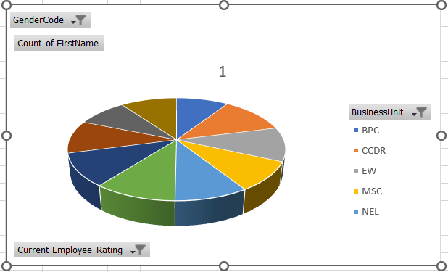
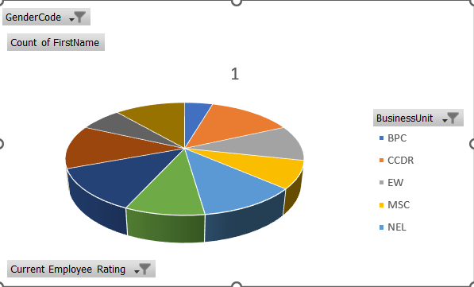
RESULTS
12

Slide 13
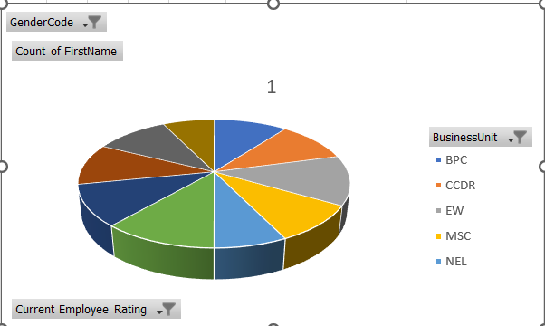
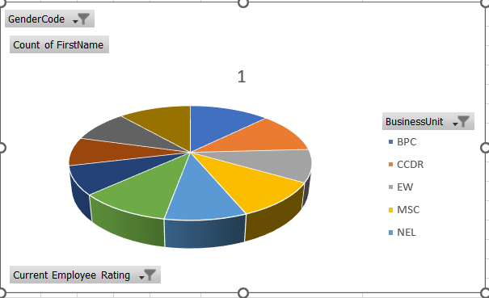

Slide 14
conclusion
This project has successfully analyzed Employee dataset.
The employee performance analysis conducted using Excel provides valuable insights into the distribution and evaluation of employee performance across various dimensions, such as gender, department, and job level.
By leveraging Excel's powerful tools, such as pivot tables, slicers, and conditional formatting, we were able to transform raw data into meaningful summaries, uncovering trends and disparities that may otherwise have gone unnoticed.

