Slide 1

JavaMentor AI
Adaptive Java Learning using Google ADK, Multi-Agent Systems & MCP

Slide 2



The Problem
The Solution

Slide 3
JavaMentor AI
• Adaptive Java learning system
• Built using Google ADK multi-agent architecture
• Specialized agents: Tutor, Quiz, Code Executor, Interview, Learning Path, News
• Grounded responses using tools + deterministic execution
• Real demo: from single chatbot → coordinated agent system
User
↓
Orchestrator
↓
Specialist Agents

Slide 4
Multi-Agent Architecture
User
│
▼
FastAPI Backend
│
▼
ADK Orchestrator (Root Agent)
│
├── Tutor Agent
├── Quiz Agent
├── Code Agent ───────► MCP Layer ─────► Piston Java Runtime
├── Interview Agent
├── Learning Path Agent
└── News Agent
│
▼
Frontend (HTML + JS + Mermaid + Highlight.js)

Slide 5
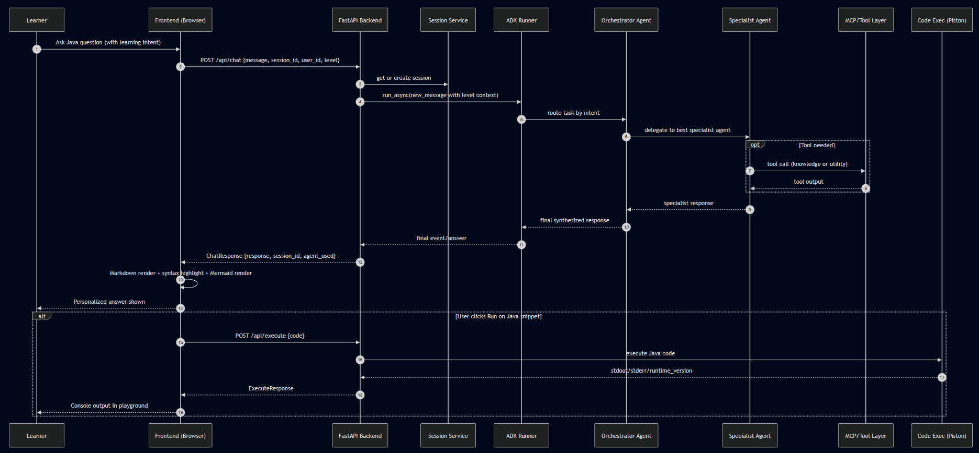
Runtime Flow
Step 1: User asks a question
Step 2: Orchestrator classifies intent
Step 3: Routes to appropriate agent
Step 4: Agent uses tools if needed (e.g., execute Java)
Step 5: Response generated with diagrams & explanations

Slide 6
Engineering Principles
• Google ADK
• MCP
• Deterministic execution
• Modularity
• Visual Learning
Core principle: System design > Prompt design

Slide 7

Model Context Protocol (MCP)
• Standardized tool interface for all agents
• Safe execution boundaries without direct model access
• Decouples reasoning (LLM) from execution (tools)
Tools exposed via MCP:
- Java code execution (Piston API)
- Java version knowledge base
- Runtime information & diagnostics
Key insight: MCP turns models into tool-using systems, not just text generators
LLM -> MCP -> Tool -> Verified Result

Slide 8
Why Agents Instead of LLMs
Traditional LLM
• Single model
• Prompt-driven only
• Unstructured outputs
• No execution guarantees
• Hallucination prone
Agentic System
• Multi-agent orchestration
• Tool + routing driven
• Role-specialized outputs
• Deterministic execution
• Grounded & verifiable

Slide 9
Key Learnings
• Structured systems are what truly unlock the power of LLMs
• Effective agents depend on orchestration, defined constraints, and tools
• Predictable, deterministic execution strengthens user confidence
• Dividing responsibilities across roles elevates the quality of reasoning
“ Context Engineering > Prompt Engineering “
“ The model is not the product—the system around it is."

Slide 10
Roadmap
• Persistent memory across sessions
• Agent Skills: modular capabilities framework
• Trajectory evaluation: measure learning outcomes
• RAG-based Java documentation grounding
• Voice-based learning assistant
Vision: From assistant → Adaptive learning system

