Slide 1

SchemeSathi
Agentic AI for Business Automation (AABA) · PGDM-BDA, Term 04, 2026-27
Report on
32
central schemes checked
against official rules
A single AI agent that finds the government schemes a citizen is entitled to, with the official source for every line
Submitted to Faculty Name: Prof. Shiva Botchu
Submitted by Mahaveer Soni · Roll No. 065089
Submitted in partial fulfilment of the requirements for the Post Graduate Diploma in Management (PGDM)
github.com/Mahaveersonii/schemesathi
Notes:
SchemeSathi means scheme companion. One agent, five tools, and a guardrail in code, so it can't guess or invent sources.

Slide 2



Benefits exist, but people cannot reach them
Each scheme has its own age bands, land, income, caste and exclusion rules, its own document list and its own route to apply. The people who need them most are the least able to read 30 sets of guidelines.
It guesses
It invents
It shows no source
An LLM alone offered the old-age pension to a 34-year-old and PM-KISAN to a tenant farmer with no land in his name.
During development it wrote government websites that do not exist and a cash total more than 8× the real one.
A family, a CSC operator or an NGO worker needs the official line to show at the bank or block office.
A wrong “yes” wastes a day and bus fare. A wrong “no” quietly costs money a family is owed.
Notes:
The design goal is an agent whose every claim can be checked, not a better chatbot.

Slide 3
An LLM alone gets eligibility wrong one time in three
27
schemes wrongly offered
22
schemes people qualify for, missed
66%
F1 for the LLM alone (rules: 100%)
Notes:
Same model the agent uses, given the profile and the list of 32 schemes, no tools. It missed MGNREGA for most rural people.

Slide 4




Rules decide, the agent explains, code verifies
01
02
03
04
Rules decide
Retrieval informs
One agent explains
Code verifies
95 checks for 32 schemes, each with its official quote. Eligible, likely or not eligible, with the reason.
522 official passages from myScheme, searched by meaning and keywords. Every fact carries a citation tag.
A single CrewAI agent picks from five tools, then answers in plain English or Hindi.
A guardrail rejects invented sources, schemes or websites, overruled verdicts and wrong totals.
Why one agent? One user, one conversation, one decision: which tools to call. Extra agents add hand-offs, tokens and blame-shifting.
Notes:
The LLM does what it is good at: planning, reading and explaining. Deterministic code does what it is bad at: rules, arithmetic and checking.

Slide 5
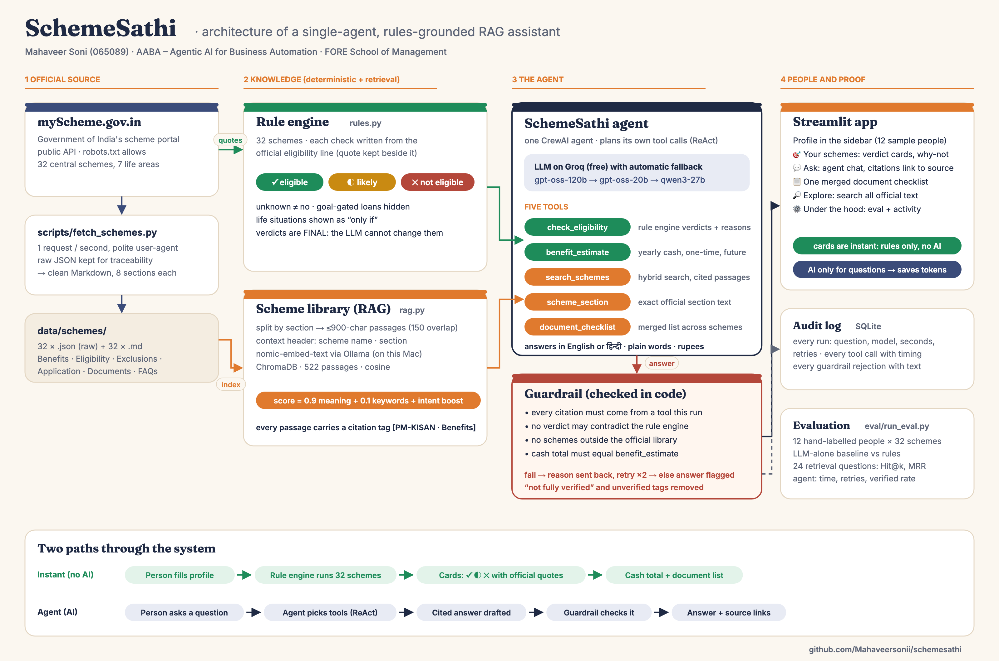
Architecture
Notes:
Two paths: the instant path uses no AI at all; the agent path runs only for questions. That saves the free token budget.

Slide 6

One agent, five tools, a model chain that never stalls
check_eligibility
Verdicts and reasons from the rule engine, with citation tags
benefit_estimate
Yearly cash total plus one-time and future benefits
LLM on Groq (free)
gpt-oss-120b → gpt-oss-20b → Qwen3
Daily limit hit? Next model at once
Malformed tool call? One retry
Embeddings local via Ollama
Typical answer: 2–15 s
search_schemes
Top official passages: 0.9 meaning + 0.1 keywords + intent boost
scheme_section
Exact text of Benefits, Eligibility, Application or Documents
document_checklist
One merged list across schemes: gather each paper once
Instructions: check eligibility first · cite every fact · quote the computed total · never invent offices, websites or documents

Slide 7
The guardrail: six checks in code, not left to the model
✓
Every citation was returned by a tool in this run
A real catch, from the audit log
✓
No sentence contradicts a rule-engine verdict
Draft 1: “apply at www.pradhanmantrijeevanjyotibima.gov.in”
→ rejected: not in the official text
Draft 2: same invented address
→ rejected again
Draft 3: real citations, no invented links
→ accepted, 6 official sources
✓
No scheme outside the official library
✓
No web address absent from the official text
✓
Document or apply questions must use that tool
Still failing after 2 retries? Keep the draft, strip unverified tags, label it “not fully verified”.
✓
Any yearly total equals benefit_estimate

Slide 8
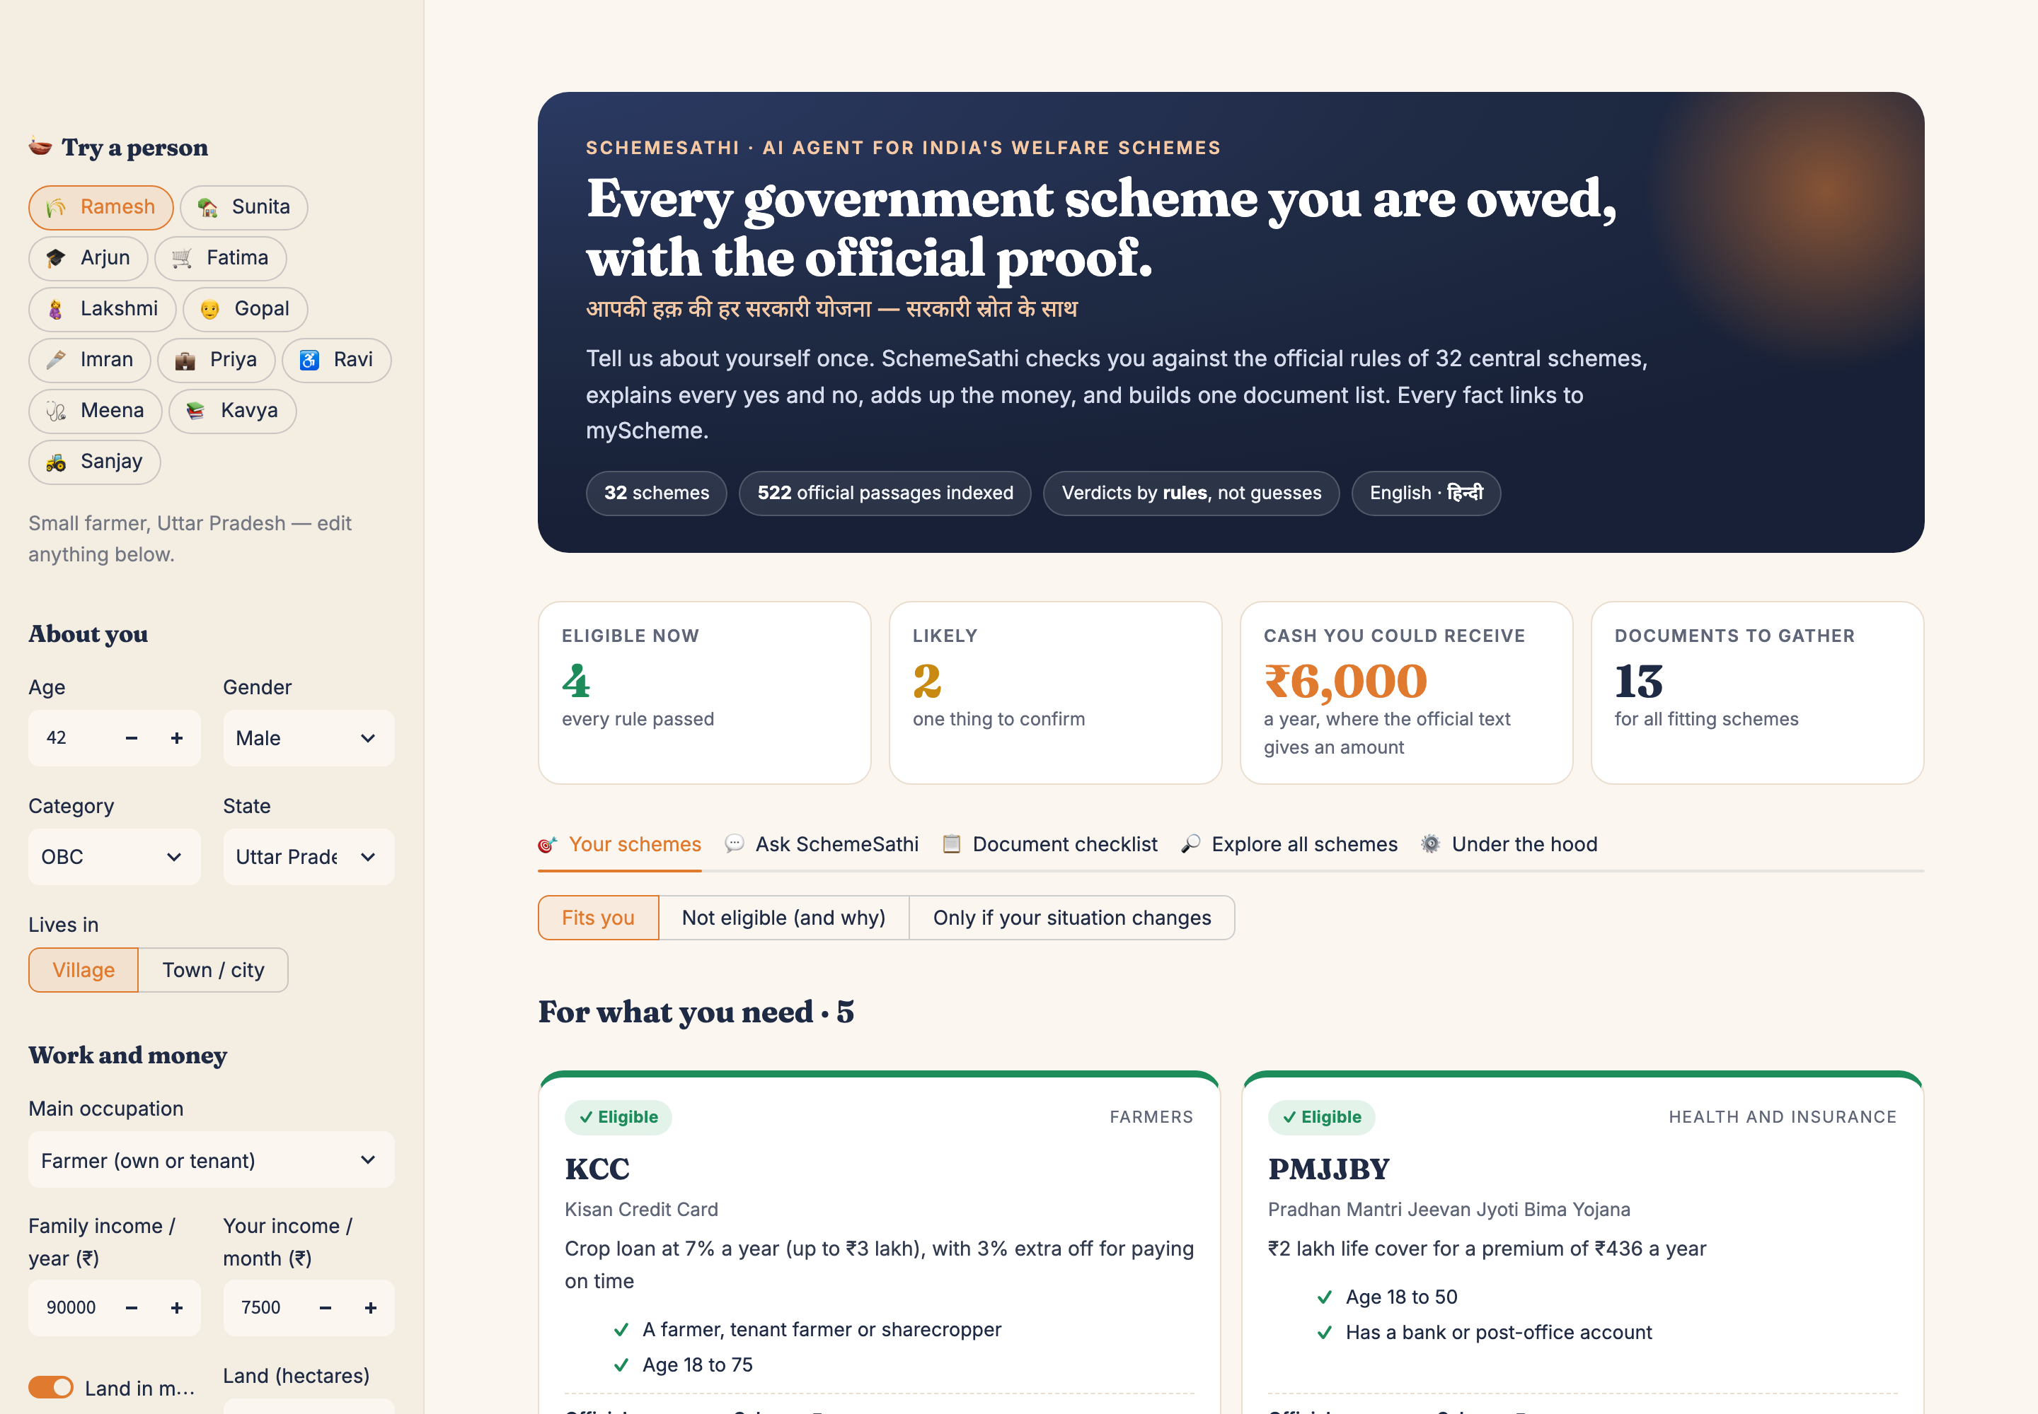
The app: a profile once, every scheme checked instantly
12 sample people, one click each
Green, amber or red cards with every reason ticked or crossed
Cash a year, only where the official text gives an amount
“Not eligible (and why)” quotes the rule that failed
“Only if” view for pregnancy, widowhood, disability and similar situations
No AI on this path: instant and free

Slide 9
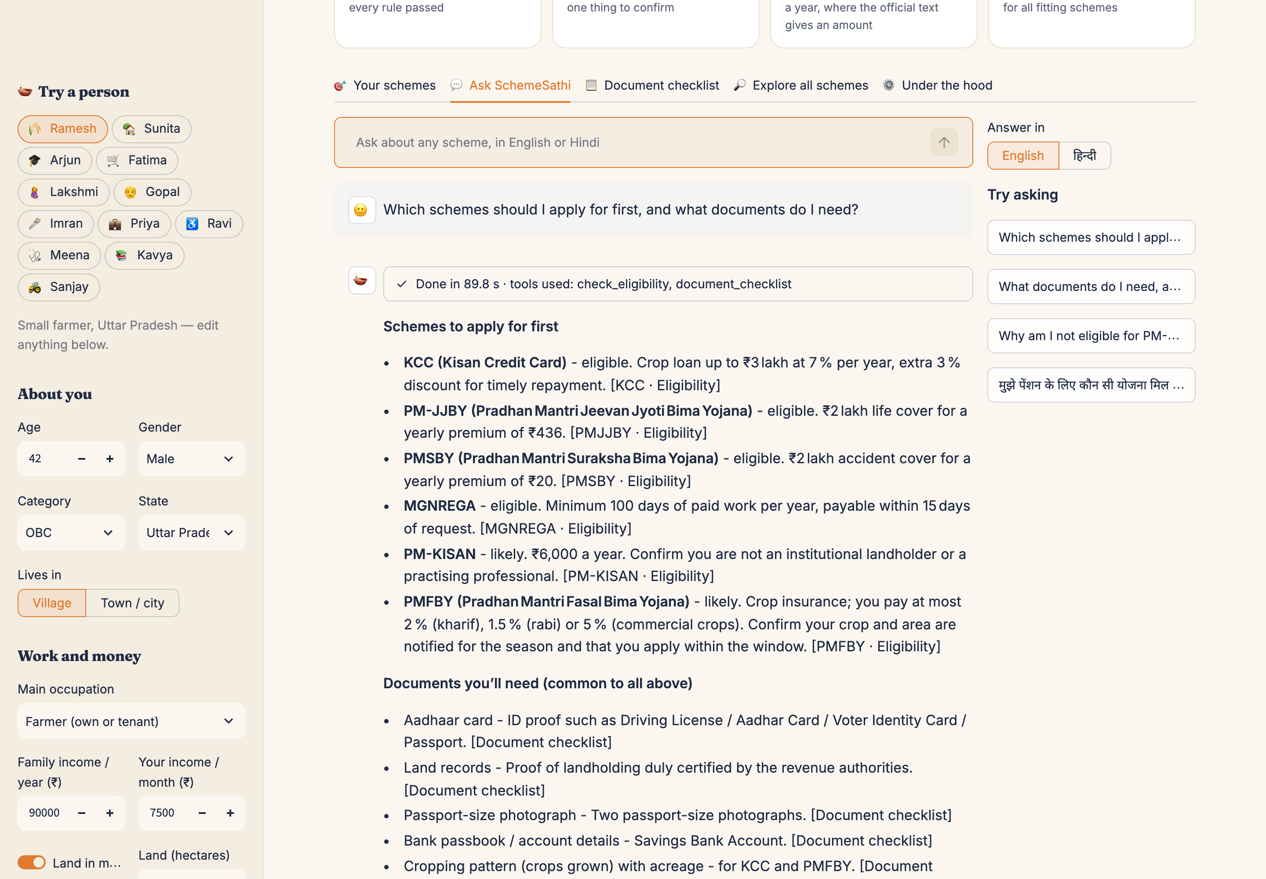
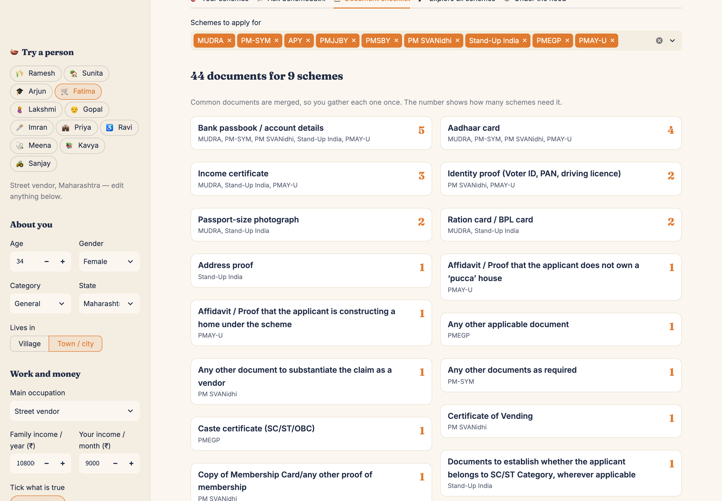
Ask in English or Hindi; take one document list to the office
The agent chose its tools, cited the official sections and passed the guardrail; the panel shows tools, model, time and retries
Fatima, street vendor: 9 schemes, with documents merged so the bank passbook and Aadhaar appear once each

Slide 10
Evaluation: the right passage, and every answer verified
83%
exact official section in the top 3
100%
agent answers passed every check
4/4
runs mentioned every fitting scheme, no wrong ones
15.3 s
average answer time
The intent boost (“documents” → Documents Required) lifted Hit@3. Weights were tuned on the same 24 questions, so treat these as optimistic.

Slide 11
What testing exposed, and what fixed it
Correct citations rejected
12 schemes lost their documents
Maternity schemes for a man
Model used different brackets
Rich-text format on myScheme
Unknown ≠ “likely”
Fix: Normalise brackets and hyphens
Fix: Converter + offline rebuild
Fix: “Only if” life situations
Cash total ₹53,600 (really ₹6,000)
NPS described with a wrong rule
Invented websites
LLM arithmetic
Out-of-library scheme
Plausible .gov.in names
Fix: Guardrail checks the computed total
Fix: Unknown-scheme check
Fix: Address must be in the official text
All locked in by 39 offline unit tests (about 1 second, no LLM needed)

Slide 12




Business value, and honest limits
Screening in seconds
Limits
95 rules applied instantly at a CSC counter, NGO desk or bank-correspondent point
32 central schemes; no state schemes yet
“Likely” still needs an office to confirm
Rules need review when schemes change
Labels written by the author, not an independent audit
A plausible wrong instruction can still slip through, so official links are always shown
Money made visible
“₹6,000 a year” or “₹2 lakh cover for ₹20” turns a scheme into a decision
One trip, right papers
A merged checklist means people bring each document once
Near-zero cost
Free LLM tier and local embeddings; runs on one laptop

Slide 13
SchemeSathi · योजना साथी
Every scheme you are owed
Next
State schemes
Voice in Indian languages
Bulk screening for NGOs
WhatsApp front end
with the official proof for every line
आपकी हक़ की हर सरकारी योजना — सरकारी स्रोत के साथ
Code, data, tests and evaluation
https://github.com/Mahaveersonii/schemesathi
Mahaveer Soni · 065089 · FORE School of Management · Thank you

