Slide 1

GRIDPILOT AI
Autonomous Grid Intelligence & Predictive Renewable Dispatch
IBM Hackathon 2026 · Track U2 — Grid Load Optimisation & Renewable Energy Performance Advisor
Team: Relentless Gladiators — Mahavir Virda · Deep Pathak · Savan Patel · Tirth Patel
"Predict the Grid. Optimize the Dispatch. Explain Every Decision."

Slide 2

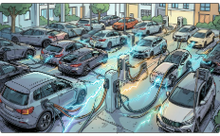


THE GRID CHALLENGE
RENEWABLE INTERMITTENCY
DEMAND SURGES
CLEAN ENERGY CURTAILMENT
OPERATOR OVERLOAD
EV fast charging and industrial loads create sudden multi‑MW spikes.
Operators interpret telemetry, alarms, and constraints manually under pressure.
Solar and wind output varies rapidly; static dispatch struggles to follow.
Grid congestion forces renewable curtailment and wasted generation.
Existing approaches (static schedules, heuristics, manual curtailment) fail due to poor prediction, slow decisions, wasted renewables, and higher risk.

Slide 3
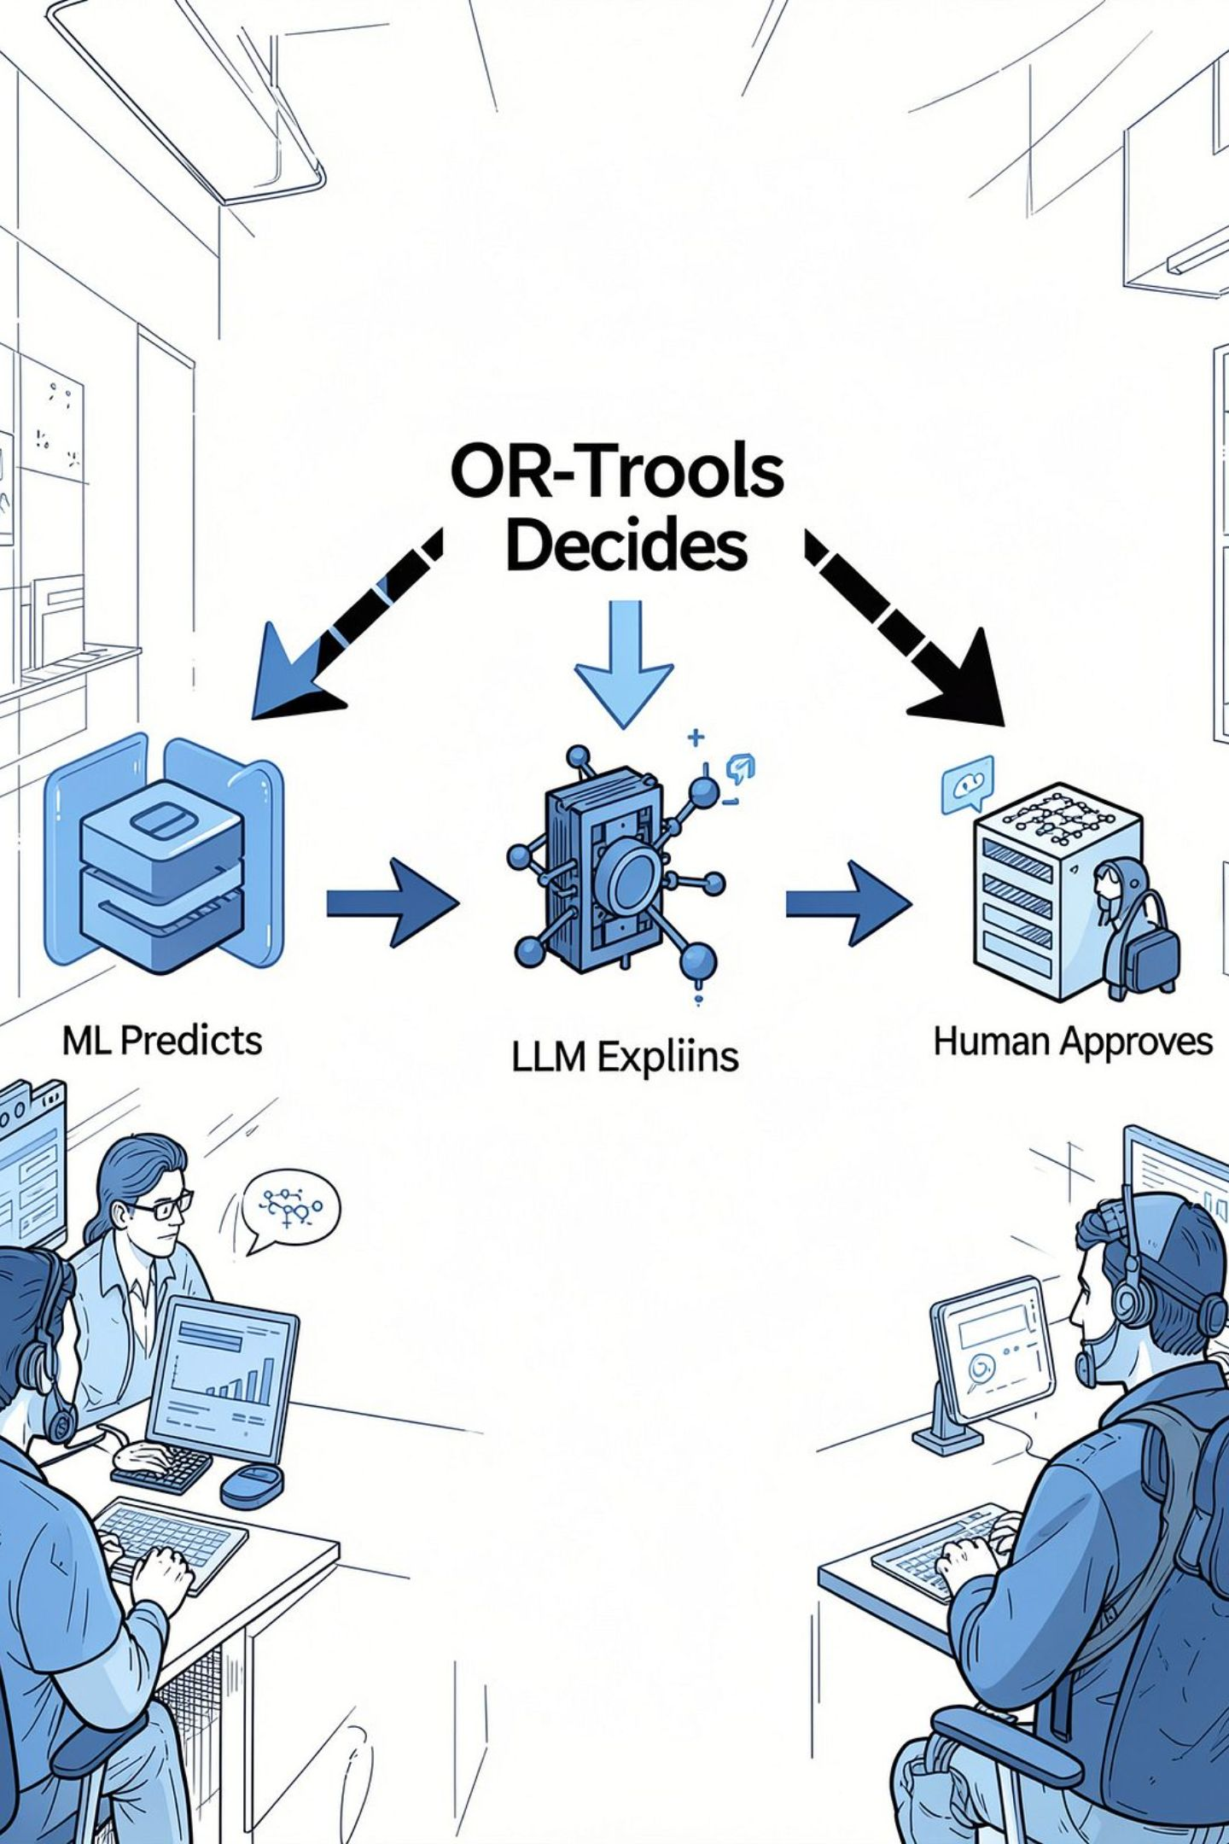
THE SOLUTION — FOUR NON-NEGOTIABLE RULES
Core principle: ML Predicts • OR-Tools Decides • LLM Explains • Human Approves
ML PREDICTS
LightGBM & XGBoost: demand forecasting and spike classification (15m/30m/60m).
OR-TOOLS DECIDES
Google OR-Tools MILP: constraint-aware, cost‑optimal dispatch (generators, BESS).
LLM EXPLAINS
IBM Bob + MCP: grounded engineering rationale — NOT a decision authority.
HUMAN APPROVES
React operator command center for final review and authorization.
Workflow: Telemetry → ML Forecast → Optimization → Safety Guardrail → AI Explanation → Human Approval
Inputs: telemetry, historical demand, weather, renewables, generator & BESS state, grid limits, tariffs. Outputs: setpoints, BESS commands, import, curtailment, cost estimate, engineering explanation.

Slide 4
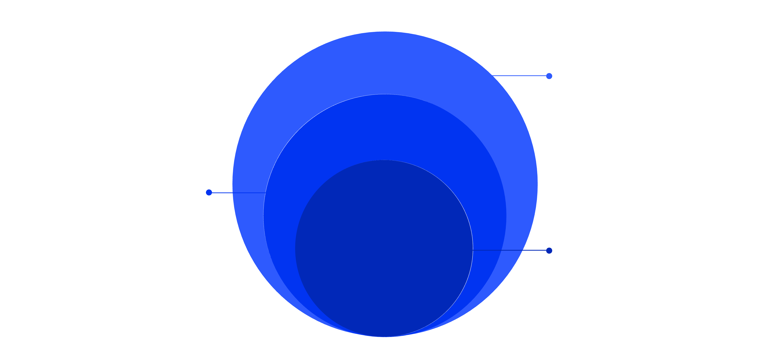
TECHNICAL ARCHITECTURE
Tier 1 — Operator Experience
1
React 18 · Vite · TailwindCSS · Recharts — Operator Command Center
Tier 2 — Gateway & Orchestration
2
Node.js · Express · MCP Server · JSON‑RPC · DispatchGuardrail
Tier 4 — Data & Optimization
Tier 3 — Intelligence Services
4
Python FastAPI (ports 8001–8003): renewable, demand, optimization
OpenSTEF pipeline → 37 zero‑leakage features → LightGBM / XGBoost → OR-Tools MILP
3
Technical specifics: LightGBM: 15/30/60‑minute forecasting. XGBoost: spike classification (Normal/Moderate/Severe). OR-Tools: generator + BESS + grid dispatch MILP. MCP: 8 grid-management tools.

Slide 5
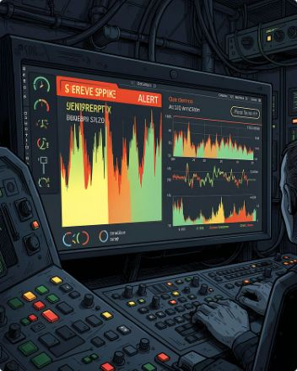
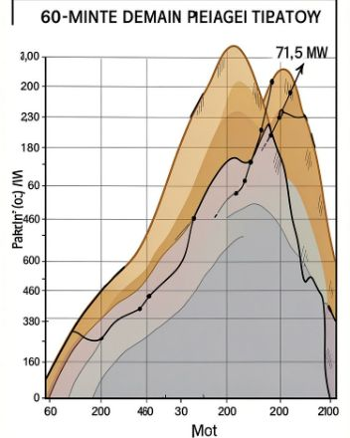
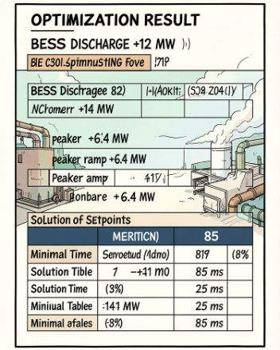
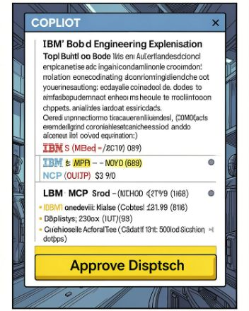

LIVE INCIDENT — FROM SPIKE TO SAFE DISPATCH
Recommended screenshots: dashboard, spike alert, optimization recommendation, copilot explanation, approval state.
ACT 1 — DETECT
ACT 2 — PREDICT
ACT 3 — OPTIMIZE
ACT 4 — EXPLAIN & APPROVE
14:15 UTC — EV surge +18.4 MW, XGBoost flags SEVERE spike.
LightGBM projects 60‑minute trajectory; peak ≈ 71.5 MW.
OR-Tools MILP → BESS +12 MW, Peaker +6.4 MW. Optimization latency <100 ms (measured).
IBM Bob + MCP provides rationale; DispatchGuardrail validates constraints; operator clicks APPROVE DISPATCH.

Slide 6
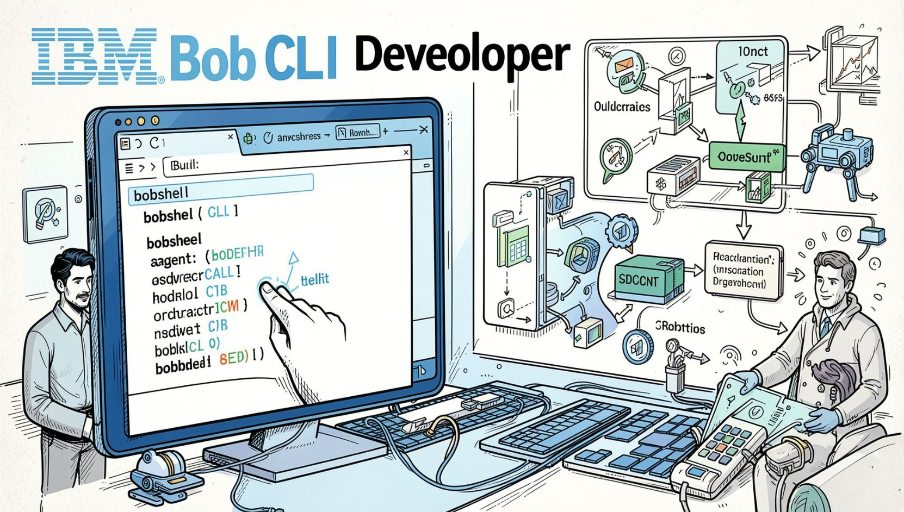

IBM TECHNOLOGY — GROUNDED AI FOR GRID OPERATIONS
IBM Bob / BobShell CLI
Agentic developer assistance, orchestration, test execution, architecture verification, automated workflows. Enables the AI copilot to operate reliably in engineering contexts.
MODEL CONTEXT PROTOCOL (MCP)
Custom MCP server exposes 8 standardized tools as JSON‑RPC endpoints for grounded, verifiable interactions with microservices (get_grid_status, optimize_dispatch, explain_dispatch, etc.).
GROUNDING PATTERN
IBM Bob → MCP JSON‑RPC → Grid Tools → Microservices → Telemetry/ML/Optimization → Grounded result for operator explanation. LLMs do not control dispatch.
Key message: IBM Bob connects the AI copilot to real grid intelligence through standardized MCP tools, while deterministic optimization—not the LLM—controls dispatch logic.

Slide 7
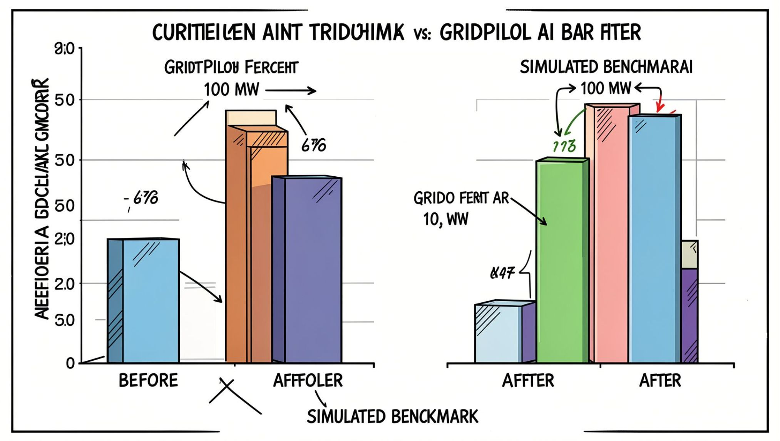
EMPIRICAL RESULTS & OPERATIONAL IMPACT
Forecast Accuracy (15‑min MAE)
0.0497 MW 15-minute demand MAE — 60.7% improvement vs seasonal‑naive baseline (simulated/validated).
Renewable Utilization
85% reduction in simulated renewable curtailment on 100 MW feeder benchmark (simulation).
Spike Detection
99.01% XGBoost classification accuracy — 100% recall on severe
spikes (test set).
Test & Latency
88 / 88 automated tests passing (44 Python, 44 Node.js). OR-Tools
optimization <100 ms in benchmark runs.
Impact — Environmental
Increased renewable utilization; fewer curtailments.
Impact — Economic
Lower peaker and balancing costs (estimated savings reported above).
Impact — Operational
Faster, constraint-aware decision support; reduced operator stress.
Economic estimate (simulated benchmark): ≈ €3,400/day savings per 100 MW feeder (estimated). Labelled as estimated.
Simulation and economic figures are explicitly labeled simulated/estimated and not claimed as deployed utility outcomes.

Slide 8




RELENTLESS GLADIATORS — TEAM & NEXT STEPS
MAHAVIR VIRDA
DEEP PATHAK
SAVAN PATEL
TIRTH PATEL
System Architecture · Optimization Engine · Solver formulation
Lead ML Engineer · Demand intelligence · Zero‑leakage pipelines
API Gateway · MCP Server · Telemetry aggregation
Frontend Lead · React Command Center · Operator UX
CURRENT DELIVERY
Trained ML models; 3 Python intelligence services; Node.js API gateway
8‑tool MCP server; Deterministic DispatchGuardrail; React operator command center
88 automated tests passing (44 Python, 44 Node.js)
FUTURE SCOPE (PLANNED)
Day‑ahead EPEX spot market bidding (planned)
Non‑linear AC‑OPF (research / future)
Native SCADA / DNP3 integration (future integration)
Items listed under FUTURE SCOPE are planned and not yet implemented.

