Slide 1
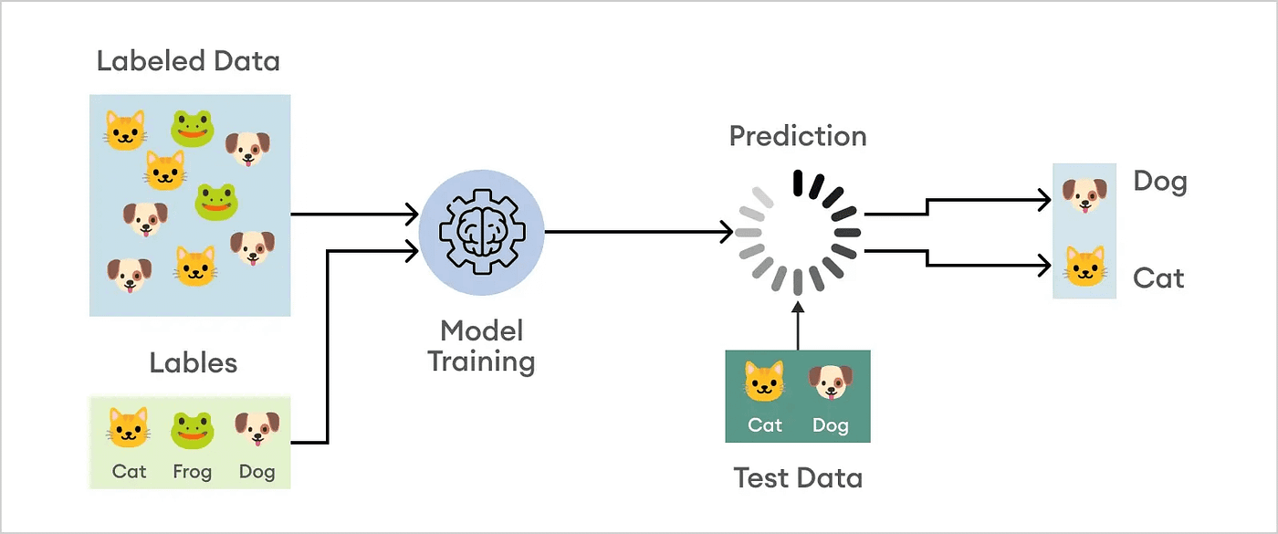
Image Classification Using CIFAR-10
By Mohamed Alsuwaidi, Mahaz Khan, Abdullah Mohammed, Hamza Luai, and Isa Alkhanous

Slide 2
Problem Description and Dataset
Class Index | Class Name | Image per Class
0 | Airplane | 6000
1 | Automobile | 6000
2 | Bird | 6000
3 | Cat | 6000
4 | Deer | 6000
5 | Dog | 6000
6 | Frog | 6000
7 | Horse | 6000
8 | Ship | 6000
9 | Truck | 6000
Goal: To classify images from the CIFAR-10 dataset using AI algorithms.
Dataset: CIFAR-10 contains 60,000 images across 10 categories, with 32x32 SIZE, ideal for algorithm testing and benchmarking.

Slide 3

Classification Methods
Convolutional Neural Network (CNN): High accuracy and works well with large datasets.
XGBoost: Effective as a feature classifier, handles imbalanced and balanced data.
Random Forest: Simple, interpretable, but less effective for complex data.

Slide 4
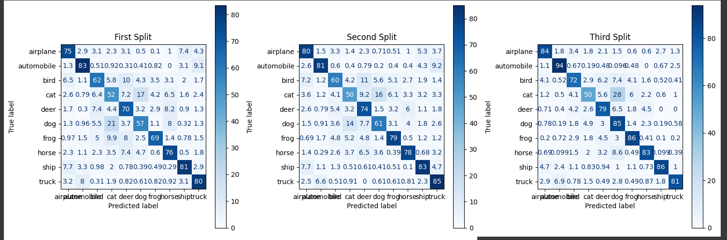
Statistical Validation
Splitting the Dataset into 3 parts

Slide 5
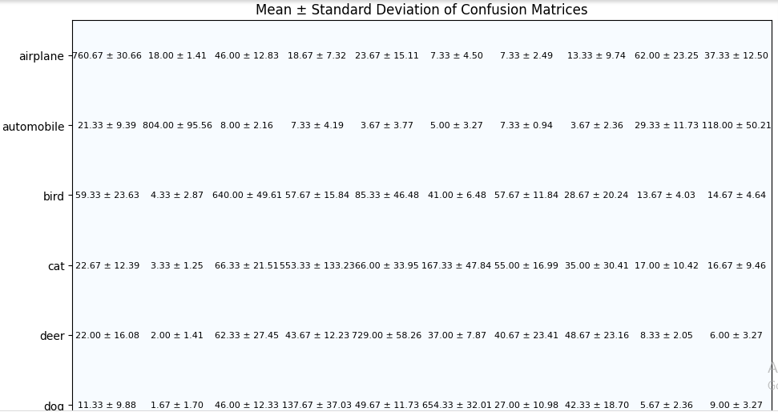
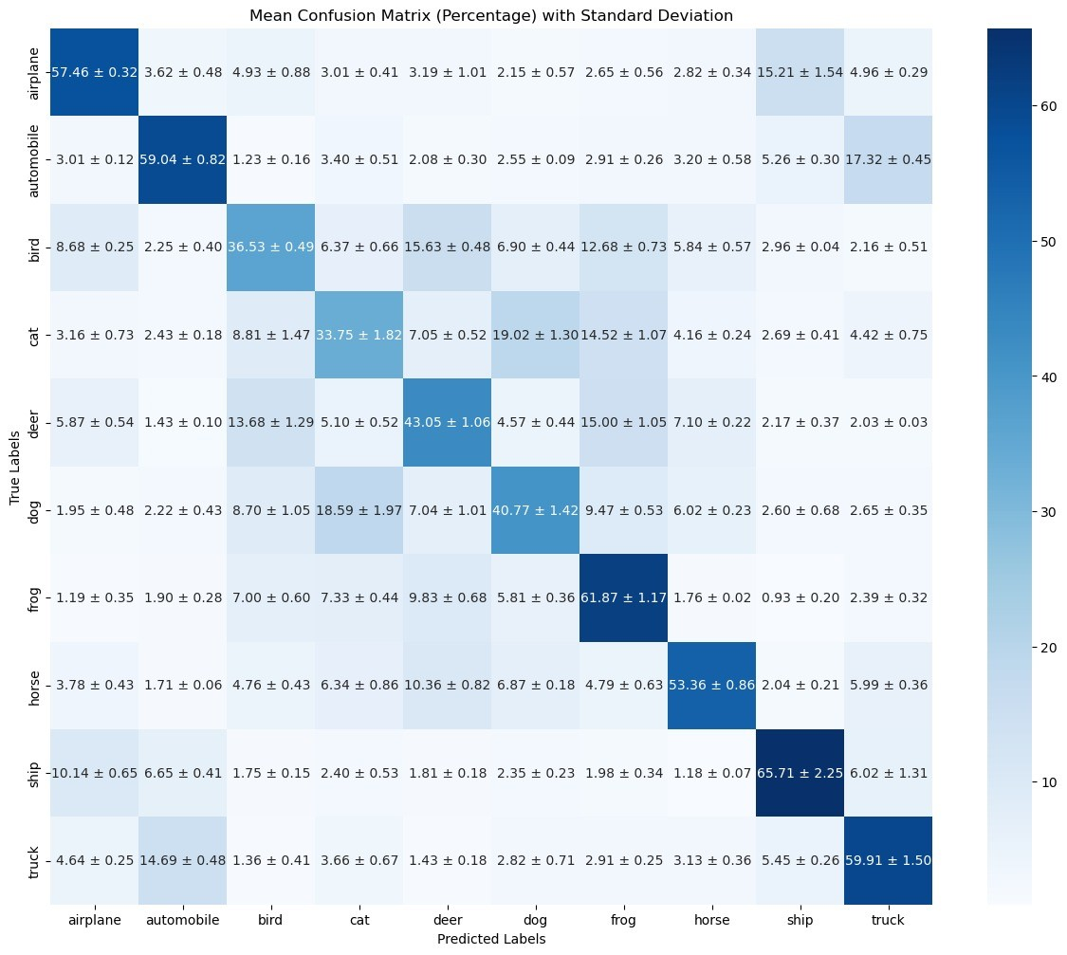
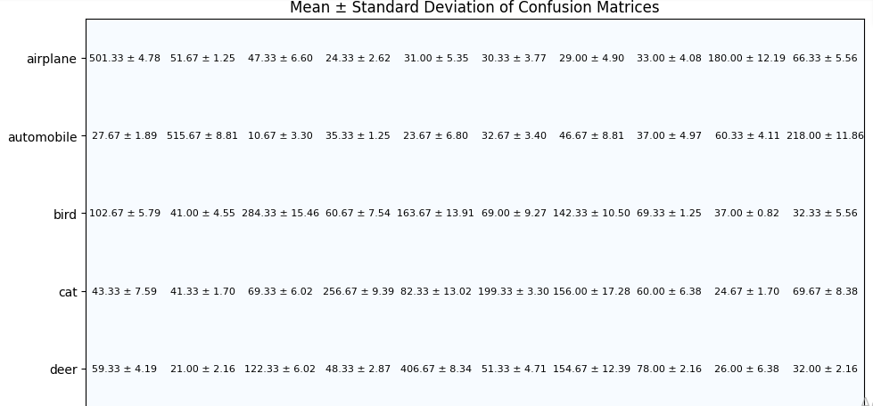
Results
Mean and Standard deviations
- CNN (Top-Left)
XGBoost (Right)
Random Forest (Bottom-Left)
Average Accuracy across 3 splits:
- CNN = ~82%
- XGBoost = ~51%
- Random Forest = ~45%

Slide 6
Conclusion and Recommendations
CNN Outperformed: Demonstrated the highest accuracy and robustness for image classification, consistent across test sets.
XGBoost Performance: Ranked second with moderate accuracy, suitable for simpler datasets or hybrid models.
Random Forest Limitations: Delivered the lowest accuracy, best for basic, less demanding tasks.
Recommendations: Optimize CNN through architectural tuning and transfer learning for better performance.

