Slide 1
Cookie Detection
Student ID: 2021-CSC-085
Mahasen B. Dasanayake

Slide 2
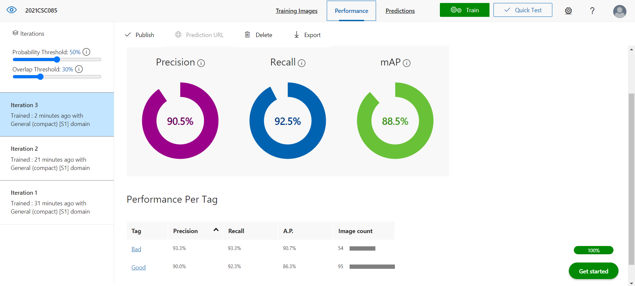
Iterations and Precision

Slide 3
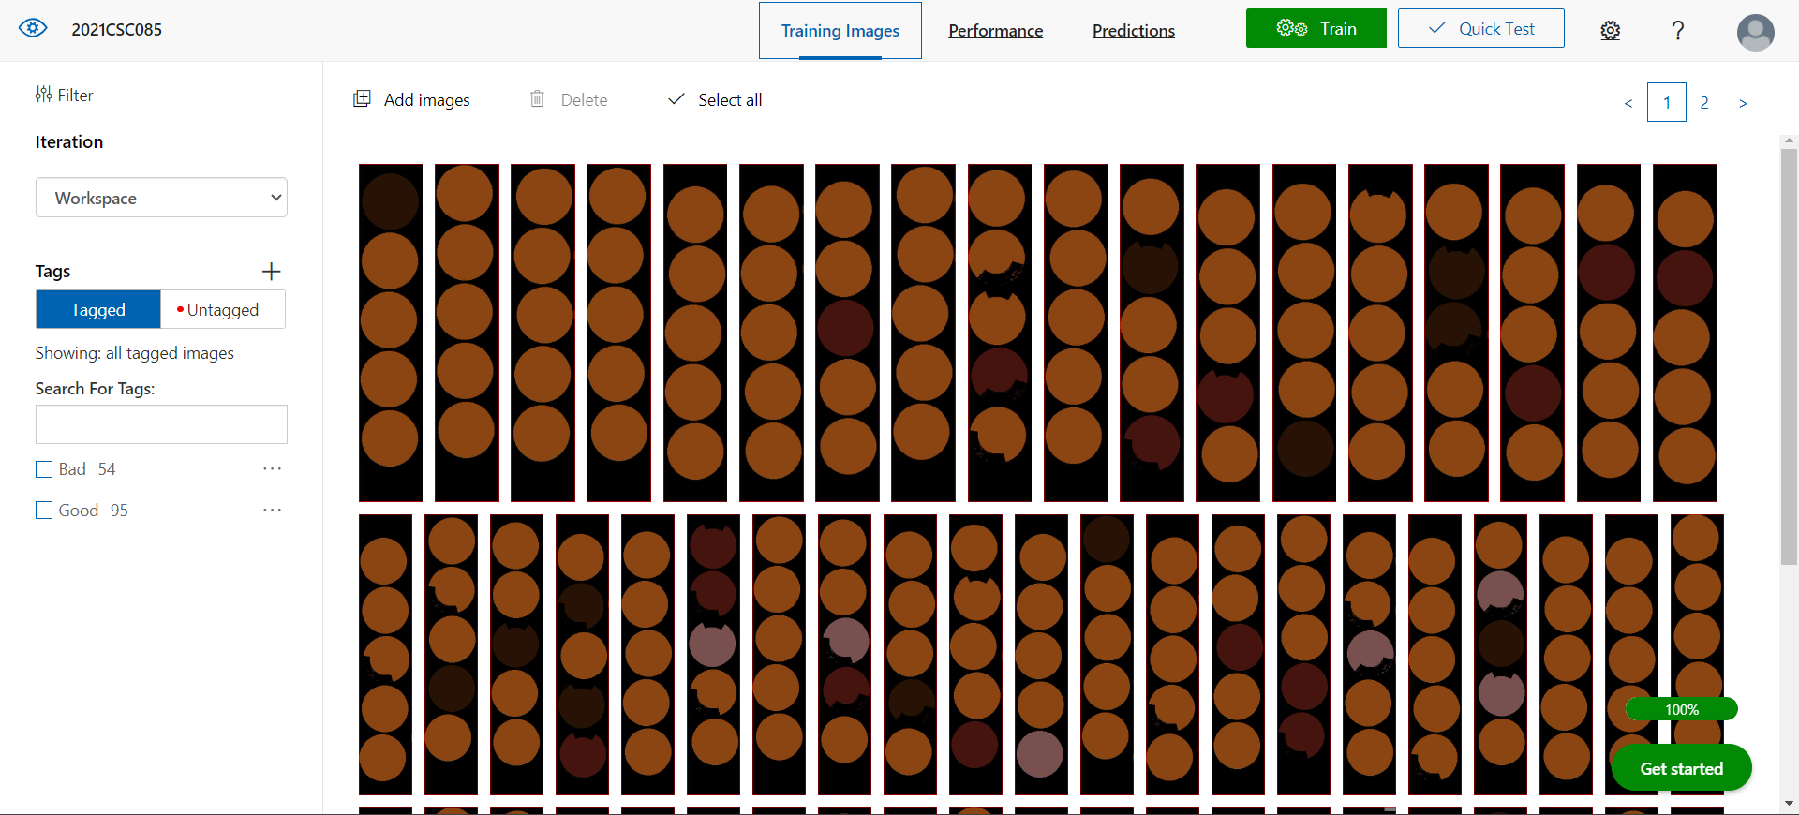
Tagged Images

Slide 4
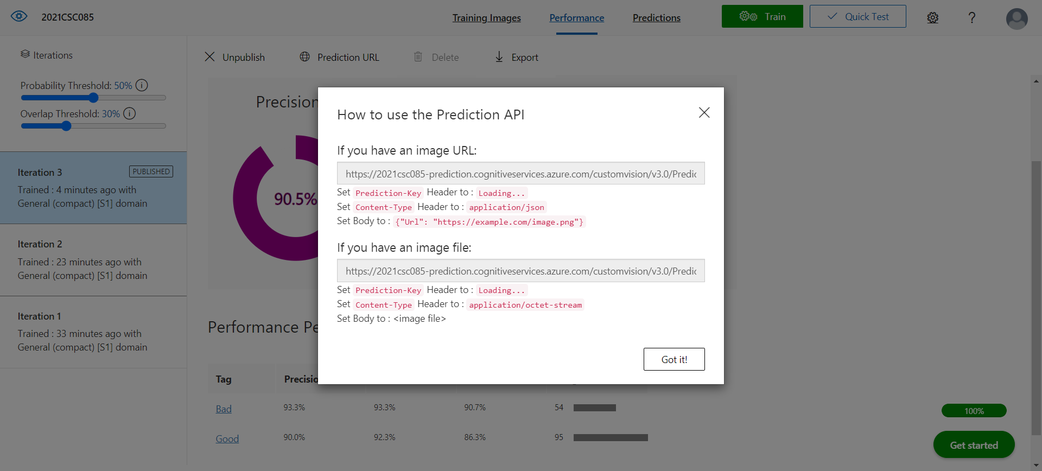
Published Prediction URL

Slide 5
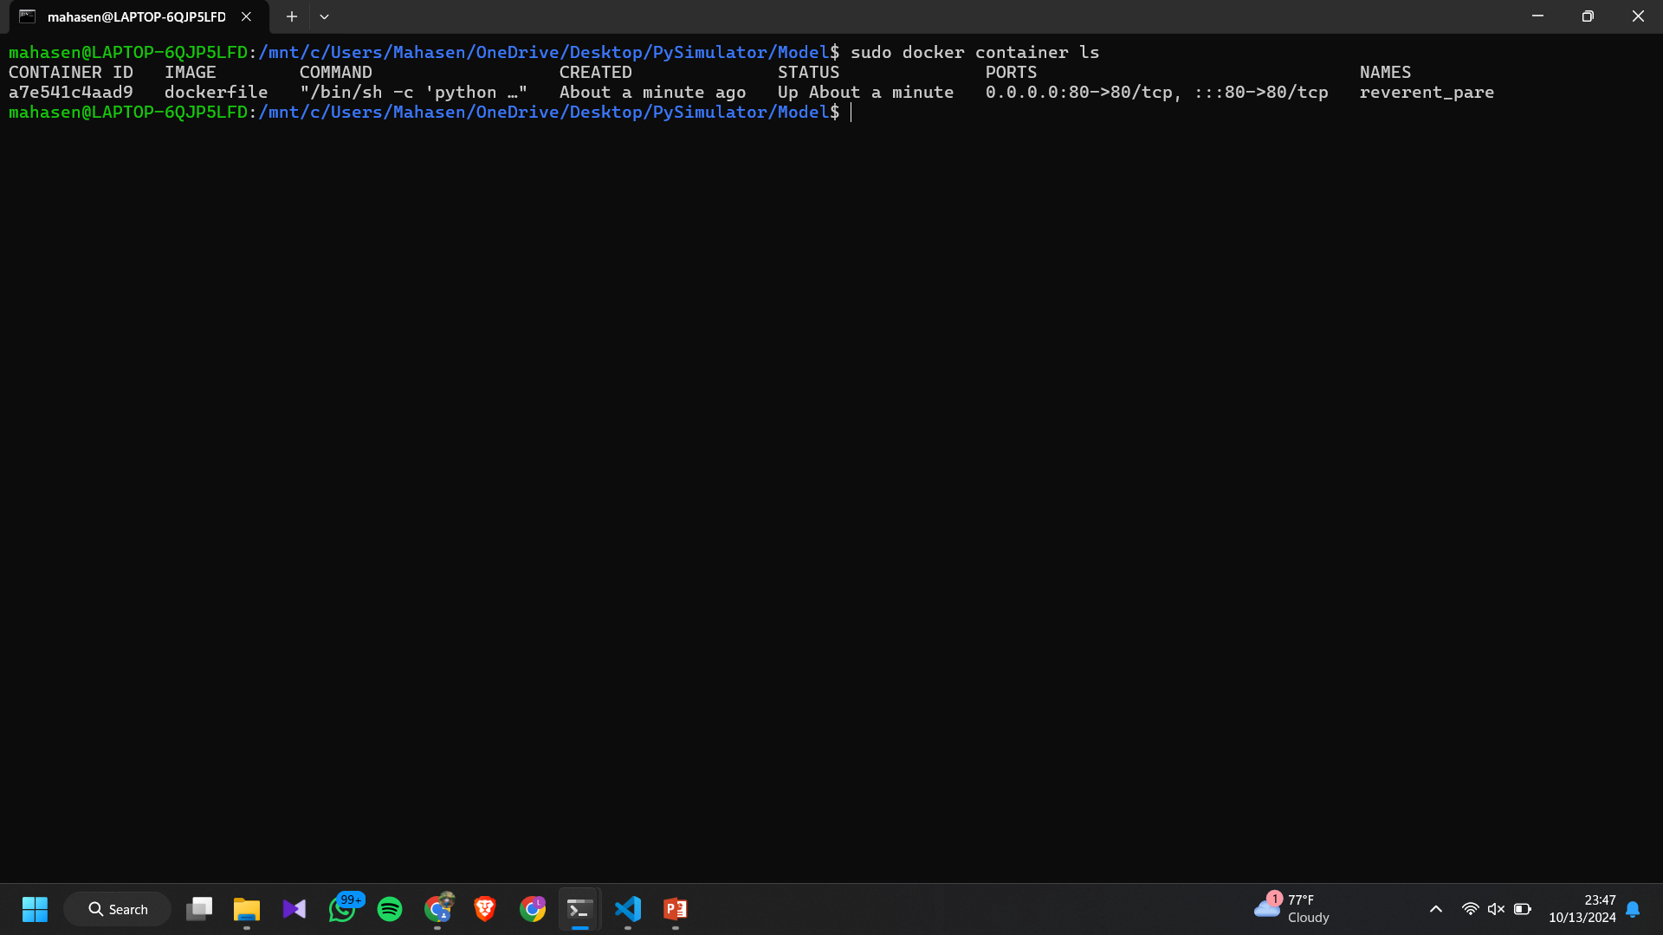
Docker Container in Running State

Slide 6
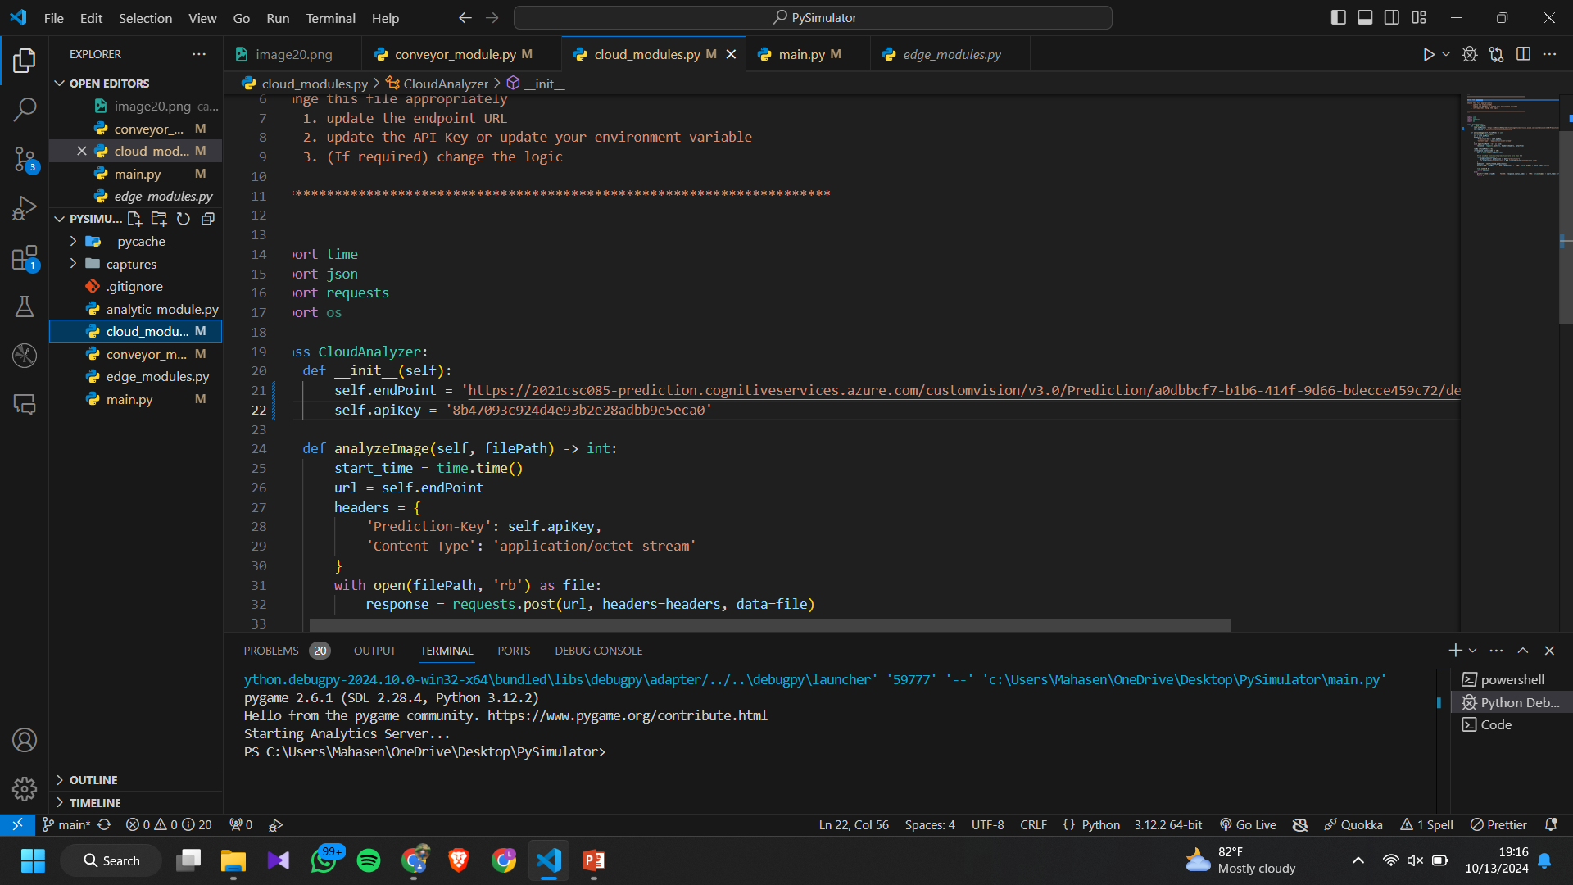
Cloud_Module.py

Slide 7
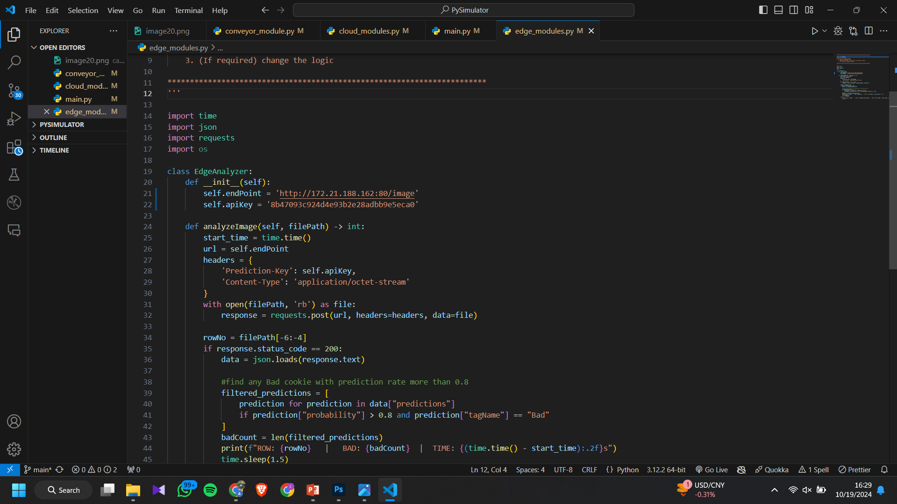
Edge_Module.py

Slide 8
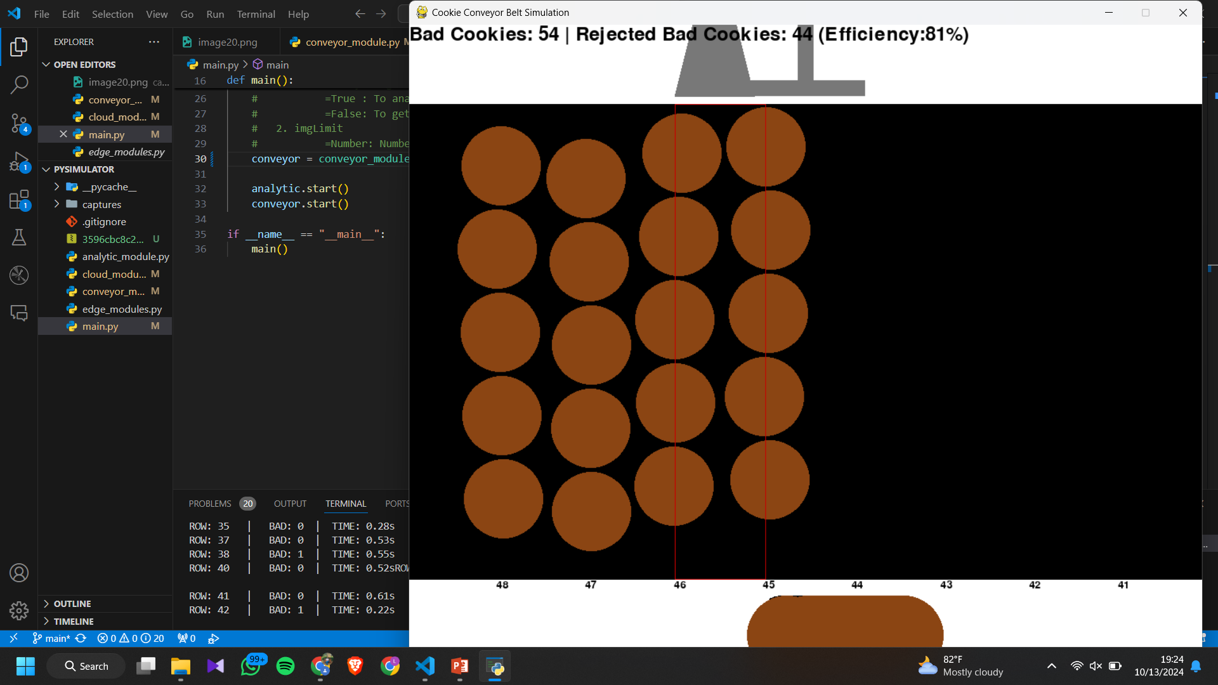
Simulator and Output Screen Side-by-Side

