Slide 1



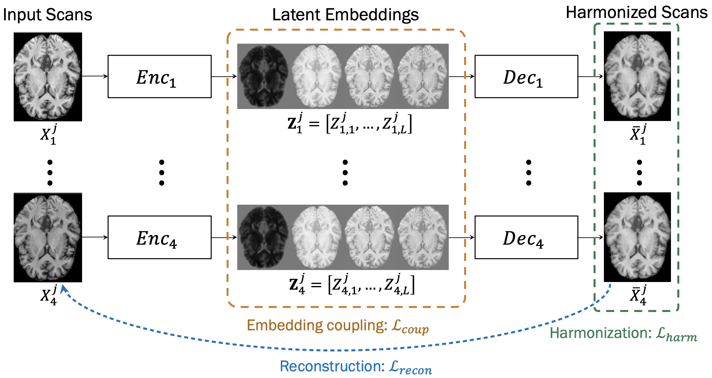
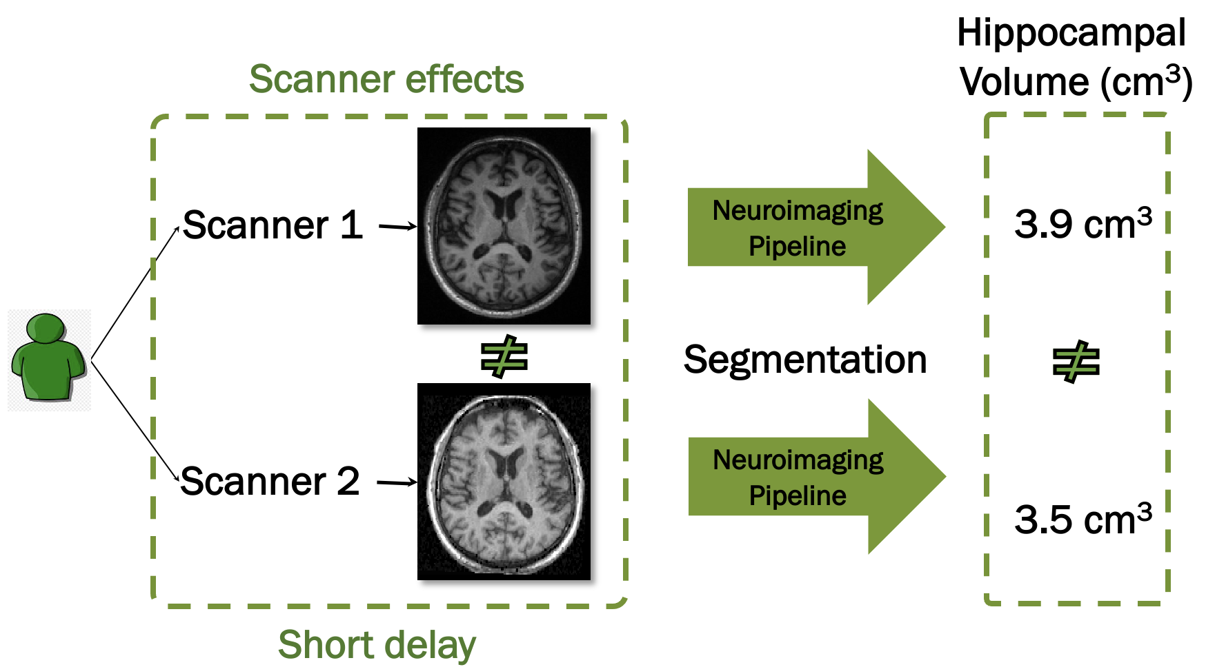
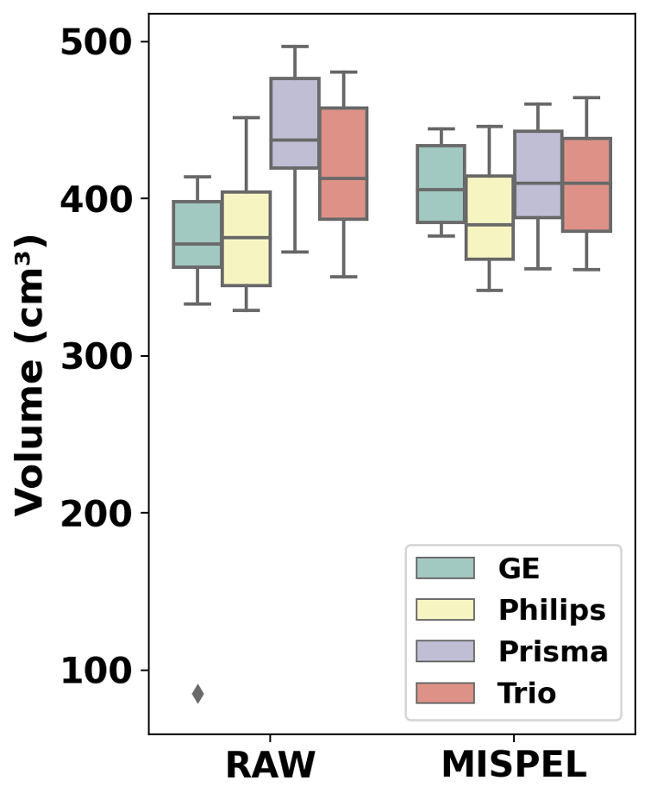
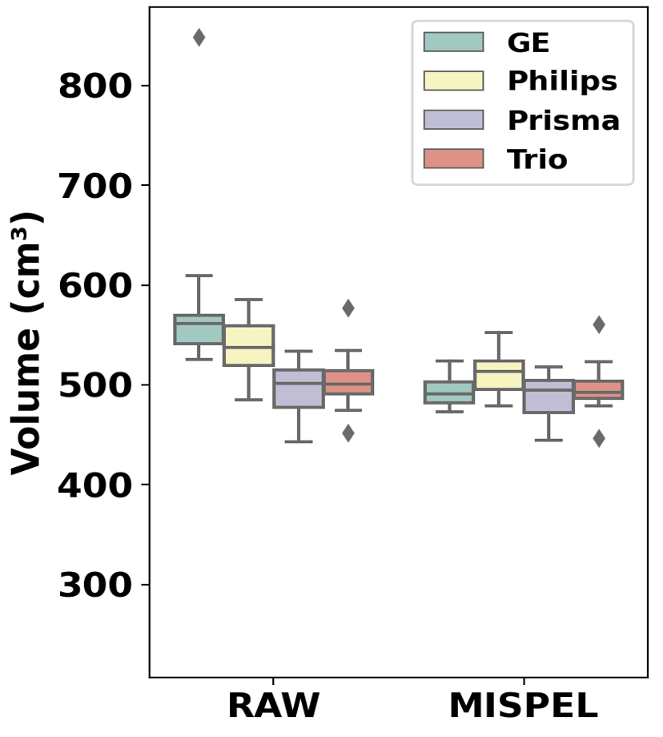
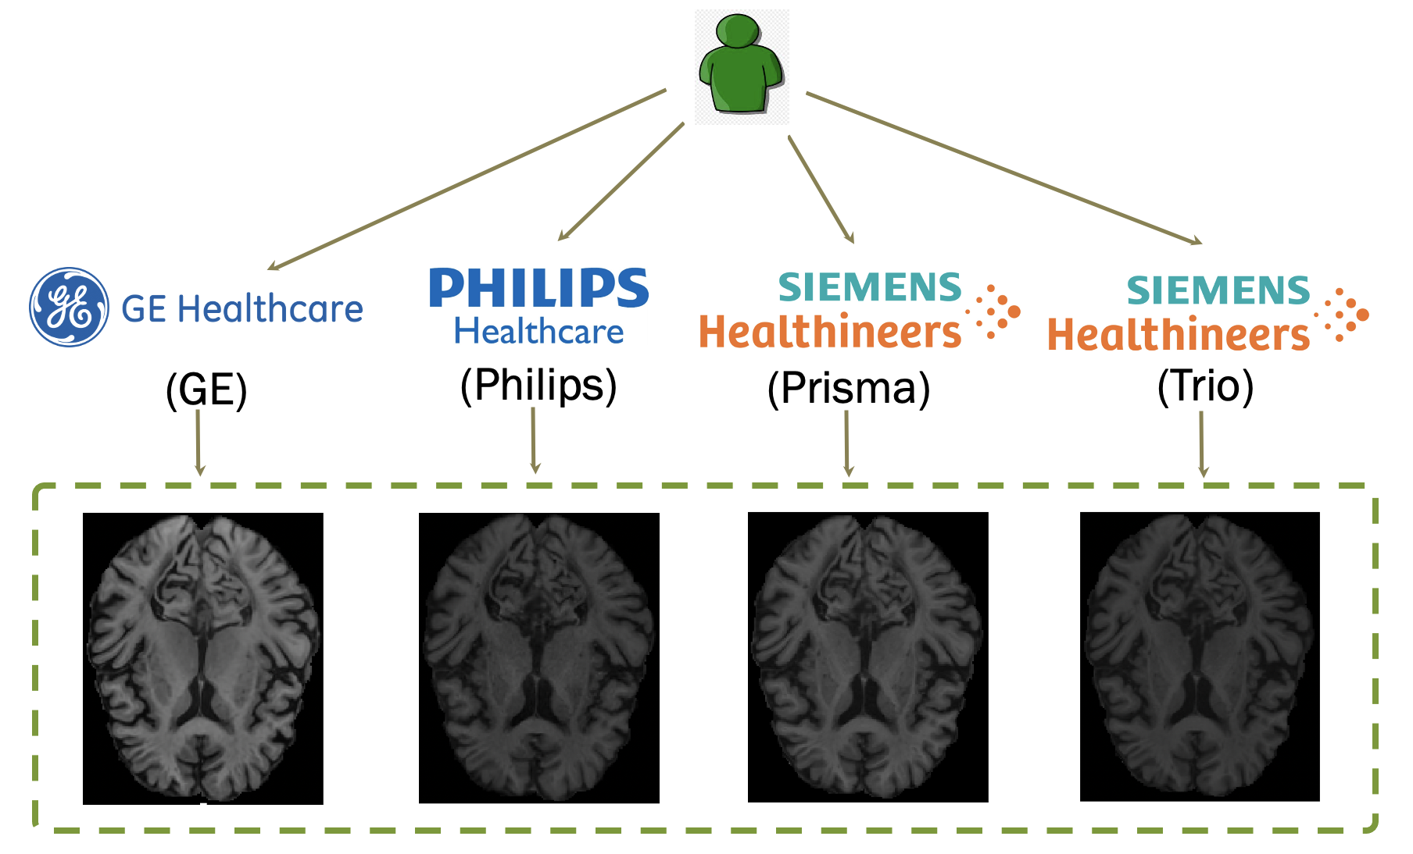


Multi-scanner Harmonization of Paired Neuroimaging Data via Structure Preserving Embedding Learning
Mahbaneh Eshaghzadeh Torbati¹, Dana L. Tudorascu¹, Davneet S. Minhas¹, Pauline Maillard², Charles S. DeCarli², Seong Jae Hwang¹
¹University of Pittsburgh, ²University of California, Davis
Background
Method: MISPEL
Results 1: Image Similarity
  Combining datasets from multiple sites/scanners has been becoming increasingly more prevalent in modern neuroimaging studies.
  MISPEL: an image-level harmonization to preserve the structure of images.
  Experiment: Comparing the similarity of RAW and MISPEL-harmonized images within pairwise combinations of scanners, using the structural similarity index measure (SSIM).
  The scanner effects were partially removed by images getting more similar (increased SSIMs) after the MISPEL harmonization (Table 1).
  Problem: Despite benefits from growth in sample size by combining datasets, substantial variability associated with site/scanner-related effects exists which may inadvertently bias down-stream analyses (Figure 1).
Methods | SSIM Between Scanners
Methods | GE-Philips | GE-Prisma | GE-Trio | Philips-Prisma | Philips-Trio | Prisma-Trio
RAW | 0.75 (0.04) | 0.78 (0.04) | 0.78 (0.05) | 0.81 (0.03) | 0.81 (0.03) | 0.87 (0.04)
MISPEL | 0.84 (0.04) | 0.85 (0.04) | 0.86 (0.05) | 0.87 (0.03) | 0.87 (0.03) | 0.91 (0.03)
  Harmonization is the task of removing scanner effects directly from image-derived measures (image-level harmonization) or the images (image-level harmonization).
  Table 1. Mean (standard deviation) of SSIMs within pairwise combinations of scanners.
Results 2: Volumetric Similarity
  Experiment: Studying scanner effects and MISPEL harmonization on volumes of gray matter (GM) and white matter (WM) tissue types extracted by FSL FAST segmentation [2].
  Scanner effects appeared as dissimilarity of distributions
  Figure 1. Example of scanner effects.
  Notations and loss functions:
  Data: N axial slices (combined across all subjects) from each of M scanners.
  Variables:
  $i, j$: Scanner and slice index, respectively
  $l$: Embedding’s component index
  $T_{1}$, $T_{2}$: Max iteration for Steps 1 and 2
  $X_{i}^{j}$: Axial slice $j$ from scanner $i$
  $Z_{i, l}^{j}$: Latent embedding $l$ of $X_{i}^{j}$
  $Z_{i}^{j}$: $L$ Latent embedding of $X_{i}^{j}$
  $p$: index for elements in $Z_{i, l}^{j}$
  ${\overline{X}}_{i}^{j}$: Harmonized $X_{i}^{j}$
  Networks:
  ${Enc}_{i}$: Encoder U-Net for $Z_{i}^{j}←{{Enc}_{i}(X}_{i}^{j})$
  ${Dec}_{i}$: Decoder linear map for ${\overline{X}}_{i}^{j}← {Dec}_{i}(Z_{i}^{j})$
  Loss functions:
  $ℒ_{recon}\left(X_{i=1:M}^{j}, {\overline{X}}_{i=1:M}^{j}\right)=\sum_{i=1}^{M}{MAE\left(X_{i}^{j}, {\overline{X}}_{i}^{j}\right)}$
  $ℒ_{coup}\left(Z_{1, l}^{i}, …,Z_{M, l}^{i}\right)= \frac{1}{LP}\sum_{l=1}^{L}{\sum_{p=1}^{P}{var (Z_{1, l}^{i}(p), …,Z_{M, l}^{i}(p))}}$
  $ℒ_{harm}\left({\overline{X}}_{i=1:M}^{j}\right)= \frac{2}{M (M −1)}\sum_{i=1}^{M}{\sum_{k=i+1}^{M}{MAE({\overline{X}}_{i}^{j},{\overline{X}}_{k}^{j})}}$
  $ℒ_{Step 1}=$ $λ_{1}ℒ_{recon}$ + $λ_{2}ℒ_{coup}$
  $ℒ_{Step 2}=λ_{3}ℒ_{recon}\text{ + }λ_{4}ℒ_{harm}$
  MISPEL Training Algorithm:
  1: Procedure Step 1: Embedding learning
  2: for $t=1, …, T_{1}$or until $X_{i}^{j}≈{\overline{X}}_{i}^{j}$ do
  3: for each slice $j$ do
  4: for each scanner $i$ do
  5: $Z_{i}^{j}← {Enc}_{i}(X_{i}^{j})$
  6: ${\overline{X}}_{i}^{j}← {Dec}_{i}(Z_{i}^{j})$
  7: end for
  8: Update ${Dec}_{i=1:M}$ and ${Enc}_{i=1:M}$
  using $ℒ_{Step 1}$
  9: end for
  10: end for
  11: end procedure (end Step 1)
  12: procedure Step 2: Harmonization
  13: for $t=1, …, T_{2}$ or until ${\overline{X}}_{1}^{j}≈…≈{\overline{X}}_{M}^{j}$ do
  14: for each slice $j$ do
  15: for each scanner $i$ do
  16: $Z_{i}^{j}← {Enc}_{i}(X_{i}^{j})$
  17: ${\overline{X}}_{i}^{j}← {Dec}_{i}(Z_{i}^{j})$
  18: end for
  19: Update only ${Dec}_{i=1:M}$ using $ℒ_{Step 2}$
  20: end for
  21: end for
  22: end procedure (end Step 2)
Contributions
  In this work, we:
    introduce the first paired multi-scanner data on four different scanners.
    propose a multi-scanner deep harmonization framework called MISPEL (Multi-scanner Image harmonization via Structure Preserving Embedding Learning).
Paired Multi-scanner Dataset
  Figure 3. GM volumes.
  Figure 4. WM volumes.
  Acquisition: 18 subjects scanned on 4 different scanners with short delay (Figure 2).
  Preprocessing:
    Non-linear registration to a T1-Weighted image atlas [1].
    Spatial intensity inhomogeneity correction.
    Skull stripping.
    Scaling.
    These preprocessed images are referred to as RAW images and are input images for harmonization.
  distributions of both tissues across scanners. Harmonization happened as distributions got more similar to each other (Figures 3 and 4).
Conclusions
  Scanner effects exist in our in-house paired multi-scanner dataset.
  MISPEL succeeded in harmonization of our data evaluated on image and volumetric similarity.
Acknowledgments
  This work was supported by the following NIH/NIA grants: R01 AG063752 (D.L. Tudorascu), P30 AG10129 and UH3 NS100608 (C. DeCarli), and the University of Pittsburgh Alzheimer’s Disease Research Center Grant P30 AG066468 (S. Hwang).
  Reference:
  [1] Kenichi Oishi, et al. Atlas-based whole brain white matter analysis using large deformation diffeomorphic metric mapping: application to normal elderly and alzheimer’s disease participants. Neuroimage, 2009.
  [2] Y Zhang, et all. Segmentation of brain MR images through a hidden markov random field model and the expectation-maximization algorithm. IEEE Trans Med Imaging, 2001.
  Figure 2. Paired multi-scanner dataset.
Mahbaneh Eshaghzadeh Torbati | mae82@pitt.edu Dana L. Tudorascu | dlt30@pitt.edu Davneet S. Minhas | minhasd@upmc.edu Pauline Maillard | pauli.maillard@gmail.com Charles S. DeCarli | cdecarli@ucdavis.edu Seong Jae Hwang | sjh95@pitt.edu

