Slide 1
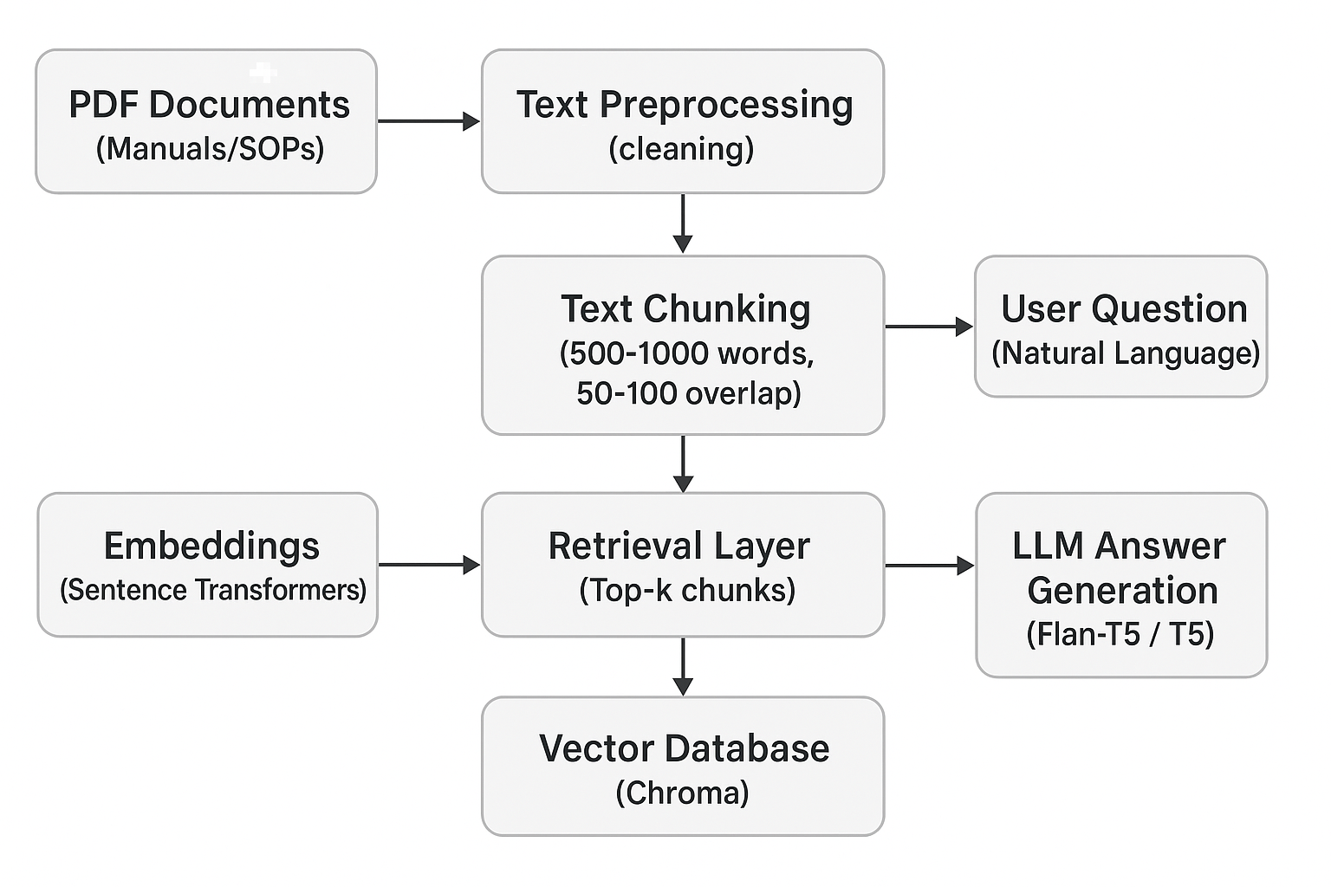
components for the RAG system architecture.

Slide 2
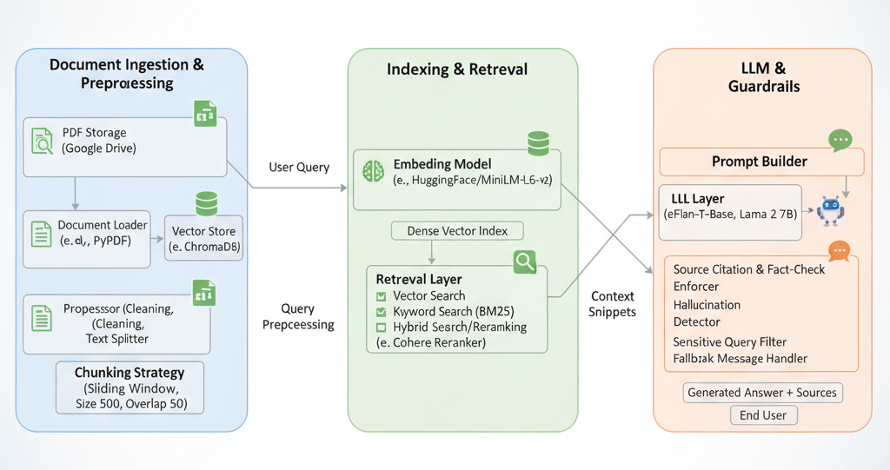
System Architecture: RAG for Technical Documentation Q&A

