Slide 1

Integrated Data Science Solutions: Time-Series Analysis & RAG Systems
Name: Mahiboob Isak Attar
Course: B.E-Artificial Intelligence and Data Science
Gmail: 1rn22ad019.mahiboobisakattar@rnsit.ac.in
Phone no: 8088944535
College: RNS Institute of Technology-Banglore

Slide 2
Task 1
Project Overview and Objectives
This presentation covers two key challenges in data science:
Cyclone Machine Data Analysis – Understanding machine behavior through 3 years of sensor data, detecting shutdowns, anomalies, and short-term forecasting.
RAG System Design – Designing an AI-powered document retrieval system for technical manuals, enabling fast and reliable Q&A.
This project has two complementary parts: first, we analyze machine sensor data to extract actionable insights; second, we build an NLP system that retrieves knowledge from technical documents efficiently and reliably. The flow diagram shows how both tasks are connected in the overall solution.

Slide 3
Task 1
Data Preparation & Exploratory Analysis
Dataset: 3 years of cyclone sensor data, 370,000+ records, 6 critical variables.
Key Steps Taken:
Handled missing timestamps and outliers.
Detected and labeled shutdown/idle periods programmatically.
Ensured strict 5-minute indexing for time-series consistency.
Explored correlation matrix:
Inlet & outlet temperatures highly correlated
Draft measurements moderately correlated
Example Insight:
Inlet & outlet temperatures are highly correlated → changes in inlet affect outlet.
Draft measurements across sections show moderate correlation → indicates airflow patterns.

Slide 4
Task 1
Shutdown / Idle Period Identification/Machine State Clustering
Applied K-Means clustering on active data (excluding shutdowns)
Identified operational states: Normal, Startup/Shutdown, High Load, Degraded
Output includes cluster statistics (mean, std, occurrence frequency)
Helps non-technical stakeholders understand operational behavior
By clustering operational data, we could define distinct machine states. Within each state, anomalies were detected contextually, ensuring alerts are meaningful. Forecasting helps anticipate temperature changes for proactive maintenance

Slide 5
Task 1
Contextual Anomaly Detection/Short-Term Forecasting
Used Isolation Forest per cluster to detect anomalies
Consolidated anomalies with timestamp, sensor readings, and cluster label
Enables root cause analysis and preventive maintenance
Examples: sudden temperature drops,
Forecasted Cyclone-Inlet-Gas-Temp for the next hour (12 steps)
Models used: Persistence baseline, ARIMA (5,1,0)
Evaluated using RMSE & MAE
Forecasts assist in short-term operational planning

Slide 6
Task 1
RAG System Architecture Overview
Document ingestion via extraction of text from PDF manuals and SOPs
Chunks created with overlap to preserve semantic context during retrieval
Text embedded into vector space using a sentence-transformer model (all-MiniLM-L6-v2)
Stored in Chroma vector database for efficient relevance-based search
Retrieval layer fetches top-k relevant chunks for the query
LLM layer generates precise, citation-backed answers, enforcing trustworthy outputs
Guardrails implemented for hallucination prevention and sensitive query handling
An NLP-based system that allows users to ask questions in natural language and get accurate answers from technical documents (manuals, SOPs, troubleshooting guides).
Uses vector embeddings to find relevant sections and LLM (Language Model) to generate answers.

Slide 7
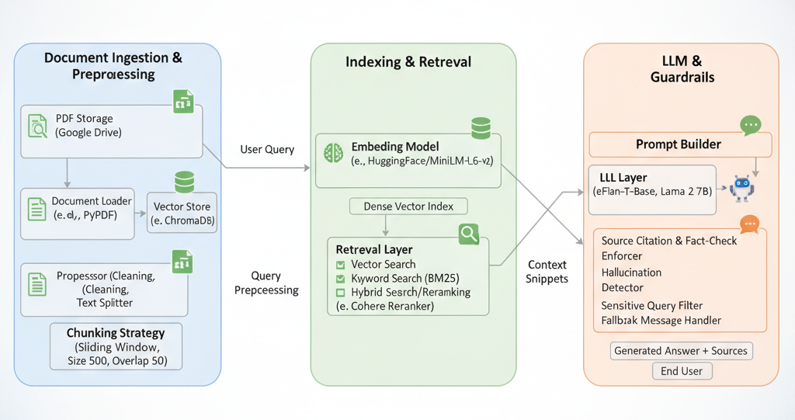
Task 2
RAG System Architecture
Components:
Document ingestion → Chunking → Embeddings → Retrieval → LLM → Answer with source

Slide 8
Task 2
Retrieval Strategy & Guardrails
Chunking: 400 token size with 100 token overlap balances context retention and performance
Dense vector search combined with reranking ensures high-quality, relevant results
Enforcing source citations combats hallucination and supports answer faithfulness
Fallback strategy handles cases with no relevant documents gracefully
Blocks or flags sensitive queries for safety and compliance
Monitors retrieval quality using precision@k, recall@k, and answer faithfulness metrics
The system uses efficient chunking and reranked vector search to improve retrieval relevance. Source citations are enforced to ensure accurate and trustworthy answers, while fallback strategies handle missing or sensitive queries gracefully. Retrieval quality is continuously monitored using precision@k, recall@k, and faithfulness metrics to maintain reliable performance.

Slide 9
Task 2
Scalability & Prototype
Scales to 10x more documents with sharding and distributed vector indexing
Supports 100+ concurrent users via serverless or containerized cloud infrastructure
Cost-effective deployment leveraging GPU-efficient inference with batching
Prototype built on open-source tools: Chroma vector store, Sentence Transformer embeddings, Hugging Face LLMs
Provides a demo supporting natural language Q&A with source citations
The prototype demonstrates how the system can answer real queries reliably. The design ensures it can scale up without performance loss and remain cost-efficient.

Slide 10
Task 2
Conclusion / Takeaways
We successfully analyzed 3 years of cyclone machine sensor data to understand operational patterns, detect anomalies, and forecast short-term behavior.
Clustering helped us identify machine states (Normal, High Load, Startup/Shutdown, Degraded) and link anomalies to potential causes.
Shutdown detection and anomaly insights provide actionable recommendations for monitoring and maintenance.
The RAG system design allows fast and reliable access to technical documents using open-source AI models with proper guardrails.
The combined solution demonstrates how data science and AI can improve operational efficiency, decision-making, and knowledge retrieval in a scalable and interpretable way.
Thank you

