Slide 1

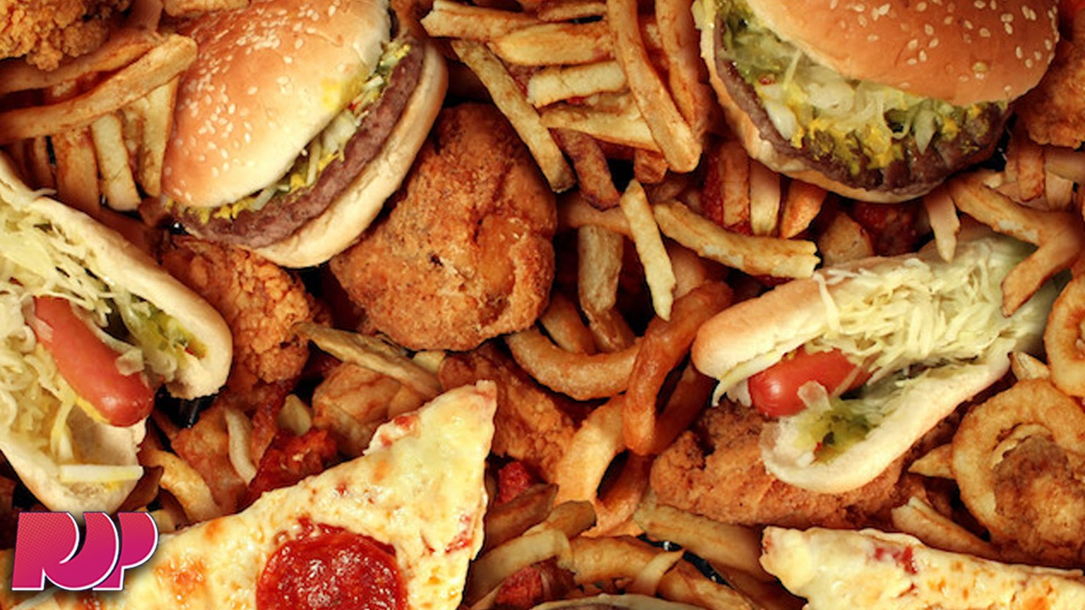
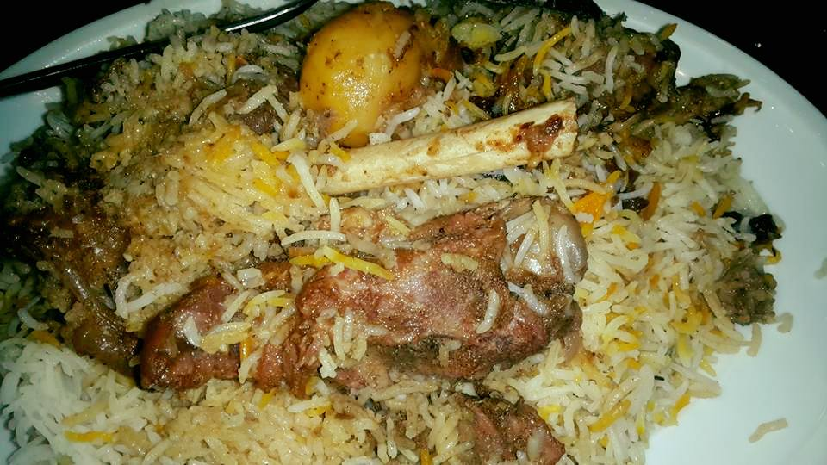
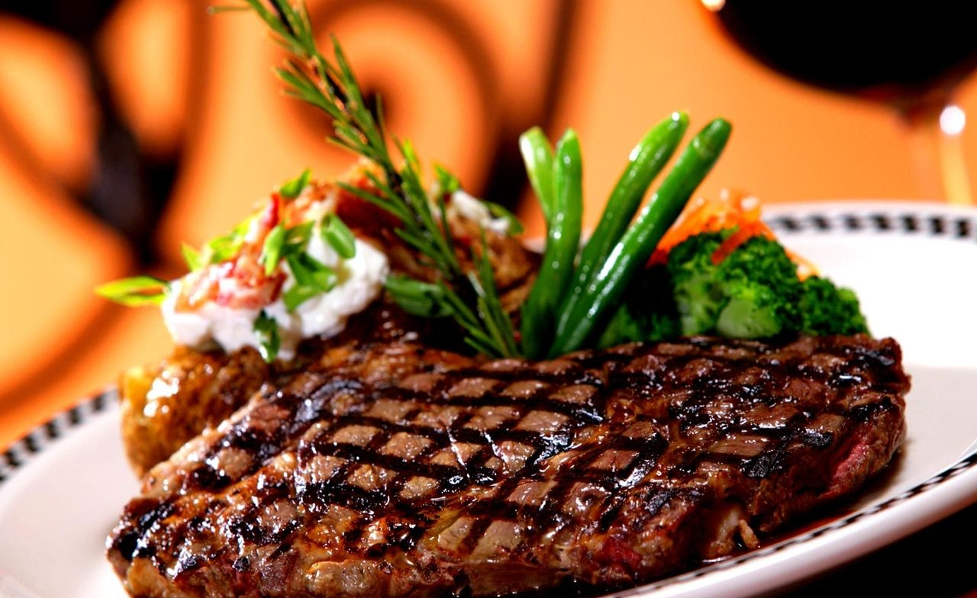


Slide 2


Slide 3
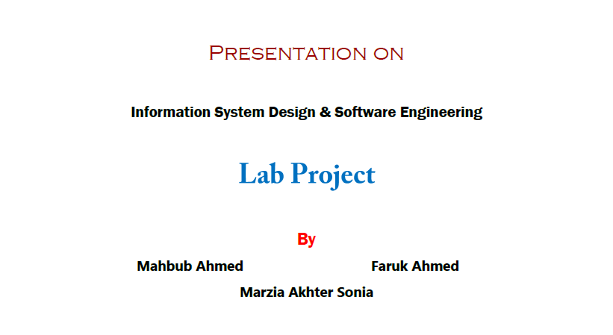

Slide 4

foodExpress

Slide 5
Problem Definition
The product(foodExpress) allows it’s customer/user to enter the expecting food name on the search bar and the system shows him the availability of the food.
User/customer can order items by clicking on the option to add that on a cart first. Finally he/she can confirm his order by clicking the specific option and fulfilling some criteria.

Slide 6
System requirement
Purpose: The reason is to describe about the system of a online buying and selling process of different types of food items.
There will be access for customers, sellers and admin.
Scope: The product is titled as foodExpress.
This system will perform the enquiry of the types of available foods,
their prices, tags, special offers, buying behavior etc.

Slide 7
System requirement
Overview: The System Requirement System contains an analysis of the requirements necessary to help easy design.
The overall description provides interface requirements for the Food Order System, product perspective, hardware interfaces, software interfaces, communication interface, memory constraints, product functions, user characteristics and other constraints.

Slide 8
Functional specification
User
Sales
Create an account
Login to the system
Search any item
Select any item and add to shopping cart for order
Remove item from shopping cart
Confirm order then admin will assign an sales man for delivery this order
Create an account as sales
Order any kind of item as a normal customer
A sales man can only see the allocated delivery items for him

Slide 9
Functional specification
Admin
Add a new/ update/ delete food type from system
Add a new/ update/ delete Special tag from system
Add a new/ update/ delete food item from menu
Update price, additional information (description, photo etc.) for a given food item.
Assign sales man for delivery
Manage user account
Lock user account for any kind of bad activity
Also order any kind of item as a customer / end user

Slide 10
The overall Description
Hard disk: the database connectivity requires a hardware configuration that is online. This makes it necessary to have a fast database system running on high rpm hard disk permitting complete data redundancy and back up system to support the primary goal of reliability.
software Interfaces
Back End : dot net core
Front End: html, css, JavaScript
Database : sql server

Slide 11
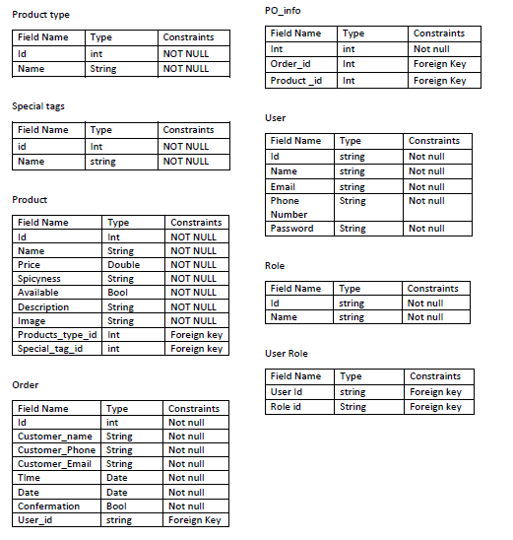
Data table

Slide 12
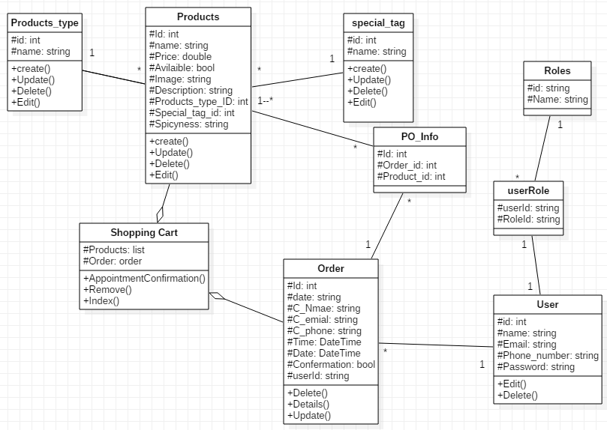
Class diagram

Slide 13
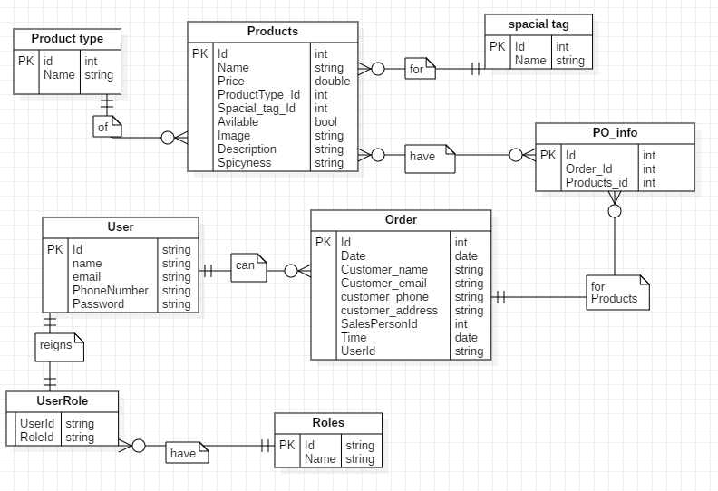
ER diagram

Slide 14
Mock project

Slide 15
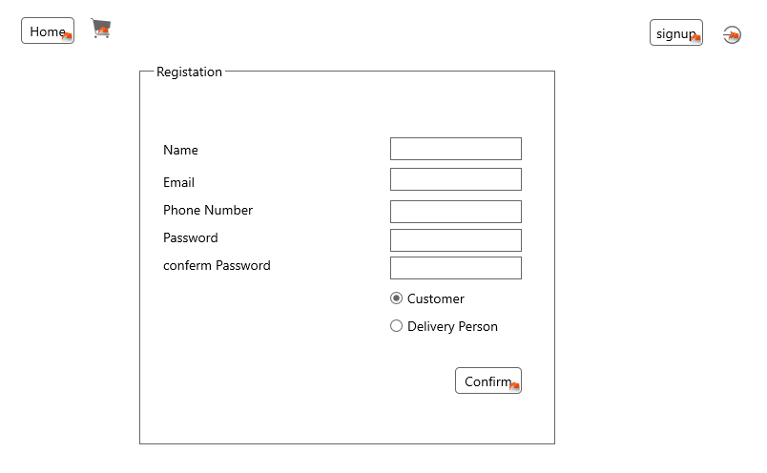
Registration

Slide 16
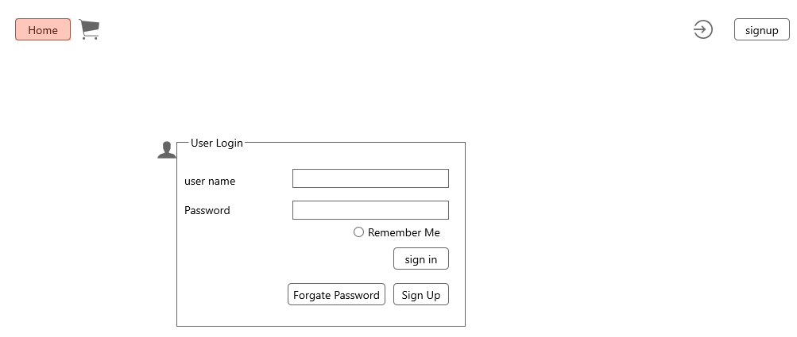
Login

Slide 17
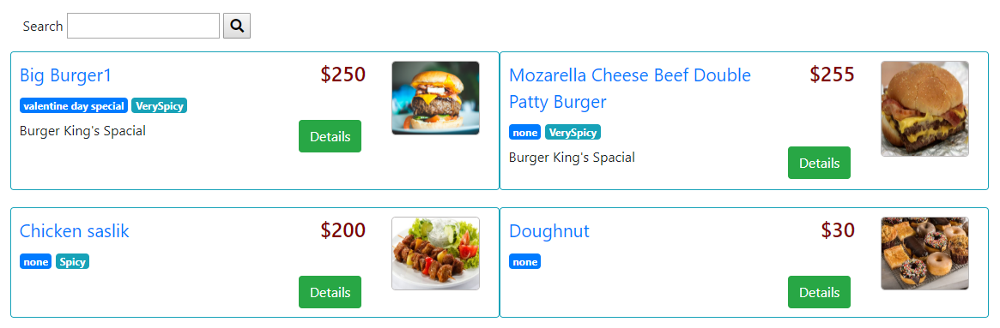
Home page

Slide 18

ADMIN

Slide 19
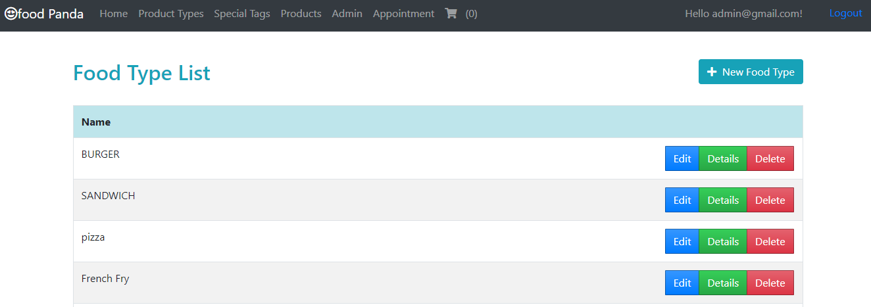
Admin add Product Types

Slide 20
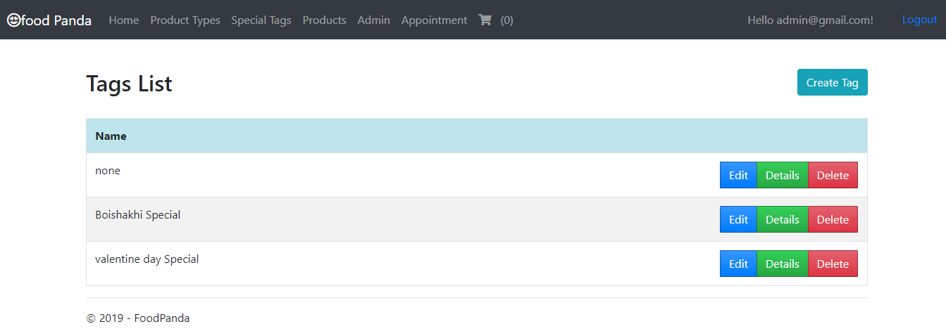
Admin add Special tag

Slide 21
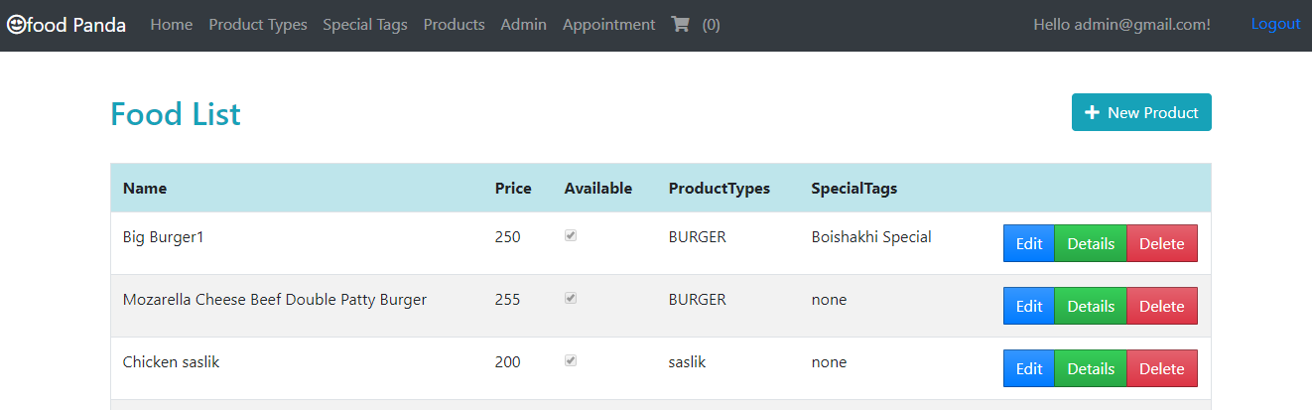
Add product

Slide 22
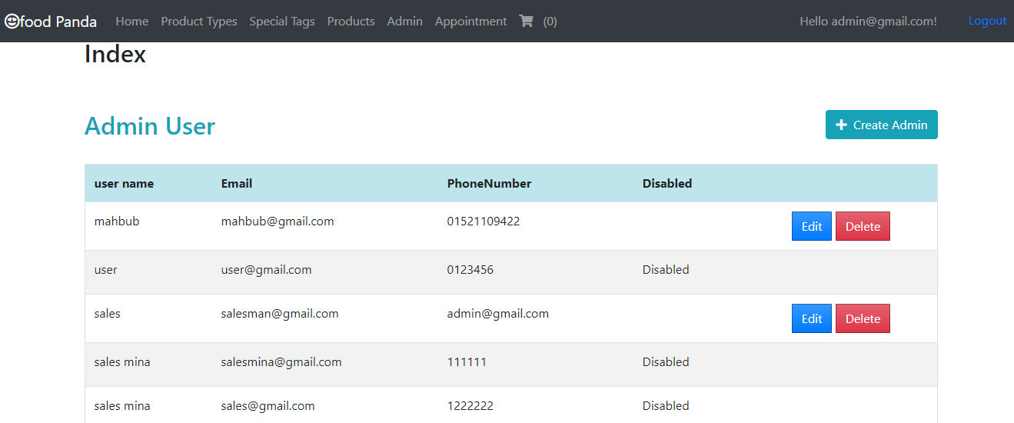
Manage user account

Slide 23
How to Order any type of Food

Slide 24
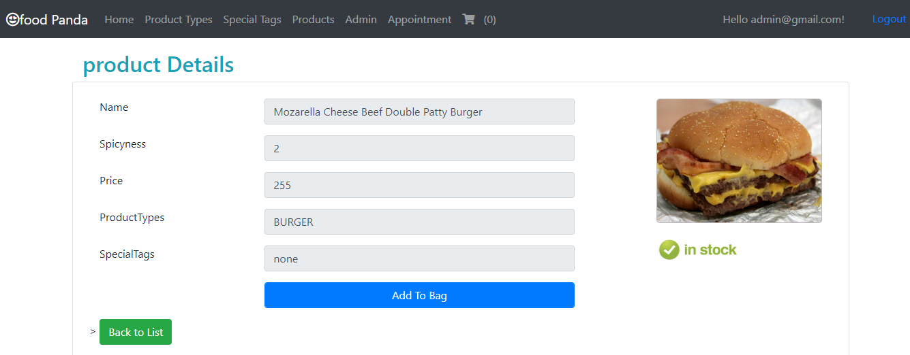
Add to cart

Slide 25
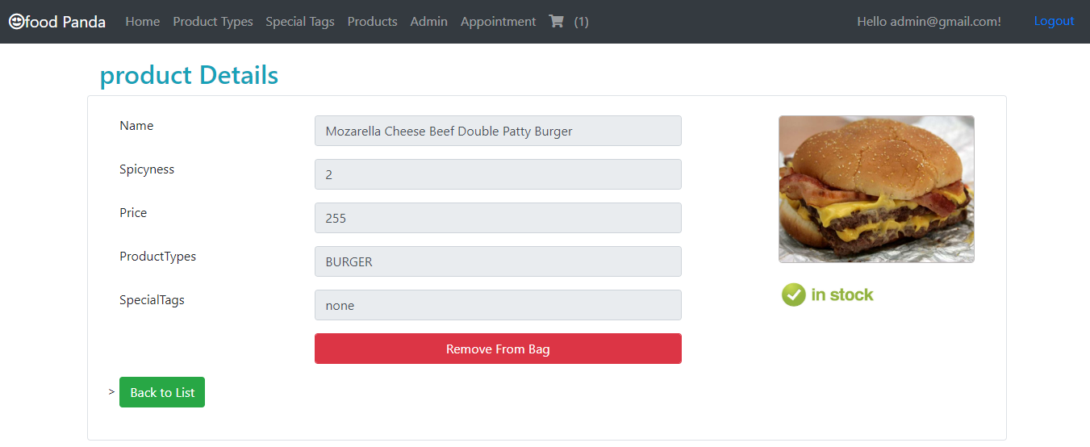
Remove from cart

Slide 26
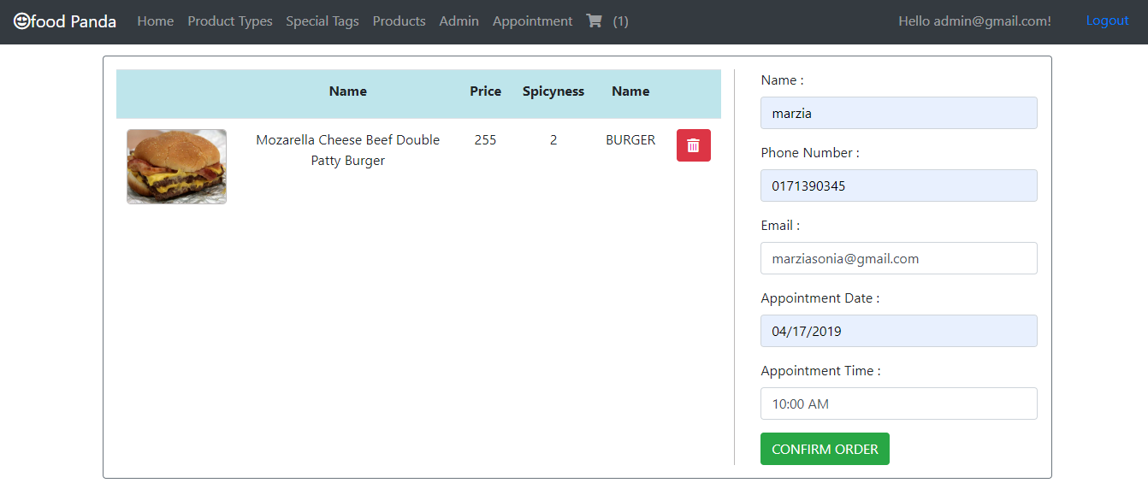
Confirm order

Slide 27
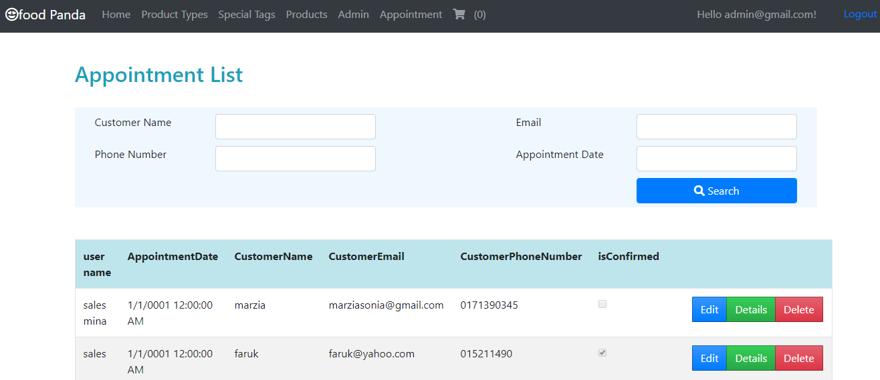
Admin assign sales man for per order

Slide 28

Delivery Person

Slide 29
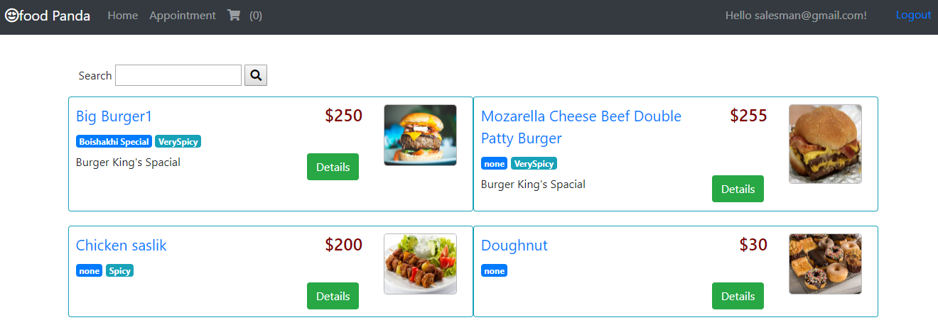
Delivery Person

Slide 30
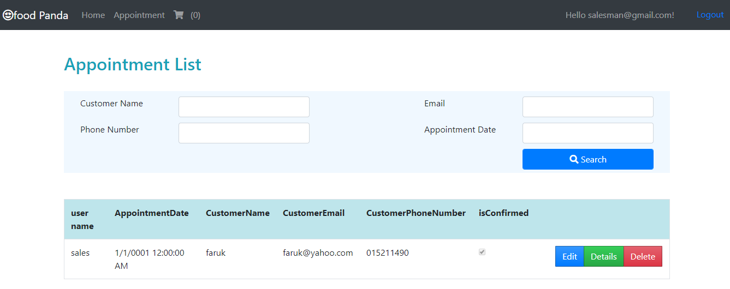
Appointment

Slide 31

End User

Slide 32

User view

Slide 33
Main Project Presentation

Slide 34


Slide 35


