Slide 1











DocTime
WE ARE HERE TO MAKE PEOPLE’S LIFE EASIER

Slide 2
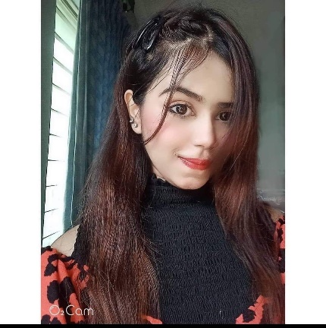
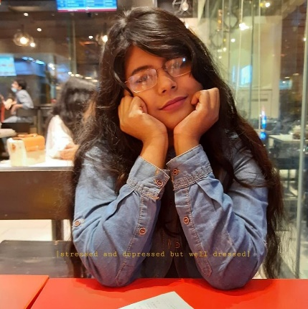
Project Member’s
MAHBUBA HAQUE LAKA
RIFAH TAMANNA
18201085
18201073

Slide 3



MOTIVATION
Main objective of this project is to remove barrier between doctor and patient.This project will help patients to reach doctor within short possible time and will help doctors to appoint more patient within vedio call.Overall it will increase medical facility in our country.

Slide 4

PROBLEM DEFINITION
In our country most of the people can’t consult doctor for various reason .People need to move from rural area to city for treatment which is costly,They are not sure either doctor is free or busy at their desired consultation time,most of the time they don’t have enough financial support to reach doctor.In this COVID situation it is miserable situation for emergency patient to reach doctor.Our project will try to reduce this barrier between doctor and patient through virtual contact.

Slide 5
OBJECTIVE,SOLUTION,
PROJECT OUTPUTS:
Scalable and sustainable project.
Virtual doctor chamber.
Availability.
Security.
>>>> Our main objective is to build a scalable and sustainable project,this project is a solution to doctor chamber which will be shifted by virtual one.Output of this project is patient can reach doctor from anywhere and get treatment.In Consult within vedio call ,for security purpose we develop hand shaking protocol where Both side must be agree to join in consultation.If doctor couldn't permit the patient then they don't join the call.So this process will run into a scheduling.

Slide 6
IMPACT ON SOCIETY
Reduce time to reach doctor.
People from any region can reach doctor.
Emergency treatment is possible to anywhere.
Consultant with doctor via video call.
In this COVID situation it will be easy to consult doctor.

Slide 7
Implementation Challenges.
Connection loss.
Sometimes need to train.
CRITICAL CHALENGES

Slide 8
CONFLICTING REQUIREMENTS
1. To make people used to in our system.
2. Internet facility for remote area’s people .
3. It will be hard to get giant investor to boost up the development process.
2.People must have smart phone.

Slide 9
How P’s & K’s are addresses for our project–

Slide 10
HOW P’S ARE ADDRESSED
Ps | Attribute | How Ps are addressed through the project | CO | PO
P1 | Depth of Knowledge Required | The project requires how bangladeshi doctor consult with patient & will analyze how the current systems work(K8), web-based backend (Python programming language and Django framework), and frontend design (HTML, raw CSS, and JavaScript) (K5, K6). | CO1 CO2, CO3, CO4, CO7, CO8 | PO(a), PO(b), PO(c), PO(e), PO(i), PO(j)
P2 | Range of Conflicting Requirement | We are trying to reach a wide range of the population of our country through our ODC system. But there are many people who don’t have the required device & internet connection which can fulfill the requirement for running this system.So, it will be a big challenge for us. | CO2, CO5, CO7 | PO(b), PO(f) PO(g) PO(i)
P3 | Depth of analysis required | There are different frameworks to implements this system such as laravel, asp.net, ruby on rails etc. So there is no obvious way. | CO5, CO6, CO7 | PO(f), PO(h), PO(i)
P4 | Familiarity of issues | There can be transaction errors because of internet issues or device related issues or server issues. Moreover, some people can not use this frequently so that they need to train at first. | CO2, CO3, CO7, CO9 | PO(b), PO(c), PO(i), PO(k)

Slide 11
HOW P’S ARE ADDRESSED
Ps | Attribute | How Ps are addressed through the project | CO | PO
P6 | Extent of stake-holder involvement and conflicting requirements | Diverse groups of stakeholders (people of every different class from all around the country ) will benefit from this project. | CO1 CO2, CO3, CO4, CO7, CO8 | PO(a), PO(b), PO(c), PO(e), PO(i), PO(j)
P7 | Interdependence | Hand-shaking protocol, Two-way authentication ,User application are the major components of our system. | CO2, CO5, CO7 | PO(b), PO(f) PO(g) PO(i)

Slide 12
How K’s ARE ADDRESSED
Ks | Attribute | How Ps are addressed through the project | CO | PO
K3 | Engineering Fundamentals | We have identified real life problems in the manual system which can be solved using engineering fundamentals knowledge such as basic programming (Django framework, Python) | CO2, CO5, CO7 | PO(b), PO(f) PO(g)
K4 | Specialist knowledge | We are applying socket programming for implementing some of the key modules of our system. Besides, we are also using, bootstrap. | CO5, CO6 | PO(f), PO(i)
K5 | Engineering Design | At the starting stage of the development, We are going to implement architectural design according to our project requirement. For designing our system’s Front-end using UI/UX | CO2, CO7, CO9 | PO(b), PO(c), PO(i),

Slide 13
How K’s ARE ADDRESSED
Ks | Attribute | How Ps are addressed through the project | CO | PO
K6 | Engineering Practices | We are using Django and Python programming language for this system development. We have planned and carried out an investigation using computational thinking. Also constructed explanations and designed the solution. | CO1 CO2, CO3, CO4, CO7, CO8 | PO(a), PO(b), PO(c), PO(e), PO(i), PO(j)
K7 | Comprehension | ODC economically benefits the society by reducing time to reach doctor & also emergency treatment is possible to anywhere. | CO2, CO5, CO7 | PO(b), PO(f) PO(g) PO(i)
K8 | Research literature | We have researched about all of the knowledge required for develop intelligence and solve problems in the current existing systems and tried to find all the solutions of these issues. | CO5, CO6, CO7 | PO(f), PO(h), PO(i)

Slide 14
PROJECT MANAGEMENT
Week 7
Development
Week 1
Week 4
Planning
Week 2
Research
Feasibility Study
.
Week 5
Ui Design
Week 6
Development
Week 8
Week 13
Documentation
Week 11
Implementation
Testing
Week 14
Week 9
Submission
Development of database
Week 10
Deployment
Week 12
Documentation

Slide 15
COST ANALYSIS
Project |  | Estimated Hours | Developers |  | Analysts |  | Others | Total Cost | Status
Phase |  |  | Req. | Avg. Cost | Req. | Avg. Cost | Cost
1 | Phase 1 | 48 | 5 | $150 | 5 | $150 | $150 | $3,030
2 | Phase 2 | 47 | 5 | $150 | 5 | $150 | $150 | $3,810
3 | Phase 3 | 55 | 5 | $90 | 5 | $150 | $150 | $3,450
 | Total | 150 | 15 |  | 15 |  | $450 | $10,290
 | Estimated Hours | 150
 | FTE | 30
 | Total Cost | $10,290
T

Slide 16
THANK YOU
IF THERE’S ANYTHING YOU WANT TO KNOW
PLEASE ASK US

