Slide 1

DocTime

Slide 2
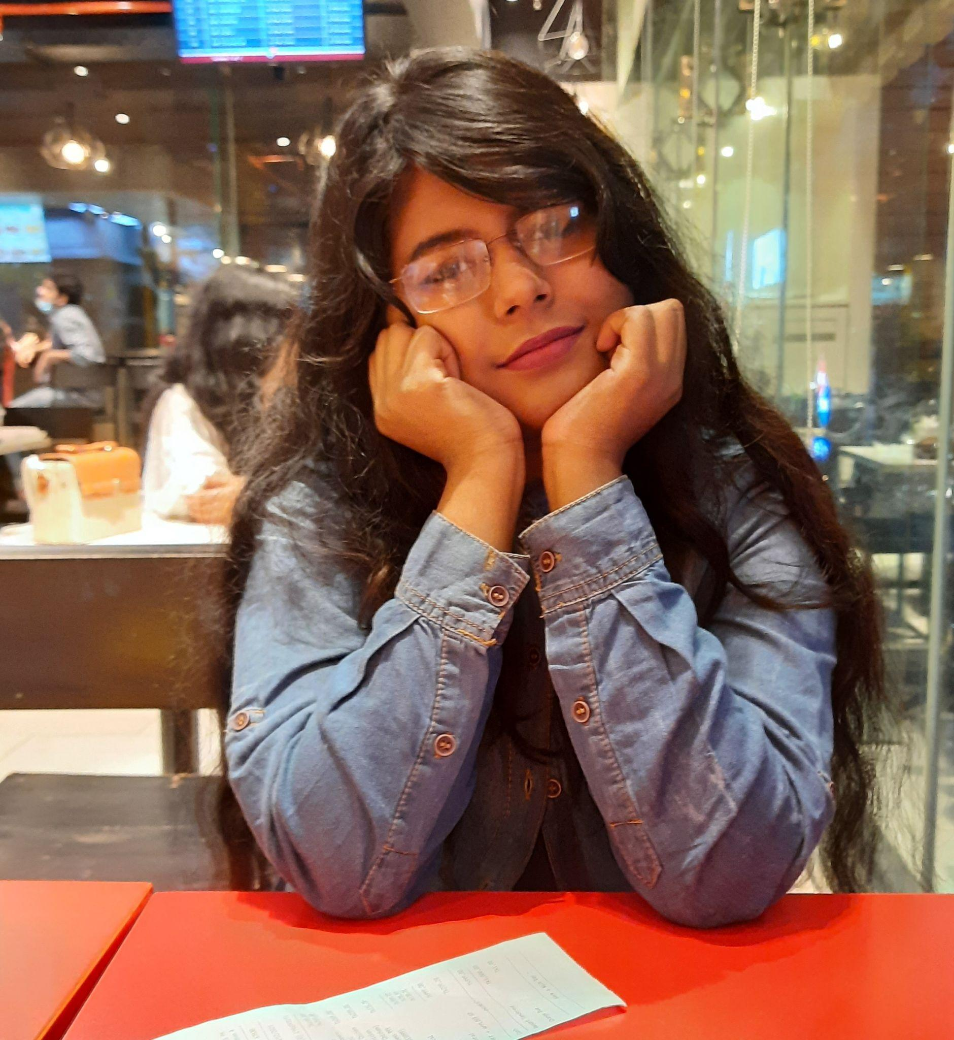

THE TEAM MEMBERS
RIFAH TAMANNA ||18201073
MAHBUBA HAQUE LAKA|| 18201085

Slide 3
Functional Requirements:
HARDWARE REQUIREMENTS–
Core i3 (2.40 Ghz)
4 MB RAM
240 GB HARD FREE DRIVE SPACE

Slide 4
SOFTWARE REQUIREMENTS
Database: SQLite version: 3.37.2
Operating System: Windows Version:10
Front end & back end technology:
Front end – Bootstrap Version: 4.0 HTML Version: 5
JavaScript Version: ES6
Back end– Python Version: 3.7.9
Django Version: 4.0
IDE: Visual Code Studio Version: 1.63.2

Slide 5
Design requirement:
Project features:
\
Appointment list
Appoint/Book Doctor
Video conversation between doctor & patient
Chat encryption
Notification/Email

Slide 6
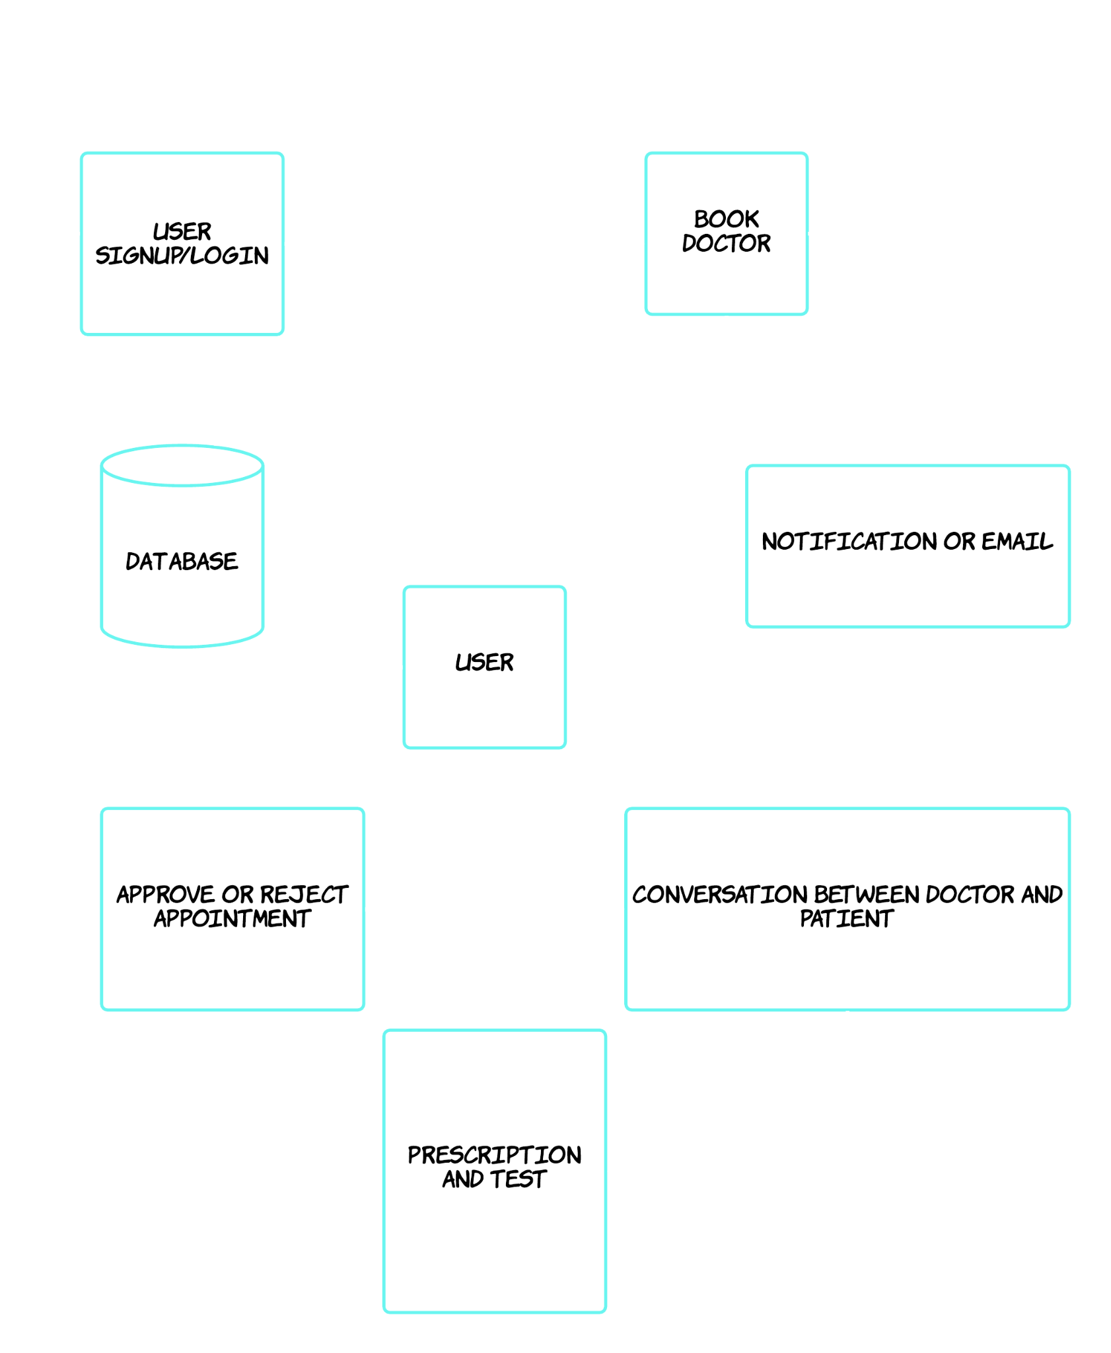

Slide 7
Module =>
Patient will login to the system and his information will be stored in the database. Then they will see some list of doctors.Patient will book their doctor according to time.
As soon as they book the doctor the notification will go to the doctor which stored in database.Then the doctor will approve the patients & reject them.
After approving consultation will start between doctor & patient via vedio call.Thus,after consultation, the doctor will give them prescription.Which is totally encrypted between them.

Slide 8
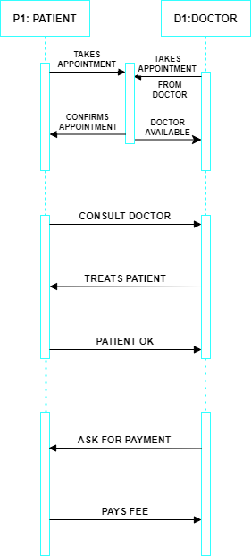
Sequence Diagram:-

Slide 9
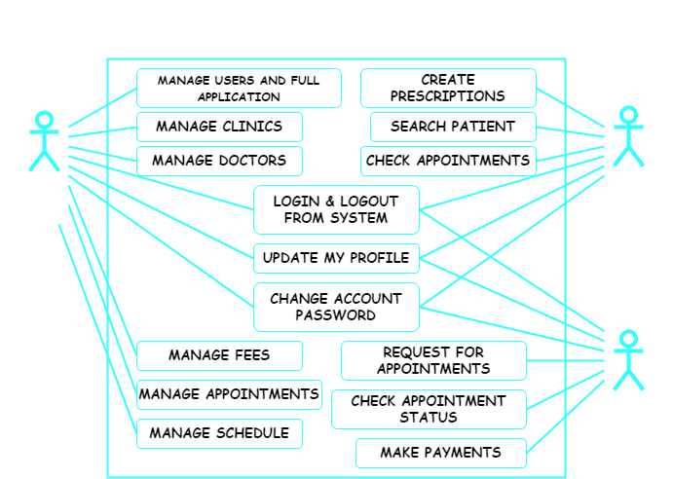

Slide 10
THANK YOU

