Slide 1
GROUP MEMBERS OF THE PROJECT
MAHBUBUR RAHMAN (18 - 36569 - 1)
ASEYA KHANOM (17 - 35394 - 3)
HABIBA NASREEN (18 - 36565 - 1)

Slide 2
DOCTOR FINDER

Slide 3
INTRODUCTION
This project is made with the basic of Object Oriented Programming II.
It’s an application to be used by two types of user:
Patient
Doctor
A patient can have one or multiple appointments from doctors and find their chambers (based on nearest location) to visit them. Based on the location, this application mainly aims for any patient to search for him/her the nearest doctors according to their required department. On the other hand, a doctor can fix appointments from patients on a particular date, accept appointments, check the selected/pending appointments and also can delete any if user (doctor) wishes.

Slide 4
PROBLEM STATEMENT
Sickness being a part of human life causes many hardships sometimes.
Bearing struggle for in need of doctor’s checkup
Time and cost concern:
Going to a hospital, stand in the queue to register desk, ask for doctor's free time schedule, make appointment, again come there on the appointment date
Waiting for a long time even it's about an emergency check up
Finding difficulties to search for a doctor’s chamber here and there for a person shifting to a new place
Finding the doctors to the nearest location instantly, this application is of a great help
Physical struggle:
Tolerating a lot of pain and stress to look for a doctor by searching on foot/vehicle for a sick person having no company at all.
On the other hand, for a doctor, managing/ a lot of record papers creates a lot of mess
Requiring of assistance to tell about his free/busy time schedule to patients
Acknowledging the problems of a patient earlier before the visiting

Slide 5
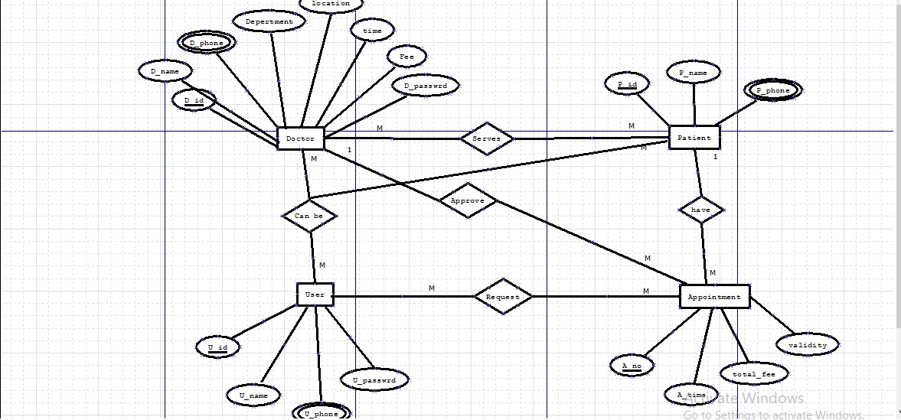
E-R DIAGRAM

Slide 6
SOFTWARES USED
VISUAL STUDIO
MYSQL

Slide 7
PROJECT FEATURES
USER: PATIENT
USER: DOCTOR
Create user- patient account
Search doctor
Create multiple appointments
Set/fix appointments
See current and pending appointments
Create user- doctor account
Accept appointments
See current appointments
Delete/cancel appointments
See patient’s short description

Slide 8
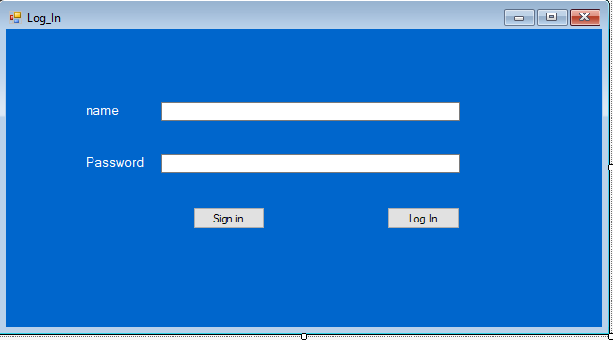
PROJECT SCREENSHOTS
LOG IN FORM

Slide 9
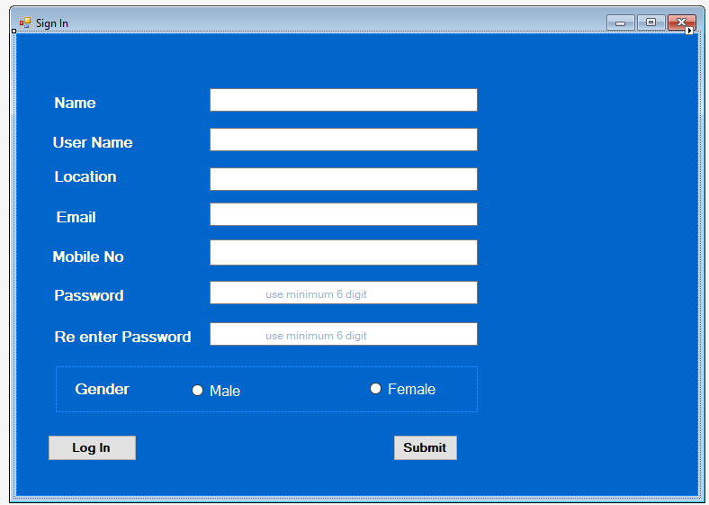
PROJECT SCREENSHOTS
SIGN IN FORM

Slide 10
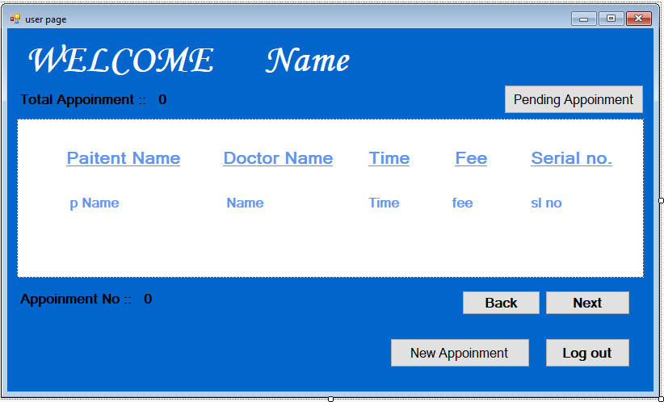
PROJECT SCREENSHOTS
USER PAGE

Slide 11
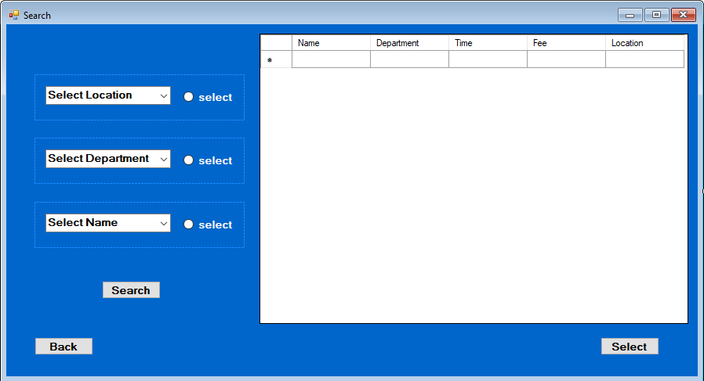
PROJECT SCREENSHOTS
SEARCH DOCTOR

Slide 12
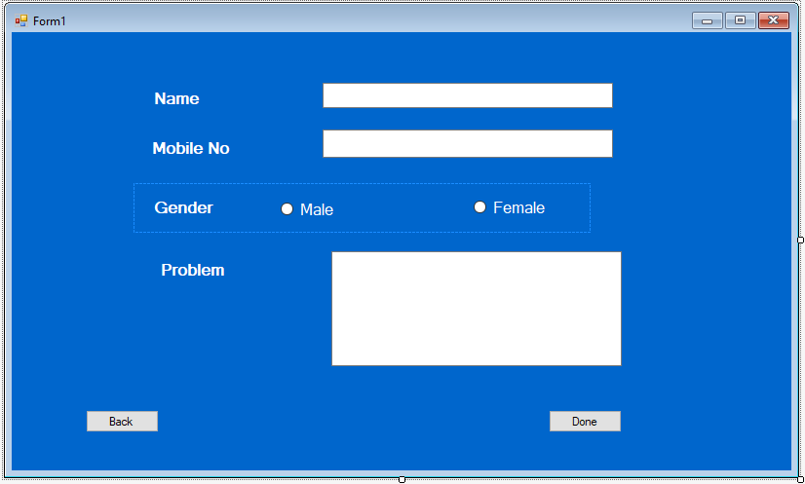
PROJECT SCREENSHOTS
APPOINTMENT APPLICATION

Slide 13
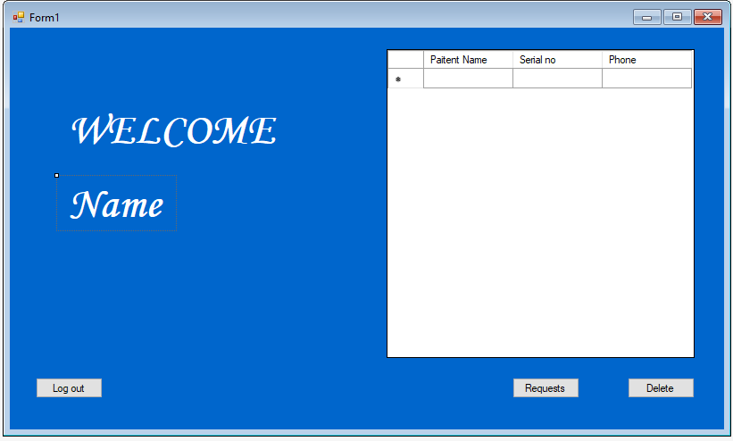
PROJECT SCREENSHOTS
DOCTOR PAGE

Slide 14
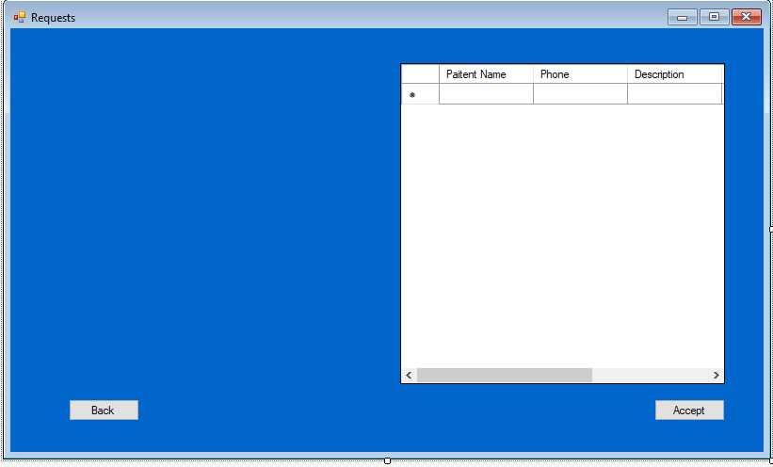
PROJECT SCREENSHOTS
APPOINTMENT REQUESTS

Slide 15
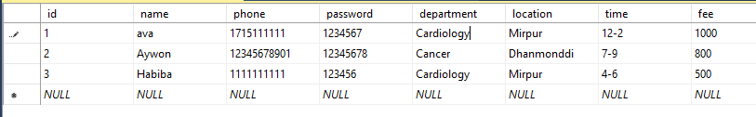
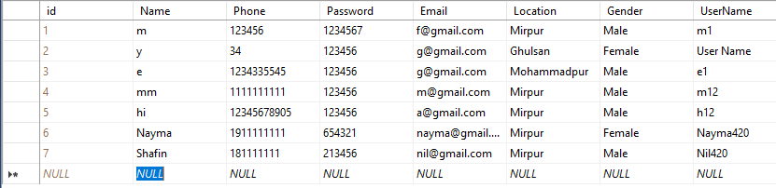
DESIGN SCREENSHOTS
Doctor log
User log

Slide 16
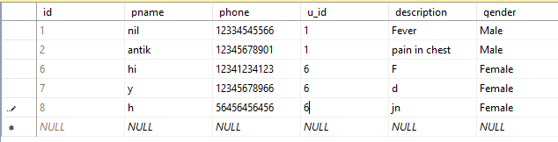
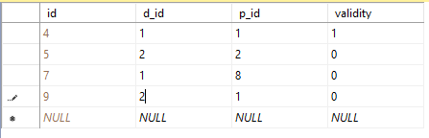

DESIGN SCREENSHOTS
Patient log
Appointment
Accepted Appointment

Slide 17
THANK YOU!

