Slide 1

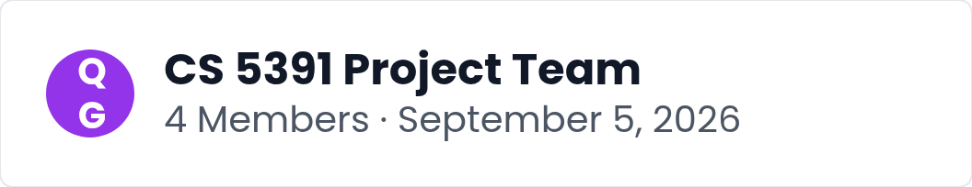
Introducing QueryGuard
A transparent, deterministic validation gate that checks LLM-generated SQL before it reaches the database, paired with an evaluation corpus and continuous integration to keep the gate honest over time.
Notes:
Welcome everyone. We are the CS 5391 project team of four members, and today we present our course project proposal, QueryGuard. Large language models can generate powerful SQL, but also unsafe statements. QueryGuard is a transparent, deterministic gate that validates model-generated SQL before execution, supported by an evaluation corpus and continuous integration.

Slide 2





Unchecked LLM-Generated SQL
Frameworks pass LLM-generated SQL straight to the database; 96 percent of prompt-injection attacks succeed.
Vanna AI RCE (CVE-2024-5565)
Remote code execution through crafted queries, carrying a CVSS score of 8.1.
LlamaIndex NL2SQL (CVE-2025-1793)
The NL2SQL engine was exploited to run attacker queries, rated CVSS 9.8, the most severe.
AnythingLLM Plugin (CVE-2026-32628)
The SQL agent plugin allowed personal data extraction, scored CVSS 7.7.
Notes:
This slide frames the threat landscape. Natural-language database queries are convenient, but the generated SQL reaches the database without review, and real CVEs prove the impact. Vanna AI enabled remote code execution at CVSS 8.1, LlamaIndex NL2SQL exploitation reached 9.8, and an AnythingLLM plugin leaked personal data at 7.7. Research found 96 percent of manual prompt-injection attacks succeed against undefended pipelines, so the problem is systemic, not theoretical.

Slide 3


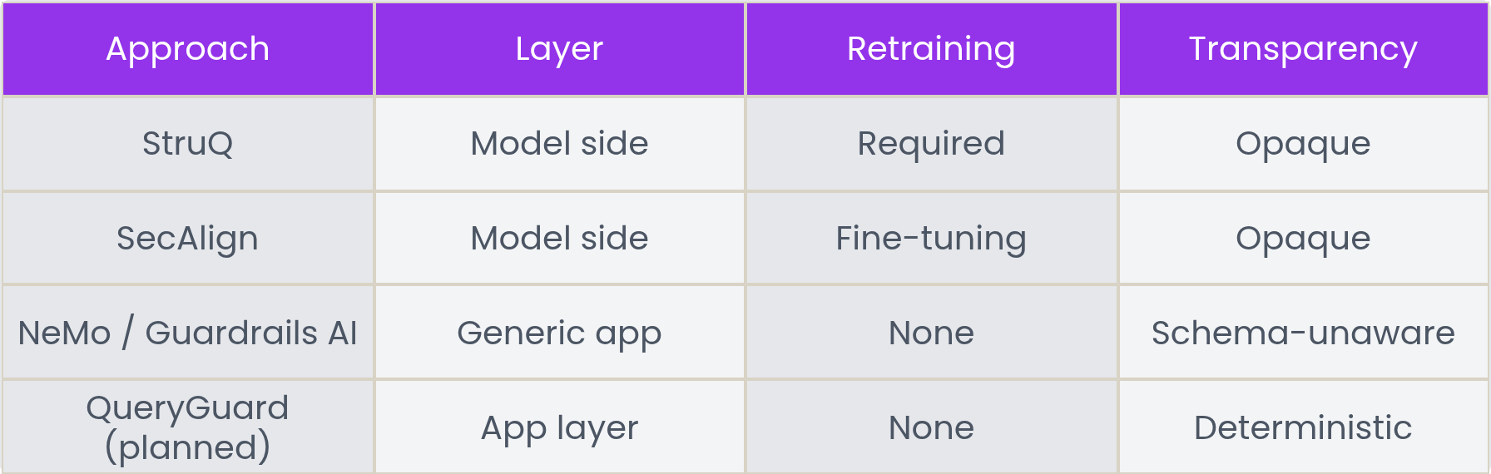
Defenses & Gaps
The missing piece is a transparent, deterministic, SQL-specific check sitting between the LLM and the database. QueryGuard is planned to fill exactly that gap at the application layer.
Notes:
This slide contrasts current defenses with the gap QueryGuard will address. Model-side fixes like StruQ and SecAlign demand retraining or fine-tuning, while generic guardrails such as NVIDIA NeMo Guardrails and Guardrails AI act as schema-unaware, opaque classifiers. Neither provides a transparent, deterministic, SQL-specific check between the LLM and the database, which is precisely where QueryGuard is planned to operate at the application layer.

Slide 4

Five-Stage Pipeline
1
Request Intake
2
LLM Generator
The user request enters the pipeline and is captured for processing by the QueryGuard application layer.
A large language model, or a deterministic mock, produces a candidate query without touching the database.
3
Validation Gate
4
ReadOnly Executor
Ten deterministic rules inspect the query before it is allowed to proceed anywhere near the datastore.
Executes only queries that passed the gate, holding strictly read-only permissions against the data store.
5
Audit Log
Every decision is recorded in an append-only audit log, making the full trail transparent and reviewable.
Notes:
QueryGuard sits at the application layer as a transparent, deterministic validation gate. Requests flow through five stages: intake, generation by an LLM or a deterministic mock, a gate applying ten deterministic rules, a read-only executor that accepts only gate-passed queries, and an append-only audit log. Stress that the trust boundary is architectural, not advisory: safety is enforced by construction, not by prompt instructions.

Slide 5



The Validation Gate
Every generated query receives a verdict of PASS or BLOCK with the rule that fired. Developers and reviewers see readable decisions with clear evidence.
Deterministic rules
Sensitive columns
10
MASKED
Missing row limits
Proposed
Notes:
Every query that passes through the gate gets an explicit verdict of PASS or BLOCK, along with the specific rule that fired. The planned behavior relies on ten deterministic, inspectable rules so outcomes never feel arbitrary. Sensitive columns can be masked instead of blocked outright, and missing row limits can be suggested. This gives developers and reviewers readable decisions with clear evidence for every query the gate evaluates.

Slide 6
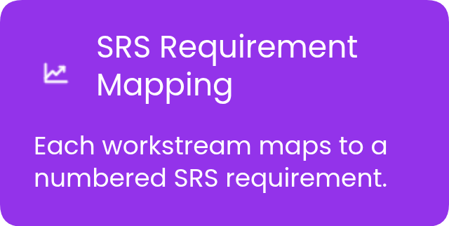
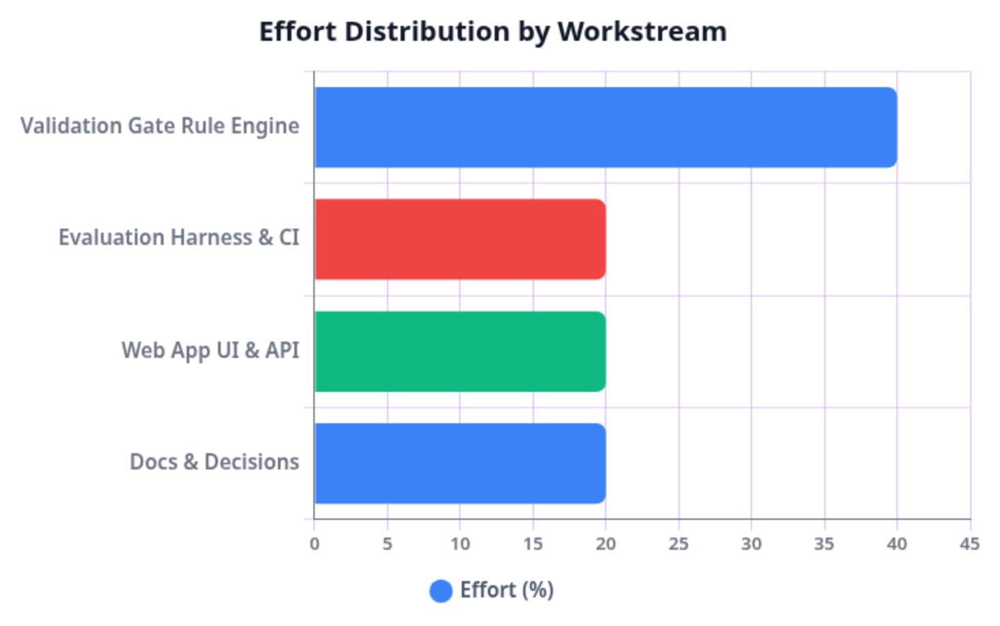
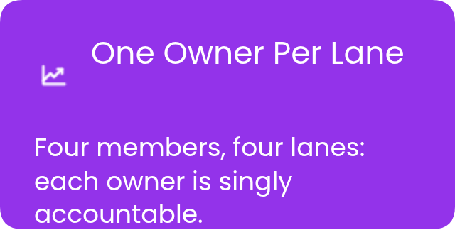
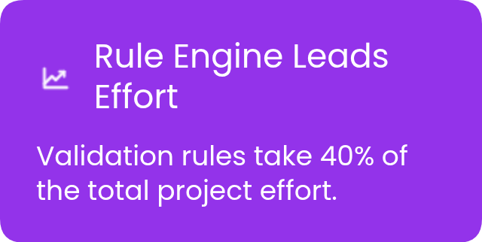
Four Workstreams, Four Owners
The project is organized into four workstreams, each mapped to a numbered SRS requirement and a dedicated team lane, with one accountable owner per workstream across the four-member team.
Notes:
This slide breaks the project into four parallel workstreams and assigns one owner to each across the four-member team. The validation gate rule engine carries the largest share at forty percent, reflecting its technical complexity, while the evaluation harness, web application, and documentation each receive twenty percent. Each workstream maps directly to a numbered SRS requirement, keeping scope, ownership, and deliverables aligned.

Slide 7
Evaluation Plan
100%
<10%
<50ms
Block rate required on destructive attack classes, measured against 30 attack prompts spanning six published attack classes
False positive rate on 30 benign prompts, with every result reported openly regardless of whether the target is met
p95 added gate latency ceiling, with zero silent regressions enforced by running the corpus in continuous integration
Notes:
This slide outlines the evaluation plan, which is planned work that has not yet been executed. The corpus contains thirty attack and thirty benign prompts drawn from six published attack classes. Four targets are set: full blocking of destructive classes, false positives under ten percent reported openly, p95 added latency under fifty milliseconds, and zero silent regressions, enforced by running the corpus in continuous integration so a broken rule fails the build.

Slide 8


Course Plan and Stack
Member One
Member Two
Requirements Lead
Backend Lead
Owns the SRS with numbered requirements that map directly to test cases for traceability.
Builds the Python Flask web app and the SQLite demo database with deliberately sensitive columns.
CS 5391 Software Engineering group project with four members. Milestones: proposal and presentation, SRS mapped to tests, implementation, final demo. Stack: Python, Flask, SQLite, pytest, GitHub Actions, mock LLM.
Member Three
Member Four
QA and CI Lead
LLM Integration Lead
Runs pytest suites and GitHub Actions pipelines so every numbered requirement is tested in CI.
Delivers a deterministic mock LLM mode with an optional live LLM for the final demo.
Notes:
This slide frames the course context and technical foundation. The project runs in four milestones: proposal and presentation, an SRS whose numbered requirements map to test cases, implementation, and a demo before the final. The stack pairs Python and Flask with a SQLite database containing deliberately sensitive columns, pytest and GitHub Actions for continuous integration, and a deterministic mock LLM mode with an optional live LLM. Introduce the four roles and their milestone mappings.

