Slide 1








QueryGuard
Safety Gate for LLM SQL
Presented by M. Mahd Amjad and Arwa Arafeh — CS 5391 Software Engineering group project, two-member team — September 9, 2026
Mahd Amjad
with Arwa Arafeh
Notes:
Good morning everyone. Today we present QueryGuard, our CS 5391 Software Engineering group project, developed by the two-member team of M. Mahd Amjad and Arwa Arafeh, dated September 9, 2026. We will outline the risk of unguarded LLM-generated SQL, review existing defenses and the gap they leave, and introduce QueryGuard as a deterministic validation gate. We will close with our workstreams, the evaluation we plan to run, and our course milestones.

Slide 2

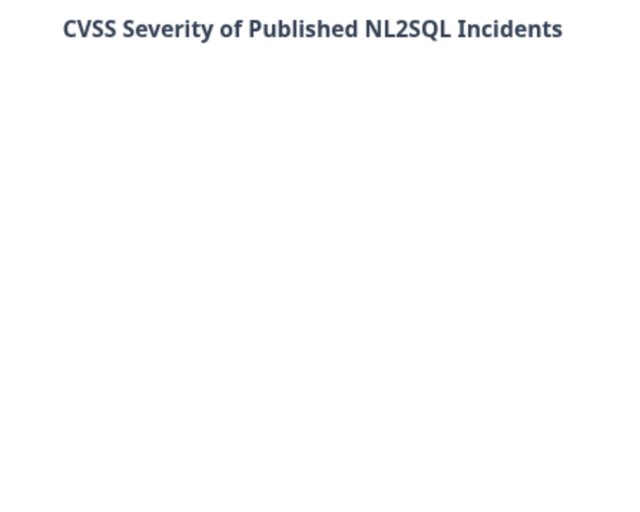
The Problem: Unguarded LLM-Generated SQL
96%
9.8
Injection Success Rate
Peak CVSS Score
Many frameworks pass model-generated SQL straight to production databases without checks.
Published CVEs from 2024 to 2026 span remote code execution and personal data extraction.
Notes:
Applications let users query databases in plain English, and many frameworks forward the model's SQL directly to the database. Published CVEs in Vanna AI, LlamaIndex, and AnythingLLM show impacts from remote code execution to personal data extraction. Our research baseline is that 96 percent of manual prompt-injection attacks succeed against undefended pipelines. Evaluating defenses is planned upcoming work by team members M. Mahd Amjad and Arwa Arafeh, presented on September 9, 2026.

Slide 3

Existing Defenses and the Gap
Model-Side Fixes
StruQ and SecAlign harden prompts at the model level, but both require retraining or fine-tuning.
Generic Guardrails
NVIDIA NeMo Guardrails and Guardrails AI are schema-unaware and rely on opaque classifiers.
The Missing Layer
A transparent, deterministic, SQL-specific check between the LLM and the database that explains every decision.
Notes:
This slide reviews prior defenses to frame our planned work. Model-side fixes like StruQ and SecAlign operate at the model level but demand retraining or fine-tuning. Generic guardrails such as NVIDIA NeMo Guardrails and Guardrails AI are schema-unaware and rely on opaque classifiers. What is missing, and what we plan to build, is a transparent, deterministic, SQL-specific check positioned between the LLM and the database that understands the schema and explains every decision it makes.

Slide 4










QueryGuard: A Deterministic Validation Gate
Executor
A read-only executor runs only gate-passed queries.
Audit Log
Append-only records make every query traceable.
Validation Gate
The deterministic gate checks SQL before execution.
Intake
Every incoming request enters the pipeline here.
Generator
An LLM or deterministic mock drafts a SQL query.
Notes:
QueryGuard sits at the application layer between the LLM and the database, giving us a transparent validation gate. The pipeline moves through five planned stages: intake, generation by an LLM or deterministic mock, validation, a read-only executor, and an append-only audit log. Because the executor accepts only gate-passed queries, the trust boundary is architectural rather than advisory, so safety does not depend on prompt wording.

Slide 5






Inside the Validation Gate
Ten Deterministic Rules
Verdict on Every Query
Evaluation is planned: ten fixed rules check every generated query, every time.
Each query receives a clear PASS or BLOCK verdict, together with the exact rule that fired.
Sensitive Columns
Suggested Missing Limits
When sensitive columns appear, the gate plans to MASK them before any query can run.
Missing limits can be SUGGESTED, giving developers a clear reason for every block.
Notes:
Inside the validation gate, ten deterministic rules are applied to every generated query. Each query receives a PASS or BLOCK verdict along with the rule that fired, sensitive columns can be masked, and missing limits can be suggested. Because outcomes are deterministic, the gate is explainable and testable, unlike opaque classifier approaches, and developers always get a clear reason for every block. Evaluation is planned work carried out by M. Mahd Amjad and Arwa Arafeh.

Slide 6

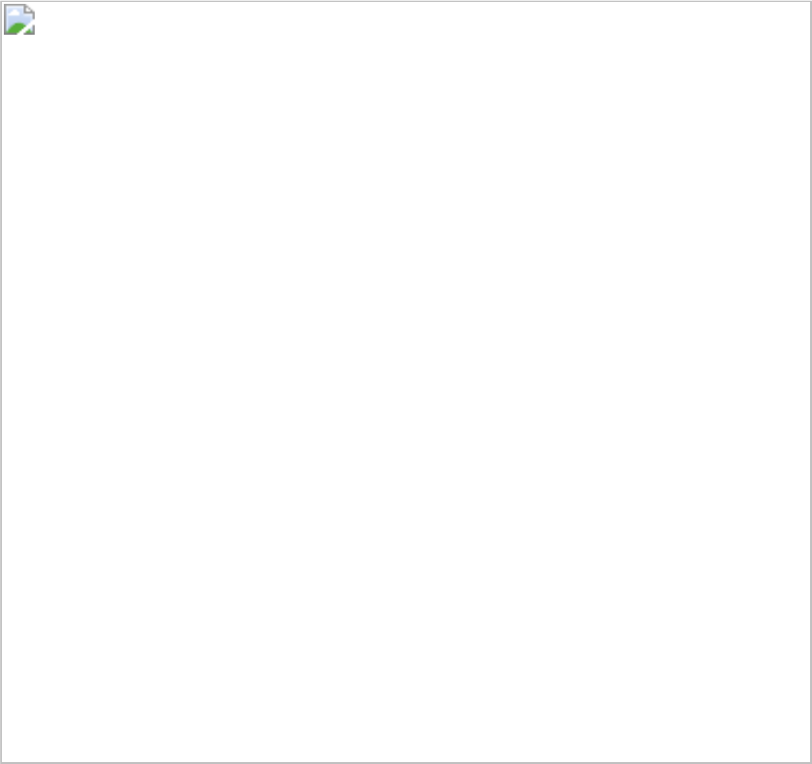








Workstreams and Ownership
40%
20%
Validation Rules
Harness and CI
M. Mahd Amjad owns the validation gate rule engine, the largest planned share.
Engine
M. Mahd Amjad builds the evaluation harness, corpus, and CI pipeline support.
Web UI
Ownership
20%
20%
Web App UI and API
Docs and Decisions
Arwa Arafeh delivers the web application UI and API layer with paired review.
Arwa Arafeh leads documentation and decision records for shared accountability.
Docs
Notes:
This slide shows how our two-person team divides the work. M. Mahd Amjad carries the validation gate rule engine at forty percent, plus the evaluation harness, corpus, and CI at twenty. Arwa Arafeh owns the web application UI and API and the documentation stream at twenty percent each. Every workstream has one accountable owner, with paired ownership keeping engineering depth and quality oversight balanced.

Slide 7






Evaluation Plan: Planned Work
<10%
False positives, reported openly
Zero
<50 ms
Silent regressions; CI-guarded
p95 added gate latency target
100%
Block rate on destructive classes
02
04
03
01
Notes:
This slide frames the evaluation as planned work, not yet run. The labeled corpus contains 30 attack and 30 benign prompts across six published attack classes. Four targets guide the plan: a 100 percent block rate on destructive classes, under 10 percent false positives reported openly, under 50 milliseconds p95 added gate latency, and zero silent regressions. The corpus runs in continuous integration, so a broken rule fails the build.

Slide 8

Flask Web App
Python with Flask powers the web application at the core of the project.
01
CS 5391: Course Plan and Stack
SQLite Demo Data
An SQLite demo database holds deliberately sensitive columns for the project.
02
A two-member team — M. Mahd Amjad and Arwa Arafeh — presents this CS 5391 plan (September 9, 2026). Milestones: proposal and presentation, then an SRS mapping requirements to tests, then build, demo, final.
Testing and CI
pytest and GitHub Actions provide continuous integration across the project.
03
Mock LLM Mode
Mock LLM mode keeps demos deterministic; a live LLM remains optional.
04
Notes:
Our two-member team, M. Mahd Amjad and Arwa Arafeh, presents the CS 5391 course plan dated September 9, 2026. Milestones run in order: proposal and presentation first, then an SRS whose numbered requirements map to test cases, then implementation and a demo before the final. The stack pairs Python Flask with an SQLite demo database, uses pytest and GitHub Actions for CI, and runs a mock LLM mode for deterministic demos, with live LLM optional.

