Slide 1

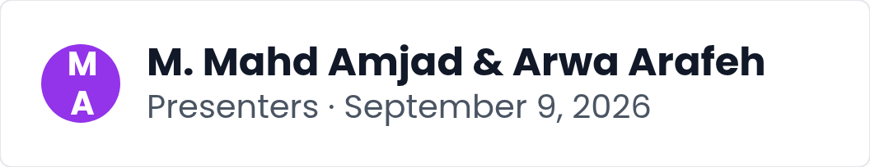
QueryGuard: A Safety Gate
An intro to why LLM-generated SQL needs a validation gate, the gap in existing defenses, and the QueryGuard pipeline. We outline our two-member workstreams, the planned evaluation, and the course roadmap ahead.
Notes:
Welcome everyone. Today we present QueryGuard, a safety gate for LLM-generated SQL. We will explain why a validation gate is needed, the gap in existing defenses, and how our pipeline works. Mahd and Arwa each lead a workstream, and we close with our planned evaluation and the course roadmap.

Slide 2
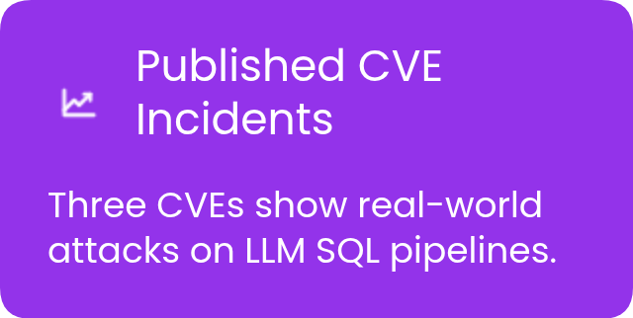
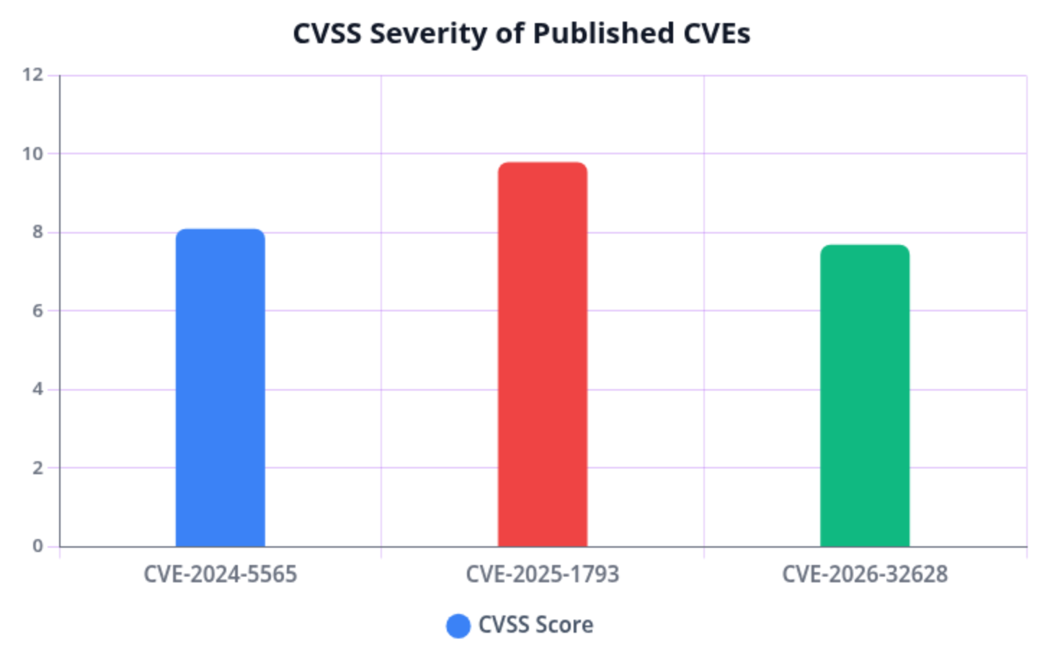
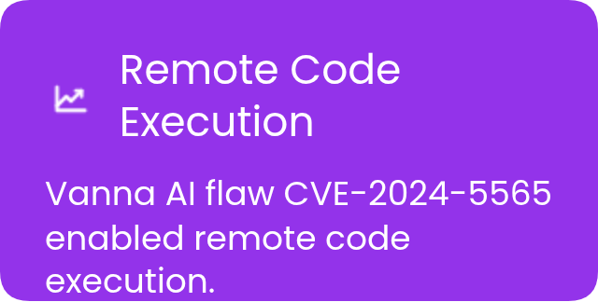
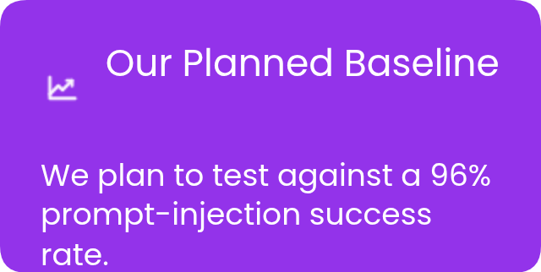
The Problem: Unguarded LLM SQL
Applications let users query databases in plain English, and frameworks pass LLM-generated SQL straight to the database with no review layer in between.
Notes:
This slide frames the threat landscape. Users type plain-English questions, frameworks forward LLM-generated SQL directly to databases, and real CVEs show the consequences: Vanna AI remote code execution at CVSS 8.1, LlamaIndex NL2SQL exploitation at 9.8, and AnythingLLM data extraction at 7.7. We close with the research baseline that 96 percent of manual prompt-injection attacks succeed against undefended pipelines, which motivates our planned evaluation.

Slide 3
Defenses & the Gap
Model-side fixes like StruQ and SecAlign require retraining or fine-tuning, while generic guardrails such as NVIDIA NeMo Guardrails and Guardrails AI are schema-unaware and opaque. QueryGuard plans a transparent, deterministic, SQL-specific check between LLM and database.
Notes:
This slide explains why a new layer of defense is needed. Model-side fixes such as StruQ and SecAlign demand retraining or fine-tuning, which is costly and inflexible. Generic guardrails like NVIDIA NeMo Guardrails and Guardrails AI operate as opaque, schema-unaware classifiers. Neither offers a transparent, deterministic, SQL-specific check. QueryGuard is planned to occupy exactly this position, at the application layer between the LLM and the database.

Slide 4

QueryGuard Pipeline
1
Intake Stage
2
Generator Stage
Incoming requests enter one transparent entry point, so every query follows a single recorded path.
A candidate SQL query is produced by the LLM or by a deterministic mock, keeping generation swappable.
3
Validation Gate
4
Executor Boundary
Every candidate query is checked against fixed rules before anything is allowed to move further.
Only gate-passed queries run; the read-only trust boundary is architectural, not advisory.
5
Audit Log
All outcomes are written to an append-only audit log, giving a complete, inspectable record.
Notes:
This slide presents our planned QueryGuard solution as a five-stage pipeline at the application layer. Queries enter through intake, are generated by the LLM or a deterministic mock, and must pass the validation gate. Only gate-passed queries reach the read-only executor, and every outcome lands in the append-only audit log. Because the trust boundary is architectural rather than advisory, no query can bypass the gate, and each stage stays inspectable for review.

Slide 5





Inside the Validation Gate
10 deterministic rules check each generated query, so enforcement relies on architecture rather than model behavior.
PASS or BLOCK Verdict
Each query receives PASS or BLOCK, together with the specific rule that fired, as planned.
Sensitive Columns MASKED
Sensitive columns are MASKED in the plan, keeping private data out of anything that executes.
Missing Limits SUGGESTED
Queries missing row limits get SUGGESTED additions, tightening safety before execution.
Notes:
Inside the validation gate, ten deterministic rules evaluate every generated query before it moves forward. Each query exits with a PASS or BLOCK verdict plus the specific rule that fired, sensitive columns can be MASKED, and missing limits are SUGGESTED. The read-only executor accepts only gate-passed queries, so enforcement depends on architecture rather than on the model behaving well.

Slide 6


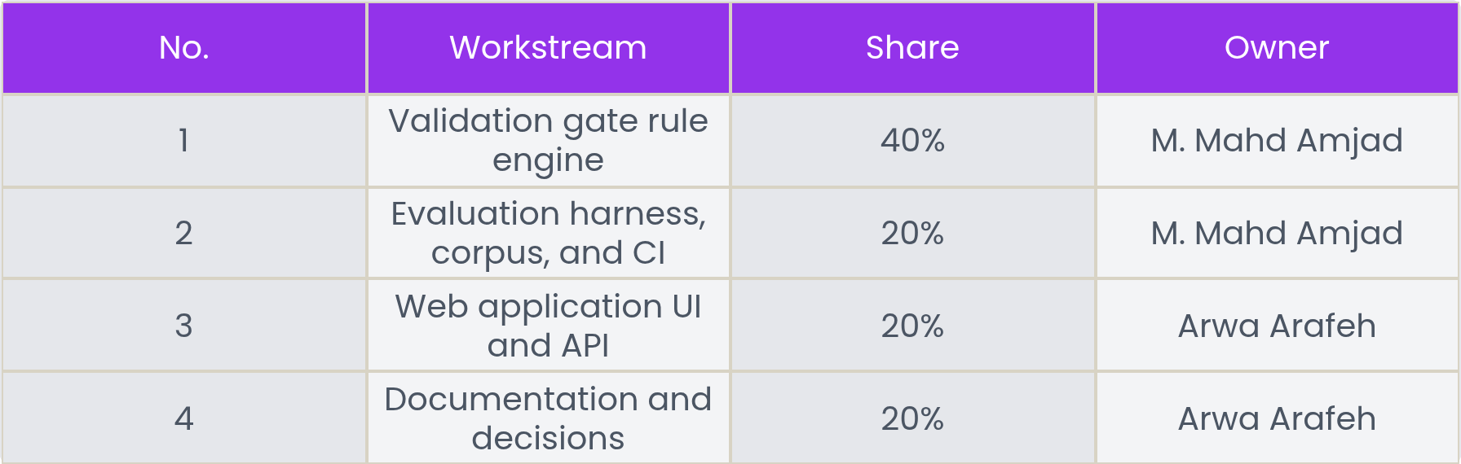
Team Ownership
Planned for September 9, 2026, the two-member team pairs M. Mahd Amjad and Arwa Arafeh across four workstreams, with shares of 40%, 20%, 20%, and 20% respectively.
Notes:
This slide introduces our two-member team and how the planned work is divided. M. Mahd Amjad leads the validation gate rule engine at forty percent, plus the evaluation harness, corpus, and CI at twenty percent. Arwa Arafeh owns the web application UI and API along with documentation and decisions, each at twenty percent. Paired ownership keeps both members engaged across all four workstreams.

Slide 7
Evaluation Plan
100%
<10%
<50ms
Target block rate on destructive attack classes, to be validated against the 30-prompt attack corpus in planned evaluation work.
False positive ceiling on the 30 benign prompts; results will be reported openly once the evaluation run is completed as planned.
Target p95 added latency for the SQL security gate, measured during the planned evaluation rather than claimed from completed runs.
Notes:
This slide frames evaluation as planned work, not finished results. The corpus holds 30 attack and 30 benign prompts across six published attack classes. Targets: full blocking of destructive classes, false positives under ten percent reported openly, p95 added gate latency under fifty milliseconds, and zero silent regressions, since the corpus runs in continuous integration and a broken rule fails the build. All figures are targets; evaluation has not yet been run.

Slide 8










Course, Milestones, Stack
Two-Member Team
Milestone Plan
CS 5391 Software Engineering group project carried out by M. Mahd Amjad and Arwa Arafeh.
Proposal and presentation first, then an SRS with numbered requirements mapped to test cases.
Flask and SQLite
pytest and CI
Python and Flask build the web app; SQLite stores a demo database with sensitive columns.
pytest runs the test suite and GitHub Actions provides continuous integration checks.
Mock LLM Mode
Final Demo
A mock LLM mode keeps demos deterministic; a live LLM integration remains optional.
Implementation and demo round out the milestone schedule ahead of the final.
Notes:
This slide sets the context: a CS 5391 Software Engineering group project by the two-member team of M. Mahd Amjad and Arwa Arafeh. We review the milestone order — proposal and presentation, an SRS whose numbered requirements map to test cases, then implementation and demo before the final — and the stack: Flask, a SQLite database with deliberately sensitive columns for our planned evaluation, pytest with GitHub Actions CI, and a mock LLM mode that keeps demos deterministic.

