Slide 1

Ishqnama Design System
NOOR E IMAAN · WEB AND ANDROID

Slide 2
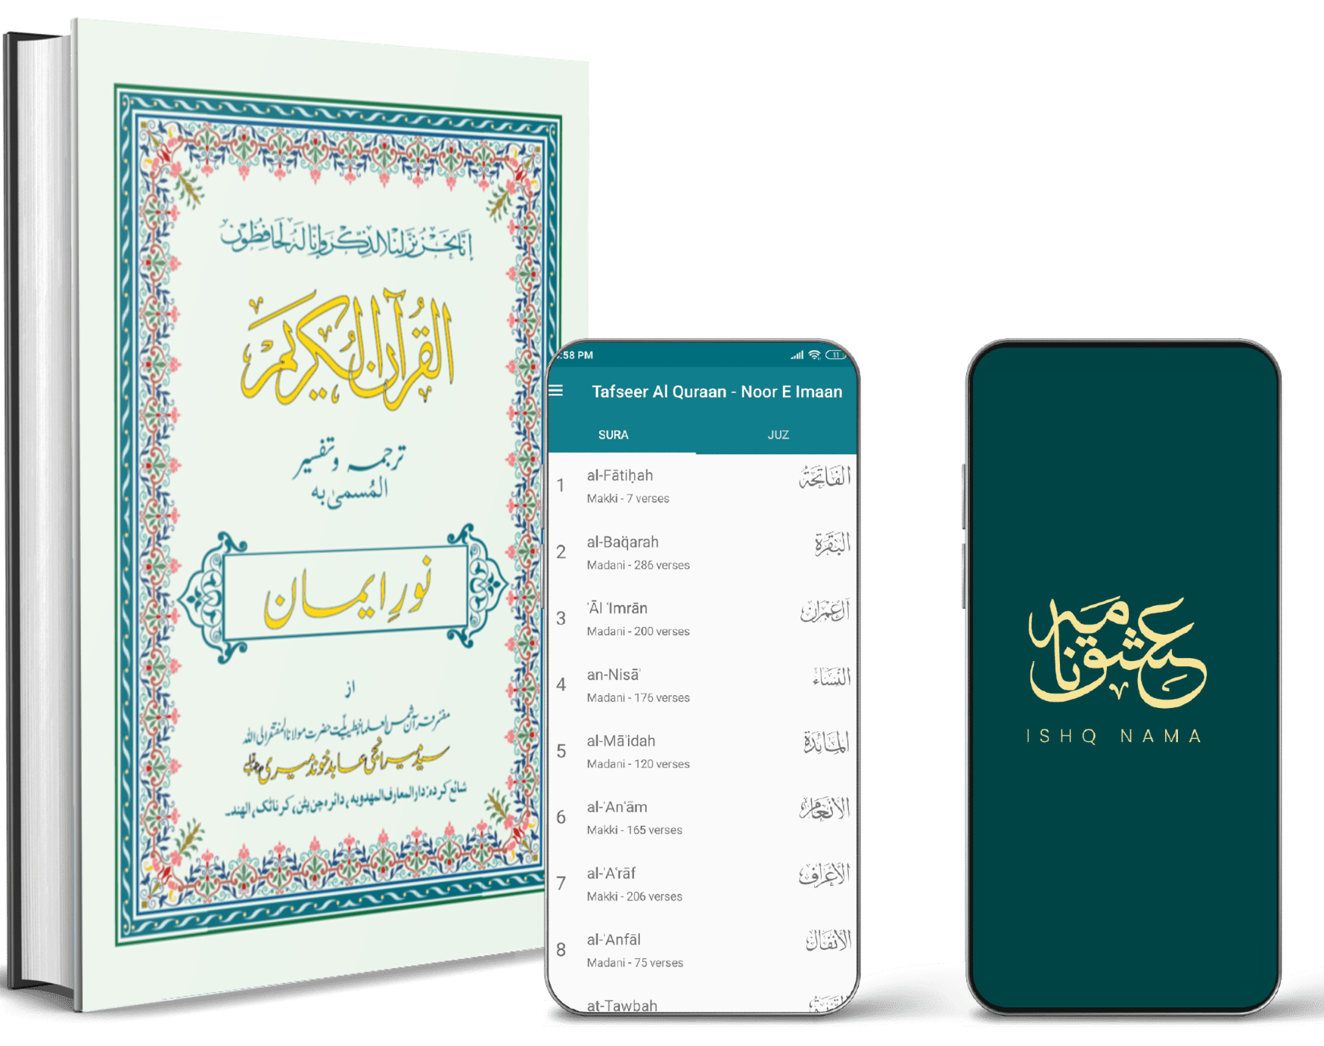
THE SOURCE
Noor e Imaan
نورِ ایمان
Tarjuma wa tafseer of the Holy Quran by Syed Meeranji Abid Khundmiri.
A printed volume from the Mahdavia tradition, carried onto the web and Android under the Ishqnama name.

Slide 3
Two products
BEING REBUILT
LIVE
Website
Android app
Home page, Quran reader, and — new in this build — sign-in via Microsoft Entra External ID.
Tafseer Al Quraan — splash, SURA / JUZ chapter index, reading view.
Reading is never gated behind an account. Signing in only adds last-read position, bookmarks and favourites.

Slide 4
Colour
Deep teal and gold carry the brand. Everything else is paper, ink, and two manuscript accents held back for illustration.
#00292B
#004446
#107E8D
#BEAA30
#F7E497
#EDF5ED
Teal-900 is the logo fill and every dark surface. Teal-600 is the Android app bar.
Gold-300 is the mark on dark. Gold-500 is the manuscript title gold.
Paper is the mint-cream of the printed page. Status colours stay desaturated.

Slide 5
Type across four scripts
Scripture sets the scale, not the interface. Quranic Arabic never falls below 26px; Urdu never below 19px, at 2.35 line-height.
اَلۡحَمۡدُ لِلّٰهِ رَبِّ الۡعٰلَمِيۡنَۙ
PDMS Saleem Quran · 2.15
Jameel Noori Nastaleeq · 2.35
ہر قسم کی تعریف اللہ ہی کے لئے ہے
Noto Serif Devanagari · substituted
हर तरह की तारीफ़ अल्लाह ही के लिए है
EB Garamond · Source Sans 3 · Noto Serif
al-Fātiḥah · Āl ʿImrān · aḍ-Ḍuḥā

Slide 6
Ornament
CSS only — no raster art, no photography. Gold at 7–10% alpha, and a single mihrab hairline per screen.
girih lattice
diagonal lattice
paper tint
mihrab arch

Slide 7
Component inventory
Twenty-seven components in five groups, derived from the two products' real surfaces rather than a generic checklist.
Core
Scripture
Navigation
Reader tools
Account
Icon Button IconButton Badge Card
AyahBlock BismillahBlock SuraHeader SuraListItem ChapterNav
AppBar AppBarLink TabBar UserMenu SectionHeading
ReaderToolbar SettingsSheet SegmentedControl FontSizeStepper SearchField · Switch
SignInCard ContinueReadingCard SavedVerseCard EmptyState

Slide 8
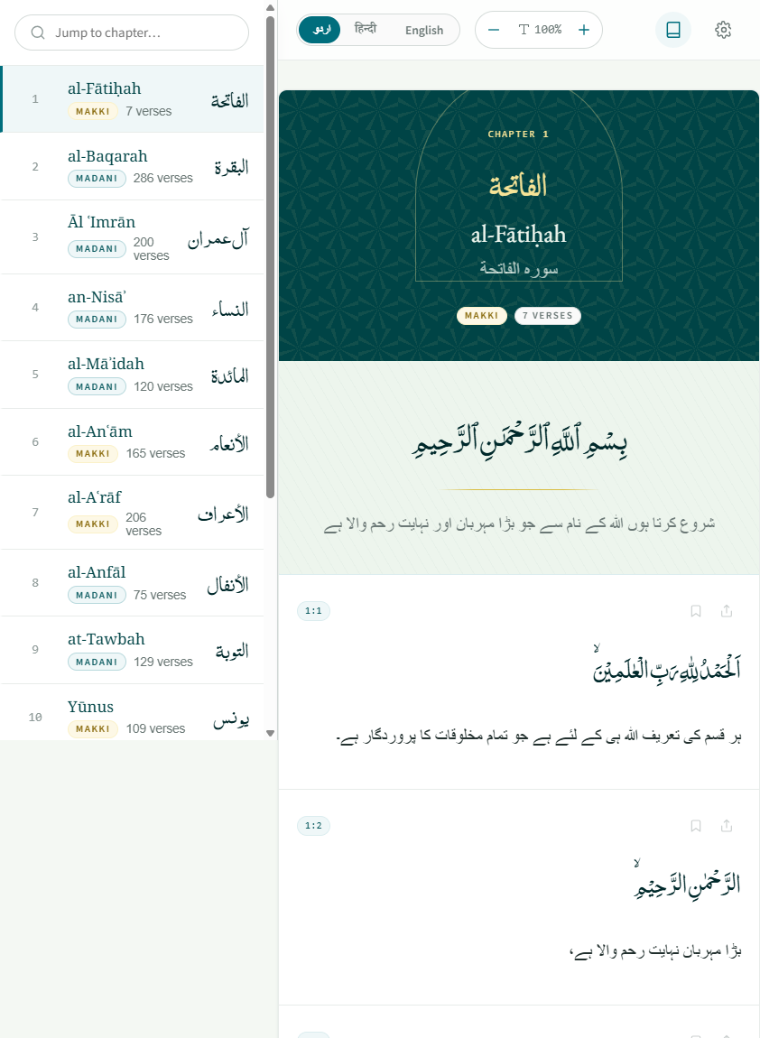
WEBSITE
The Quran reader
Arabic first, then the reader's chosen translation. Every tool for readability sits in one sticky strip.
Language switch — اردو · हिन्दी · English
Six fixed text-size steps, 85% to 160%
Show or hide the translation entirely
Bookmark and share, per verse

Slide 9
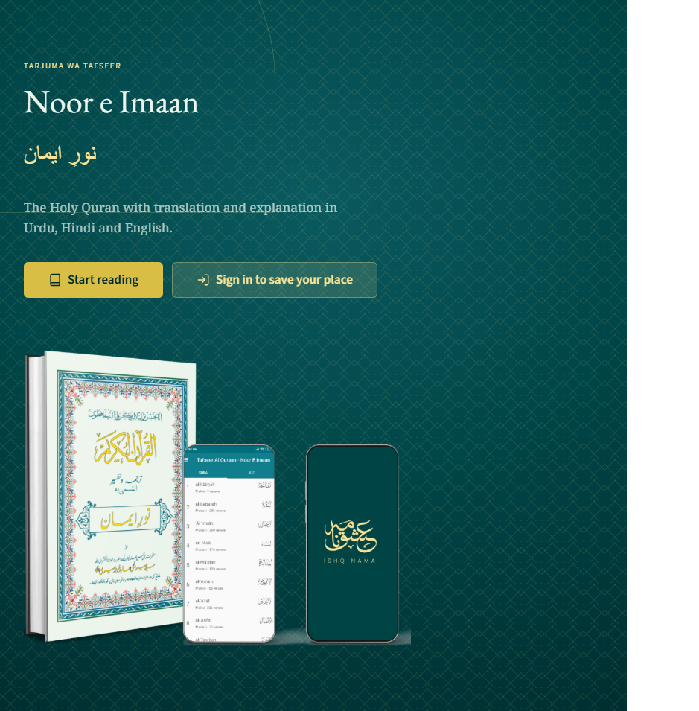
WEBSITE
The home page
A signed-in reader lands on their own position first, then their saved verses, then the full index of 114 chapters.
Signed out, the personal sections are replaced by a single invitation to sign in — never a wall.

Slide 10
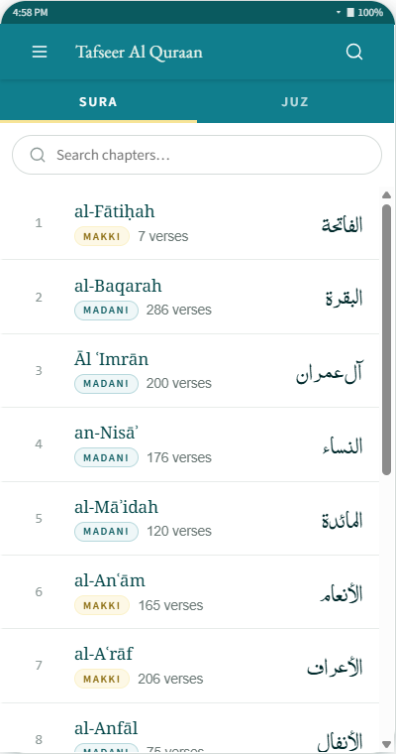
ANDROID · LIVE
Tafseer Al Quraan
The existing app sets the chrome: teal-600 bar, uppercase SURA / JUZ tabs, and a row per chapter carrying ordinal, transliteration, Makki or Madani, verse count and Arabic name.
Recreated from one marketing screenshot — no app source or Figma file was available.

Slide 11
Content rules
Three names, always
Sentence case
al-Fātiḥah · الفاتحة · سورہ الفاتحة. Never anglicised to "The Opening" in the interface.
Everywhere. Uppercase belongs to the wordmark and small structural labels only.
No emoji
Attribution by name
The only decorative glyph in the product is the Quranic verse separator ۝.
The product never speaks as "we" about religious matters. Credit goes to the author.
Interface copy runs under twelve words. Empty states state one fact and offer one action, with no apology.

Slide 12
Substitutions to confirm
ICONS
HINDI AND ENGLISH FACES
A 21-glyph Lucide subset stands in. The legacy site's own set was not reachable.
Noto Serif Devanagari, EB Garamond and Source Sans 3 — chosen freely, as invited.
COLOUR VALUES
VERSE TEXT
Sampled from the supplied artwork, not from a stylesheet.
Only al-Fātiḥah is real. Hindi and English lines are placeholders — do not ship them.
What would make this exact: the legacy site's CSS, your real icon set, and a sample of the actual Hindi and English translation text.

