Slide 1
Heart Failure Prediction
Machine Learning & Deep Learning Analysis
Advanced ML & Data Analytics Course | Nexa-land | Prof. Hamed Mamani, University of Washington

Slide 2
Table of Contents
1. Project Overview & Problem Statement
2. Dataset Information & Characteristics
3. Exploratory Data Analysis - Part 1
4. Exploratory Data Analysis - Part 2
5. ML & Deep Learning Models Overview
6. Feature Importance Analysis
7. All Models Performance Comparison
8. Deep Learning: Neural Network Details
9. Model Selection & Recommendation
10. Confusion Matrix & ROC Curve
11. Streamlit Web Application
12. Conclusions & Recommendations

Slide 3
Project Overview & Problem Statement
Objective:
Develop ML/DL system to predict heart failure risk
Problem Statement:
• Healthcare professionals need data-driven tools
• Early prediction can save lives
• Comparing traditional ML vs Deep Learning
Our Approach:
• Evaluate 6 models (5 Traditional + 1 Deep Learning)
• Rigorous cross-validation and test evaluation
• Deploy as interactive web application
• Focus on healthcare: maximize Recall

Slide 4
Dataset Information & Characteristics
Dataset: Heart Failure Prediction
Quality Metrics:
• Total Samples: 918 patient records
• Training Set: 734 samples (80%)
• Test Set: 184 samples (20%)
• Missing Values: 0
• Duplicate Rows: 0
11 Clinical Features:
Age, Sex, ChestPainType, RestingBP, Cholesterol
FastingBS, RestingECG, MaxHR, ExerciseAngina, Oldpeak, ST_Slope
Target: HeartDisease
Binary - 55.3% vs 44.7%

Slide 5
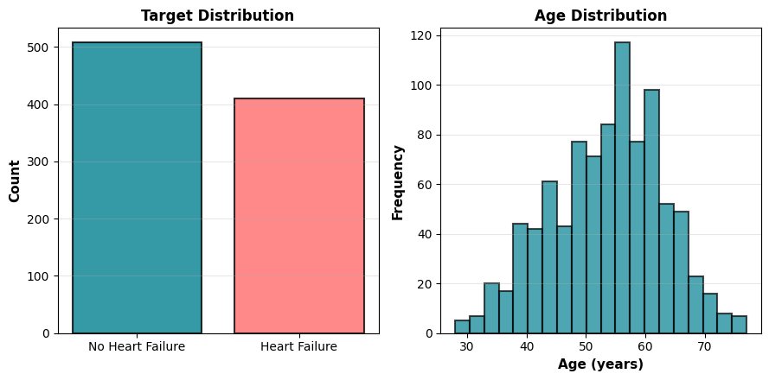
Exploratory Data Analysis - Part 1

Slide 6
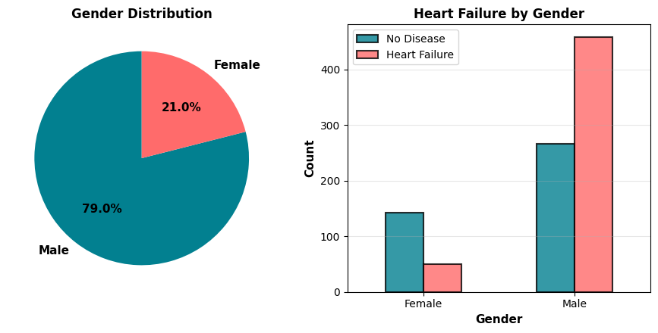
Exploratory Data Analysis - Part 2

Slide 7
ML & Deep Learning Models Overview
Traditional ML (5 Models):
1. Logistic Regression
Linear classification
2. SVM Linear
Linear support vectors
3. SVM RBF
Non-linear kernels
4. Decision Tree
Tree-based rules
5. Random Forest
Ensemble of 100 trees
Deep Learning:
Neural Network (TensorFlow/Keras)
3-layer feedforward
128 -> 64 -> 32 neurons
ReLU + Sigmoid activations
Dropout (0.2-0.3) regularization
100 epochs + Early Stopping
Preprocessing:
LabelEncoder + StandardScaler
5-fold stratified cross-validation

Slide 8
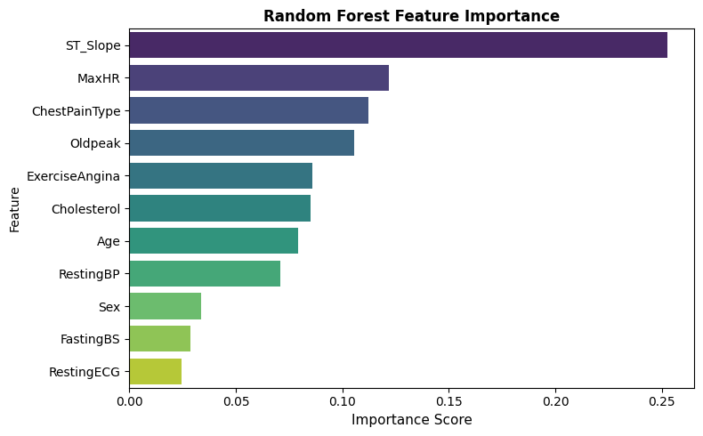
Feature Importance Analysis

Slide 9
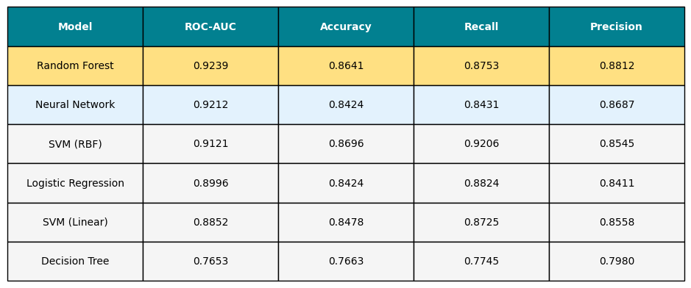
All Models Performance Comparison

Slide 10
Deep Learning: Neural Network Details
Network Architecture:
Layer Structure:
Input
11 clinical features
Hidden 1
128 neurons + ReLU + Dropout(0.3)
Hidden 2
64 neurons + ReLU + Dropout(0.3)
Hidden 3
32 neurons + ReLU + Dropout(0.2)
Output
1 neuron + Sigmoid
Training:
Optimizer
Adam (lr=0.001)
Loss
Binary Crossentropy
Epochs
100 with Early Stopping (patience=15)
Batch
32 | Validation: 20%
Performance:
ROC-AUC: 0.9212 | Accuracy: 84.24% | Recall: 84.31%

Slide 11
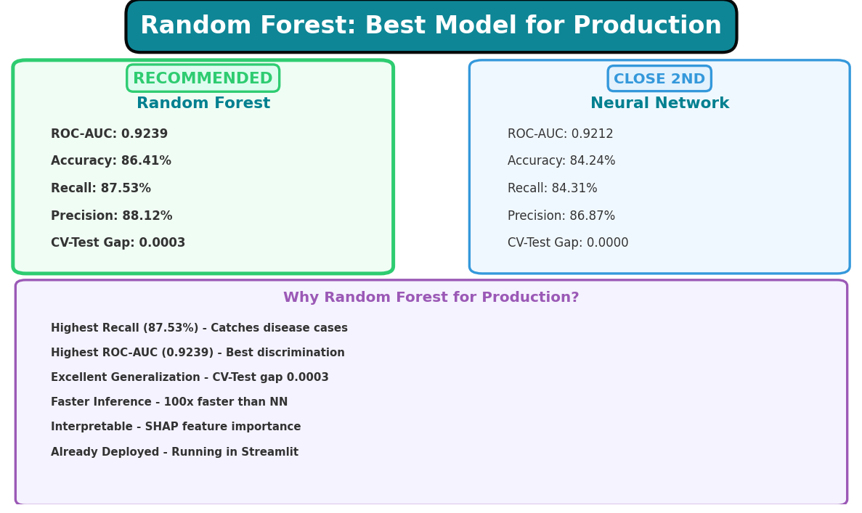
Model Selection & Production Recommendation

Slide 12
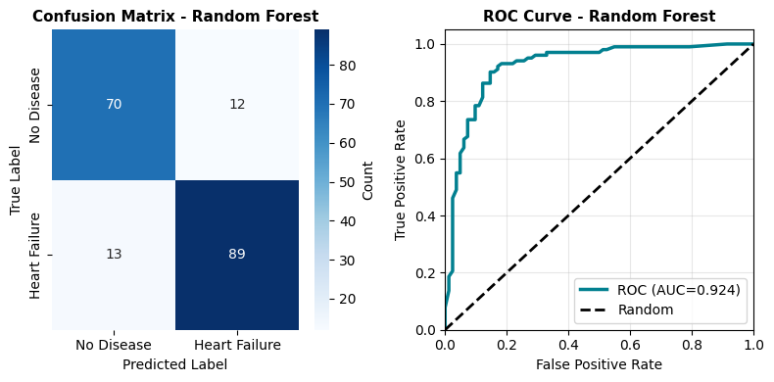
Confusion Matrix & ROC Curve

Slide 13
Streamlit Web Application Deployment
Features:
1. Real-Time Predictions
Instant risk assessment
2. Interactive Dashboard
Adjustable parameters
3. Risk Score
Probability + classification
4. Patient History
Save & view history
5. Trend Analysis
Visualize trends
6. Feature Importance
SHAP analysis
Technical Stack:
Framework: Streamlit
Model: Random Forest
Storage: JSON
Visualization: Plotly, Matplotlib
Deployment: Streamlit Cloud
URL: https://heart-disease-predictor...

Slide 14
Conclusions & Recommendations
Achievements:
Built & evaluated 6 ML/DL models
Achieved 92.39% ROC-AUC (Random Forest)
Neural Network: 92.12% ROC-AUC
Exceptional generalization (gap: 0.0003)
Deployed production-ready app
Implemented SHAP explainability
Recommended: RANDOM FOREST
Status: PRODUCTION READY
Future Work:
1. Continuous Monitoring
Track new data
2. Quarterly Retraining
Update model
3. Clinical Validation
Healthcare testing
4. Ensemble Methods
RF + NN combination
5. Mobile Apps
iOS/Android
6. Hospital Integration
Real-world use

