Slide 1

Kmlp;[‘];lmk
BATR Performance Analysis & Operational Improvement Plan Data Analysis Project
Mahdi Aghaei – mahdiaghaei.official@gmail.com

Slide 2

Table of Contents
1 - Understanding BATR & Problem Definition BATR components, performance gap, and regional structure 2 - Operational Monitoring Framework Core KPIs and dashboard-based performance monitoring 3 - Performance Analysis City-level gaps, trends over time, and geographic differences | 4 - Bottleneck Diagnosis Context-adjusted analysis and identification of Acceptance vs. Arrival problems 5 - Operational Response & Early Intervention Bottleneck-based actions, monitoring thresholds, and predictive early warning 6 - Recommended Pilots & Next Steps Targeted interventions, testing approach, and scaling decisions
Mahdi Aghaei
BART Performance Analysis & Operational Improvement Plan
Page 1 of 24

Slide 3

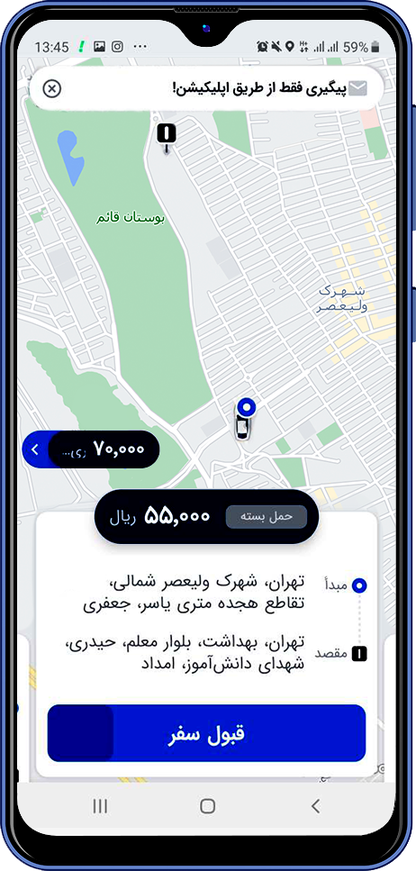



Biker Arrival at Restaurant Time (BART)
Biker Arrival at Restaurant Time (BART)
Biker Acceptance Time (BAT)
Biker Post-Acceptance Arrival Time (BPAT)
Mahdi Aghaei
Page 2 of 24

Slide 4
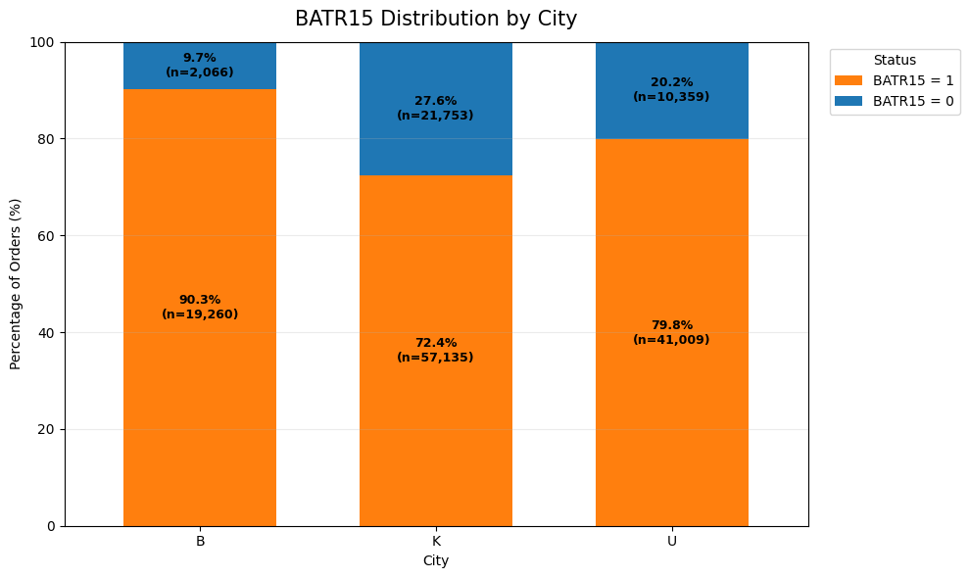
What Is the Problem?
ATR performance is below the expected operational target, with overall BATR15 at 77.45% versus the 90% target.
The key challenge is that poor BATR performance can come from different parts of the process. Adelay may be caused by a long Acceptance Time, a long Arrival Time, or both.
BATR can also vary significantly across different locations and time periods, with some cities, districts, and peak hours performing much worse than others.
Mahdi Aghaei
Page 3 of 24

Slide 5
Region Structure
Mahdi Aghaei
Page 4 of 24

Slide 6
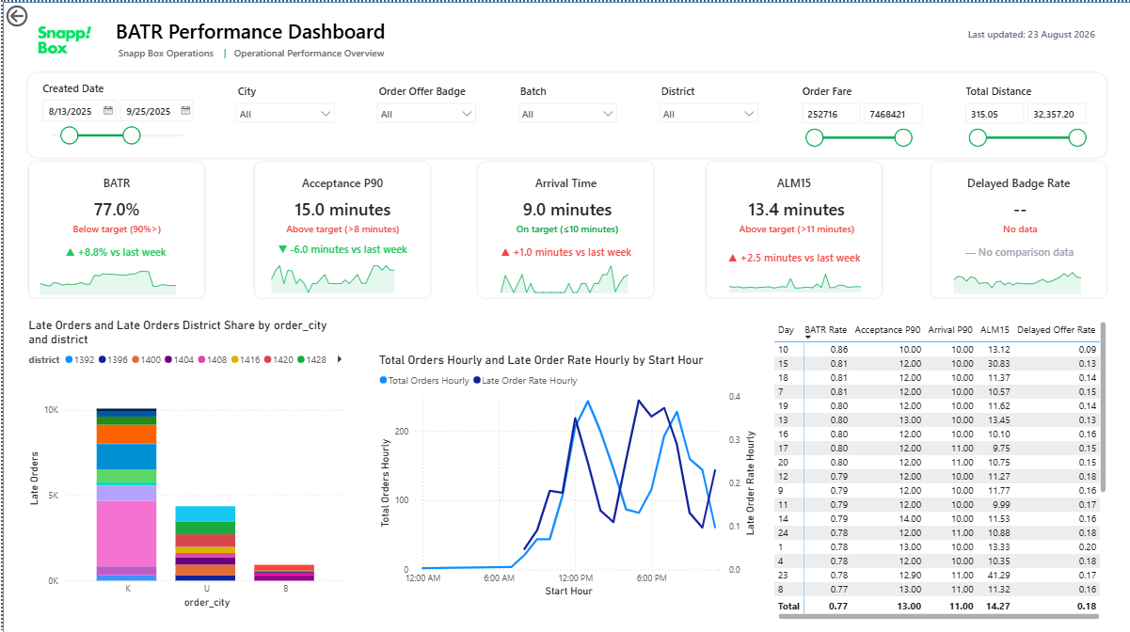
How We Monitor BATR Performance?
We monitor BATR through one Outcome KPI and four supporting operational indicators. Together, they show not only whether performance is deteriorating, but also where the deterioration is coming from.
Core KPIs
BATR15: % of orders reaching the restaurant within 15 minutes
ALM15: severity of delay among late orders
Acceptance P90: tail performance before acceptance
Delayed Offer Rate: early warning for the offer/acceptance process
Arrival P90: tail performance after acceptance
Mahdi Aghaei
Page 5 of 24

Slide 7
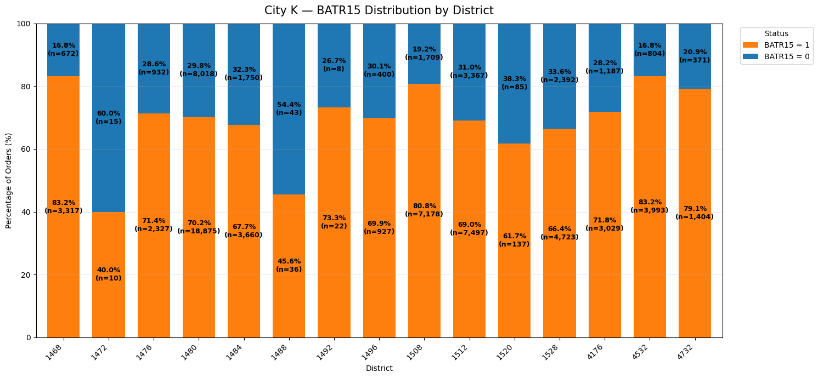
Where Is the Largest Performance Gap?
The first major difference appears at the city level.
City B: BATR15 ≈ 90.3% — approximately on target
City U: BATR15 ≈ 79.8% — below target
City K: BATR15 ≈ 72.4% — weakest performance
City K is especially important because it generates approximately 63.6% of all Late Orders. Therefore, improving City K provides the largest opportunity for network-level impact.
Mahdi Aghaei
Page 6 of 24

Slide 8
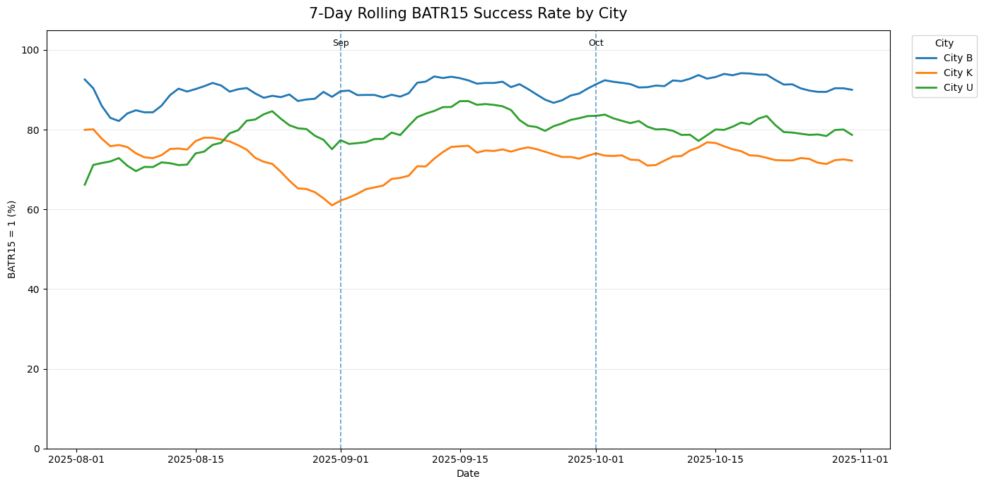
Is the Problem Temporary or Persistent?
The three cities show very different trends.
City B gradually improved and exceeded the target in October.
City K remained weak throughout the three-month period, suggesting a persistent operational issue rather than a temporary shock.
City U improved in September but deteriorated again in October.
Mahdi Aghaei
Page 7 of 24

Slide 9
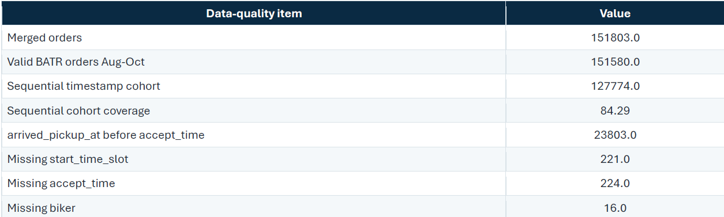
Data Preparation and Data Quality
151,580 valid orders were analyzed, with an overall BATR15 of 77.45% versus the 90% target.
23,803 orders (15.7%) had inconsistent timestamps; these were retained for general KPIs but excluded from exact process decomposition.
A Sequential Cohort of 127,774 orders (84.3%) was used for Acceptance vs. Arrival analysis.
Small or temporary districts were treated cautiously to avoid misleading comparisons.
Mahdi Aghaei
Page 8 of 24

Slide 10
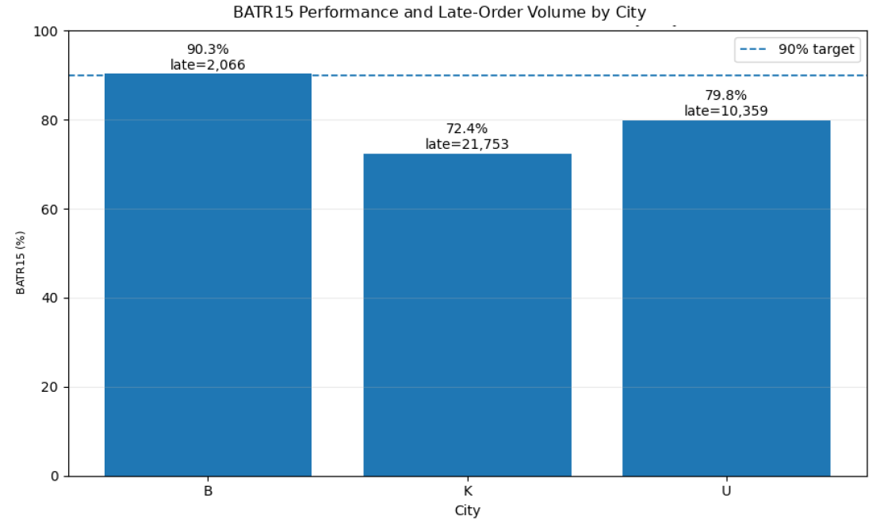
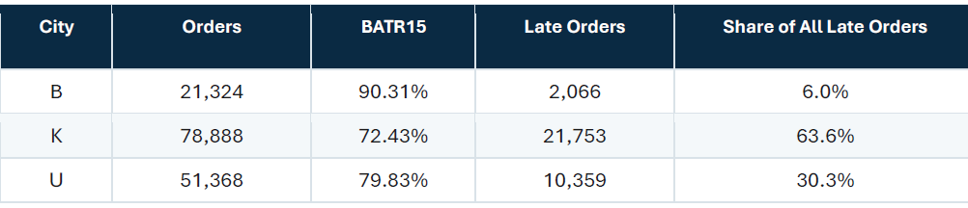
Overall and City-Level Performance
City B meets the 90% target with 90.3% BATR15.
City K is the weakest performer at 72.4% and generates 63.6% of all Late Orders.
City U also remains below target at 79.8%.
Mahdi Aghaei
Page 9 of 24

Slide 11
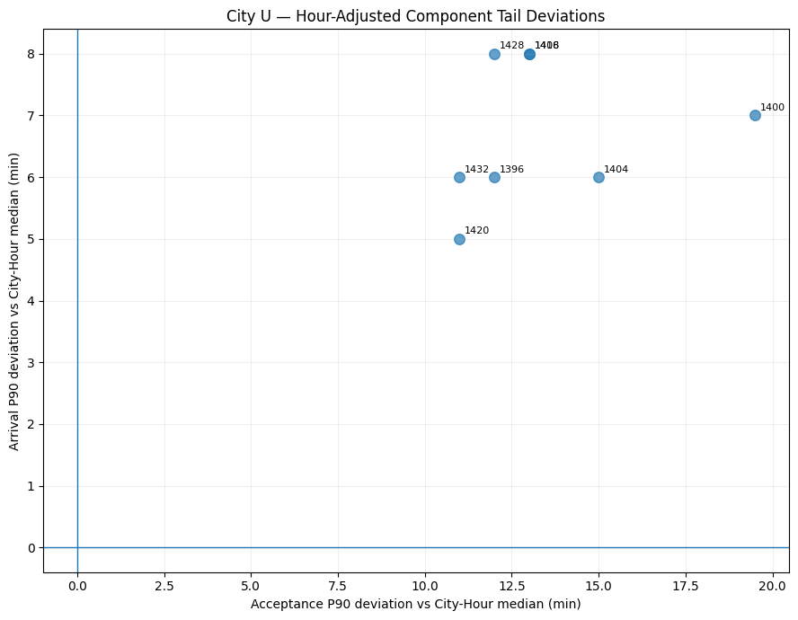
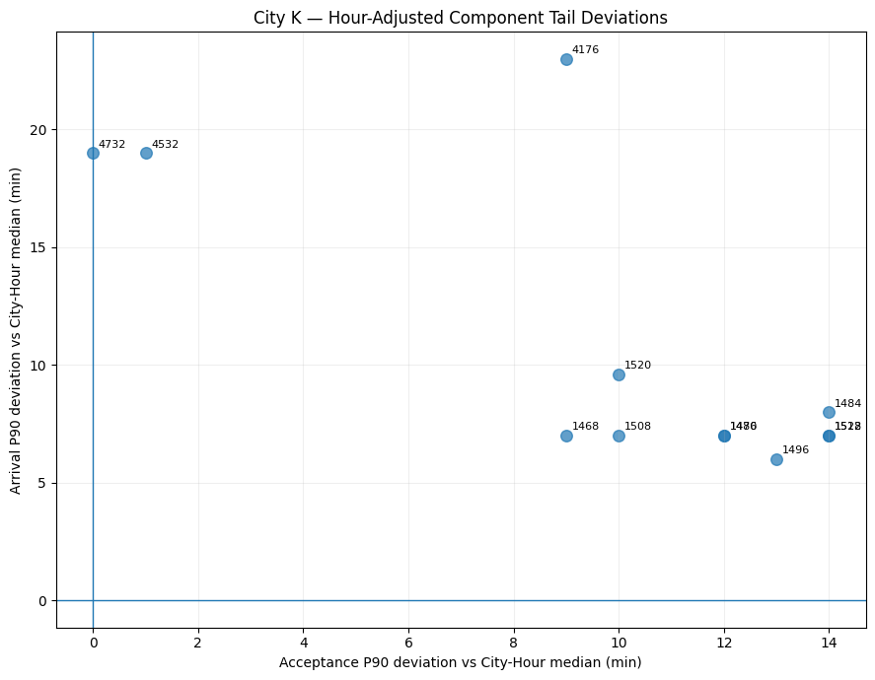
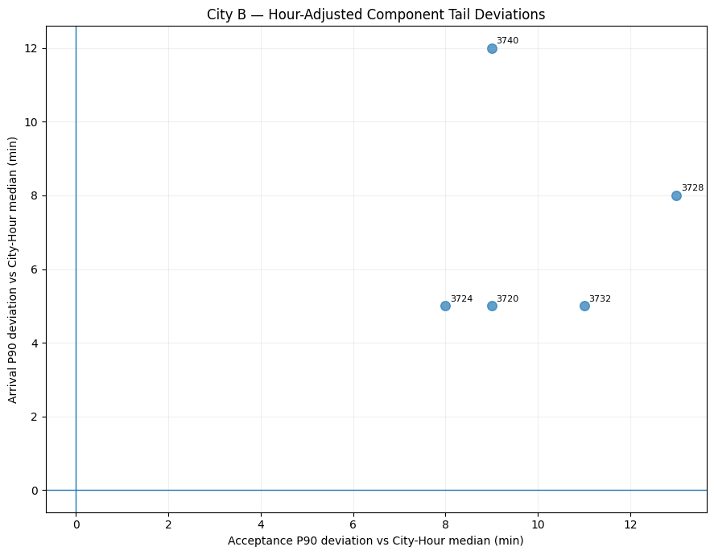
Not Every Low-Performing District Has the Same Problem
Mahdi Aghaei
Page 10 of 24

Slide 12
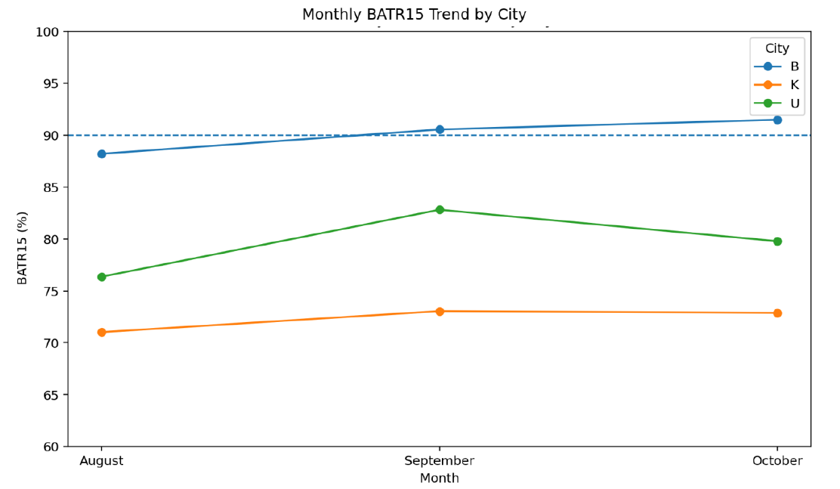
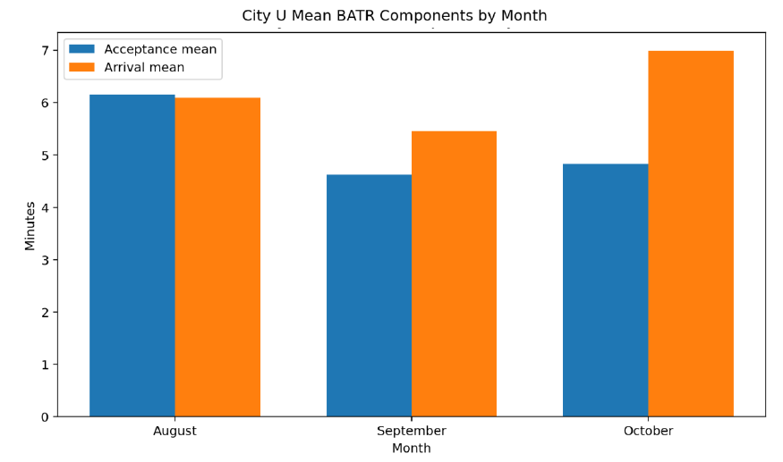
Performance Trend over Time
Overall BATR15 improved from 75.2% in August to 78.8% in September, then slightly declined to 77.9% in October.
City U: Mean BATR increased by 1.74 min from September to October. Only 0.21 min came from Acceptance, while 1.53 min came from Arrival.
Mahdi Aghaei
Page 11 of 24

Slide 13
Performance Trend over Time
Overall BATR15 improved from 75.2% in August to 78.8% in September, then slightly declined to 77.9% in October.
City U: Mean BATR increased by 1.74 min from September to October. Only 0.21 min came from Acceptance, while 1.53 min came from Arrival.
Mahdi Aghaei
Page 12 of 24

Slide 14
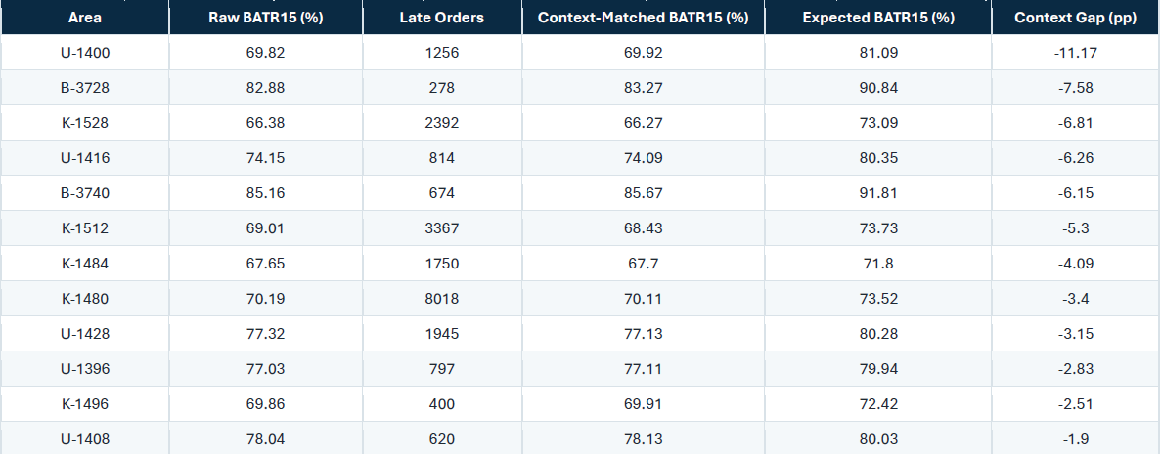
District-Level Performance and Context-Adjusted Benchmark
Raw BATR15 can be misleading because districts operate under different City × Month × Weekday × Hour conditions.
Each district was therefore compared with other districts under the same operating context, excluding itself from the benchmark.
Mahdi Aghaei
Page 13 of 24

Slide 15
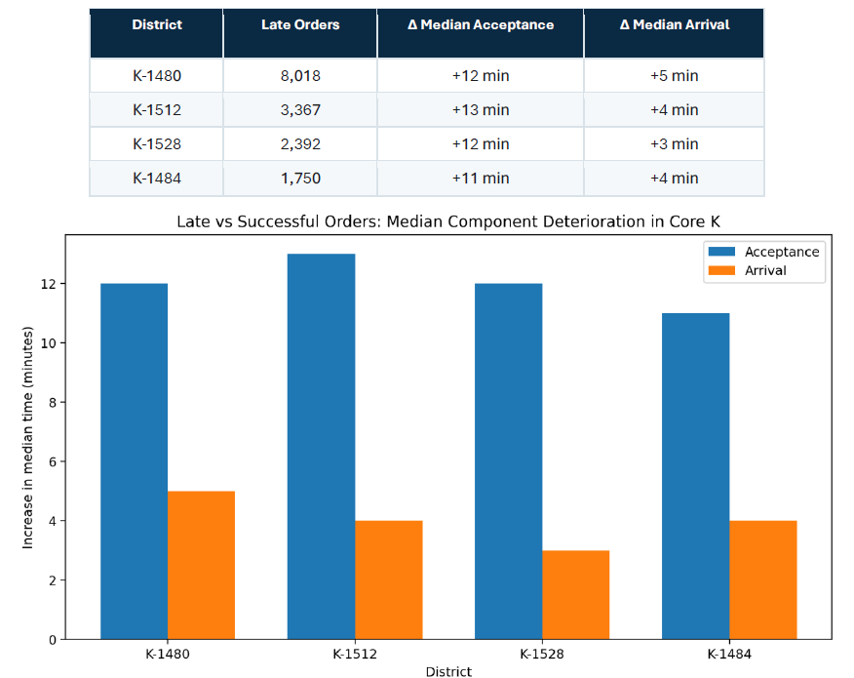
Acceptance Time versus Arrival Time
Late orders show a much larger increase in Acceptance Time than in Arrival Time.
In the four main problem districts, Acceptance Median increases by 11–13 min, while Arrival rises only 3–5 min.
These districts account for about 71% of all late orders in City K.
The main source of delay in City K occurs before or during the Acceptance Stage, not during post-acceptance arrival.
Mahdi Aghaei
Page 14 of 24

Slide 16
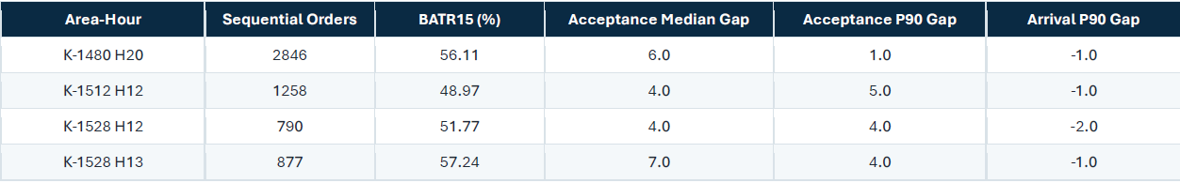
District-Hour Hotspots
District-level averages can mask short but severe hourly performance issues. Analysis at the District × Hour level reveals several critical hotspots in City K.
Across the major hotspots, BATR deterioration is primarily driven by delays in the Acceptance Stage rather than post-acceptance Arrival, making Acceptance the main operational bottleneck to investigate.
Mahdi Aghaei
Page 15 of 24

Slide 17
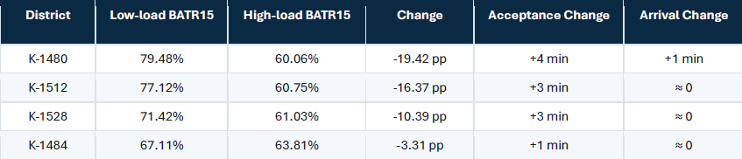
Order Load, Supply and Demand
Higher local order load is associated with a clear drop in BATR15, especially in key City K districts.
High local demand mainly affects the Acceptance Stage, suggesting a potential supply–demand imbalance.
Mahdi Aghaei
Page16 of 24

Slide 18
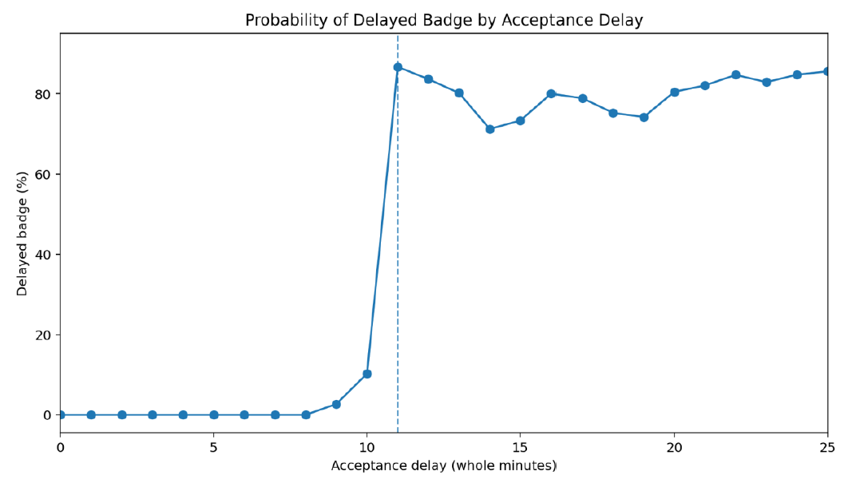
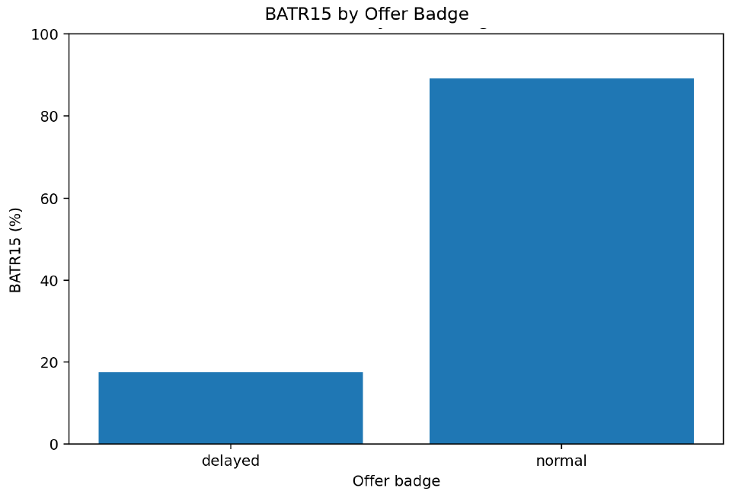
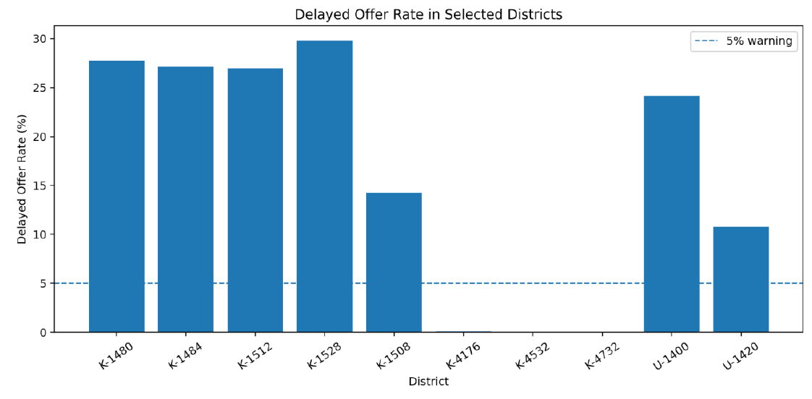
Order Offer Badge
Delayed Badge orders have dramatically lower BATR15 (17.6% vs. 89.2% for Normal Badge).
Although only 16.3% of orders are delayed-badge orders, they account for nearly 60% of all Late Orders.
Mahdi Aghaei
Page 17 of 24

Slide 19
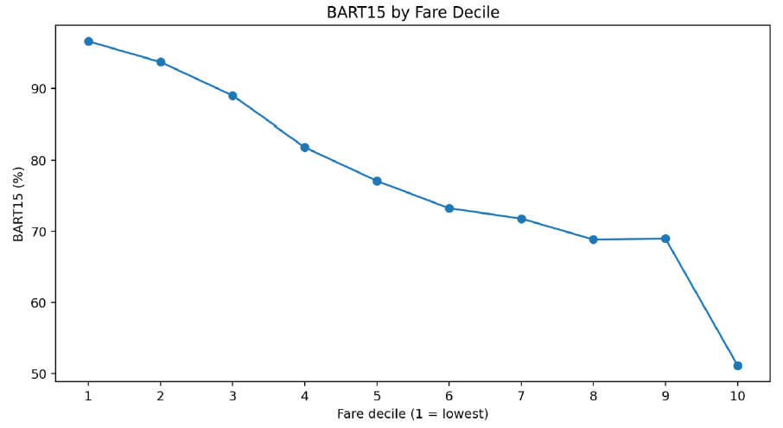
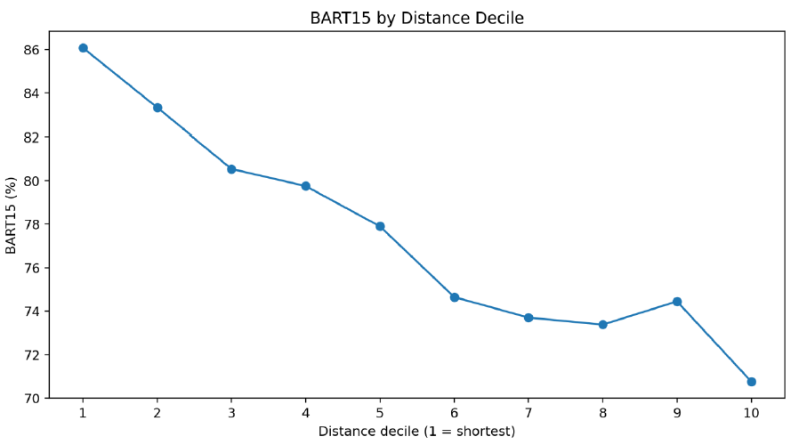
Fare, Distance and Fare per Distance
Longer-distance orders show lower BATR15, but distance refers to restaurant-to-customer distance, not biker-to-restaurant travel.
Higher Fare is also associated with worse BATR15, but this relationship becomes much weaker after controlling for other factors.
Fare per Distance does not show a consistent relationship with BATR15.
Mahdi Aghaei
Page 18 of 24

Slide 20
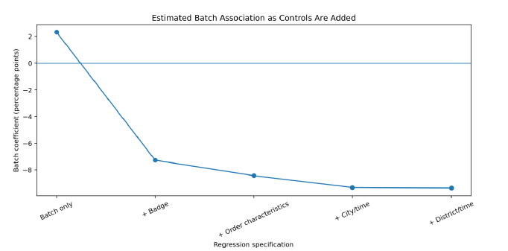
Batch
Raw results suggest Batch Orders perform slightly better (79.5% vs. 77.2% BATR15), but this is driven by selection bias.
After matching and controlling for Badge, Distance, Fare, City and Time, Batch Orders show about 8–9 pp lower BATR15.
The result is consistent across cities, but does not prove a causal Batch effect.
Mahdi Aghaei
Page 19 of 24

Slide 21
Different Problems Require Different Actions
The analysis shows that low BATR performance is not driven by a single operational issue.
Core City K is mainly an Acceptance-side problem, especially during high-load periods. Orders remain unaccepted for longer, while Arrival Time changes much less.
U-1400 also has a strong Acceptance problem, but it is not explained by higher local Order Load, suggesting an issue in the Offer or Assignment process.
B-3740, in contrast, is mainly an Arrival-side problem, where the delay occurs after the biker has already accepted the order.
The operational response should depend on where the delay is actually created.
Mahdi Aghaei
Page 20 of 24

Slide 22
Operational Response by Bottleneck
Bottleneck Type | What We Observe | Recommended Operational Response
Acceptance – High Load | Acceptance Time increases during peak demand, while Arrival changes much less. | Reposition available bikers from nearby areas with spare capacity and intervene before the backlog becomes severe.
Acceptance – Assignment / Offer Process | Acceptance remains weak even when local Order Load is not unusually high. | Prioritize aging orders, expand the Offer Pool earlier, and investigate Reject, Ignore, and Re-offer behavior.
Arrival – Positioning / Mobility | Orders are accepted, but bikers take too long to reach the restaurant. | Prioritize bikers with lower ETA and pre-position available bikers near high-volume Vendor clusters.
Key Principle: The intervention should match the bottleneck. A single network-wide response can increase cost or shift the problem to another area.
Mahdi Aghaei
Page 21 of 24

Slide 23
Different Problems Require Different Actions
The analysis shows that low BATR performance is not driven by a single operational issue.
Core City K is mainly an Acceptance-side problem, especially during high-load periods. Orders remain unaccepted for longer, while Arrival Time changes much less.
U-1400 also has a strong Acceptance problem, but it is not explained by higher local Order Load, suggesting an issue in the Offer or Assignment process.
B-3740, in contrast, is mainly an Arrival-side problem, where the delay occurs after the biker has already accepted the order.
The operational response should depend on where the delay is actually created.
Mahdi Aghaei
Page 22 of 24

Slide 24
From Monitoring to Early Intervention
The dashboard provides the operational monitoring layer, while the next step is to make the process increasingly proactive.
The five core KPIs provide early signals of deterioration. For example:
Acceptance P90 > 8 min indicates growing Acceptance pressure.
Delayed Offer Rate > 5% can provide an early warning of deterioration in the Offer process.
Arrival P90 > 10 min indicates increasing post-Acceptance travel pressure.
In addition, the predictive model can identify orders with a high probability of BATR15 failure before the failure occurs.
The model achieved a ROC-AUC of 0.858 and 66.9% Late-order Recall, suggesting that it can be used as an additional Early-Warning Layer rather than as a replacement for operational KPIs.
Mahdi Aghaei
Page 23 of 24

Slide 25
Recommended Next Steps
The analysis suggests moving from a single network-wide response toward targeted, bottleneck-based operational interventions.
I would start with three focused pilots:
K-1480 - Peak-Hour Supply Repositioning Test biker repositioning before Dinner Peak when Acceptance pressure begins to rise.
K-1512 / K-1528 - Earlier Offer-Pool Expansion Intervene before orders enter severe delay by prioritizing aging orders and expanding assignment earlier.
B-3740 - ETA-Based Assignment & Pre-positioning Prioritize better-positioned bikers and move available Supply closer to high-volume Vendor clusters.
Each pilot should be tested on a limited scale, compared with a Control or historical baseline, and expanded only when the target KPI improves without unacceptable increases in Cost or deterioration in neighboring areas.
Mahdi Aghaei
Page 24 of 24

