Slide 1
NATURAL LANGUAGE PROCESSING — COURSE PROJECT
Neapolitan Artistic Heritage
Dialogue System
A speech chatbot that answers questions about Caravaggio and Battistello Caracciolo in Naples — grounded in a Neo4j knowledge graph, with inconsistency detection built in.
Mahdi Miri · University of Naples Federico II, DIETI

Slide 2
The brief
A speech chatbot for Caravaggio and Battistello Caracciolo in Naples. Four requirements, non-negotiable:
• Voice in, voice out — ASR and TTS
• Facts from DBpedia SPARQL, loaded into Neo4j
• Catch inconsistencies in what the user claims
• Remember the conversation across turns

Slide 3
A general-purpose model will happily get this wrong.
Wrong artist. Wrong museum. A Roman painting claimed for Naples. So I kept the scope narrow — two painters, eight paintings, five venues — and grounded every answer in a graph instead of a guess.

Slide 4
Caravaggio and Battistello, in Naples
2
8
5
painters
paintings
venues, all in central Naples
Every work is still physically on display today — nothing in the catalog is hypothetical.

Slide 5
Four layers, one job each
Data
Graph
Dialogue
Speech
SPARQL queries against DBpedia
Neo4j graph database
Coreference, inconsistency checks, responses
Whisper in, Edge-TTS out
I split it this way so each piece could be tested — and explained — on its own.

Slide 6
Built with
Data & Knowledge
Dialogue
DBpedia · SPARQLWrapper · Neo4j (Docker)
Python 3.11 · Pydantic
Speech
Interface & Testing
OpenAI Whisper · Edge-TTS · pyttsx3
Streamlit · pytest
Plus Docker, which runs the Neo4j instance the whole project now depends on (no fallback), and ReportLab and Graphviz to build the report and its diagrams.

Slide 7
The graph, in one line
(:Artist)-[:PAINTED]->(:Artwork)-[:LOCATED_AT]->(:Location)-[:IN_CITY]->(:City)
40
46
nodes
relationships
Neo4j is the only store - an earlier SQLite fallback turned out to mask a real bug (most reads quietly hit SQLite even when Neo4j was "active"), so I removed it.

Slide 8
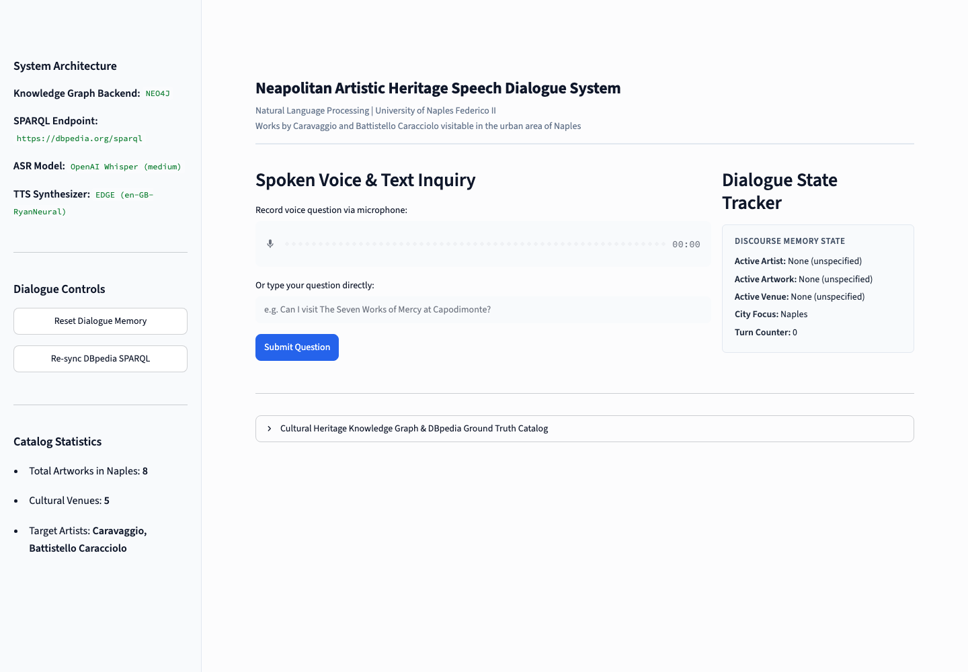
What it looks like

Slide 9
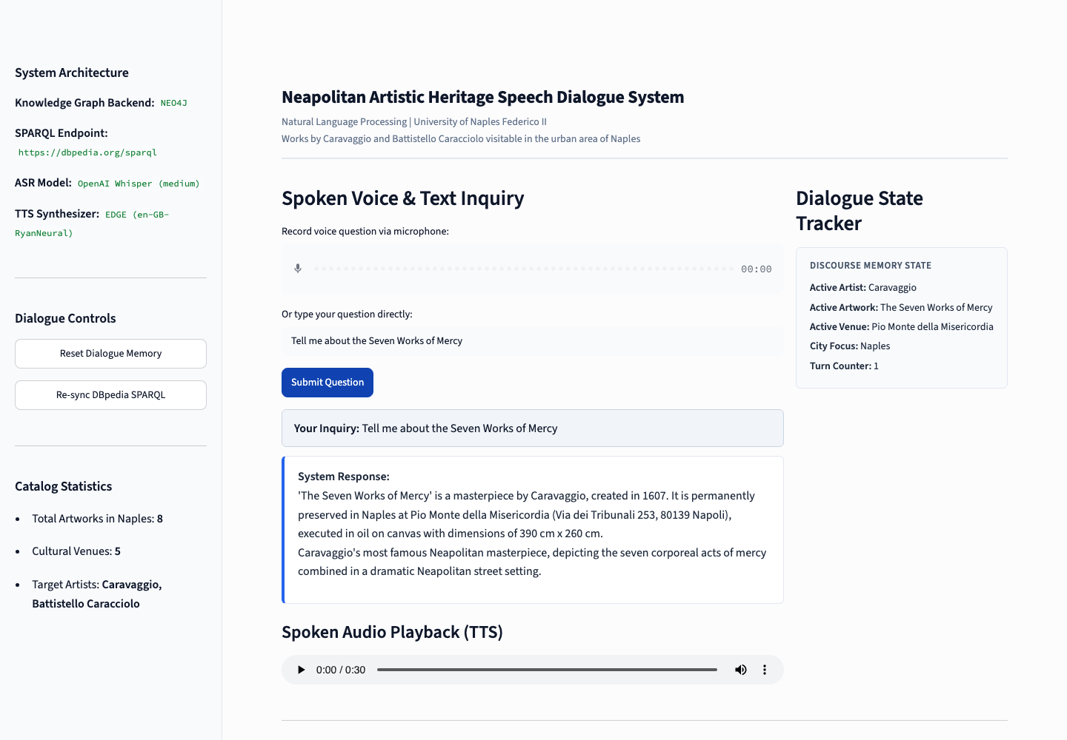
Ask it something
Every sentence in that answer traces back to a specific node in the graph.

Slide 10
When the user gets it wrong
“I thought Caravaggio painted the Liberation of Saint Peter.”
“To clarify — that one's Battistello Caracciolo, from 1615. Caravaggio has three other works in Naples, though.”
Checked against the graph before the system answers, not after.

Slide 11
Does it hold up?
20 / 20
150 / 150
0
unit tests pass
stress-test queries pass
false positives on inconsistency checks
I wrote that benchmark myself, so it proves the implementation is internally consistent — not that it would survive an unscripted visitor. I tested that by hand too, with typos, nonsense input, and contradictions dropped mid-conversation.

Slide 12
Stress-testing past the happy path
The 150-case suite and the synthetic voice clip both score perfectly because I wrote them to match my own rules. So I went looking for where it actually breaks.
Speech: real accent, not synthetic
Dialogue rules: 3 bugs found
18.1% → 15.0%
• “Michelangelo Merisi da Caravaggio” — his real name — flagged as out-of-scope
• “Which painter...?” disambiguation wrongly flagged as a false claim
• Negation ignored — “Caravaggio did NOT paint X” (true) flagged as wrong
WER on 10 self-recorded sentences, switching small → medium Whisper. Dropping the domain prompt nearly doubled the error rate back up to 29.7%.
All three fixed, plus two more an independent review caught in my own fix. 9 new regression tests added. Full suite — 20 unit tests, 150-case benchmark — still green.

Slide 13
An experiment: local Whisper vs. free cloud ASR
Groq hosts Whisper for free, with daily quota instead of a trial credit, and is marketed on speed. I ran the same 10 real-voice samples through it.
Local Whisper medium (kept)
Groq whisper-large-v3
Groq whisper-large-v3-turbo
15.0% WER
16.8% WER
26.1% WER
1.83 s / query — CPU, no network
0.46 s / query — 4x faster, cloud
0.42 s / query — fastest, least accurate
Why I kept the local model: it's still the most accurate on this project's heavy vocabulary of invented-sounding proper nouns (Battistello Caracciolo, Certosa di San Martino) — exactly what the system is judged on. Groq's large-v3 is a near-tied, 4x-faster alternative worth revisiting for a networked deployment; turbo trades away too much accuracy to be worth it here.

Slide 14
What it doesn't do
• Rule-based matching, not statistical — paraphrases it doesn't expect get missed
• No generative language model — every word traces back to the graph, on purpose
• One in-memory session — no persistence across restarts
• No voice cloning — one fixed, reliable narrator voice

Slide 15
Thank you
Happy to walk through the code, the graph, or a live question.
Mahdi Miri · Natural Language Processing · University of Naples Federico II

