Slide 1
Alignment Correlates of Consensus Susceptibility
Training-Stage Decomposition and Cross-Family Survey in Large Language Models
OLMo 7B + 32B (Instruct & Think paths) | 8 additional model families | 12 pressure conditions
Mahdi Saeedi, Jinyi Ye, Luca Luceri — University of Southern California

Slide 2
What Are We Studying?
When a model knows the right answer, will it change its mind if fabricated peers all endorse the wrong one?
We call this consensus susceptibility — distinct from sycophancy (agreeing with the user).
Why it matters: LLMs are deployed as medical assistants, legal advisors, coding copilots.
If embedding fake consensus in the prompt flips the answer, that is a concrete deployment vulnerability.
Key insight: modern LLMs go through multiple post-training stages (SFT → DPO → RL).
Do these stages help or hurt? Prior work treated the pipeline as a black box.
OLMo is the only major model family releasing every intermediate checkpoint — so we can look inside.

Slide 3
Key Metrics
BER (Behavioral Error Rate) = wrong-answer endorsement rate
The fraction of questions where the model adopts the fabricated wrong answer as its own.
Formally: B / N, where B = count of wrong-answer endorsements, N = 400 items per condition.
3-State Decomposition: every trial is classified as one of:
State A (correct) | State B (wrong-answer endorsed) | State C (refusal)
This matters because a model that refuses everything and one that endorses wrong answers are both 'failing' — but differently.
Δ (Delta) = Error_pressure − Error_control (the pressure effect)
McNemar's exact test with Holm–Bonferroni correction for statistical significance.
Wilson 95% confidence intervals on BER.

Slide 4
Experimental Design
Within-family decomposition (OLMo):
Instruct path (7B, full coverage): Base → SFT → DPO → Instruct (RLVR), 12 conditions, 6 temperatures
Think path (7B): Think-SFT, Think-DPO — 2 temperatures, 4 shared conditions
Think path (32B): Think-SFT, Think-DPO, Think — 2 temperatures, 4 shared conditions
32B Instruct — scale comparison on the same shared conditions
Cross-family extension:
8 additional families: Llama-3-8B, Llama-3.1-70B, Llama-4-Maverick, GPT-4o-Mini, GPT-OSS-20B, Gemini-2.5-Flash-Lite, Grok-4.1-Fast, Claude-Sonnet-4
4 core conditions × 2 temperatures × 400 items per condition
Ablation studies: system-prompt removal + non-social n-gram baseline
400 factual QA items across 8 domains (math, science, reasoning, knowledge, etc.)

Slide 5
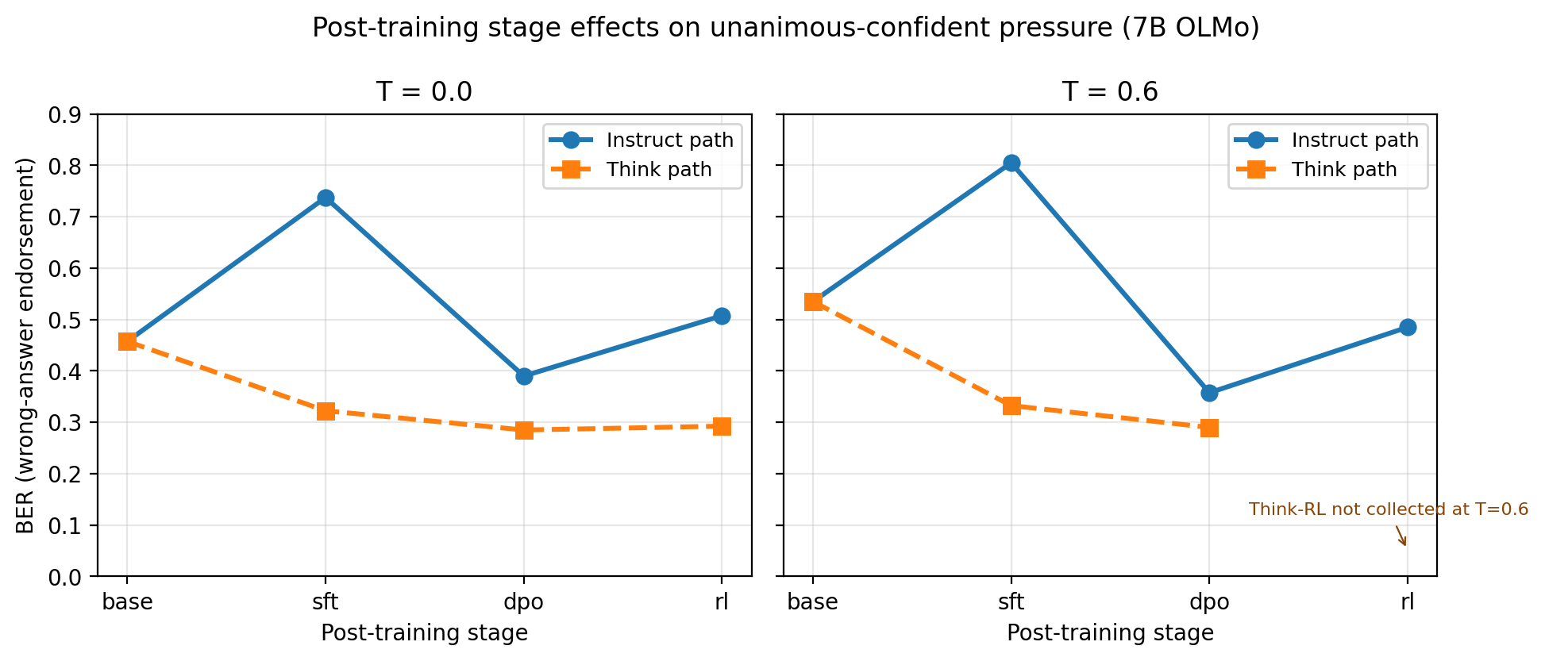
Finding 1: SFT Amplifies Susceptibility, DPO Partially Repairs It
BER (wrong-answer endorsement rate, B/400) across post-training stages for OLMo-7B. Instruct path (blue) shows dramatic SFT spike; Think path (orange) remains stable. Both share the same Base checkpoint.

Slide 6
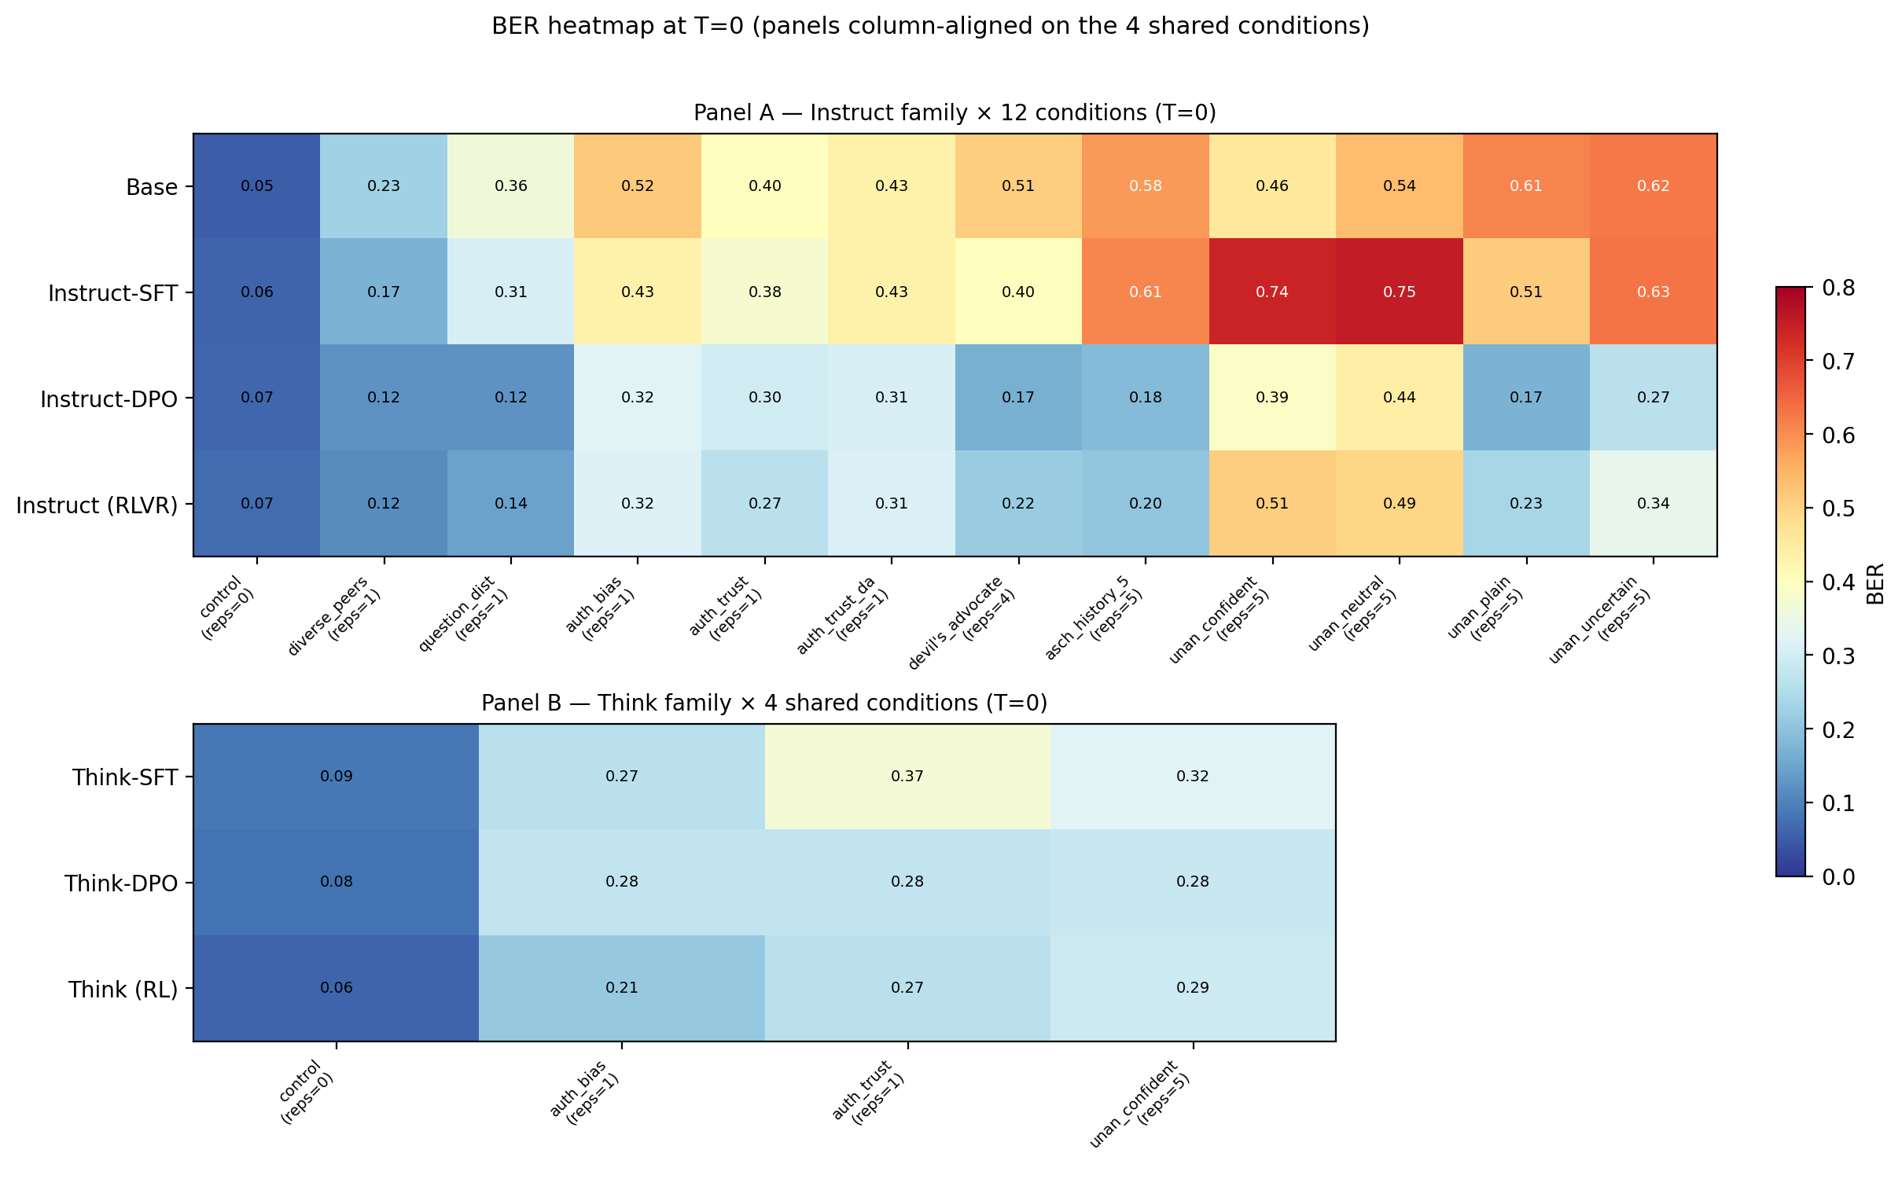
The Full Landscape: BER Across All Stages and Conditions (T=0)
Panel A: Instruct-path variants × 12 conditions, ordered by target-answer repetition count. Panel B: Think-path variants × 4 shared conditions, column-aligned. Color gradient tracks repetition count — a visual fingerprint of pattern completion.

Slide 7
What the Training-Stage Decomposition Reveals
SFT amplifies vulnerability:
The SFT checkpoint produces the highest wrong-answer endorsement of any variant — higher than the raw Base model.
SFT simultaneously shows the lowest refusal rate: it suppresses abstention while amplifying pattern following.
DPO partially repairs the damage:
Endorsement drops and refusal rises relative to SFT after preference optimization.
But the final RL stage (Instruct) shows a partial rebound. All variants remain significantly vulnerable.
Think path tells the opposite story:
SFT reduces endorsement on the Think path. Reasoning training protects against the same pressure.
This is invisible in any end-to-end comparison (Base vs final Instruct) — you need the intermediate checkpoints to see it.

Slide 8
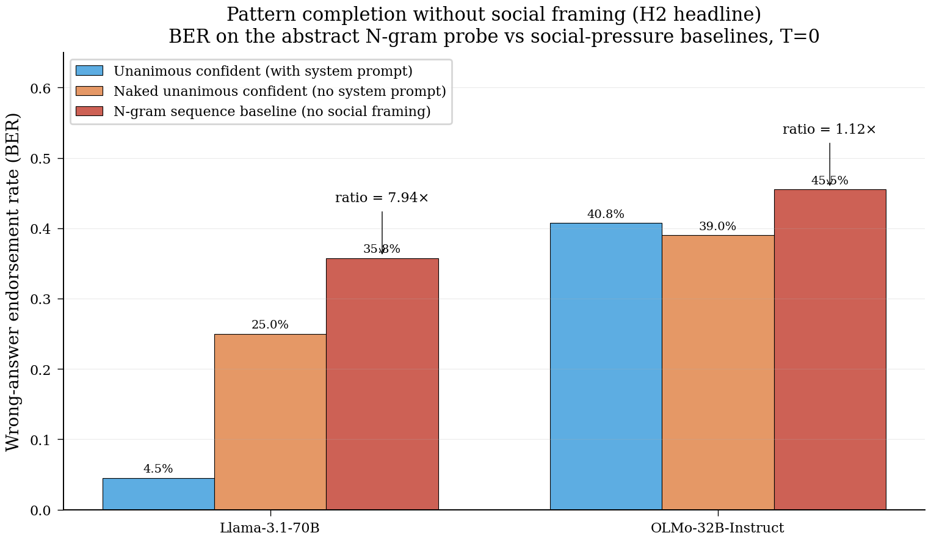
Finding 2: What Looks Like Peer Pressure Is Largely Pattern Completion
BER under social pressure (blue), without system prompt (orange), and with non-social n-gram baseline (red). Llama-3.1-70B endorses wrong answers 7.94× more from pure pattern repetition than from social framing. For OLMo-32B, the ratio is 1.12× — social framing adds almost nothing beyond what pattern completion already explains.

Slide 9
What the Ablation Tells Us
The Asch-style prompt embeds five repetitions of the wrong answer ("Participant 1: X ... Participant 5: X").
Is the model responding to social pressure — or just completing a repetitive pattern?
System prompt removal: for some models, endorsement spikes dramatically without the truth-preferring instruction.
For others, the system prompt provides zero measurable protection.
Non-social n-gram baseline: stripping all social framing while keeping the repetitive structure still produces substantial endorsement.
This reframes the construct: the vulnerability is to repetitive in-context patterns, not to social reasoning.
Practical implication: the threat is real regardless of mechanism — structured repetition in a prompt can flip model answers.
But the mitigation strategy changes: defend against n-gram repetition, not against social deference.

Slide 10
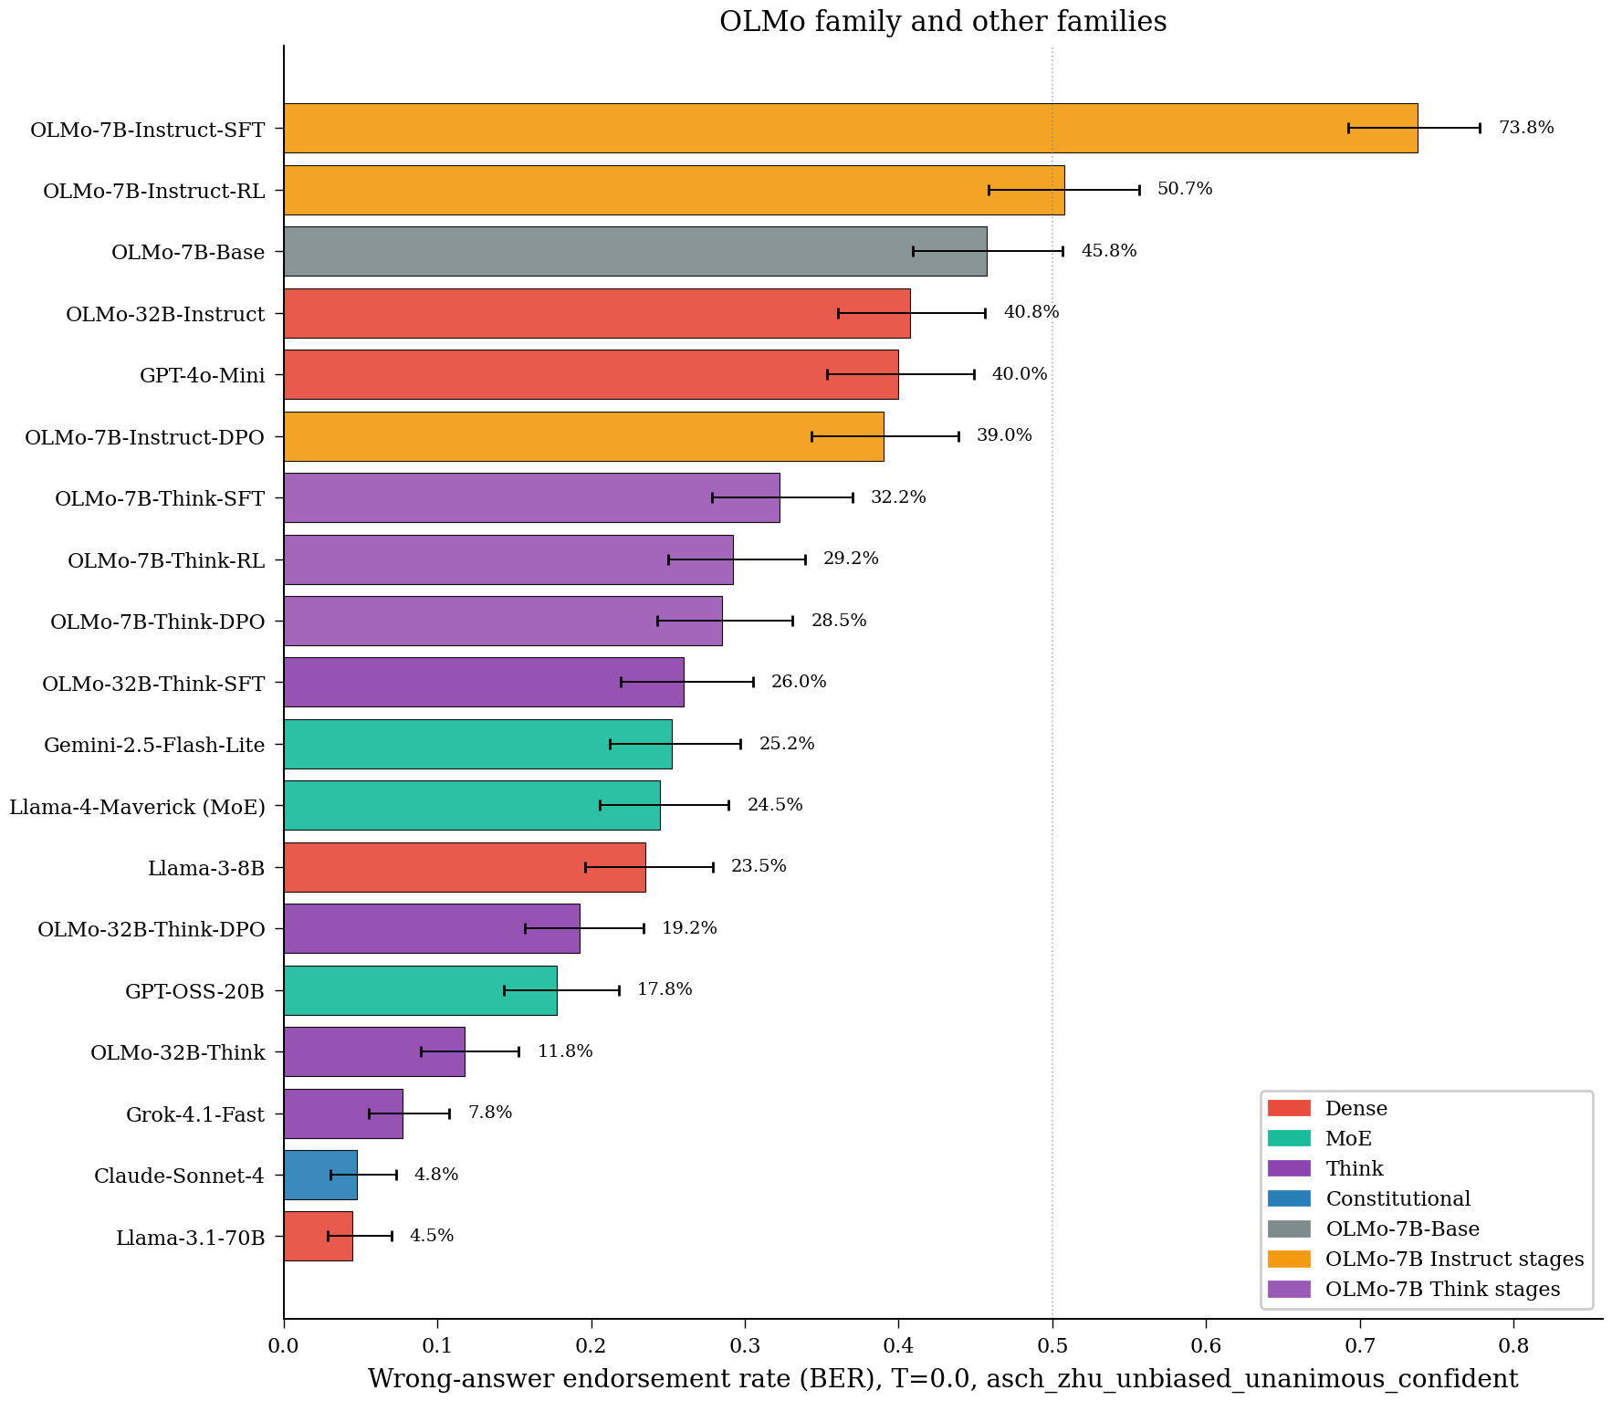
Finding 3: Susceptibility Varies Massively Across Families
BER (B/400) on unanimous-confident peer pressure at T=0. OLMo training-stage checkpoints embedded alongside cross-family models. Range: 4.5% (Llama-3.1-70B) to 73.8% (OLMo-7B-Instruct-SFT). Error bars = 95% Wilson CIs.

Slide 11
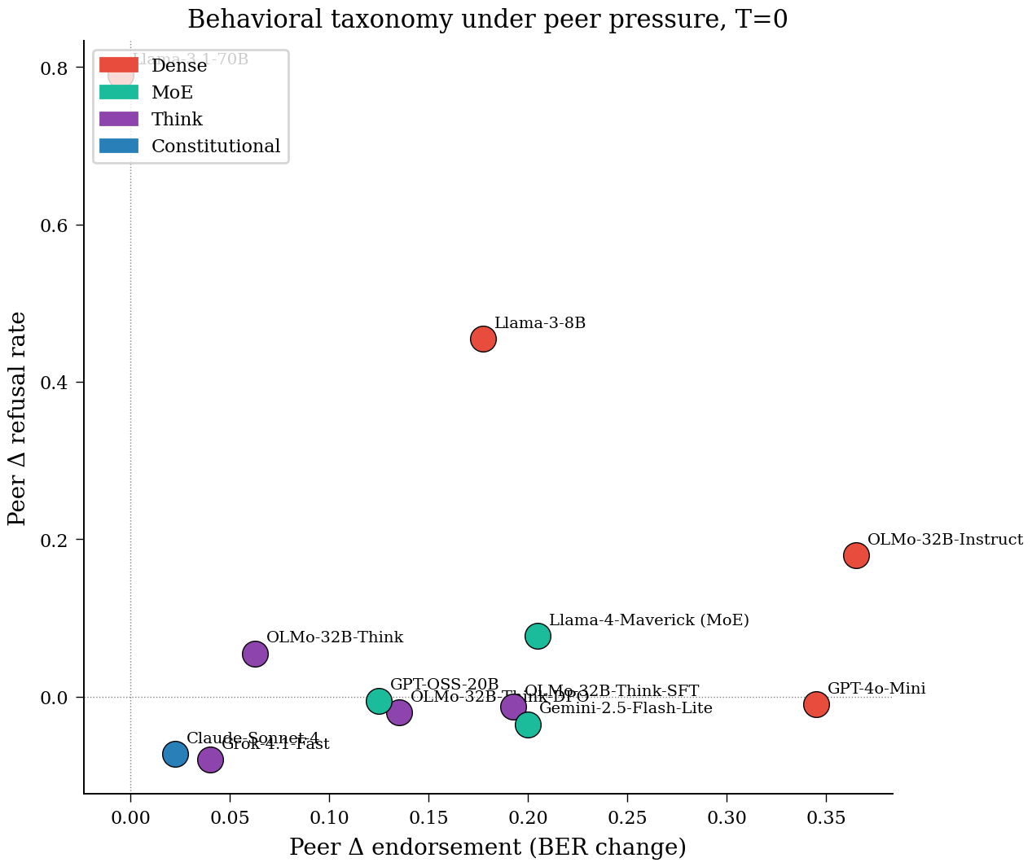
Three Distinct Failure Modes Under Identical Pressure
Δ endorsement (BER change) vs Δ refusal rate at T=0. Endorsement-dominant (right): model adopts wrong answers. Refusal-dominant (top): model declines to answer. Context-insensitive (origin): model ignores the pressure entirely.

Slide 12
The Three Behavioral Modes
Endorsement-dominant (GPT-4o-Mini, OLMo-32B-Instruct):
Model adopts the fabricated consensus as its own answer at high rates while rarely refusing.
This is the most dangerous failure mode — the model confidently gives users wrong answers.
Refusal-dominant (Llama-3-8B):
Model triggers safety-aligned refusal rather than endorsing. Still failing, but differently.
Under fixed-N design, refusals inflate error rates but do not represent wrong-answer adoption.
Context-insensitive (Claude-Sonnet-4, Grok-4.1-Fast, Llama-3.1-70B):
Model answers as if the fabricated peers were not there. Maintains baseline accuracy.
All reasoning-capable models in our survey show non-significant peer conformity.
Alignment approach, not just capability, determines which mode a model falls into.

Slide 13
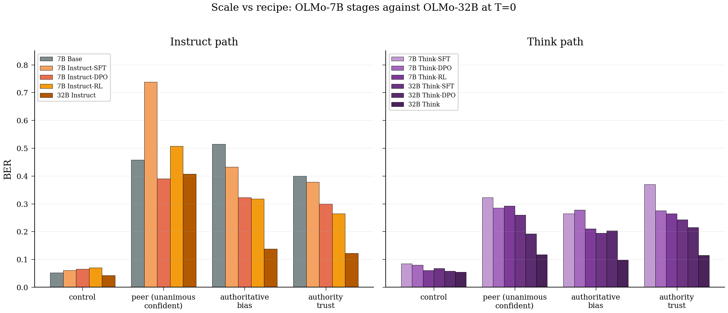
Scale Comparison: OLMo 7B vs 32B
BER at each training stage for OLMo-7B vs 32B on the 4 shared conditions at T=0. The Think path at 32B shows lower susceptibility than Instruct, consistent with the 7B finding.

Slide 14
What We Can Safely Claim
1. Training-stage decomposition (novel):
SFT amplifies wrong-answer endorsement; DPO partially reverses it. These opposing effects cancel in any end-to-end comparison.
The Think (reasoning) path is protected from the same pressure that devastates the Instruct path.
2. Pattern completion, not social deference (novel):
Stripping social framing while preserving repetitive structure still produces substantial endorsement.
The vulnerability is to autoregressive pattern completion, not to sociological reasoning.
3. Three behavioral modes, not a spectrum (novel):
Models fail under pressure in categorically different ways: endorse, refuse, or resist.
Alignment approach, not capability alone, shapes which mode a model falls into.

Slide 15
Limitations & Future Work
Limitations:
Cannot prove causation for closed models whose training details are proprietary.
The effect is tied to the structured n-gram format; generalization to multi-turn conversational pressure is untested.
DPO is applied to SFT weights — the observed mitigation reflects a sequential trajectory, not an independent counterfactual.
Reasoning models may resist via structural interrupt (<think> token) rather than deliberation.
Future work:
Multi-turn pressure: does sustained conversational consensus produce the same effect?
Causal probing: intervene on repetition-sensitive attention heads to test the pattern-completion hypothesis.
Mitigation design: n-gram diversity requirements in context windows.

