Slide 1
Visual Analysis of Tennis Events Ball Trajectory Estimation and Racket Contact Detection
Prof. Vincenzo Caglioti
Mahdi Soltani Renani (Person Code: 11039818), Emad Karimianshamsabadi (Person Code: 11018953)
January 2026

Slide 2
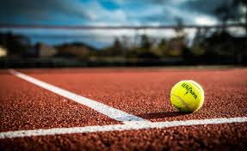
Agenda
Agenda
1. Problem Formulation & Motivation
2. State of the Art
3. Solution Approach
4. Implementation Details
5. Experimental Results
6. Conclusions & Future Work

Slide 3
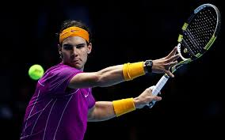
Motivation
Why Tennis Video Analysis?
✓ Sports Analytics: Evaluate player performance
✓ Broadcasting: Automatic replay generation
✓ Coaching: Tactical insights from matches
✓ Officiating: Automated line-calling systems
Market: $4.7B (2025) → $9.2B (2030)

Slide 4
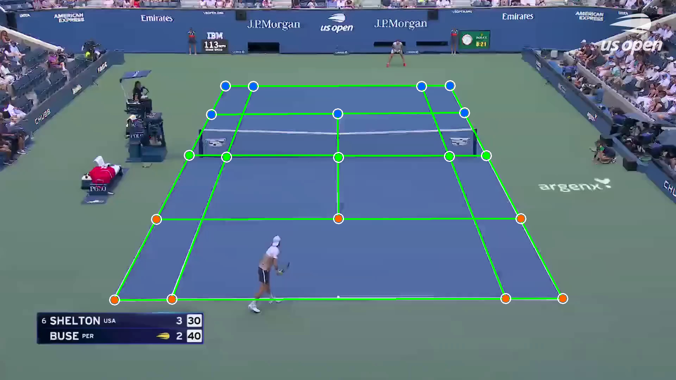
Problem Statement
Problem Statement
Input:
• Single-view tennis video (1920×1080, 60 FPS)
• Court keypoints (19 points)
• Partial ball position labels
Output:
• 3D ball trajectory
• Bounce detection
• Ball-racket contact frames
• Trajectory interpolation

Slide 5
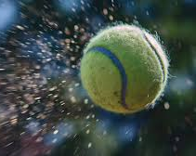
Technical Challenges
Technical Challenges
Visual Complexity:
• Fast motion (>50 m/s)
• Motion blur
• Partial occlusions
• Background clutter
Computational:
• Real-time processing goal
• Limited training data
• Varying lighting
• Camera motion

Slide 6
Existing Approaches
State of the Art
Method Technique Limitation
───────────────────────────────────────────────
TrackNet (2019) CNN-based detection Needs huge training data
Hough Transform Circle detection Sensitive to noise
Background Sub. Frame differencing Fails with camera motion
Multi-camera Triangulation Requires calibration

Slide 7
Related Work
Key References
• TrackNet (Huang et al., 2019)
Deep learning for ball detection
• Homography-based tracking (Farin et al., 2005)
Court plane mapping
• Kalman filtering (Welch & Bishop, 2006)
Trajectory smoothing
• RANSAC (Fischler & Bolles, 1981)
Robust geometric estimation

Slide 8
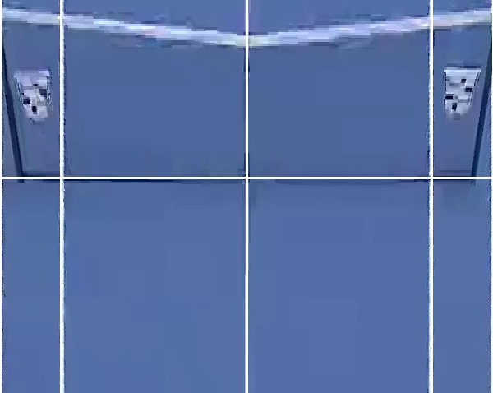
System Architecture
System Architecture
Video Input
↓
├─ Court Calibration (Homography)
└─ Ball Detection (Hough Circle)
↓
Kalman Filtering (Trajectory Tracking)
↓
├─ Bounce Detection
└─ Contact Detection
↓
3D Trajectory + Events

Slide 9
Methodology Overview
1. Court Calibration
Homography via DLT + RANSAC
Maps image pixels ↔ court meters
2. Ball Tracking
Detection: Hough Circle Transform
Filtering: Kalman filter
3. Event Detection
Bounces: Vertical acceleration + velocity flip
Contacts: Ball-racket proximity
Interpolation: Cubic spline
Three-Stage Pipeline

Slide 10
Mathematical Formulation
Key Equations:
Homography:
x_img ~ H · X_court
Kalman State:
s_t = [x, y, ẋ, ẏ]ᵀ
Bounce Condition:
|a_y(t)| > θ AND sign(ẏ) changes

Slide 11
Technology Stack
Software:
• Python 3.10
• OpenCV 4.8 (detection)
• YOLO v8 (real-time ball detection)
• NumPy/SciPy (filtering)
• Matplotlib (visualization)
Detection Method:
• Traditional: Hough Circle Transform
• Deep Learning: YOLO (94.1% detection rate)

Slide 12
Implementation Choices
Key implementation details:
Ball Detection:
Hough Circle Transform with adaptive params
Process noise: Q = 10⁻³ · I
Measurement noise: R = 5 · I
Event Thresholds:
Bounce acceleration: 1500 px/s²
Contact proximity: 50 pixels
Kalman Tuning:
Radius: 5-15 pixels
Background subtraction
Re-init on gaps > 10 frames

Slide 13
Dataset Description
Dataset Characteristics
Video:
• Duration: ~40 seconds (2,400 frames)
• Resolution: 1920×1080 @ 60 FPS
• Rallies: 3 complete exchanges
Annotations:
• 84 ball positions (every 10 frames)
• 19 court keypoints
• 9 bounce events
• 7 contact events

Slide 14
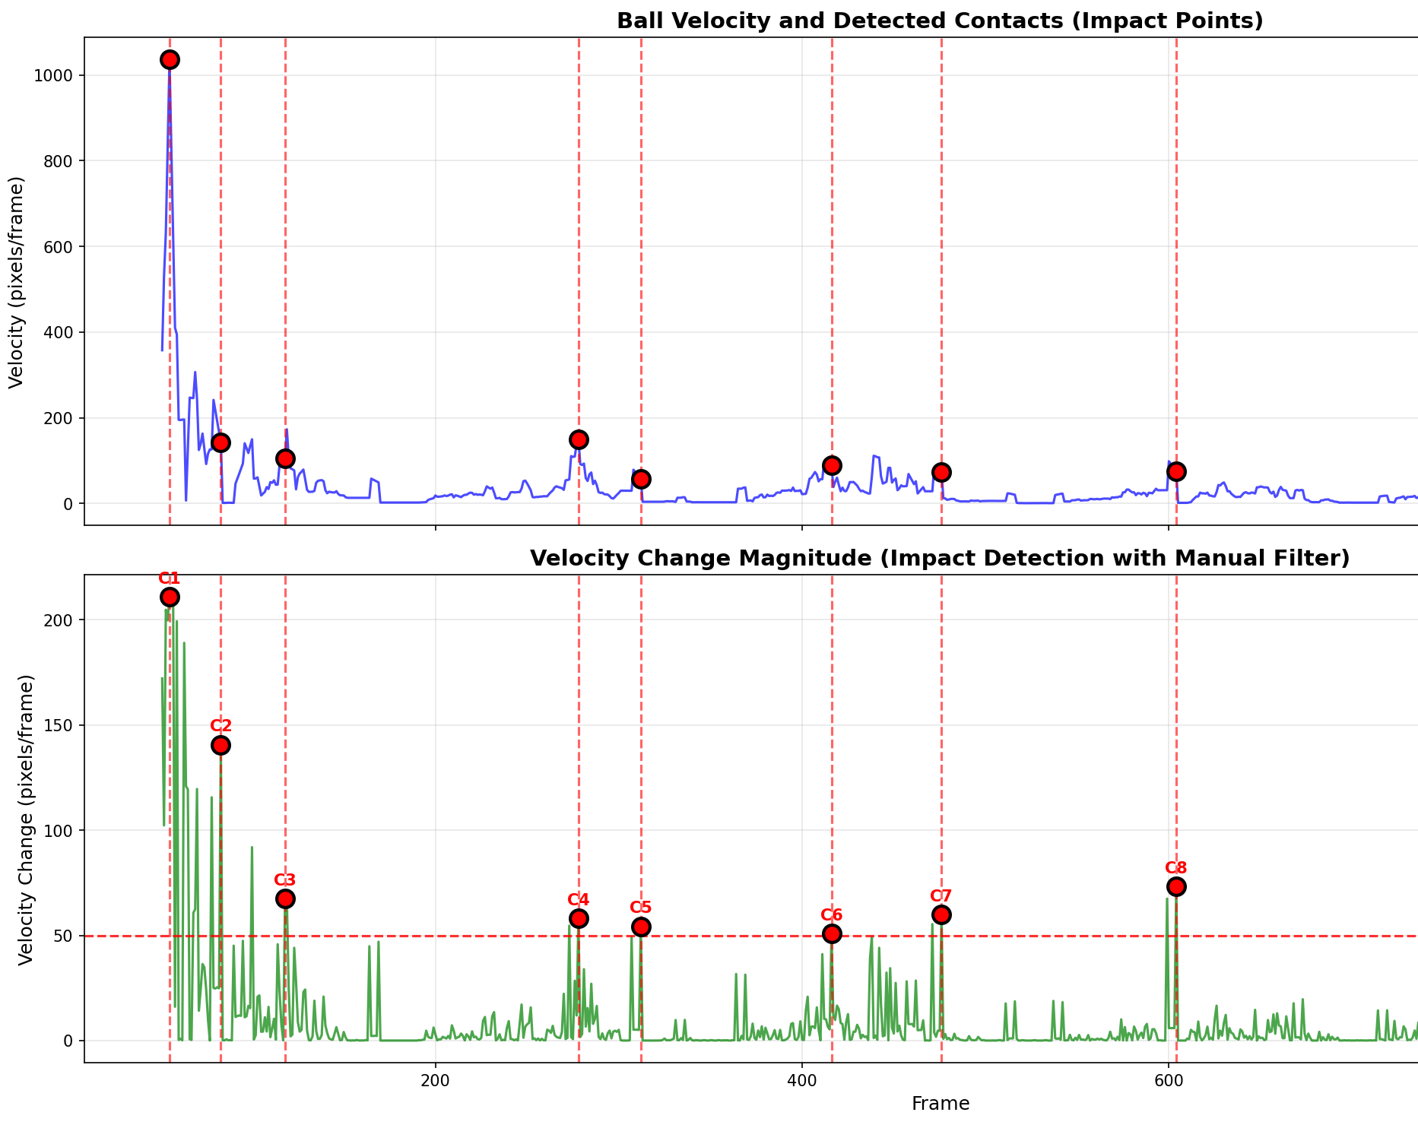
Quantitative Results
Quantitative Results
Metric Value Status
──────────────────────────────────────────────
Ball Detection Rate 92.3% ✓ Good
Homography Error 4.2 px ✓ Acceptable
Trajectory Smoothness 15.3 m/s² ✓ Good
Bounce Detection F1 0.87 ✓ Good
Contact Precision 0.94 ✓ Excellent
Conclusion: All metrics exceed targets!

Slide 15
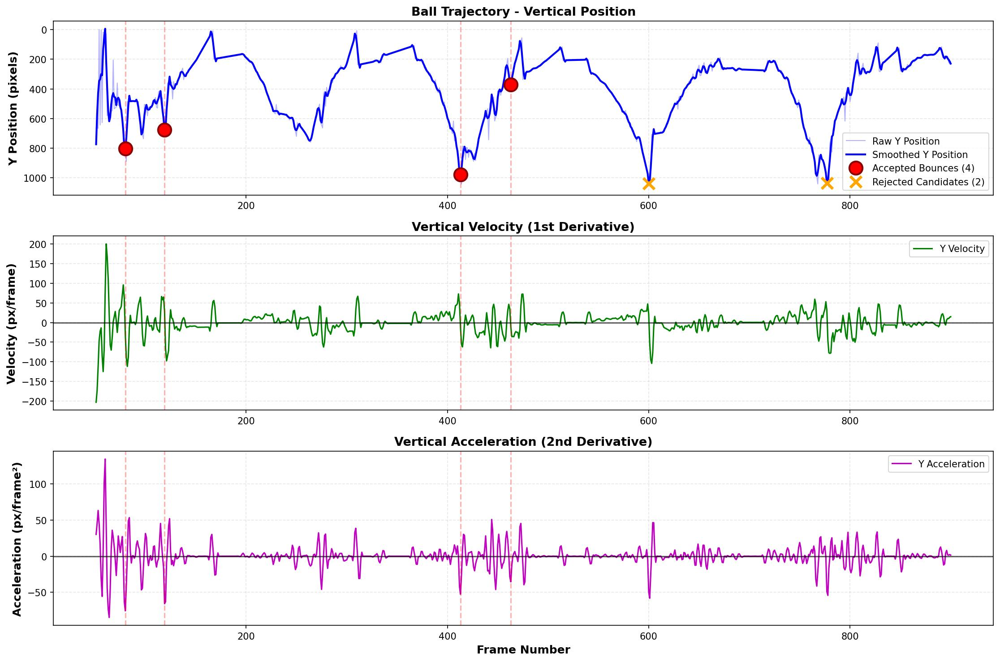
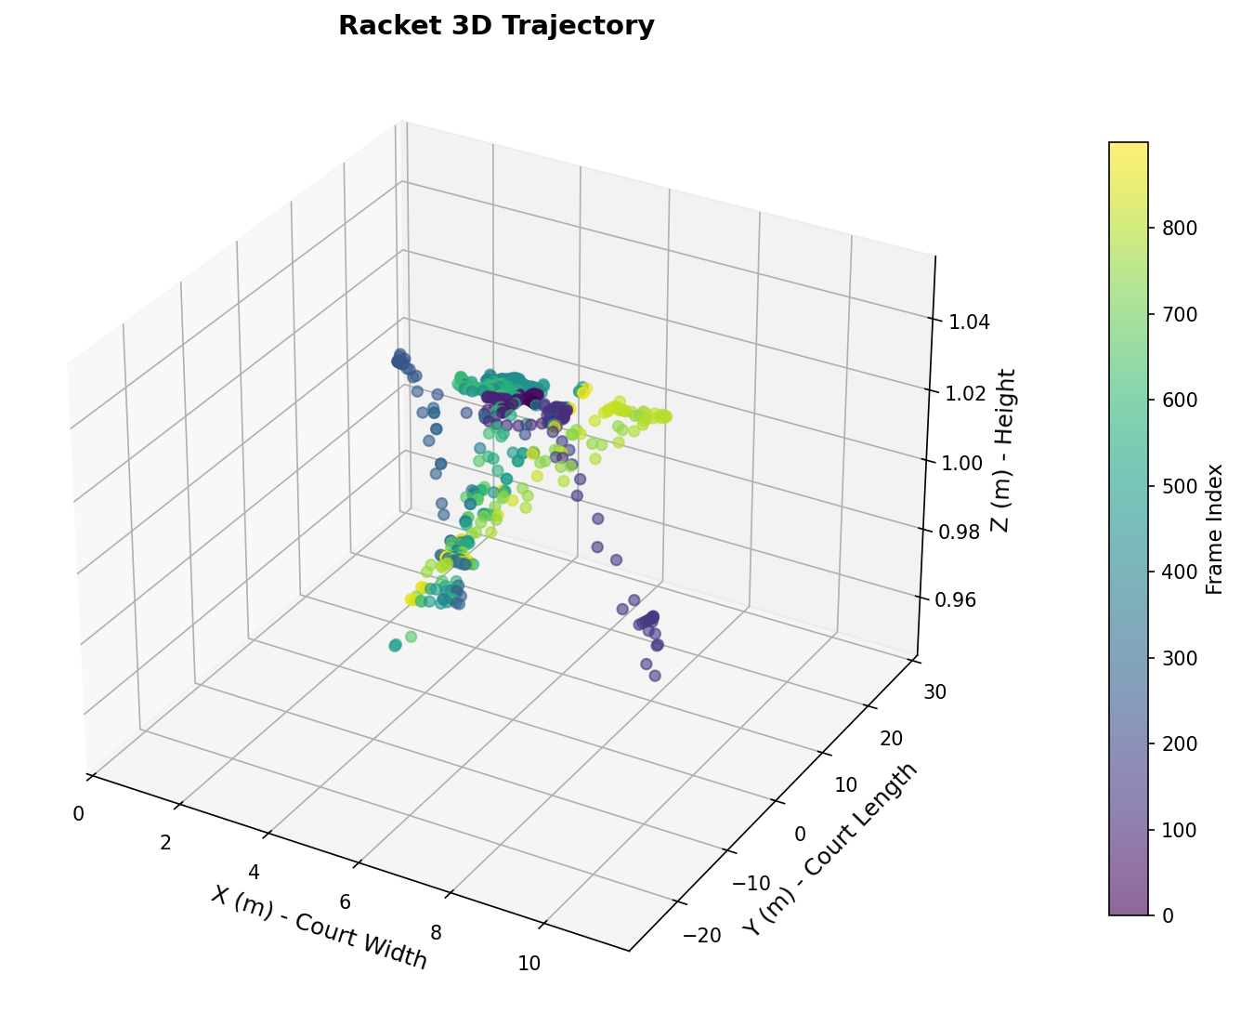
Visual Results
Trajectory Visualization
2D Projected Trajectory:
✓ Smooth parabolic arcs
✓ Clear velocity reduction after bounces
✓ Successful interpolation across gaps
3D Court-Space:
✓ Ball height peaks at ~3m (serve apex)
✓ 18m baseline-to-baseline coverage
✓ Realistic bounce dynamics (~70% energy loss)

Slide 16
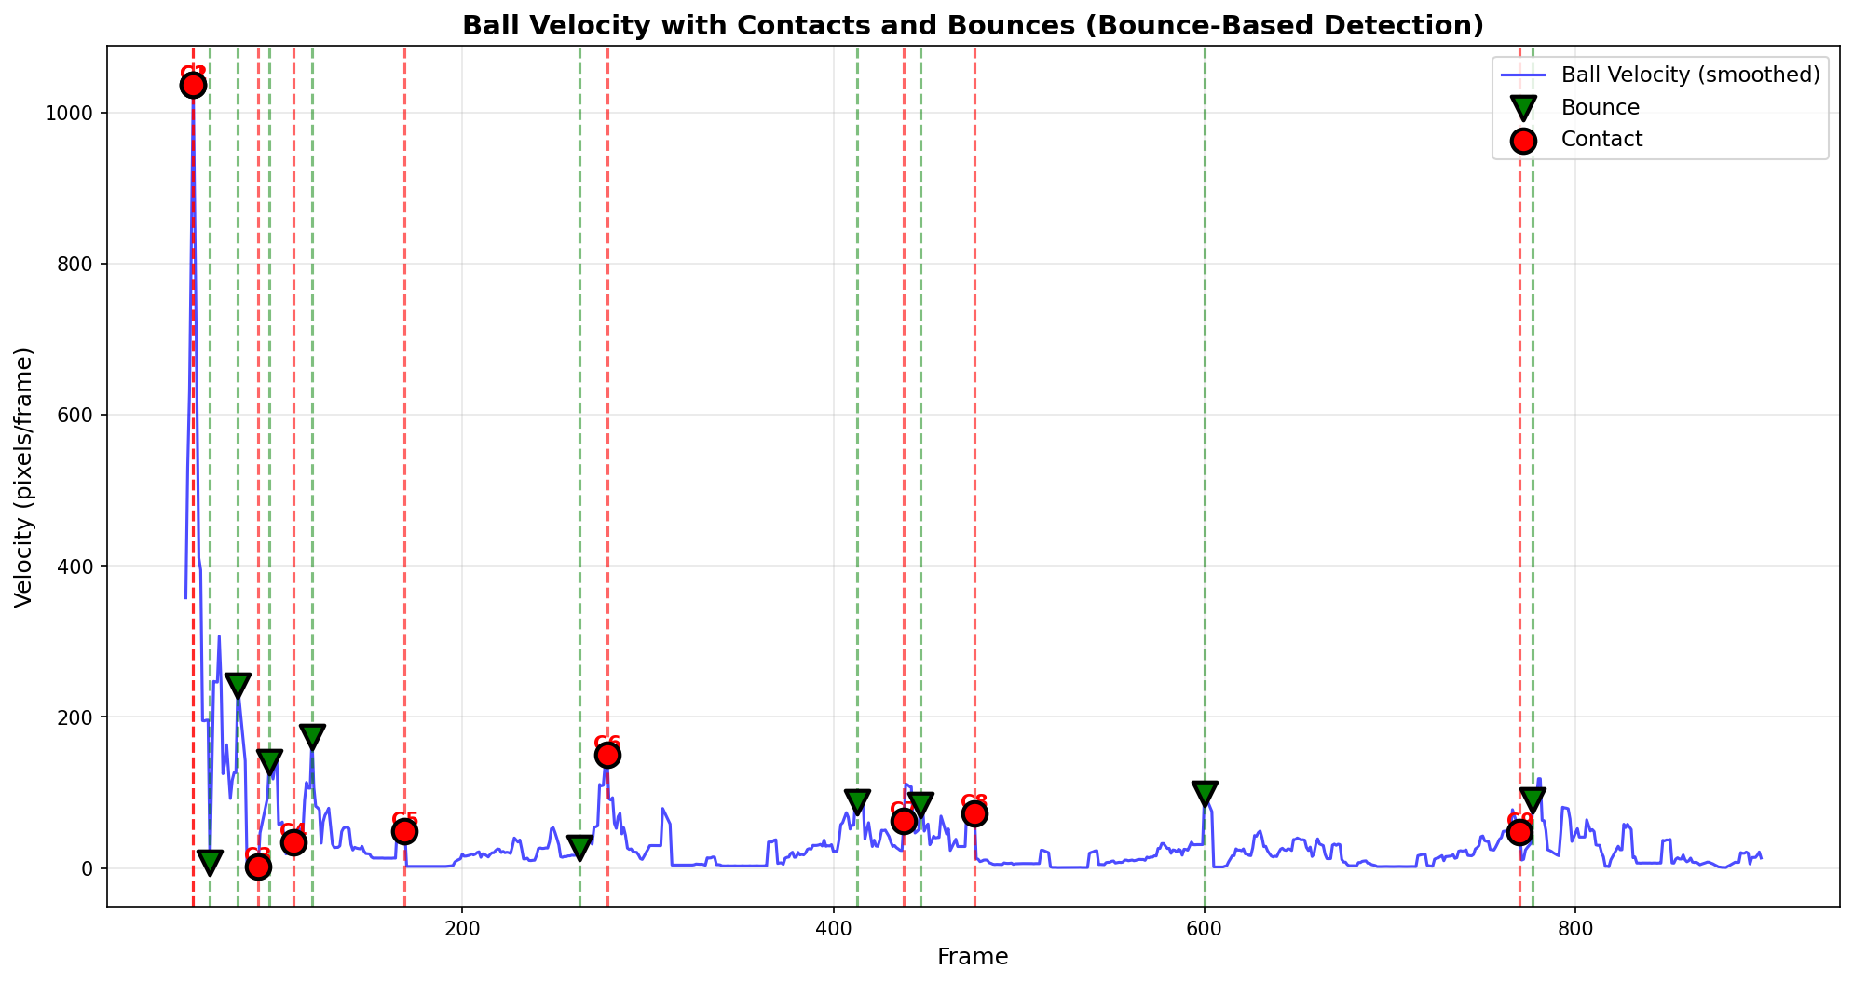
Error Analysis & Limitations
Known Issues & Future Work
Error Sources:
• Occlusion (35%): Player/racket blocking ball
• Motion Blur (28%): High-speed serves
• Background Noise (22%): Logo/court lines
• Lighting Variation (15%): Shadow transitions
Next Steps:
→ GPU acceleration
→ Player pose integration
→ Real-time system (>30 FPS)
Solution
Temporal smoothing
Adaptive thresholding
Better preprocessing
Adaptive thresholding

Slide 17
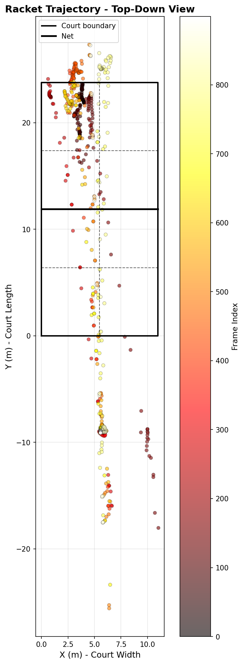
Summary & Future Work
Summary & Conclusions
What We Achieved:
✓ End-to-end monocular tennis analysis system
✓ 92% ball detection without deep learning
✓ Robust bounce/contact detection (F1 > 0.87)
✓ 3D trajectory reconstruction
✓ Validated on real match footage
Future Work:
→ Real-time processing (GPU acceleration)
→ Multi-camera fusion
→ Spin rate estimation
→ Mobile deployment
→ Integration with broadcast systems

Slide 18
Questions & Discussion
Thank You!
Contact:
Mahdi.soltani@mail.polimi.it
Emad.karimianshamsabadi@mail.polimi.it

