Slide 1
The Property Graph Model
The property graph model is the most popular model for modern graph databases.
Correspondingly, it’s a common basis for creating knowledge graphs.

Slide 2
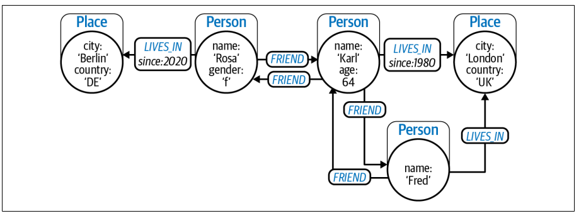

Slide 3
It consists of the following elements:
Nodes representing entities in the domain
• Nodes can contain zero or more properties, which are key-value pairs represent‐
ing entity data such as price or date of birth.
• Nodes can have zero or more labels, which declare the node’s purpose in the
graph, such as representing a Customer or a Product.
Relationships representing how entities interrelate
• Relationships have a type, such as BOUGHT, FOLLOWS, or LIKES.
• Relationships have a direction, going from one node to another (or back to the
same node).
• Relationships can contain zero or more properties, which are key-value pairs
representing some characteristic of the link, such as a timestamp or distance.
• Relationships never dangle—there are always a start node and an end node
(which can be the same node)

Slide 4
The property graph model does not enforce any schemas based on labels or relationship types.
you can apply constraints to the label to ensure those properties exist, are unique, and so on. You can view this not as schema or schemaless, but schema-ish.
In the property graph model, there are no limits on the number of nodes or the
number or type of relationships that interconnect them. Some nodes are densely
connected while others are sparsely connected. All that matters is that the model
matches the problem domain.
building even very large knowledge graphs is achievable.

Slide 5
Knowledge Graphs
Knowledge graphs are a specific type of graph with an emphasis on contextual understanding.
knowledge graphs must have an organizing principle so that a user (or a computer system) can reason about the underlying data.

Slide 6
organizing principle
The organizing principle provides an additional layer of structure that adds context to support knowledge discovery. The organizing principle makes the data itself smarter.

Slide 7
what transforms a graph into a knowledge graph is the application of an organizing principle that helps people and software to understand it. Historically, this has loftily been called semantics, but you can think of it as making the data smarter.
Rather than having to repeatedly encode smart behavior into applications, it is encoded once, directly into the data. Smarter data enables knowledge reuse and reduces duplication and discrepancies.
organizing principle makes a graph self-describing (to a certain extent)

Slide 8
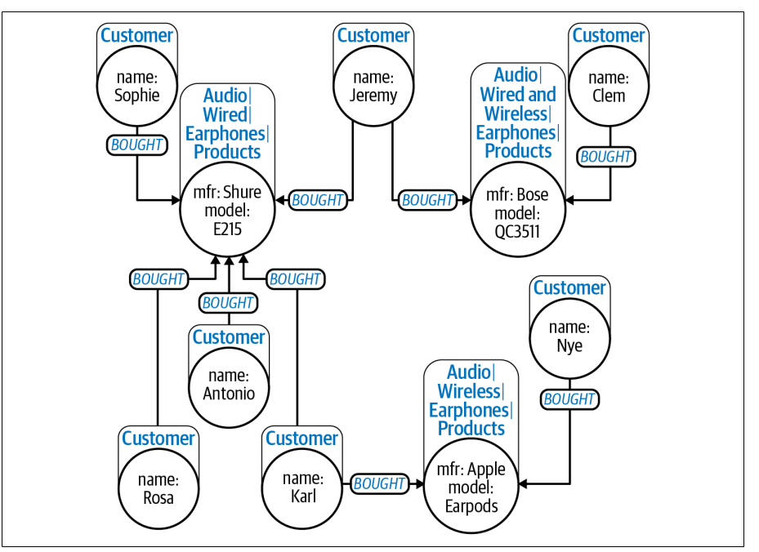

Slide 9
A property graph gives human and software agents a set of essential clues about the information it contains: node labels, relationship types and direction, and the types and names of property data stored on them. It is even possible to get a formal
description of the shape of the graph (its schema) via introspection. Effectively, this
organizing principle makes a graph self-describing (to a certain extent) and is a clear
first step toward making data smarter.

Slide 10
you saw that the connection between customers and the
products they’ve bought is explicit in the graph in the form of a relationship. Creating categories of nodes using labels is also clearly useful, but the between labels was missing.

Slide 11
The Labeled Property Graph Model
In the labeled property graph model, labels are akin to tags which describe the role of a node in the graph. There is no associativity between labels.

Slide 12
To support x is a kind of y reasoning, you need a more hierarchical view of your data
using a structure known as a taxonomy. A taxonomy is a classification scheme that
organizes categories in a broader-narrower or generalization-specialization hierarchy.
Items that share similar qualities are grouped into the same category, and the taxonomy organizes concepts by relating categories to one another. This kind of hierarchical organization places more specific things like products (which are numerous) at the bottom of the hierarchy while more general things like brands or product families (which are less numerous) are placed toward the top of the hierarchy.
The hierarchy is constructed with Category nodes connected by SUBCATEGORY_OF relationships, though on the framework or vocabulary used, these could also be called NARROWER_THAN or SUBCLASS_OF

Slide 13
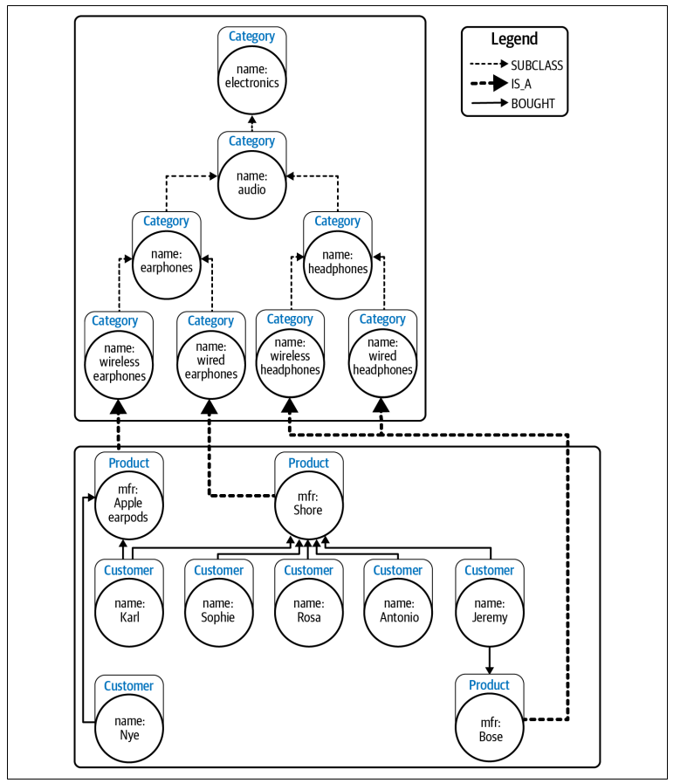

Slide 14
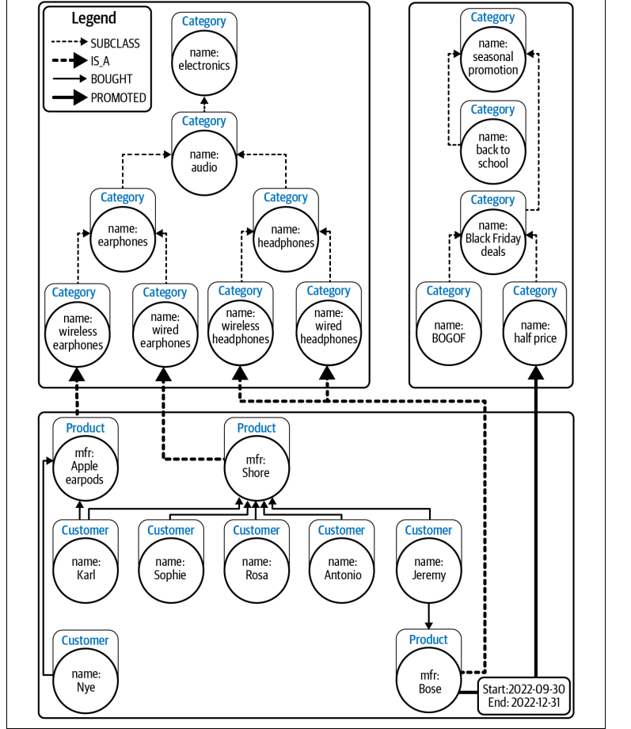
Using multiple categories makes the data more expressive and allows for sophisticated exploitation with low complexity.

Slide 15
ontologies
ontologies are classification schemes that describe the categories in a domain and the relationships between them. But ontologies are not restricted to hierarchical (broader-narrower) structures, so they can offer richer associativity.
you can explore the categories in a domain not just vertically (hierarchically) but also horizontally, which allows you to address cross-cutting concerns.

Slide 16
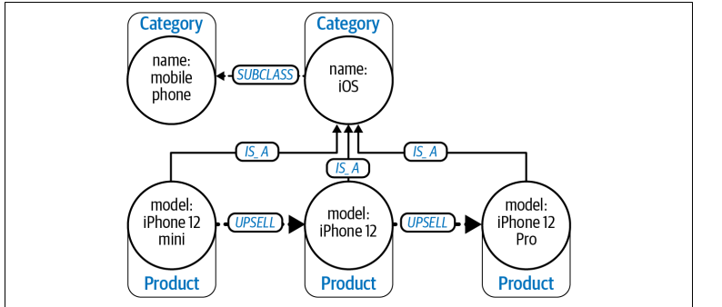
from the semantics of the UPSELL relationship defined in the ontology, you can further reason that an iPhone 12 Pro should be recommended to customers looking at an iPhone 12

Slide 17
Organizing Principles: Standards Versus Create Your Own
There are several widely used ontologies that serve particular domains.
Financial Industry Business Ontology (FIBO) for finance and business.

Slide 18
Creating Your Own Organizing Principle
If you are faced with the task of creating an organizing principle, there are a few approaches from which to choose.
Another way is to formally define the organizing principle using one of the standard
languages available. The most widely used standard languages are RDF Schema and Web Ontology Language (called OWL) for ontologies and Simple Knowledge Organization System (SKOS) for taxonomical classification schemes. Each of these languages allows for different expressivity levels: from the basic definition of categories and relationships to taxonomies and more sophisticated constructs like complex classes

Slide 19
RDF
Resource Description Framework (RDF) is a model for data exchange, not a guide to query. It describes how data is serialized as triples of subject, predicate, and object (roughly equivalent to start node, relationship, and end node)

