Slide 1
The Property Graph Model
The property graph model is the most popular model for modern graph databases.
Correspondingly, it’s a common basis for creating knowledge graphs.

Slide 2
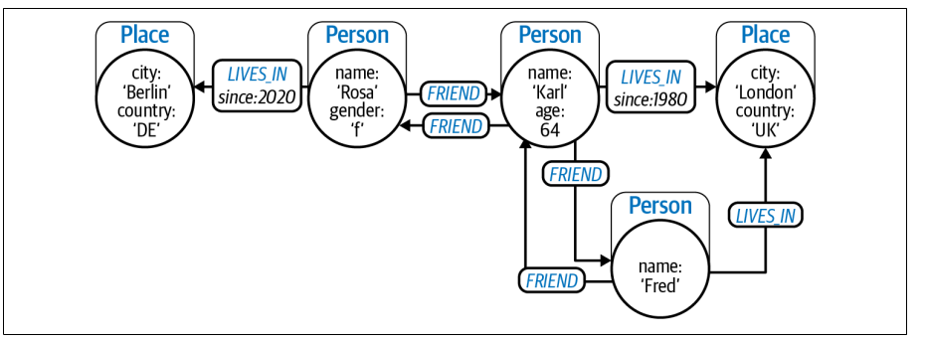

Slide 3
It consists of the following elements:
Nodes representing entities in the domain
• Nodes can contain zero or more properties, which are key-value pairs represent‐
ing entity data such as price or date of birth.
• Nodes can have zero or more labels, which declare the node’s purpose in the
graph, such as representing a Customer or a Product.
Relationships representing how entities interrelate
• Relationships have a type, such as BOUGHT, FOLLOWS, or LIKES.
• Relationships have a direction, going from one node to another (or back to the
same node).
• Relationships can contain zero or more properties, which are key-value pairs
representing some characteristic of the link, such as a timestamp or distance.
• Relationships never dangle—there are always a start node and an end node
(which can be the same node)

Slide 4
The property graph model does not enforce any schemas based on labels or relationship types.
you can apply constraints to the label to ensure those properties exist, are unique, and so on. You can view this not as schema or schemaless, but schema-ish.
In the property graph model, there are no limits on the number of nodes or the
number or type of relationships that interconnect them. Some nodes are densely
connected while others are sparsely connected. All that matters is that the model
matches the problem domain.
building even very large knowledge graphs is achievable.

Slide 5
Knowledge Graphs
Knowledge graphs are a specific type of graph with an emphasis on contextual understanding.
knowledge graphs must have an organizing principle so that a user (or a computer system) can reason about the underlying data.

Slide 6
organizing principle
The organizing principle provides an additional layer of structure that adds context to support knowledge discovery. The organizing principle makes the data itself smarter.

Slide 7
what transforms a graph into a knowledge graph is the application of an organizing principle that helps people and software to understand it. Historically, this has loftily been called semantics, but you can think of it as making the data smarter.
Rather than having to repeatedly encode smart behavior into applications, it is encoded once, directly into the data. Smarter data enables knowledge reuse and reduces duplication and discrepancies.
organizing principle makes a graph self-describing (to a certain extent)

Slide 8
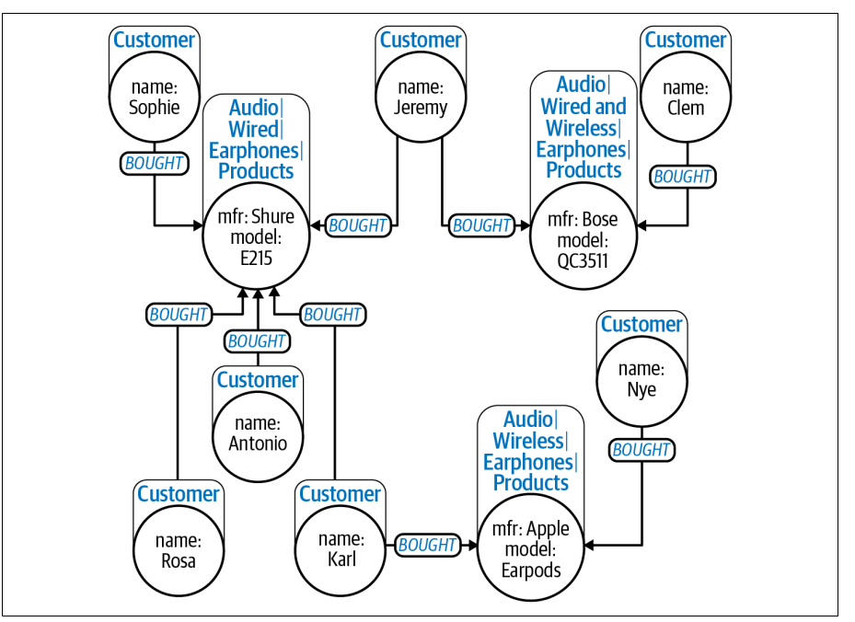

Slide 10
A property graph gives human and software agents a set of essential clues about the information it contains: node labels, relationship types and direction, and the types and names of property data stored on them. It is even possible to get a formal
description of the shape of the graph (its schema) via introspection. Effectively, this
organizing principle makes a graph self-describing (to a certain extent) and is a clear
first step toward making data smarter.

Slide 11
you saw that the connection between customers and the
products they’ve bought is explicit in the graph in the form of a relationship. Creating categories of nodes using labels is also clearly useful, but the between labels was missing.

Slide 12
The Labeled Property Graph Model
In the labeled property graph model, labels are akin to tags which describe the role of a node in the graph. There is no associativity between labels.

Slide 13
To support x is a kind of y reasoning, you need a more hierarchical view of your data
using a structure known as a taxonomy. A taxonomy is a classification scheme that
organizes categories in a broader-narrower or generalization-specialization hierarchy.
Items that share similar qualities are grouped into the same category, and the taxonomy organizes concepts by relating categories to one another. This kind of hierarchical organization places more specific things like products (which are numerous) at the bottom of the hierarchy while more general things like brands or product families (which are less numerous) are placed toward the top of the hierarchy.
The hierarchy is constructed with Category nodes connected by SUBCATEGORY_OF relationships, though on the framework or vocabulary used, these could also be called NARROWER_THAN or SUBCLASS_OF

Slide 14
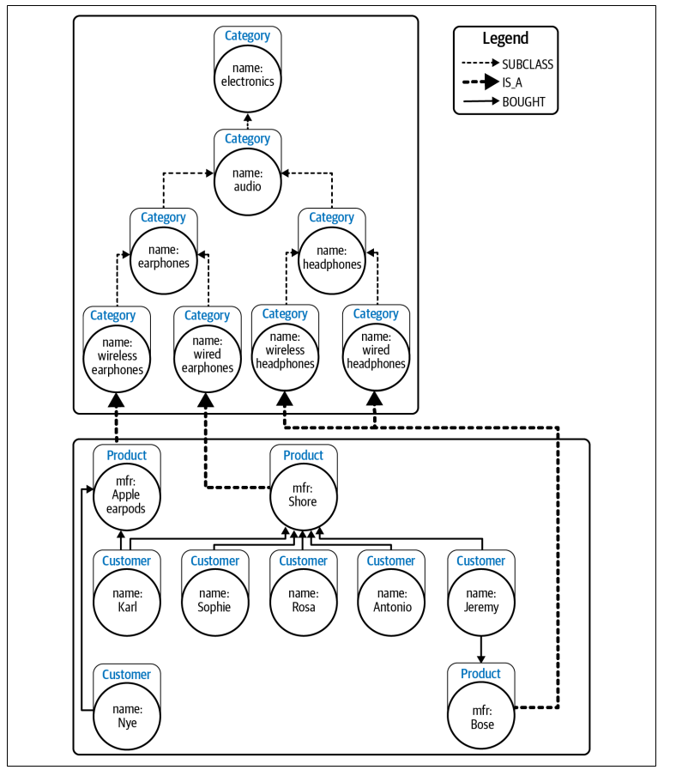

Slide 15
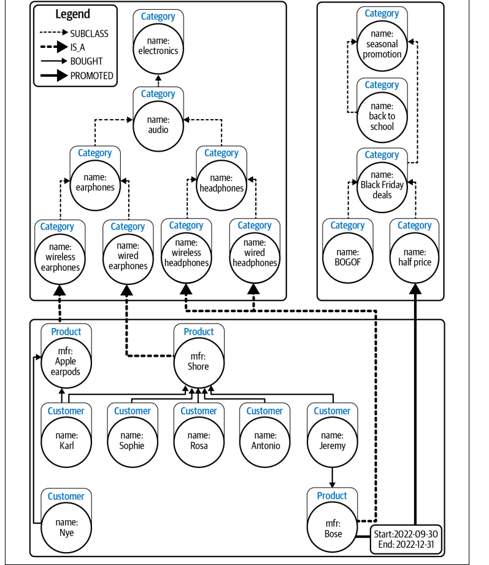
Using multiple categories makes the data more expressive and allows for sophisticated exploitation with low complexity.

Slide 16
ontologies
ontologies are classification schemes that describe the categories in a domain and the relationships between them. But ontologies are not restricted to hierarchical (broader-narrower) structures, so they can offer richer associativity.
you can explore the categories in a domain not just vertically (hierarchically) but also horizontally, which allows you to address cross-cutting concerns.

Slide 17
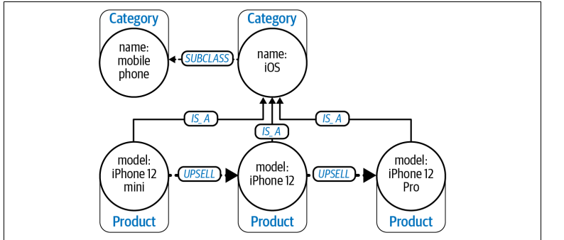
from the semantics of the UPSELL relationship defined in the ontology, you can further reason that an iPhone 12 Pro should be recommended to customers looking at an iPhone 12

Slide 18
Organizing Principles: Standards Versus Create Your Own
There are several widely used ontologies that serve particular domains.
Financial Industry Business Ontology (FIBO) for finance and business.

Slide 19
Creating Your Own Organizing Principle
If you are faced with the task of creating an organizing principle, there are a few approaches from which to choose.
Another way is to formally define the organizing principle using one of the standard
languages available. The most widely used standard languages are RDF Schema and Web Ontology Language (called OWL) for ontologies and Simple Knowledge Organization System (SKOS) for taxonomical classification schemes. Each of these languages allows for different expressivity levels: from the basic definition of categories and relationships to taxonomies and more sophisticated constructs like complex classes

Slide 20
RDF
Resource Description Framework (RDF) is a model for data exchange, not a guide to query. It describes how data is serialized as triples of subject, predicate, and object (roughly equivalent to start node, relationship, and end node)

Slide 21
Enriching Knowledge Grpahs with Data Science
(Introducing Graph Data Science)
The aim of graph data science is to gain insight into your knowledge graph using graph algorithms.
Graph algorithms yield some insight about a knowledge graph’s structure.

Slide 22
Graph Algorithms
There are many graph algorithms from which to choose, each of which performs some computation over a given graph to generate insight from the underlying topology and data.
The first step is to sort the algorithms into categories to provide a high-level view of what kinds of insights can be computed.

Slide 23
Categories of Graph Algorithm
(Purpose: computing over KG)
1) Statistical
Provides metrics about the graph, such as the number of nodes and relationships, degree distribution of relationships, types of node labels, and so on. These will provide context for interpretation of your results.
2) Analytical
Surfaces significant patterns or latent knowledge over the whole knowledge graph or significant subcomponents.

Slide 24
Categories of Graph Algorithm
(Purpose: computing over KG)
3) Machine Learning
Uses the results from graph algorithms as features to train machine learning models or uses machine learning to evolve the knowledge graph itself.

Slide 25
Categories of Statistical and Analytical Algorithms
1) Network Propagation
Understanding how signals propagate through a knowledge graph requires deep path computations. The resulting pathways can identify the spread of disease in a community or supply-chain weaknesses. Correspondingly, the results can be used to optimize for containment or adding redundancy to critical paths.

Slide 26
Categories of Statistical and Analytical Algorithms
2) Influence
Influential nodes act as bridges (and bottlenecks) between subgraphs and are ideally positioned to spread information (or disruption) around the network quickly since they are, on average, close to all the other nodes. A measure of a node’s influence is known as its centrality.

Slide 27
Categories of Statistical and Analytical Algorithms
3) Community detection
to find tightly knit communities, graph algorithms tend to partition groups by looking for weak links to remove. Being able to detect communities in a knowledge graph tells you about related works that you might want to read, fraudsters cooperating to commit financial crimes, or communities where pathogens (including disinformation) will spread quickly.

Slide 28
Categories of Statistical and Analytical Algorithms
4) Similarity
When you visualize a knowledge graph, you can often easily spot similar patterns being repeated in the graph. For example, you can see customers with a particular purchase history who would be well served with a particular product recommendation or road intersections associated with abnormal levels of vehicle collisions. But when the graph is large, manual inspection falls short. Similarity algorithms search for known relationships/hierarchies between nodes or common properties on them.

Slide 29
Categories of Statistical and Analytical Algorithms
5) Link prediction
link prediction algorithms can enrich the knowledge graph by computing missing relationships. This is a common use case in social networks where possible friends/followers/contacts can be computed.

Slide 30
Graph Data Science Operations
- Neo4j Graph Data Science is a graph computation framework that is conveniently integrated with the Neo4j graph database. This means you can project data from your knowledge graph stored in Neo4j, then compute an analysis using a graph algorithm (using multiple CPUs).
- The tight integration between Neo4j Graph Data Science and the graph database removes many operational burdens, allows you to focus on running algorithms, and minimizes data wrangling.

Slide 31
Graph Data Science Operations
- Currently, Neo4j Graph Data Science is highly optimized for CPU and RAM.
not all graph algorithms can be expressed as linear algebra problems which are efficiently executable on GPUs
- Neo4j Graph Data Science offers a broad range of high-performance, parallelized
algorithms. You choose an algorithm based on the kind of insight you need and
run algorithms with Cypher procedure calls

Slide 32
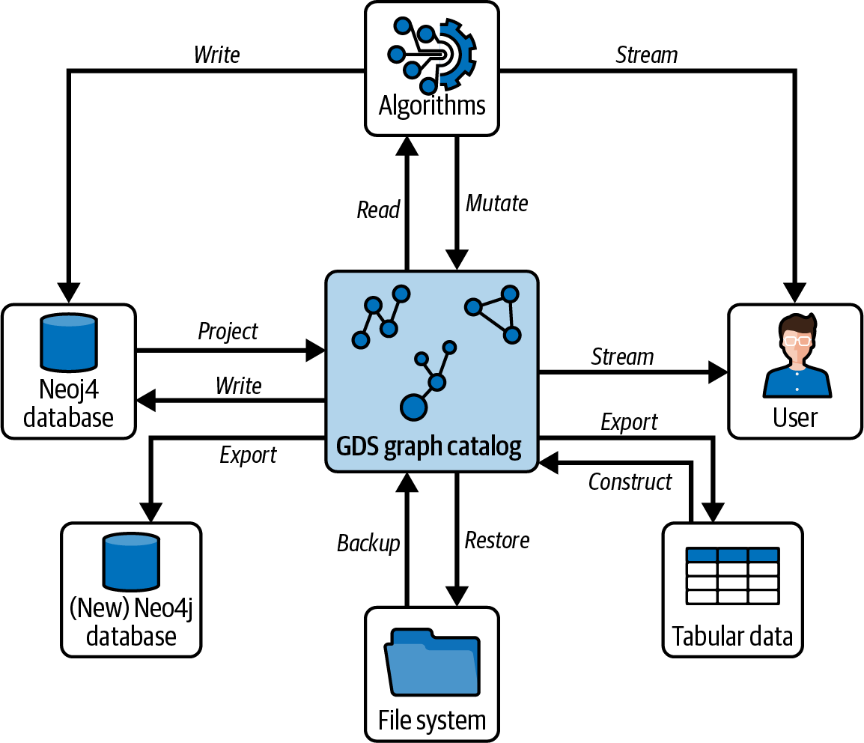
The components involved in running a graph algorithm over a knowledge graph in Neo4j

Slide 33
The components involved in running a graph algorithm over a knowledge graph in Neo4j
Center: GDS Graph Catalog
- This is the in-memory graph workspace used by Neo4j Graph Data Science (GDS).
- It acts like a “graph playground” where projected data from Neo4j is held, modified, analyzed, and streamed back to users or databases.
- Graphs here are temporary and optimized for algorithms (not for transactional storage).

Slide 34
The components involved in running a graph algorithm over a knowledge graph in Neo4j
Top: Algorithms
- These are graph algorithms (e.g., PageRank, community detection, shortest paths).
- They read graphs from the GDS catalog.
They can:
- Stream results back to the user.
- Mutate the graph in GDS (add properties like centrality scores).
- Write results back into the Neo4j database for persistence.

Slide 35
The components involved in running a graph algorithm over a knowledge graph in Neo4j
Left: Neo4j database
- The transactional Neo4j database (OLTP system = Online Transaction Processing system).
- Provides persistent data storage.
- Graphs are projected from here into the GDS catalog.
- Results of algorithms can be written back here.
- You can also export GDS graphs into a new Neo4j database.

Slide 36
The components involved in running a graph algorithm over a knowledge graph in Neo4j
Bottom-left: (New) Neo4j database
- Sometimes, instead of writing results into the same database, you may want to create a new Neo4j instance with processed/cleaned graphs.
- This is done via the Export step.

Slide 37
The components involved in running a graph algorithm over a knowledge graph in Neo4j
Bottom: File system
- Used for backup and restore of GDS in-memory graphs.
- Enables reusing computationally expensive graph projections without rebuilding them every time.

Slide 38
The components involved in running a graph algorithm over a knowledge graph in Neo4j
Right: User
- The end user or analyst interacts with the GDS graph catalog.
They can:
- Stream results directly (e.g., for visualization, reports).
- Run algorithms interactively.
- Export results into external formats.

Slide 39
The components involved in running a graph algorithm over a knowledge graph in Neo4j
Bottom-right: Tabular data
- Graph results can also be exported into tables (CSV, DataFrames, etc.).
These tables can be:
- Constructed from graph projections.
- Exported for use in ML pipelines, BI tools, or other databases.

Slide 40
The components involved in running a graph algorithm over a knowledge graph in Neo4j
- Read projected graph
Choose the parts of the graph that you are interested in processing and create a projection. This can be a subgraph, specific labels and relationship types, patterns from a Cypher query, or even the whole knowledge graph.
- Load projected graph
Export the graph projection into a compact, in-memory format ready for parallel processing.

Slide 41
The components involved in running a graph algorithm over a knowledge graph in Neo4j
- Execute algorithm:
Run the algorithm with parameters you choose.
- Store results
Write the results back into the knowledge graph (e.g., enriching nodes) or com‐
pute results that can be sent to downstream systems or the calling user.

Slide 42
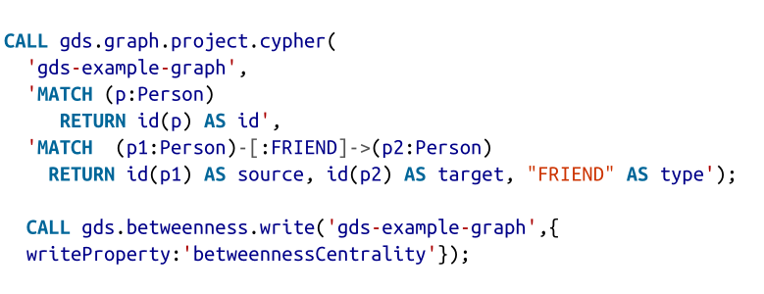
Example: Running Graph Data Science from Cypher

Slide 43
Example: Running Graph Data Science from Cypher
- Name the graph projection
Here it is gds-example-graph, and that projection will be stored under that name in the graph catalog for access by subsequent computations.
** Note that once a projection is created, you can run the algorithm as many times as you need against that projection without having to recreate it.
- Node query
Select the nodes that will be included in the projection. Neo4j Graph Data Science has multiple ways of doing this, including simply by node label. The most flexible choice is a Cypher projection that allows you to specify Cypher code to select nodes of interest. The node IDs have to be returned as a column called id as part of the contract for projections.

Slide 44
Example: Running Graph Data Science from Cypher
- Relationship query
Select the relationships that will be included in the projection. Since this is a Cypher projection, you must supply a Cypher query that identifies the relationships of interest. Importantly, these relationships must connect to nodes from the node projection (or it will fail). The start, end, and type of each relationship must be returned as source, target, and type columns as per the contract for relationship projections.

Slide 45
Example: Running Graph Data Science from Cypher
- Execute the algorithm
The line gds.betweenness.write means that the betweenness centrality algorithm will be called and that it will write back its results into the graph, as opposed to streaming them back to the caller (gds.betweenness.stream) or enriching only the projection (gds.betweenness.mutate). Its parameters are the projection on which to operate (gds-example-graph) and the name of the node property into which results will be written (betweennessCentrality).

Slide 46
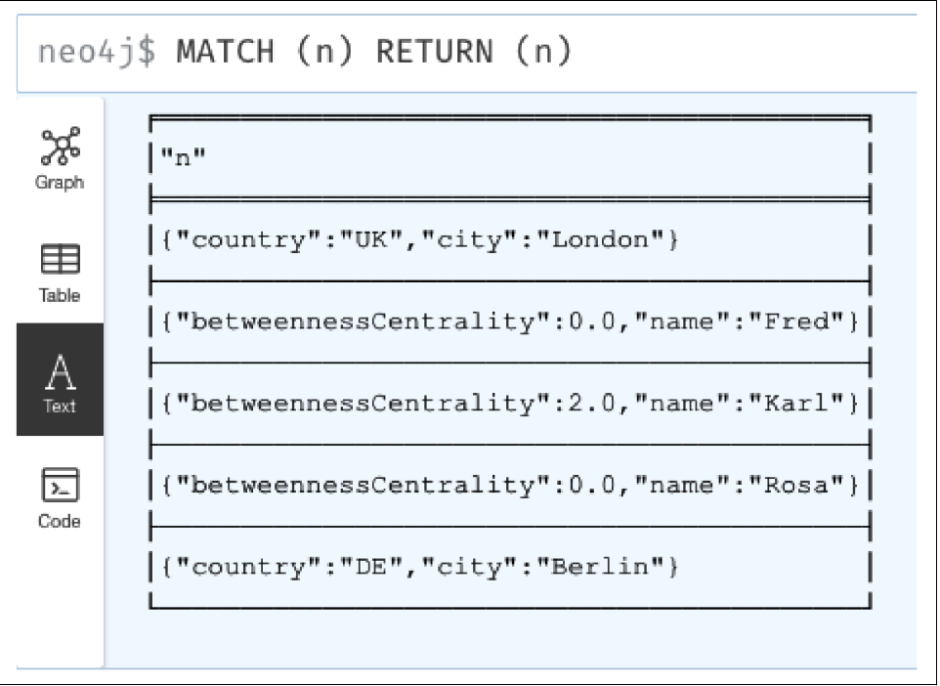
Example: Running Graph Data Science from Cypher
Betweenness centrality computes the number of paths that pass through a given node to establish the node’s importance in the graph.
Betweenness centrality isn’t the only thing you can use to enrich your knowledge graphs. You can choose from 65+ algorithms, including pathfinding, PageRank, Louvain, and so forth.

