Slide 1


IN THE NAME OF GOD
THE MEASUREMENT OF THE BEHAVIOR OF THE FOREARM FROM TOP TO BOTTOM OF A WEIGHT USING THE TRICEPS MUSCLE WITH A STRAIN GAUGE IN THE WEIGHT LIFTING PHASE AND SURFACE ELECTROMYOGRAPHY WITH TWO ELECTRODES ON THE TRICEPS MUSCLE OF ONE ARM.
OUR TEAM :
AISASADAT TAKYAR
SAYYED AMIRMAHDI SADRZADEH
MOHAMMADKAZEM SHAHRABI
PROJECT NO.7

Slide 2
INTRODUCTION AND LITERATURE REVIEW
Existing Systems and Their Specifications
Best System for our Application
Several advanced systems are currently used for EMG-based muscle activity analysis and strain gauge-based force measurement.
Delsys Trigno EMG System
Biometrics Ltd DataLOG EMG System
Tekscan Grip System
In this project, we will develop a biomechanical recording system to analyze forearm movement during weightlifting and lowering using the triceps brachii muscle. The sys?tem will integrate surface electromyography (sEMG) and a strain gauge to capture mus?cle activation and force exertion simultaneously.

Slide 3

USE AND APPLICATION
IMPORTANCE OF THE RECORDING SYSTEM
Biomechanical Analysis
Medical and Rehabilitation Applications
Ergonomics and Sports Science
APPLICATIONS OF THE RECORDING SYSTEM
Rehabilitation & Medical Diagnosis
Sports Science & Strength Training
Ergonomics & Prosthetics Development

Slide 4
CHALLENGES AND CONSIDERATIONS IN EXISTING SYSTEMS AND CIRCUIT/SIGNAL ACQUISITION DESIGN
Signal Quality Challenges
Calibration and Sensor Sensitivity Challenges
Noise and Artifacts in sEMG Signals
sEMG systems are highly sensitive to motion artifacts (e.g., movement of electrodes on the skin), which can lead to false readings of mus?cle activity during dynamic movements.
Strain Gauge Signal Issues
Complex Calibration: Strain gauge systems require precise calibration with known forces (weights) to map the electrical signal to accurate force mea?surements. Miscalibration leads to significant errors
Hardware Design and Circuit Challenges
Data Integration and Synchronization Challenges
Signal Amplification and Bandwidth
Power Supply and Stability
Consider low-power electronics for signal processing and commu?nication or use power-saving techniques such as duty cycling.
Synchronization of Multiple Signals
Solution: Use machine learning algorithms or sensor fusion techniques to in?tegrate data streams and derive meaningful metrics, such as force-activation patterns.

Slide 5
METHODOLOGY
Key Steps of Implementation
Measurement Parameters and Specifications
01
03
Signal Specifications
02
04
Analog circuit design

Slide 6
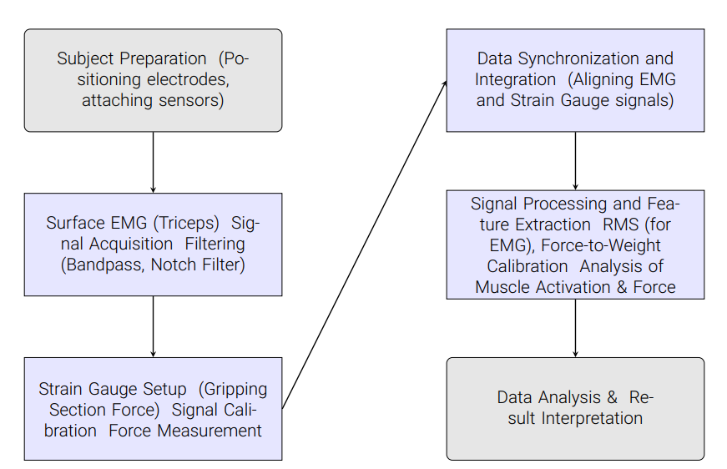
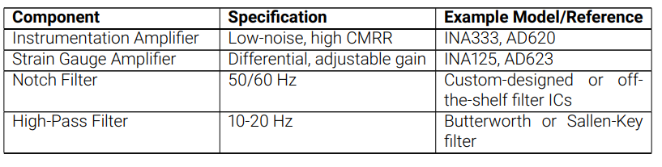
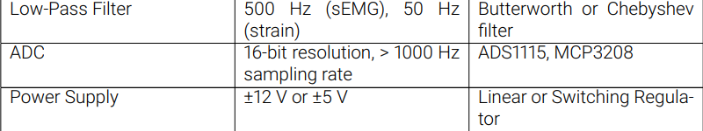

Slide 7
INTRODUCTION TO COMMON METHODS IN THE DESIGN AND CONSTRUCTION OF SIMILAR SYSTEM
Surface Electromyography (sEMG) System Design and Method?ologies
Electrode Placement and Sensor Selection
Signal Amplification and Processing and Feature Extraction
Strain Gauge System Design and Methodologies
Strain Gauge Configuration and Signal Amplification
Calibration and Force Measurement
Integration of sEMG and Strain Gauge Systems
Multi-Sensor Fusion
Signal Synchronization and Data Fusion

Slide 8
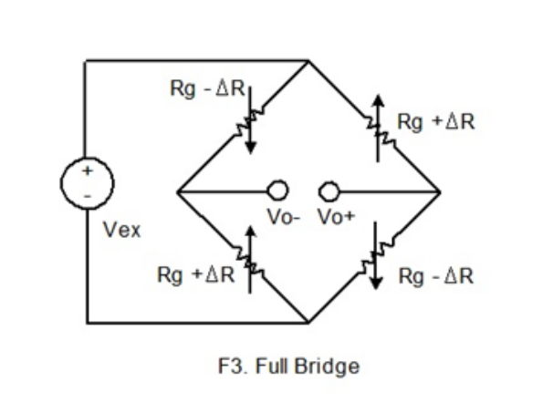
METHODOLOGY FOR PROJECT EXECUTION
1. WHEATSTONE BRIDGE FOR STRAIN GAUGE SYSTEM
The Wheatstone Bridge will serve as the initial signal conditioning circuit for the strain gauge used to measure the force during the movement of the weight. The bridge configuration converts the resistance change of the strain gauge (due to applied force) into a measurable voltage signal.
The Wheatstone Bridge is a critical component because it allows for accurate measurement of strain-induced voltage changes, ensuring that even small forces (e.g., during light lifting) are detected with high precision.

Slide 9
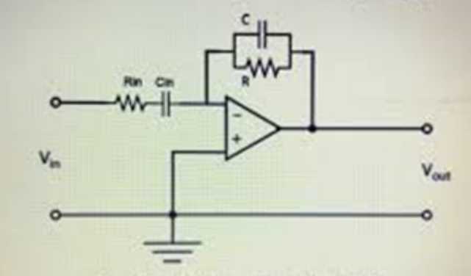
METHODOLOGY FOR PROJECT EXECUTION
2. BAND-PASS FILTER (BPF) FOR SIGNAL CONDITIONING
After the strain gauge system has been modeled using the Wheatstone Bridge, the next step is to apply a Band-Pass Filter (BPF) to condition the signal further. The BPF allows us to isolate the relevant frequency range for muscle activity and force measurement, removing unwanted low and high-frequency noise.
The BPF ensures that only relevant data related to the muscle activity and force exertion during the weight lifting is passed on, improving the signal-to?noise ratio for the subsequent stages.

Slide 10
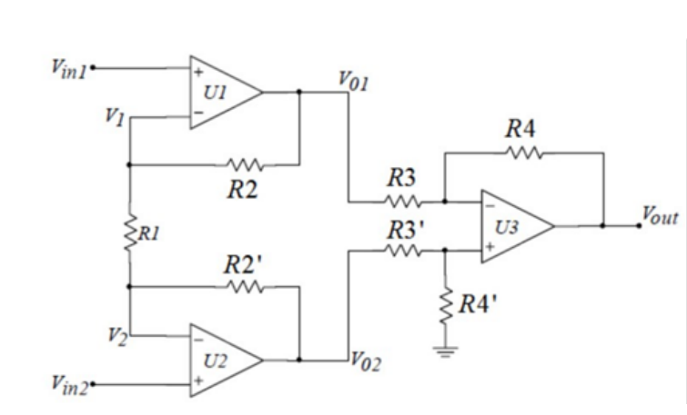
METHODOLOGY FOR PROJECT EXECUTION
3. INSTRUMENTATION AMPLIFIER
The Instrumentation Amplifier is used to amplify the signal coming from the strain gauge system (via the Wheatstone Bridge) and the sEMG system, en?suring that the small signals are boosted sufficiently for the next stages of processing.
The instrumentation amplifier plays a critical role in ensuring that low-amplitude signals from both the strain gauge and muscle activity (sEMG) are sufficiently amplified while maintaining the integrity of the signal by reducing common?mode interference.

Slide 11
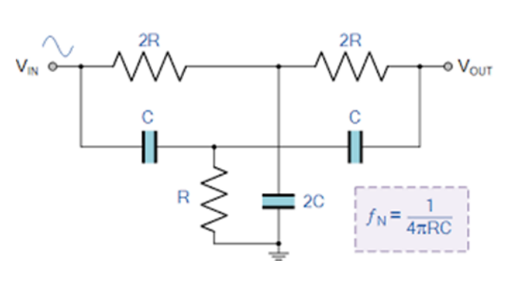
METHODOLOGY FOR PROJECT EXECUTION
4. NOTCH FILTER
The Notch Filter is used to remove powerline interference at 50 Hz or 60 Hz, which is commonly found in environments with electrical devices. This is es?sential for obtaining clean signals from both the strain gauge and sEMG sys?tems, as powerline interference can significantly distort the signal.
By removing powerline interference, the Notch Filter ensures that the final sig?nal contains minimal noise, improving the accuracy of the measurements and the overall data quality

Slide 12
METHODOLOGY FOR PROJECT EXECUTION
5. ANALOG-TO-DIGITAL CONVERTER (ADC IC)
he Analog-to-Digital Converter (ADC) will convert the processed analog sig?nal from the strain gauge and sEMG systems into digital form that can be analyzed by a microcontroller or computer.
The ADC is crucial because it allows for the digital representation of the sig?nals, which can then be processed, stored, and analyzed using data acquisi?tion software or real-time monitoring systems. The quality of the ADC directly influences the precision and accuracy of the final measurements.

Slide 13
OVERVIEW OF SOFTWARE USED IN DESIGN AND SIMULATION
• Analog Circuit Simulation
• Transient Analysis
• Frequency Domain Analysis
• Noise Analysis
• Parameter Sweeps
CONFIGURATIONS
• Wheatstone Bridge Configuration
• BPF
• Instrumentation
• Notch Filter

Slide 14
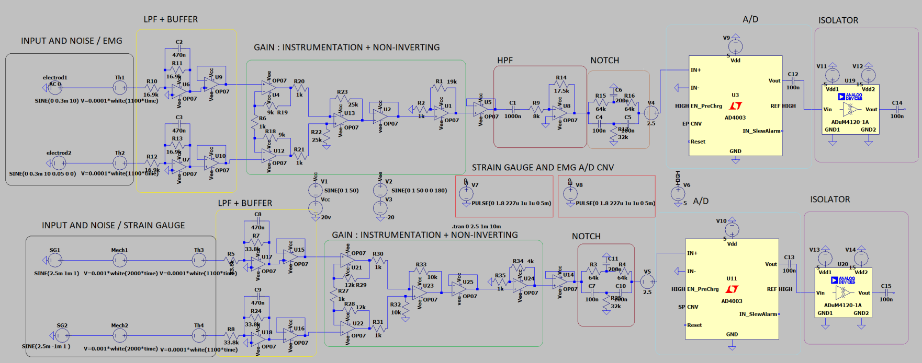
SIMULATION AND RESULTS

Slide 15
SIMULATION AND RESULTS
Input Signals & Noises
01
05
Notch Filter
02
Lowpass Filters
06
Buffer
03
Gain Stages
07
ADC
04
Highpass Filter
08
Isolator

Slide 16

THANK YOU

