Slide 1
In The Name of God
Our Team :
AisaSadat Takyar
Seyyed Amirmahdi Sadzadeh
MohammadKazem Shahrabi
surface electromyogram signal recording and processing
Sharif University of Technology
winter 2025

Slide 2
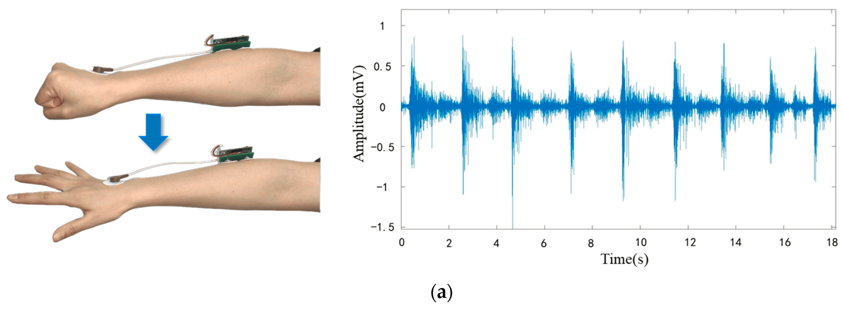
surface electromyogram signal
Surface electromyography (sEMG) is a non-invasive technique used to record the electrical activity produced by skeletal muscles via electrodes placed on the skin.

Slide 3
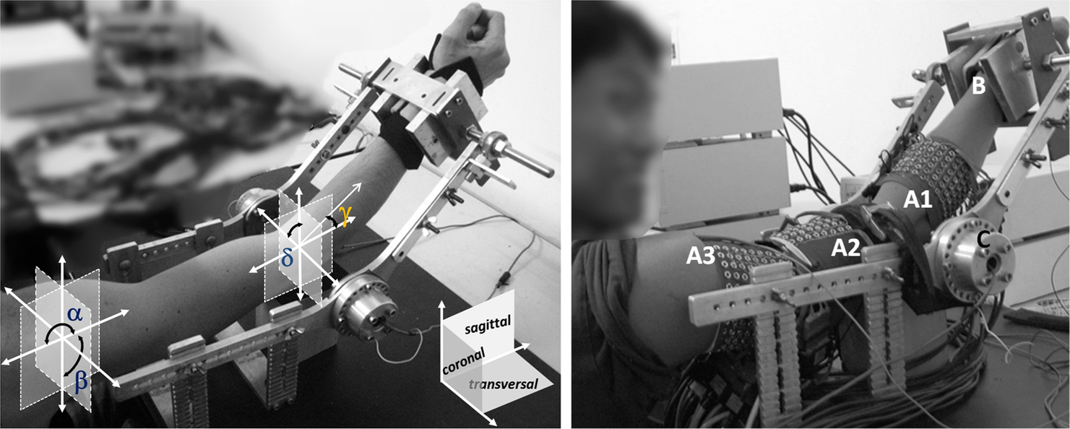
experimental protocol
1
Preparation Phase and Electrode Placement
2
Baseline Recording
3
Movement Execution Protocol

Slide 4
TOOLS AND EQUIPMENT USED IN THE EXPERIMENT
1
sEMG Recording System/Amplifier and Surface Electrodes
2
LAB CHART (features)
3
Additional Accessories and Consumables

Slide 5
EXPERIMENTAL PROCEDURE
1
general explanation of process
2
Suggested method(s) for surface electromyogram signal preprocessing and processing
3
Desired features for the detection of purposeful hand movements

Slide 6
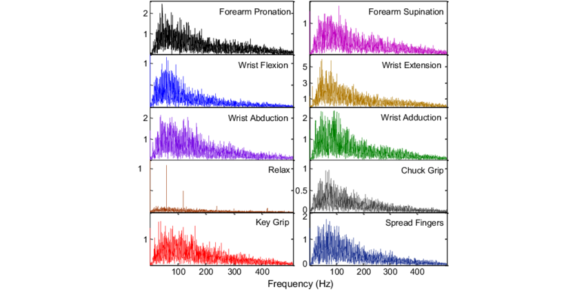


sEMG analysis

Slide 7


Challenges and Results
electrode-skin impedance
Movement artifacts
secure electrode placement
differential amplification
noise interference

