Slide 1


C++ Software Engineering Portfolio
Mahdi Tavakol — Postdoctoral Researcher, University of Oxford
Selected C++17/20 projects demonstrating modern design, numerical algorithms, and parallel computing on Linux. Focus Areas:
RAII, Eigen, and exception-safe design
Object Oriented code design
OpenMP and MPI parallelism
CMake and Git
High-performance numerical algorithms and simulation frameworks

Slide 2

Project #1: Constant – pH simulation
LAMMPS plugin implementing protonation state transitions.
Goal : On-the-fly constant pH simulation
$$V \left(R,λ\right)=\left(1−λ\right)∗V_{A}\left(R\right)∗λ∗V_{B}\left(R\right)+V^{pH}\left(λ\right)+V^{MM}\left(λ\right)+ V^{bias}(λ)$$
Code architecture:
Data Layer: constant_pH_structures.cpp
State & physics: Fix_constant_pH.cpp (protonation state, buffer, potentials, commands hook)
Integration: Fix_nh_constant_pH.cpp (integrates DOFs, applies constrain on the total charge)
Logic : Fix_adaptive_protonation.cpp (environment, change qs)
Output state: Compute_temp_constant_pH.cpp (computes temp)
Analysis: Compute_solute_coordination.cpp (environment)
Input (1) – Core Engine (2-3) – Adaptive Logic (4) – Analysis (5-6)

Slide 3
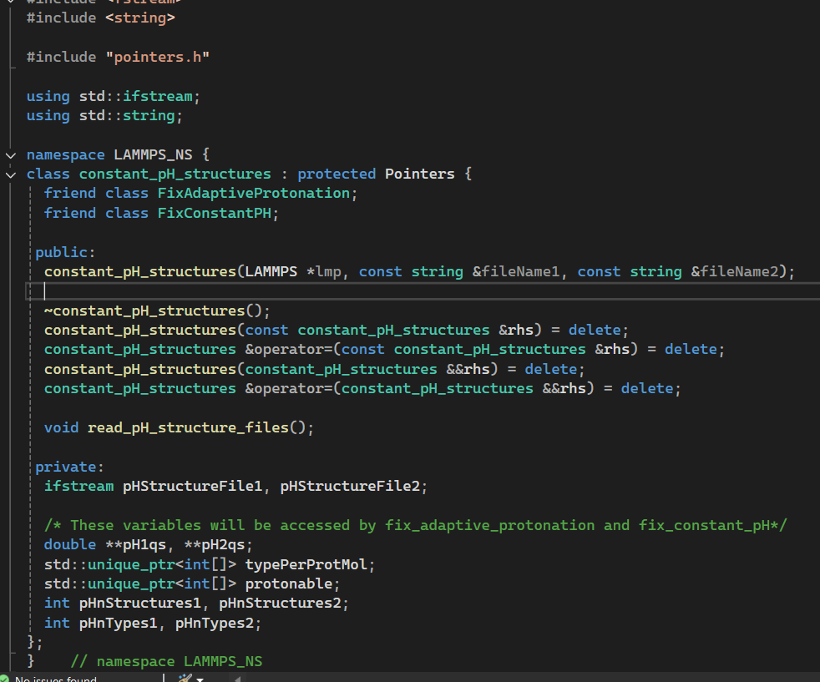
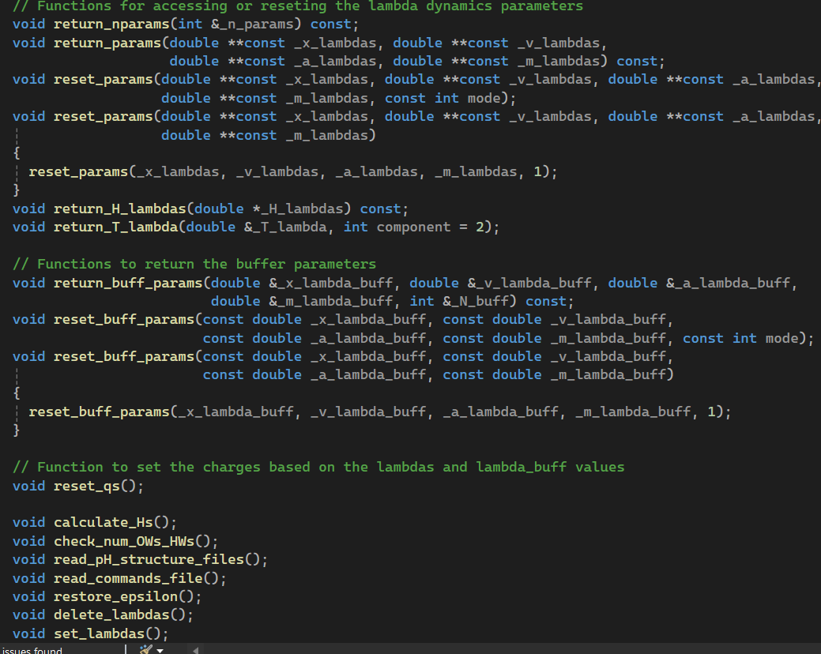
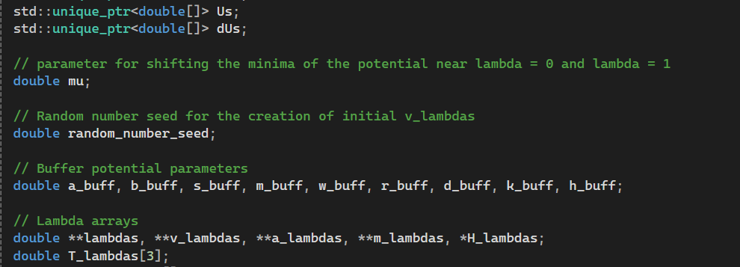
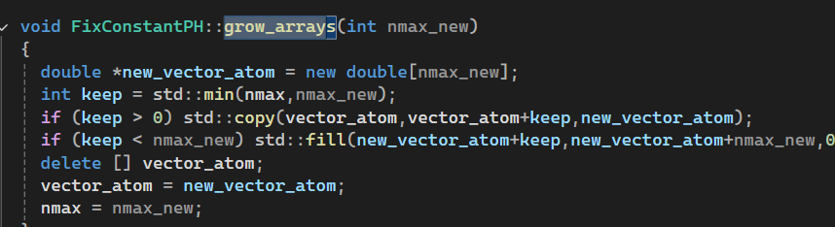
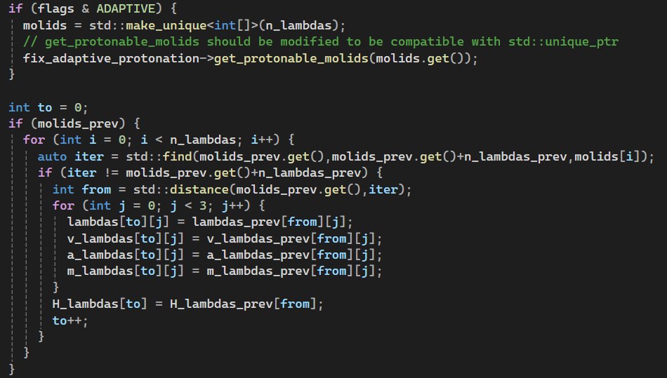
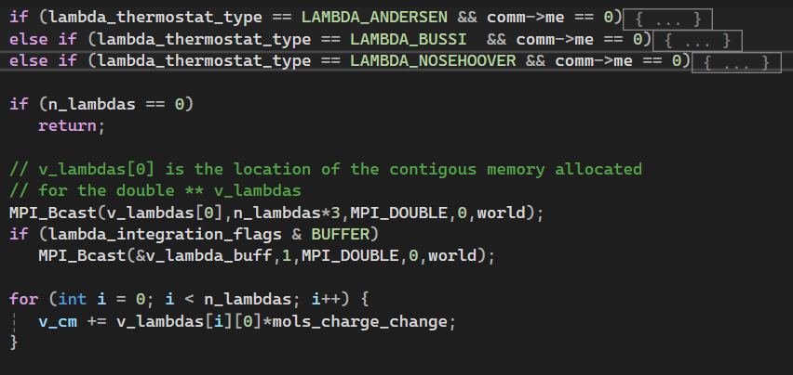
Project #1: Constant – pH simulation
constant_pH_structures.cpp
RAII + smart_ptr
fix_constant_pH:
Getter and Setter Funcs
fix_constant_pH.cpp: MPI_comm
fix_constant_pH.cpp: keeping lambdas from the prev step
fix_nh_constant_pH.cpp: deterministic
Modern C++ 17 – RAII – MPI – Deterministic Integration – Modular Design

Slide 4
Project #2: C++17 Plugin Architecture for Adaptive Biasing (LAMMPS Extension)
Adaptive bias potential framework for free-energy surface exploration.
Goal : Apply adaptive biasing forces to escape metastable states
Code architecture:
Parent abstract class: compute_diff_atom.cpp (pure abstract class)
compute_entropy_atom.h (user defined CVs)
compute_cparam_atom.h (user defined CVs)
compute_enthalpy_atom.h (user defined CVs)
compute_q6_smooth_atom.h (complex math, many ghost communications, on-the-fly computation due to large memory demand)
State & physics: Fix_metaAR.h (Integration logic, file I/O, history management, bias update scheme)
Integration: fix_nvt.h (integrates DOFs, applies constraint on the total charge)
Input (1) – Core Engine (2-3) – Adaptive Logic (2) – Analysis (2)

Slide 5
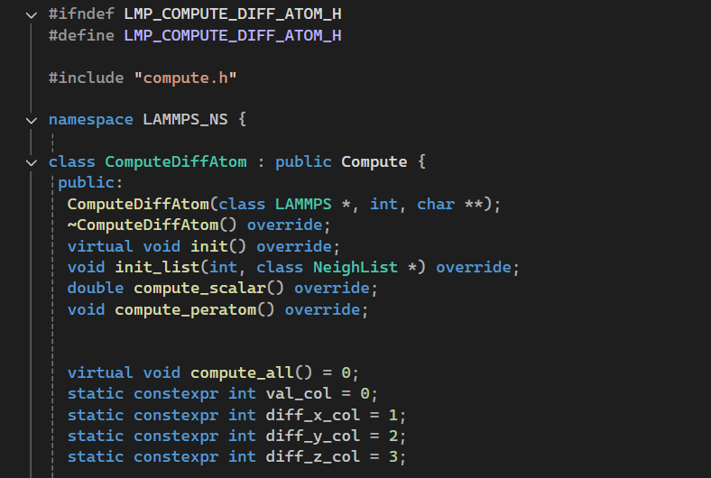
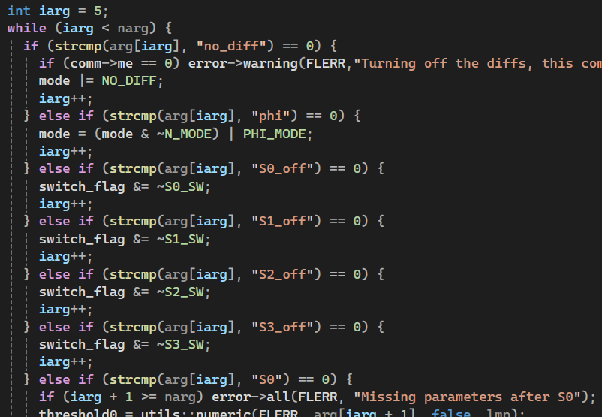
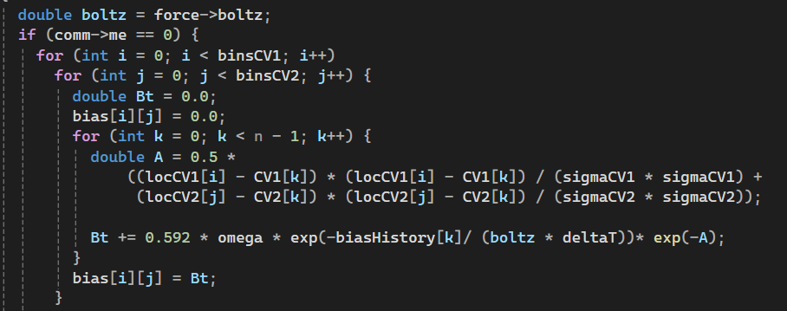
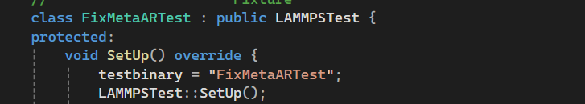
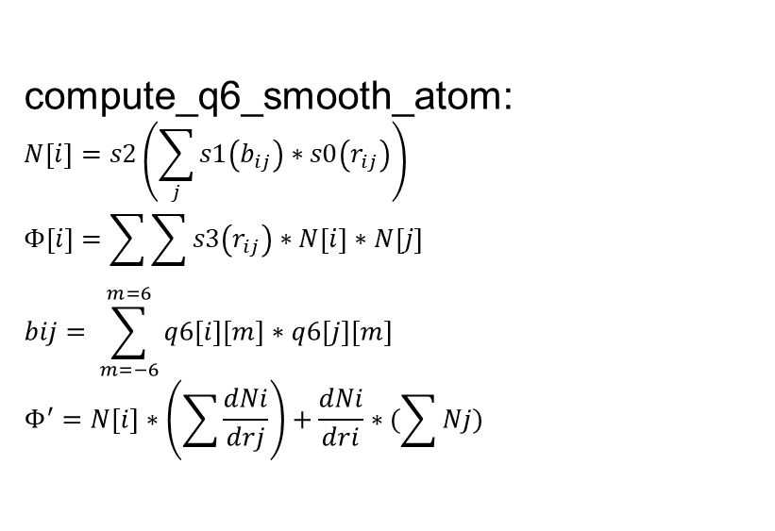
Project #2: C++17 Plugin Architecture for Adaptive Biasing (LAMMPS Extension)
constant_diff_atom.cpp
Inheritance + modern C++ 17
compute_q6_smooth_atom.cpp:
Input parsing
fix_metaAR.cpp: testing
compute_q6_smooth_atom:
$$N\left[i\right]=s2\left(\sum_{j}{s1\left(b_{ij}\right)∗s0\left(r_{ij}\right)}\right)$$
$$Φ\left[i\right]=\sum{\sum{s3\left(r_{ij}\right)∗N\left[i\right]∗N\left[j\right]}}$$
$$bij= \sum_{m=−6}^{m=6}{q6\left[i\right]\left[m\right]∗q6[j][m]}$$
$$Φ^{′}=N\left[i\right]∗\left(\sum{\frac{dNi}{drj}}\right)+\frac{dNi}{dri}∗(\sum{Nj})$$
Central atom q6m, diffq6m and coeffs
Fill ghost atoms q6m, diffq6m, s2, ds2 and coeffs
dcij/dri = qj*dqi/dri(A) + qi*dqj/dri(B) (We do not have the B)
Fill A in for the atom i and fill B for the atom j in h[j]
Add from the h calculated by the ghost atoms
Add the diff related to s2 and s0 (distance)
We have Ni and diffNi/diffri
Send Ni to ghost atoms
Calculate the dNj/dri on-the-fly from qj and coeffs
RAII-safe memory allocation (LAMMPS Memory API)- Constexpr – Virtual overrides – C++ smart pointers – On-the-fly calculations to avoid heap exhaustion

Slide 6
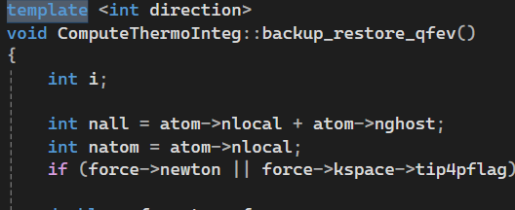
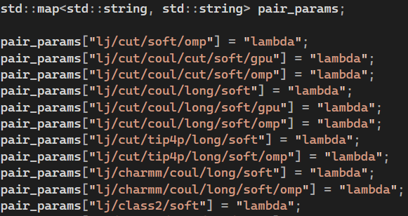
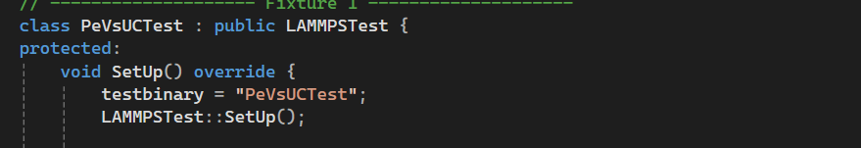
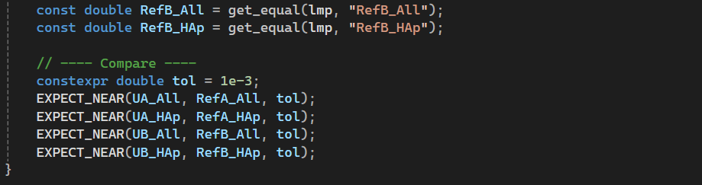
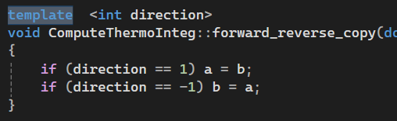
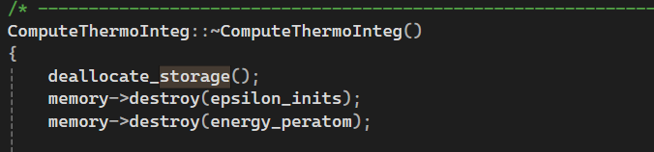
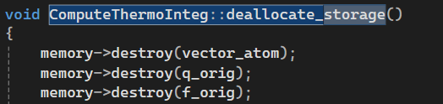
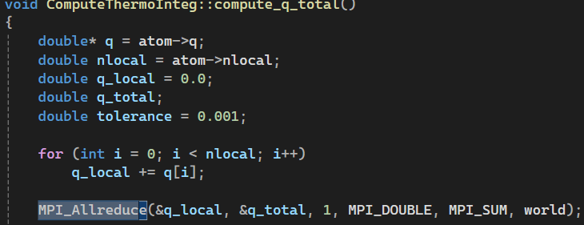
Project #3: Free energy Part A: C++ Thermodynamic Integration module
Custom C++ LAMMPS compute for thermodynamic-integration (TI) energy derivatives.
Code architecture:
Parent abstract class: compute.h (pure abstract class)
compute_thermo_integ.h
testing
templates
stl:maps
RAII implementation for double**
(mdspan was not available yet!)
MPI (Distributed parallelisation)
Verified, reproducible, and parallel-safe C++ compute module integrated with LAMMPS core

Slide 7
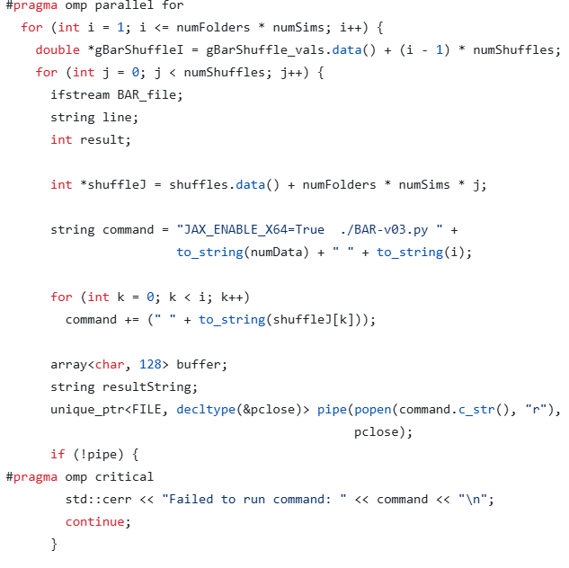
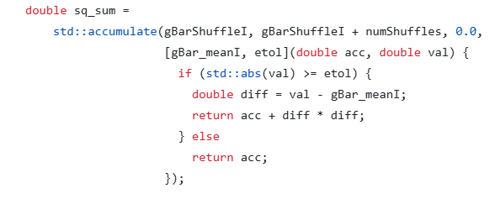
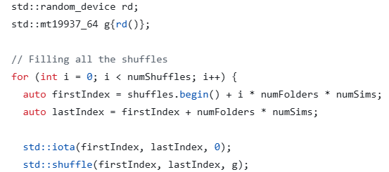
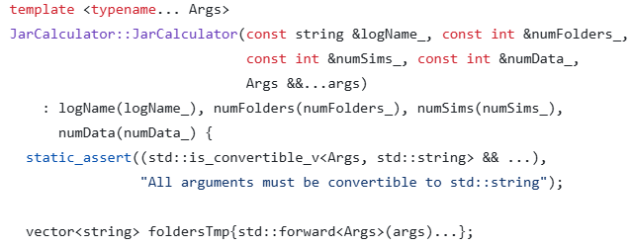
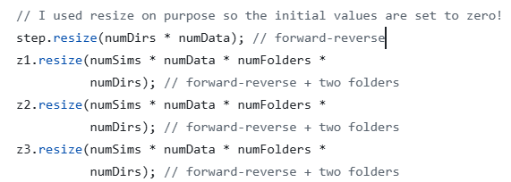
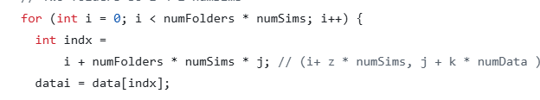
Project #3: Free energy Part B: C++ and Python Pipeline for high throughput data
OpenMP
STL algorithms
python from C++
Making a C command RAII compatible
Thread safety
Variadic Templates
N-D vector + contiguous memory
Parallel, memory-efficient, and language-integrated C++ pipeline for high-throughput free-energy computation.

Slide 8
Project #4: Mandelbrot Parallel Renderer
A Modular C++ Framework for Parallel Simulation and Rendering
(1) Main.cpp
|
|── (2) Runner/ (run_mandelbrot_timing, run_mandelbrot_animation)
| └── Factory-like controller
|
|── (3) Algorithm/
| └── mandelbrot.h
| |── mandelbrot_xmesh(_inner/outerloop).h (inheritance)
| └── mandelbrot_xmesh(_inner/outerloop).h
|── (4) Array/
| |── array.h (Base interface)
| | └── array_c / array_cpp / array_modern / array_mdspan
| └── array_allocator (RAII factory)
|
|── (5) Numerical/
| └── complex.h (templates)
|
└── (6) Plotting/
└──Mandelbrot_plot_frames.py
Input (1) – Control Layer (2) – Core Engine (3) – Memory & Data Layer (4) – Numerical Library (5) – Post-processing (6)

Slide 9
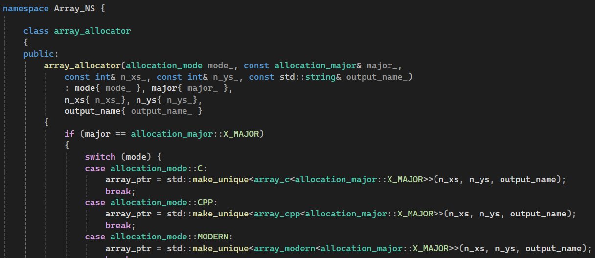
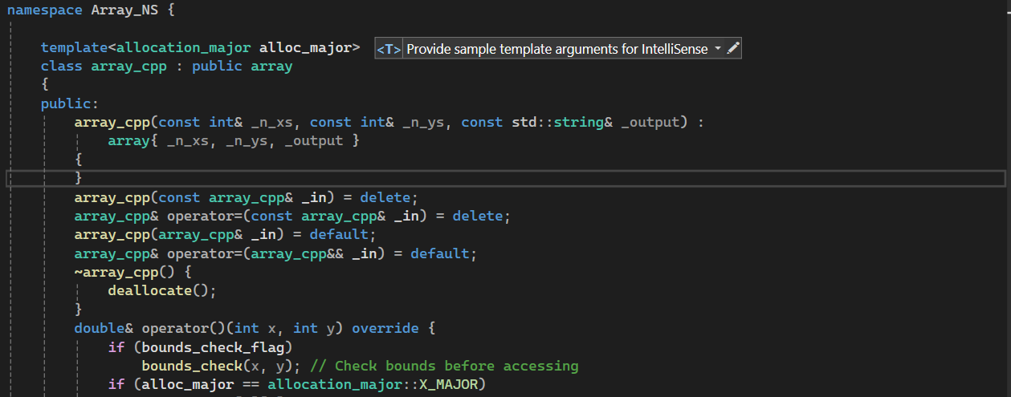
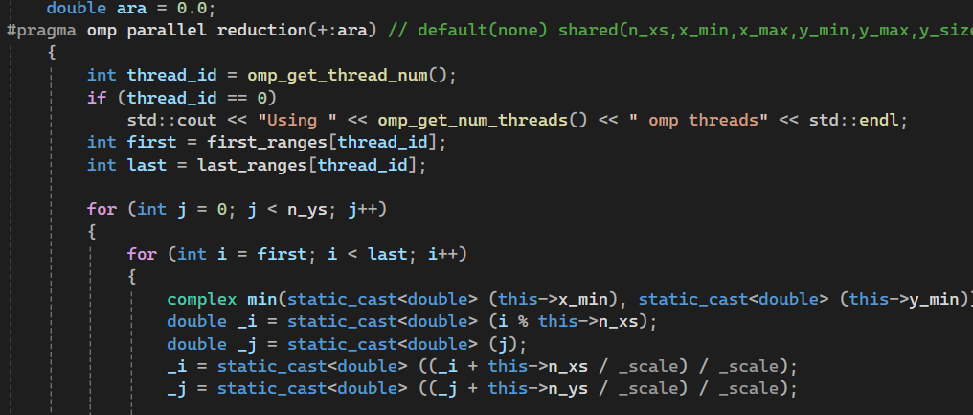
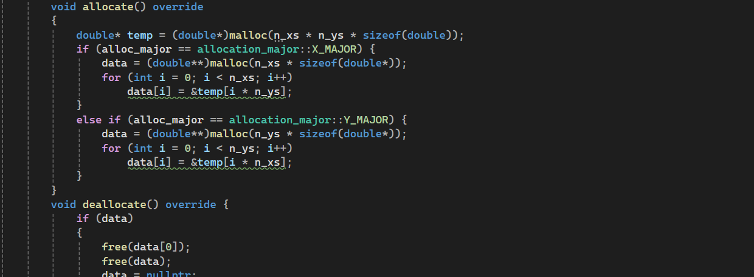
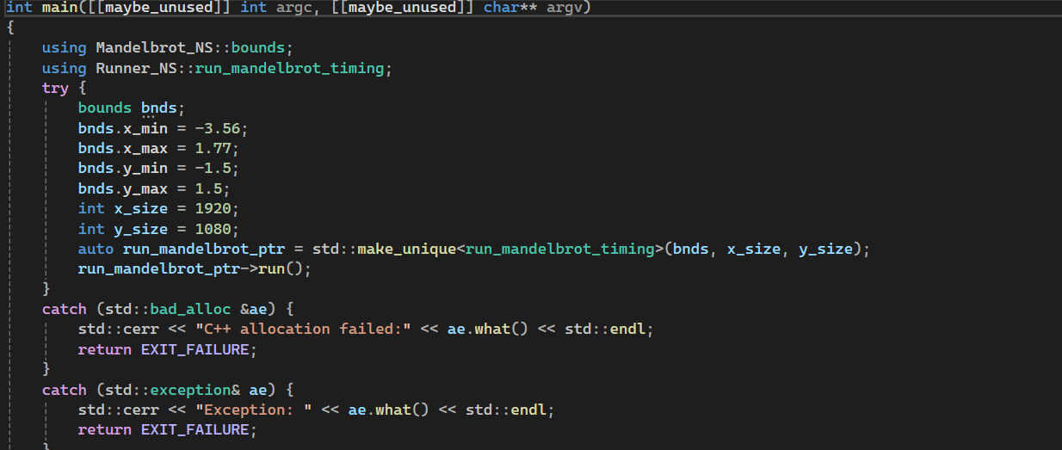
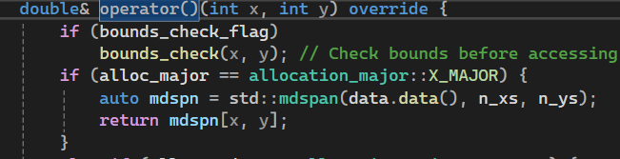
Project #4: Mandelbrot Parallel Renderer
namespace +
Factory pattern
Template +
Operator overloading
Contiguous memory allocation for cache locality
Parallelism +
Threads safety
C++23 style
Exception Safety +
RAII Smart Pointers

Slide 10
Project #5: Neural Network:
A Modular C++ Framework for Training Feed-Forward Nets
Input/Configuration
main.cpp
InputArgs.h --- Parsing CLI
InputFile.h --- CSV reader
InputFileMPI.h --- Parallel CSV reader
(2) Data Processing & Logging
Scaler.h --- MinMaxScaler,…
Logger.h --- log to cout, log file, multi-stream
(3) Core Engine
NeuralNetwork.h --- Core training/Feed-forward
NeuralNetworkMPI.h --- MPI accelerator
NeuralNetworkOpenMP.h ---OpenMP accelerator
(4) Model Components
Layer.h --- Layers
Activation.h --- Relu/Sigmoid/Tanh
Dropout.h --- Regularization
(5) Numerical Library
Eigen
(6) Optimization
Loss.h --- MSE, MAE, Huber
Optimizers.h --- SGD, RMSProp, …
(7) Builds and tests
CMakeLists.txt --- Debug/release, MPI/OpenMP
tests/ --- regression test with catch
Input (1) ➔ Data (2) ➔ Core/Model (3-4) ➔ Math/Opt (5-6) ➔ Builds/tests (7)
Input (1) – Control Layer (2) – Core Engine (3) – Memory & Data Layer (4) – Numerical Library (5) – Post-processing (6)

Slide 11
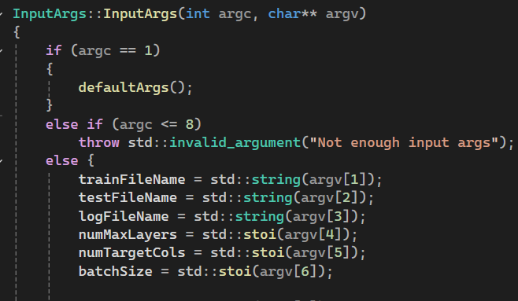
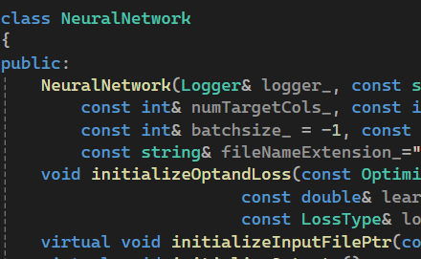
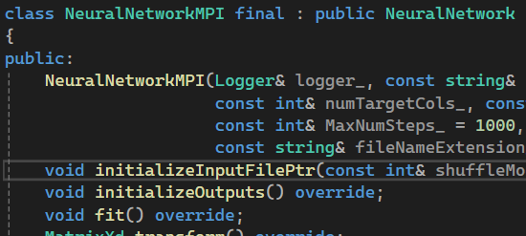
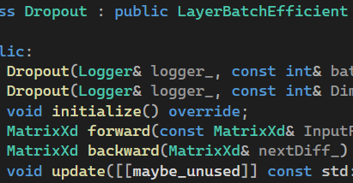
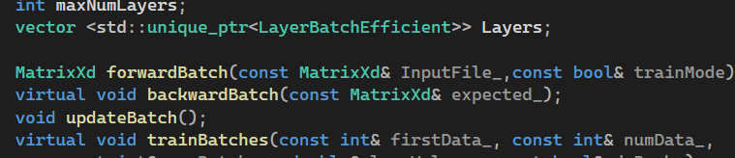
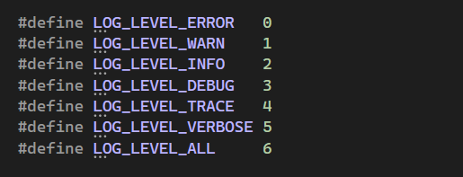
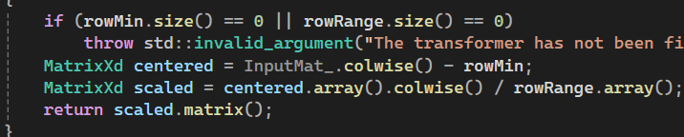
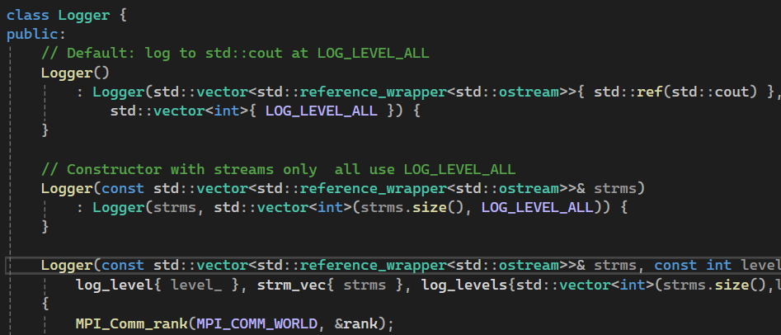
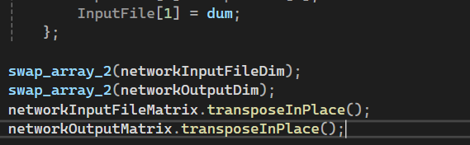
Project #5: Neural Network
InputArgs :
Easy for mock in tests
MPI/OpenMPI accelerator through inheritance
Multilevel logging
RAII resource management + Eigen
Eigen
Transpose:
Data are in columns and Eigen is col-major → Cache efficiency in parallel
Multistream logger
Modern C++ Features: RAII · Inheritance · Eigen · Parallel I/O · Logging Design – Test Design
Input (1) – Control Layer (2) – Core Engine (3) – Memory & Data Layer (4) – Numerical Library (5) – Post-processing (6)

Slide 12
Summary and Discussions
Designed and implemented multiple C++17/20 scientific frameworks using RAII, Eigen, OpenMP, MPI and CUDA.
Focused on numerical stability, deterministic parallelism and cache-efficient computation.
Modular, testable and cross-compiler code with unit testing.
Applied design patterns (Factory, Interface, Strategy) for extensibility.

