Slide 1
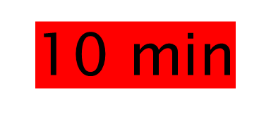
Mining Online Sources to Analysis Socio-economic Impacts of Hamun Lake Desiccation
Natural Language Processing & Text Mining
Mahdi Akbari

Slide 2
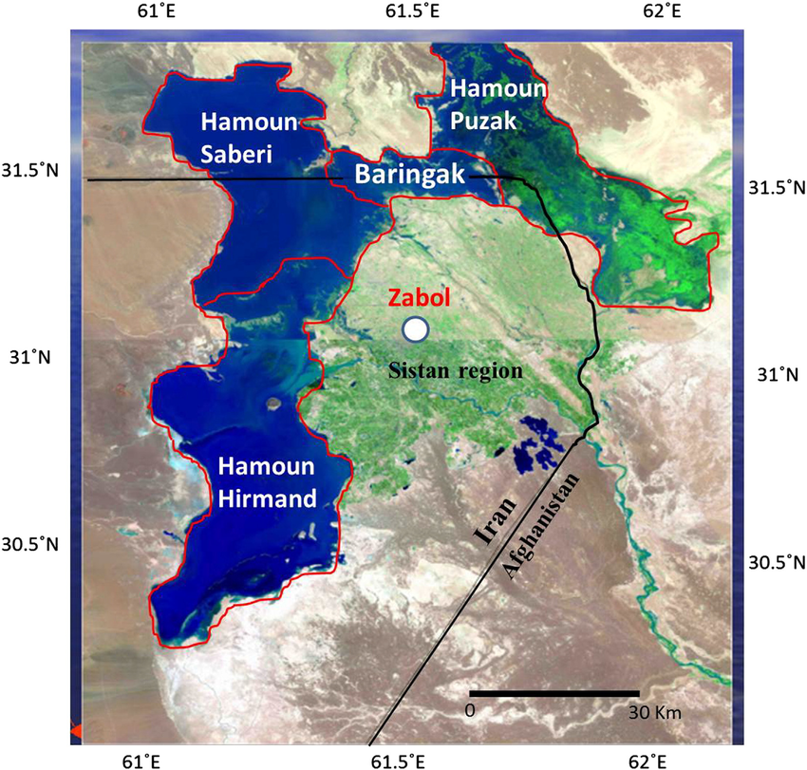
Abstract
Hamun Lake is desiccated in border of Iran, Afghanistan and Pakistan.
Desiccation of this lake caused unemployment and dust storms in Zabol city
We are trying to see how this
fact is reflected in people
tweets. This helps for
socio-economic impact
analysis to cover lack of data

Slide 3
Topics
Collect positive and negative Tweets dataset related to Hamun Lake desiccation. Store the two positive and negative tweets as D1 and D2.
Use Open translation API to translate all non-English tweets to English.
Use TweetTokenizer package to tokenize the tweet messages and use use MWETokenizer in order to handle composed words. Draw histogram of the most common terms, excluding stop-words, for D1 and D2.
Draw histogram of the 20 most co-occurring words, excluding stopwords, where one of the word is a verb and the other one is a noun (should use par-of speech tagger to identify part of speech of individual word in the tweet message), for each of D1 and D2.
Use wordCloud to draw a graphical representation of the words present in D1 and D2.
Use SentiStrength to determine the global sentiment associated to D1 and D2. Discuss the finding with respect to the nature of D1 and D2 which are meant to represent positive and negative sentiments respectively.
Apply Empath Client to D1 and D2 and report those categories who held non-zero weights. Record these findings in database, where for each tweet message, assign the corresponding set of Empath categories.
Using google API, suggest an implementation WebJaccard similarity for semantic similarity of few examples for queries in a way to assess potential hypotheses about effects of Hamun Lake desiccation, and calculate the underlying similarity using a set of Search engines, you may suggest other examples of search repositories where there is likelihood to contain relevant information.

Slide 4
Relevant prior work
Communicating on Twitter during a disaster: An analysis of tweets during Typhoon Haiyan in the Philippines (by Takahashi et al. 2015 in Journal of Computers in Human Behavior: social networks are used for dissemination of second-hand information, in coordinating relief efforts, and in memorializing those affected
Twitter for crisis communication: lessons learned from Japan’s tsunami disaster (by Acar et al. 2011 in International Journal of Web Based Communities): found that people in directly affected areas tend to tweet about their unsafe and uncertain situation while people in remote areas post messages to let their followers know that they are safe. unreliable retweets (RTs) on Twitter was the biggest problem the users have faced during the disaster
WebSim: A Web-based Semantic Similarity Measure (by Bollegala et al. 2007 in Proc. of the 21st Annual Conference of the Japanese Society of Artificial Intelligence): proposed a measure that uses page count to calculate semantic similarity between queries using Jaccard formulation.

Slide 5
Data sources, tools and Technologies
Tweets using Twitter API
Content of websites using Google API
Translation Google Module in Python
WordCloud (www.geeksforgeeks.org/generating-word-cloud-python/)
SentiStrength
Empath Client (github.com/Ejhfast/empath-client"github.com/Ejhfast/empath-client)
Python programming language

Slide 6
Implementation Details and
Results

Slide 7
Task1: building +/- datasets
First, we defined two queries to build D1 and D2 datasets:
Positive query (D1):
query=‘(Beautiful hamun lake) OR (tourism sistan) OR (blue hamun lake) OR (full hamun lake) OR (zabol love) -is:retweet’
Negative query (D2):
query=‘(hamun lakedesiccation) OR (unemployment sistan) OR (thirsty hamun lake) OR (thisty zabol) -is:retweet’

Slide 8
Task2: translation of tweets
Before translation, we had to clean tweets in Persian from English characters (e.g. https, @, etc.). Also, after translation we should omit all Persian characters from translated tweet to have clean translated tweet dataset:
for tweet in tweets_data:
clean_tweet = "".join(
[char for char in tweet if
char not in 'qwertyuiopasdfghjkl\:zxcvbnm/ABCDEFGHIJKLMNOPQRSTUVWXYZ1234567890@#$%^&*_=-_,:.;?!']
).strip()
clean_tweet_trans = translator.translate(clean_tweet, src='fa', dest='en').text
clean_tweet_trans_clean = "".join(
[char for char in clean_tweet_trans if char not in ',:;،ضصثقفغعهخحجچپگکمنتالبیسشظطزرذدئوې']
).strip()
# print(clean_tweet_trans_clean)
translated_tweet.append(clean_tweet_trans_clean)

Slide 9
Task3: Most frequent words of D1/D2
First, we tokenized each tweet in D1 and D2, then we omitted stop words to draw below figures:
Some same Persian words were translated to different English equivalents (e.g. Zabul, Zabool, Hamun, Hamoon, etc.), so we made them all consistent by:
Also we had some composed words problem (e.g. Kamal Khan as a Persian name) so we used MWETokenizer() instead of split()
wrong_spell = ("zabol","zaboul","hamoun","hamon")
correct_spell = ("zabul","zabul","hamun","hamun")
for word in flattened_tweets:
if word in wrong_spell:
flattened_tweets[flattened_tweets.index(word)] = correct_spell[wrong_spell.index(word)]

Slide 10
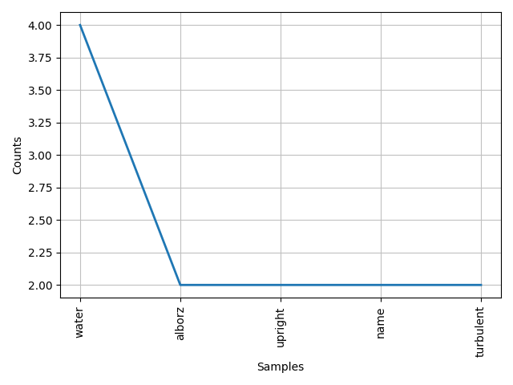
Most common words of D1

Slide 11
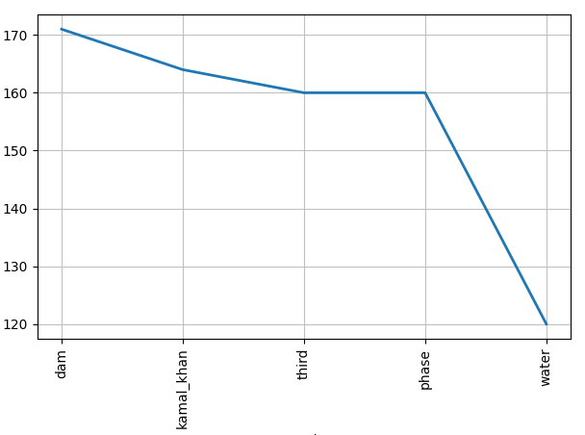
Most common words of D2

Slide 12
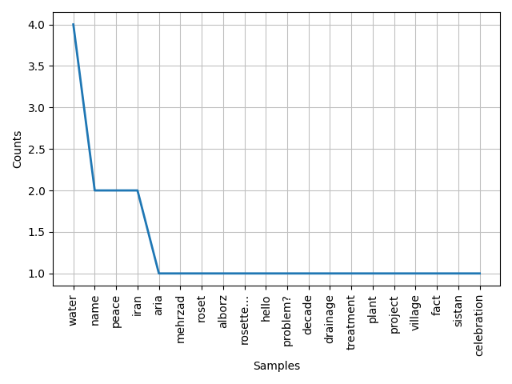
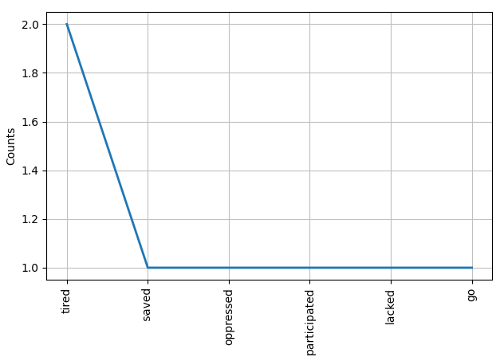
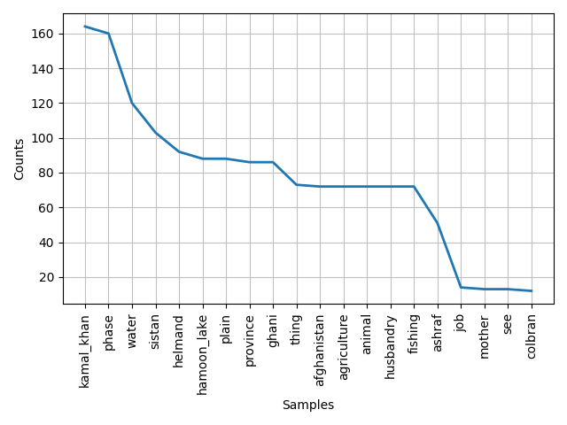
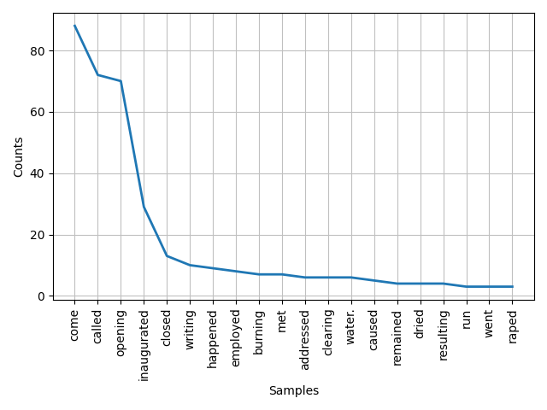
Task4: 20 most common co-occurring noun and verbs
D1-noun:
D2-noun:
D1-verb:
D2-verb:

Slide 13
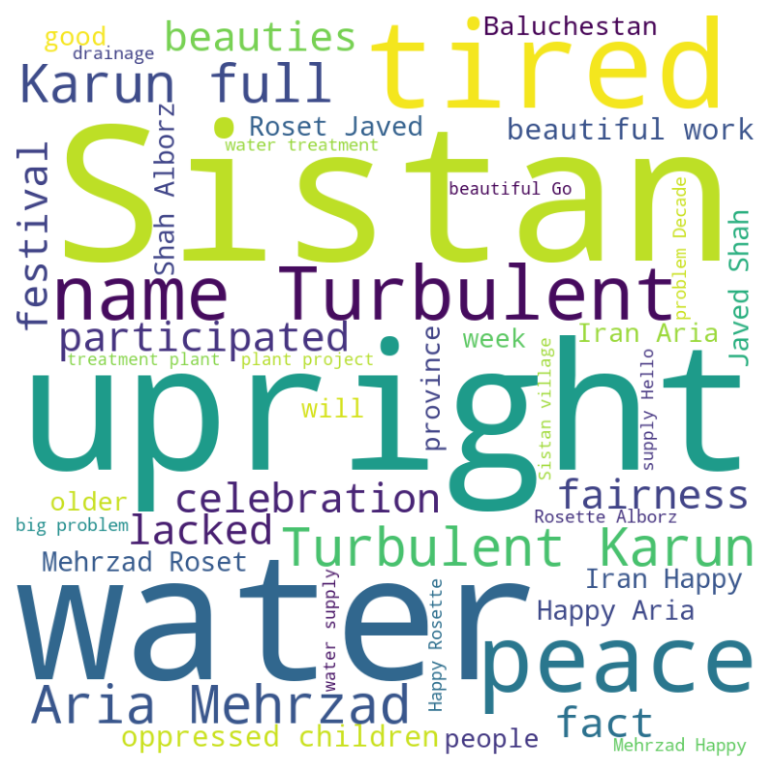
Task5: wordCloud of D1

Slide 14
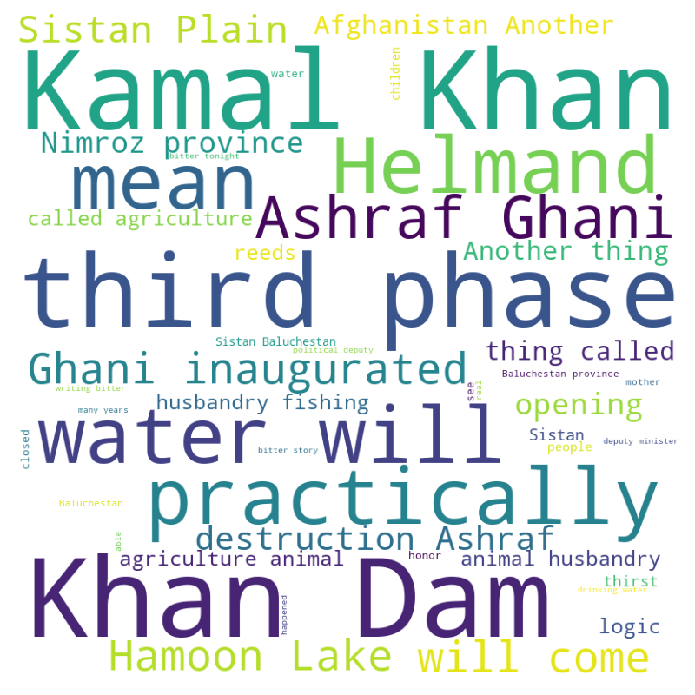
Task5: wordCloud of D2

Slide 15
Task6: SentiStrength
import sentistrength
from sentistrength import PySentiStr
senti= PySentiStr()
senti.setSentiStrengthPath('C:/Users/35840/SentiStrength.jar')
senti.setSentiStrengthLanguageFolderPath('C:/Users/35840/SentiStrengthData/')
senti.getSentiment(tweets_words)
Overal score for each D1 and D2:
D1=> 0
D2=> -1

Slide 16
Task7: Empath Client
Categories for D1:
Beach
Water
Swimming
Sailing
Cleaning
Ocean
Major categories for D2:
negative_emotion
Economics
Poor
Aggression
Vacation
Water
government

Slide 17
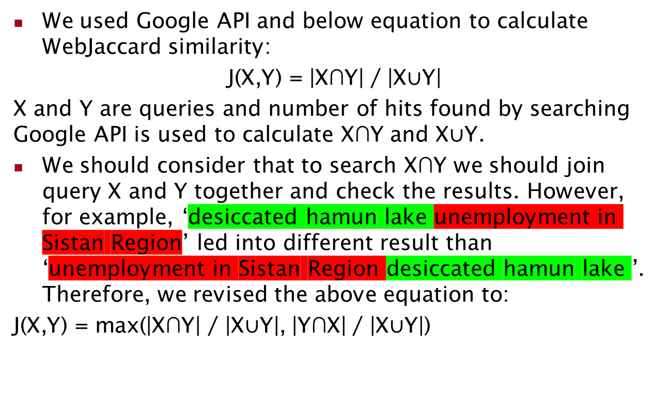
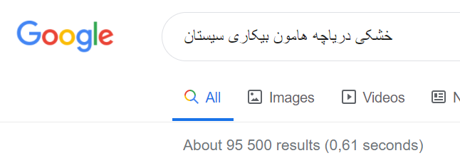
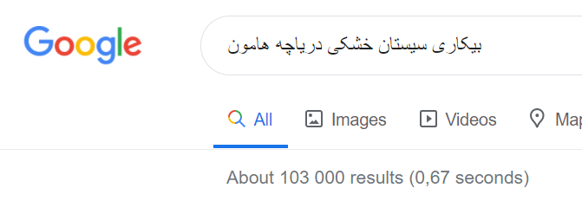
Task8: WebJaccard similarity by Google API

Slide 18
Task8: WebJaccard similarity by Google API
Query | Jaccard Sim. (%) | Max Sim. (%)
X=خشکی دریاچه هامون | 0.53 | 0.53
Y=بیکاری سیستان و زابل | 0.05
X=خشکی دریاچه هامون | 20.6 | 20.6
Y=توقف ماهیگیری سیستان | 20.2
X=خشکی دریاچه هامون | 2.9 | 2.9
Y=کمبود آب شرب | 2.7
X=خشکی دریاچه هامون | 20.3 | 20.3
Y=گرد و غبار زابل | 18.0
X=خشکی دریاچه هامون | 5.9 | 5.9
Y=کاهش گردشگری سیستان و زابل | 2.6

Slide 19
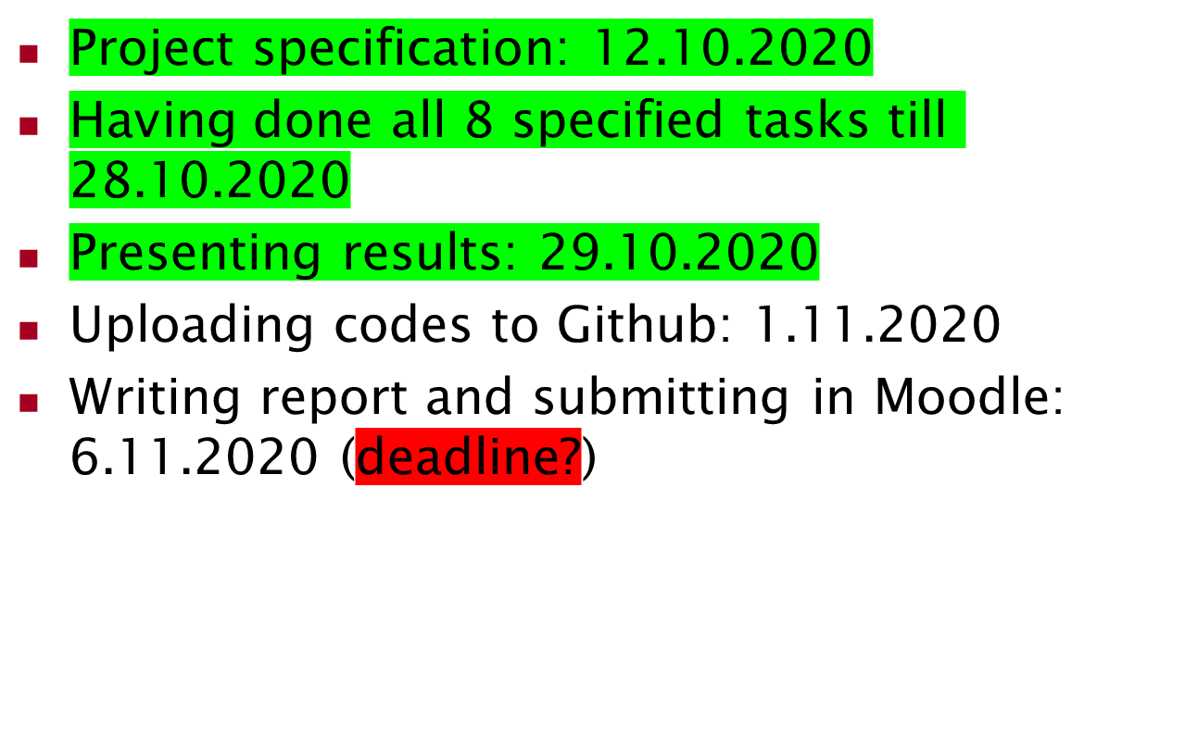
Time-chart

Slide 20
Thanks you
Questions ? ☺

