Slide 1

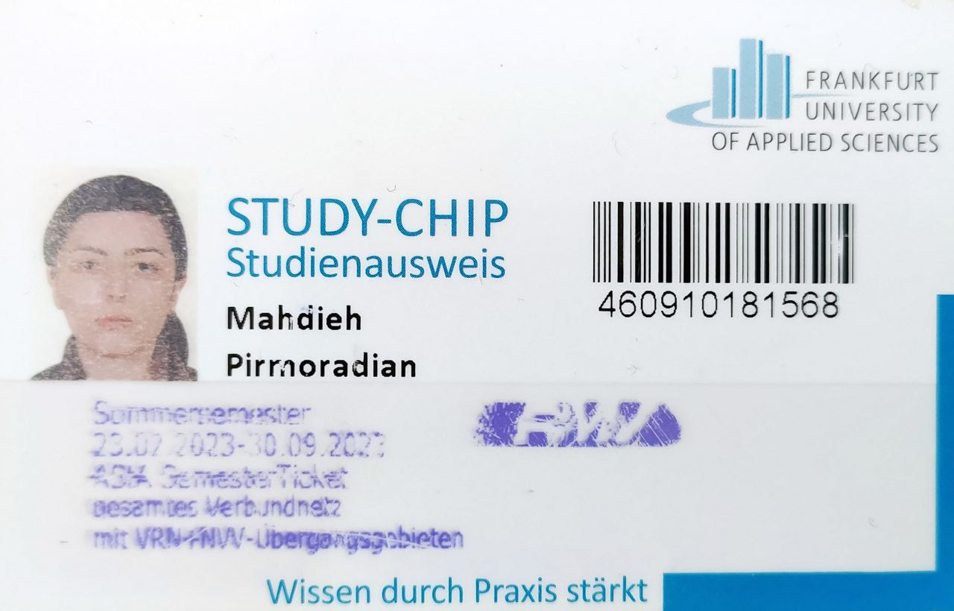
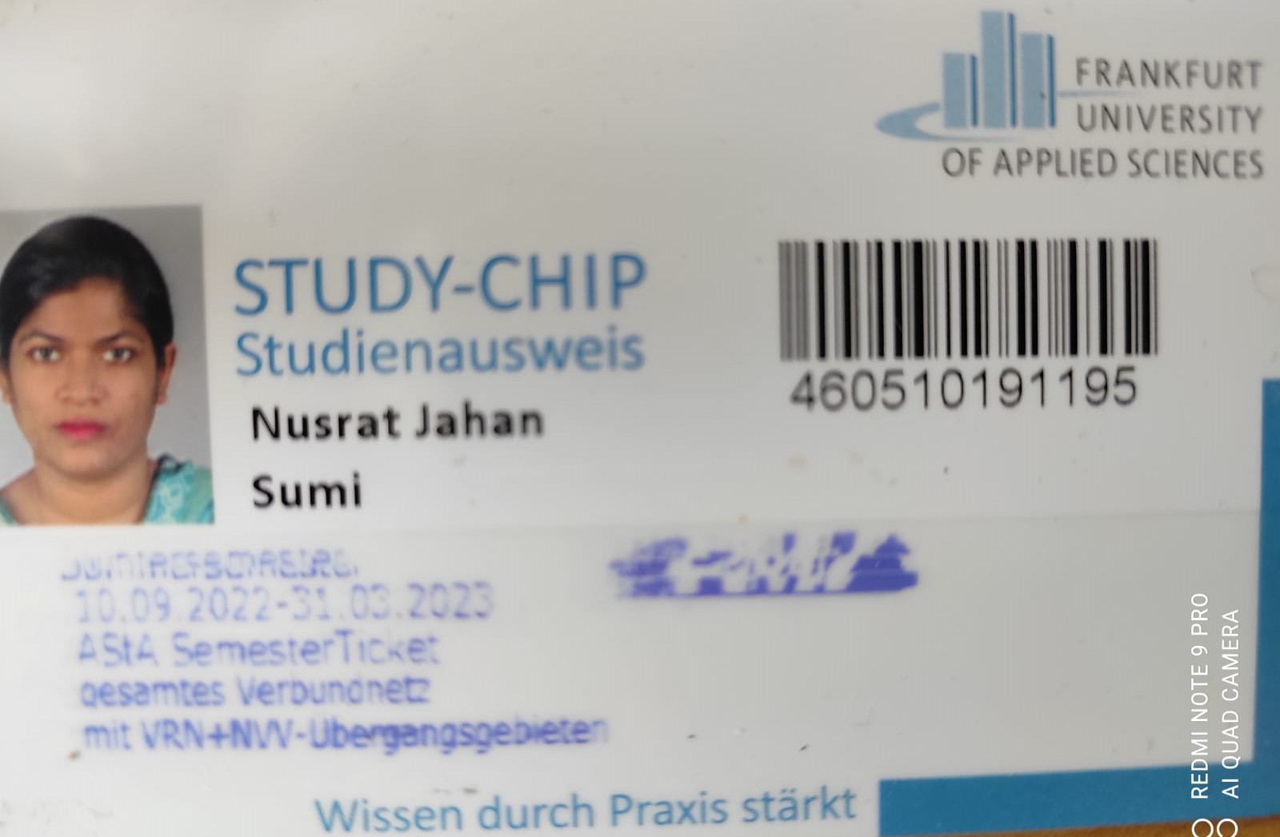
Frankfurt University of Applied Sciences
Open5GS & OpenAirInterface UE / RAN, simple UPF by focus on accessing to File_sharing_Platform, Streaming and Sip_Call_Server Sample Configuration
Subject : Mobile Computing
By : Armin Lehman
Team : LTE (Group4)
Team Members :
Mahdieh Pirmoradian (1323281) Nusrat Jahan Sumi (1345476)

Slide 2
Open5GS & OpenAirInterface UE / RAN, simple UPF by focous on accessing to File_sharing_Platform, Streaming and Sip_Call_Server Sample Configuration
Introduction(5GS, Open Air Interface)
Structure of the Network
Solution and configuration
Packet flows
Conclusion

Slide 3
Why 5GS?
With today innovation in industries such as
remote healthcare
autonomous vehicles
the network operators are looking to deploy networks that can deliver these services
efficiently
cost-effectively
The 5G wireless standard has revolutionized the telecommunications industry, providing
higher data speeds
lower latency
improved network reliability.

Slide 4
Why Open-Air Interface?
It is an open-source implementation of the 5G core network
Enables customization and flexibility in deployment.
It can be integrated with existing hardware and software, making it an attractive option for network operators looking to upgrade their infrastructure.

Slide 5
Why 5GS and Open-Air Interface with a single UPF?
It enable network operators to deliver high-speed connectivity,
support emerging use cases
achieve operational efficiency
This can have a significant impact on various industries, from
Healthcare to
Transportation and
pave the way for a new era of connectivity and innovation.

Slide 6
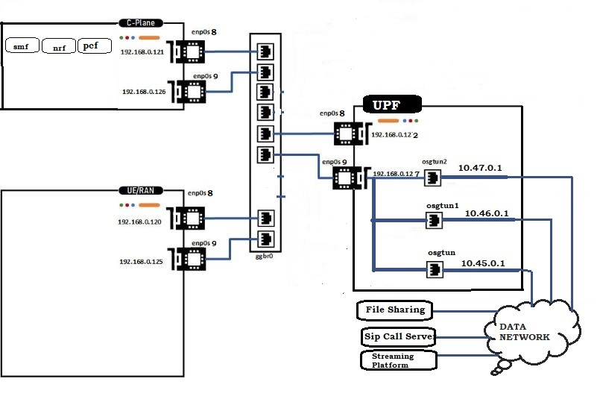
Overall Infrastructure

Slide 7
Requirements
Machine ID | Function | IP/MAC Address enp0s3 | IP/MAC Address enp0s4 | RAM | CPU | HDD | Operating system
machine 01 | UE/RAN Simulation | 192.168.0.120 52:54:00:12:34:51 | 192.168.0.125 52:54:00:12:34:61 | 8 GB | 2 | 40GB | Ubuntu 18.04
machine 02 | C-Plane | 192.168.0.121 52:54:00:12:34:52 | 192.168.0.126 52:54:00:12:34:62 | 8 GB | 2 | 40GB | Ubuntu 18.04
machine 03 | UPF | 192.168.0.122 52:54:00:12:34:53 | 192.168.0.127 52:54:00:12:34:63 | 8 GB | 2 | 40GB | Ubuntu 18.04
Table 1. Considered Virtual machines for the simulating of UE/RAN and deploying C-Plane and single U-Planes.

Slide 8
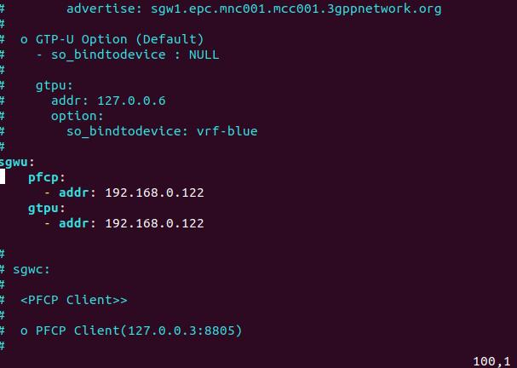
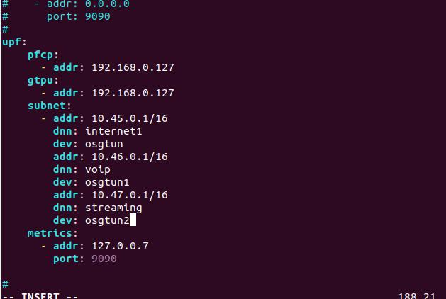
Configuring 5G network U-Plane
SGWU UPF

Slide 9
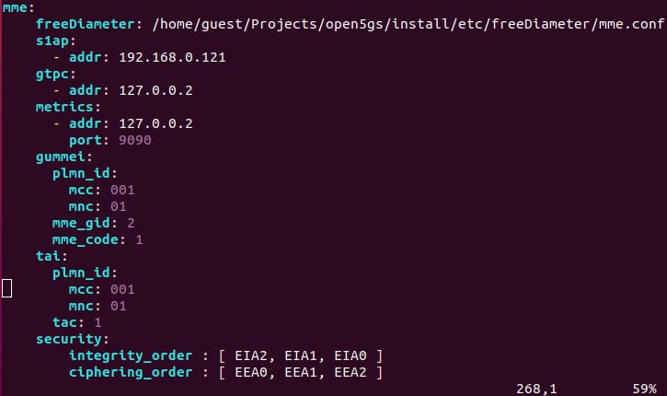
Configuring Core-Plane
hssd
mme
Pcrf
Sgw
smf
mme

Slide 10
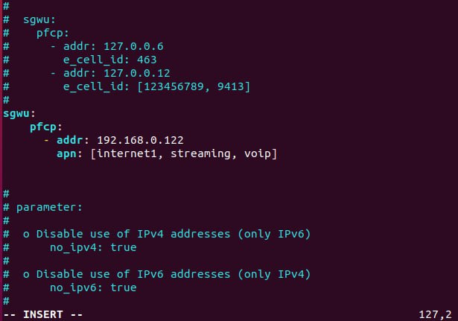
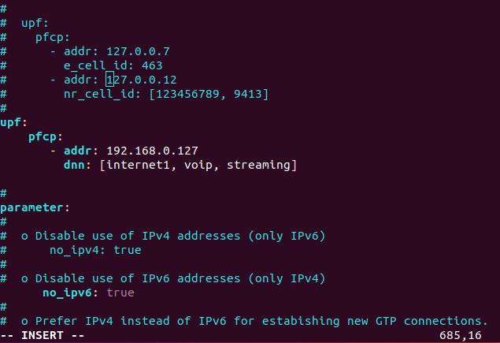
Configuring Core-Plane
sgw smf

Slide 11
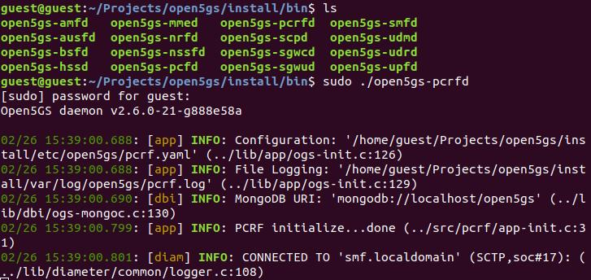
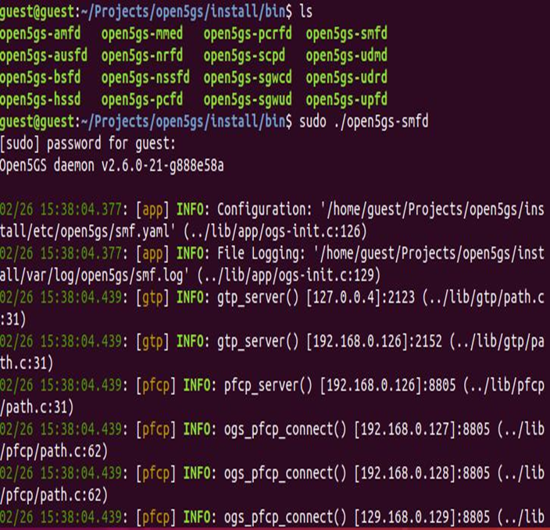
Configuring Core-Plane
pcrf

Slide 12
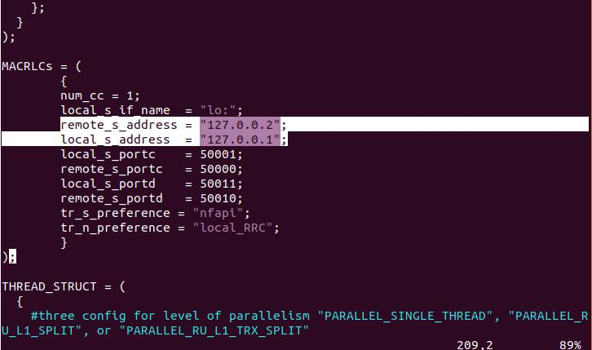
Configuring ues and gnodeB

Slide 13
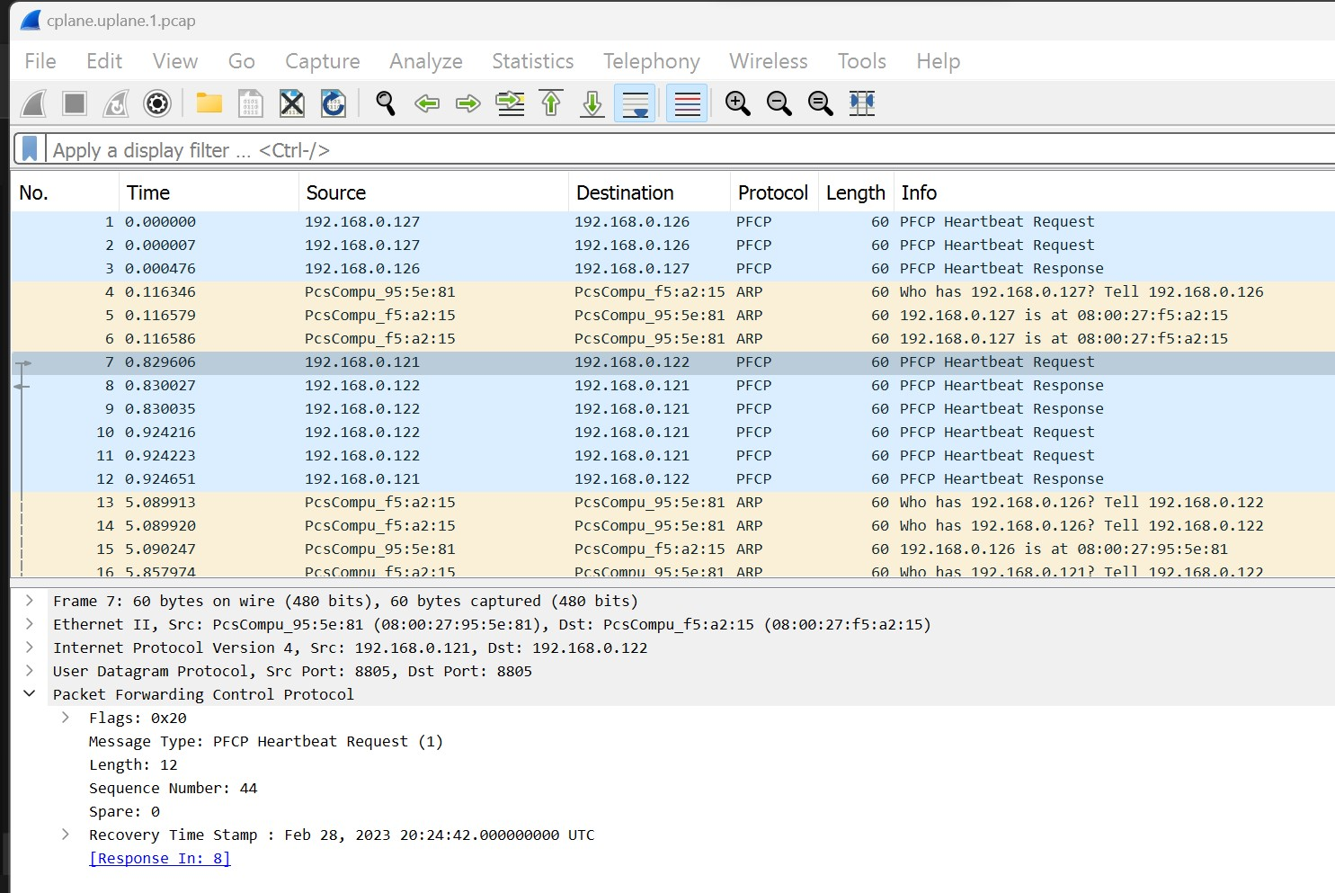
Packet Traces (Uplane and Coreplane)

Slide 14
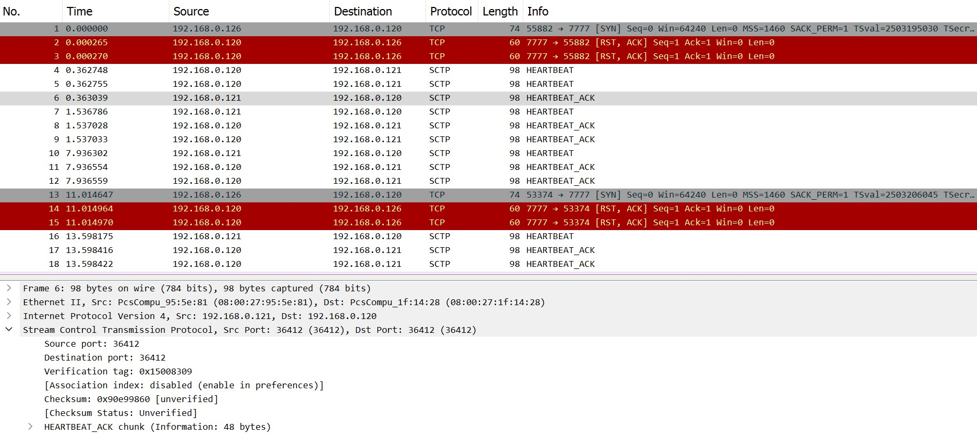
Packet Traces (EnodeB and Coreplane)

Slide 15
Conclusion
In summary, network operators may offer high-speed connection, support developing use cases, and achieve operational efficiency by implementing a network based on 5G and Open-Air Interface with a single UPF. This has the potential to have a tremendous influence on industries ranging from healthcare to transportation, providing the way for a new era of connectedness and innovation.

Slide 16
Thank you
for your attention
If you have any question, you can contact us:
mahdieh.pirmoradian@stud.fra-uas.de nusrat.sumi@stud.fra-uas.de

Slide 17
Sources
Open5GS, 2022. Open5GS. [Online] Available at: https://open5gs.org/.
OpenAirInterface, 2022. OpenAirInterface | 5G software alliance for democratising wireless innovation. [Online] Available at: https://openairinterface.org/.
Trick, U., 2021. 5G - An Introduction to the 5th Generation Mobile Networks. De Gruyter STEM ed. Berlin/München/Boston: De Gruyter Oldenbourg
Ishida, S., 2020. open5gs_epc_oai_sample_config. [Online] Available at: https://github.com/s5uishida/open5gs_epc_oai_sample_config/blob/main/README.md [Accessed 01 Feb 2023].

