Slide 1
IBM University Engagement Project Submission
“Exploring the Power of Agentic AI with IBM Granite and LangFlow”

Slide 2

Project Tile – [Intelligent Shopping Agent]
Domain of Project – [ AI-powered E-commerce]
Student Name | Recent Passport Photo | Email ID | Mobile number [WhatsApp]
Gundgi Mahdiya Fatima Abdul Jabbar |  | mahdiyafatimagundgi@gmail.com | 9321287760

Slide 3
Problem Statement -
Problem Statement : Intelligent Shopping Agent
The Challenge
Shoppers today face an overload of product options, scattered reviews, and dynamic pricing across e-commerce platforms. Finding the right product that balances price, quality, and personal preferences is time-consuming and frustrating. Traditional recommendation systems often fail to capture real-time trends, personalized needs, or contextual factors like urgency, budget, or sustainability. The challenge is not just to recommend products but to act as a smart shopping companion that helps buyers make informed and confident decisions.
.
The Objective
Build an agentic AI shopping assistant that provides intelligent, personalized, and real-time support. The solution should:
Fuse Multisource Data: Aggregate product details, reviews, ratings, and price comparisons across multiple e-commerce sites into unified insights.
Enable Multimodal Search: Allow users to input voice queries, images (e.g., a photo of a product), or text descriptions to find best-matching products.
Create a Predictive & Agentic Layer: Suggest purchase timing (e.g., discounts, seasonal offers), recommend alternatives, and alert users about price drops or fake reviews.
Visualize Smart Shopping Pulse: Provide a dashboard summarizing comparisons, sustainability scores, trending products, and personalized shopping lists.

Slide 4
Proposed Solution -
Proposed Solution: AI-Powered Intelligent Shopping Agent
The proposed solution is a multi-agent AI-powered Intelligent Shopping Agent built using LangFlow and Large Language Models (LLMs) to provide personalized, real-time product recommendations. The system addresses common challenges in online shopping such as information overload, scattered reviews, and price comparison through an intelligent and modular architecture.
At its core, the solution leverages a Retrieval-Augmented Generation (RAG) pipeline to gather relevant product data from various sources, including e-commerce platforms, user reviews, and pricing datasets. This data is processed and stored efficiently, enabling the system to retrieve and summarize key product details such as price, features, ratings, and reviews using LLM capabilities.
The system consists of four key agents:
Product Search Agent retrieves relevant products based on user queries and preferences using intelligent search mechanisms.
Recommendation Agent generates personalized product suggestions by analyzing user needs, budget, and preferences.
Review Analysis Agent summarizes customer reviews and ratings to provide clear insights into product quality and user satisfaction.
Price Comparison Agent compares prices across different platforms and suggests the best available deals to the user.
The solution can include a user-friendly interface (such as a web-based dashboard) that allows users to interact with the agent, view product recommendations, and make informed purchasing decisions.
LangFlow is used to design and orchestrate the workflow between different agents, while LLMs power natural language understanding, reasoning, and response generation.
Overall, this solution delivers an intelligent shopping assistant that simplifies the buying process, saves time, and helps users make better purchasing decisions through personalized recommendations, real-time insights, and smart comparisons.

Slide 5
Technology Used
Langflow (Local Setup via CMD) Used to design and orchestrate the Intelligent Shopping Agent through a visual workflow. The agent was built and executed locally using Command Prompt, enabling flexible development and testing.
Google Generative AI (Gemini 3.5 Flash) Powers the agent’s natural language understanding and reasoning. It helps interpret user queries, compare products, and generate personalized shopping recommendations.
RAG (Retrieval-Augmented Generation) Enables the agent to fetch relevant product data (such as price, features, and reviews) before generating responses, ensuring accurate and up-to-date recommendations.
IBM Cloud Provides a scalable and secure environment for deploying the Intelligent Shopping Agent, ensuring reliable performance.
IBM watsonx.ai Used for model deployment, embeddings, and managing AI workflows, helping improve recommendation quality and maintain governance.

Slide 6
Langflow component Used -
1) Chat Input – Interface where users enter their queries, preferences, or meal details (text/voice/image).
2) Google generative ai- Processes user input using Granite models to generate personalized nutrition insights and recommendations.
3) Name of Google Generative ai – Gemini-3.5-flash → Fast, efficient for real-time diet recommendations
4) Chat output -Displays AI-generated responses such as diet plans, nutritional analysis, and health suggestions.
5) File component - Stores and retrieves user data, meal logs, and nutritional datasets for analysis and tracking.

Slide 7
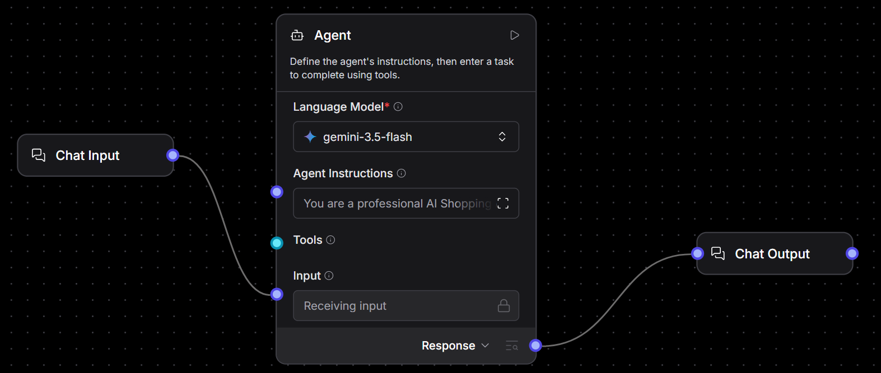
Langflow workflow -

Slide 8

Role of Agentic AI in the solution
Role of Agentic AI in Intelligent Shopping Agent
Agentic AI enables the Intelligent Shopping Agent to function as a smart, autonomous system rather than a basic search tool. Using LangFlow and Large Language Models (LLMs), it coordinates multiple specialized agents to deliver personalized and efficient shopping assistance.
Each agent performs a specific role—such as searching products, generating recommendations, analyzing customer reviews, and comparing prices—while working collaboratively. This multi-agent approach ensures faster processing, better accuracy, and more relevant results for users.
Agentic AI also provides context awareness by understanding user preferences such as budget, product requirements, brand choices, and urgency. Based on this context, the system generates tailored product suggestions that match the user’s needs.
It supports real-time adaptation, continuously refining recommendations as users modify their queries or preferences. For example, if a user changes budget or product type, the system instantly updates its suggestions.
Additionally, agents communicate with each other to combine insights from different tasks, leading to smarter decision-making and improved user experience.
Overall, Agentic AI makes the system proactive, personalized, and goal-driven, acting like a smart digital shopping assistant that helps users make informed and efficient purchasing decisions.

Slide 9
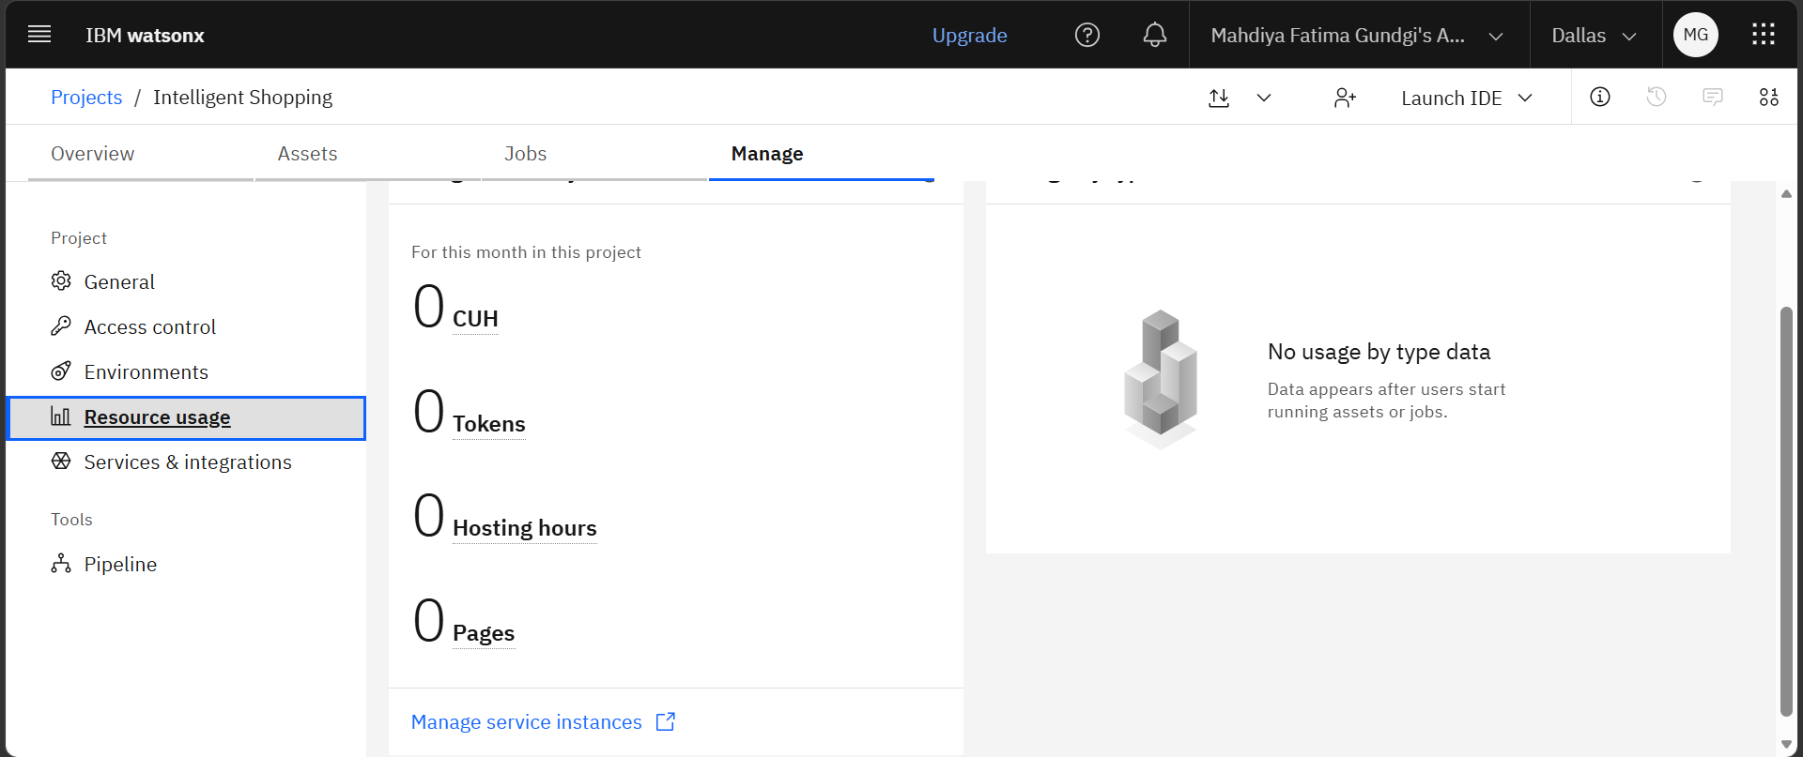
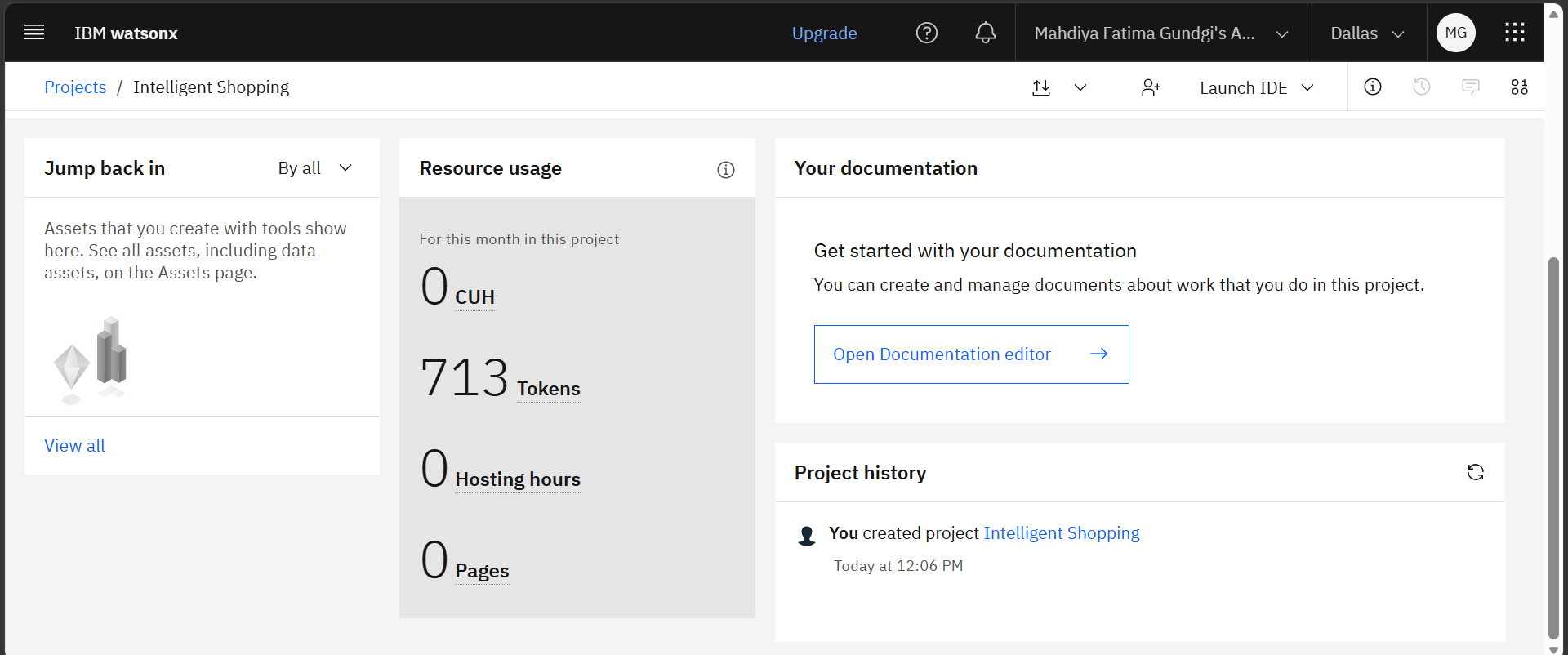
Token Usage
11,761 token are used
Before Prompt
After the Prompt
·
·
·

Slide 10
Novelty and Uniqueness
The proposed Intelligent Shopping Agent stands out by combining Agentic AI, RAG, and personalization into a single intelligent system.
Multi-Agent Intelligence – Instead of a single chatbot, multiple specialized agents collaborate to deliver accurate and context-aware product recommendations.
RAG-Based Accuracy – Integrates real-time product data retrieval with AI-generated responses, reducing misinformation and ensuring reliable suggestions.
Hyper-Personalization – Tailors recommendations based on user preferences such as budget, brand choices, product requirements, and shopping behavior.
Real-Time Adaptation – Continuously updates recommendations based on user queries and changes in preferences, ensuring relevant results at all times.
Review & Insight Analysis – Summarizes customer reviews and ratings to provide clear insights into product quality and user satisfaction.
Smart Price Comparison – Compares prices across different platforms to help users find the best deals and save money.
Scalable & Enterprise-Ready – Built on IBM watsonx.ai with IBM Granite models, ensuring reliability and governance.
This makes the solution a smart, adaptive, and proactive digital shopping assistant, not just a basic product search tool.

Slide 11
Git Hub Link
This project presents an Intelligent Shopping Agent developed using Langflow, designed to assist users in finding the best products based on preferences, pricing, and reviews. The complete project, including source files and documentation, is available at the following GitHub repository:
[My Project]
·
·
·

Slide 12
Future Scope
1.Integration with Wearables & Health Devices –
The system can be integrated with smartwatches and fitness trackers to collect real-time data such as steps, calories burned, heart rate, and sleep patterns. This will enable the Nutrition Agent to provide more accurate and dynamic diet recommendations based on actual user activity and health metrics.
2.AI-Powered Voice Assistant & Multilingual Support –
Enhancing the system with a voice-enabled assistant and support for multiple languages will improve accessibility. Users can interact naturally in their preferred language, making the solution more inclusive and suitable for diverse populations, especially in regions with varied linguistic backgrounds.
·
·
·

Slide 13
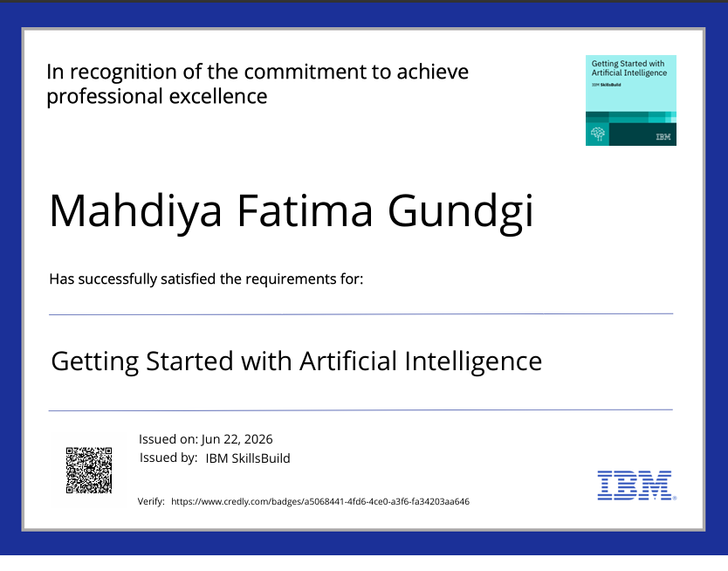
Certificates Earned:

Slide 14
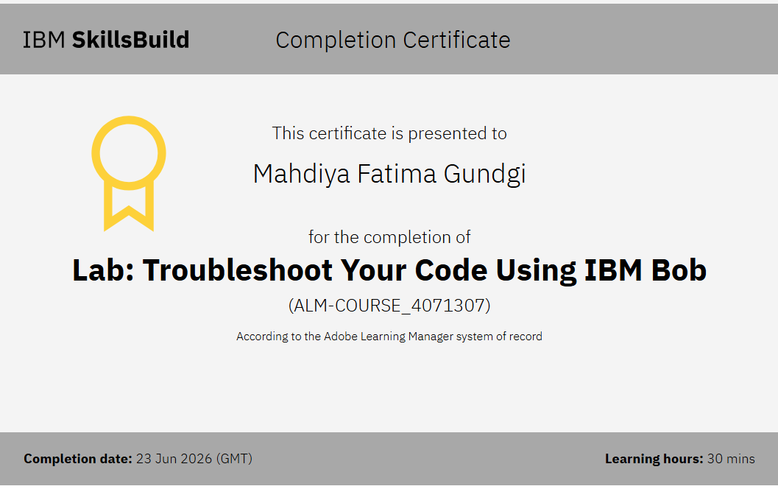
Certificates Earned:​

Slide 15


